Slide 2
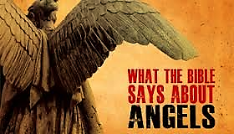

Slide 3
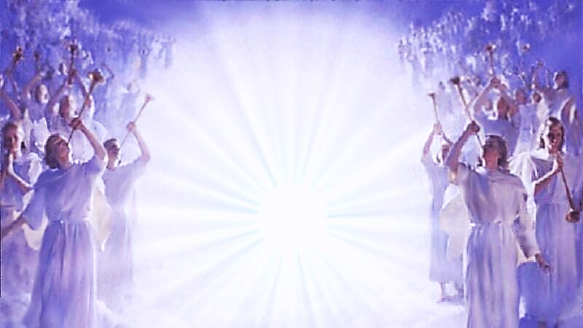
“Likewise, I say unto you, there is joy in the presence of the angels of God over one sinner that repenteth.” (Luke 15:10)

Slide 6
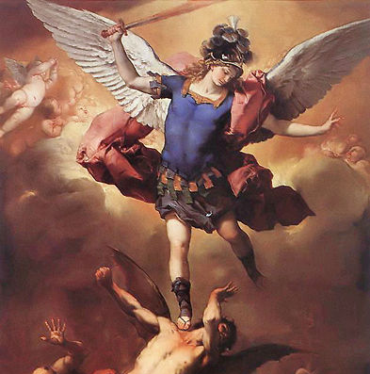
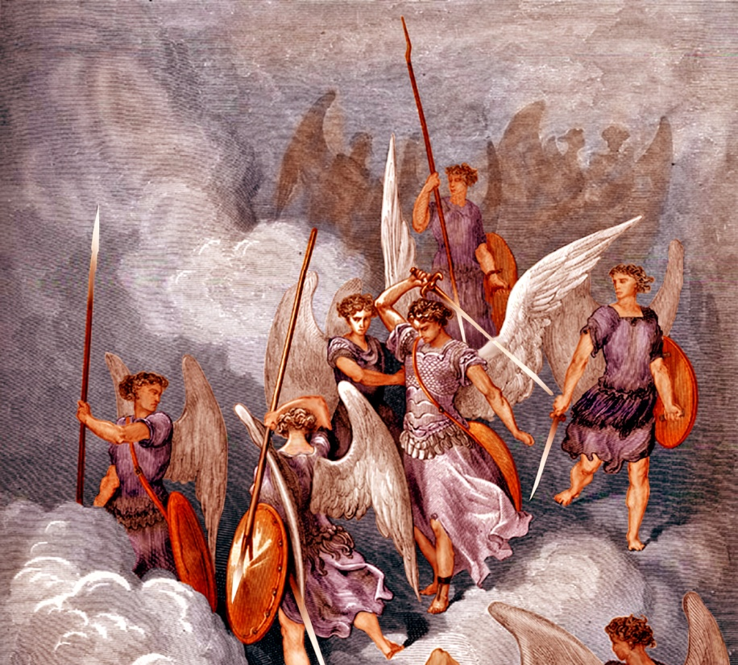
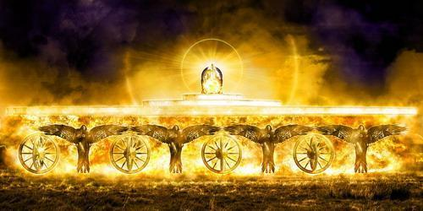
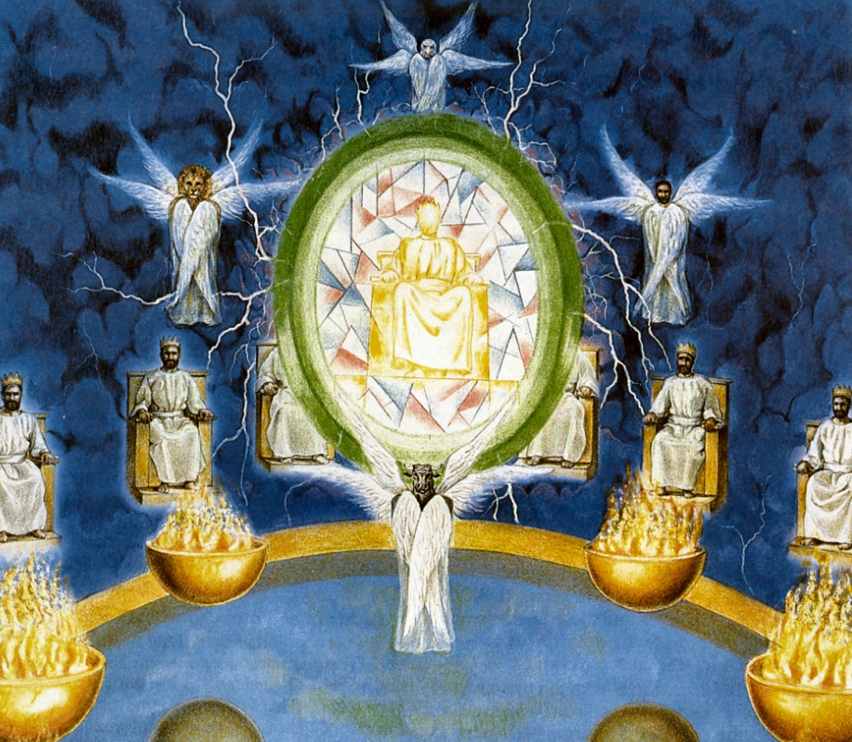
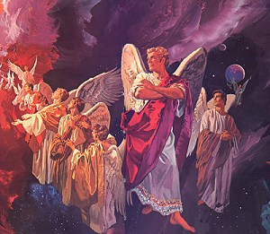
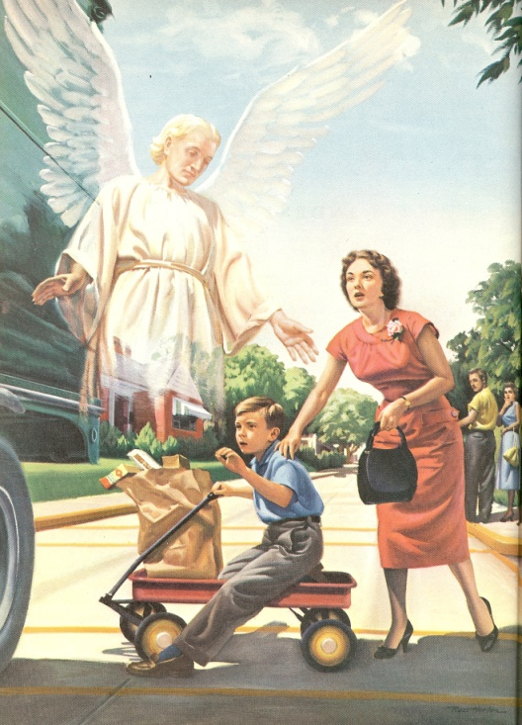
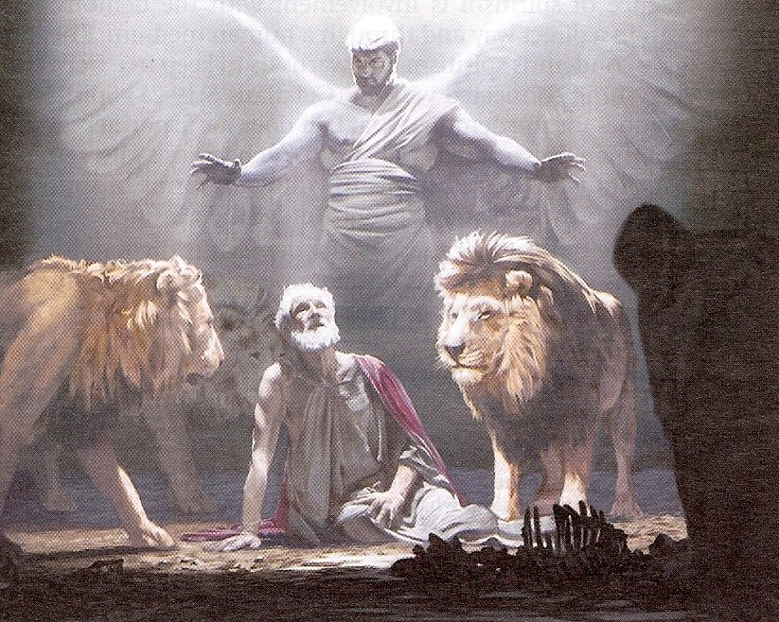
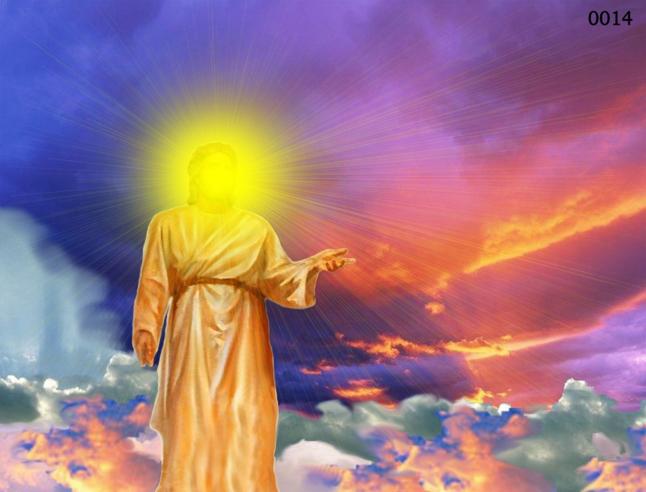
Different Types of Angels
Archangels – Michael and Gabriel
Cherubim's – Ezekiel 1:4-28
Seraphim’s – Isaiah 6:1-7
Ruling angels – I Peter 3:22
Guarding angels – Hebrews 1:14
Angel of the Lord – Zechariah 3:1-10

Slide 7
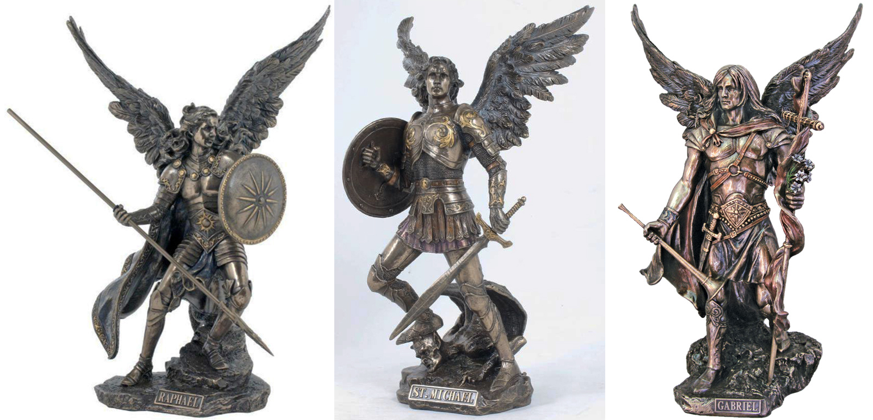
Archangels – Michael and Gabriel
Warrior - Michael Messenger - Gabriel

Slide 8
Michael the Warrior of God

Slide 9
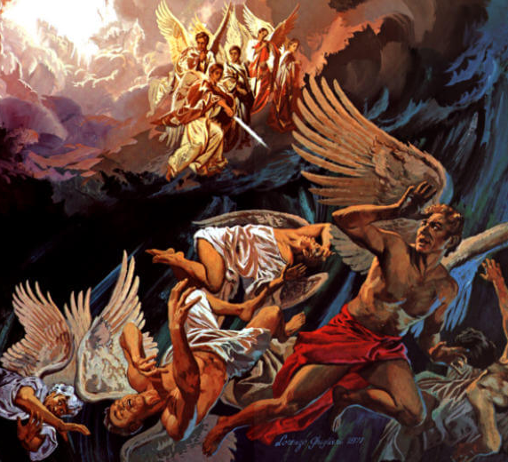
“And there was war in heaven: Michael and his angels fought against the dragon; and the dragon fought and his angels, And prevailed not; neither was their place found any more in heaven. And the great dragon was cast out, that old serpent, called the Devil, and Satan, which deceiveth the whole world: he was cast out into the earth, and his angels were cast out with him.” (Revelation 12:7-9)

Slide 10
Gabriel the Messenger of God

Slide 11
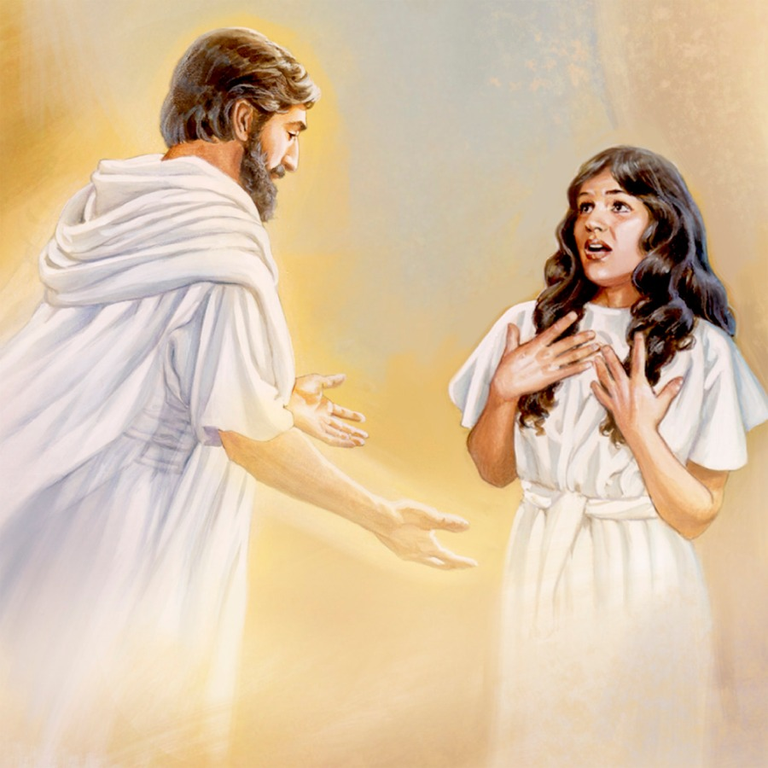
“And in the sixth month the angel Gabriel was sent from God unto a city of Galilee, named Nazareth, To a virgin espoused to a man whose name was Joseph, of the house of David; and the virgin's name was Mary.” (Luke 1:26-27)

Slide 12
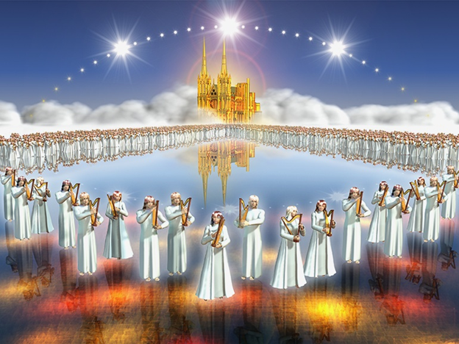
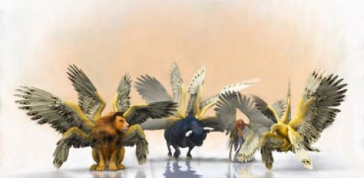
“And before the throne there was a sea of glass like unto crystal: and in the midst of the throne, and round about the throne, were four beasts full of eyes before and behind.”

Slide 13
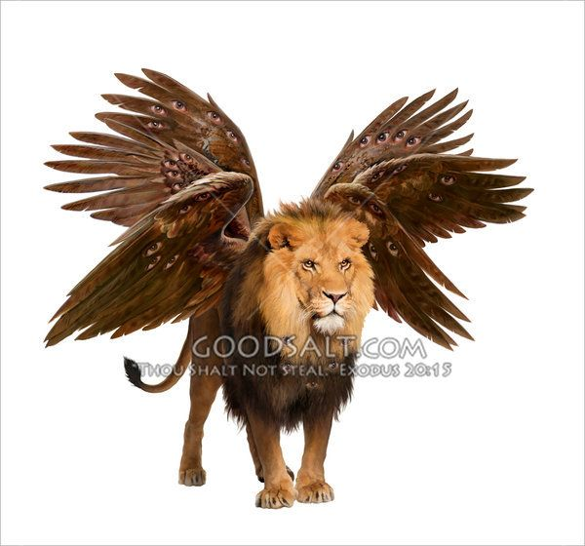
And the first beast was like a lion

Slide 14
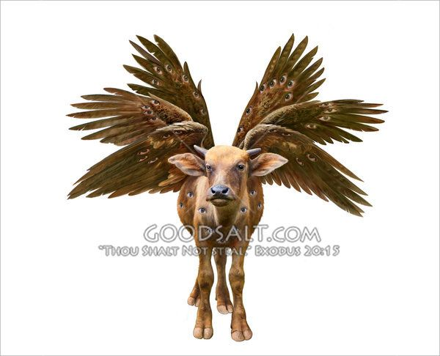
And the second beast like a calf

Slide 15
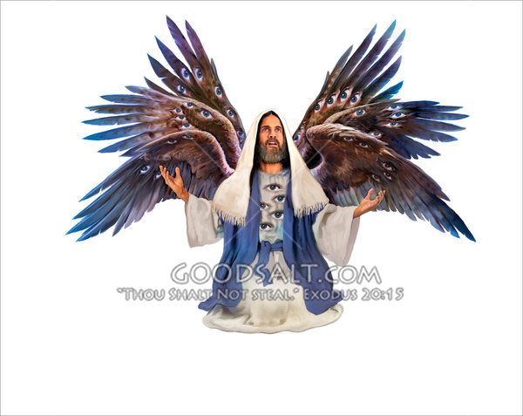
And the third beast had a face as a man

Slide 16
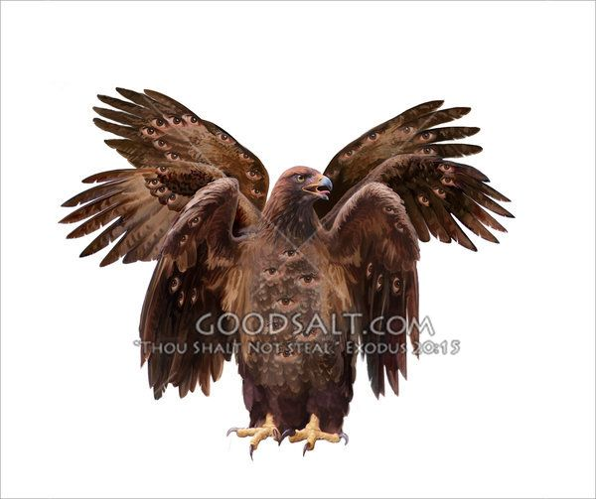
And the fourth beast was like a flying eagle

Slide 17
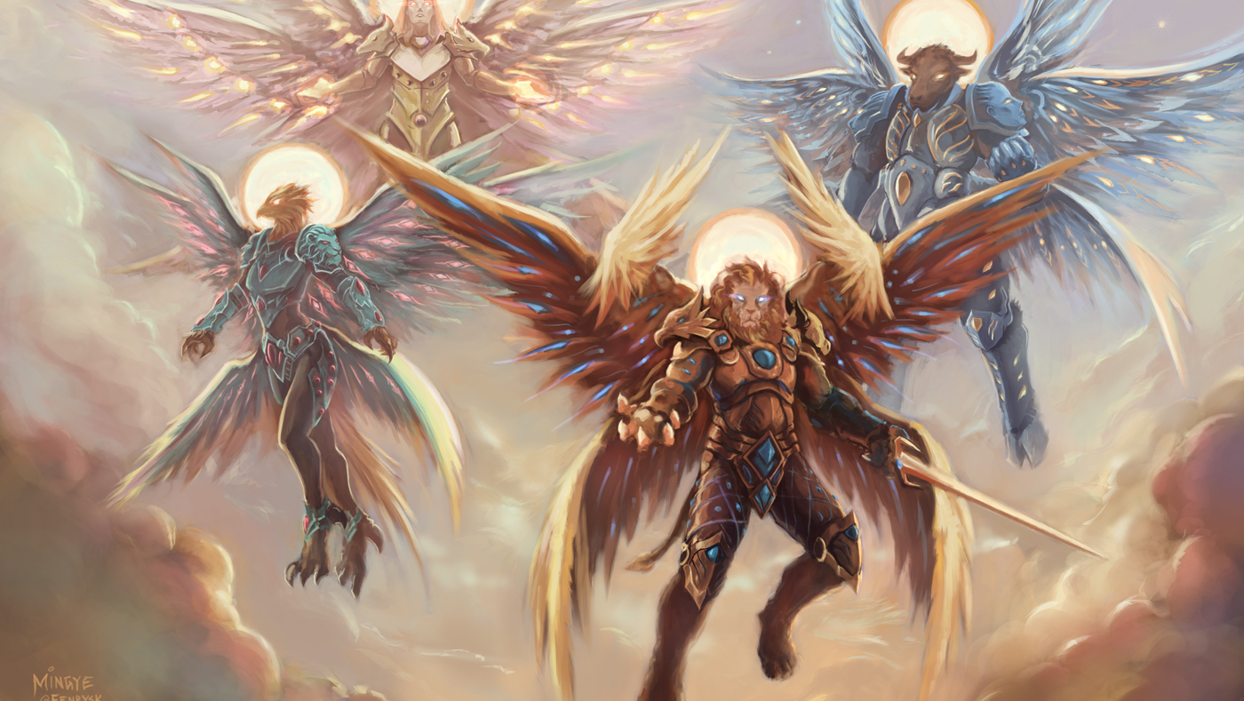
“And the four beasts had each of them six wings about him; and they were full of eyes within: and they rest not day and night, saying, Holy, holy, holy, Lord God Almighty, which was, and is, and is to come.”

Slide 18
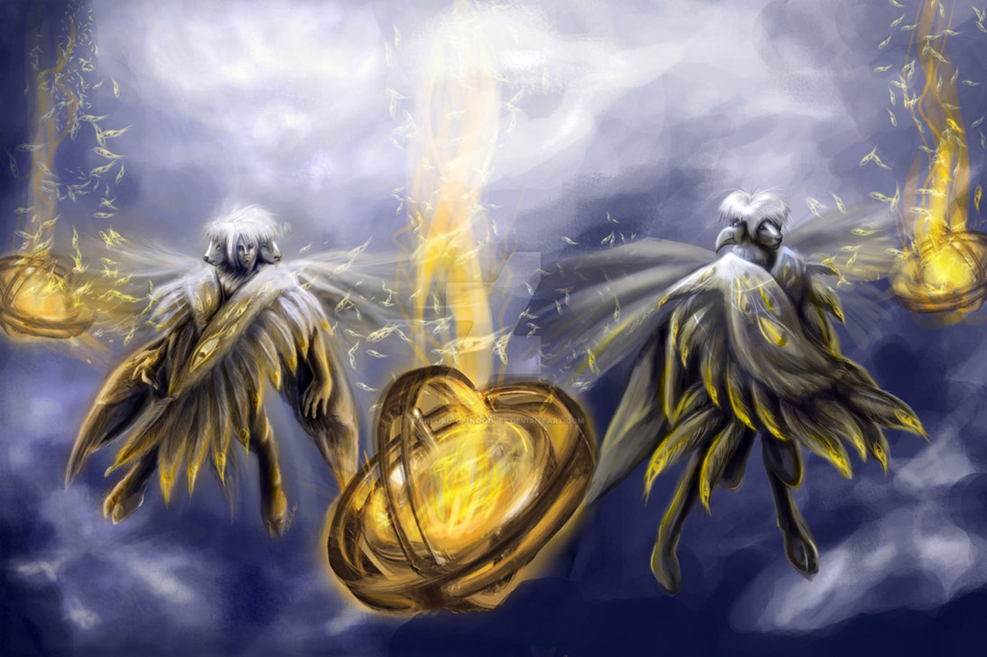
Cherubims
(Ezekiel 1:1-28, 10:15-22)

Slide 19
“Every one had four faces apiece, and every one four wings; and the likeness of the hands of a man was under their wings…As for the likeness of their faces, they four had the face of a man, and the face of a lion, on the right side: and they four had the face of an ox on the left side; they four also had the face of an eagle.”

Slide 20
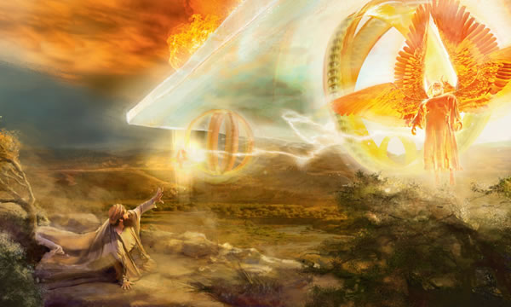
“And when the living creatures went, the wheels went by them: and when the living creatures were lifted up from the earth, the wheels were lifted up. And the cherubim’s lifted up their wings, and mounted up from the earth in my sight: when they went out, the wheels also were beside them, and every one stood at the door of the east gate of the LORD'S house; and the glory of the God of Israel was over them above. This is the living creature that I saw…And as they went, I heard the noise of their wings, like the noise of great waters, as the voice of the Almighty.” ”

Slide 21
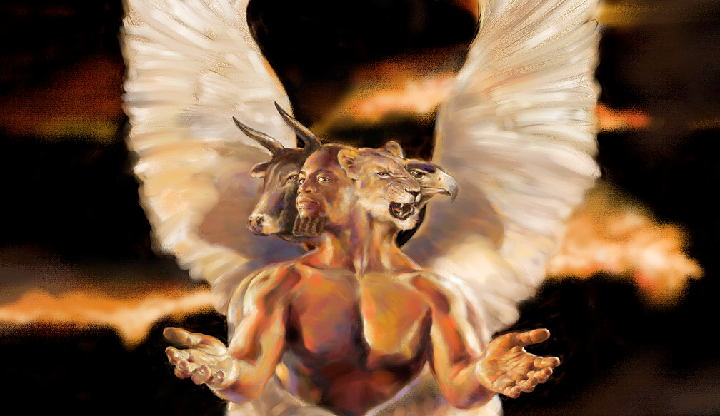
The ministry of the Seraphim's and Cherubim’s “The Glory of God”

Slide 22
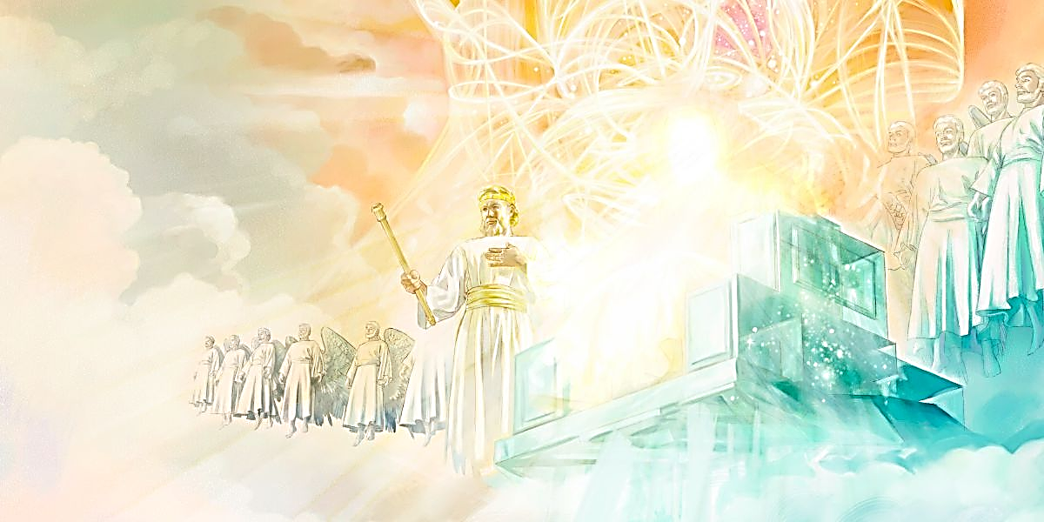
Ruling Angels

Slide 23
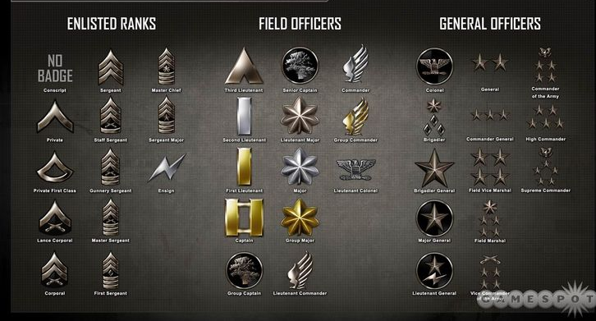
These verses describe various levels of ruling positions assigned to angels, ranging perhaps (to use an earthly analogy) from privates to generals.

Slide 24
Ten Ranks of Angels

Slide 25
Archangels - The word “archangel” comes from a Greek word meaning "chief angel or an angel of high rank."
Princes - Royal ruler subject to a king or emperor
Cherubims - Powerful heavenly beings surrounding the throne
Seraphims – One of the highest order of the celestial beings
Thrones - Seats of authority
Authorities - A magistrate, potentate, monarch or ruler
Principalities - Ruler over a jurisdictional area
Dominions - A territory of sovereign control
Powers - Delegated authority, jurisdiction, strength
Might - Powerful, forceful, strong

Slide 26
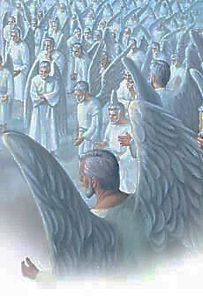
The Bible attributes a number of names and titles to angels. Each of their names and titles helps us to better understand their ministries and attributes. It is interesting to note just how many different descriptions the Bible gives of angels - obviously they are all under authority and very busy in carrying out God's plan of the ages.

Slide 28
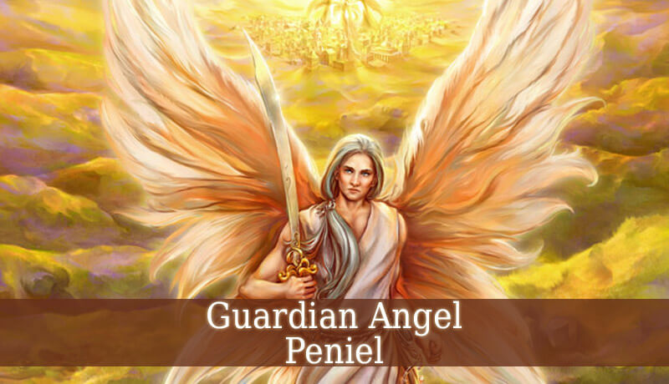

Slide 29
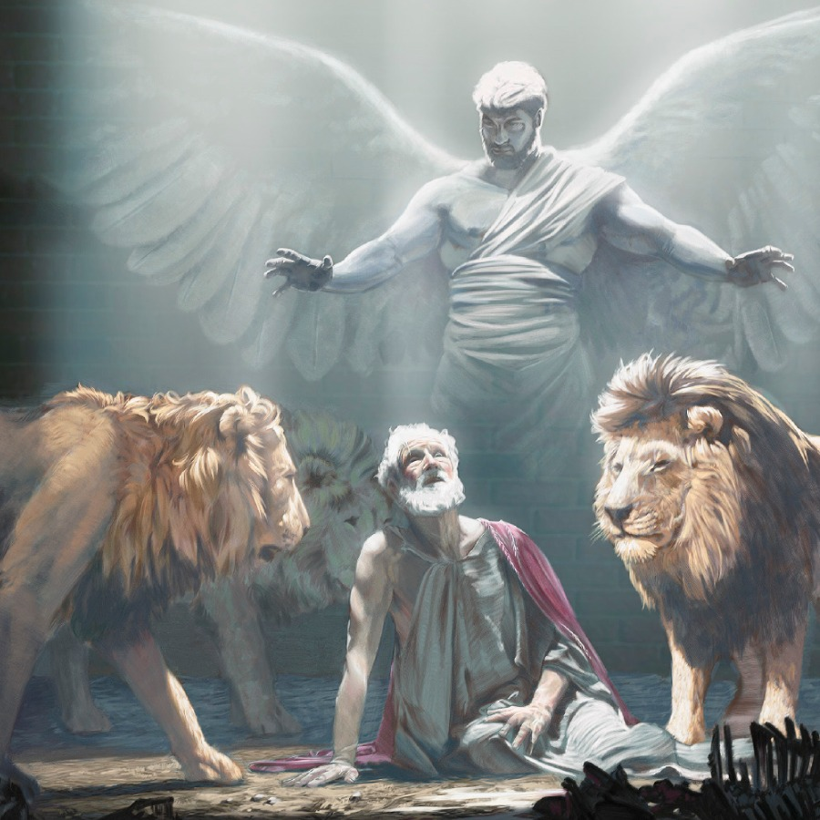
“Then the king commanded, and they brought Daniel, and cast him into the den of lions. Now the king spake and said unto Daniel, Thy God whom thou servest continually, he will deliver thee…Then the king arose very early in the morning, and went in haste unto the den of lions…Then said Daniel unto the king, O king, live for ever. My God hath sent his angel, and hath shut the lions' mouths, that they have not hurt me.” (see Daniel chapter 6)

Slide 30
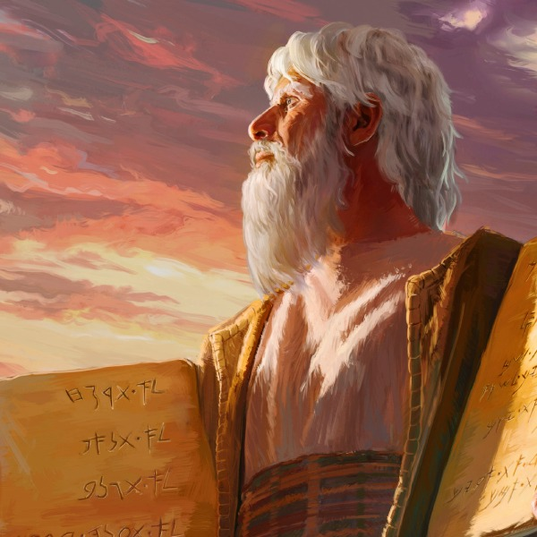
“Behold, I send an Angel before thee, to keep thee in the way, and to bring thee into the place which I have prepared…For mine Angel shall go before thee, and bring thee in unto the Amorites, and the Hittites, and the Perizzites, and the Canaanites, the Hivites, and the Jebusites: and I will cut them off.” (Exodus 23:20, 23)

Slide 31
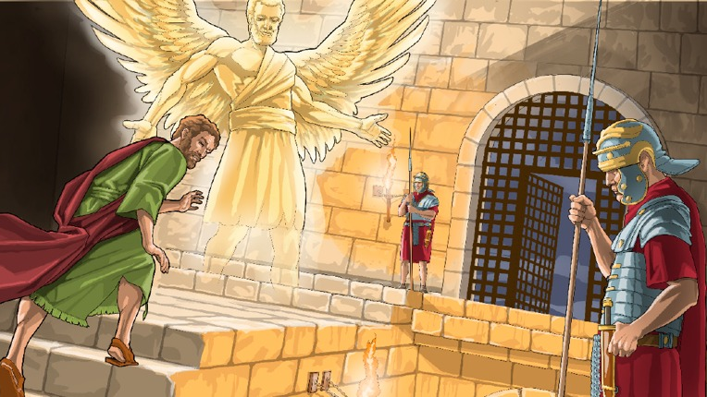

Slide 32
“And the angel said unto him, Gird thyself, and bind on thy sandals. And so he did. And he saith unto him, Cast thy garment about thee, and follow me. And he went out, and followed him; and wist not that it was true which was done by the angel; but thought he saw a vision. When they were past the first and the second ward, they came unto the iron gate that leadeth unto the city; which opened to them of his own accord: and they went out, and passed on through one street; and forthwith the angel departed from him.” (Acts 12:8-10)

Slide 33
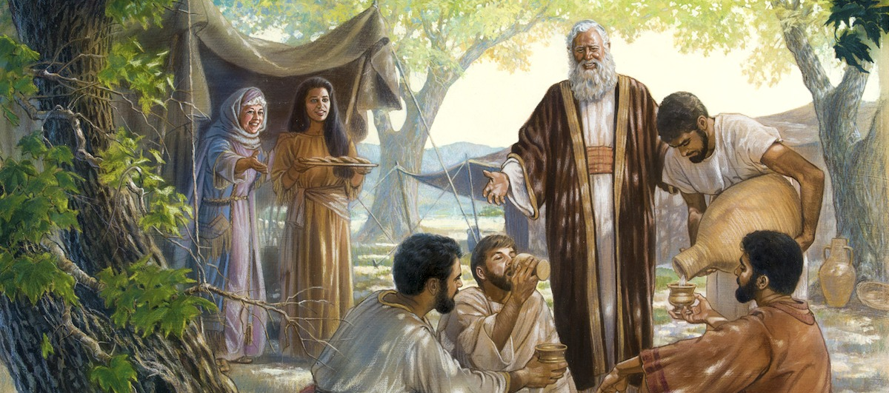
“Be not forgetful to entertain strangers: for thereby some have entertained angels unawares.” (Hebrews 13:2)

Slide 34
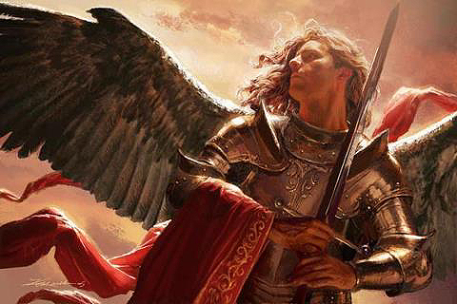
(Daniel 10:13-14, 21 ) “But the prince of the kingdom of Persia withstood me one and twenty days: but, lo, Michael, one of the chief princes, came to help me…Now I am come to make thee understand what shall befall thy people in the latter days: for yet the vision is for many days…But I will shew thee that which is noted in the scripture of truth: and there is none that holdeth with me in these things, but Michael your prince.”

Slide 35
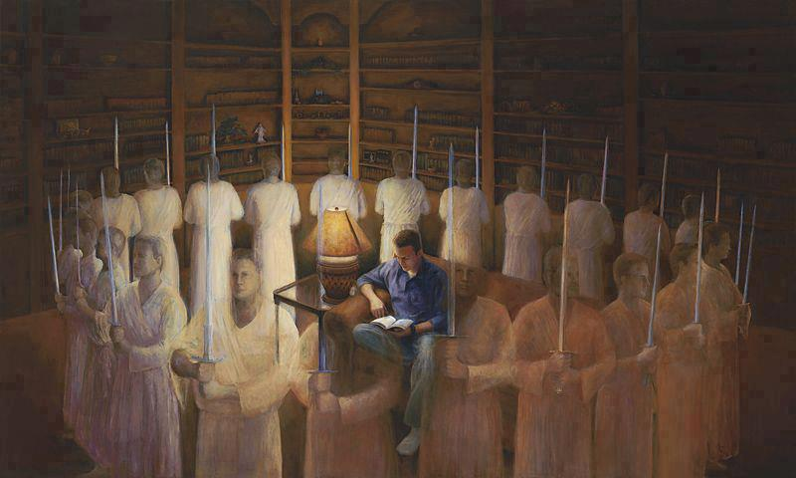
“This poor man cried, and the LORD heard him, and saved him out of all his troubles. The angel of the LORD encampeth round about them that fear him, and delivereth them.” (Psalms 34:6-7)

Slide 36
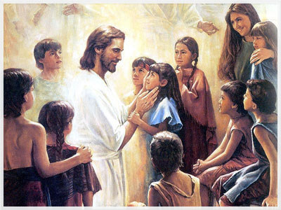
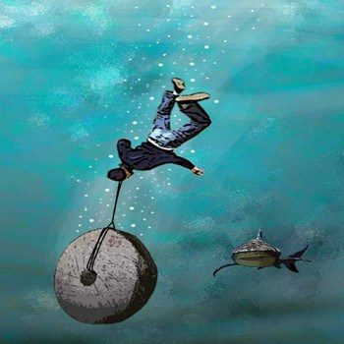
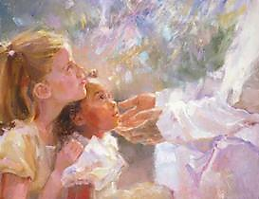
“But whoso shall offend one of these little ones which believe in me, it were better for him that a millstone were hanged about his neck, and that he were drowned in the depth of the sea…Take heed that ye despise not one of these little ones; for I say unto you, That in heaven their angels do always behold the face of my Father which is in heaven.” (Matthew 18:6-10)

Slide 37
“But to which of the angels said he at any time, Sit on my right hand, until I make thine enemies thy footstool? Are they not all ministering spirits, sent forth to minister for them who shall be heirs of salvation?” (Hebrews 1:13-14)

Slide 38
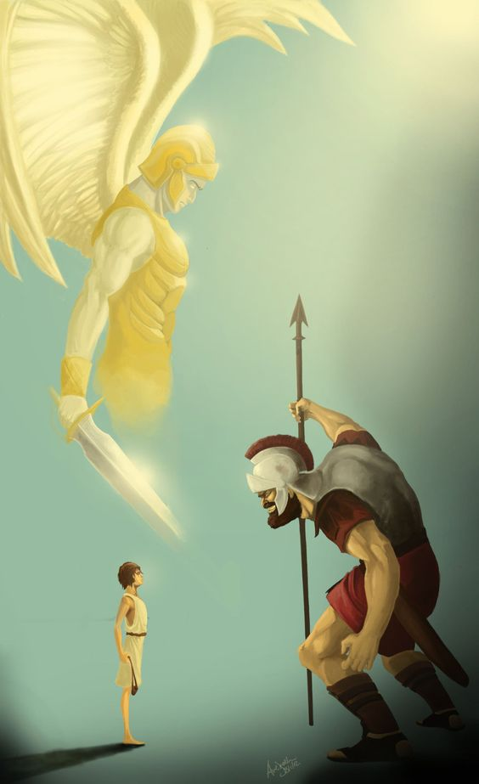
“Then said David to the Philistine, Thou comest to me with a sword, and with a spear, and with a shield: but I come to thee in the name of the LORD of hosts, the God of the armies of Israel, whom thou hast defied.” (1 Samuel 17:45)

Slide 39
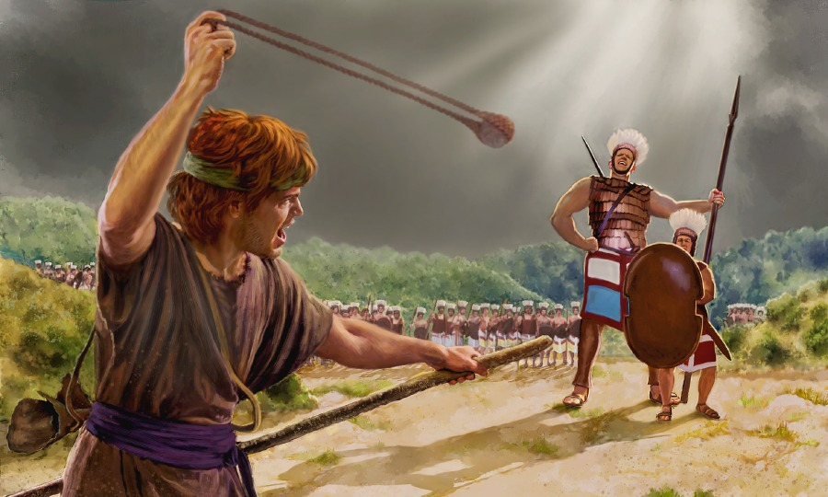

Slide 40
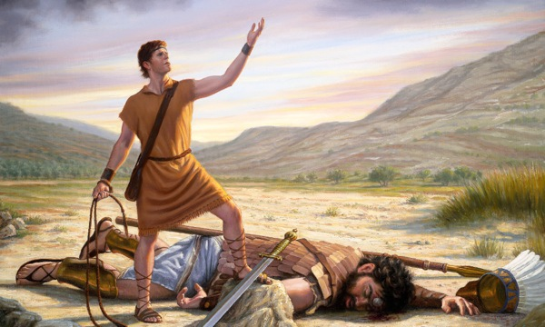

Slide 41
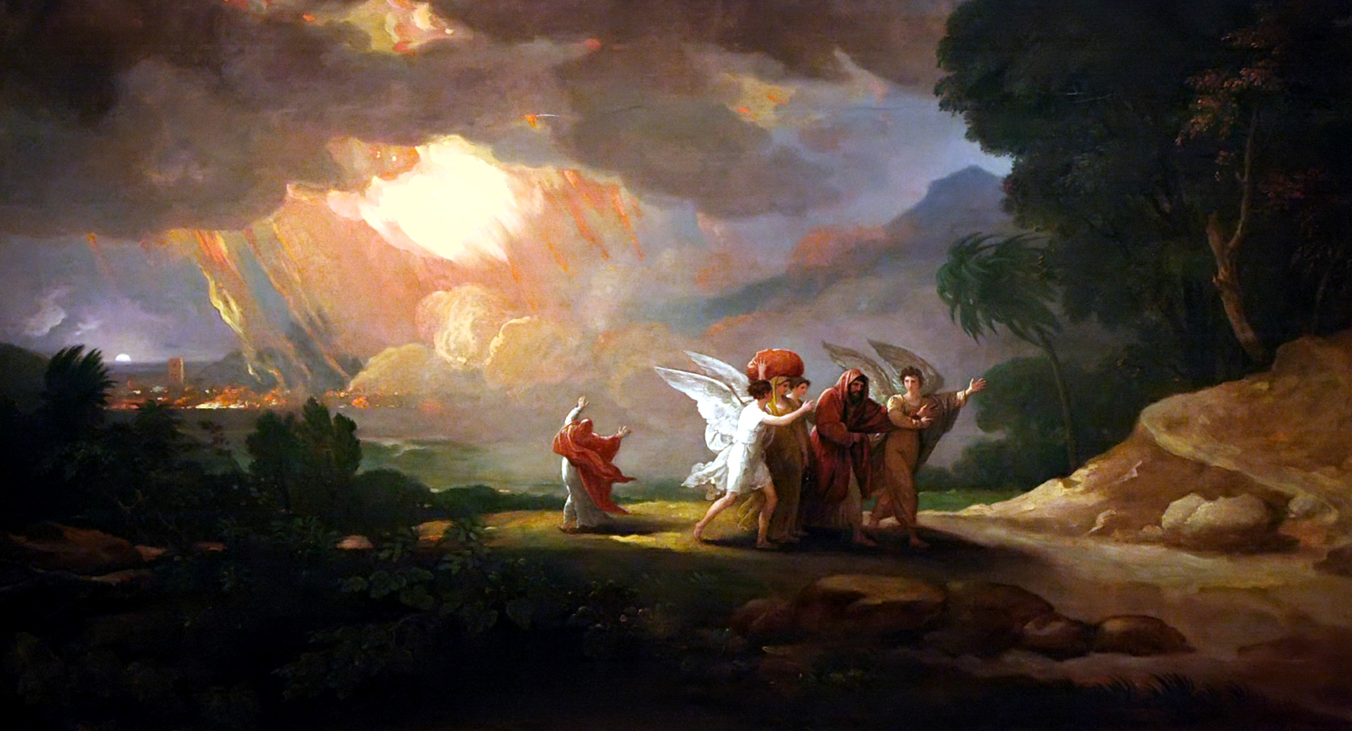
“And when the morning arose, then the angels hastened Lot, saying, Arise, take thy wife, and thy two daughters, which are here; lest thou be consumed in the iniquity of the city. And while he lingered, the men laid hold upon his hand, and upon the hand of his wife, and upon the hand of his two daughters; the LORD being merciful unto him: and they brought him forth, and set him without the city.” (Genesis 19:15-16)

Slide 42
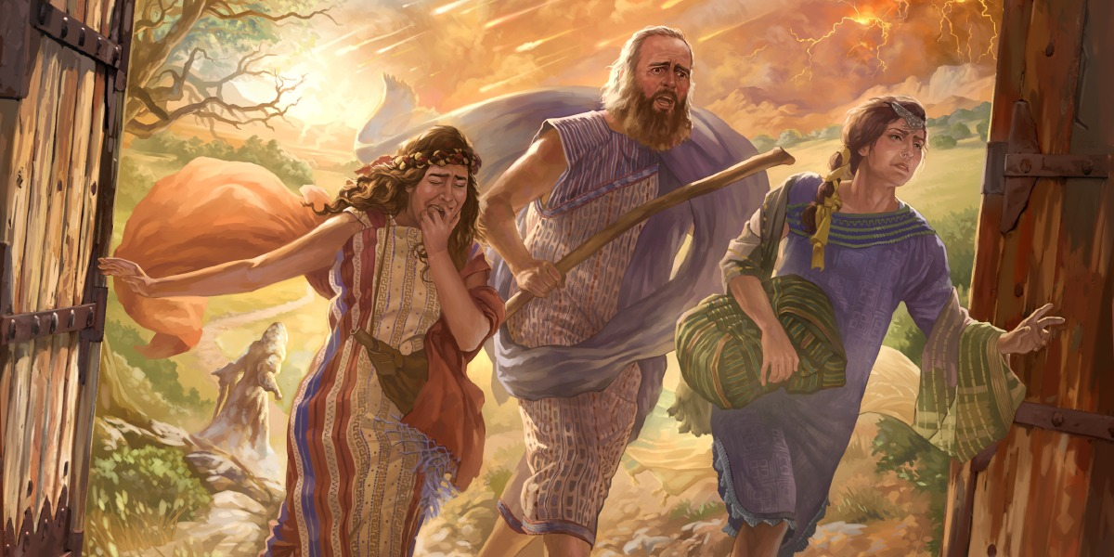

Slide 43
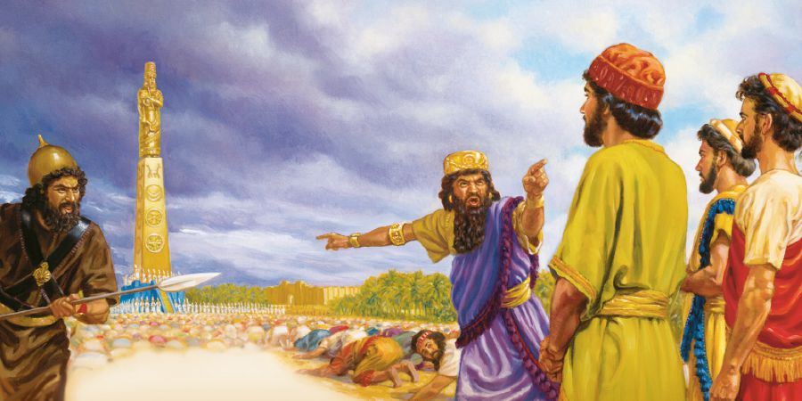
“And whoso falleth not down and worshippeth shall the same hour be cast into the midst of a burning fiery furnace.” (Daniel 3:6)

Slide 44
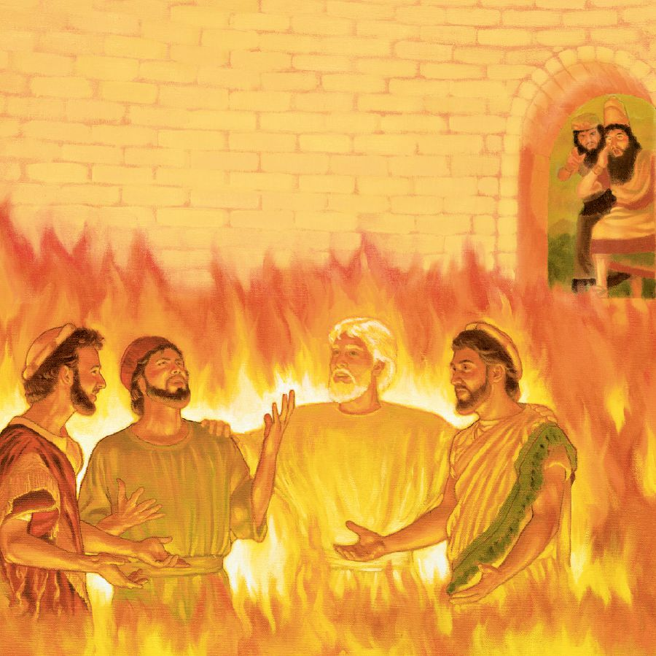
“Then Nebuchadnezzar came near to the mouth of the burning fiery furnace, and spake, and said, Shadrach, Meshach, and Abednego, ye servants of the most high God, come forth, and come hither. Then Shadrach, Meshach, and Abednego, came forth of the midst of the fire.”(Daniel 3:26)

Slide 45
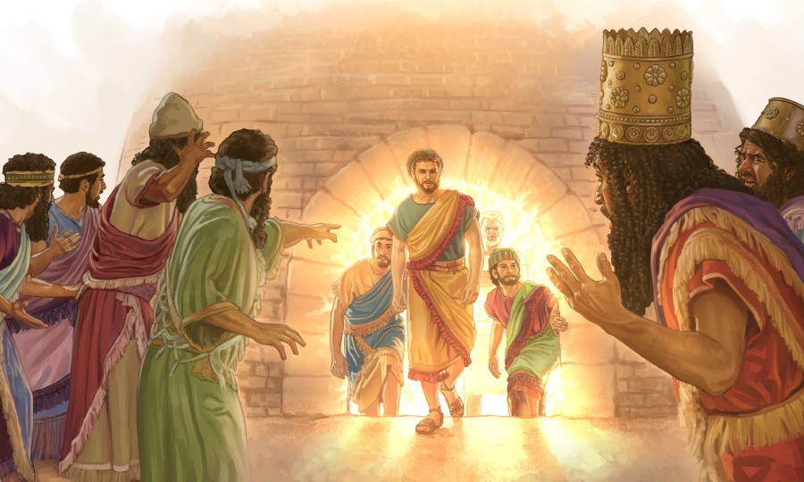

Slide 46
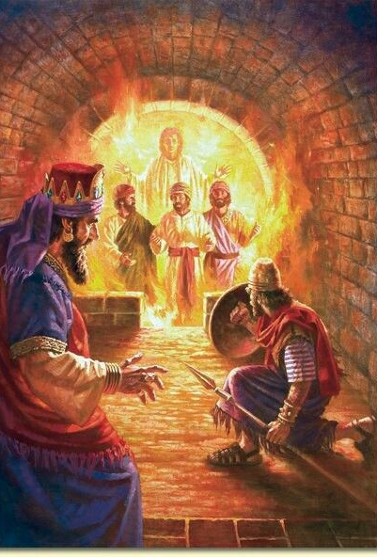
“Then Nebuchadnezzar spake, and said, Blessed be the God of Shadrach, Meshach, and Abednego, who hath sent his angel, and delivered his servants that trusted in him, and have changed the king's word, and yielded their bodies, that they might not serve nor worship any god, except their own God. Therefore I make a decree, That every people, nation, and language, which speak any thing amiss against the God of Shadrach, Meshach, and Abednego, shall be cut in pieces, and their houses shall be made a dunghill: because there is no other God that can deliver after this sort.” (Daniel 3:28-29)

Slide 47
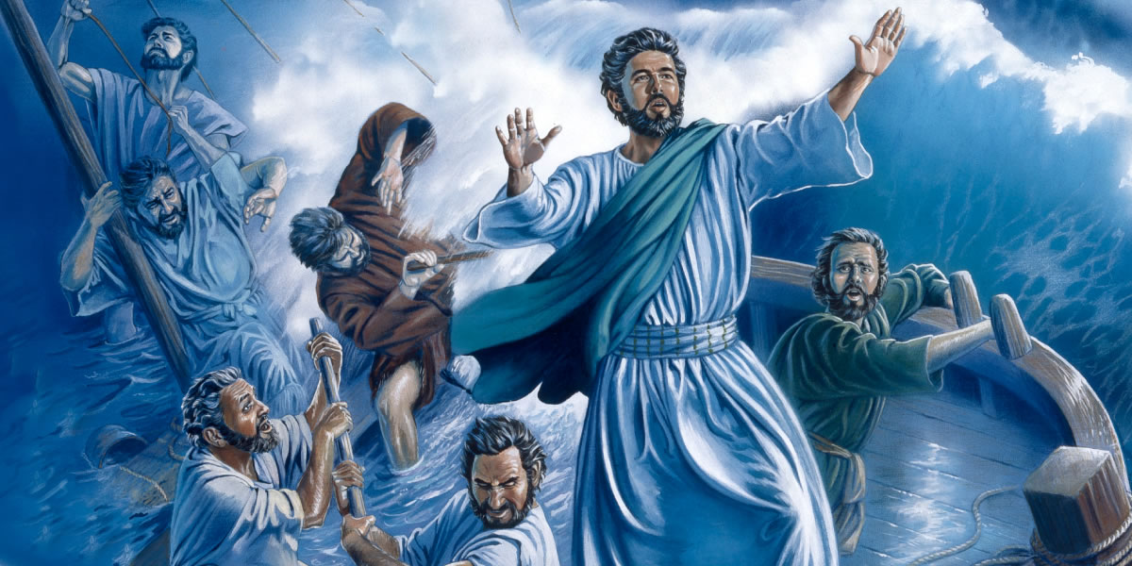
“And now I exhort you to be of good cheer: for there shall be no loss of any man's life among you, but of the ship. For there stood by me this night the angel of God, whose I am, and whom I serve, Saying, Fear not, Paul; thou must be brought before Caesar: and, lo, God hath given thee all them that sail with thee. Wherefore, sirs, be of good cheer: for I believe God, that it shall be even as it was told me.” (Acts 27:22-25)

Slide 48
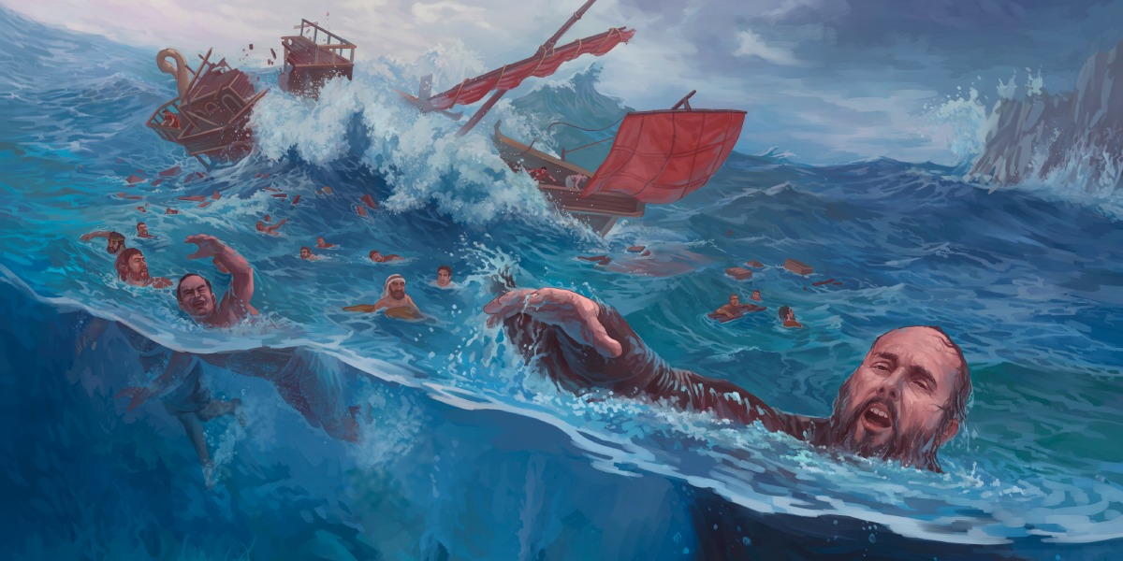
“The centurion, willing to save Paul, kept them from their purpose; and commanded that they which could swim should cast themselves first into the sea, and get to land: And the rest, some on boards, and some on broken pieces of the ship. And so it came to pass, that they escaped all safe to land.”

Slide 49
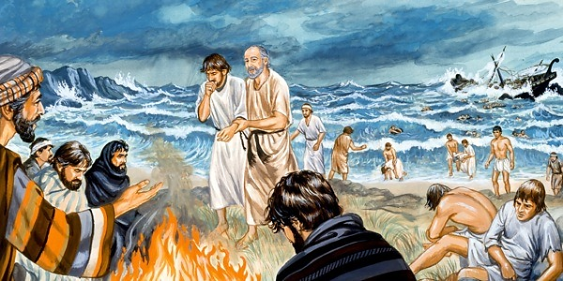
“And we were in all in the ship two hundred threescore and sixteen souls (276)… And when they were escaped, then they knew that the island was called Melita.”

Slide 50
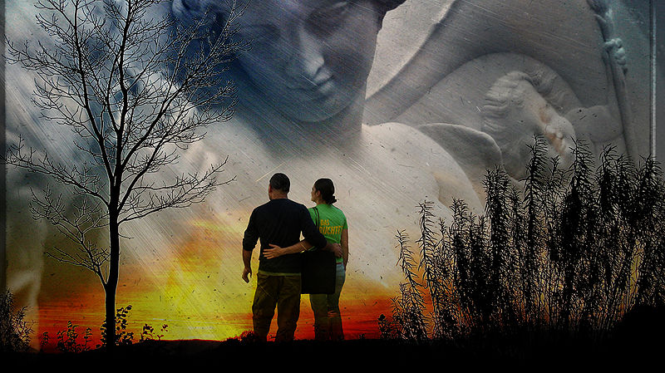
“For he shall give his angels charge over thee, to keep thee in all thy ways.” (Psalms 91:11)

Slide 51
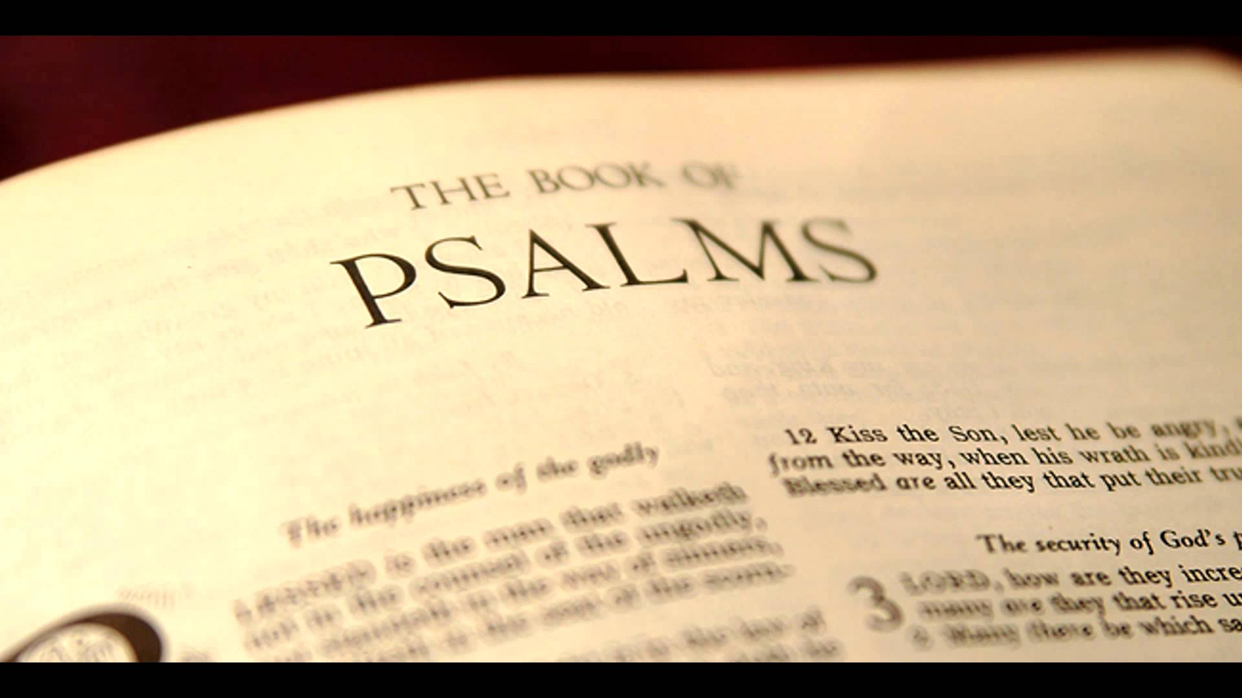
Closer look at Psalms chapter 91:1-16

Slide 52
vs. 1-13 “He that dwelleth in the secret place of the most High shall abide under the shadow of the Almighty. I will say of the LORD, He is my refuge and my fortress: my God; in him will I trust. Surely he shall deliver thee from the snare of the fowler, and from the noisome pestilence. He shall cover thee with his feathers, and under his wings shalt thou trust: his truth shall be thy shield and buckler. Thou shalt not be afraid for the terror by night; nor for the arrow that flieth by day; Nor for the pestilence that walketh in darkness; nor for the destruction that wasteth at noonday.”

Slide 53
“A thousand shall fall at thy side, and ten thousand at thy right hand; but it shall not come nigh thee. Only with thine eyes shalt thou behold and see the reward of the wicked. Because thou hast made the LORD, which is my refuge, even the most High, thy habitation; There shall no evil befall thee, neither shall any plague come nigh thy dwelling. For he shall give his angels charge over thee, to keep thee in all thy ways. They shall bear thee up in their hands, lest thou dash thy foot against a stone. Thou shalt tread upon the lion and adder: the young lion and the dragon shalt thou trample under feet.”

Slide 54
vs. 14-16 “Because he hath set his love upon me, therefore will I deliver him: I will set him on high, because he hath known my name. He shall call upon me, and I will answer him: I will be with him in trouble; I will deliver him, and honour him. With long life will I satisfy him, and shew him my salvation.”

Slide 56
King James Study Bible – The key word to describe this psalm is security. There are two distinct voices in the psalm, and each speaks to the trusting believer in the Lord.
The first voice assures the faithful of God’s protection (vs.1-13).
The second voice is that of the Lord Himself who likewise pledges His watchful care (vs.14-16).
An important caution is necessary here. The great promises of verse 3-13 should not be taken in an absolute sense. One may not be presumptuous in applying them. Satan himself has already suggested that (see Matthew 4:6-7).
Rather, the believer must recall that deliverance still has to be the will of God and that even if harm should come, he can still be secure (see Luke 21:16-18; Romans 8:28, 35-37; Hebrews 11:32-39).

Slide 57
“And ye shall be betrayed both by parents, and brethren, and kinsfolks, and friends; and some of you shall they cause to be put to death. And ye shall be hated of all men for my name's sake. But there shall not an hair of your head perish.” (Luke 21:16-18)

Slide 58
“And we know that all things work together for good to them that love God, to them who are the called according to his purpose…Who shall separate us from the love of Christ? shall tribulation, or distress, or persecution, or famine, or nakedness, or peril, or sword? As it is written, For thy sake we are killed all the day long; we are accounted as sheep for the slaughter. Nay, in all these things we are more than conquerors through him that loved us.” (Romans 8:28, 35-37)

Slide 60
“And what shall I more say? for the time would fail me to tell of Gedeon, and of Barak, and of Samson, and of Jephthae; of David also, and Samuel, and of the prophets: Who through faith subdued kingdoms, wrought righteousness, obtained promises, stopped the mouths of lions, Quenched the violence of fire, escaped the edge of the sword, out of weakness were made strong, waxed valiant in fight, turned to flight the armies of the aliens. Women received their dead raised to life again: and others were tortured, not accepting deliverance; that they might obtain a better resurrection: And others had trial of cruel mockings and scourgings, yea, moreover of bonds and imprisonment: They were stoned, they were sawn asunder, were tempted, were slain with the sword: they wandered about in sheepskins and goatskins; being destitute, afflicted, tormented; they wandered in deserts, and in mountains, and in dens and caves of the earth. And these all, having obtained a good report through faith, received not the promise.” (Hebrews 11:32-39)

Slide 61
“Thou art my hiding place and my shield: I hope in thy word.” (Psalms 119:114)

Slide 62
“And it came to pass, that the beggar died, and was carried by the angels into Abraham's bosom: the rich man also died, and was buried; And in hell he lift up his eyes, being in torments, and seeth Abraham afar off, and Lazarus in his bosom.” (Luke 16:22-23)

