Slide 2
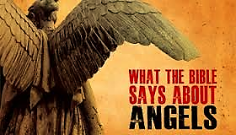

Slide 5
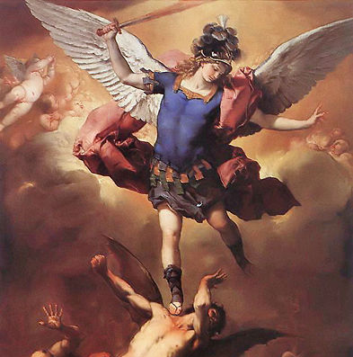
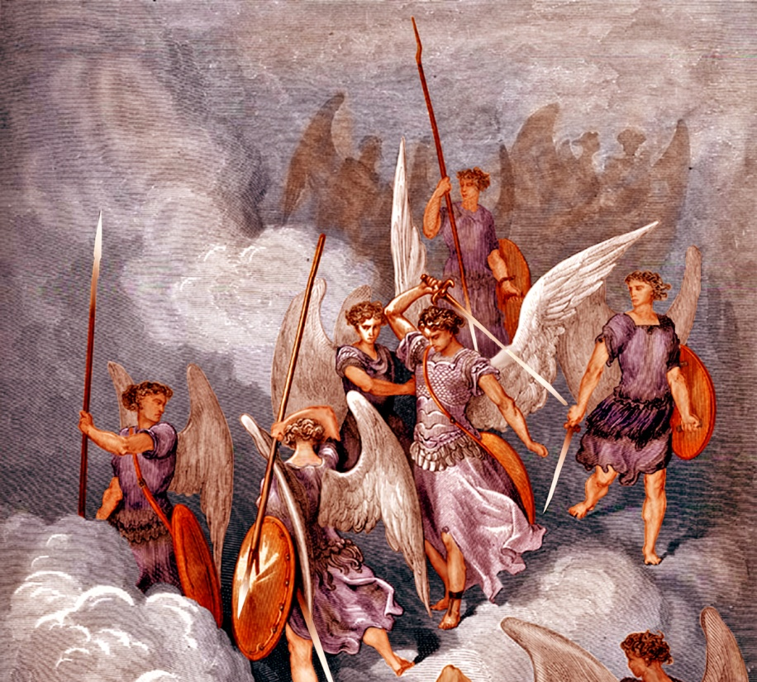
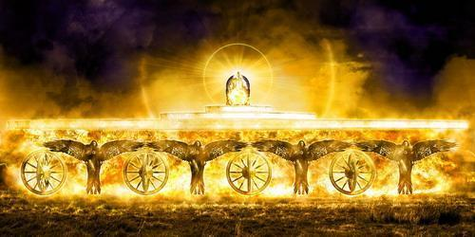
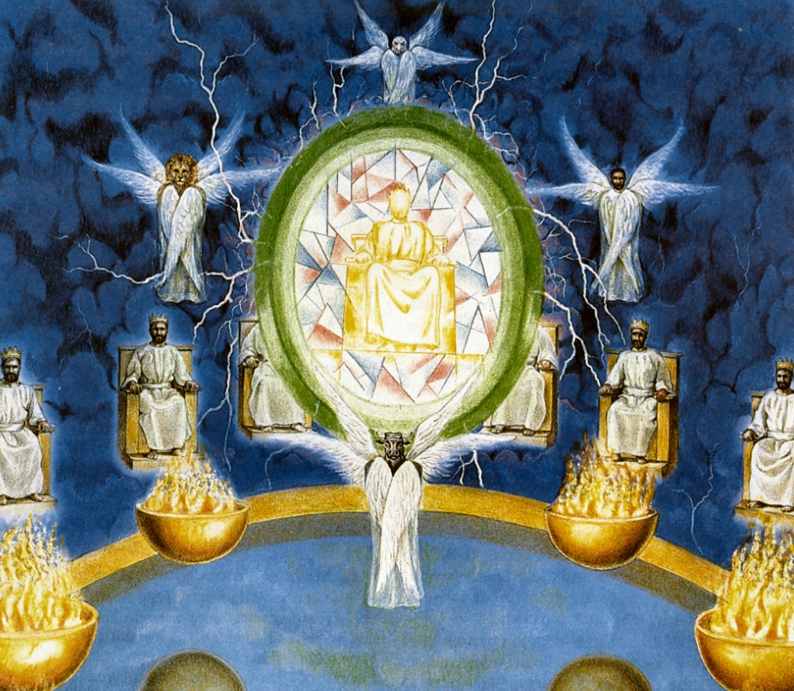
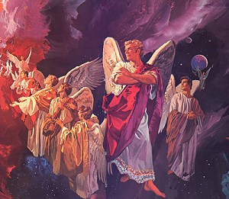
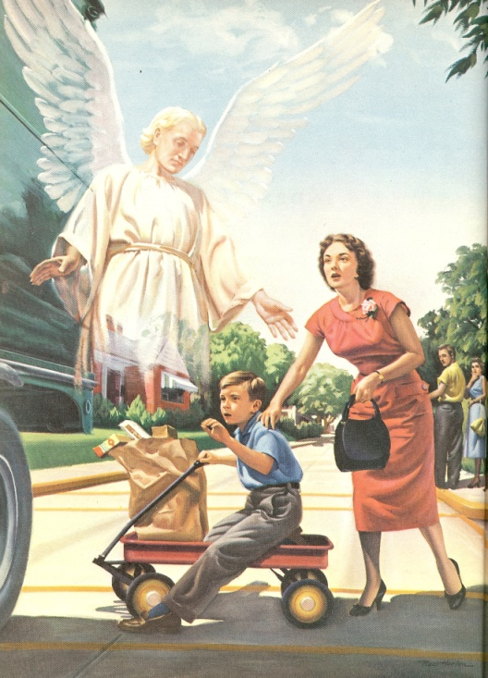
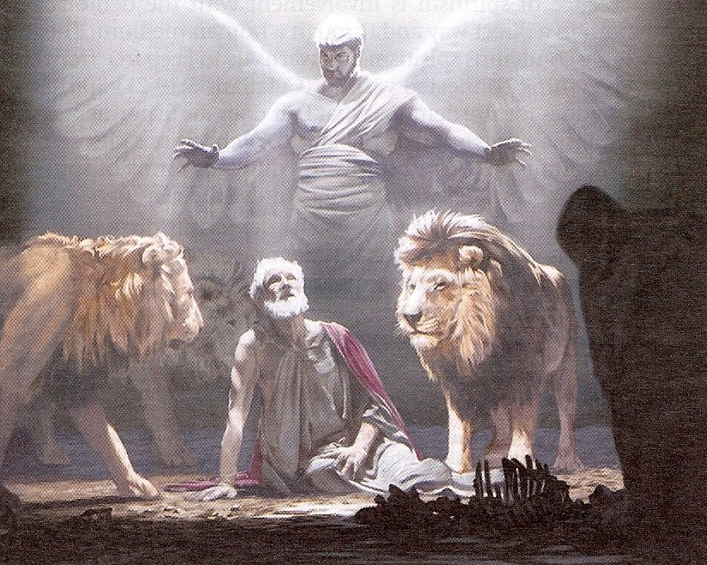
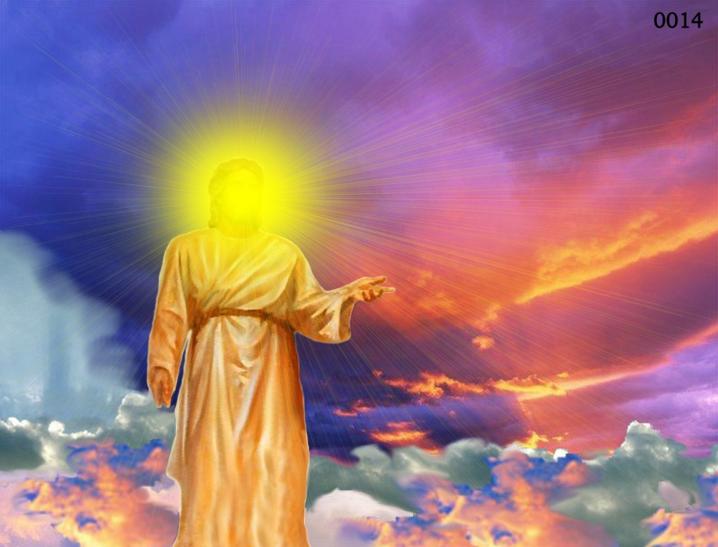
Different Types of Angels
Archangels – Michael and Gabriel
Cherubim's – Ezekiel 1:4-28
Seraphim’s – Isaiah 6:1-7
Ruling angels – I Peter 3:22
Guarding angels – Hebrews 1:14
Angel of the Lord – Zechariah 3:1-10

Slide 6
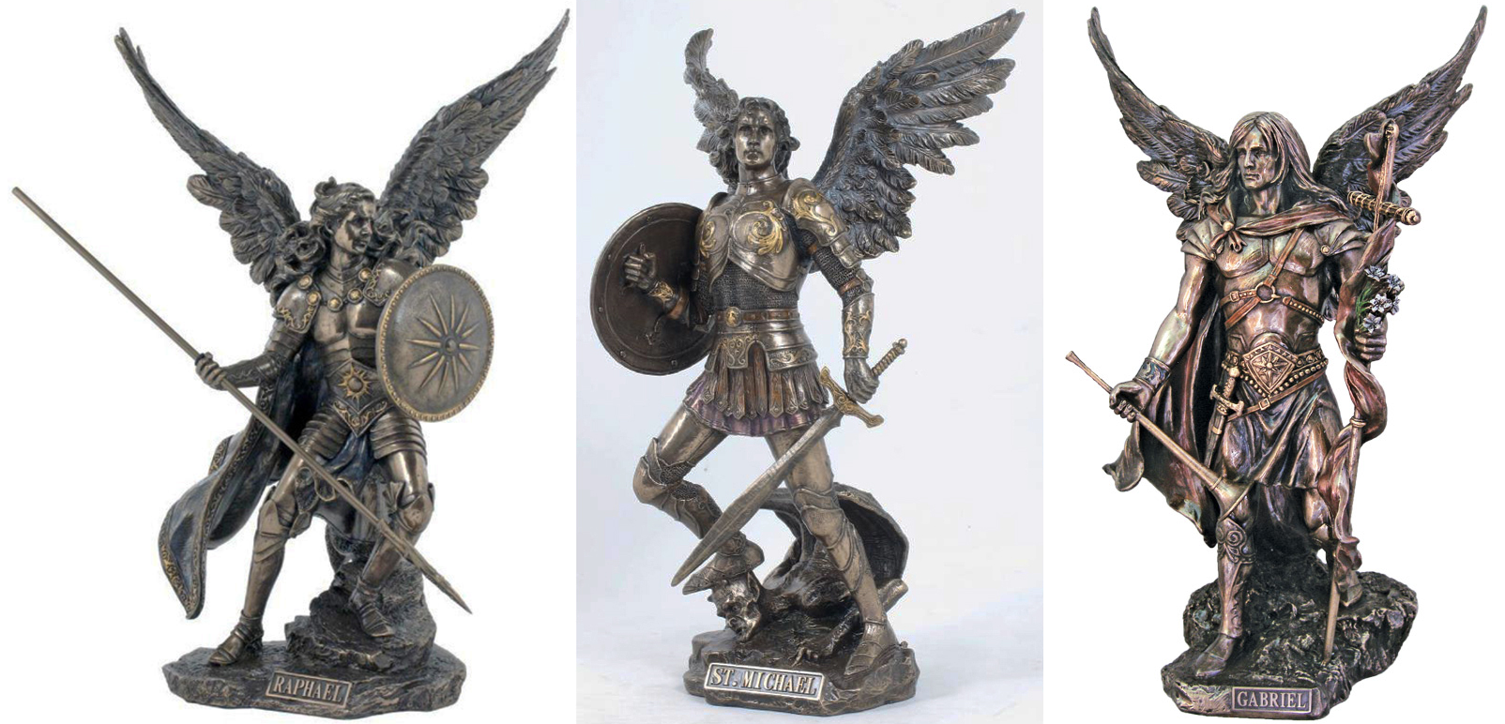
Archangels – Michael and Gabriel
Warrior - Michael Messenger - Gabriel

Slide 7
Michael the Warrior of God

Slide 8
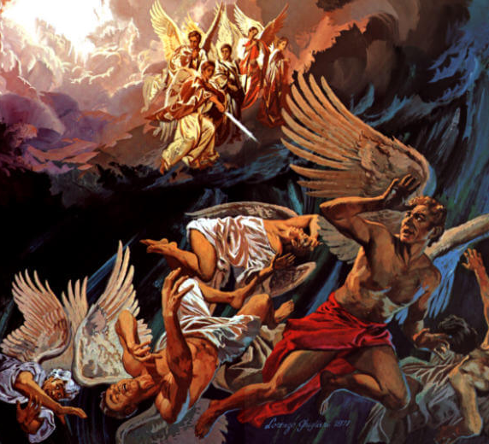
“And there was war in heaven: Michael and his angels fought against the dragon; and the dragon fought and his angels, And prevailed not; neither was their place found any more in heaven. And the great dragon was cast out, that old serpent, called the Devil, and Satan, which deceiveth the whole world: he was cast out into the earth, and his angels were cast out with him.” (Revelation 12:7-9)

Slide 9
Gabriel the Messenger of God

Slide 10
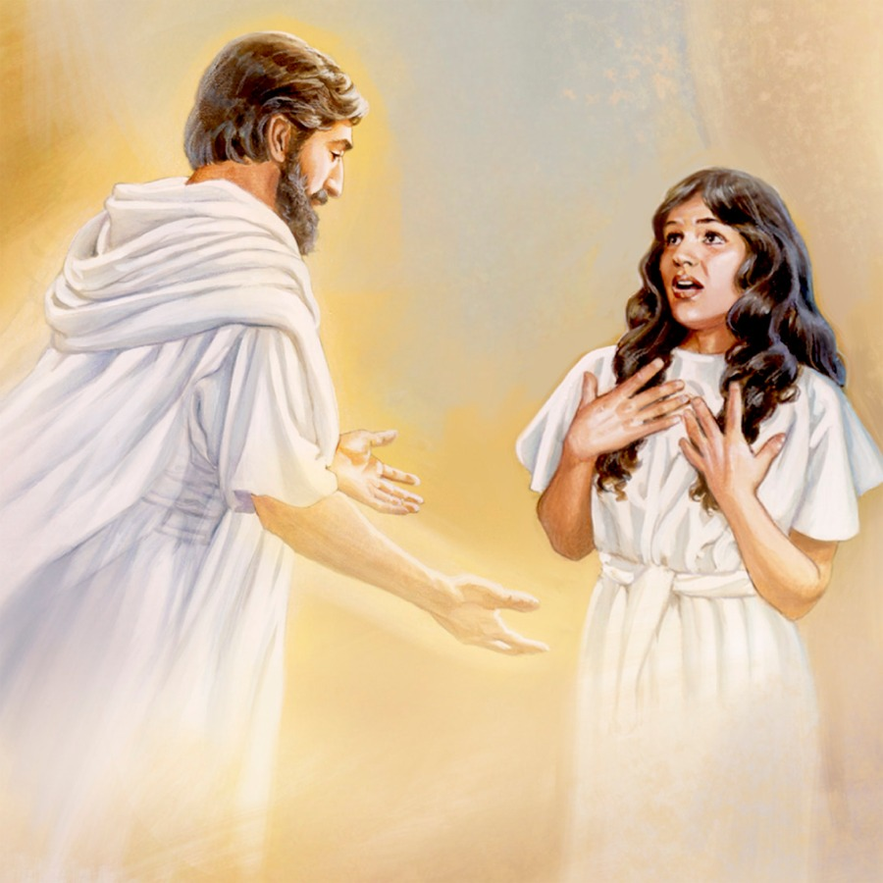
“And in the sixth month the angel Gabriel was sent from God unto a city of Galilee, named Nazareth, To a virgin espoused to a man whose name was Joseph, of the house of David; and the virgin's name was Mary.” (Luke 1:26-27)

Slide 11
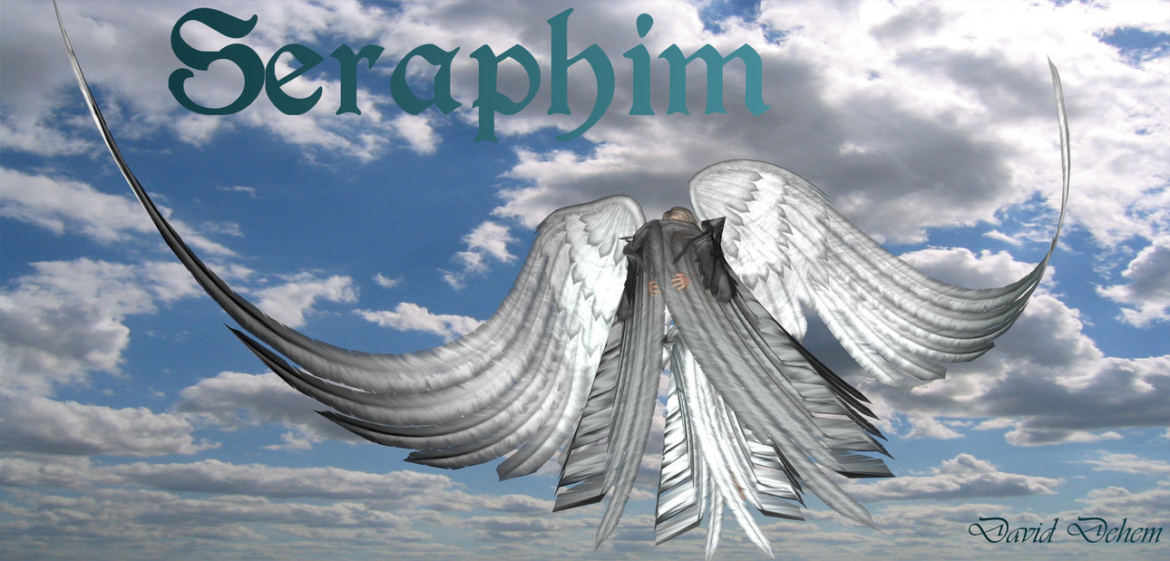
Seraphim’s

Slide 12
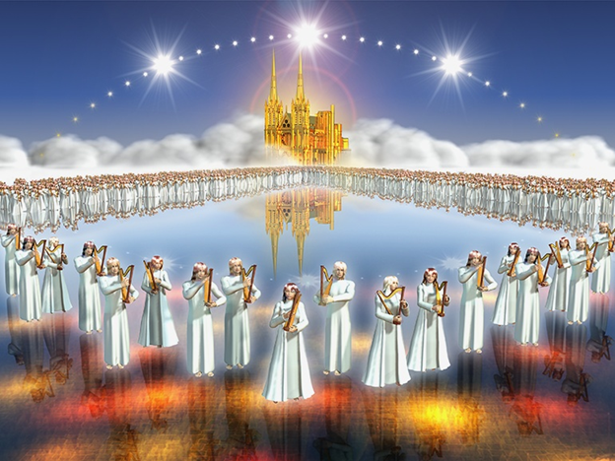
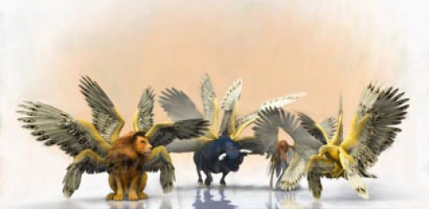
“And before the throne there was a sea of glass like unto crystal: and in the midst of the throne, and round about the throne, were four beasts full of eyes before and behind.”

Slide 13
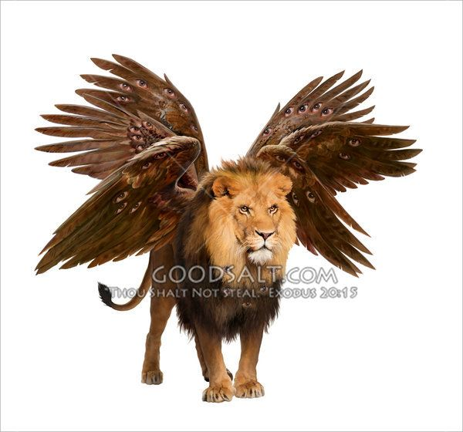
And the first beast was like a lion

Slide 14
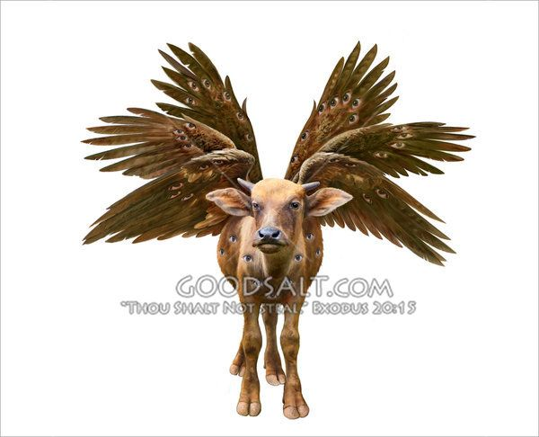
And the second beast like a calf

Slide 15
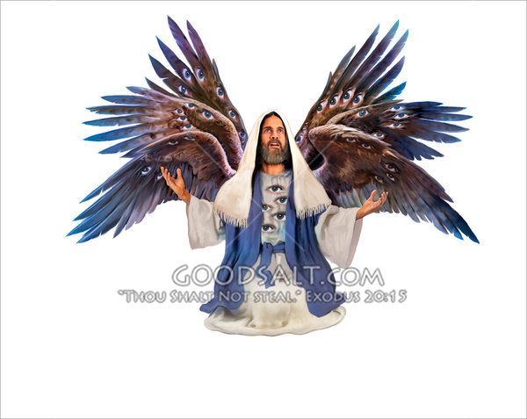
And the third beast had a face as a man

Slide 16
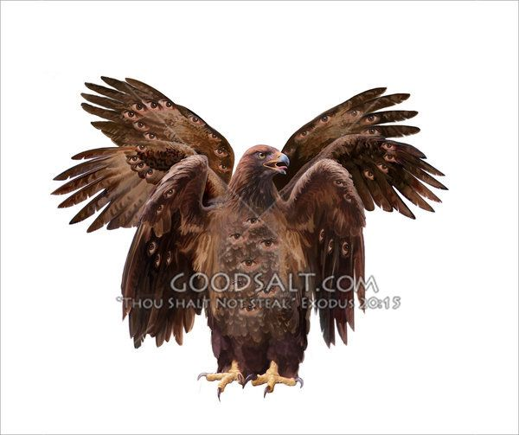
And the fourth beast was like a flying eagle

Slide 17
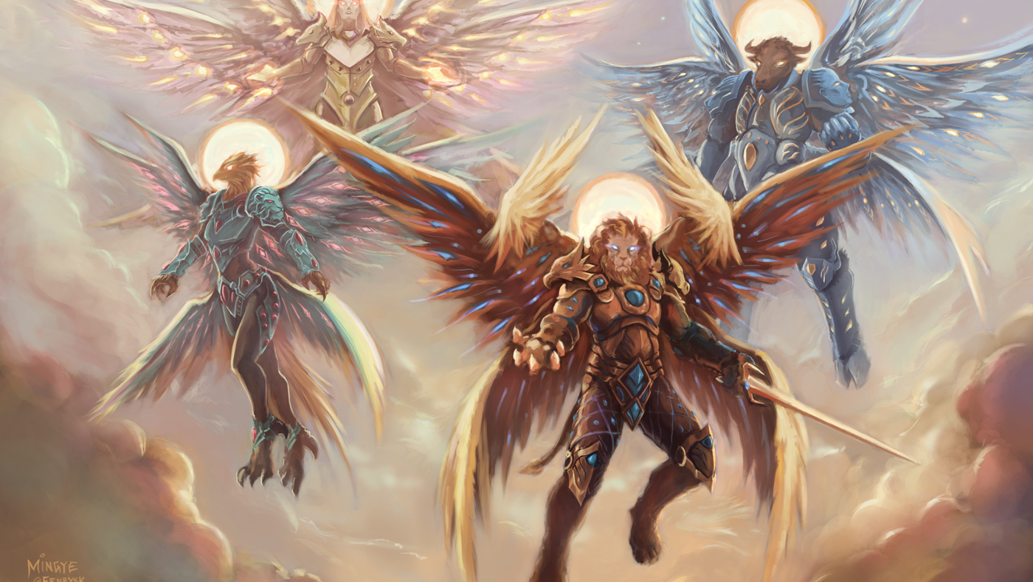
“And the four beasts had each of them six wings about him; and they were full of eyes within: and they rest not day and night, saying, Holy, holy, holy, Lord God Almighty, which was, and is, and is to come.”

Slide 18
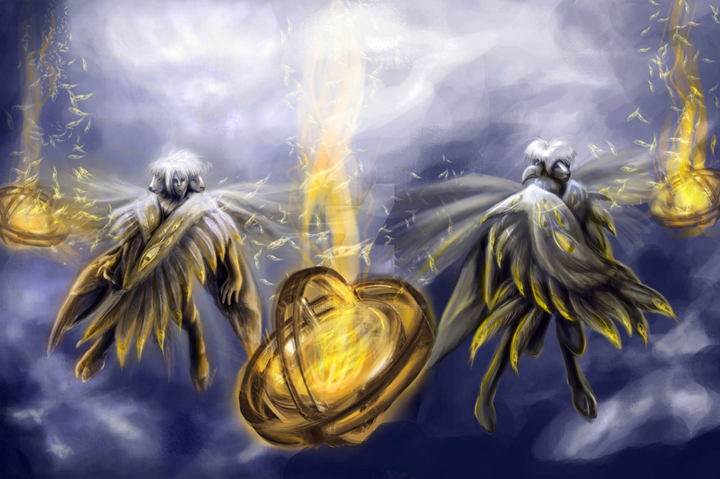
Cherubims
(Ezekiel 1:1-28, 10:15-22)

Slide 19
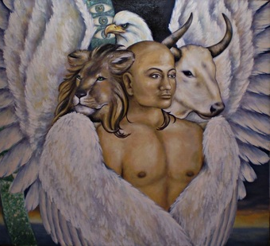
“Every one had four faces apiece, and every one four wings; and the likeness of the hands of a man was under their wings…As for the likeness of their faces, they four had the face of a man, and the face of a lion, on the right side: and they four had the face of an ox on the left side; they four also had the face of an eagle.”

Slide 20
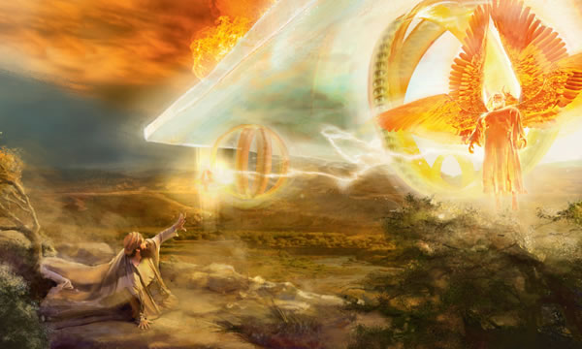
“And when the living creatures went, the wheels went by them: and when the living creatures were lifted up from the earth, the wheels were lifted up. And the cherubim’s lifted up their wings, and mounted up from the earth in my sight: when they went out, the wheels also were beside them, and every one stood at the door of the east gate of the LORD'S house; and the glory of the God of Israel was over them above. This is the living creature that I saw…And as they went, I heard the noise of their wings, like the noise of great waters, as the voice of the Almighty.” ”

Slide 21
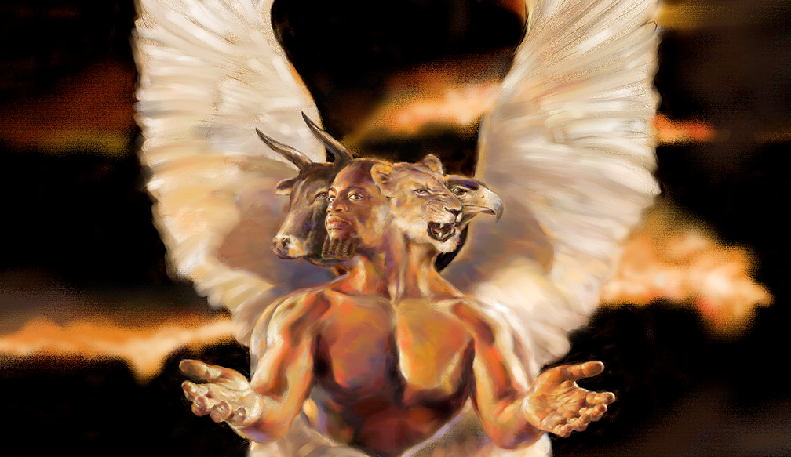
The ministry of the Seraphim's and Cherubim’s “The Glory of God”

Slide 22
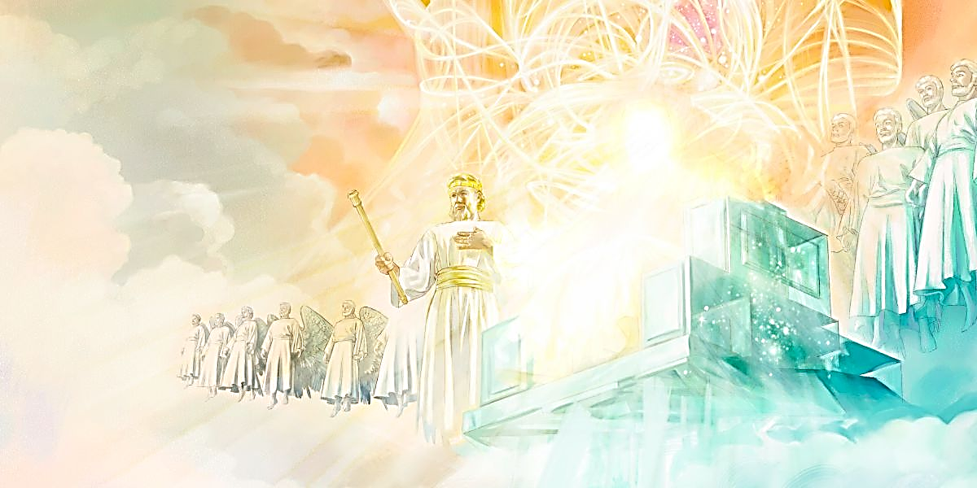
Ruling Angels
(Colossians 1:16)
“For by him were all things created, that are in heaven, and that are in earth, visible and invisible, whether they be thrones, or dominions, or principalities, or powers: all things were created by him, and for him.”

Slide 23
Ten Ranks of Angels

Slide 24
Archangels - The word “archangel” comes from a Greek word meaning "chief angel or an angel of high rank."
Princes - Royal ruler subject to a king or emperor
Cherubims - Powerful heavenly beings surrounding the throne
Seraphims – One of the highest order of the celestial beings
Thrones - Seats of authority
Authorities - A magistrate, potentate, monarch or ruler
Principalities - Ruler over a jurisdictional area
Dominions - A territory of sovereign control
Powers - Delegated authority, jurisdiction, strength
Might - Powerful, forceful, strong

Slide 25
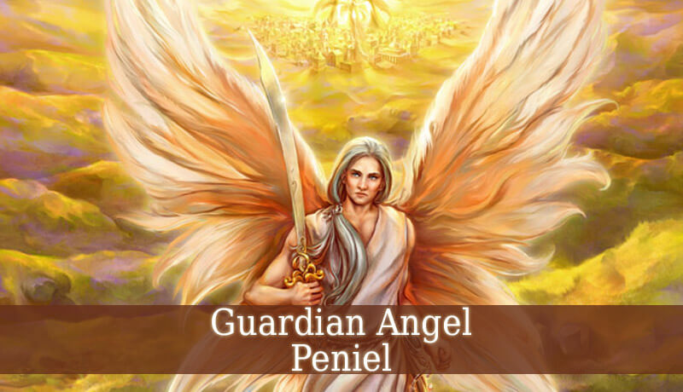

Slide 26
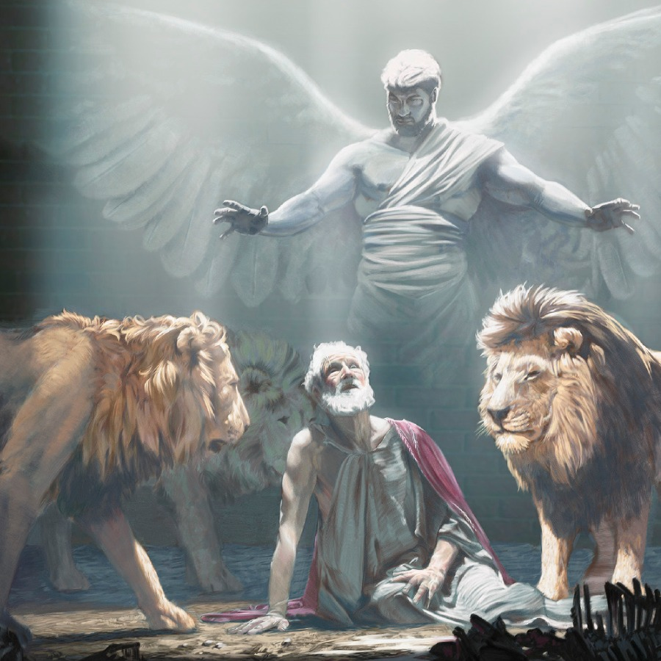
“Then the king commanded, and they brought Daniel, and cast him into the den of lions. Now the king spake and said unto Daniel, Thy God whom thou servest continually, he will deliver thee…Then the king arose very early in the morning, and went in haste unto the den of lions…Then said Daniel unto the king, O king, live for ever. My God hath sent his angel, and hath shut the lions' mouths, that they have not hurt me.” (see Daniel chapter 6)

Slide 27
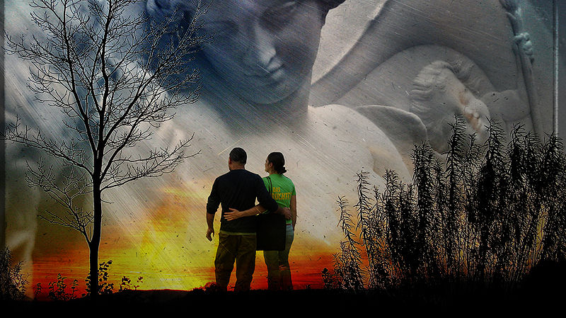
“For he shall give his angels charge over thee, to keep thee in all thy ways.” (Psalms 91:11)

Slide 30
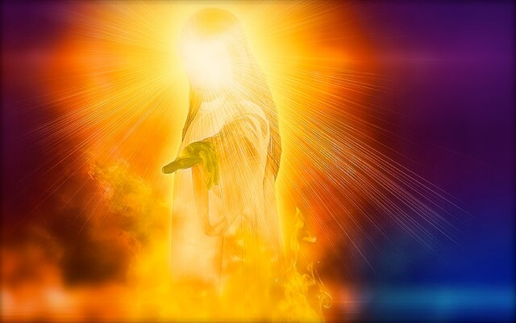
Who is the Angel of the Lord?

Slide 31
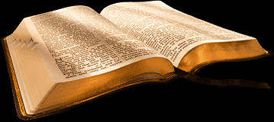
There are 64 mentions of the Angel of the Lord in Scripture

Slide 32
The precise identity of the “angel of the Lord” is not given in the Bible. However, there are many important “clues” to his identity.
There are Old and New Testament references to “angels of the Lord,” “an angel of the Lord,” and “the angel of the Lord.”
It seems when the definite article “the” is used, it is specifying a unique being, separate from the other angels.

Slide 33
Gabriel the Messenger of God “The Angel of the Lord”

Slide 34
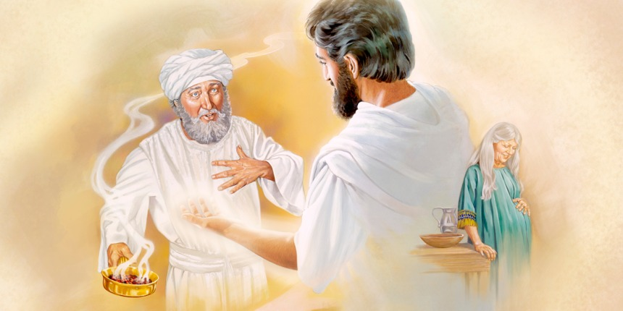
“And there appeared unto him an angel of the Lord standing on the right side of the altar of incense. And when Zacharias saw him, he was troubled, and fear fell upon him. But the angel said unto him, Fear not, Zacharias: for thy prayer is heard; and thy wife Elisabeth shall bear thee a son, and thou shalt call his name John.” (Luke 1:11-13)

Slide 35
“And Zacharias said unto the angel, Whereby shall I know this? for I am an old man, and my wife well stricken in years. And the angel answering said unto him, I am Gabriel, that stands in the presence of God; and am sent to speak unto thee, and to shew thee these glad tidings.” (Luke 1:18-19)

Slide 36
“And in the sixth month the angel Gabriel was sent from God unto a city of Galilee, named Nazareth, To a virgin espoused to a man whose name was Joseph, of the house of David; and the virgin's name was Mary.” (Luke 1:26-27)

Slide 37
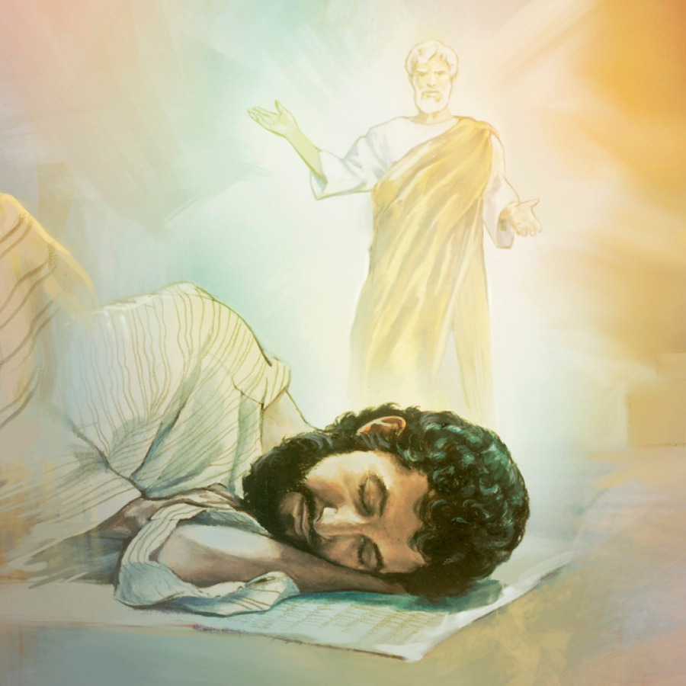
“Then Joseph her husband, being a just man, and not willing to make her a publick example, was minded to put her away privily. But while he thought on these things, behold, the angel of the Lord appeared unto him in a dream, saying, Joseph, thou son of David, fear not to take unto thee Mary thy wife: for that which is conceived in her is of the Holy Ghost.” (Matthew 1:19-20)

Slide 38
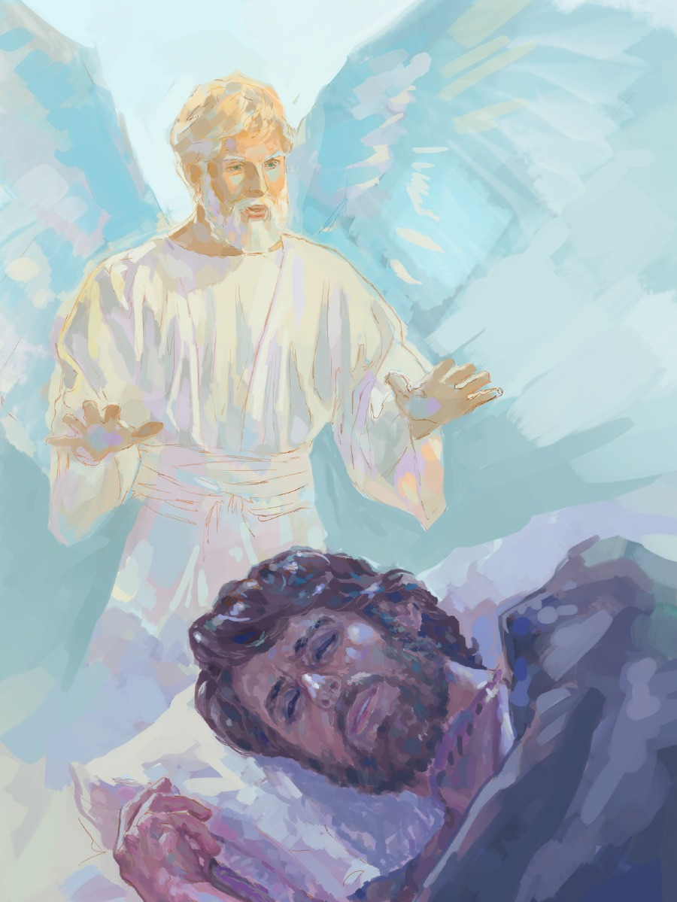
“And being warned of God in a dream that they should not return to Herod, they departed into their own country another way. And when they were departed, behold, the angel of the Lord appeareth to Joseph in a dream, saying, Arise, and take the young child and his mother, and flee into Egypt, and be thou there until I bring thee word: for Herod will seek the young child to destroy him.” (Matthew 2:12-13)

Slide 39
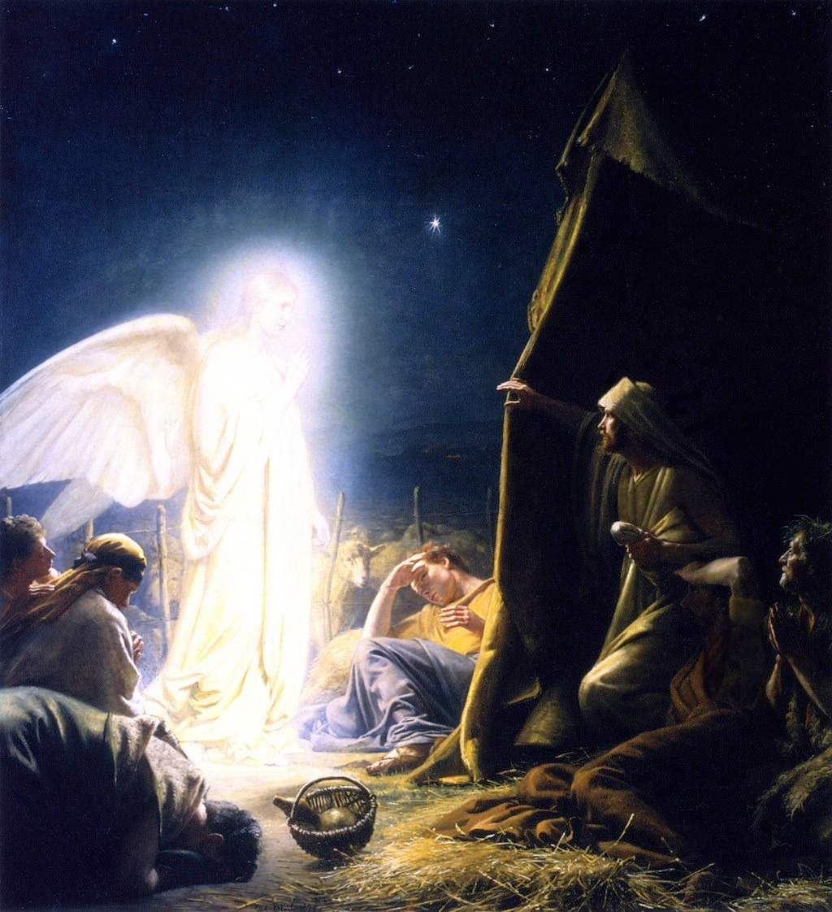
“And, lo, the angel of the Lord came upon them, and the glory of the Lord shone round about them: and they were sore afraid. And the angel said unto them, Fear not: for, behold, I bring you good tidings of great joy, which shall be to all people. For unto you is born this day in the city of David a Saviour, which is Christ the Lord.” (Luke 2:9-11)

Slide 40
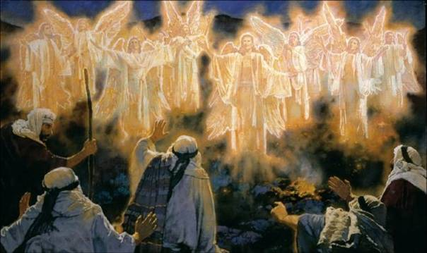
“And suddenly there was with the angel a multitude of the heavenly host praising God, and saying, Glory to God in the highest, and on earth peace, good will toward men.” (Luke 2:13-14)

Slide 41
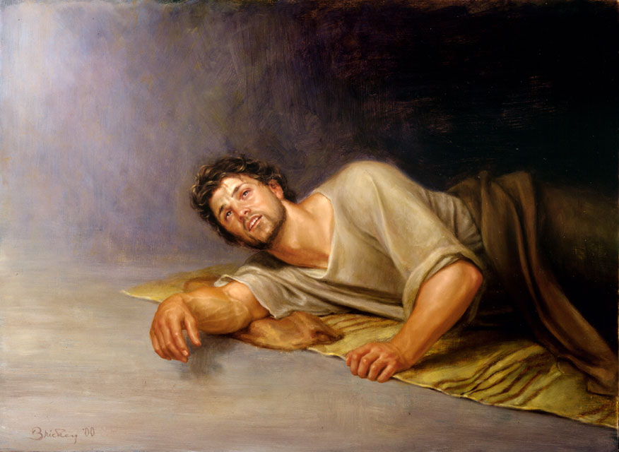
“But when Herod was dead, behold, an angel of the Lord appeareth in a dream to Joseph in Egypt, Saying, Arise, and take the young child and his mother, and go into the land of Israel: for they are dead which sought the young child's life.” (Matthew 2:19-20)

Slide 42
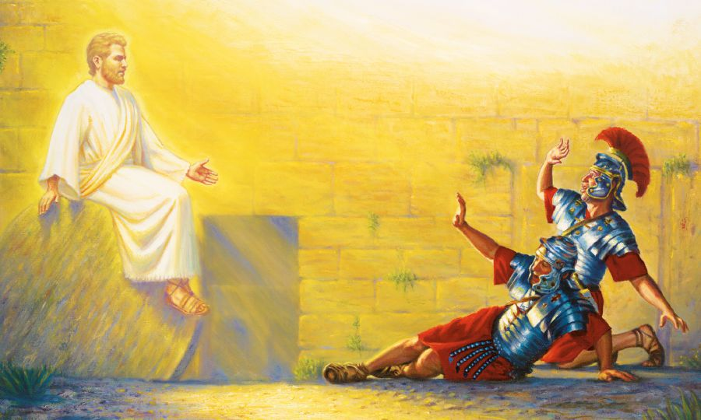
“And, behold, there was a great earthquake: for the angel of the Lord descended from heaven, and came and rolled back the stone from the door, and sat upon it.” (Matthew 28:2)

Slide 43
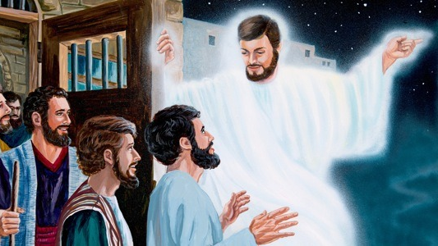
“Then the high priest rose up, and all they that were with him, (which is the sect of the Sadducees,) and were filled with indignation, And laid their hands on the apostles, and put them in the common prison. But the angel of the Lord by night opened the prison doors, and brought them forth, and said, Go, stand and speak in the temple to the people all the words of this life.” (Acts 5:17-20)

Slide 44
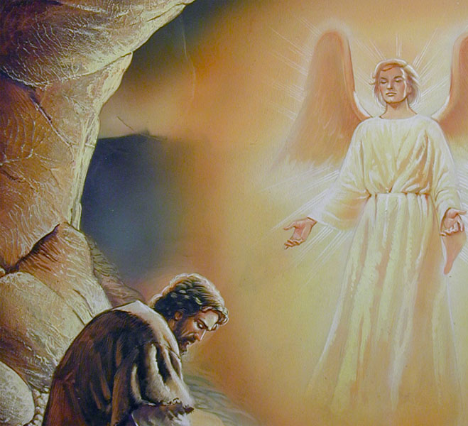
“And the angel of the Lord spake unto Philip, saying, Arise, and go toward the south unto the way that goeth down from Jerusalem unto Gaza, which is desert.” (Acts 8:26)

Slide 45
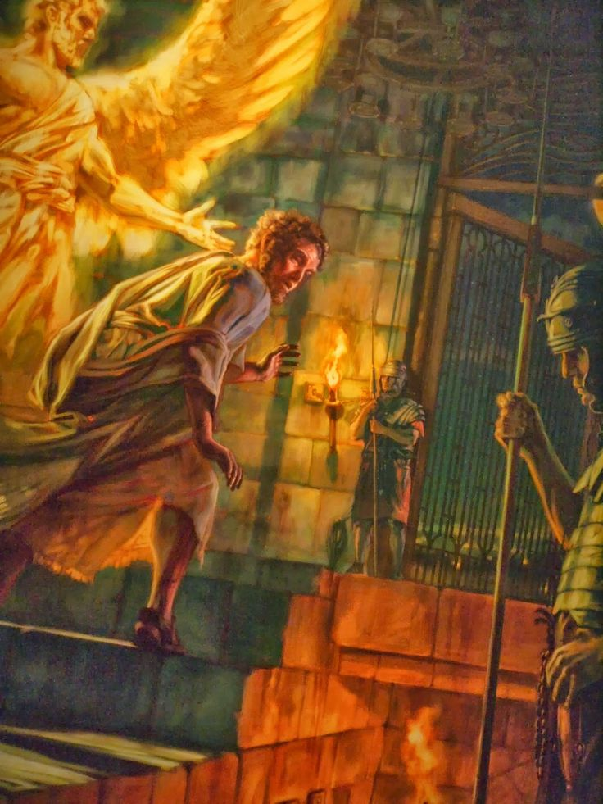
“And, behold, the angel of the Lord came upon him, and a light shined in the prison: and he smote Peter on the side, and raised him up, saying, Arise up quickly. And his chains fell off from his hands.” (Acts 12:7)

Slide 46
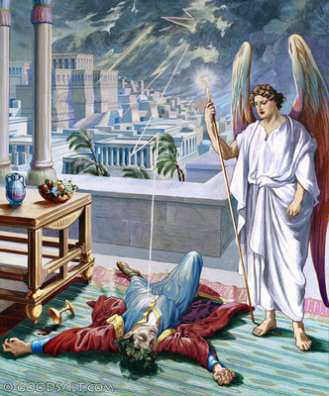
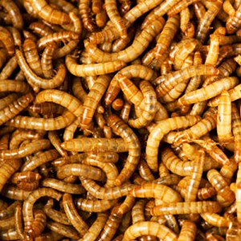
“And upon a set day Herod, arrayed in royal apparel, sat upon his throne, and made an oration unto them. And the people gave a shout, saying, It is the voice of a god, and not of a man. And immediately the angel of the Lord smote him, because he gave not God the glory: and he was eaten of worms, and gave up the ghost. But the word of God grew and multiplied.” (Acts 12:21-24)

Slide 47
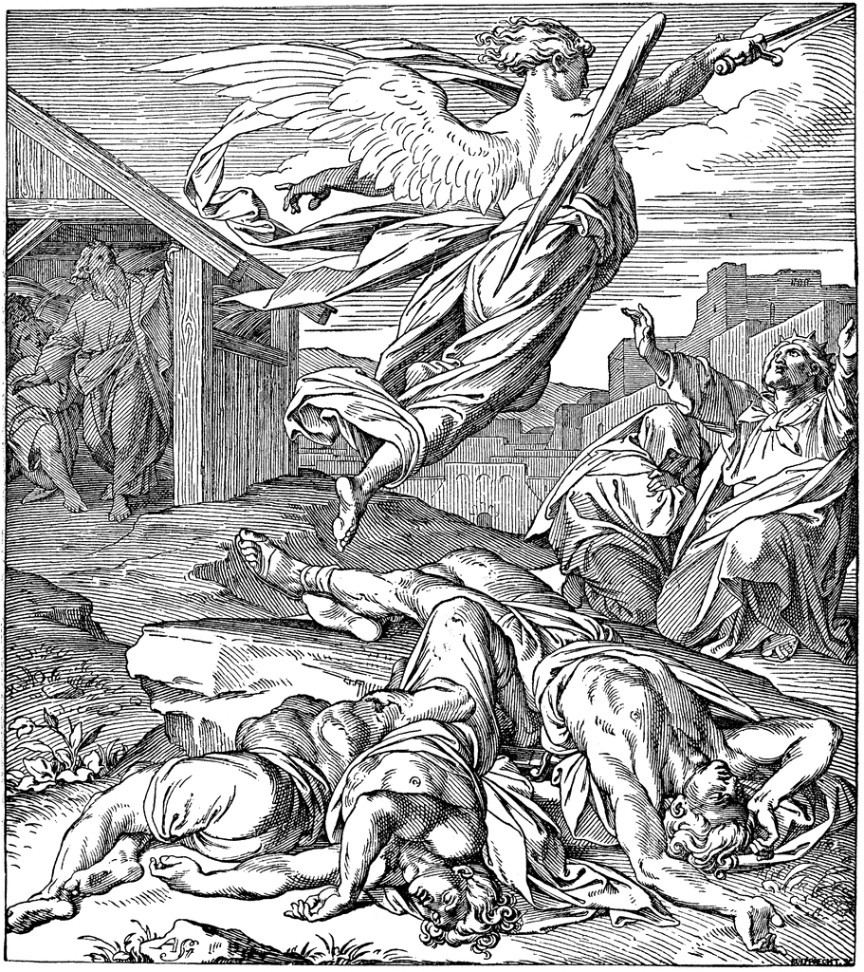
“And when the angel of the Lord stretched out his hand upon Jerusalem to destroy it, the LORD repented him of the evil, and said to the angel that destroyed the people, It is enough: stay now thine hand.” (2 Samuel 24:16)

Slide 48
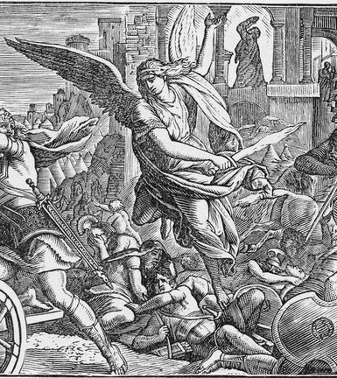
“And it came to pass that night, that the angel of the LORD went out, and smote in the camp of the Assyrians an hundred fourscore and five thousand (185,000): and when they arose early in the morning, behold, they were all dead corpse.” (2 Kings 19:35)

Slide 49
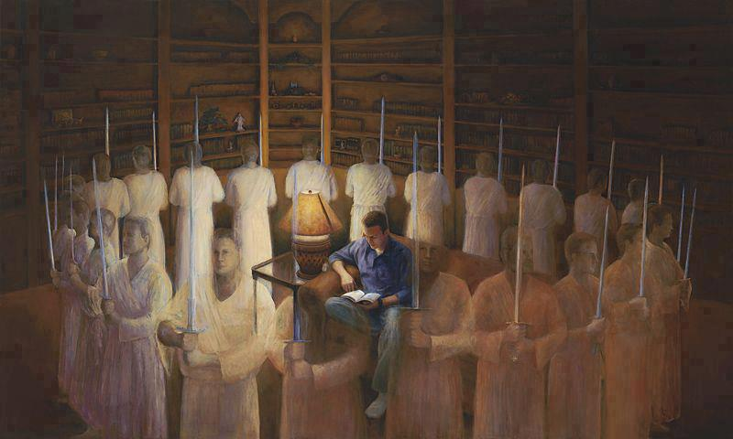
“This poor man cried, and the LORD heard him, and saved him out of all his troubles. The angel of the LORD encampeth round about them that fear him, and delivereth them.” (Psalms 34:6-7)

Slide 50
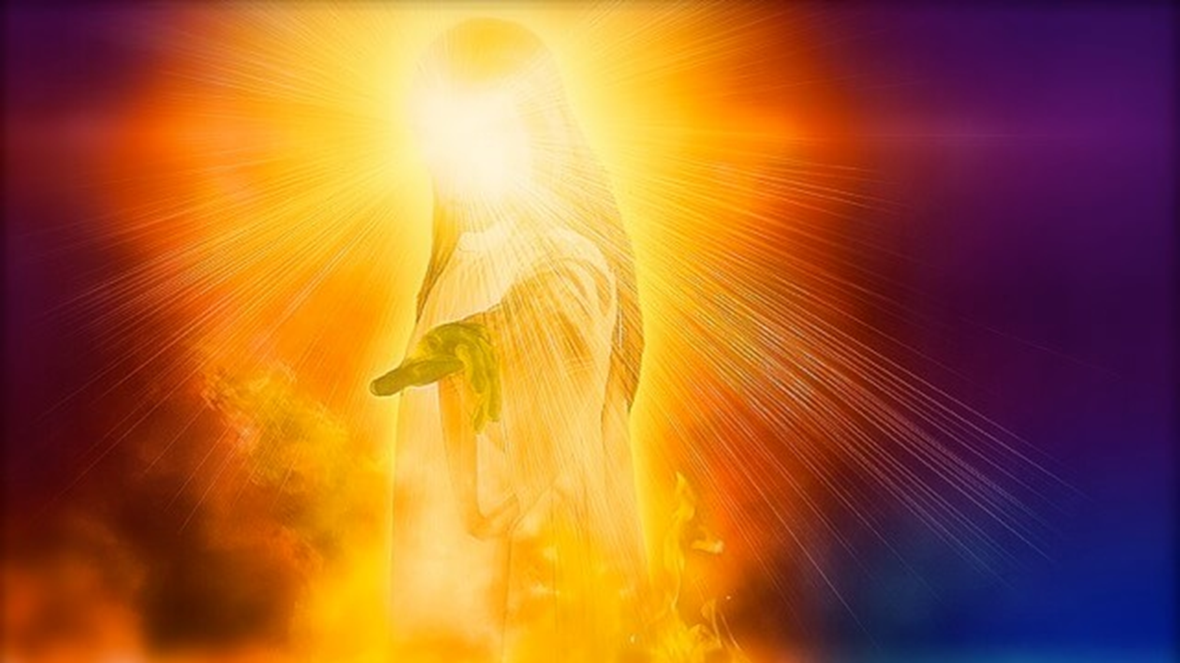
The Angel of the Lord (Theophany) “An appearance of God in physical form”

Slide 51
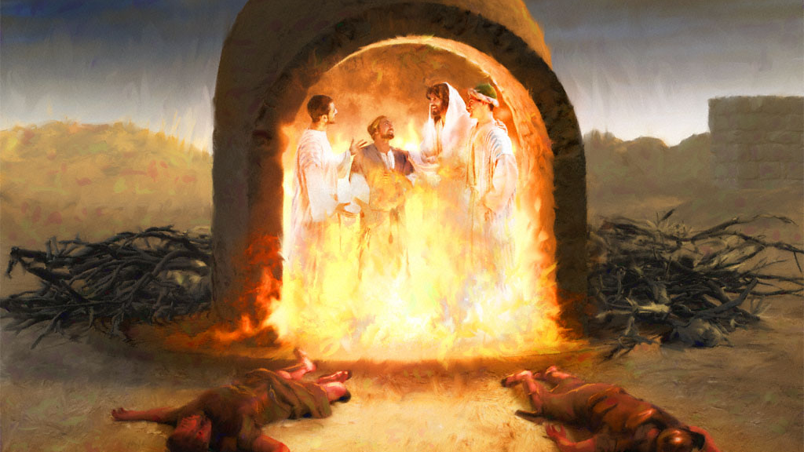
“Then Nebuchadnezzar the king was astonied, and rose up in haste, and spake, and said unto his counsellors, Did not we cast three men bound into the midst of the fire? They answered and said unto the king, True, O king. He answered and said, Lo, I see four men loose, walking in the midst of the fire, and they have no hurt; and the form of the fourth is like the Son of God.” (Daniel 3:24-25)

Slide 52
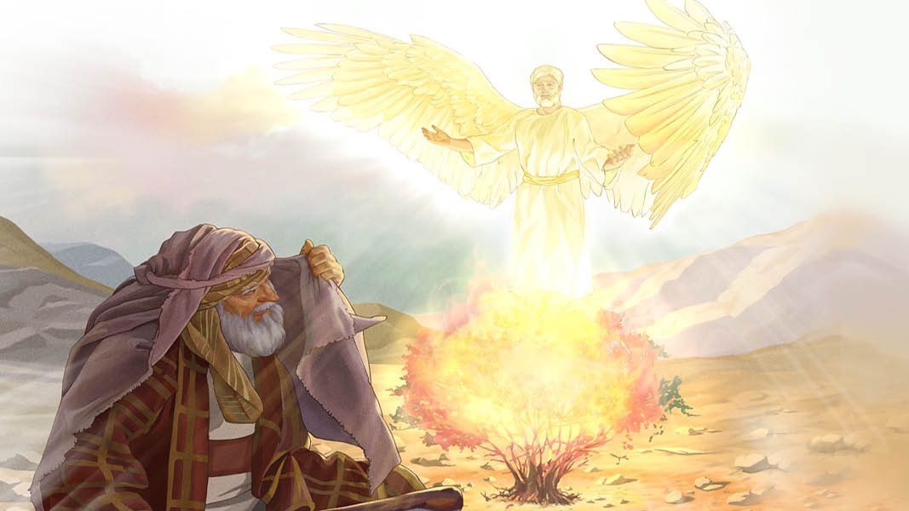
“And the angel of the LORD appeared unto him in a flame of fire out of the midst of a bush: and he looked, and, behold, the bush burned with fire, and the bush was not consumed.”
(Exodus 3:2)

Slide 53
“And Moses said, I will now turn aside, and see this great sight, why the bush is not burnt. And when the LORD saw that he turned aside to see, God called unto him out of the midst of the bush, and said, Moses, Moses. And he said, Here am I.”
(Exodus 3:3-4)

Slide 54
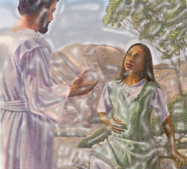
“And the angel of the LORD said unto her, I will multiply thy seed exceedingly, that it shall not be numbered for multitude. And the angel of the LORD said unto her, Behold, thou art with child, and shalt bear a son, and shalt call his name Ishmael; because the LORD hath heard thy affliction.

Slide 55
And he will be a wild man; his hand will be against every man, and every man's hand against him; and he shall dwell in the presence of all his brethren. And she called the name of the LORD that spake unto her, Thou God seest me.” (Genesis 16:10-16)

Slide 56
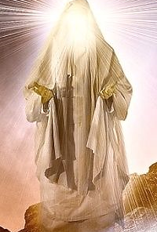
The Angel of the Lord (Christophany) “An appearance of Christ in physical form in the Old Testament”

Slide 57
“And the LORD appeared unto him in the plains of Mamre: and he sat in the tent door in the heat of the day.” (Genesis 18:1)

Slide 58
“And the angel of the LORD called unto him out of heaven, and said, Abraham, Abraham: and he said, Here am I. And he said, Lay not thine hand upon the lad, neither do thou any thing unto him: for now I know that thou fearest God, seeing thou hast not withheld thy son, thine only son from me.” (Genesis 22:11-12)

Slide 59
“And Abraham lifted up his eyes, and looked, and behold behind him a ram caught in a thicket by his horns: and Abraham went and took the ram, and offered him up for a burnt offering in the stead of his.”(Genesis 22:13)

Slide 60
“And the angel of the LORD called unto Abraham out of heaven the second time, And said, By myself have I sworn, saith the LORD, for because thou hast done this thing, and hast not withheld thy son, thine only son: That in blessing I will bless thee, and in multiplying I will multiply thy seed as the stars of the heaven, and as the sand which is upon the sea shore; and thy seed shall possess the gate of his enemies.” (Genesis 22:15-17)

Slide 61
(Numbers 22) “And God's anger was kindled because he went: and the angel of the LORD stood in the way for an adversary against him… And the ass saw the angel of the LORD standing in the way, and his sword drawn in his hand: and the ass turned aside out of the way, and went into the field: and Balaam smote the ass, to turn her into the way.”

Slide 62
“But the angel of the LORD stood in a path of the vineyards, a wall being on this side, and a wall on that side. And when the ass saw the angel of the LORD, she thrust herself unto the wall, and crushed Balaam's foot against the wall: and he smote her again.”

Slide 63
“And the angel of the LORD went further, and stood in a narrow place, where was no way to turn either to the right hand or to the left. And when the ass saw the angel of the LORD, she fell down under Balaam: and Balaam's anger was kindled, and he smote the ass with a staff.”

Slide 64
“And the LORD opened the mouth of the ass, and she said unto Balaam, What have I done unto thee, that thou hast smitten me these three times? And Balaam said unto the ass, Because thou hast mocked me: I would there were a sword in mine hand, for now would I kill thee.”

Slide 65
“And the ass said unto Balaam, Am not I thine ass, upon which thou hast ridden ever since I was thine unto this day? was I ever wont to do so unto thee? And he said, Nay. Then the LORD opened the eyes of Balaam, and he saw the angel of the LORD standing in the way, and his sword drawn in his hand: and he bowed down his head, and fell flat on his face.”

Slide 66
“And the angel of the LORD said unto him, Wherefore hast thou smitten thine ass these three times? behold, I went out to withstand thee, because thy way is perverse before me: And the ass saw me, and turned from me these three times: unless she had turned from me, surely now also I had slain thee, and saved her alive.”

Slide 67
“And Balaam said unto the angel of the LORD, I have sinned; for I knew not that thou stoodest in the way against me: now therefore, if it displease thee, I will get me back again. And the angel of the LORD said unto Balaam, Go with the men: but only the word that I shall speak unto thee, that thou shalt speak. So Balaam went with the princes of Balak.”

Slide 68
(Judges 6) “And there came an angel of the LORD, and sat under an oak which was in Ophrah…and Gideon threshed wheat by the winepress, to hide it from the Midianites. And the angel of the LORD appeared unto him, and said unto him, The LORD is with thee, thou mighty man of valour.”

Slide 69
“And he said unto him, If now I have found grace in thy sight, then shew me a sign that thou talkest with me…And the angel of God said unto him, Take the flesh and the unleavened cakes, and lay them upon this rock, and pour out the broth. And he did so. Then the angel of the LORD put forth the end of the staff that was in his hand, and touched the flesh and the unleavened cakes; and there rose up fire out of the rock, and consumed the flesh and the unleavened cakes. Then the angel of the LORD departed out of his sight”

Slide 70
“And when Gideon perceived that he was an angel of the LORD, Gideon said, Alas, O Lord GOD! for because I have seen an angel of the LORD face to face. And the LORD said unto him, Peace be unto thee; fear not: thou shalt not die.”

Slide 71
“Then Gideon built an altar there unto the LORD.”

Slide 77
“And there was a certain man whose name was Manoah; and his wife was barren, and bare not. And the angel of the LORD appeared unto the woman, and said unto her, Behold now, thou art barren, and bearest not: but thou shalt conceive, and bear a son.”

Slide 78
“Then Manoah intreated the LORD, and said, O my Lord, let the man of God which thou didst send come again unto us, and teach us what we shall do unto the child that shall be born. And God hearkened to the voice of Manoah.”

Slide 79
“And the angel of the LORD said unto Manoah, Of all that I said unto the woman let her beware. She may not eat of any thing that cometh of the vine, neither let her drink wine or strong drink, nor eat any unclean thing: all that I commanded her let her observe.”

Slide 80
“And Manoah said unto the angel of the LORD, What is thy name, that when thy sayings come to pass we may do thee honour? And the angel of the LORD said unto him, Why askest thou thus after my name, seeing it is secret?”

Slide 81
“So Manoah took a kid with a meat offering, and offered it upon a rock unto the LORD: and the angel did wondrously; and Manoah and his wife looked on. For it came to pass, when the flame went up toward heaven from off the altar, that the angel of the LORD ascended in the flame of the altar. And Manoah and his wife looked on it, and fell on their faces to the ground.”

Slide 82
“But the angel of the LORD did no more appear to Manoah and to his wife. Then Manoah knew that he was an angel of the LORD. And Manoah said unto his wife, We shall surely die, because we have seen God. But his wife said unto him, If the LORD were pleased to kill us, he would not have received a burnt offering and a meat offering at our hands.”

Slide 83
“And it came to pass, when Joshua was by Jericho, that he lifted up his eyes and looked, and, behold, there stood a man over against him with his sword drawn in his hand: and Joshua went unto him, and said unto him, Art thou for us, or for our adversaries?”

Slide 84
“And he said, Nay; but as captain of the host of the LORD am I now come. And Joshua fell on his face to the earth, and did worship, and said unto him, What saith my lord unto his servant? And the captain of the LORD'S host said unto Joshua, Loose thy shoe from off thy foot; for the place whereon thou standest is holy. And Joshua did so.”

Slide 85
The Case For A Theophany
The Angel of the Lord is identified as God – (Gen. 22:11–15)
The Angel of the Lord has power to give life – (Gen. 16:10)
The Angel of the Lord is All-Knowing – (Gen. 16:13; Exod. 3:7)
The Angel of the Lord is called the Judge of all the earth – (Gen. 18:25)
The Angel of the Lord can forgive sin – (Isa. 43:25, Exod. 23:21)
The Angel of the Lord received worship – (Moses, Joshua, Manoah and his wife)

Slide 86
The angel of the Lord speaks as God, identifies Himself as God, and exercises the responsibilities of God (Genesis 16:7-12; 21:17-18; 22:11-18; Exodus 3:2; Judges 2:1-4; 5:23; 6:11-24; 13:3-22; 2 Samuel 24:16; Zechariah 1:12; 3:1; 12:8). In several of these appearances, those who saw the angel of the Lord feared for their lives because they had “seen the Lord.”

Slide 87
Different Types of Angels
Archangels – Michael and Gabriel
Cherubim's – Ezekiel 1:4-28
Seraphim’s – Isaiah 6:1-7
Ruling angels – I Peter 3:22
Guarding angels – Hebrews 1:14
Angel of the Lord – Zechariah 3:1-10

