Slide 2
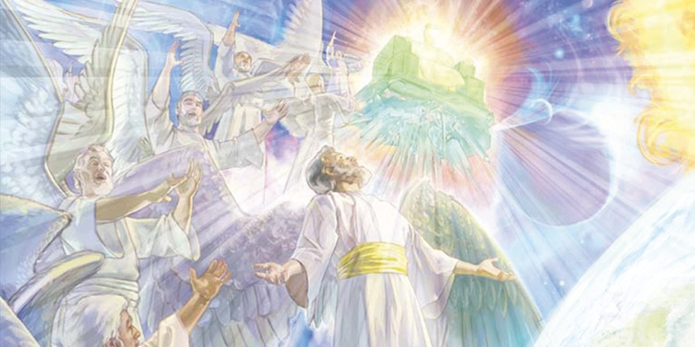
“Are they not all ministering spirits.” (Hebrews 1:14)

Slide 5
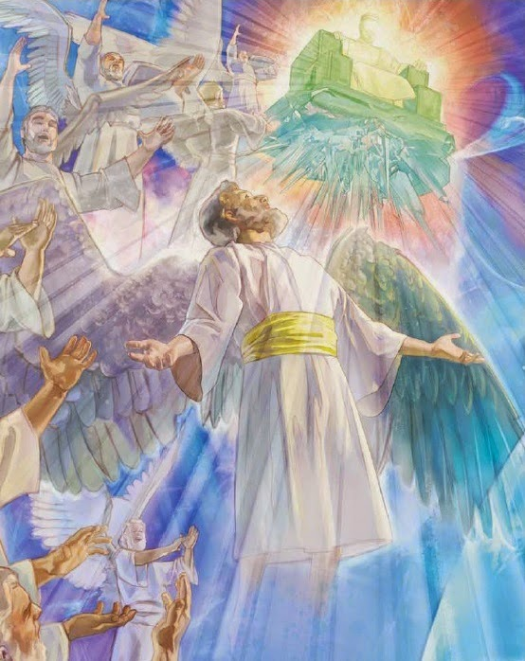
Angels in the Word of God
Angels are mentioned in 34 books of the Bible for a total of 281 times (106 times in the Old Testament and 174 in the New Testament).

Slide 6
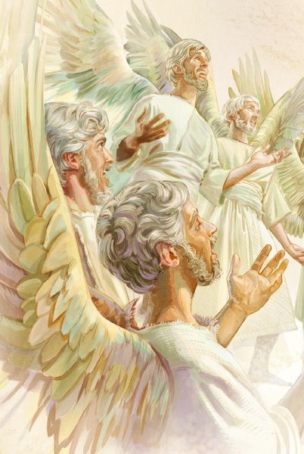
“Praise ye him, all his angels: praise ye him, all his hosts…for he commanded, and they were created.” (Psalms 148:2-5)

Slide 7
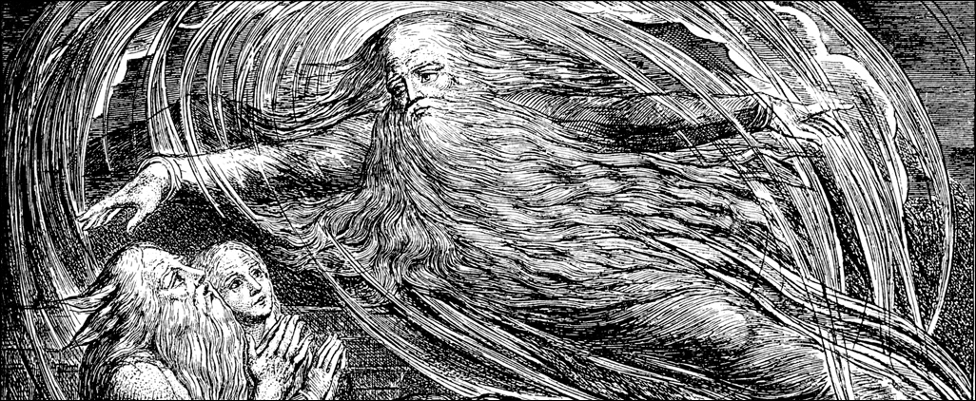
The time of their creation
"Then the Lord answered Job out of the whirlwind, and said...Where wast thou when I laid the foundations of the earth? Declare, if thou hast understanding when the morning stars sang together, and all the sons of God shouted for joy?" (Job 38:1, 4, 7).
In these verses God declares that creation of angels took place prior to the creation of the earth.

Slide 8
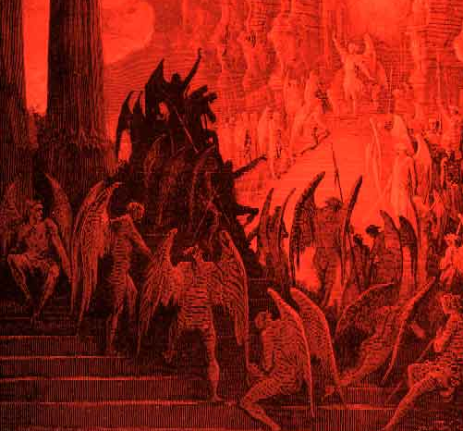
Evil Angels (Demons)

Slide 9
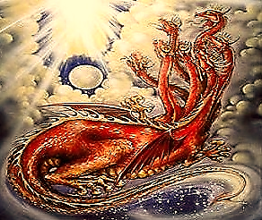
“His (Satan’s) tail drew a third part of the stars of heaven, and did cast them to the earth…” (Revelation 12:4)

Slide 10
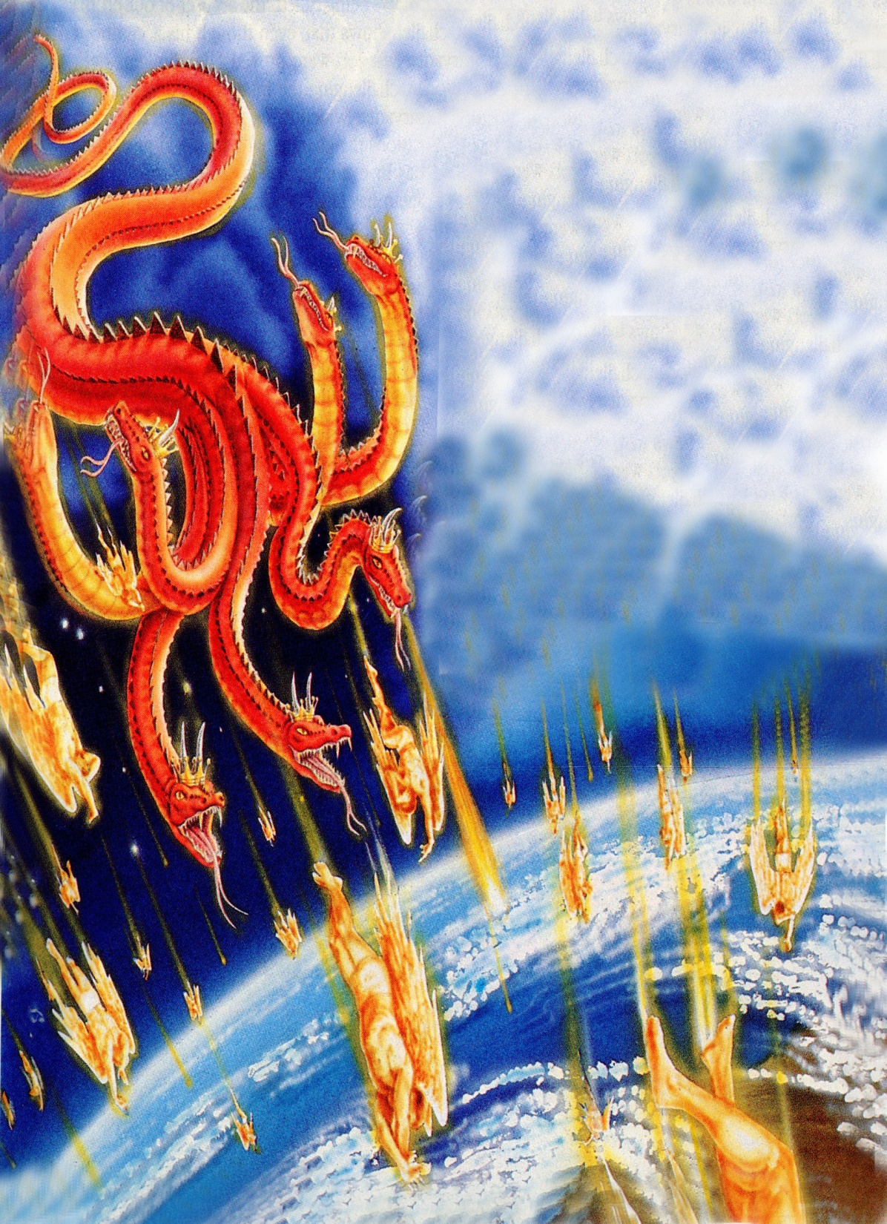
“And did cast them to the earth…”

Slide 11
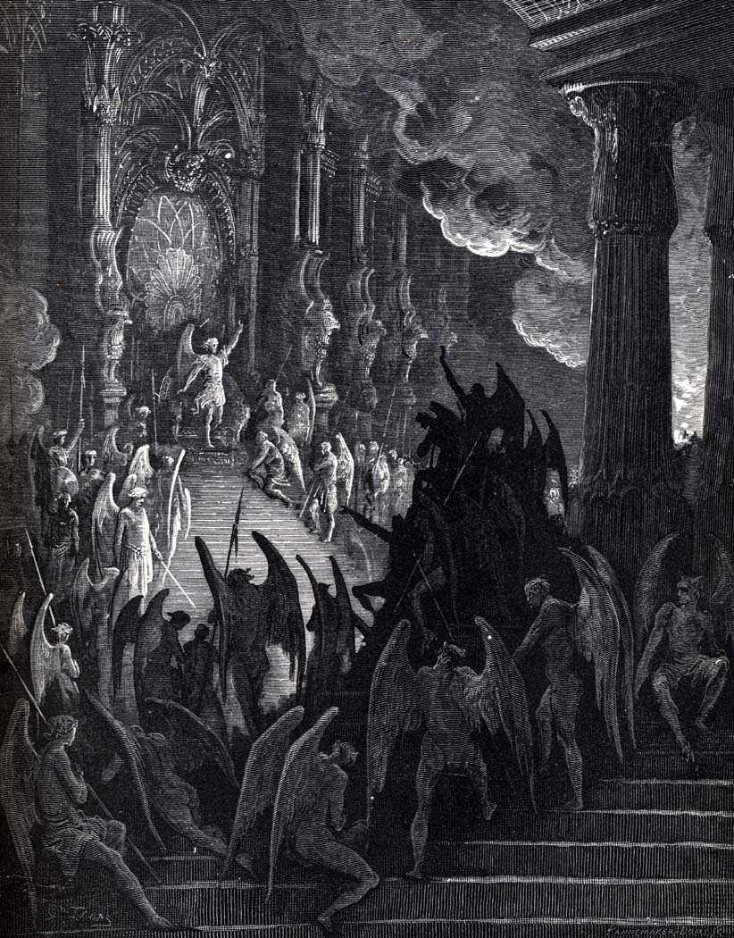
“And the angels which kept not their first estate, but left their own habitation.” Jude 1:6
“For if God spared not the angels that sinned, but cast [them] down to hell.” 2 Peter 2:4

Slide 12
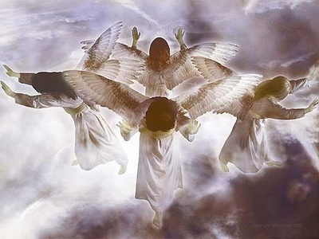
The Purpose of their Creation
"For by him were all things created, that are in heaven, and that are in earth, visible and invisible, whether they be thrones, or dominions, or principalities, or powers: all things were created by him, and for him" (Col. 1:16)
"Thou art worthy, O Lord, to receive glory and honour and power: for thou hast created all things, and for thy pleasure they are and were created" (Rev. 4:11)

Slide 13
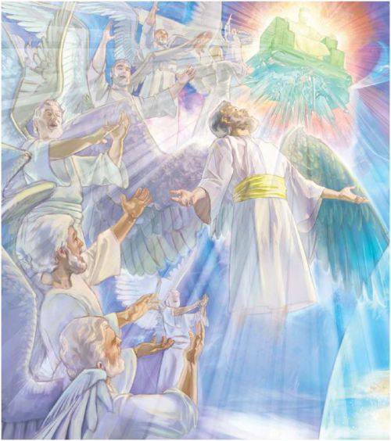
Angels were Created
to Worship God
“And let all the angels of God worship him.” (Hebrews 1:6)

Slide 14
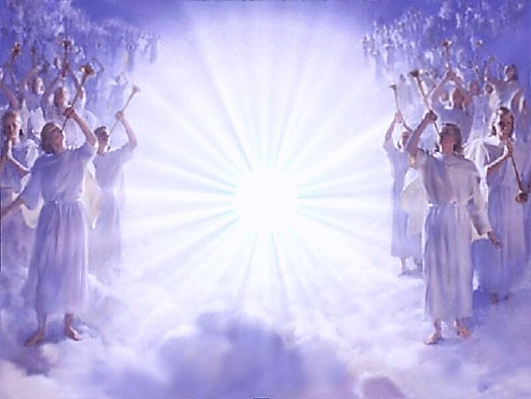
“Bless the LORD, ye his angels, that excel in strength, that do his commandments, hearkening unto the voice of his word.” (Psalm 103:20)
Angels were Created to Serve and Obey God

Slide 15
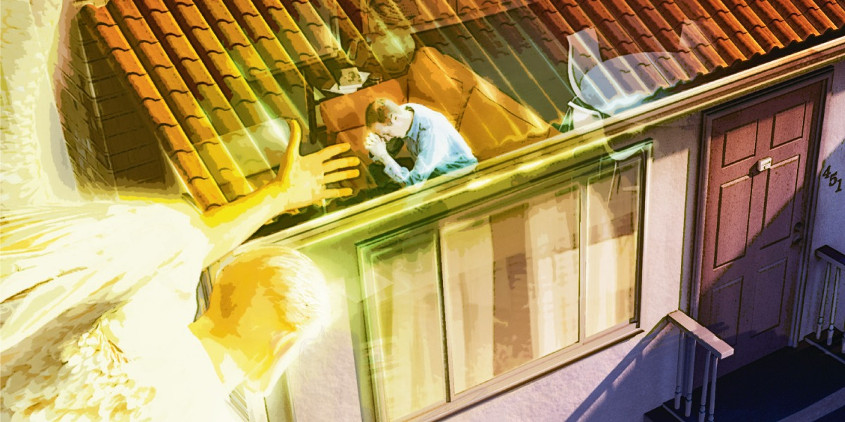
Angels were Created to Minister to Man
“Are they not all ministering spirits, sent forth to minister for them who shall be heirs of salvation?”
(Hebrews 1:14)

Slide 16
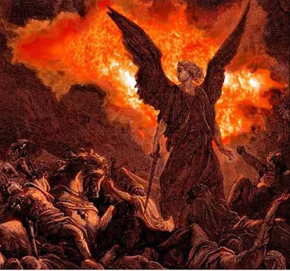
Angels both good and evil were used by God through out the Bible as instruments of judgment.
“He cast upon them the fierceness of his anger, wrath, and indignation, and trouble, by sending evil angels among them.” (Psalms 78:49)

Slide 17
The Nature of Angels

Slide 18
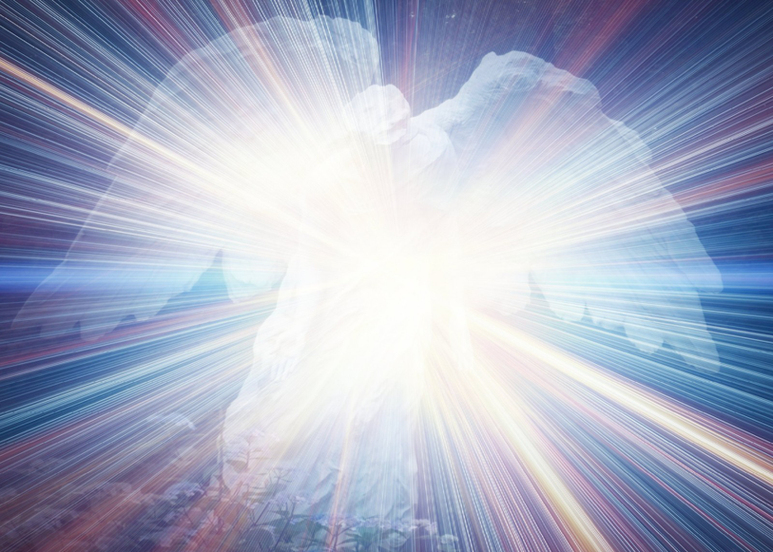
Angels are spirit beings (Psalms 104:4; Heb. 1:7, 14)
(Psalms 104:4) “Who maketh his angels spirits…”
(Hebrews 1:7, 14) “And of the angels he saith, Who maketh his angels spirits…Are they not all ministering spirits, sent forth to minister for them who shall be heirs of salvation?”

Slide 19
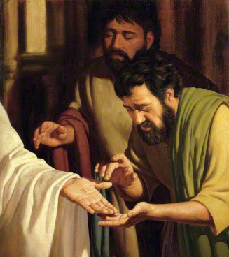
We are informed by Christ himself that spiritual beings do not possess flesh and bone
“Behold my hands and my feet, that it is I myself: handle me, and see; for a spirit hath not flesh and bones, as ye see me have.” (Luke 24:39)

Slide 20
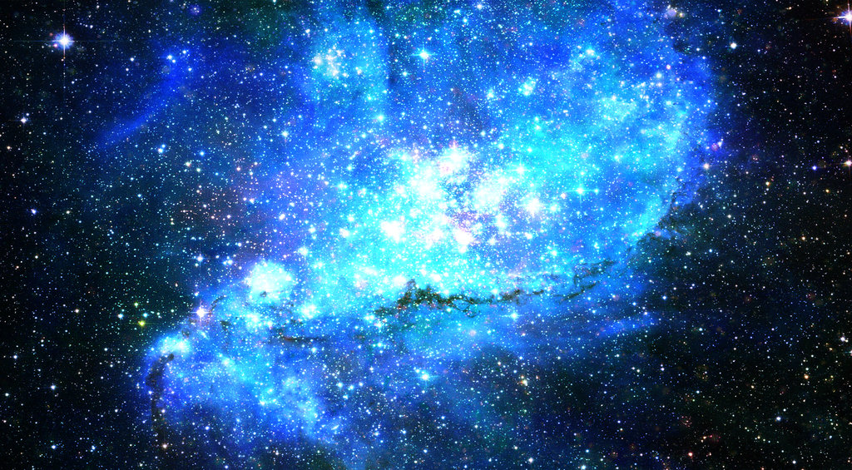
Does this mean that angels do not have any kind of body?
“There are also celestial bodies, and bodies terrestrial: but
the glory of the celestial is one, and the glory of the
terrestrial is another.” (1 Corinthians 15:40)
Celestial = pertaining to the sky or heaven, to the universe beyond the earth’s atmosphere
Terrestrial = relating to the earth or its inhabitants
(1 Corinthians 15:41-58)

Slide 21
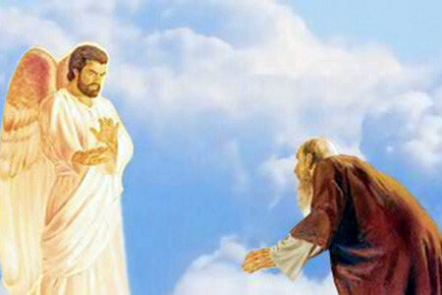
While on rare occasion angels do manifest themselves, their normal practice is to remain invisible.
One basic reason for this is to prevent men from worshiping them.
(Rom. 1:18-32)
(Col. 2:18) warns us not to “worship angels.”

Slide 22
Angels are innumerable
God, of course, knows their number, but they are presented to men as uncountable - "But ye are come unto Mount Zion, and unto the city of the living God, the heavenly Jerusalem, and to an innumerable company of angels" (Heb. 12:22)
There may be as many angels as there are stars in the heavens, for angels are associated with the stars (Job 38:7; Ps. 148:1-3; Rev. 9:1, 2; 12:3, 4, 7-9).
If this be so, there would exist untold trillions of these heavenly beings.

Slide 23
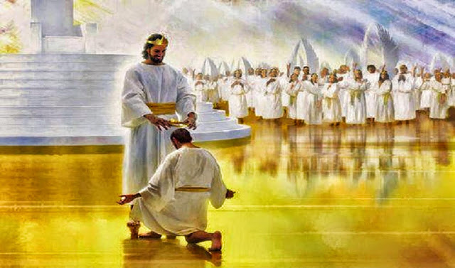
Our interaction with Angels in Heaven

Slide 24
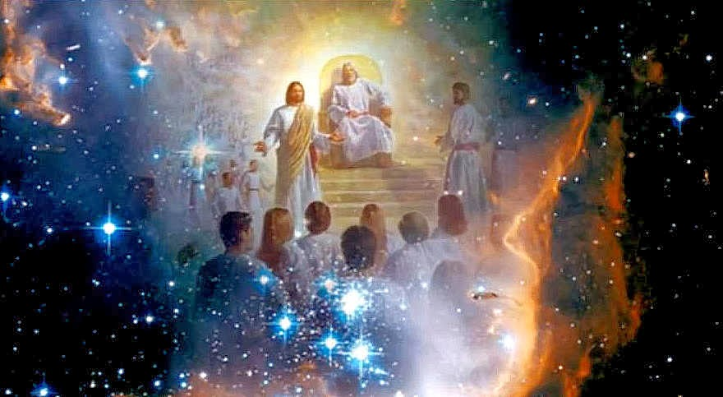
“That in the ages to come he might shew the exceeding riches of his grace in his kindness toward us through Christ Jesus" (Ephesians 2:7)

Slide 25
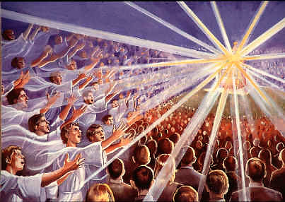

Slide 26
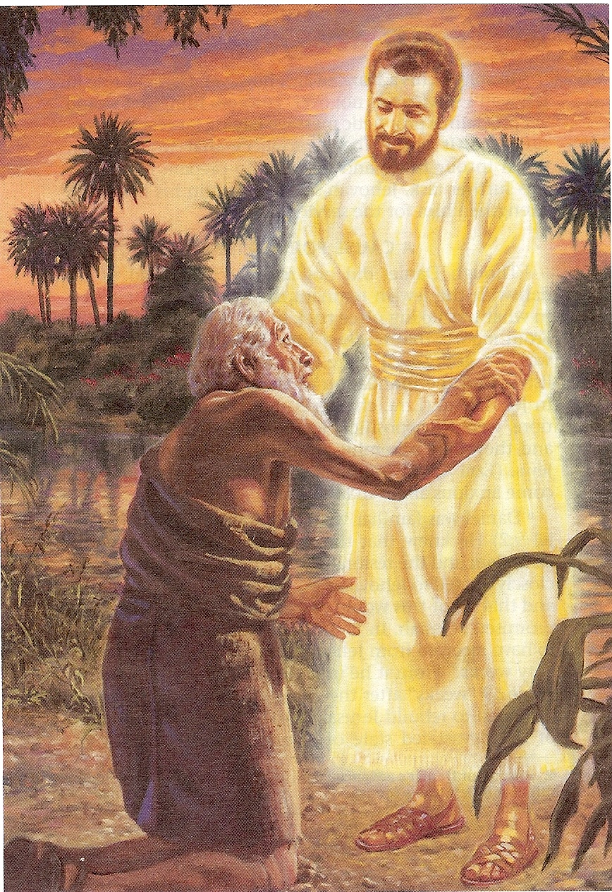
Angels possess separate and individual personalities, probably no two alike. (They possess three necessary features required in personality)
Angels possess intelligence - Daniel 9:21-22
Angels possess emotion - 1 Peter 1:12
Angels posses a will - Jude 1:6

Slide 27
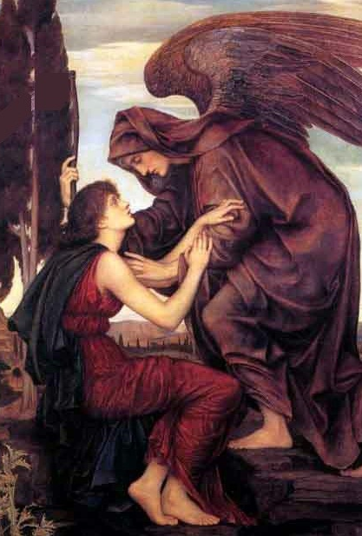
Evil angels cohabited with women (Genesis 6)
“And it came to pass, when men began to multiply on the face of the earth, and daughters were born unto them, That the sons of God saw the daughters of men that they were fair; and they took them wives of all which they chose…There were giants in the earth in those days; and also after that, when the sons of God came in unto the daughters of men, and they bare children to them, the same became mighty men which were of old, men of renown. And GOD saw that the wickedness of man was great in the earth, and that every imagination of the thoughts of his heart was only evil continually.”

Slide 28
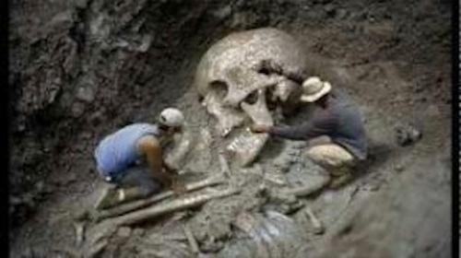
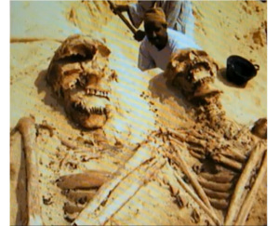
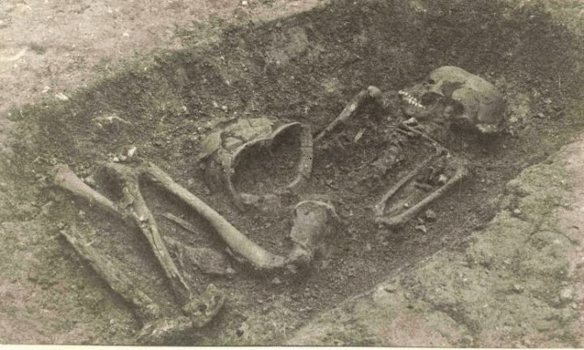
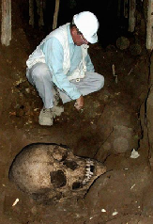
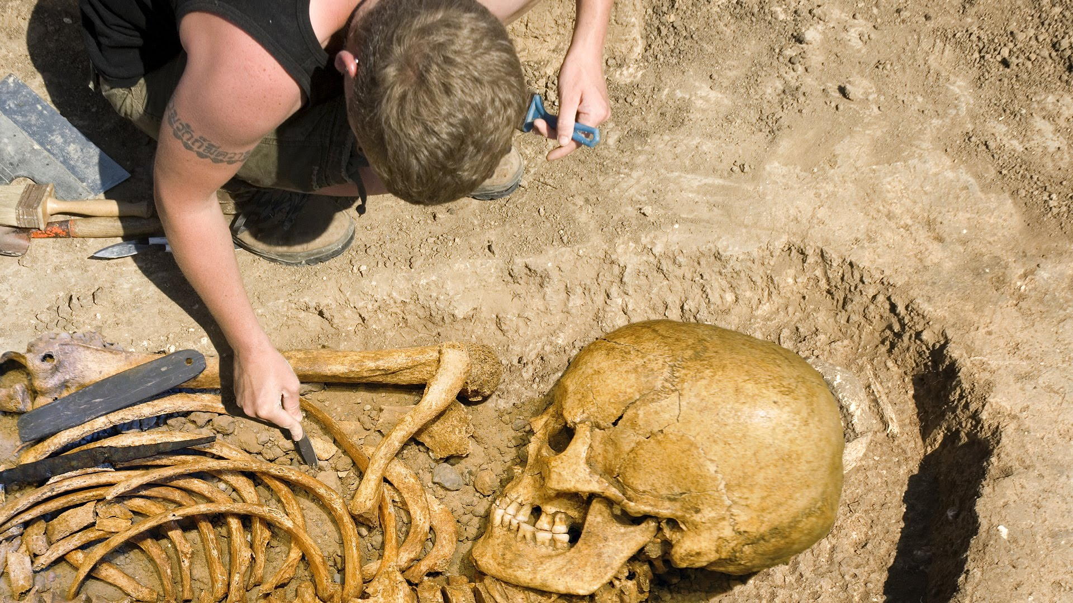

Slide 29
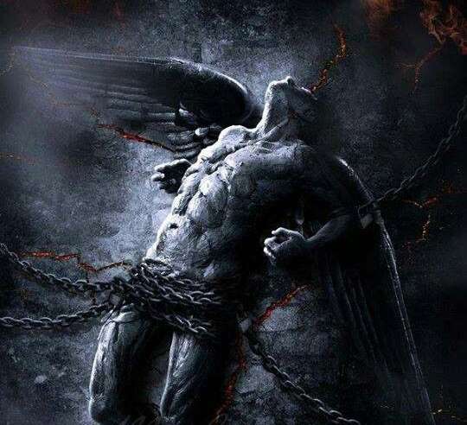
“For if God spared not the angels that sinned, but cast them down to hell, and delivered them into chains of darkness, to be reserved unto judgment.” (2 Peter 2:4)

Slide 30
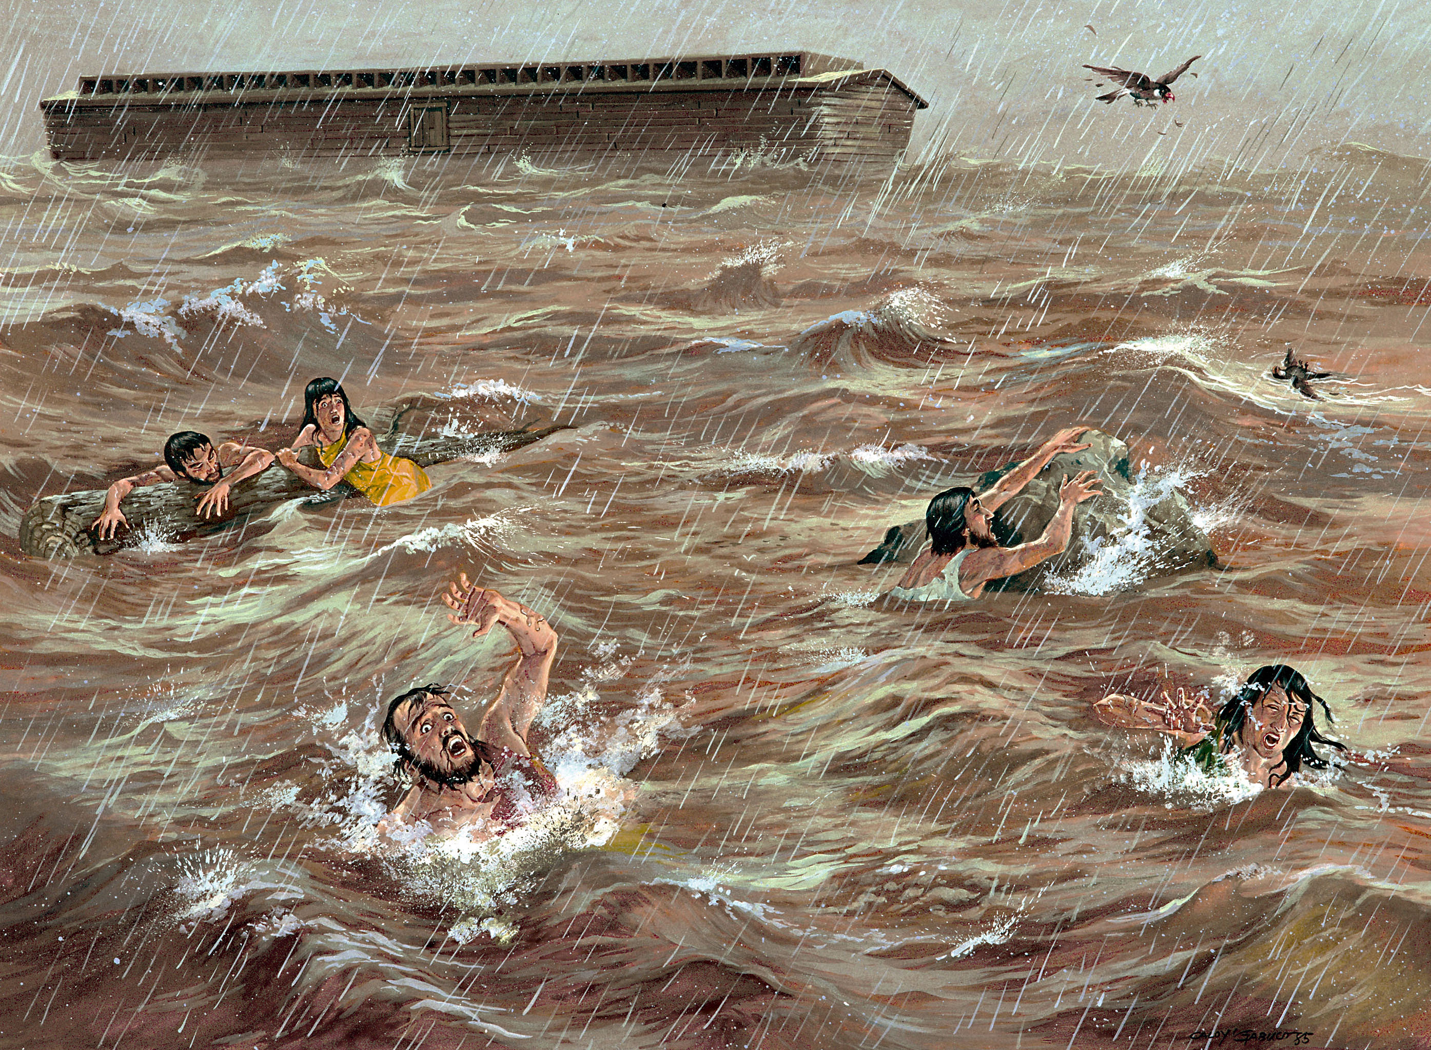
“And it repented the LORD that he had made man on the earth, and it grieved him at his heart. And the LORD said, I will destroy man whom I have created from the face of the earth; both man, and beast, and the creeping thing, and the fowls of the air; for it repenteth me that I have made them. But Noah found grace in the eyes of the LORD.”

Slide 31
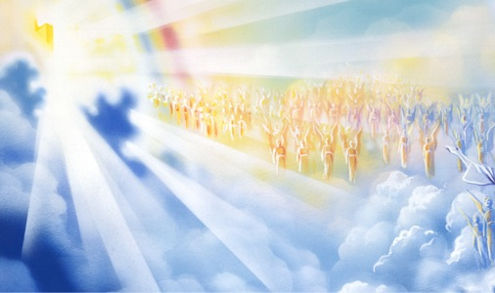
Angels are (because of Adam’s fall) superior to men. (Psalm 8:4, 5; Hebrews 2:6-11.)
Angels are stronger than men - Psalms 103:20
Angels are smarter than men - Daniel 9:21-22
Angels are swifter than men - Daniel 9:21

Slide 32
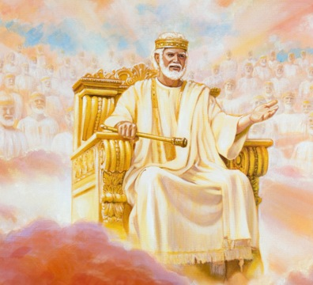
They are, however, inferior to God
They are not omnipresent - Daniel 10:12
They are not omnipotent - Daniel 10:13
They are not omniscient - Matthew 24:36

Slide 33
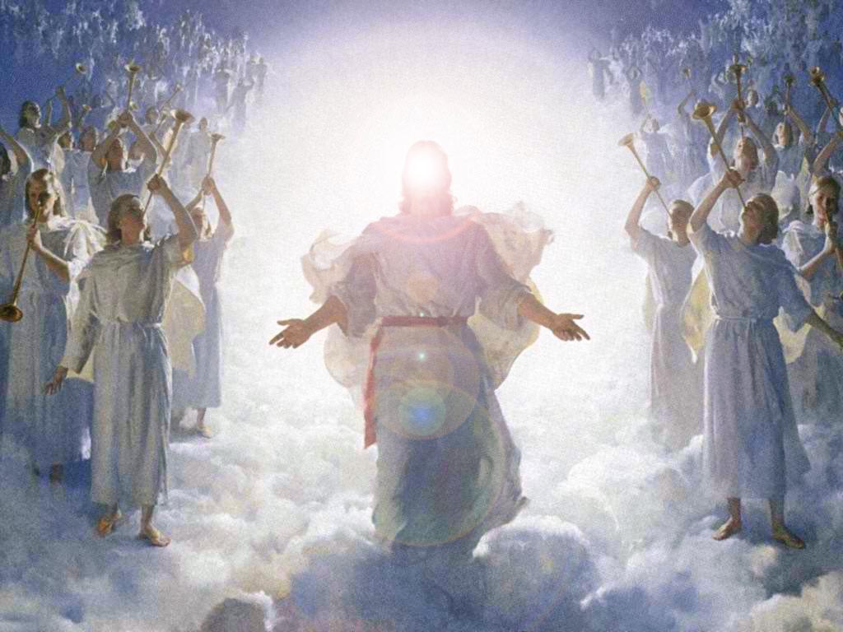
“All things were created by him, and for him.”

Slide 36
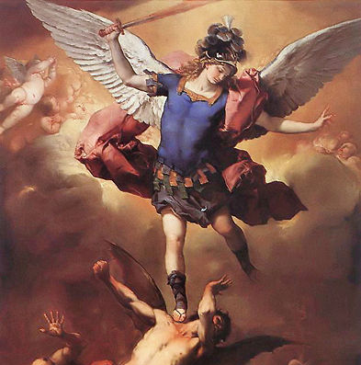
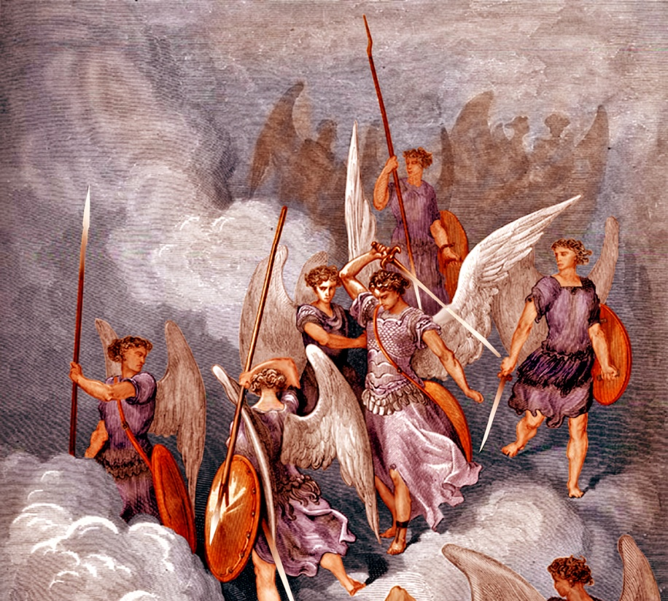
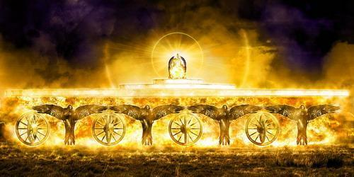
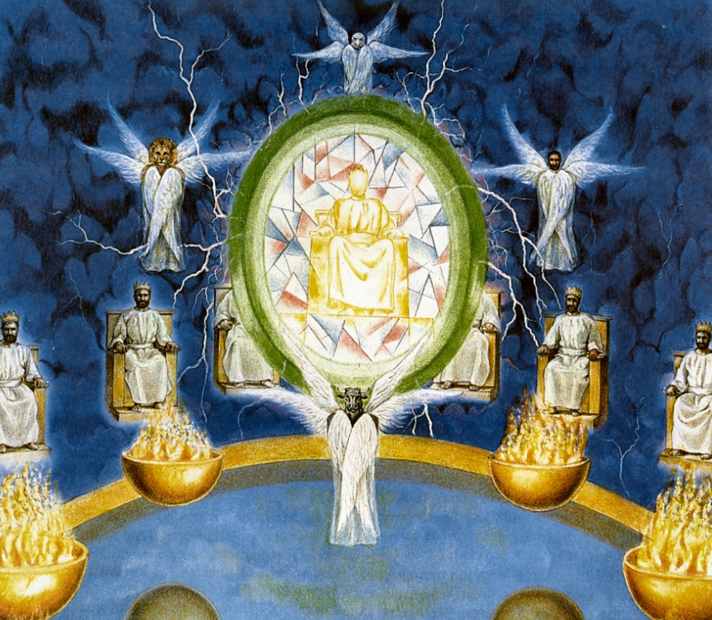
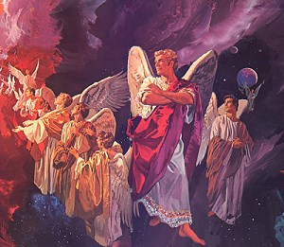
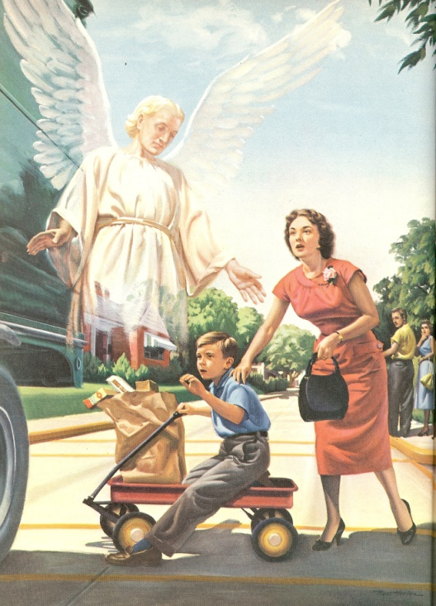
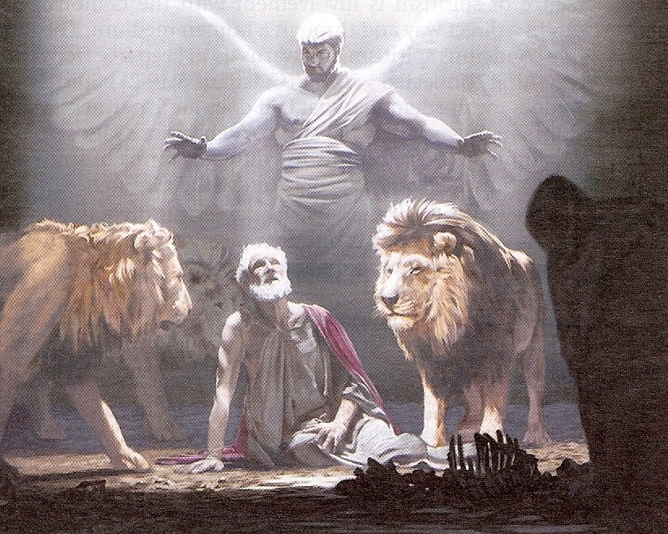
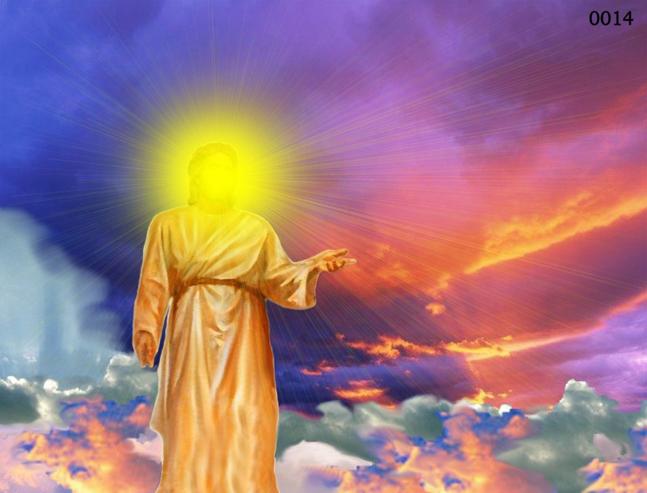
Different Types of Angels
Archangels – Michael and Gabriel
Cherubim's – Ezekiel 1:4-28
Seraphim’s – Isaiah 6:1-7
Ruling angels – I Peter 3:22
Guarding angels – Hebrews 1:14
Angel of the Lord – Zechariah 3:1-10

Slide 37
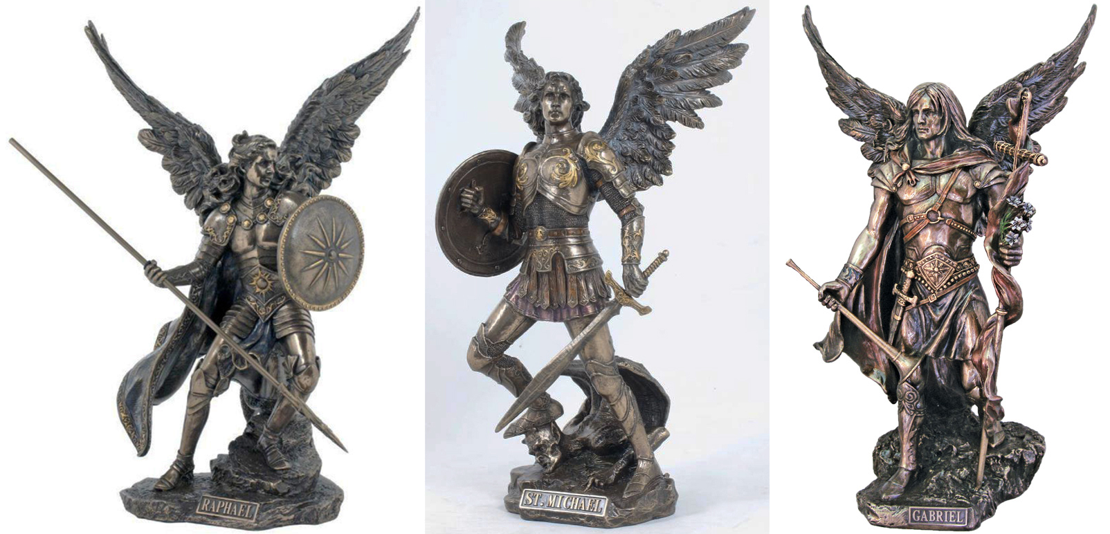
Archangels – Michael and Gabriel
Warrior - Michael Messenger - Gabriel

Slide 38
Michael the Warrior of God

Slide 39
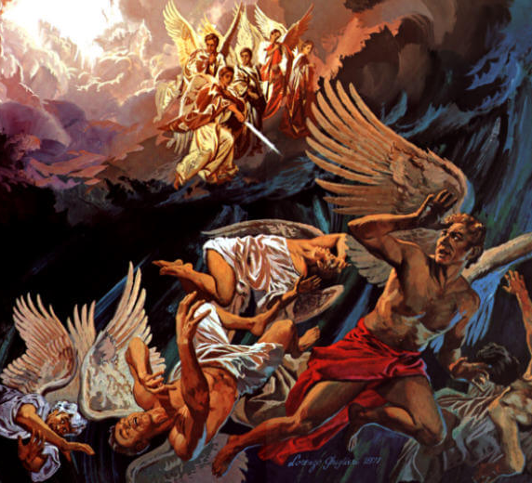
“And there was war in heaven: Michael and his angels fought against the dragon; and the dragon fought and his angels, And prevailed not; neither was their place found any more in heaven. And the great dragon was cast out, that old serpent, called the Devil, and Satan, which deceiveth the whole world: he was cast out into the earth, and his angels were cast out with him.” (Revelation 12:7-9)

Slide 40
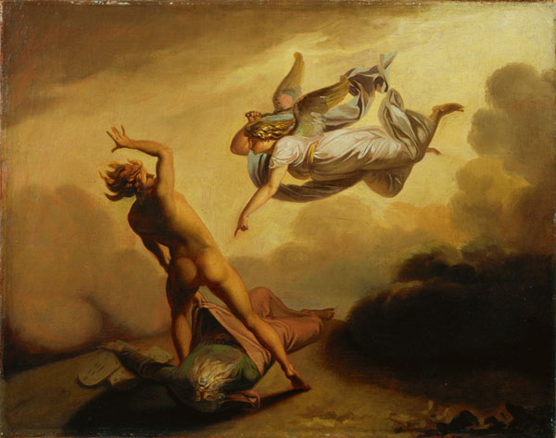
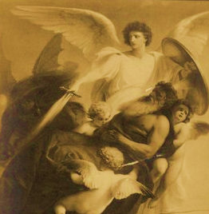
“Yet Michael the archangel, when contending with the devil he disputed about the body of Moses, durst not bring against him a railing accusation, but said, The Lord rebuke thee.” (Jude 1:9)

Slide 41
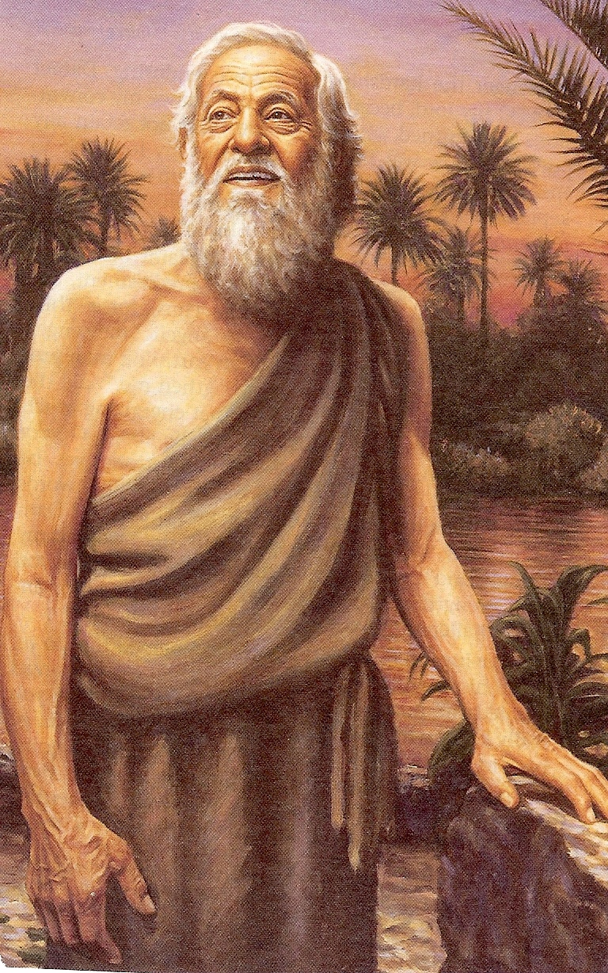
(Daniel 10:1-14) “In the third year of Cyrus king of Persia a thing was revealed unto Daniel, whose name was called Belteshazzar; and the thing was true, but the time appointed was long: and he understood the thing, and had understanding of the vision. In those days I Daniel was mourning three full weeks. I ate no pleasant bread, neither came flesh nor wine in my mouth, neither did I anoint myself at all, till three whole weeks were fulfilled.

Slide 42
And in the four and twentieth day of the first month, as I was by the side of the great river, which is Hiddekel; Then I lifted up mine eyes, and looked, and behold a certain man clothed in linen, whose loins were girded with fine gold of Uphaz: His body also was like the beryl, and his face as the appearance of lightning, and his eyes as lamps of fire, and his arms and his feet like in colour to polished brass, and the voice of his words like the voice of a multitude.

Slide 43
And I Daniel alone saw the vision: for the men that were with me saw not the vision; but a great quaking fell upon them, so that they fled to hide themselves. Therefore I was left alone, and saw this great vision, and there remained no strength in me: for my comeliness was turned in me into corruption, and I retained no strength. Yet heard I the voice of his words: and when I heard the voice of his words, then was I in a deep sleep on my face, and my face toward the ground.

Slide 44
And, behold, an hand touched me, which set me upon my knees and upon the palms of my hands. And he said unto me, O Daniel, a man greatly beloved, understand the words that I speak unto thee, and stand upright: for unto thee am I now sent. And when he had spoken this word unto me, I stood trembling.

Slide 45
Then said he unto me, Fear not, Daniel: for from the first day that thou didst set thine heart to understand, and to chasten thyself before thy God, thy words were heard, and I am come for thy words.

Slide 46
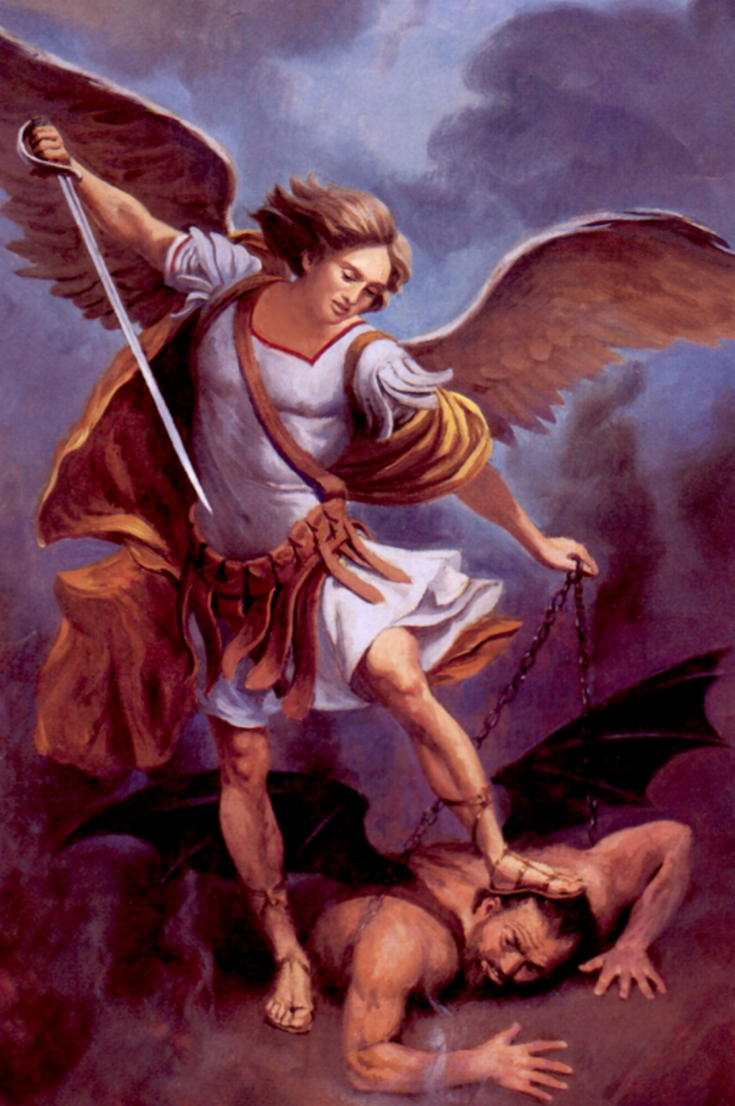
But the prince of the kingdom of Persia (Satan) withstood me one and twenty days: but, lo, Michael, one of the chief princes, came to help me.”

Slide 47
“And at that time (tribulation) shall Michael stand up, the great prince which standeth for the children of thy people: and there shall be a time of trouble, such as never was since there was a nation even to that same time: and at that time thy people shall be delivered, every one that shall be found written in the book.” (Daniel 12:1)

Slide 48
Gabriel the Messenger of God

Slide 49
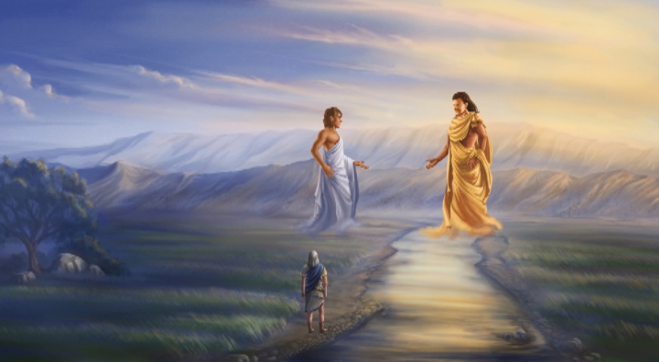
“And it came to pass, when I, even I Daniel, had seen the vision, and sought for the meaning, then, behold, there stood before me as the appearance of a man. And I heard a man's voice between the banks of Ulai, which called, and said, Gabriel, make this man to understand the vision. So he came near where I stood: and when he came, I was afraid, and fell upon my face: but he said unto me, Understand, O son of man: for at the time of the end shall be the vision.” (Daniel 8:15-17)

Slide 50
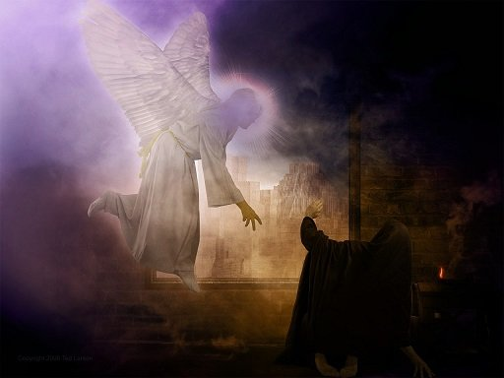
“Yea, whiles I was speaking in prayer, even the man Gabriel, whom I had seen in the vision at the beginning, being caused to fly swiftly, touched me about the time of the evening oblation. And he informed me, and talked with me, and said, O Daniel, I am now come forth to give thee skill and understanding” (Daniel 9:21-22)

Slide 51
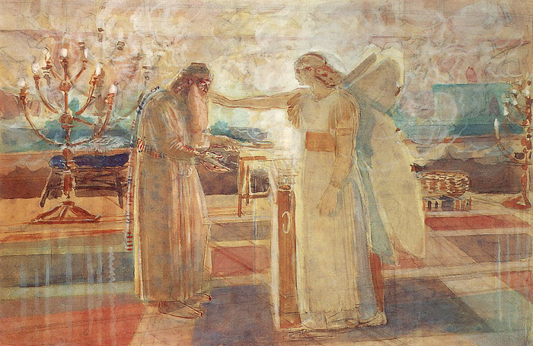
“But the angel said unto him, Fear not, Zacharias: for thy prayer is heard; and thy wife Elisabeth shall bear thee a son, and thou shalt call his name John…And he shall go before him in the spirit and power of Elias, to turn the hearts of the fathers to the children, and the disobedient to the wisdom of the just; to make ready a people prepared for the Lord. And Zacharias said unto the angel, Whereby shall I know this? for I am an old man, and my wife well stricken in years. And the angel answering said unto him, I am Gabriel, that stands in the presence of God; and am sent to speak unto thee, and to shew thee these glad tidings.” (Luke 1:13, 17-19)

Slide 52
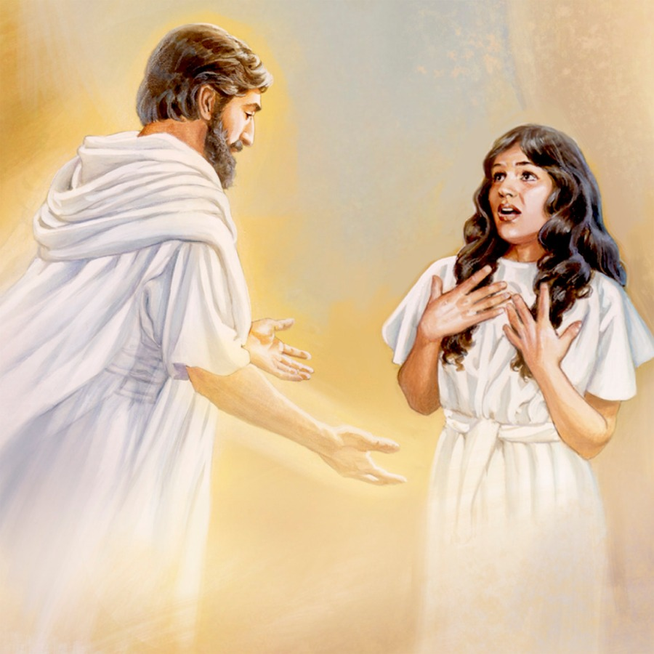
“And in the sixth month the angel Gabriel was sent from God unto a city of Galilee, named Nazareth, To a virgin espoused to a man whose name was Joseph, of the house of David; and the virgin's name was Mary.” (Luke 1:26-27)

Slide 53
“Then Joseph her husband, being a just man, and not willing to make her a publick example, was minded to put her away privily. But while he thought on these things, behold, the angel of the Lord appeared unto him in a dream, saying, Joseph, thou son of David, fear not to take unto thee Mary thy wife: for that which is conceived in her is of the Holy Ghost.” (Matthew 1:19-20)

Slide 54
“And when they were departed, behold, the angel of the Lord appeareth to Joseph in a dream, saying, Arise, and take the young child and his mother, and flee into Egypt, and be thou there until I bring thee word: for Herod will seek the young child to destroy him.” (Matthew 2:13)

Slide 55
“But when Herod was dead, behold, an angel of the Lord appeareth in a dream to Joseph in Egypt, Saying, Arise, and take the young child and his mother, and go into the land of Israel: for they are dead which sought the young child's life.” (Matthew 2:19-20)

Slide 56
“But I would not have you to be ignorant, brethren, concerning them which are asleep, that ye sorrow not, even as others which have no hope. For if we believe that Jesus died and rose again, even so them also which sleep in Jesus will God bring with him. For this we say unto you by the word of the Lord, that we which are alive and remain unto the coming of the Lord shall not prevent them which are asleep. For the Lord himself shall descend from heaven with a shout, with the voice of the archangel, and with the trump of God: and the dead in Christ shall rise first: Then we which are alive and remain shall be caught up together with them in the clouds, to meet the Lord in the air: and so shall we ever be with the Lord. Wherefore comfort one another with these words.” (1 Thessalonians 4:13 - 4:18)

