Slide 2
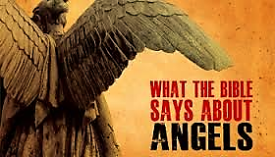

Slide 3
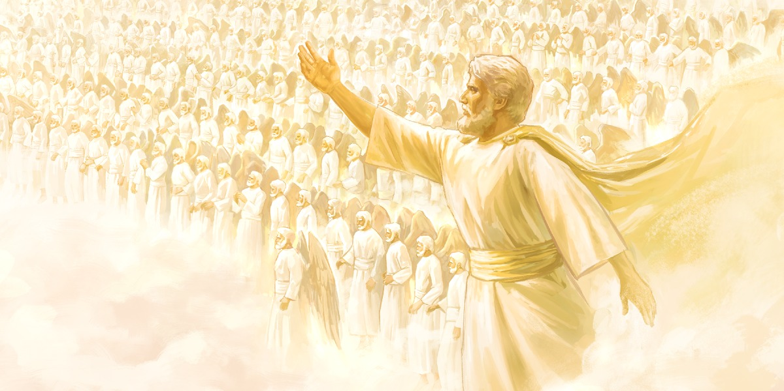
“And I beheld, and I heard the voice of many angels round about the throne and the beasts and the elders: and the number of them was ten thousand times ten thousand, and thousands of thousands; Saying with a loud voice, Worthy is the Lamb that was slain to receive power, and riches, and wisdom, and strength, and honour, and glory, and blessing. And every creature which is in heaven, and on the earth, and under the earth, and such as are in the sea, and all that are in them, heard I saying, Blessing, and honour, and glory, and power, be unto him that sitteth upon the throne, and unto the Lamb for ever and ever. And the four beasts said, Amen. And the four and twenty elders fell down and worshipped him that liveth for ever and ever.” (Revelation 5:11-14)

Slide 6
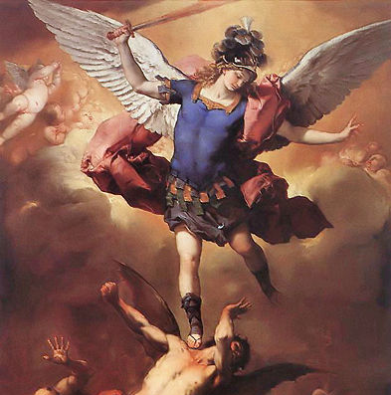
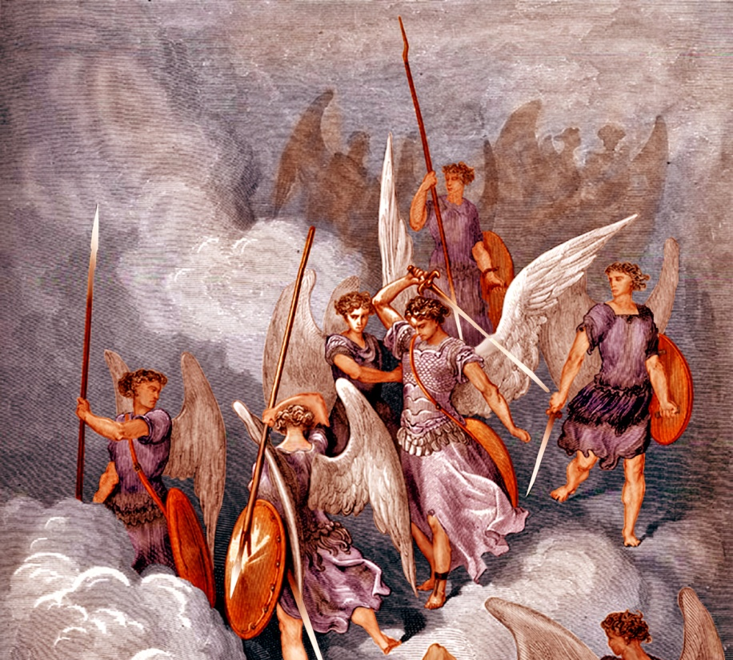
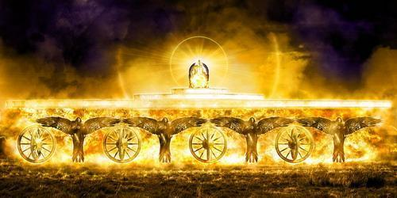
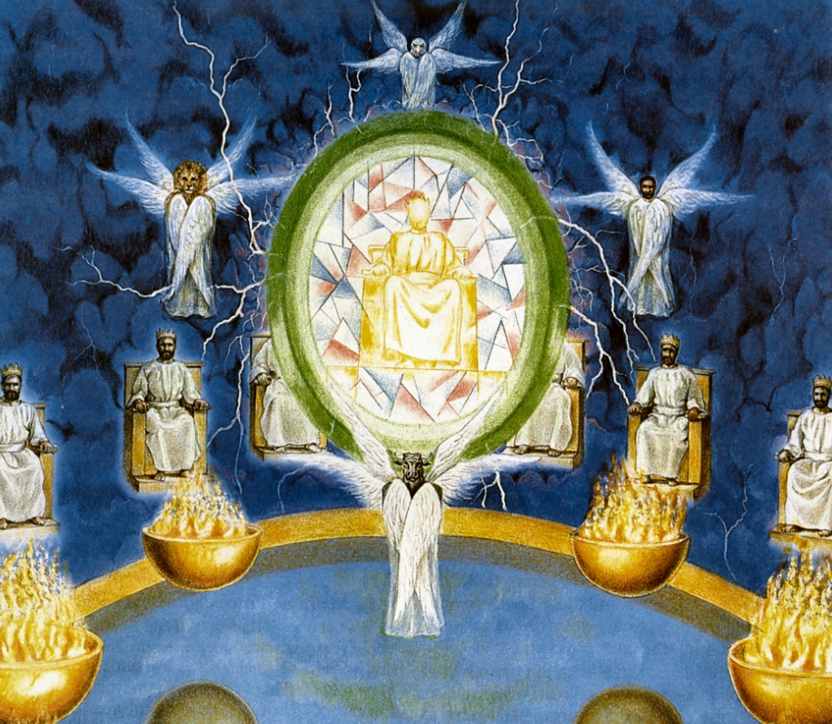
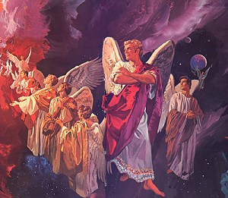
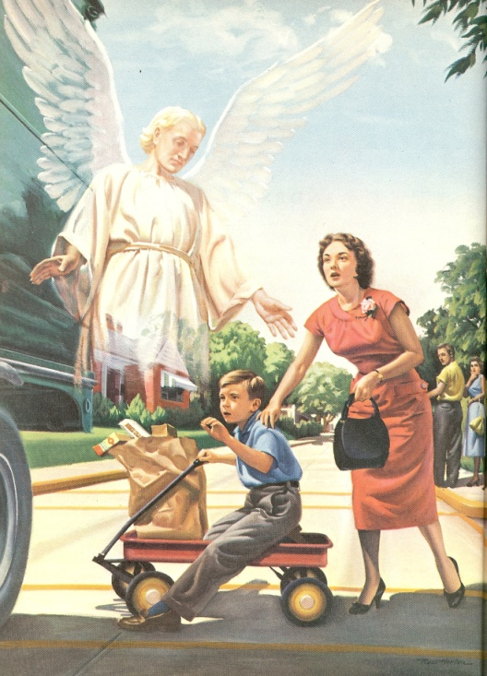
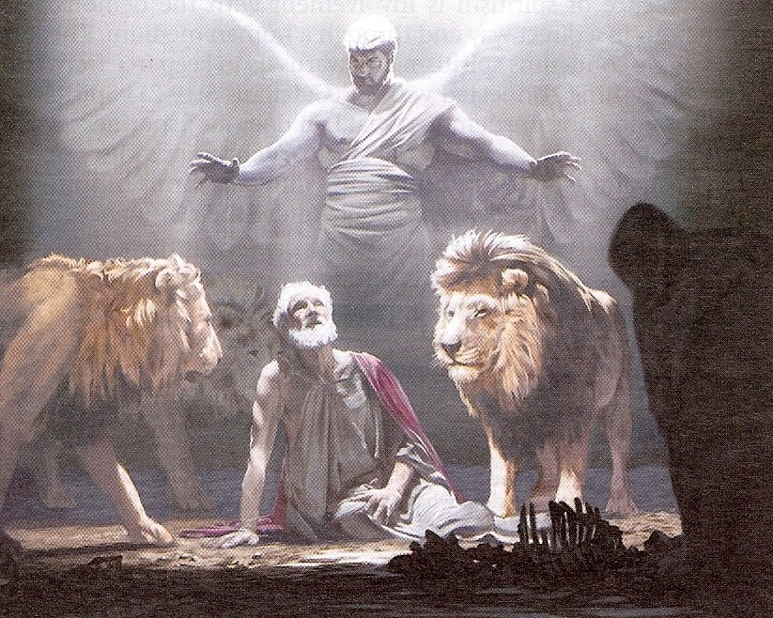
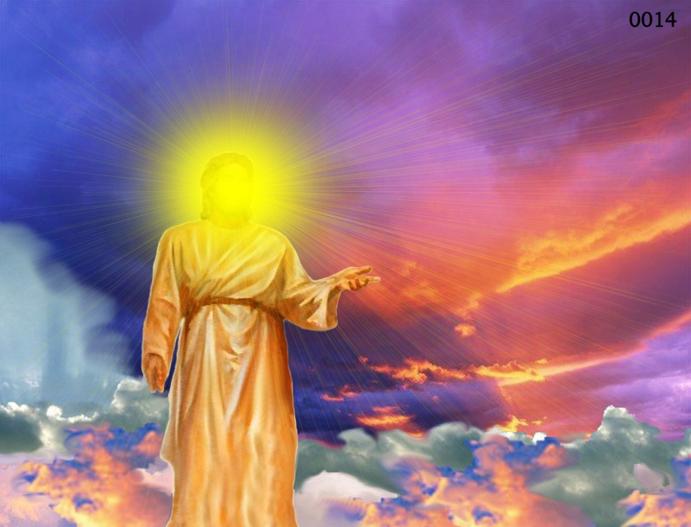
Different Types of Angels
Archangels – Michael and Gabriel
Cherubim's – Ezekiel 1:4-28
Seraphim’s – Isaiah 6:1-7
Ruling angels – I Peter 3:22
Guarding angels – Hebrews 1:14
Angel of the Lord – Zechariah 3:1-10

Slide 7
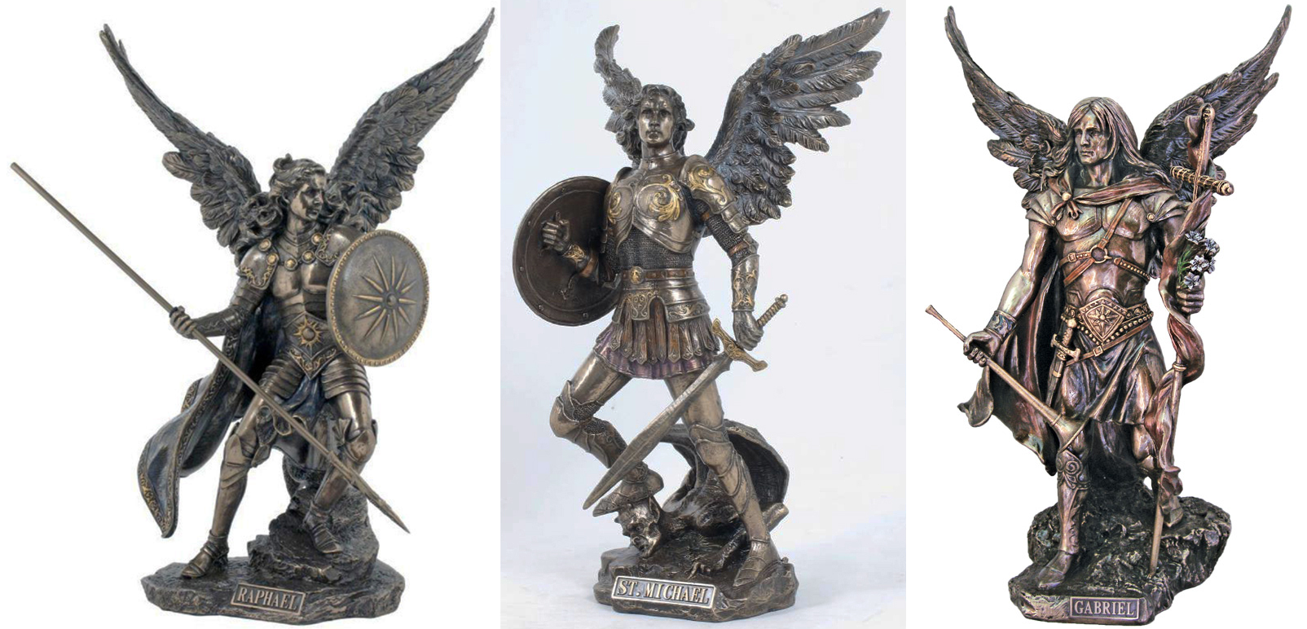
Archangels – Michael and Gabriel
Warrior - Michael Messenger - Gabriel

Slide 8
Michael the Warrior of God

Slide 9
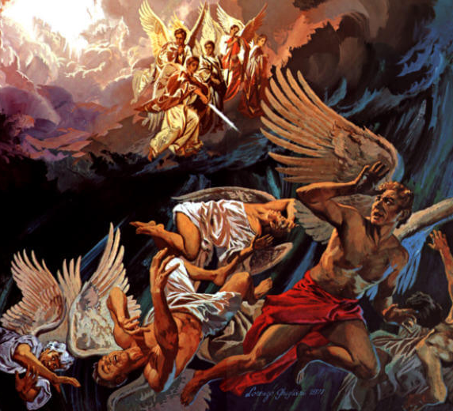
“And there was war in heaven: Michael and his angels fought against the dragon; and the dragon fought and his angels, And prevailed not; neither was their place found any more in heaven. And the great dragon was cast out, that old serpent, called the Devil, and Satan, which deceiveth the whole world: he was cast out into the earth, and his angels were cast out with him.” (Revelation 12:7-9)

Slide 10
Gabriel the Messenger of God

Slide 11
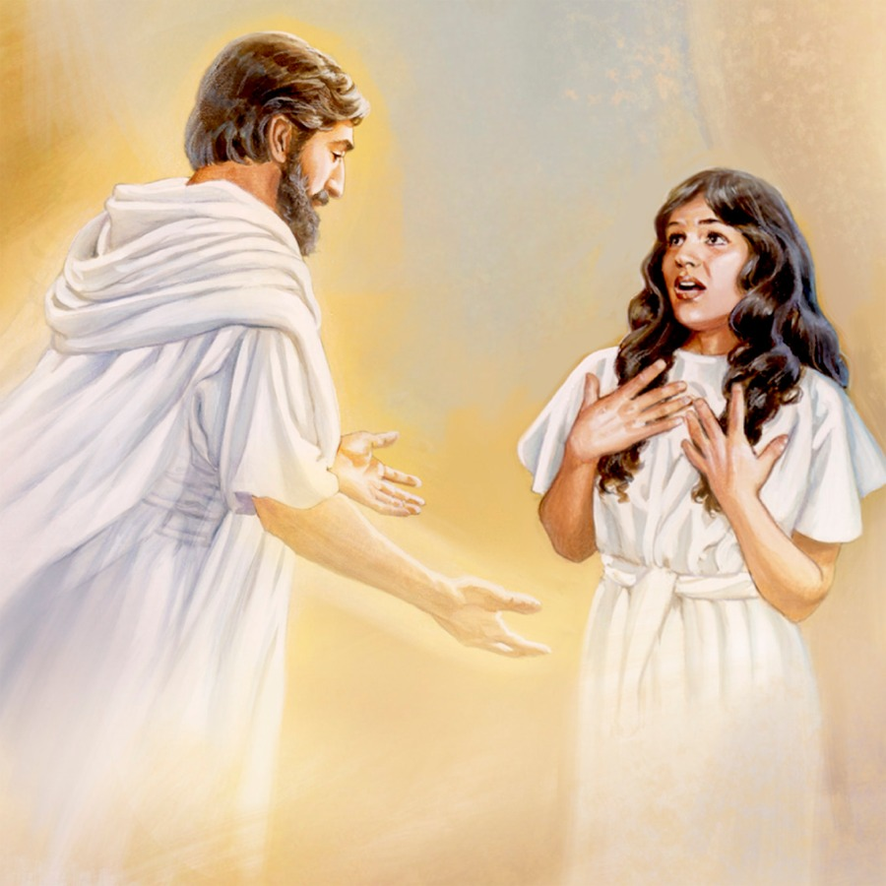
“And in the sixth month the angel Gabriel was sent from God unto a city of Galilee, named Nazareth, To a virgin espoused to a man whose name was Joseph, of the house of David; and the virgin's name was Mary.” (Luke 1:26-27)

Slide 13
“And before the throne there was a sea of glass like unto crystal: and in the midst of the throne, and round about the throne, were four beasts (Seraphim Angels) full of eyes before and behind.” (Revelation 4:6)

Slide 14
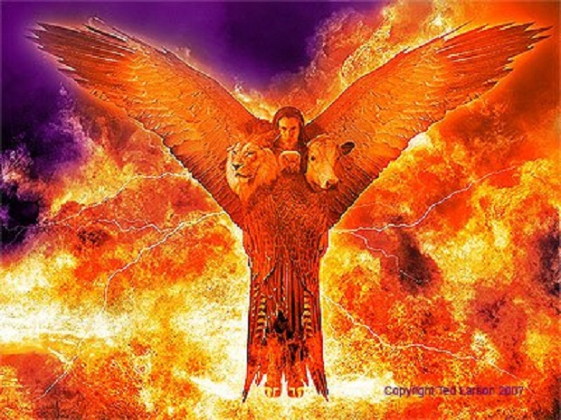
“Every one (Cherubim Angels) had four faces, and every one had four wings…And as they went, I heard the noise of their wings, like the noise of great waters, as the voice of the Almighty.”
(Ezekiel 10:15-20)

Slide 15
Revelation 4:1-11

Slide 16
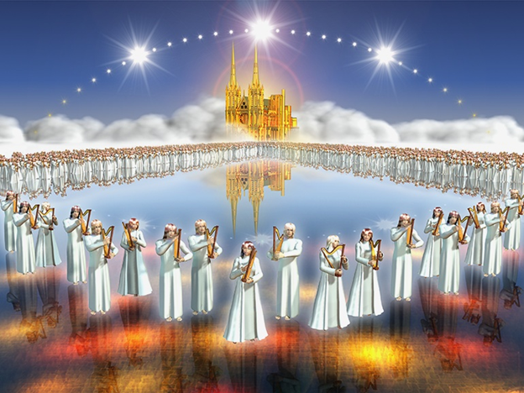
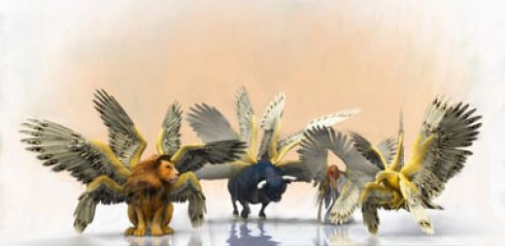
“And before the throne there was a sea of glass like unto crystal: and in the midst of the throne, and round about the throne, were four beasts full of eyes before and behind.”

Slide 17
“And the first beast was like a lion, and the second beast like a calf, and the third beast had a face as a man, and the fourth beast was like a flying eagle. And the four beasts had each of them six wings about him; and they were full of eyes within: and they rest not day and night, saying, Holy, holy, holy, Lord God Almighty, which was, and is, and is to come.”

Slide 18
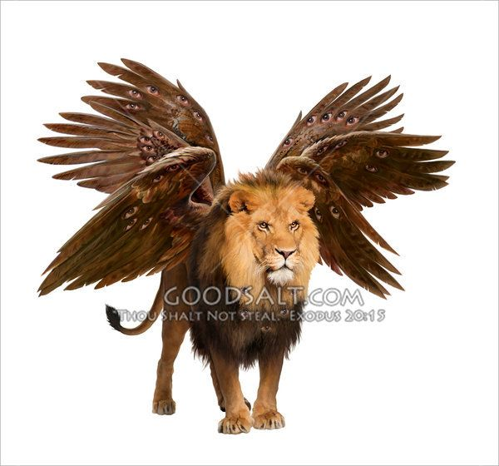
And the first beast was like a lion

Slide 19
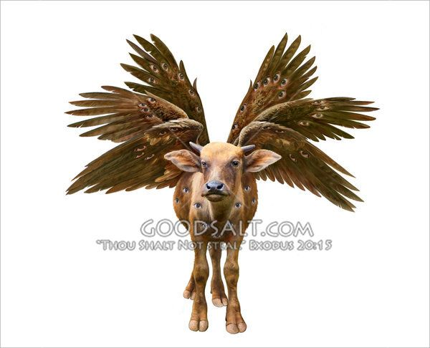
And the second beast like a calf

Slide 20
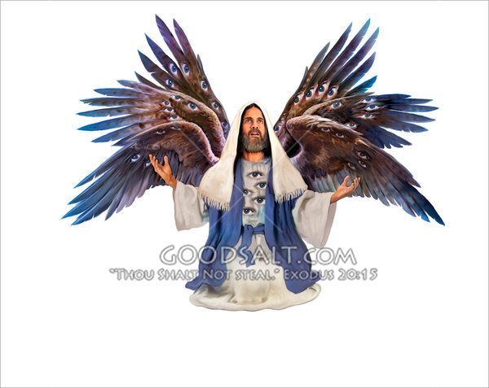
And the third beast had a face as a man

Slide 21
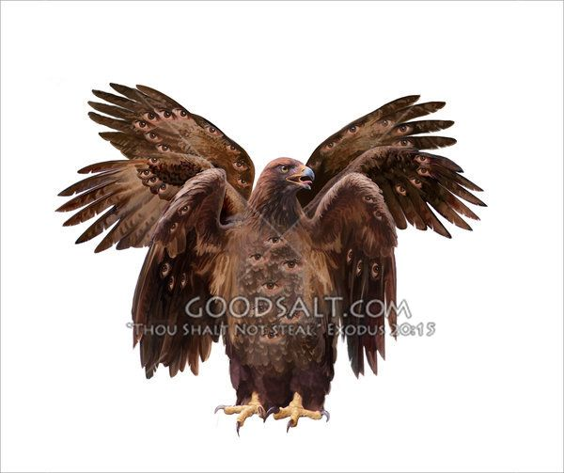
And the fourth beast was like a flying eagle

Slide 22
Four living creatures
“Seraphims”
(Isaiah 6:1-3)
“In the year that king Uzziah died I saw also the Lord sitting upon a throne, high and lifted up, and his train filled the temple. Above it stood the seraphim's: each one had six wings; with twain he covered his face, and with twain he covered his feet, and with twain he did fly. And one cried unto another, and said, Holy, holy, holy, is the LORD of hosts: the whole earth is full of his glory.”

Slide 23
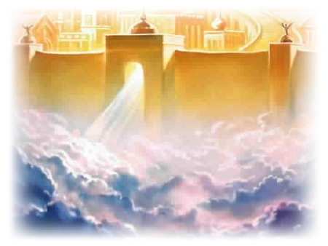
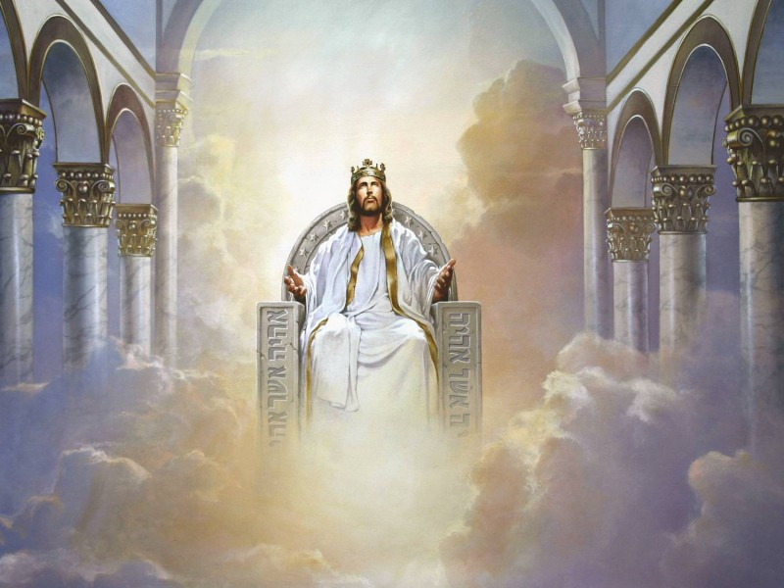
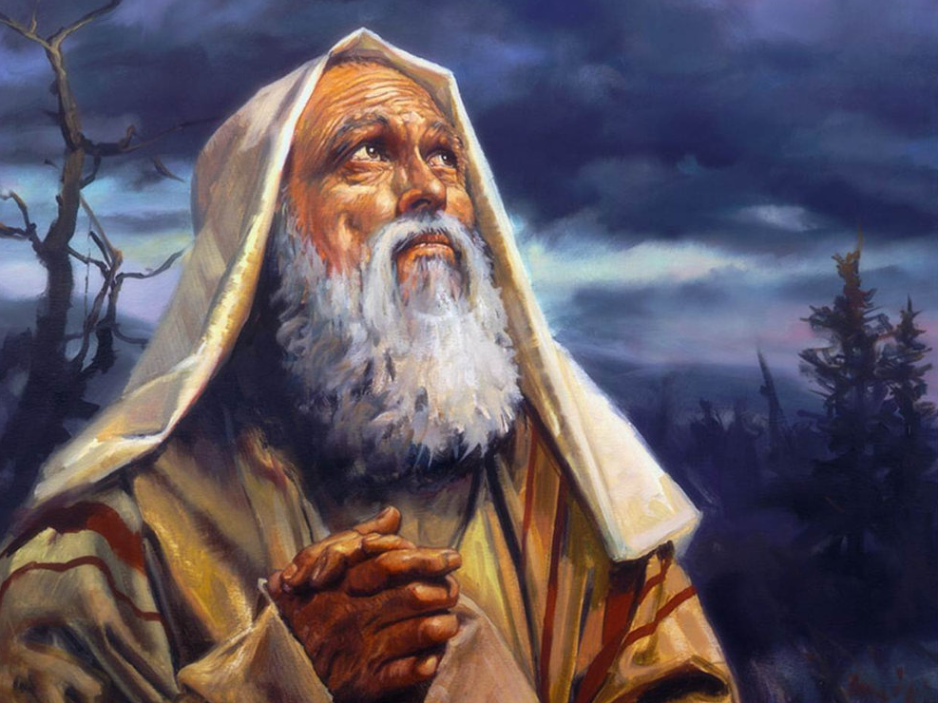

Slide 24
Eyes = wisdom
Wings = swift movement
Lion = strength
Calf = service
Face of a man = Intelligence
Eagle = power and authority

Slide 25
It has been suggested that the faces of both the cherubim’s and the seraphim's are to remind the reedemed throughout all eternity of the earthly ministry performed by our blessed Lord.
These faces correspond directly to the fourfold gospel presentation of Christ.
In Matthew we see Christ the Messiah-King (the lion).
In Mark we see Christ the servant (the ox).
In Luke we see Christ the Son of Man (the man).
In John we see Christ the Son of God (the eagle).

Slide 26
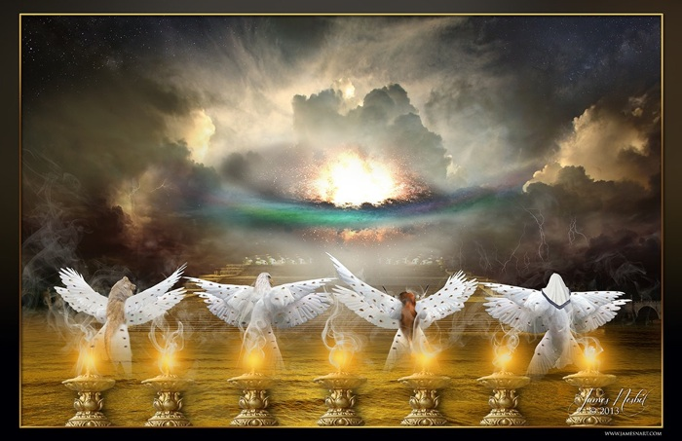
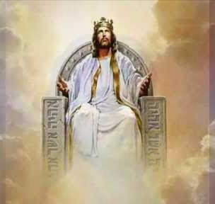
“And the four beasts had each of them six wings about him; and they were full of eyes within: and they rest not day and night, saying, Holy, holy, holy, Lord God Almighty, which was, and is, and is to come.” (Revelation 4:8)

Slide 27
The Ministry of the Seraphim's
Without ceasing day or night, they proclaim God’s praise, saying: "Holy, holy, holy, Lord God Almighty, who was, and is, and is to come" (Rev. 4:8).
Each of the four living creatures will announce the great tribulation judgments.

Slide 28
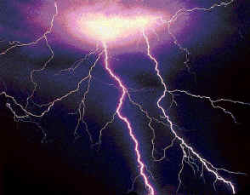
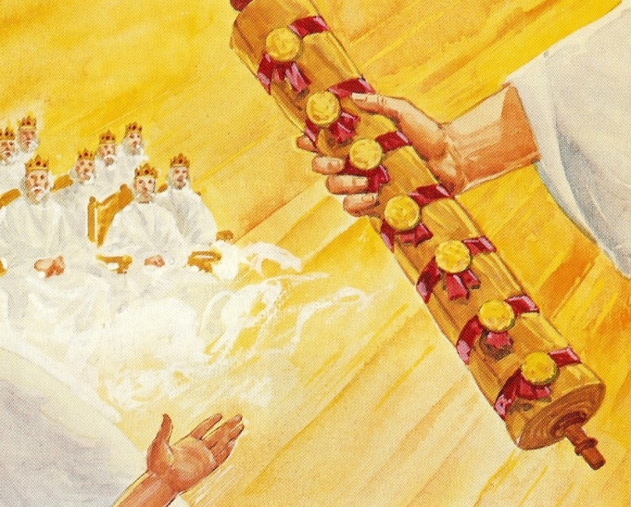
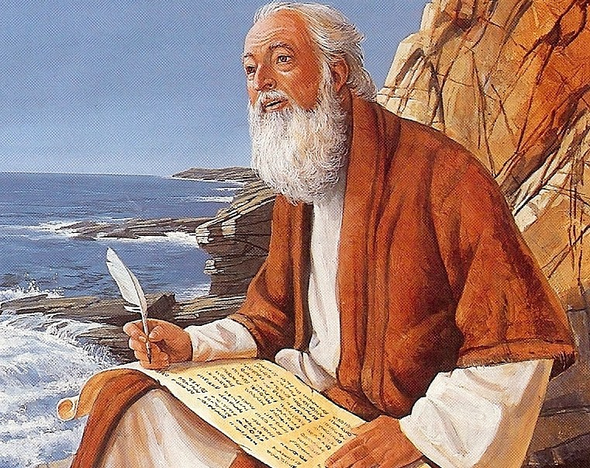
“And I saw when the Lamb opened one of the seals, and I heard, as it were the noise of thunder, one of the four beasts saying Come and see.”

Slide 29
Rev. 6:2

Slide 30
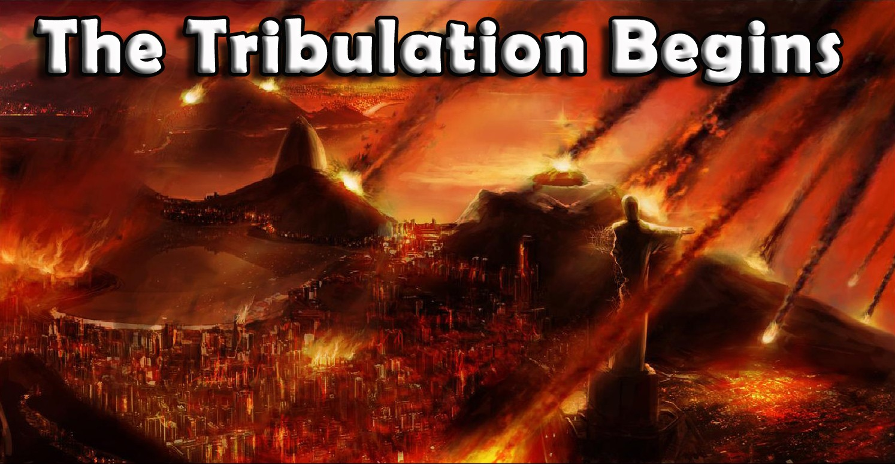
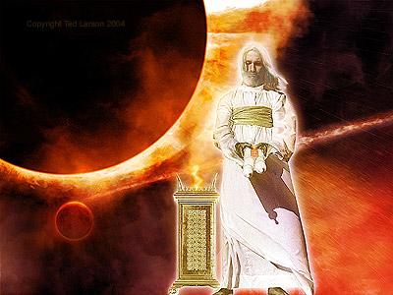

Slide 31
(Matthew 24:21)
“For then shall be great tribulation, such as was not since the beginning of the world to this time, no, nor ever shall be.”

Slide 32
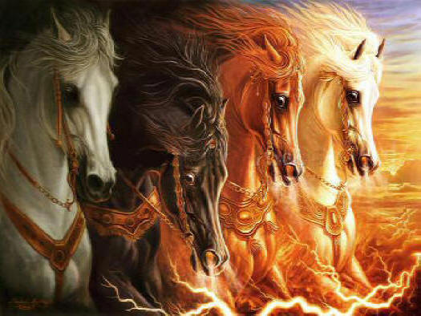

Slide 33
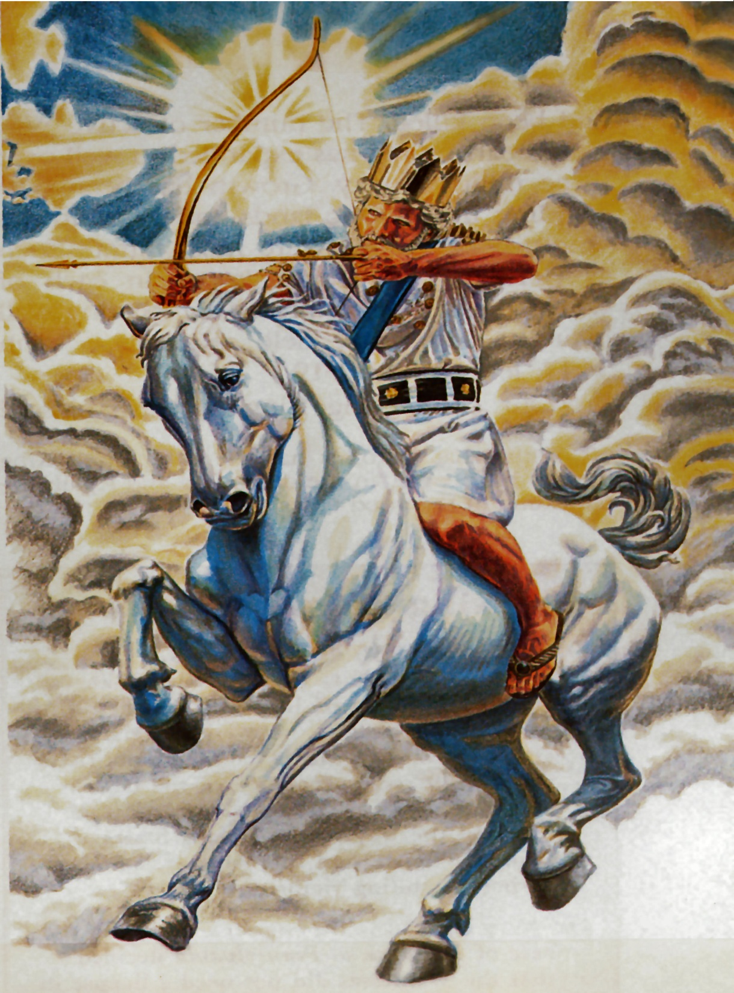
“And I saw, and behold a white horse: and he that sat on him had a bow; and a crown was given unto him: and he went forth conquering, and to conquer.”

Slide 34
6:3-4

Slide 35
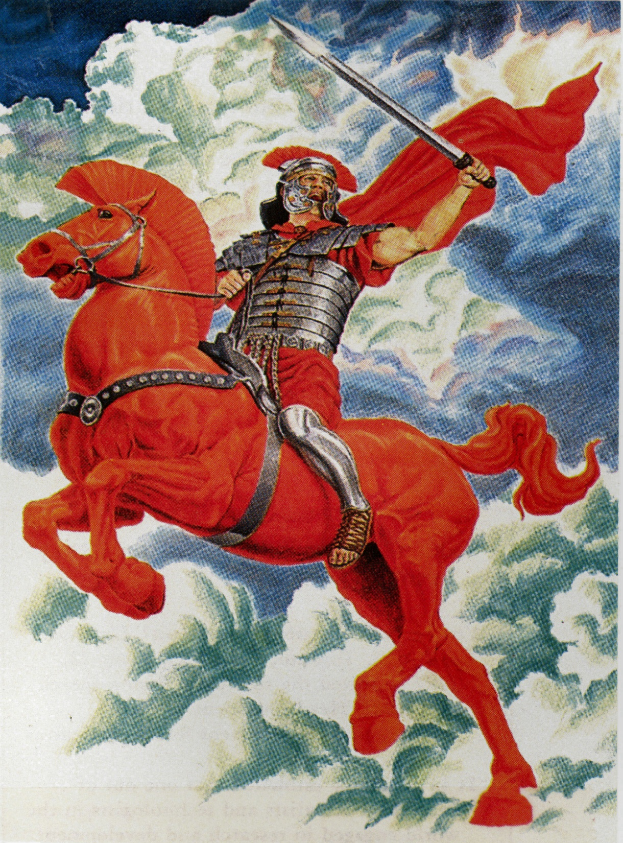
“And when he had opened the second seal, I heard the second beast say, Come and see. And there went out another horse that was red: and power was given to him that sat thereon to take peace from the earth, and that they should kill one another: and there was given unto him a great sword.”

Slide 36
6:5-6

Slide 37
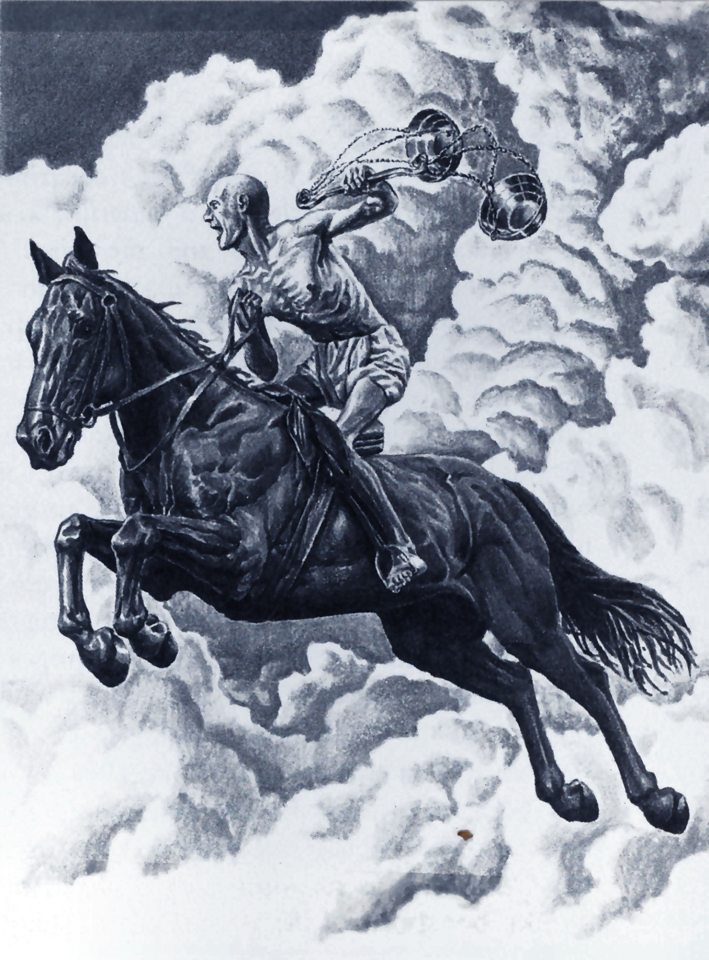
“And when he had opened the third seal, I heard the third beast say, Come and see. And I beheld, and lo a black horse; and he that sat on him had a pair of balances in his hand. And I heard a voice in the midst of the four beasts say, A measure of wheat for a penny, and three measures of barley for a penny; and see thou hurt not the oil and the wine.”

Slide 38
6:7-8

Slide 39
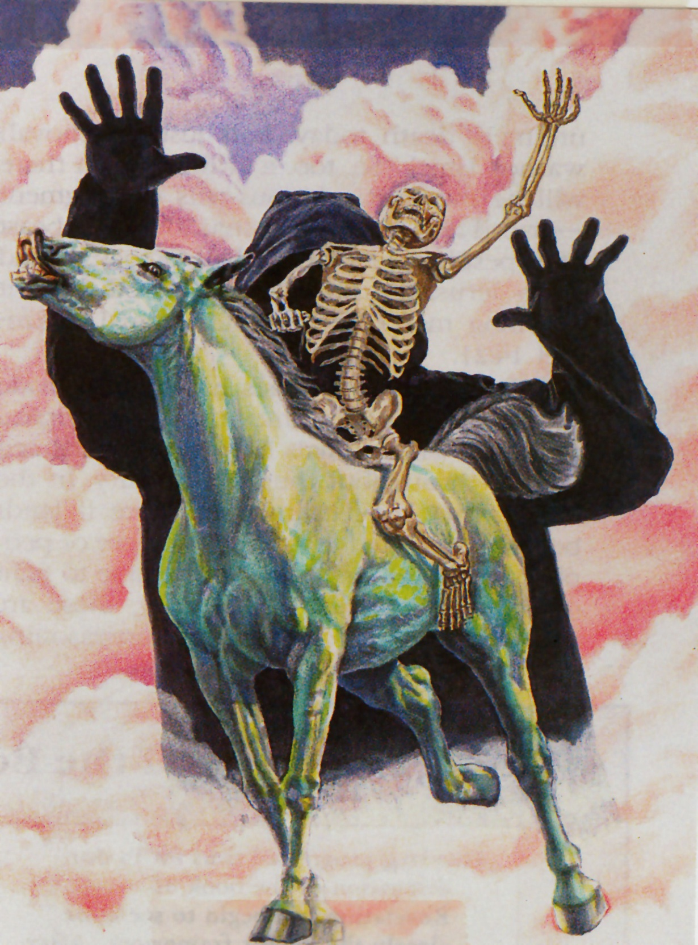
“And when he had opened the fourth seal, I heard the voice of the fourth beast say, Come and see. And I looked, and behold a pale horse: and his name that sat on him was Death, and Hell followed with him. And power was given unto them over the fourth part of the earth, to kill with sword, and with hunger, and with death, and with the beasts of the earth.”

Slide 40
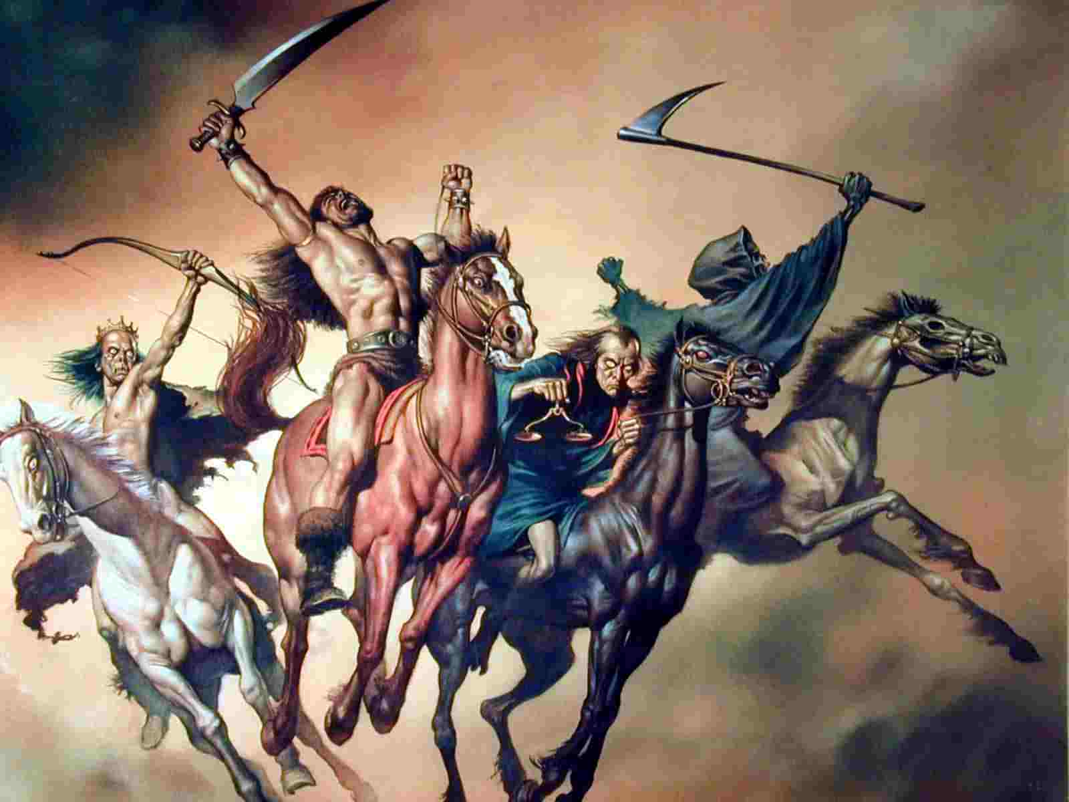

Slide 41
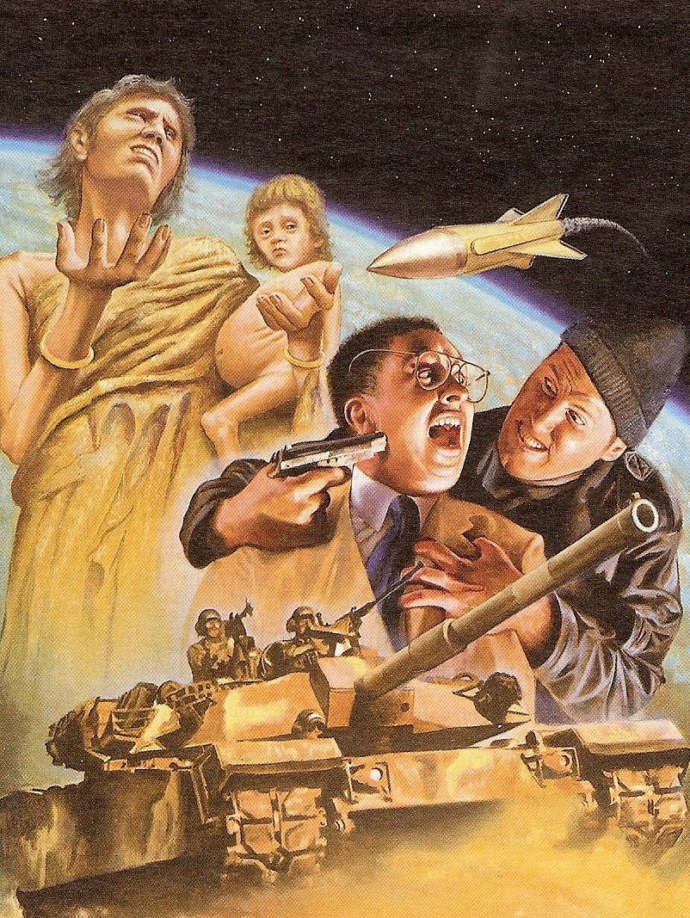
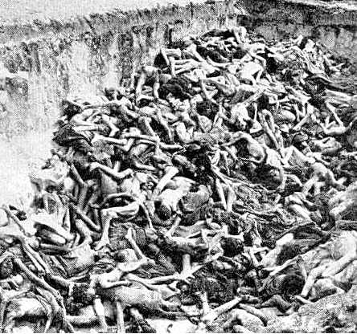
World’s present population 7 billion ¼ of the world’s population = 1.75 billion

Slide 42
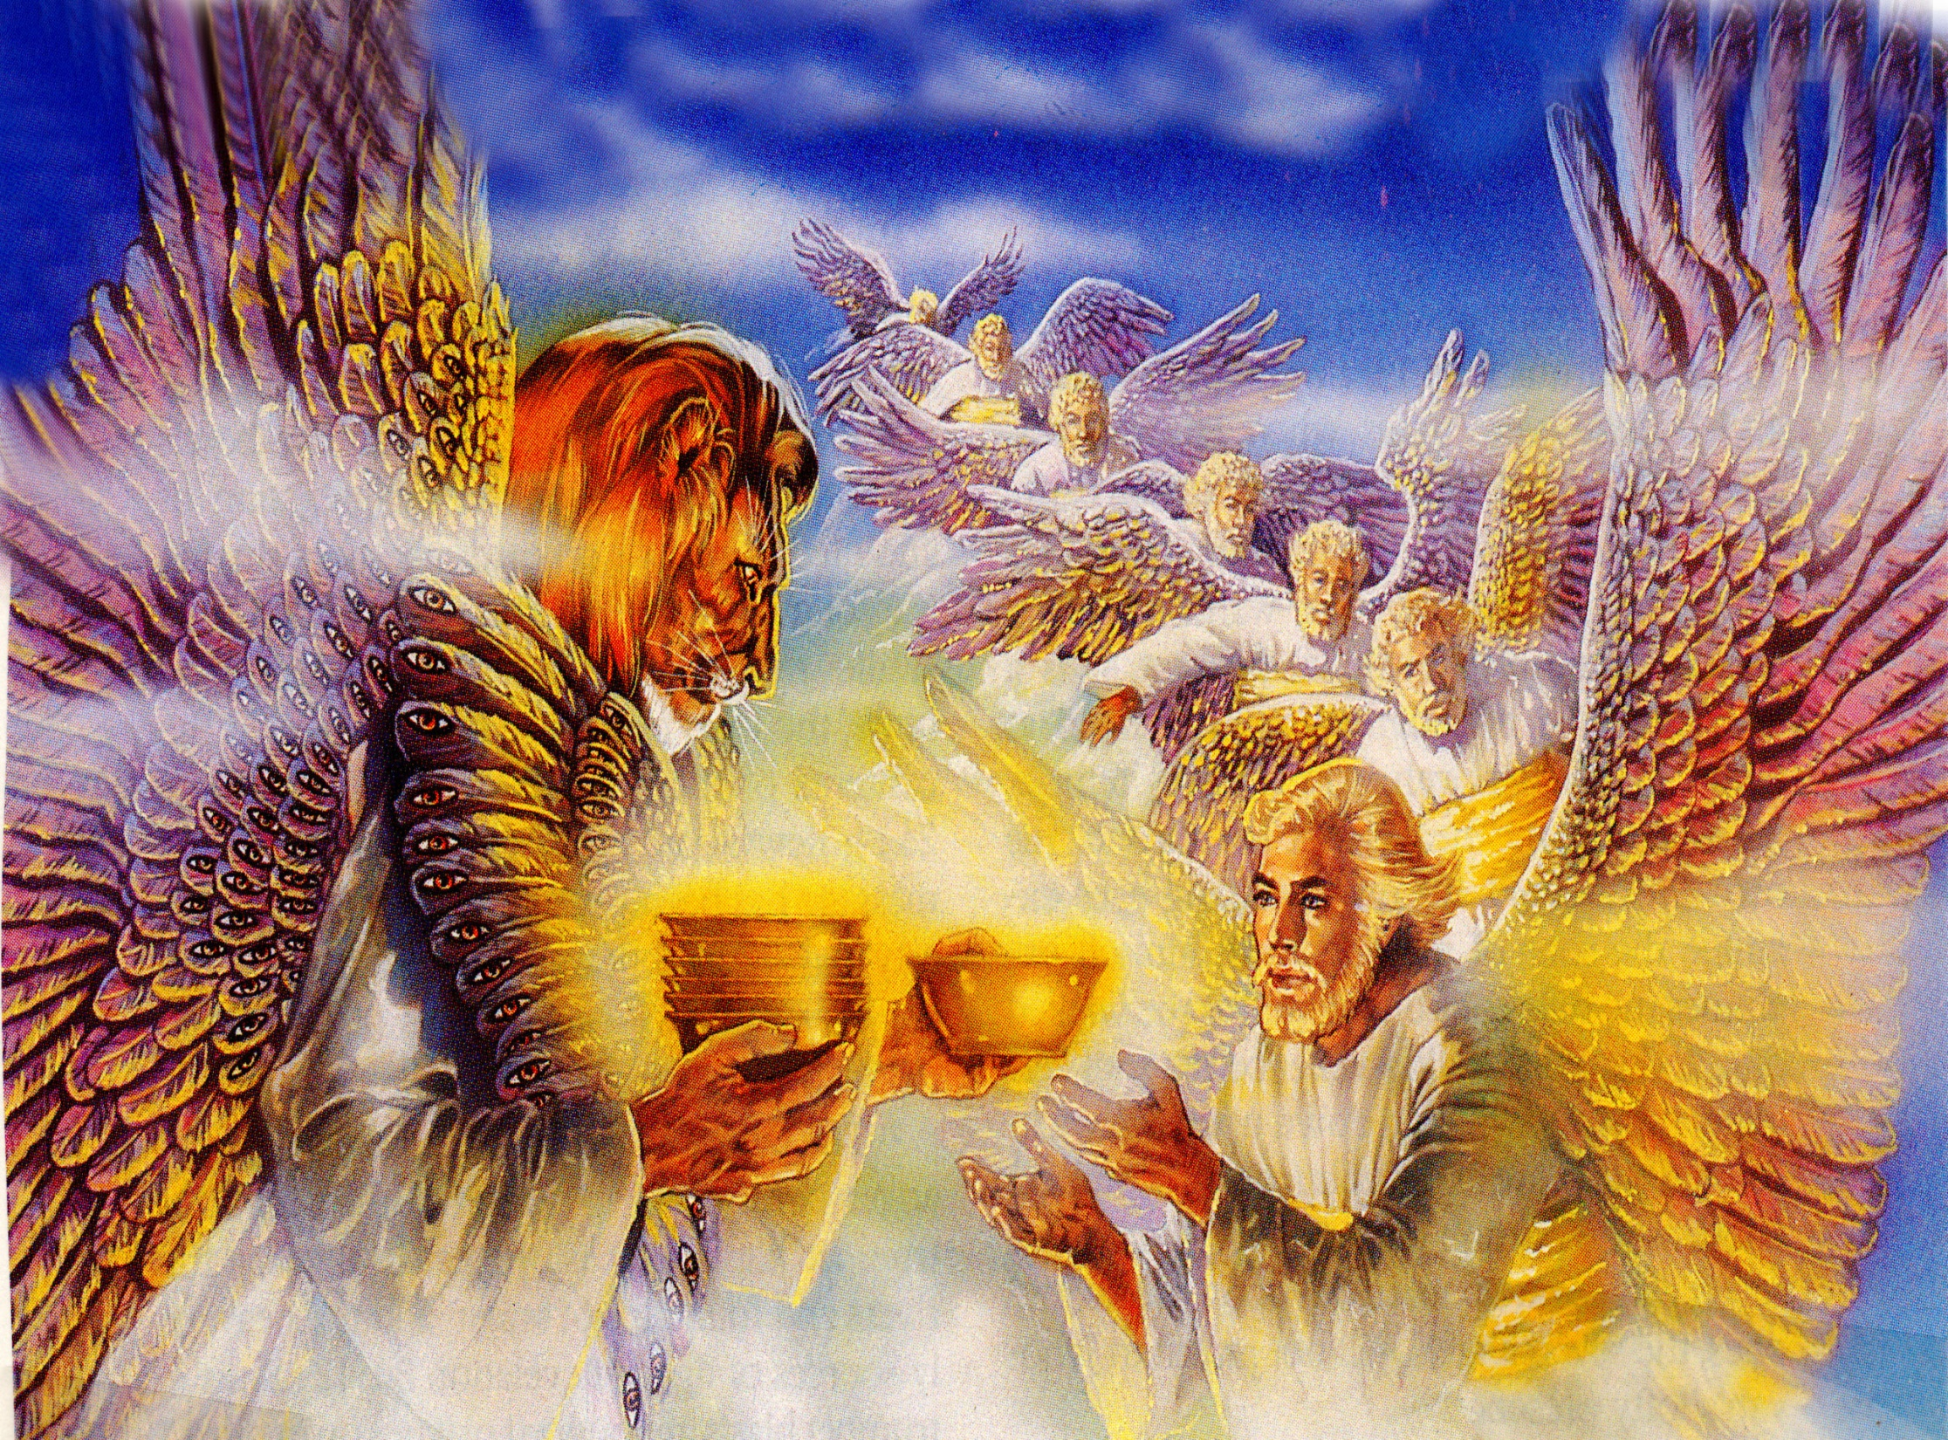
“And one of the four beasts gave unto the seven angels seven golden vials full of the wrath of God, who liveth for ever and ever.”

Slide 43
Grievous sores upon those who have the mark of the beast and worship his image
Sea turns to the blood of a dead man
Every living thing in the sea dies
Rivers and fountains of waters become blood
Men are scorched with fire from heaven
Darkness over the face of the whole earth
Men are afflicted with great pain

Slide 44
Powerful storms
Great earthquakes
Major cities around the world are destroyed
Every island disappears
Every mountain is removed
Great hail the weight of a talent
Man blaspheme God
Battle of Armageddon

Slide 45
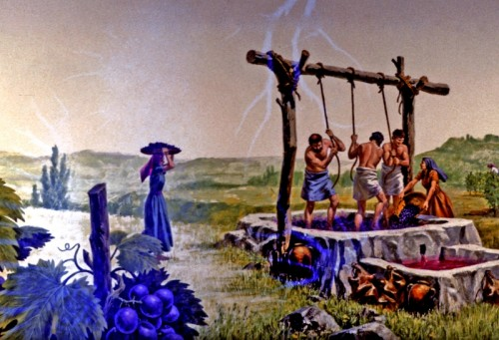
“And the winepress was trodden without the city, and blood came out of the winepress, even unto the horse bridles, by the space of a thousand and six hundred furlongs (184 miles).” (Revelation 14:20)

Slide 46
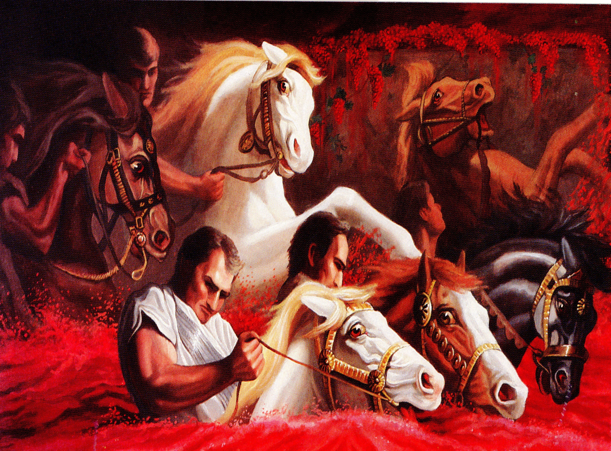

Slide 47
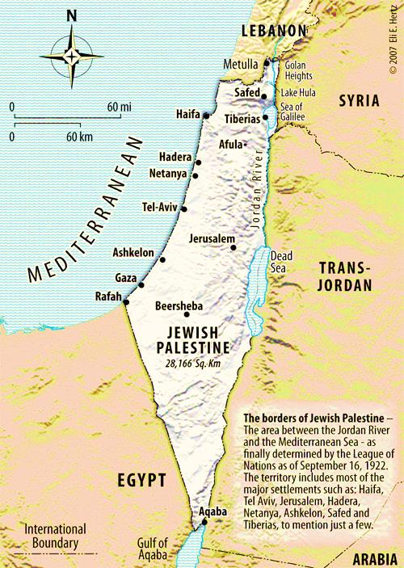
(184 miles)

Slide 48
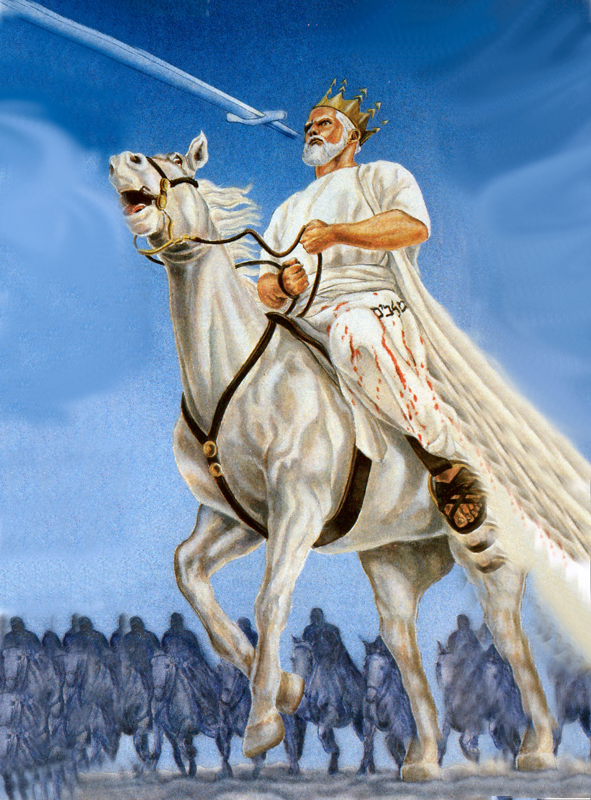
(Revelation 19:21)
“And the remnant were slain with the sword of him that sat upon the horse, which sword proceeded out of his mouth: and all the fowls were filled with their flesh.”

Slide 49
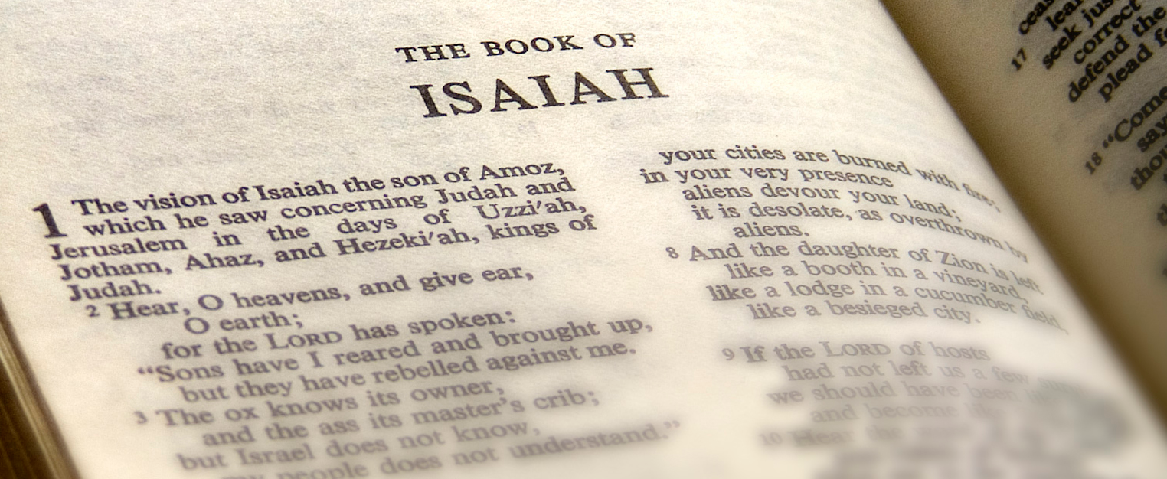
Isaiah’s Vision of the Seraphim's

Slide 50
“In the year that king Uzziah died I saw also the Lord sitting upon a throne, high and lifted up, and his train filled the temple. Above it stood the seraphims: each one had six wings; with twain he covered his face, and with twain he covered his feet, and with twain he did fly. And one cried unto another, and said, Holy, holy, holy, is the LORD of hosts: the whole earth is full of his glory. And the posts of the door moved at the voice of him that cried, and the house was filled with smoke. Then said I, Woe is me! for I am undone; because I am a man of unclean lips, and I dwell in the midst of a people of unclean lips: for mine eyes have seen the King, the LORD of hosts. Then flew one of the seraphims unto me, having a live coal in his hand, which he had taken with the tongs from off the altar: And he laid it upon my mouth, and said, Lo, this hath touched thy lips; and thine iniquity is taken away, and thy sin purged. Also I heard the voice of the Lord, saying, Whom shall I send, and who will go for us? Then said I, Here am I; send me.” (Isaiah 6:1-8)

Slide 51
The Hebrew word for Seraphim means "burning ones"
They have six wings.
Two are used to cover their face, two to cover their feet, and two are used to fly.
They proclaim in a great chorus the majesty of God, crying out: "Holy, holy, holy, is the Lord of hosts; the whole earth is full of his glory" (Isa. 6:3).
The awesome sound of their mighty praises shakes the foundation of the heavenly temple.
When Isaiah, the prophet, views all this in a vision. He is immediately convicted concerning both his sin and the sin of the nation Israel.

Slide 52
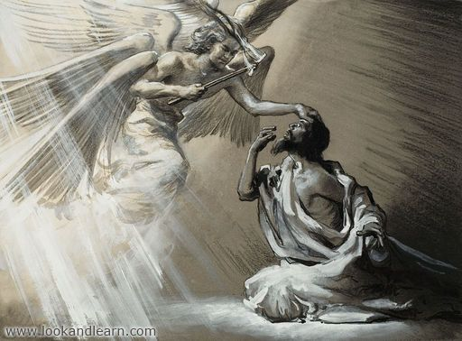
He is ministered to by one of the seraphim, who flew over to the heavenly altar and, with a pair of tongs, picked out a burning coal. He then touched Isaiah’s lips with it and said: "Lo, this hath touched thy lips, and thine iniquity is taken away, and thy sin purged" (Isa. 6:7).

Slide 53
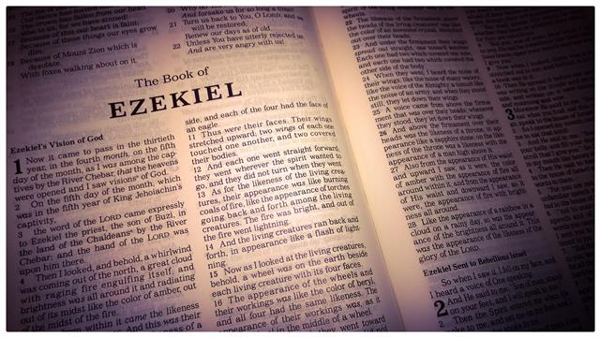

Slide 54
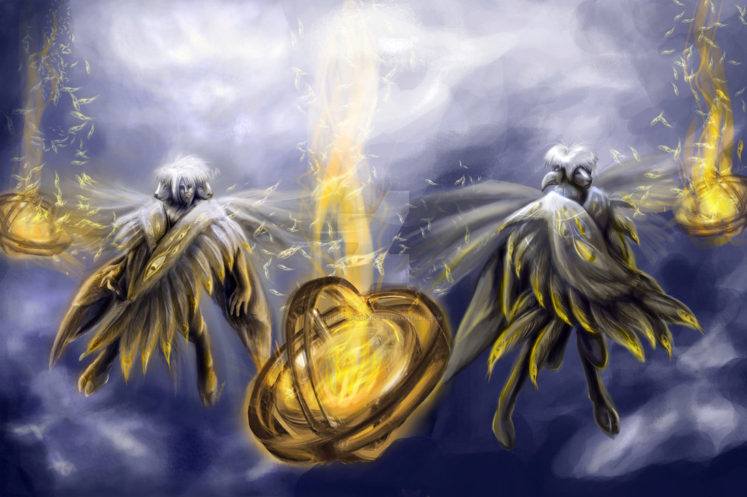
Ezekiel 1:1-28

Slide 55
“And I looked, and, behold, a whirlwind came out of the north, a great cloud, and a fire infolding itself, and a brightness was about it, and out of the midst thereof as the colour of amber, out of the midst of the fire.”
“And every one had four faces, and every one had four wings. And their feet were straight feet; and the sole of their feet was like the sole of a calf's foot: and they sparkled like the colour of burnished brass.”

Slide 56
“As for the likeness of their faces, they four had the face of a man, and the face of a lion, on the right side: and they four had the face of an ox on the left side; they four also had the face of an eagle.”
“As for the likeness of the living creatures, their appearance was like burning coals of fire…and the fire was bright, and out of the fire went forth lightning.”

Slide 57
“Every one had four faces, and every one had four wings…And as they went, I heard the noise of their wings, like the noise of great waters, as the voice of the Almighty…”
“The appearance of the wheels and their work was like unto the colour of a beryl...and their appearance and their work was as it were a wheel in the middle of a wheel.”

Slide 58
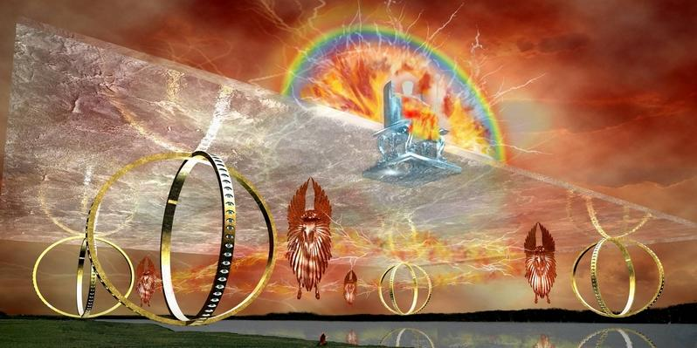
“Their rings were high that they were dreadful; and their rings were full of eyes round about them And when the living creatures went, the wheels went by them: and when the living creatures were lifted up from the earth, the wheels were lifted up.”

Slide 59
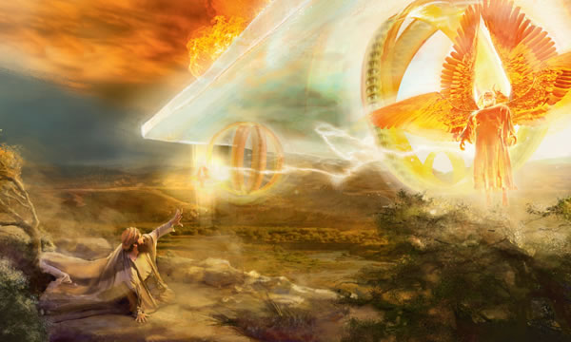
“And when the living creatures went, the wheels went by them: and when the living creatures were lifted up from the earth, the wheels were lifted up.”

Slide 60
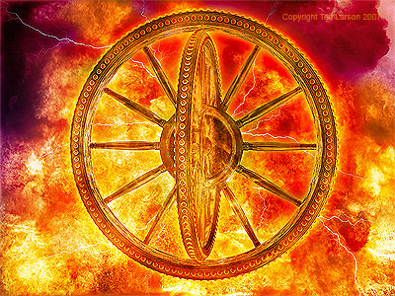

Slide 61
“And I saw a throne, as the appearance of a sapphire stone: and upon the likeness of the throne was the likeness as the appearance of a man upon it…I saw the appearance of fire round about. From the appearance of His loins even upward, and from the appearance of His loins even downward, I saw as it were the appearance of fire and it had brightness round about…this was the appearance of the likeness of the glory of the Lord. And when I saw it, I fell upon my face.”

Slide 62
Four Living Creatures “Cherubim's” (Ezekiel 10:15-22)

Slide 63
“And the cherubims were lifted up. This is the living creature that I saw by the river of Chebar. And when the cherubims went, the wheels went by them: and when the cherubims lifted up their wings to mount up from the earth, the same wheels also turned not from beside them. When they stood, these stood; and when they were lifted up, these lifted up themselves also: for the spirit of the living creature was in them. Then the glory of the LORD departed from off the threshold of the house, and stood over the cherubims. And the cherubims lifted up their wings, and mounted up from the earth in my sight:

Slide 64
when they went out, the wheels also were beside them, and every one stood at the door of the east gate of the LORD'S house; and the glory of the God of Israel was over them above. This is the living creature that I saw under the God of Israel by the river of Chebar; and I knew that they were the cherubims. Every one had four faces apiece, and every one four wings; and the likeness of the hands of a man was under their wings. And the likeness of their faces was the same faces which I saw by the river of Chebar, their appearances and themselves: they went every one straight forward.”

Slide 65
The Description of the Cherubim’s
Each has four faces.
The face in front is as a man.
The face on the right is as a lion.
The face on the left is as an ox.
The face in back is as an eagle.
Each has two pairs of wings.

Slide 66
One pair spreads out from the middle of the back.
The other pair is used to cover the body.
These wings make a noise like waves crashing upon the seashore.
They have the legs of men, but their feet are cloven like calves’ feet, which shine like burnished brass.
They have four human hands, with one located under each wing.
They travel in groups of four.
The outstretched wings of each Cherubim touches the other Cherubim’s wings.
When they move, they move as a group without turning their bodies.

Slide 67
The Ministry of the Cherubim’s
They kept Adam from the Tree of Life after the fall, lest he eat of it and live forever in his sin (Gen. 3:24).

Slide 68
Two golden cherubim were constructed at God’s command and placed at either end on top of the ark lid in the tabernacle Holy of Holies (Exodus 25:18-20; Heb. 9:5).

Slide 69
Prior to his fall, Satan (then known as Lucifer)
was the chief cherub angel (Isa. 14:12; Ezek. 28:14).

Slide 70
“Thou hast been in Eden the garden of God; every precious stone was thy covering, the sardius, topaz, and the diamond, the beryl, the onyx, and the jasper, the sapphire, the emerald, and the carbuncle, and gold: the workmanship of thy tabrets and of thy pipes was prepared in thee in the day that thou wast created. Thou art the anointed cherub that covereth; and I have set thee so: thou wast upon the holy mountain of God; thou hast walked up and down in the midst of the stones of fire. Thou wast perfect in thy ways from the day that thou wast created, till iniquity was found in thee.” (Ezekiel 28:13-15)

Slide 71
“Thou hast sinned: therefore I will cast thee as profane out of the mountain of God: and I will destroy thee, O covering cherub, from the midst of the stones of fire. Thine heart was lifted up because of thy beauty, thou hast corrupted thy wisdom by reason of thy brightness: I will cast thee to the ground, I will lay thee before kings, that they may behold thee. Thou hast defiled thy sanctuaries by the multitude of thine iniquities, by the iniquity of thy traffick; therefore will I bring forth a fire from the midst of thee, it shall devour thee, and I will bring thee to ashes upon the earth in the sight of all them that behold thee. All they that know thee among the people shall be astonished at thee: thou shalt be a terror, and never shalt thou be any more.”
(Ezekiel 28:16-19)

Slide 72
The ministry of the Seraphim's and Cherubim’s “The Glory of God”

