Slide 2
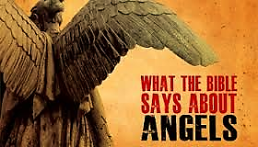

Slide 3
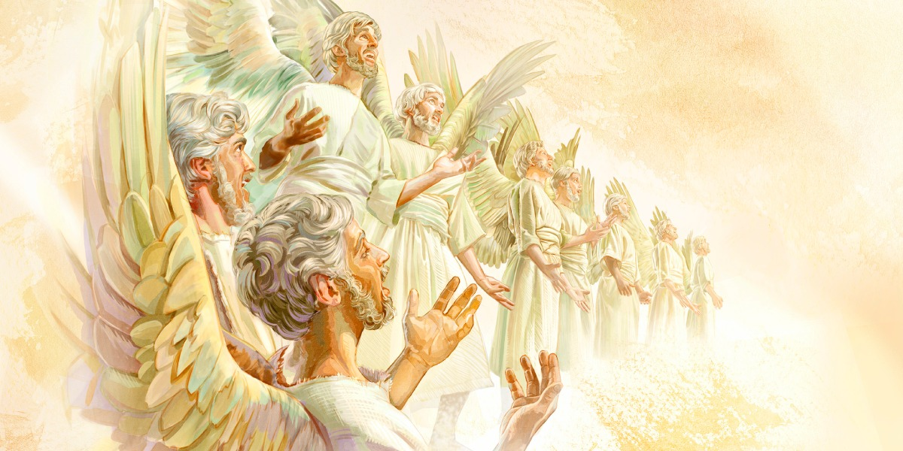
(Psalms 103:20) “Bless the LORD, ye his angels, that excel in strength, that do his commandments, hearkening unto the voice of his word.”

Slide 6
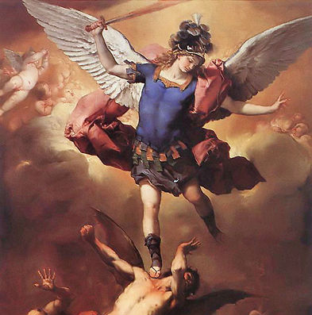
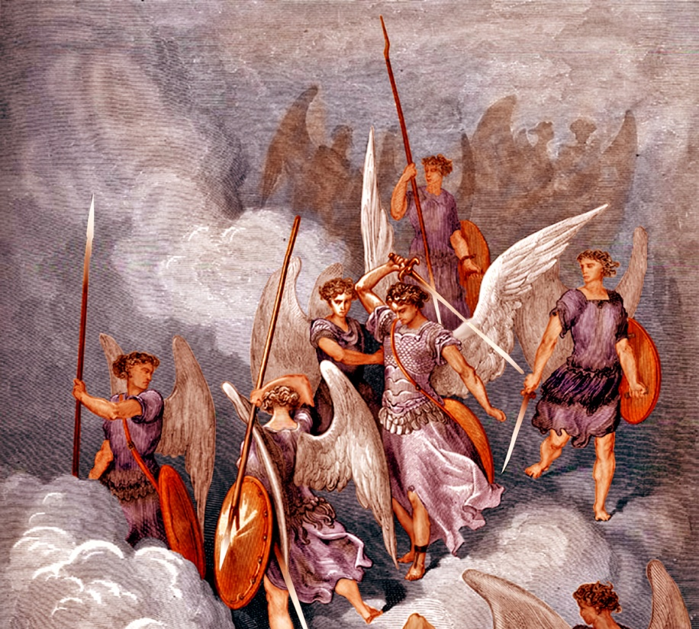
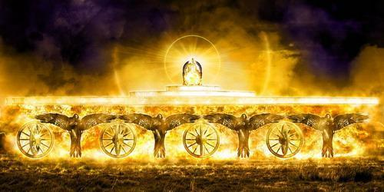
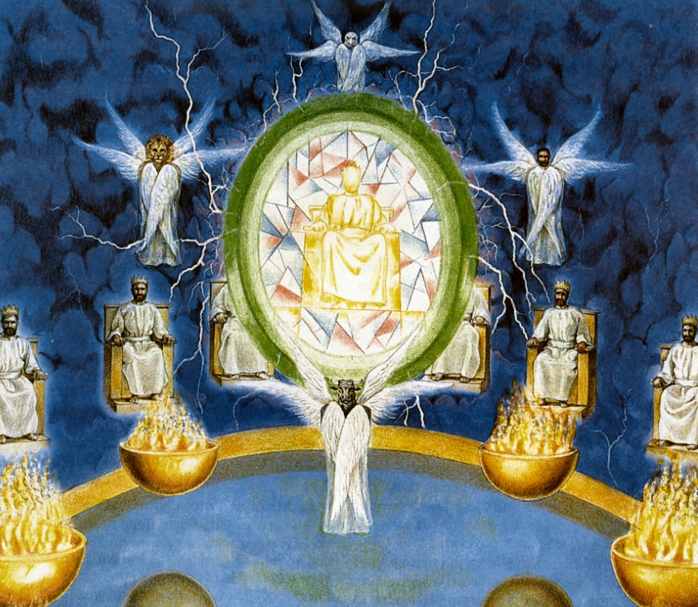
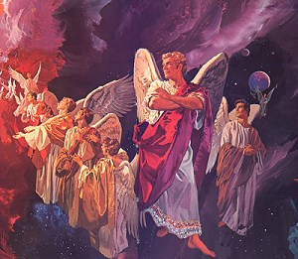
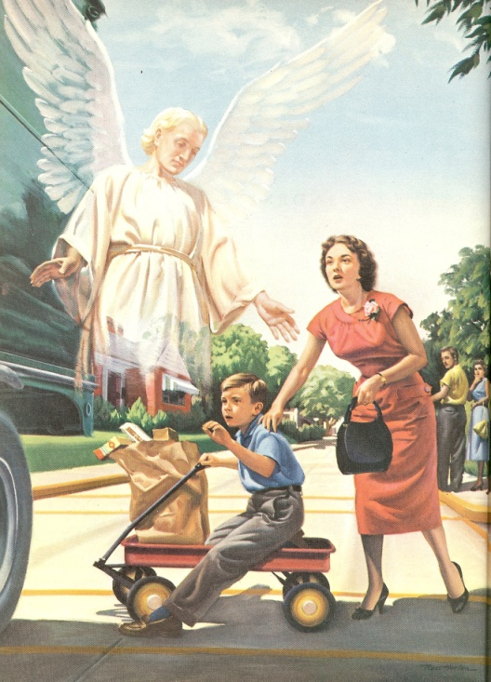
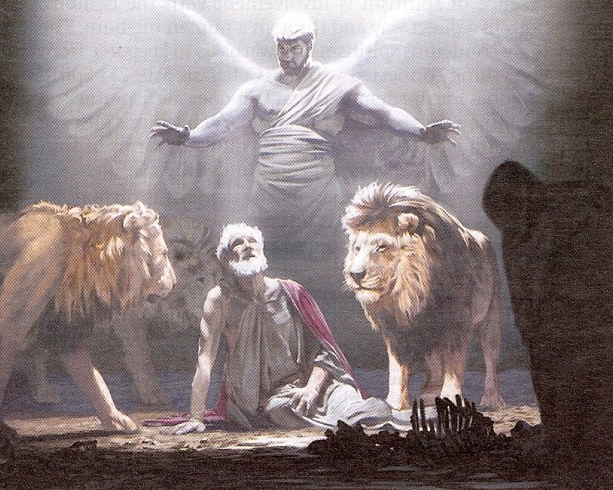
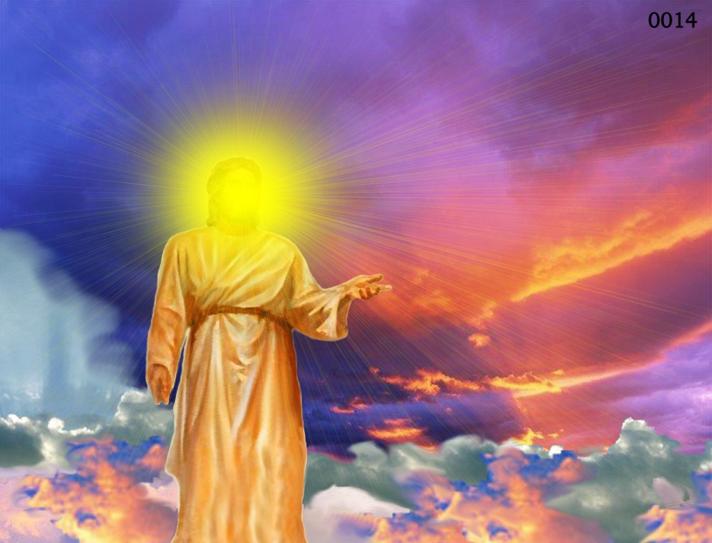
Different Types of Angels
Archangels – Michael and Gabriel
Cherubim's – Ezekiel 1:4-28
Seraphim’s – Isaiah 6:1-7
Ruling angels – I Peter 3:22
Guarding angels – Hebrews 1:14
Angel of the Lord – Zechariah 3:1-10

Slide 7
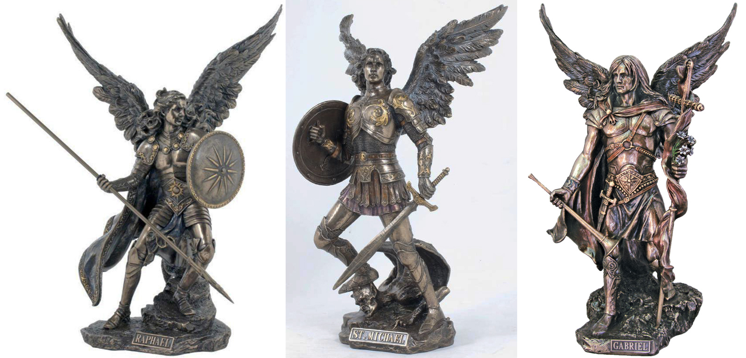
Archangels – Michael and Gabriel
Warrior - Michael Messenger - Gabriel

Slide 8
Michael the Warrior of God

Slide 9
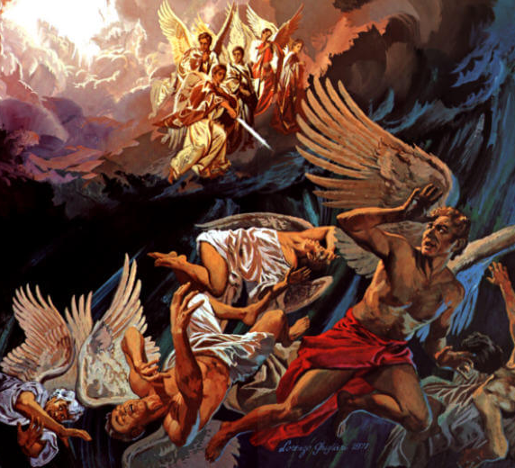
“And there was war in heaven: Michael and his angels fought against the dragon; and the dragon fought and his angels, And prevailed not; neither was their place found any more in heaven. And the great dragon was cast out, that old serpent, called the Devil, and Satan, which deceiveth the whole world: he was cast out into the earth, and his angels were cast out with him.” (Revelation 12:7-9)

Slide 10
Gabriel the Messenger of God

Slide 11
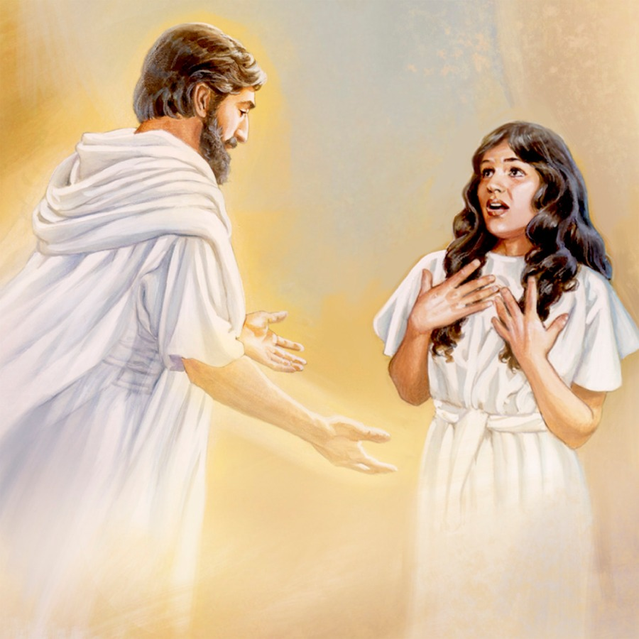
“And in the sixth month the angel Gabriel was sent from God unto a city of Galilee, named Nazareth, To a virgin espoused to a man whose name was Joseph, of the house of David; and the virgin's name was Mary.” (Luke 1:26-27)

Slide 12
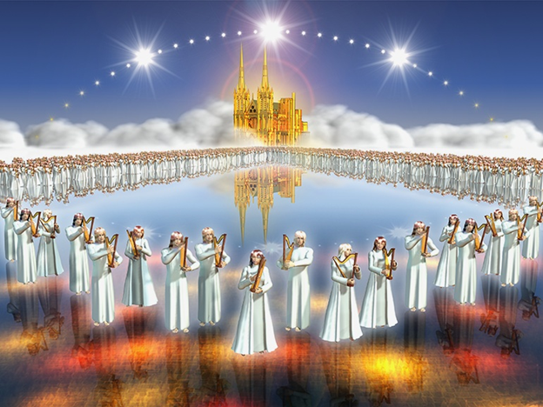
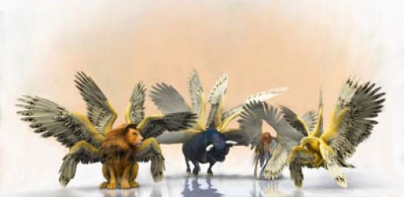
“And before the throne there was a sea of glass like unto crystal: and in the midst of the throne, and round about the throne, were four beasts full of eyes before and behind.”

Slide 13
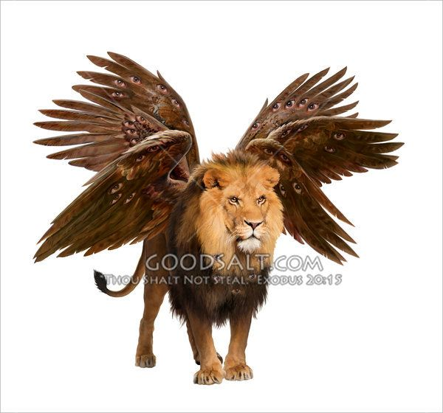
And the first beast was like a lion

Slide 14
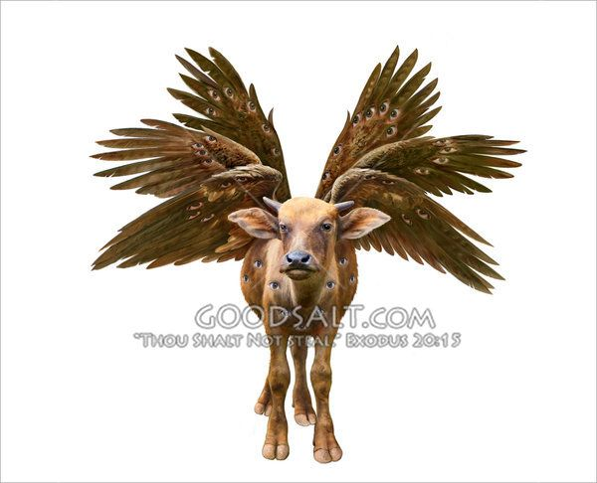
And the second beast like a calf

Slide 15
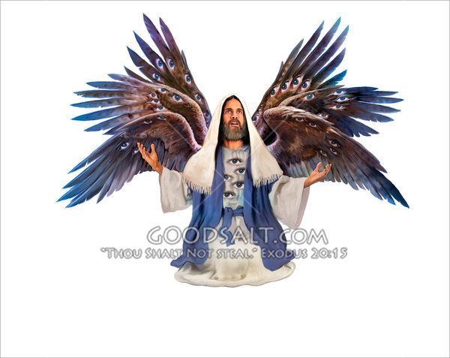
And the third beast had a face as a man

Slide 16
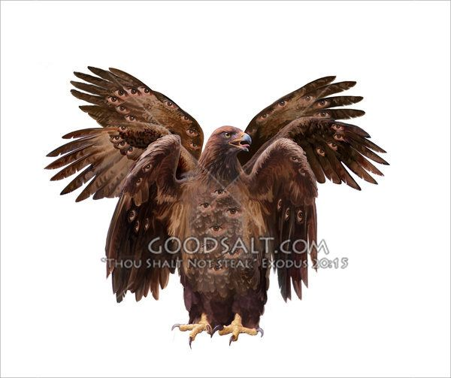
And the fourth beast was like a flying eagle

Slide 17
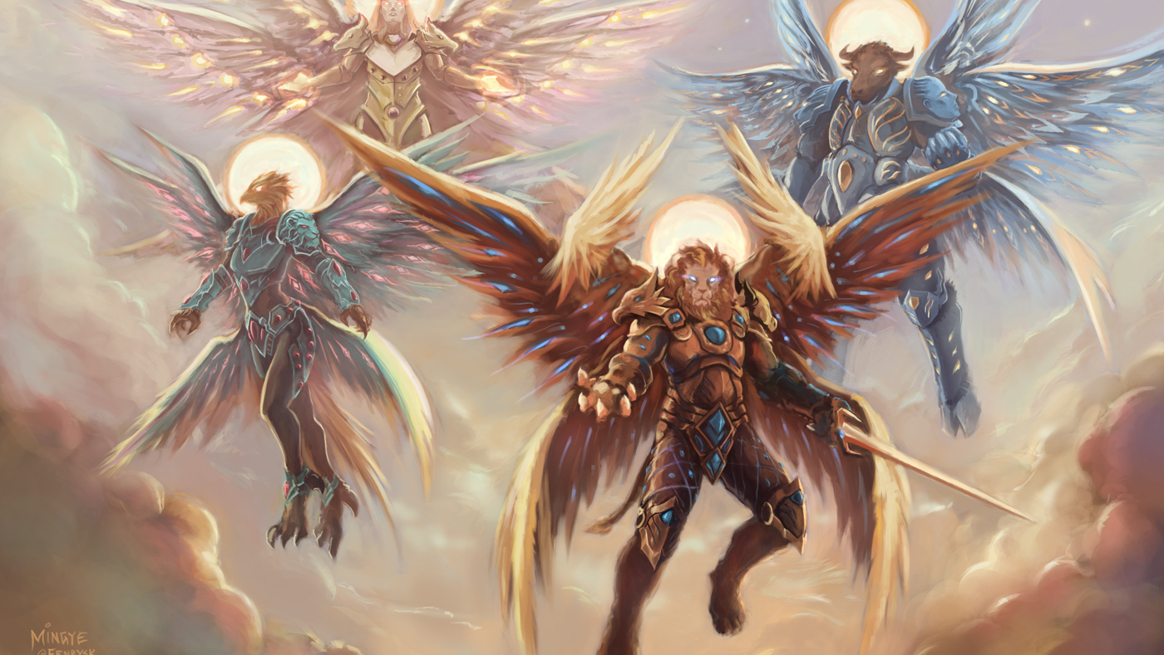
“And the four beasts had each of them six wings about him; and they were full of eyes within: and they rest not day and night, saying, Holy, holy, holy, Lord God Almighty, which was, and is, and is to come.”

Slide 18
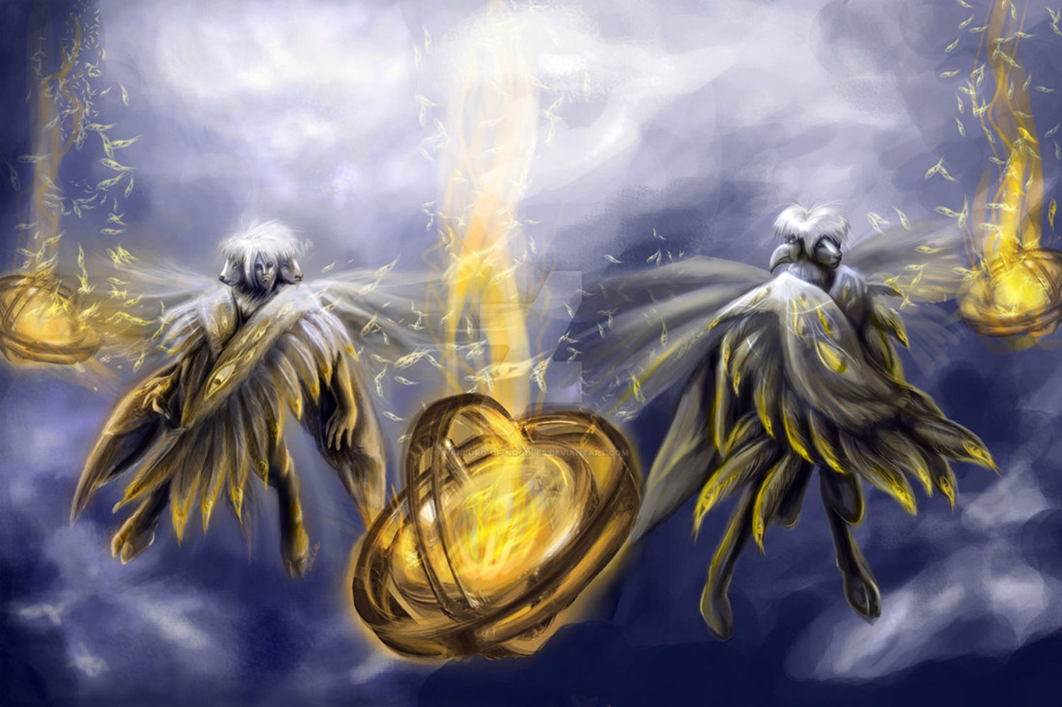
Cherubims
(Ezekiel 1:1-28, 10:15-22)

Slide 19
“Every one had four faces apiece, and every one four wings; and the likeness of the hands of a man was under their wings…As for the likeness of their faces, they four had the face of a man, and the face of a lion, on the right side: and they four had the face of an ox on the left side; they four also had the face of an eagle.”

Slide 20
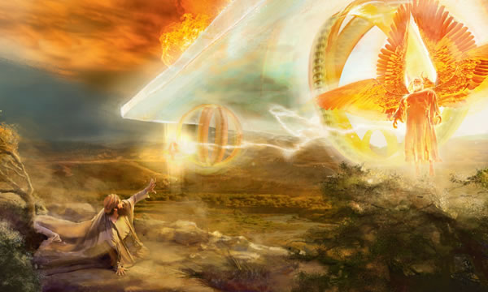
“And when the living creatures went, the wheels went by them: and when the living creatures were lifted up from the earth, the wheels were lifted up. And the cherubim’s lifted up their wings, and mounted up from the earth in my sight: when they went out, the wheels also were beside them, and every one stood at the door of the east gate of the LORD'S house; and the glory of the God of Israel was over them above. This is the living creature that I saw…And as they went, I heard the noise of their wings, like the noise of great waters, as the voice of the Almighty.” ”

Slide 21
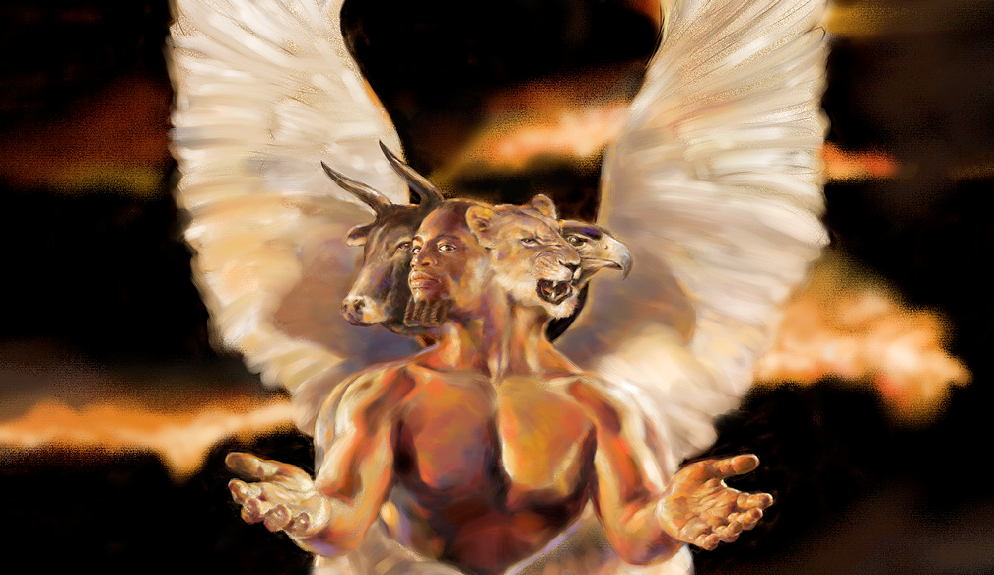
The ministry of the Seraphim's and Cherubim’s “The Glory of God”

Slide 23
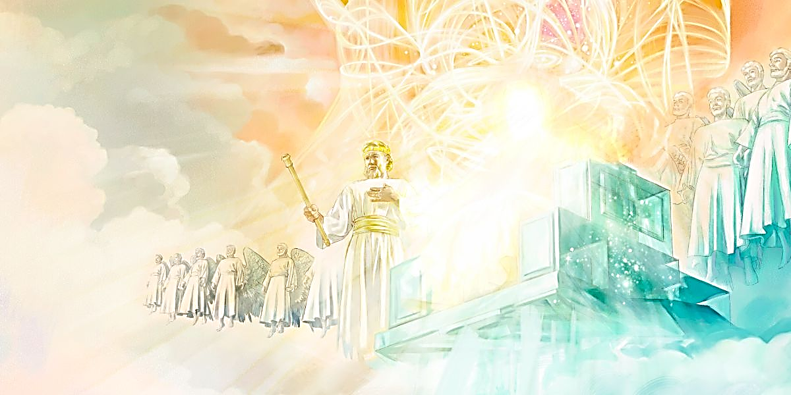
Ruling Angels

Slide 24
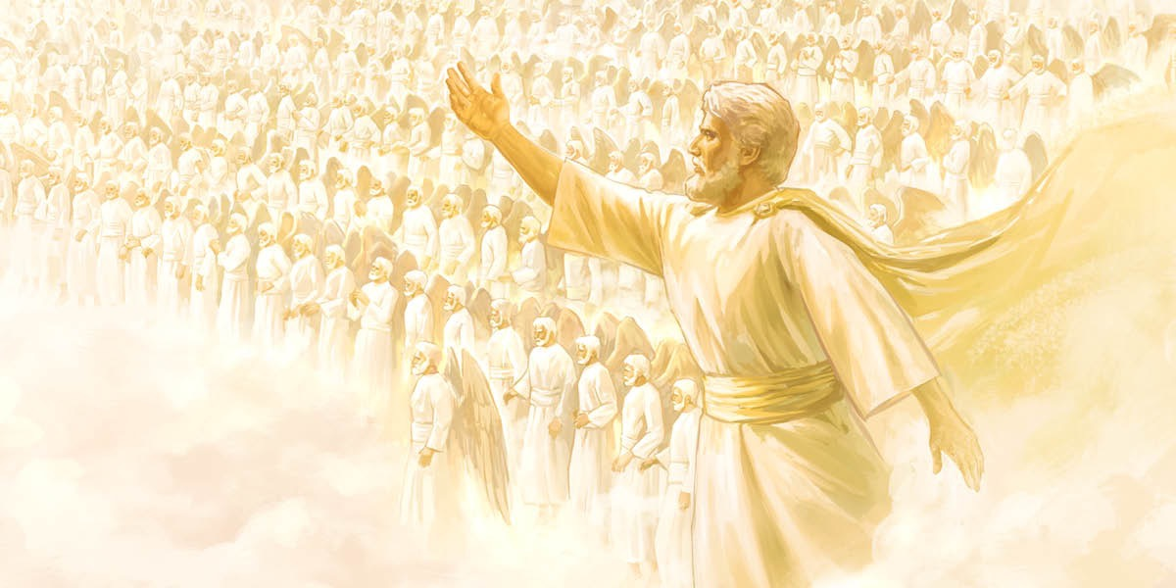
(Ephesians 1:18-23) “The eyes of your understanding being enlightened; that ye may know what is the hope of his calling, and what the riches of the glory of his inheritance in the saints, And what is the exceeding greatness of his power to us-ward who believe, according to the working of his mighty power, Which he wrought in Christ, when he raised him from the dead, and set him at his own right hand in the heavenly places, Far above all principality, and power, and might, and dominion, and every name that is named, not only in this world, but also in that which is to come: And hath put all things under his feet, and gave him to be the head over all things to the church, Which is his body, the fulness of him that filleth all in all.”

Slide 25
(Ephesians 3:9-11) “And to make all men see what is the fellowship of the mystery (Church), which from the beginning of the world hath been hid in God, who created all things by Jesus Christ: To the intent that now unto the principalities and powers in heavenly places might be known by the church the manifold wisdom of God, According to the eternal purpose which he purposed in Christ Jesus our Lord.”

Slide 26
(Colossians 1:16-18) “For by him were all things created, that are in heaven, and that are in earth, visible and invisible, whether they be thrones, or dominions, or principalities, or powers: all things were created by him, and for him: And he is before all things, and by him all things consist. And he is the head of the body, the church: who is the beginning, the firstborn from the dead; that in all things he might have the preeminence.”

Slide 27
(Colossians 2:9-10) “For in him dwelleth all the fulness of the Godhead bodily. And ye are complete in him, which is the head of all principality and power.”

Slide 28
(1 Peter 3:21-22) “…by the resurrection of Jesus Christ: Who is gone into heaven, and is on the right hand of God; angels and authorities and powers being made subject unto him.”

Slide 29
(Daniel 10:13) “But the prince of the kingdom of Persia withstood me one and twenty days: but, lo, Michael, one of the chief princes, came to help me.”

Slide 30
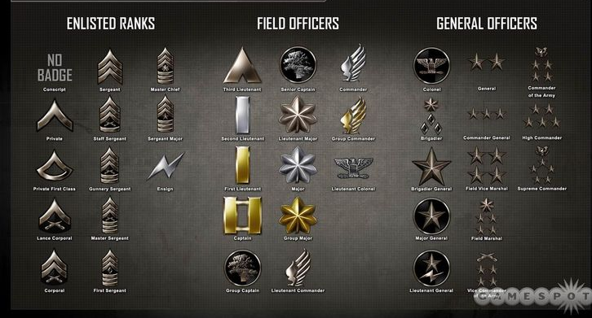
These verses describe various levels of ruling positions assigned to angels, ranging perhaps (to use an earthly analogy) from privates to generals.

Slide 31
Ten Ranks of Angels

Slide 32
Archangels - The word “archangel” comes from a Greek word meaning "chief angel or an angel of high rank."
Princes - Royal ruler subject to a king or emperor
Cherubims - Powerful heavenly beings surrounding the throne
Seraphims – One of the highest order of the celestial beings
Thrones - Seats of authority
Authorities - A magistrate, potentate, monarch or ruler
Principalities - Ruler over a jurisdictional area
Dominions - A territory of sovereign control
Powers - Delegated authority, jurisdiction, strength
Might - Powerful, forceful, strong

Slide 33
Titles Given to Angels
Ministers (Psalms 103:20, 21; 104:4) - This signifies their spiritual service.
Host of heaven/Heavenly host (Gen. 32:1, 2; Josh. 5:14; 1 Sam. 17:45; Psalms 89:8) - This name speaks of their military service.
Chariots (2 Kings 6:16, 17; Psalms 68:17; Zech. 6:5) - This may refer to their swiftness.
Watchers (Dan. 4:13, 17) - This title speaks of their duties as supervisors and agents.
Morning stars - (Job 38:7) – This title speaks of angels being present at creation.
Stars (Rev. 12:3, 4) -This title may indicate both their number and their brightness.

Slide 34
Sons of the mighty (Psalms 89:6) - This title may refer to their awesome strength and power.
Sons of God (Gen. 6:2, 4; Job 1:6; 2:1; 38:7) - This title speaks of Angels being a direct creation of God.
Heavenly Beings (Psalm 29:1) - This title speaks of them having celestial bodies (I Cor. 15:40).
Spirits (Hebrews 1:14) - This title speaks of them being spirit beings.
Holy Angels/Holy ones (Luke 9:26; Psalms 89:5-7) - This title speaks of their confirmed state of holiness.
Angels of God and of Jesus - (Luke 12:8; Matt. 16:27) - This title speaks to whom angels belong.
Flames of fire (Psalm 104:4) - This title speaks of instruments of judgment.

Slide 35
God is a God of Authority
In the Bible, God outlines authority structures that provide direction for the family, church, workplace, and government. “Let every soul be subject unto the higher powers. For there is no power but of God: the powers that be are ordained of God” (Romans 13:1).
Recognizing and obeying the one in charge brings security, guidance and order to a group (Hebrews 13:17).
Each person under authority is to look to the leader for direction and accountability (Hebrews 13:7).
Leadership provides guidance for working through questions and problems that arise (2 Thess. 3:7-9).
The one in charge is ultimately responsible for the activities and productivity of the group (James 3:1-2).

Slide 36
God Is the Source of All Authority
By virtue of who God is as creator of all things, God is the sovereign ruler of the universe - Psalms 103:19 “The LORD hath prepared his throne in the heavens; and his kingdom ruleth over all.”
He has all power and all authority, and He entrusts roles of leadership to individuals in the family, church, workplace, and government – Matt. 28:18 “And Jesus came and spake unto them, saying, All power is given unto me in heaven and in earth.”

Slide 37
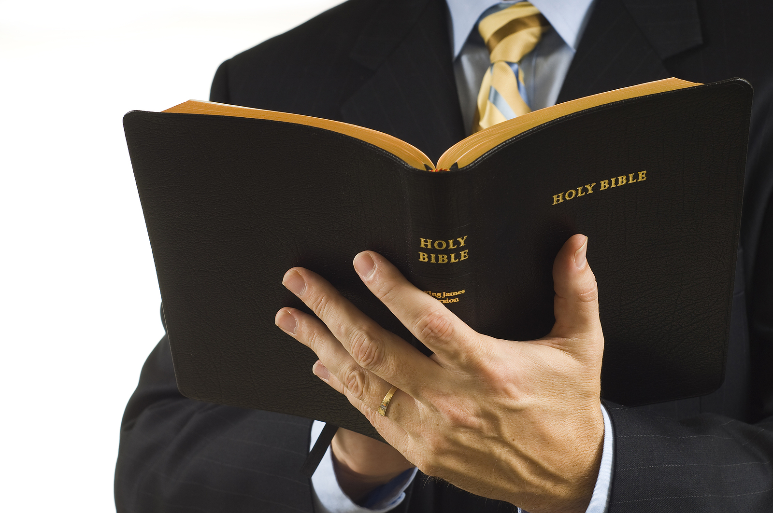
God ordained human authority in four areas
Family: Husband (Ephesians 5:21–6:4 and Proverbs 6:20–21)
Government: National and State leaders—Local officials—Citizens: (I Peter 2:13–17 and Romans 13:1–5)
Church: Pastor: (Ephesians 4:11–16, Hebrews 13:17, and I Peter 5:1–11)
Business: Employers: (Colossians 3:22–4:1 and I Peter 2:18)

Slide 38
Human authorities are accountable to God for how they exercise their authority – (James 3:1-2)
They are responsible to provide protection and direction for those under their care, to punish those who do wrong, and to praise those who do well – (Romans 13:1-8)
Those under authority are accountable to God for their responses to authority – (Romans 14:12)
Since God placed authorities over us, to obey them is to submit to God’s authority in our lives – (I Peter 2:13)
If an authority asks us to do something that is wrong, we need to appeal to him and explain why we cannot violate God’s laws – (Acts 5:29)

Slide 39
“Yea, all of you be subject one to another, and be clothed with humility: for God resisteth the proud, and giveth grace to the humble. Humble yourselves therefore under the mighty hand of God, that he may exalt you in due time: casting all your care upon him; for he careth for you.Be sober, be vigilant; because your adversary the devil, as a roaring lion, walketh about, seeking whom he may devour.” (I Peter 5:5–8)

Slide 40
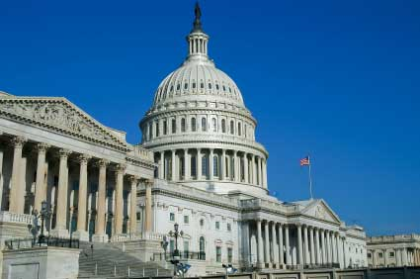
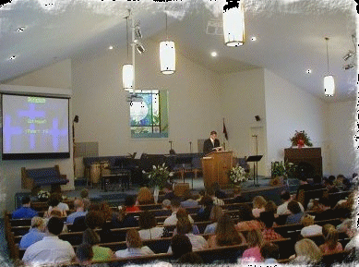
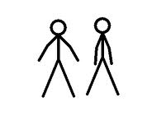

Slide 41
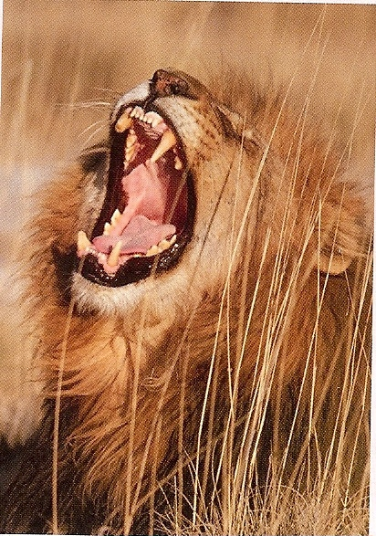
God (I Timothy 6:15)
Authority
(I Tim. 2:2)
Satan
(I Peter 5:6-8)
Submission
Protection
Blessing
Rebellion
Destruction
Cursing
FOOL

Slide 42
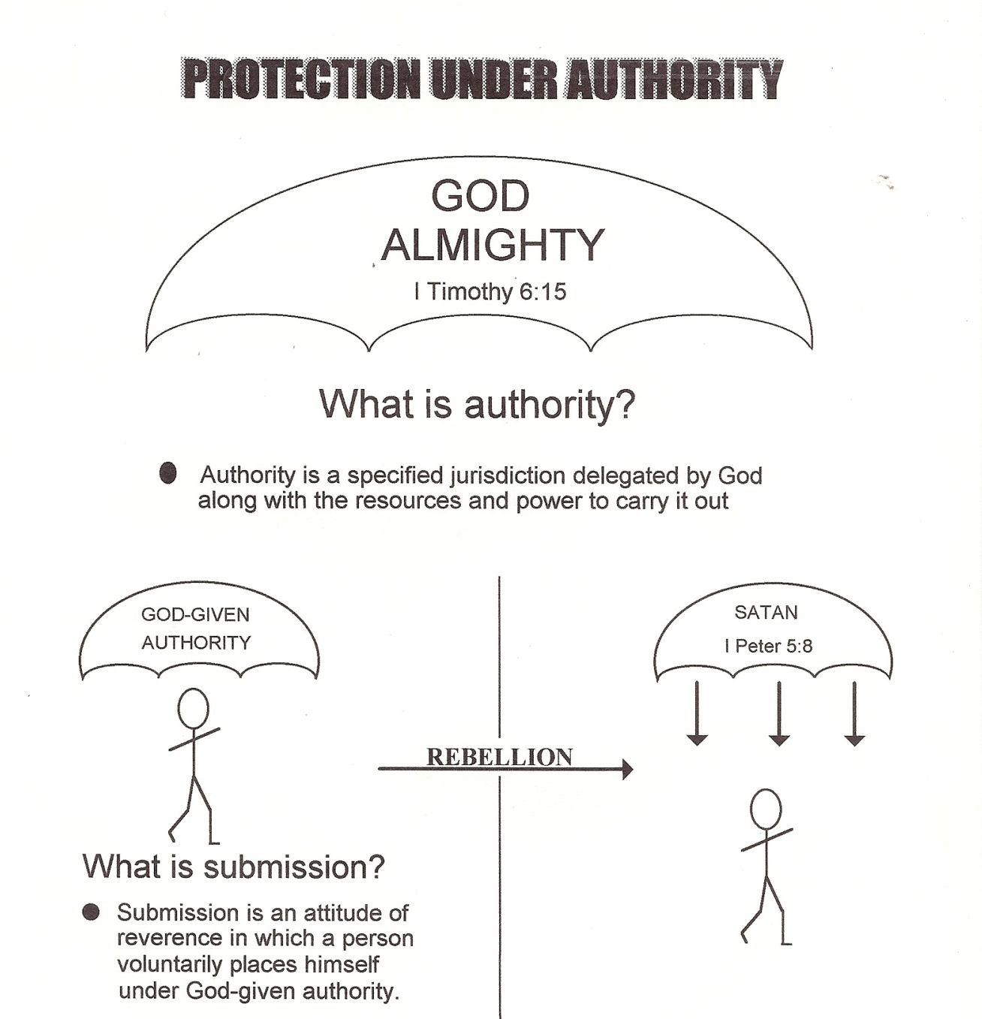

Slide 43
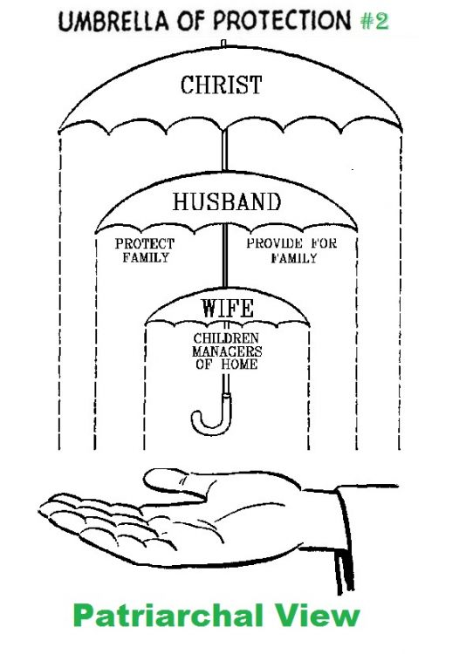
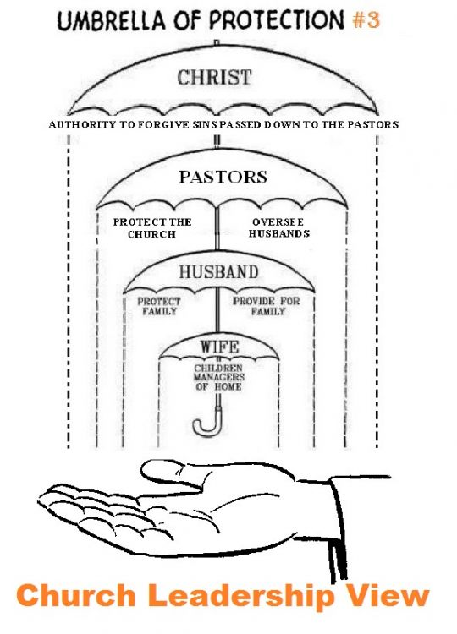

Slide 44
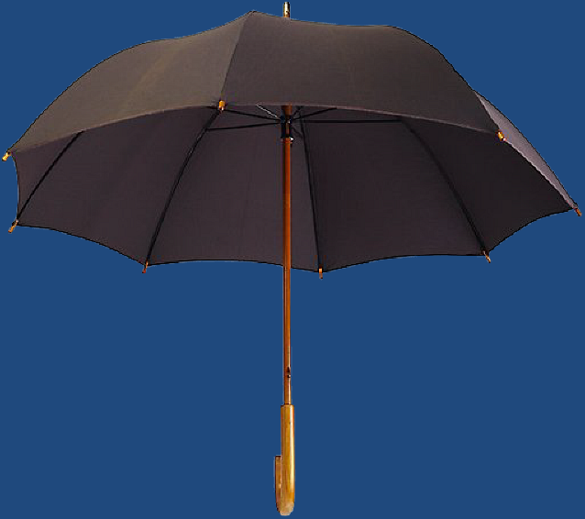
God Almighty
(I Timothy 6:15)
Satan
Destruction (John 10:10)
God Given
Authority
(Romans 13:1)
“Be sober, be vigilant; because your adversary the devil, as a roaring lion,
walketh about, seeking whom he may devour.” (I Peter 5:8)
I Corinthians 11:3
Colossians 3:18

Slide 45
God Almighty
(I Timothy 6:15)
Satan
Destruction (John 10:10)
God Given
Authority
(Romans 13:1)
“Be sober, be vigilant; because your adversary the devil, as a roaring lion,
walketh about, seeking whom he may devour.” (I Peter 5:8)
I Timothy 5:17
Hebrews 13:7, 17

Slide 46
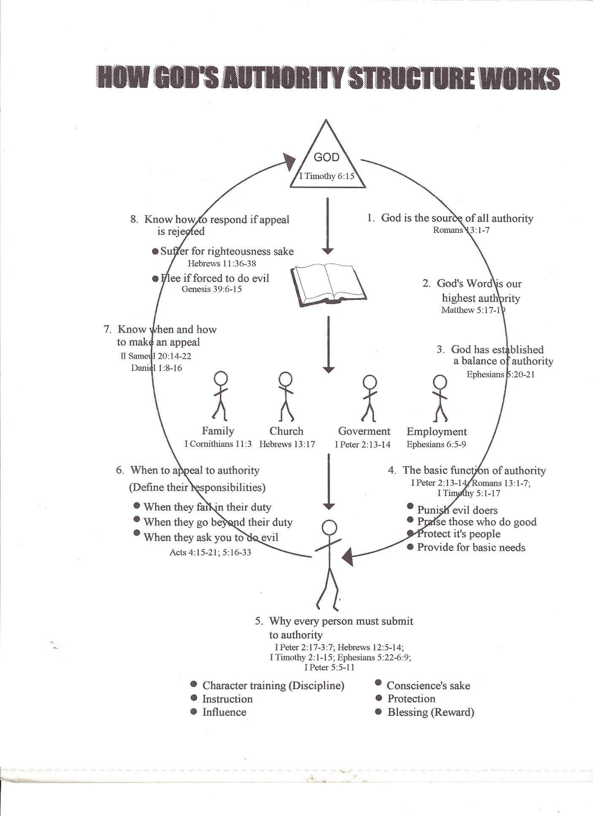

Slide 47
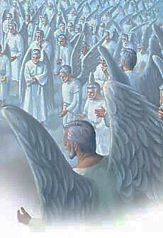
Summary The Bible attributes a number of names and titles to angels. Each of their names and titles helps us to better understand their ministries and attributes. It is interesting to note just how many different descriptions the Bible gives of angels - obviously they are all under authority and very busy in carrying out God's plan of the ages.

