Slide 3
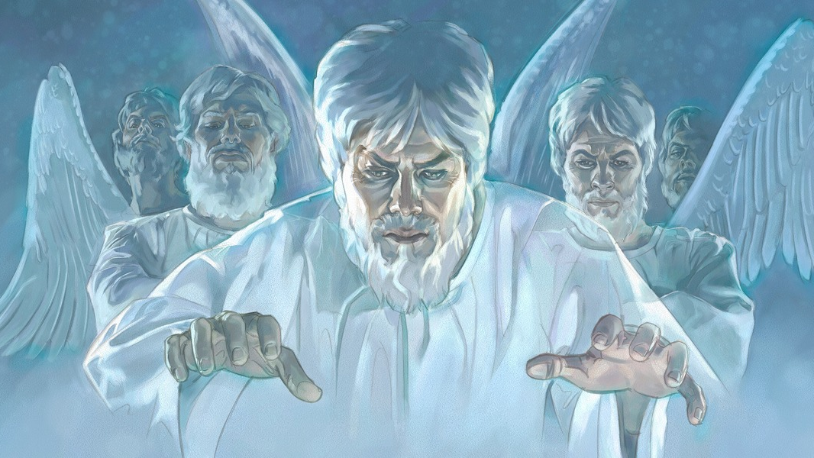
Evil Angels

Slide 4
“Nay, in all these things we are more than conquerors through him that loved us. For I am persuaded, that neither death, nor life, nor angels, nor principalities, nor powers, nor things present, nor things to come, Nor height, nor depth, nor any other creature, shall be able to separate us from the love of God, which is in Christ Jesus our Lord.” (Romans 8:37-39)

Slide 5
“Nay, in all these things we are more than conquerors through him that loved us. For I am persuaded, that neither death, nor life, nor angels, nor principalities, nor powers, nor things present, nor things to come, Nor height, nor depth, nor any other creature, shall be able to separate us from the love of God, which is in Christ Jesus our Lord.” (Romans 8:37-39)
“And there was war in heaven: Michael and his angels fought against the dragon; and the dragon fought and his angels.” (Revelation 12:7)

Slide 6
“Nay, in all these things we are more than conquerors through him that loved us. For I am persuaded, that neither death, nor life, nor angels, nor principalities, nor powers, nor things present, nor things to come, Nor height, nor depth, nor any other creature, shall be able to separate us from the love of God, which is in Christ Jesus our Lord.” (Romans 8:37-39)
“And the great dragon was cast out, that old serpent, called the Devil, and Satan, which deceiveth the whole world: he was cast out into the earth, and his angels were cast out with him.” (Revelation 12:9)

Slide 7
What have we learned last week?
Satan is a fallen angel
Devils/Demons are fallen angel
Fallen Angels have names
Fallen Angels can speak
Fallen Angels are highly intelligent
Fallen Angels are able to formulate a systematic Satanic centered system of theology
Fallen Angels possess great ability and strength

Slide 9
The Activities of Fallen Angels
“When the unclean spirit is gone out of a man, he walketh through dry places, seeking rest, and findeth none. Then he saith, I will return into my house from whence I came out; and when he is come, he findeth it empty, swept, and garnished. Then goeth he, and taketh with himself seven other spirits more wicked than himself, and they enter in and dwell there: and the last state of that man is worse than the first. Even so shall it be also unto this wicked generation” (Matthew 12:43-45)

Slide 10
“For if after they have escaped the pollutions of the world through the knowledge of the Lord and Saviour Jesus Christ, they are again entangled therein, and overcome, the latter end is worse with them than the beginning. For it had been better for them not to have known the way of righteousness, than, after they have known it, to turn from the holy commandment delivered unto them. But it is happened unto them according to the true proverb, The dog is turned to his own vomit again; and the sow that was washed to her wallowing in the mire.” (2 Peter 2:20-22)

Slide 11
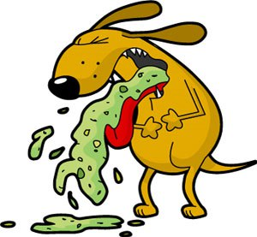
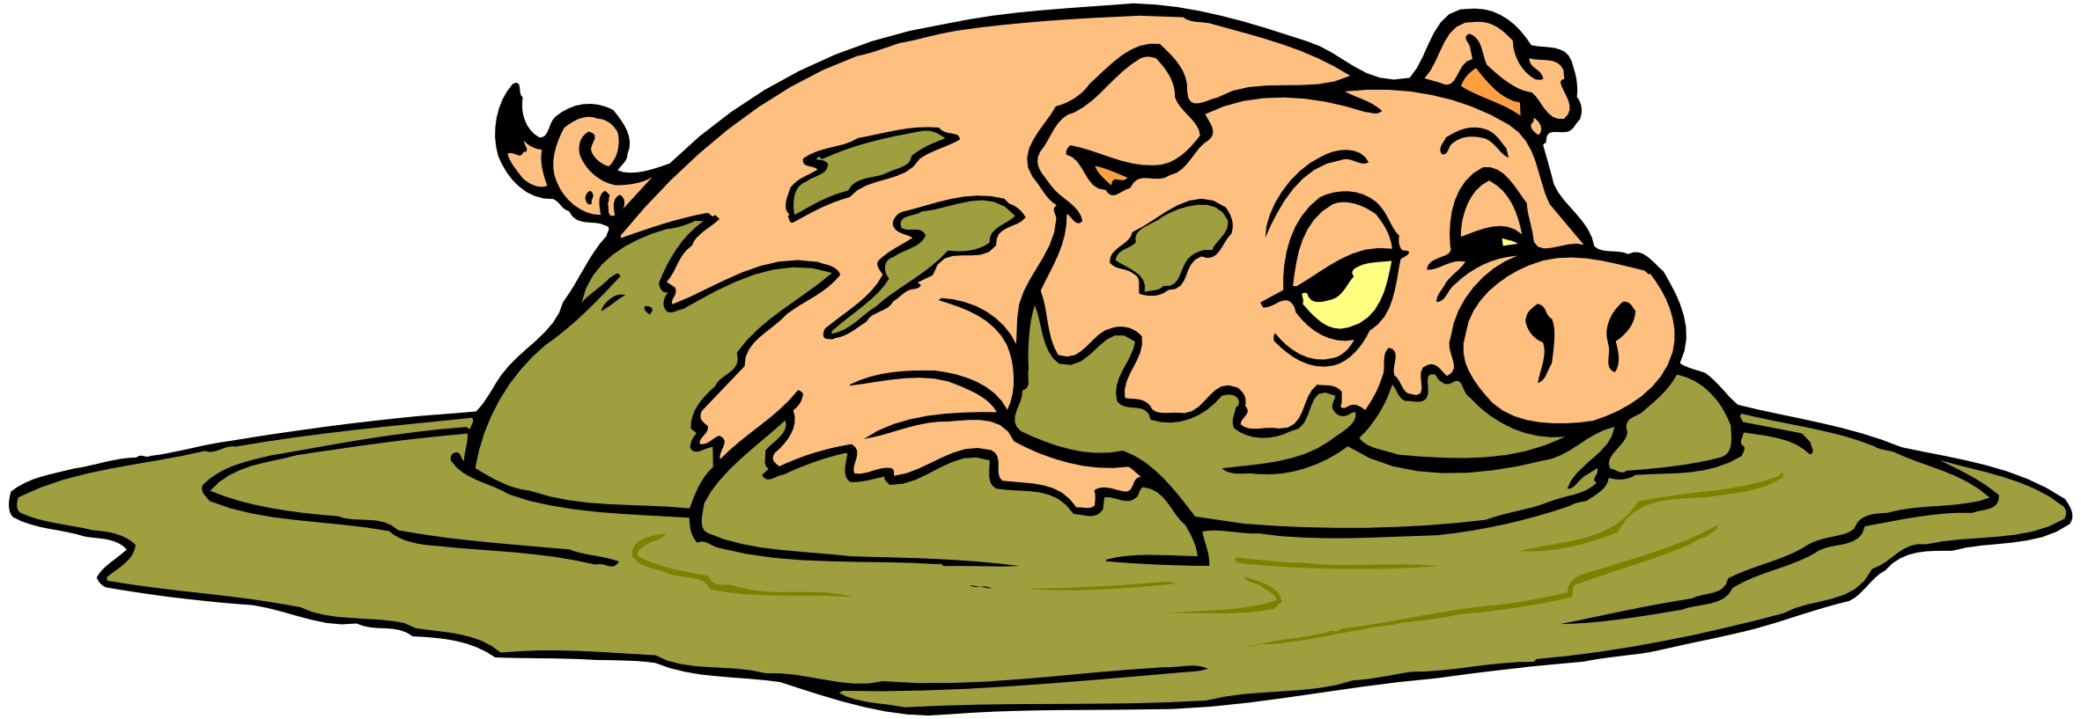

Slide 12
Fallen Angels oppose God’s purpose
“Put on the whole armour of God, that ye may be able to stand against the wiles of the devil. For we wrestle not against flesh and blood, but against principalities, against powers, against the rulers of the darkness of this world, against spiritual wickedness in high places.” (Ephesians 6:11-12)

Slide 13
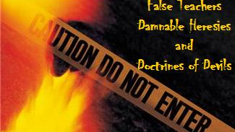
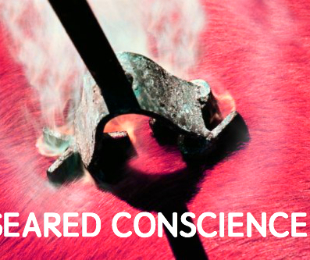
Fallen Angels execute Satan’s program
“Now the Spirit speaketh expressly, that in the latter times some shall depart from the faith, giving heed to seducing spirits, and doctrines of devils; Speaking lies in hypocrisy; having their conscience seared with a hot iron.” (1 Timothy 4:1-2)

Slide 14
Fallen Angels disseminate false doctrine
“Now we beseech you, brethren, by the coming of our Lord Jesus Christ, and by our gathering together unto him, That ye be not soon shaken in mind, or be troubled, neither by spirit, nor by word, nor by letter as from us, as that the day of Christ is at hand. Let no man deceive you by any means: for that day shall not come, except there come a falling away first, and that man of sin be revealed, the son of perdition.” (2 Thessalonians 2:1-3)

Slide 16
“That we henceforth be no more children, tossed to and fro, and carried about with every wind of doctrine, by the sleight of men, and cunning craftiness, whereby they lie in wait to deceive; But speaking the truth in love, may grow up into him in all things, which is the head, even Christ.” (Ephesians 4:13-15)
“Holding fast the faithful word as he hath been taught, that he may be able by sound doctrine both to exhort and to convince the gainsayers.” (Titus 1:9)
“But speak thou the things which become sound doctrine: In all things shewing thyself a pattern of good works: in doctrine shewing uncorruptness, gravity, sincerity.” (Titus 2:1,7)

Slide 18
“If thou put the brethren in remembrance of these things, thou shalt be a good minister of Jesus Christ, nourished up in the words of faith and of good doctrine, whereunto thou hast attained.” (1 Timothy 4:6)
“But there were false prophets also among the people, even as there shall be false teachers among you, who privily shall bring in damnable heresies, even denying the Lord that bought them, and bring upon themselves swift destruction. And many shall follow their pernicious ways; by reason of whom the way of truth shall be evil spoken of. And through covetousness shall they with feigned words make merchandise of you: whose judgment now of a long time lingereth not, and their damnation slumbereth not.” (2 Peter 2:1-3)

Slide 19
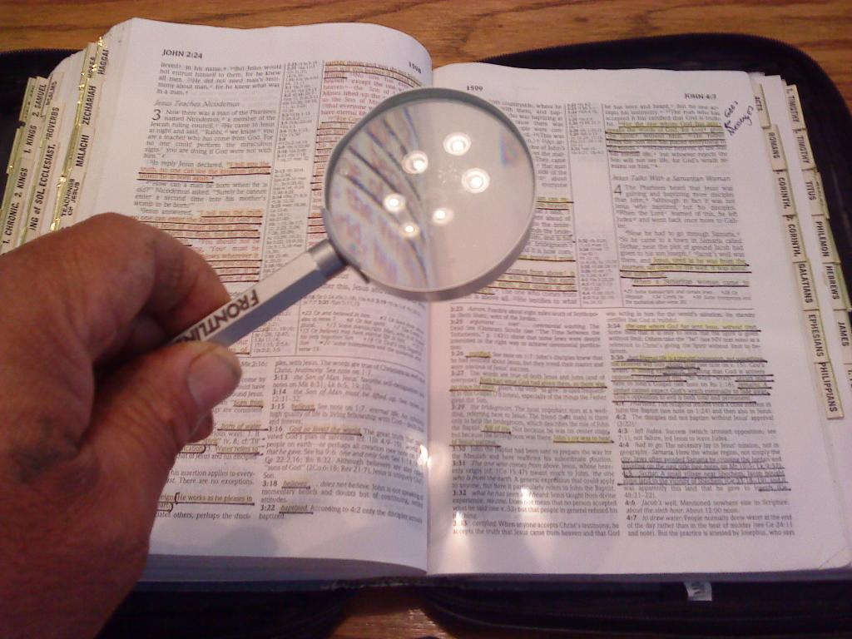
“These were more noble than those in Thessalonica, in that they received the word with all readiness of mind, and searched the scriptures daily, whether those things were so.” (Acts 17:11)

Slide 20
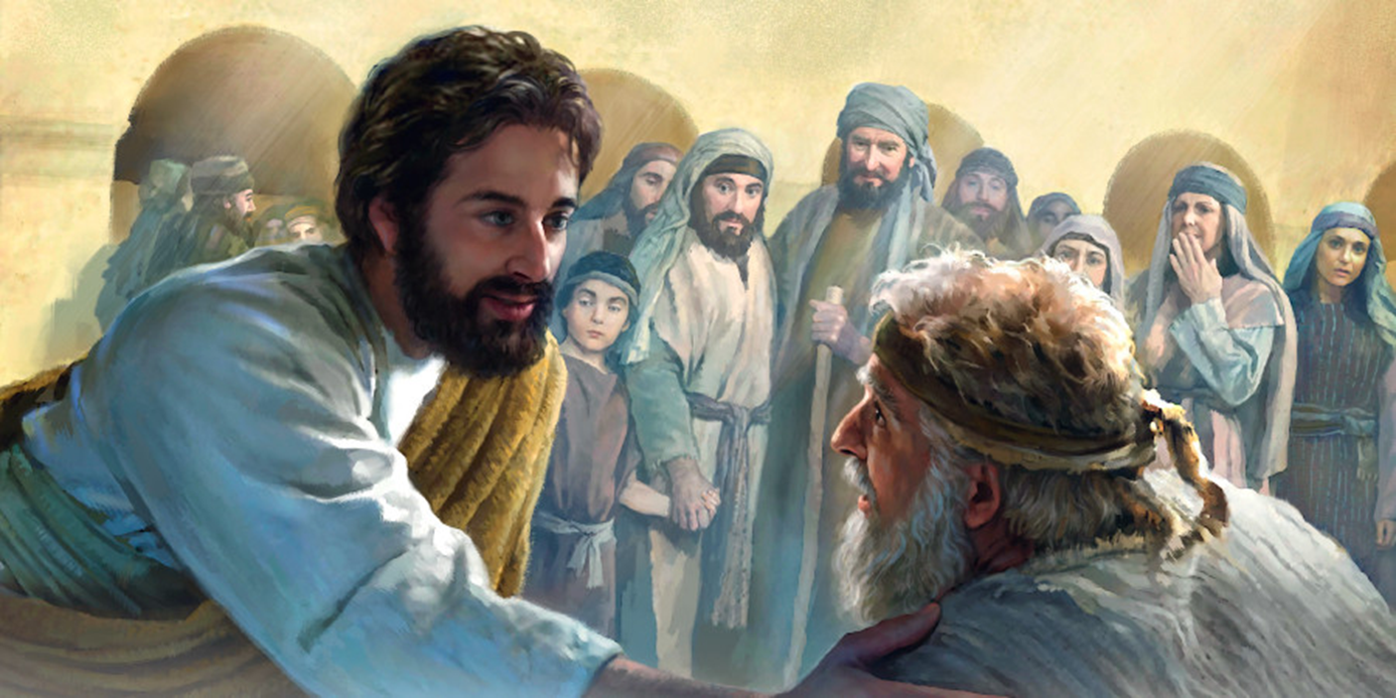
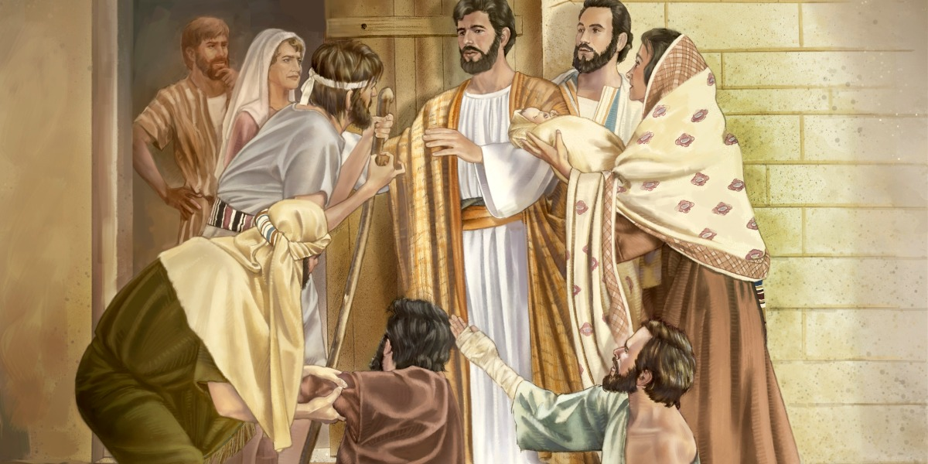
Fallen Angels can afflict human beings in many different ways
“And his fame went throughout all Syria: and they brought unto him all sick people that were taken with divers diseases and torments, and those which were possessed with devils, and those which were lunatick, and those that had the palsy; and he healed them.” (Matt. 4:24)

Slide 21
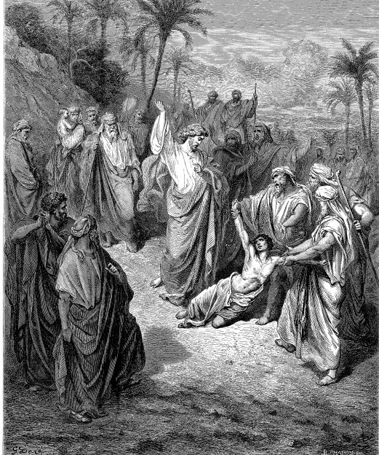
Fallen Angels can cause insanity
“And when they were come to the multitude, there came to him a certain man, kneeling down to him, and saying, Lord, have mercy on my son: for he is lunatic…And Jesus rebuked the devil; and he departed out of him: and the child was cured from that very hour.” (Matthew 17:14-15, 18)

Slide 22
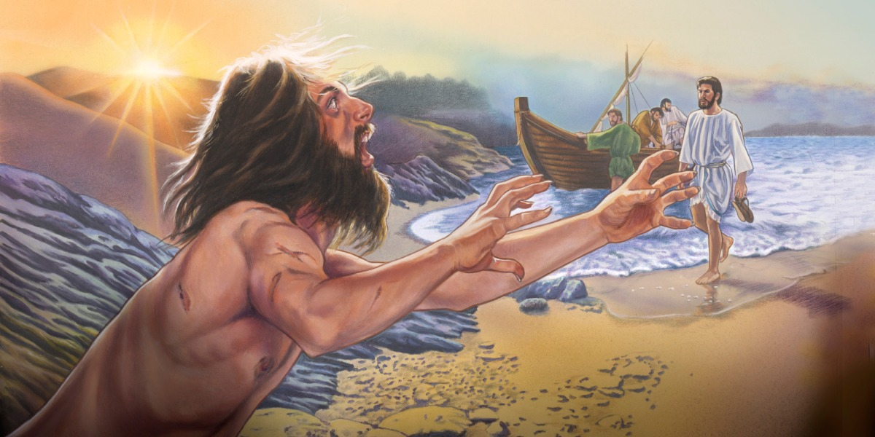
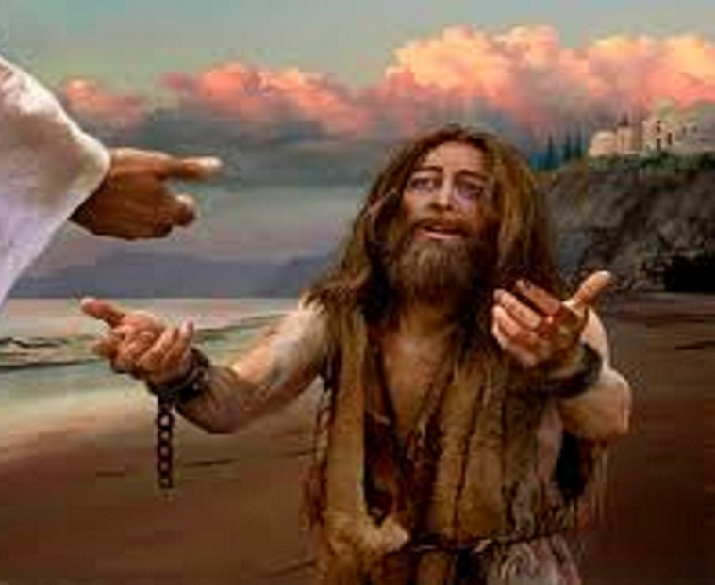
“And they come to Jesus, and see him that was possessed with the devil, and had the legion, sitting, and clothed, and in his right mind: and they were afraid.” (Mark 5:15)

Slide 23
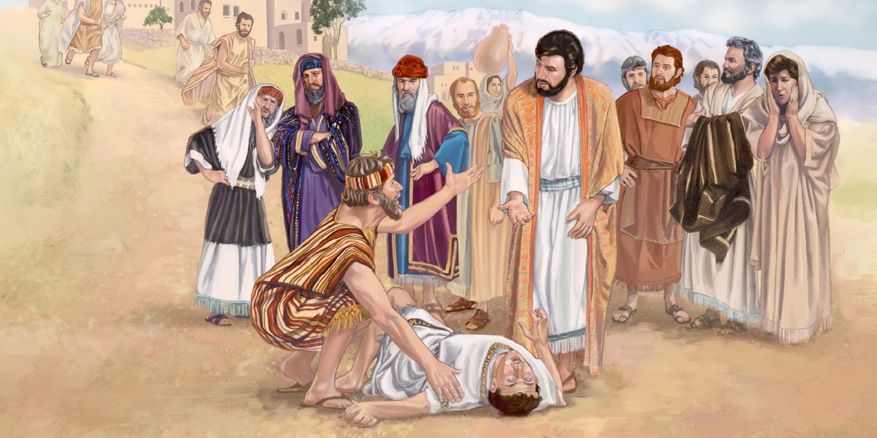
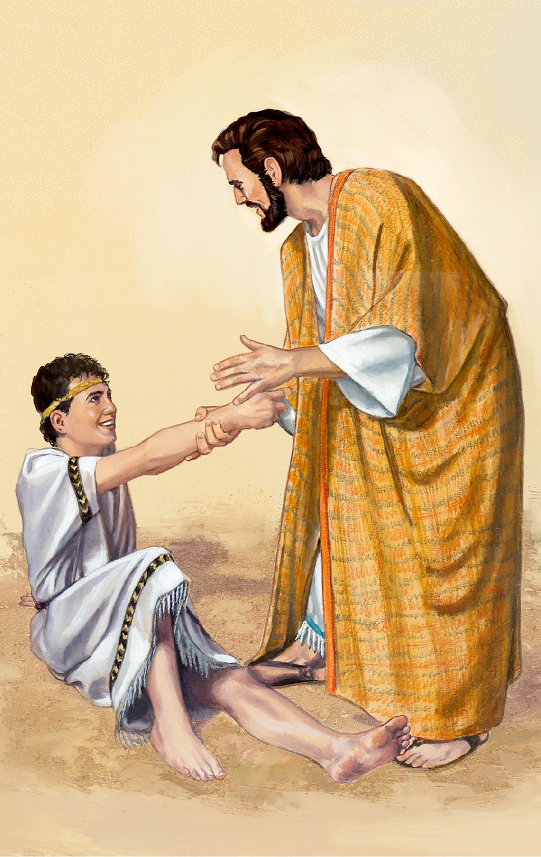
Fallen Angels can cause suicidal tendencies
“Lord, have mercy on my son: for he is lunatick, and sore vexed: for ofttimes he falleth into the fire, and oft into the water.”
“And Jesus rebuked the devil; and he departed out of him: and the child was cured from that very hour.” (Matthew 17:15, 18)

Slide 24
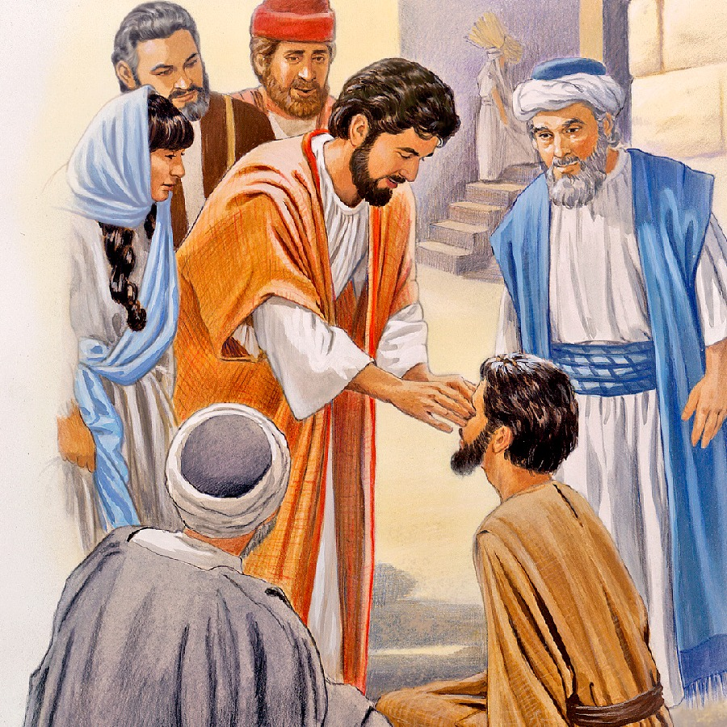
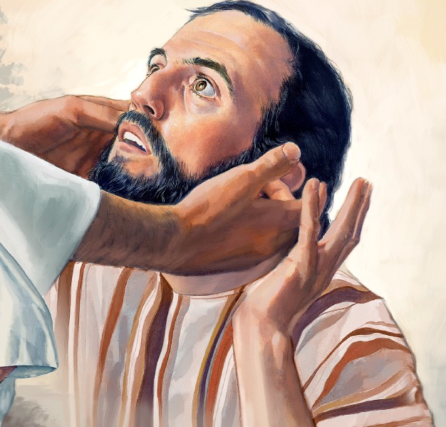
Fallen Angels can cause blindness and deafness

Slide 25
Matthew 12:22-32 ²² Then was brought unto him one possessed with a devil, blind, and dumb: and he healed him, insomuch that the blind and dumb both spake and saw. ²³ And all the people were amazed, and said, Is not this the son of David? ²⁴ But when the Pharisees heard it, they said, This fellow doth not cast out devils, but by Beelzebub the prince of the devils. ²⁵ And Jesus knew their thoughts, and said unto them, Every kingdom divided against itself is brought to desolation; and every city or house divided against itself shall not stand: ²⁶ And if Satan cast out Satan, he is divided against himself; how shall then his kingdom stand? ²⁷ And if I by Beelzebub cast out devils, by whom do your children cast them out? therefore they shall be your judges.

Slide 26
²⁸ But if I cast out devils by the Spirit of God, then the kingdom of God is come unto you. ²⁹ Or else how can one enter into a strong man's house, and spoil his goods, except he first bind the strong man? and then he will spoil his house. ³⁰ He that is not with me is against me; and he that gathereth not with me scattereth abroad. ³¹ Wherefore I say unto you, All manner of sin and blasphemy shall be forgiven unto men: but the blasphemy against the Holy Ghost shall not be forgiven unto men. ³² And whosoever speaketh a word against the Son of man, it shall be forgiven him: but whosoever speaketh against the Holy Ghost, it shall not be forgiven him, neither in this world, neither in the world to come.

Slide 27
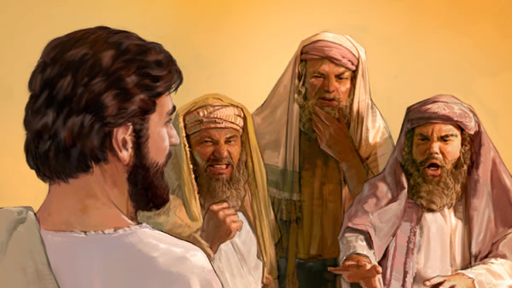

Slide 28
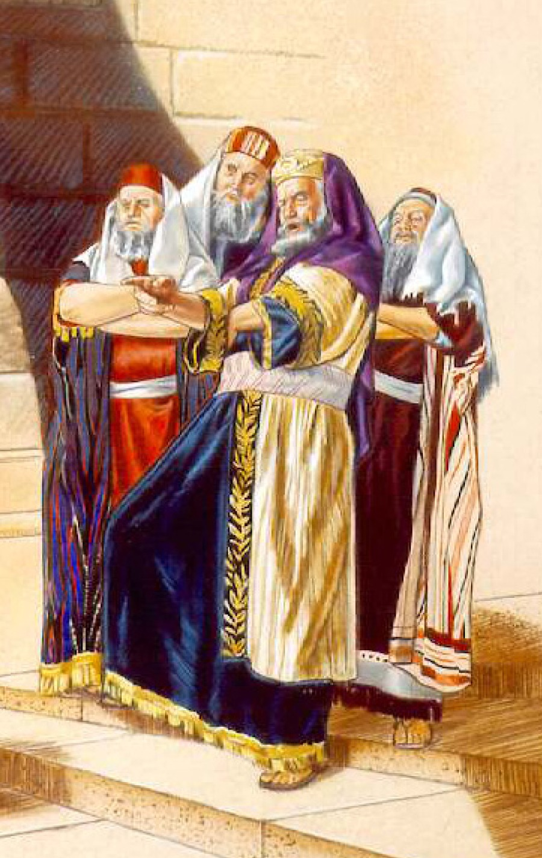
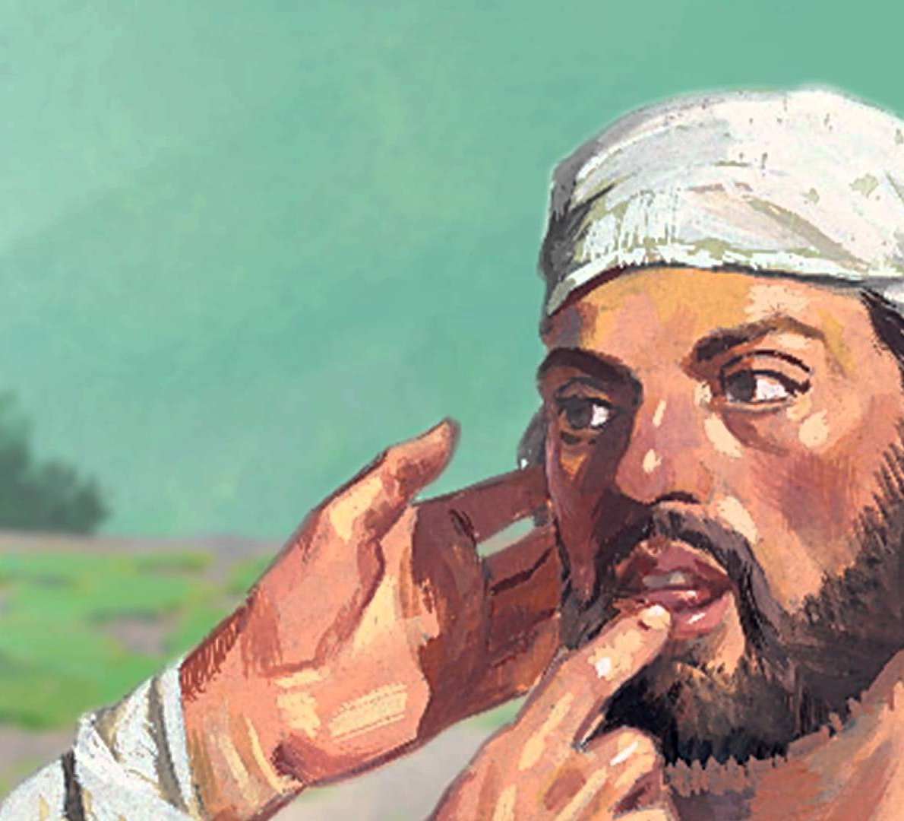
Fallen Angels can cause muteness
“As they went out, behold, they brought to him a dumb man possessed with a devil. And when the devil was cast out, the dumb spake: and the multitudes marvelled, saying, It was never so seen in Israel. But the Pharisees said, He casteth out devils through the prince of the devils.” (Matthew 9:32-34)

Slide 29
Fallen Angels can cause immorality
Matt. 10:1 “And when he had called unto him his twelve disciples, he gave them power against unclean spirits, to cast them out.”
Mark 3:11 “And unclean spirits, when they saw him, fell down before him, and cried, saying, Thou art the Son of God.”
Mark 5:13 “And forthwith Jesus gave them leave. And the unclean spirits went out, and entered into the swine.”
Luke 4:36 “And they were all amazed, and spake among themselves, saying, What a word is this! for with authority and power he commandeth the unclean spirits, and they come out.”
Luke 6:18 “And they that were vexed with unclean spirits: and they were healed.”
Acts 8:7 “For unclean spirits, crying with loud voice, came out of many that were possessed with them.”

Slide 30
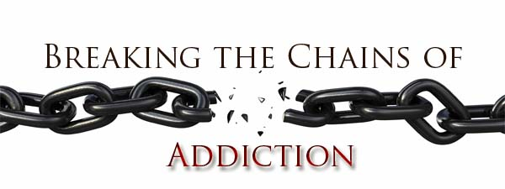
Word “Unclean” in the Greek = morally impure; lewd

Slide 32
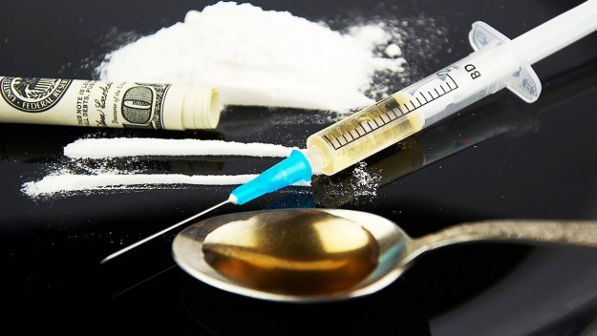
The connection between drugs, addiction and sorcery

Slide 33
The words "pharmacy" and "pharmaceutical" are derived from the Greek word, pharmakeia (Strong’s Concordance - pharmacy, magic, sorcery, sorcerers, witchcraft.)
This word is found in the Bible in the following passages of scripture –
(Galatians 5:19-21) “Now the works of the flesh are manifest, which are these; Adultery, fornication, uncleanness, lasciviousness, Idolatry, witchcraft (pharmakeia), hatred, variance, emulations, wrath, strife, seditions, heresies, Envyings, murders, drunkenness, revellings, and such like: of the which I tell you before, as I have also told you in time past, that they which do such things shall not inherit the kingdom of God.”
(Revelation 21:8) “But the fearful, and unbelieving, and the abominable, and murderers, and whoremongers, and sorcerers (pharmakos), and idolaters, and all liars, shall have their part in the lake which burneth with fire and brimstone: which is the second death.

Slide 34
Pharmakia “Primarily signified the use of medicine, drugs and spells.”

Slide 35
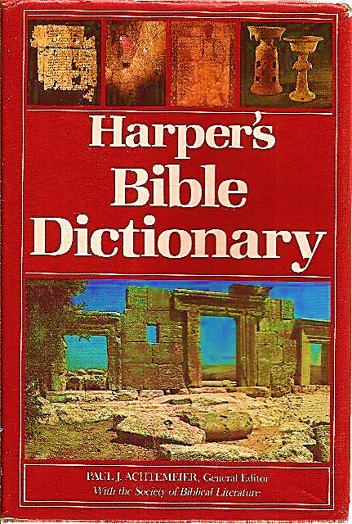
Sorcerers were skilled in the use of herbs, potions and drugs.

Slide 36
Opioid Epidemic in America
America leads the world in drug overdose deaths
America has about 4 percent of the world’s population — but about 27 percent of the world’s drug overdose deaths.
That’s one of the startling conclusions from a recent report by the United Nations Office on Drugs and Crime.

Slide 37
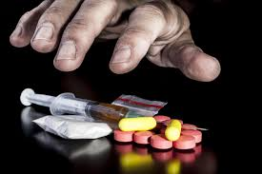
“The thief cometh not, but for to steal, and to kill, and to destroy: I am come that they might have life, and that they might have it more abundantly.” (John 10:10)

Slide 38
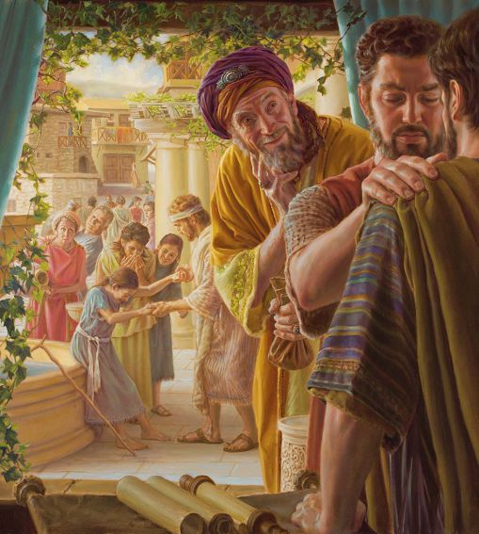
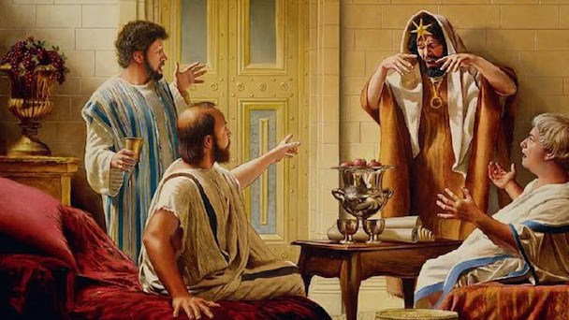
Two drug dealers in the Bible
Simon (Acts chapter 8)
Barjesus (Acts chapter 13)

Slide 39
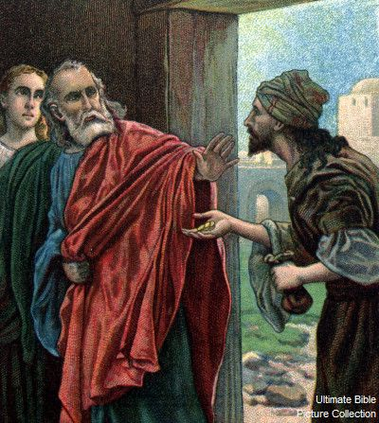
“But there was a certain man, called Simon, which beforetime in the same city used sorcery, and bewitched the people of Samaria, giving out that himself was some great one: To whom they all gave heed, from the least to the greatest, saying, This man is the great power of God. And to him they had regard, because that of long time he had bewitched them with sorceries…And when Simon saw that through laying on of the apostles' hands the Holy Ghost was given, he offered them money, Saying, Give me also this power, that on whomsoever I lay hands, he may receive the Holy Ghost. But Peter said unto him, Thy money perish with thee, because thou hast thought that the gift of God may be purchased with money. Thou hast neither part nor lot in this matter: for thy heart is not right in the sight of God. Repent therefore of this thy wickedness, and pray God, if perhaps the thought of thine heart may be forgiven thee. For I perceive that thou art in the gall of bitterness, and in the bond of iniquity.”

Slide 40
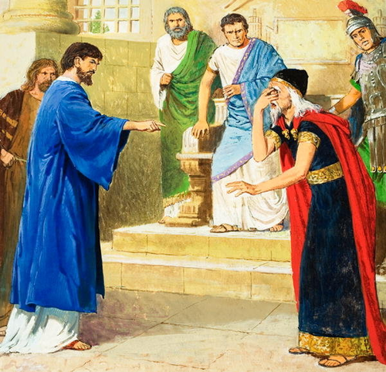
(Acts 13:6-12) “And when they had gone through the isle unto Paphos, they found a certain sorcerer, a false prophet, a Jew, whose name was Barjesus: Which was with the deputy of the country, Sergius Paulus, a prudent man; who called for Barnabas and Saul, and desired to hear the word of God. But Elymas the sorcerer (for so is his name by interpretation) withstood them, seeking to turn away the deputy from the faith. Then Saul, (who also is called Paul,) filled with the Holy Ghost, set his eyes on him, And said, O full of all subtilty and all mischief, thou child of the devil, thou enemy of all righteousness, wilt thou not cease to pervert the right ways of the Lord? And now, behold, the hand of the Lord is upon thee, and thou shalt be blind, not seeing the sun for a season. And immediately there fell on him a mist and a darkness; and he went about seeking some to lead him by the hand. Then the deputy, when he saw what was done, believed, being astonished at the doctrine of the Lord.”

Slide 41
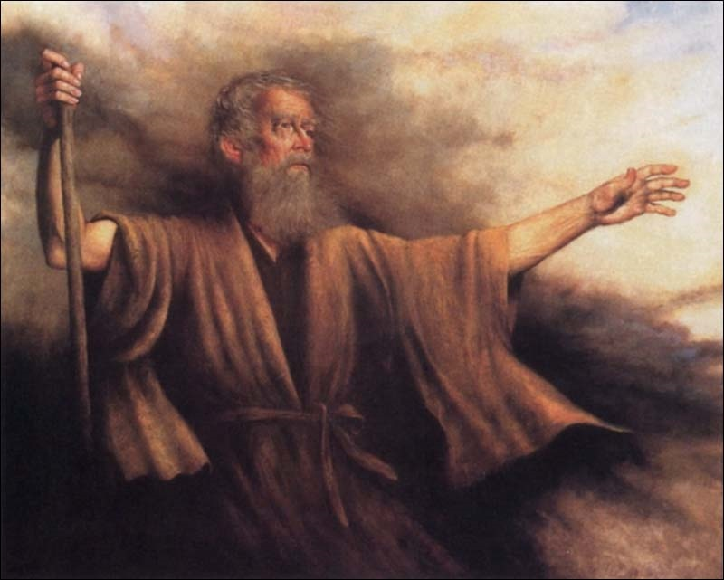
Biblical Warning Concerning Occult Involvement (Deuteronomy 18:9-13)
“When thou art come into the land which the LORD thy God giveth thee, thou shalt not learn to do after the abominations of those nations. There shall not be found among you any one that…For all that do these things are an abomination unto the LORD: and because of these abominations the LORD thy God doth drive them out from before thee. Thou shalt be perfect with the LORD thy God.”

Slide 42
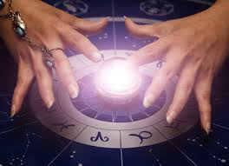
Magician: A person who PRODUCES baffling effects or illusions by sleight of hand - Exodus 9:11
Curious Arts: Sorcery - Acts 19:19
Snake Charmer - Luke 10:19
Astrologers: A person who professes to interpret or determine the supposed influence of the stars on human events - Daniel 1:20; 2:2, 10, 27

Slide 43
Pass THROUGH THE FIRE: The worship of Molech which involved human sacrifices - Deuteronomy 12:31
Divination: General term covering all types of magic, witchcraft and occult practices - Acts 19:18-20
OBSERVER of times: One who interprets natural events of nature - Leviticus 19:26
Enchanter: One who interprets omens (Omens = sign oR indication of some future events: Tarot cards, fortune telling, palming, etc.) - Jeremiah 27:9
Enchantments: The art of casting spells or the use of magic to charm; bringing a person under a spell - Numbers 23:23

Slide 44
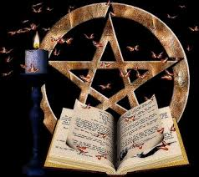
Witch: A woman who possess supernatural power by compact with the devil or evil spirits - Exodus 22:18
Witchcraft: The power or practice of witches; sorcery; black magic; bewitching - Micah 5:12
Charmer: One who uses the power of the devil to charm, deceive, subdue, or enchant another; The power of a charmer delights and attracts the affection of a person leading them into occult practices - Psalm 58:5

Slide 45
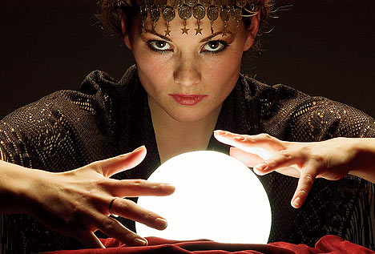
Consulter with FAMILIAR spirits: (Medium) - Leviticus 19:31
Wizard: (Spiritist) - Leviticus 20:6-7, A man who PRACTICES black magic; magician; sorcerer; one who RECEIVES his wisdom from the devil - I Samuel 28:3
Necromancer: A person who inquires and speaks with the dead - Deuteronomy 18:11
Soothsayer: A person who predicts or pretends to foretell the future - Numbers 23:23

Slide 47
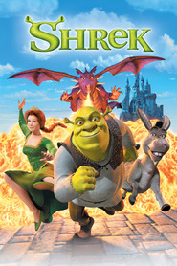
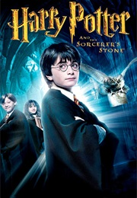
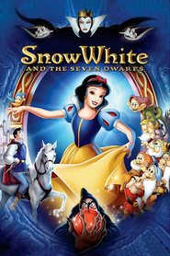

Slide 48
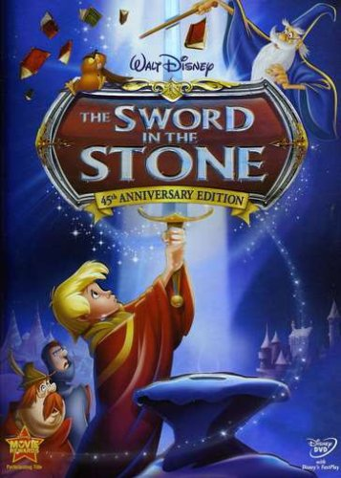

Slide 49
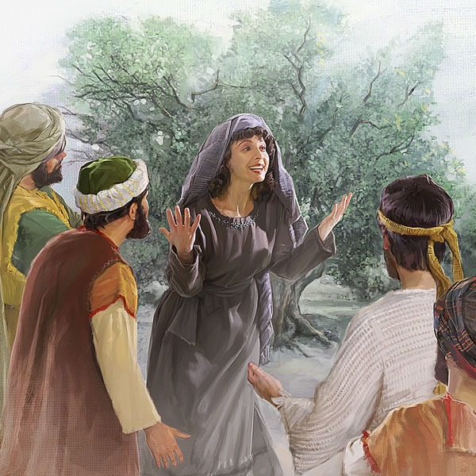
Fallen Angels can cause illness
“And certain women, which had been healed of evil spirits and infirmities, Mary called Magdalene, out of whom went seven devils.” (Luke 8:2)

Slide 50
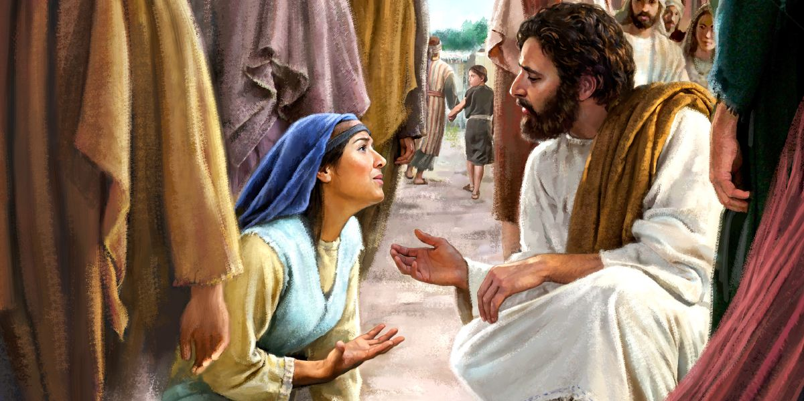

Slide 51
Luke 13:10-17 ¹⁰ And he was teaching in one of the synagogues on the sabbath. ¹¹ And, behold, there was a woman which had a spirit of infirmity eighteen years, and was bowed together, and could in no wise lift up herself. ¹² And when Jesus saw her, he called her to him, and said unto her, Woman, thou art loosed from thine infirmity. ¹³ And he laid his hands on her: and immediately she was made straight, and glorified God. ¹⁴ And the ruler of the synagogue answered with indignation, because that Jesus had healed on the sabbath day, and said unto the people, There are six days in which men ought to work: in them therefore come and be healed, and not on the sabbath day.

Slide 52
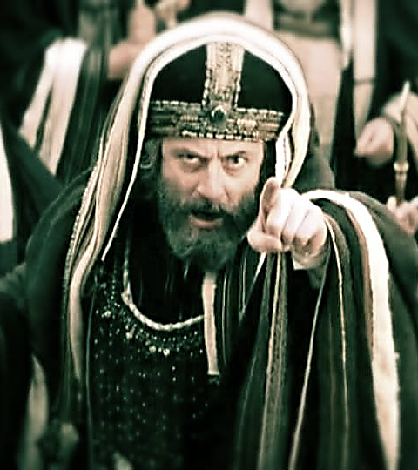
¹⁵ The Lord then answered him, and said, Thou hypocrite, doth not each one of you on the sabbath loose his ox or his ass from the stall, and lead him away to watering? ¹⁶ And ought not this woman, being a daughter of Abraham, whom Satan hath bound, lo, these eighteen years, be loosed from this bond on the sabbath day? ¹⁷ And when he had said these things, all his adversaries were ashamed: and all the people rejoiced for all the glorious things that were done by him.

Slide 53
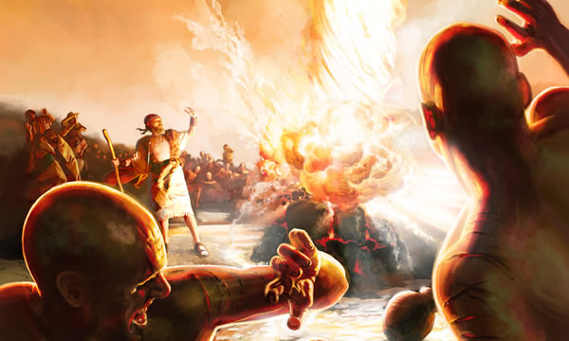
Fallen Angels can cause physical mutilation
“And they cried aloud, and cut themselves after their manner with knives and lancets, till the blood gushed out upon them.” (1 Kings 18:28)

Slide 54
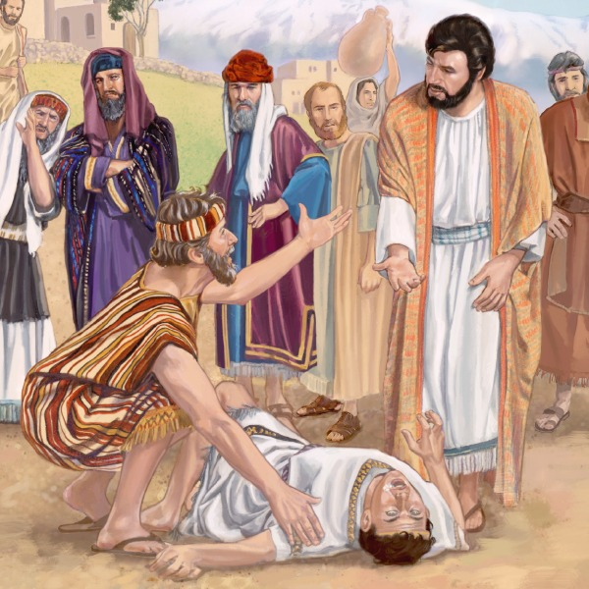
“And one of the multitude answered and said, Master, I have brought unto thee my son, which hath a dumb spirit; And wheresoever he taketh him, he teareth him: and he foameth, and gnasheth with his teeth, and pineth away: and I spake to thy disciples that they should cast him out; and they could not.” (Mark 9:17-18)

Slide 55
What have we learned so far?
Satan is a Fallen Angel
Devils/Demons are Fallen Angels
Fallen Angels have names
Fallen Angels can speak
Fallen Angels are highly intelligent
Fallen Angels are able to formulate a systematic Satanic centered system of theology
Fallen Angels possess great ability and strength

Slide 56
What have we learned so far?
Fallen Angels are very active in the world
Fallen Angels oppose God’s purpose
Fallen Angels can possess individuals
Fallen Angels execute Satan’s plan and program
Fallen Angels disseminate false doctrine
Fallen Angels can afflict human beings in many different ways
Fallen Angels can cause insanity
Fallen Angels can cause suicidal tendencies

Slide 57
What have we learned so far?
Fallen Angels can cause blindness and deafness
Fallen Angels can cause muteness
Fallen Angels can cause immorality
Fallen Angels can cause addiction
Fallen Angels can cause illness
Fallen Angels can cause physical self mutilation

Slide 58
“But thanks be to God, which giveth us the victory through our Lord Jesus Christ.” (1 Corinthians 15:57)

