Slide 1
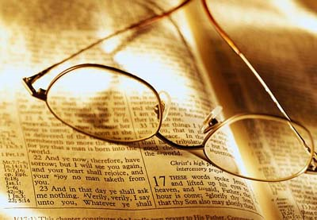
Why the Child of God Should Study Bible Doctrine?
“Give attendance to reading,
to exhortation, to doctrine…”
(I Tim. 4:13)

Slide 2
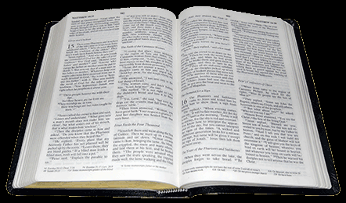
Most Christians know very little about the Bible and Bible Doctrine!

Slide 3
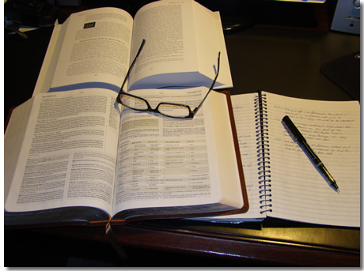
II Tim. 3:16 “All scripture is given by inspiration of God, and is profitable for doctrine, for reproof, for correction, for instruction in righteousness.”
Doctrine
Reproof
Correction
Instruction in righteousness

Slide 4
Reasons for Studying Biblical Doctrine

Slide 5
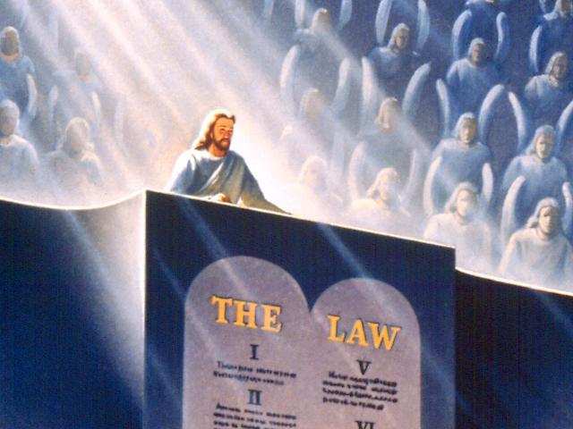
Because of its Author (II Tim.3:16)
God has written a book, and that profound and priceless book is the Bible.
The nicest thing one can say to an author is, "Oh, yes, I’ve read your book.“
The Judgment seat – Romans 14:10
Dear Jesus, I am so sorry that I did not take time to read your book.

Slide 6
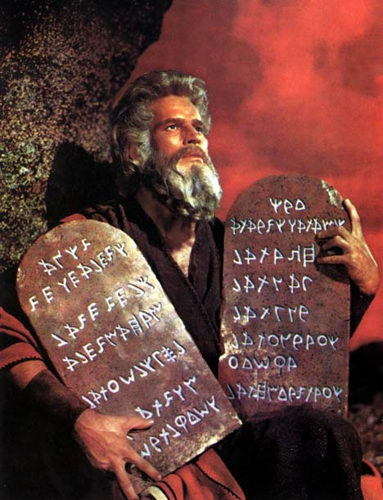
Because of the often repeated command to read it.
"This book of the law shall not depart out of thy mouth; but thou shalt meditate therein day and night, that thou mayest observe to do according to all that is written therein: for then thou shalt make thy way prosperous, and then thou shalt have good success." (Josh. 1:8)

Slide 7
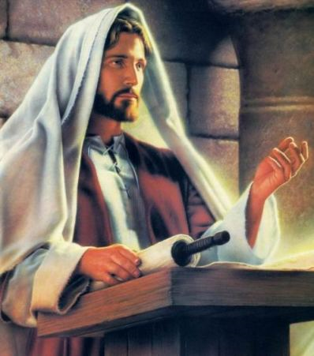
"But he answered and said, It is written, Man shall not live by bread alone, but by every word that proceedeth out of the mouth of God." (Matt. 4:4)

Slide 9
Because the Bible is God’s chosen way to discover His divine will (I Cor. 2:1-16)

Slide 10
Because sinners are saved through the message of the Bible
"For whosoever shall call upon the name of the Lord shall be saved. How then shall they call on him in whom they have not believed? and how shall they believe in him of whom they have not heard? and how shall they hear without a preacher? And how shall they preach, except they be sent? as it is written, How beautiful are the feet of them that preach the gospel of peace, and bring glad tidings of good things! But they have not all obeyed the gospel. For Esaias saith, Lord, who hath believed our report? So then faith cometh by hearing, and hearing by the word of God" (Rom. 10:13-17)

Slide 11
Because saints are sanctified through the message of the Bible
"Sanctify them through thy truth: thy word is truth." (John 17:17)
"As newborn babies, desire the sincere milk of the word, that ye may grow thereby.“ (I Pet. 2:2)
"Wherewithal shall a young man cleanse his way? by taking heed thereto according to thy word.” (Psalm 119:9)

Slide 12
"Every word of God is pure: he is a shield unto them that put their trust in him. Add thou not unto his words, lest he reprove thee, and thou be found a liar." (Prov. 30:5-6)
"If ye abide in me, and my words abide in you, ye shall ask what ye will, and it shall be done unto you." (John 15:7)
"And now, brethren, I commend you to God, and to the word of his grace, which is able to build you up, and to give you an inheritance among all them which are sanctified." (Acts 20:32)

Slide 13
Because our enemy the devil knows the Bible and uses the Bible
(Matthew 4)
Christ was tempted three times by the devil.
On each occasion the Savior answered Satan with the phrase, "It is written," and then proceeded to quote from the Word of God as found in the book of Deuteronomy.
The phrase "it is written" is repeated four times, and the fourth time it is the devil using it to quote Scripture to Christ.

Slide 14
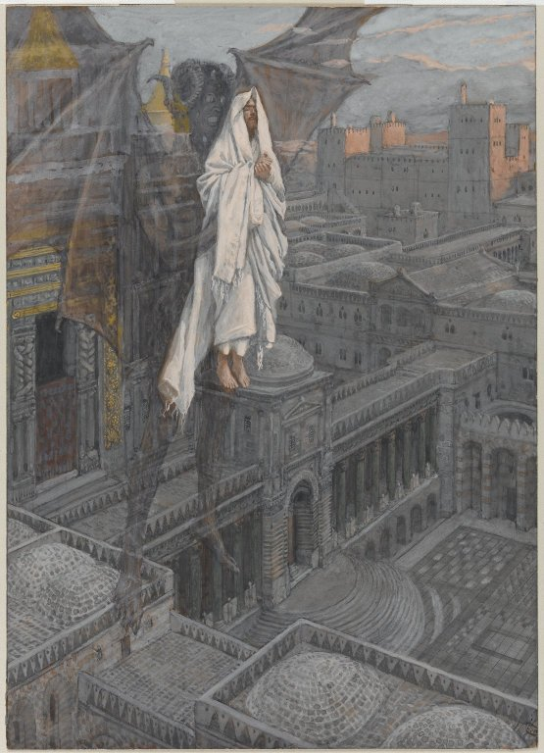
"Then the devil taketh him up into the holy city, and setteth him on a pinnacle of the temple, and saith unto him, If thou be the Son of God, cast thyself down: for it is written, He shall give his angels charge concerning thee: and in their hands they shall bear thee up, lest at any time thou dash thy foot against a stone."

Slide 15
Because Satan’s lies and temptations are resisted through the Word of God
I John 2:14 “I have written unto you, fathers, because ye have known him that is from the beginning. I have written unto you, young men, because ye are strong, and the word of God abideth in you, and ye have overcome the wicked one.”
Eph 6:11 “Put on the whole armour of God, that ye may be able to stand against the wiles of the devil.”

Slide 17
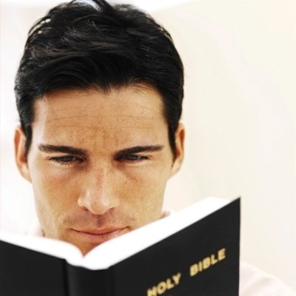

Slide 18
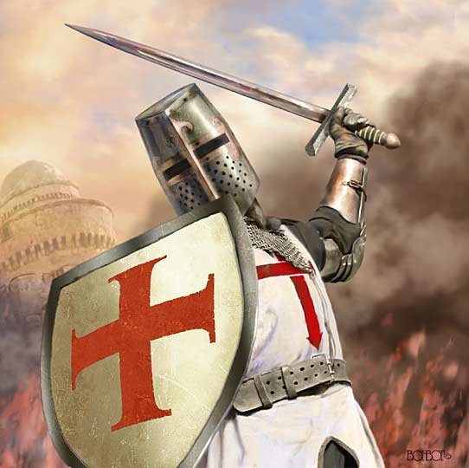

Slide 19
Because of the example of the Apostle Paul
Paul was probably the greatest Christian that ever lived.
His spiritual accomplishments are nothing short of staggering.
Here was a man who made the first three missionary journeys.
Founded and pastored the first fifty or more churches.
Wrote over half of the New Testament.
On five occasions saw the resurrected Christ.
Once was actually caught up into the third heaven itself!

Slide 20
When he was arrested, condemned to death, and placed in prison his final words to Timothy just prior to his execution were –
"For I am now ready to be offered, and the time of my departure is at hand. I have fought a good fight, I have finished my course, I have kept the faith: Henceforth there is laid up for me a crown of righteousness, which the Lord, the righteous judge, shall give me at that day: and not to me only, but unto all them also that love his appearing. The cloak that I left at Troas with Carpus, when thou comest, bring with thee, and the books, but especially the parchments." (II Tim. 4:6-8)

Slide 21
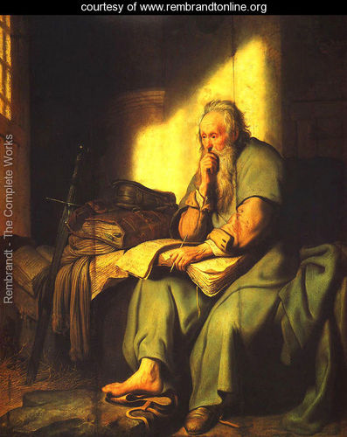
What were the parchments?
They were his copies of the Old Testament scrolls.
The point to be made here is that old apostle still felt he could profit from studying the Word of God on the eve of his death.

Slide 22
Because it keeps the believer from being tossed to and fro
“And he gave some, apostles; and some, prophets; and some, evangelists; and some, pastors and teachers; For the perfecting of the saints, for the work of the ministry, for the edifying of the body of Christ: Till we all come in the unity of the faith, and of the knowledge of the Son of God, unto a perfect man, unto the measure of the stature of the fullness of Christ: That we henceforth be no more children, tossed to and fro, and carried about with every wind of doctrine, by the sleight of men, and cunning craftiness, whereby they lie in wait to deceive; But speaking the truth in love, may grow up into him in all things, which is the head, even Christ.”
(Ephesians 4:11-15)

Slide 23
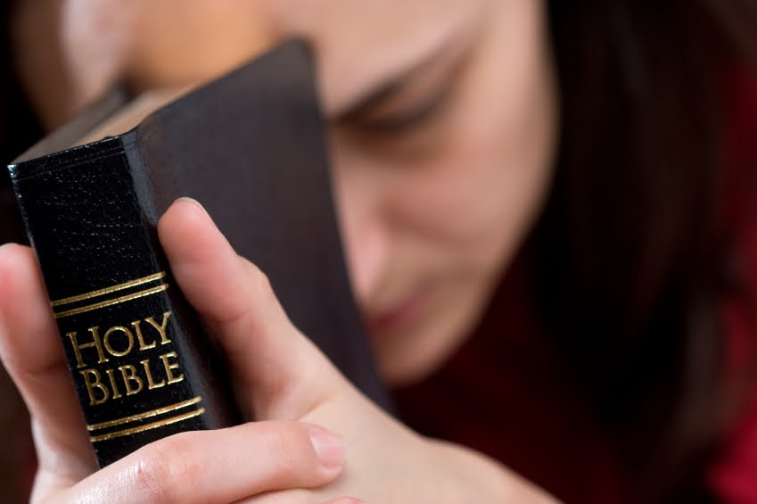
Because it produces spiritually mature believers
I Tim. 4:6 “If thou put the brethren in remembrance of these things, thou shalt be a good minister of Jesus Christ, nourished up in the words of faith and of good doctrine, whereunto thou hast attained.”
I Peter 3:15 “But sanctify the Lord God in your hearts: and be ready always to give an answer to every man that asketh you a reason of the hope that is in you.”

Slide 24
“ For when for the time ye ought to be teachers, ye have need that one teach you again which be the first principles of the oracles of God; and are become such as have need of milk, and not of strong meat. For every one that useth milk is unskilful in the word of righteousness: for he is a babe. But strong meat belongeth to them that are of full age, even those who by reason of use have their senses exercised to discern
both good and evil.”
(Hebrews 5:12-14)

Slide 25
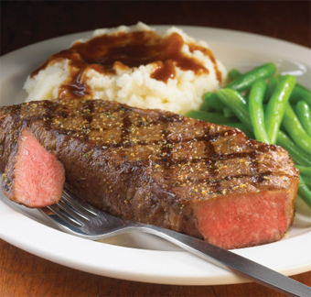
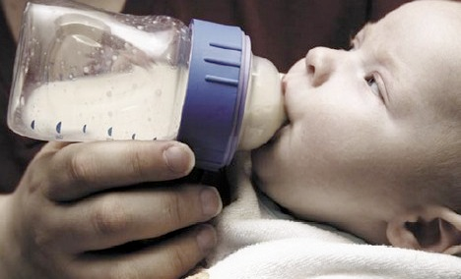

Slide 26
Because it produces unity in the Church
Phil. 3:16 “Nevertheless, whereto we have already attained, let us walk by the same rule, let us mind the same thing.”
I Cor. 1:10 “Now I beseech you, brethren, by the name of our Lord Jesus Christ, that ye all speak the same thing, and that there be no divisions among you; but that ye be perfectly joined together in the same mind and in the same judgment.”
Amos 3:3 “Can two walk together, except they be agreed?”

Slide 28
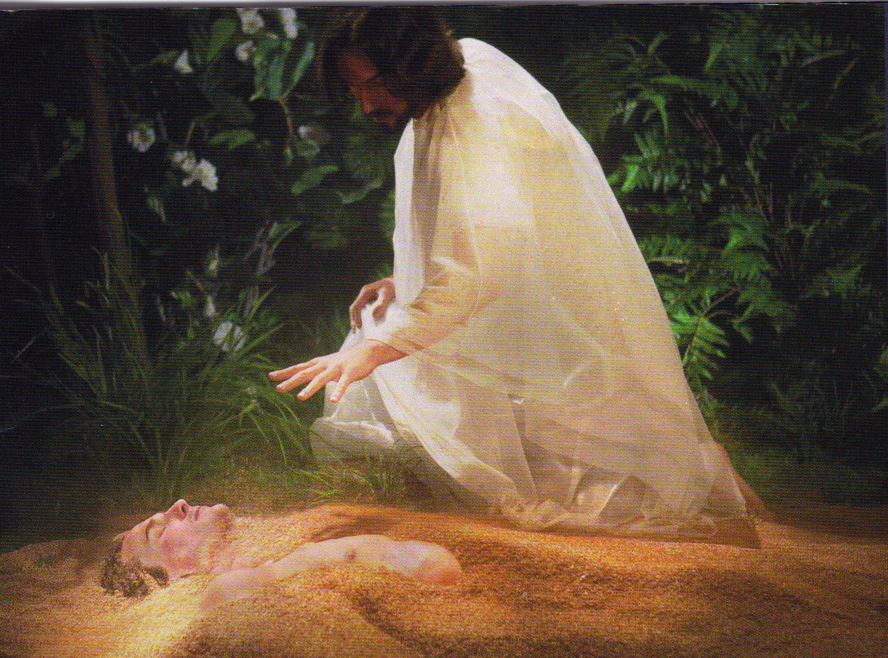
Because the Bible alone provides answers to life’s three most important questions
1. Where did I come from?
"And God said, Let us make man in our image, after our likeness: and let them have dominion over the fish of the sea, and over the fowl of the air, and over the cattle, and over all the earth, and over every creeping thing that creepeth upon the earth. So God created man in his own image, in the image of God created he him; male and female created he them" (Gen. 1:26, 27).
"Know ye that the Lord he is God: it is he that hath made us, and not we ourselves; we are his people, and the sheep of his pasture" (Ps. 100:3).

Slide 29
2. Why am I here?
"Let us hear the conclusion of the whole matter: Fear God, and keep his commandments: for this is the whole duty of man." (Eccl. 12:13)
"Thou are worthy, O Lord, to receive glory and honour and power: for thou hast created all things, and for thy pleasure they are and were created." (Rev. 4:11)

Slide 30
3. Where am I going?
"For God so loved the world, that he gave his only begotten Son, that whosoever believeth in him should not perish, but have everlasting life. For God sent not his Son into the world to condemn the world; but that the world through him might be saved. He that believeth on him is not condemned: but he that believeth not is condemned already, because he hath not believed in the name of the only begotten Son of God." (John 3:16-18)

Slide 31
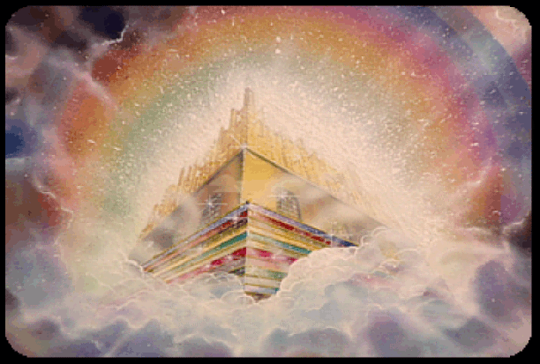
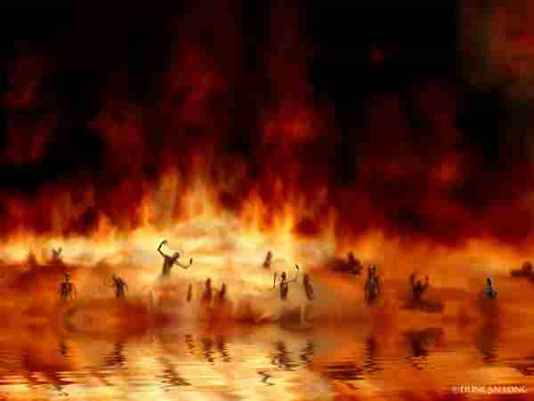
"The Lord is my shepherd; I shall not want. Surely goodness and mercy shall follow me all the days of my life: and I will dwell in the house of the Lord for ever." (Psalm 23:1, 6)
"And whosoever was not found written in the book of life was cast into the lake of fire." (Rev. 20:15)

Slide 32
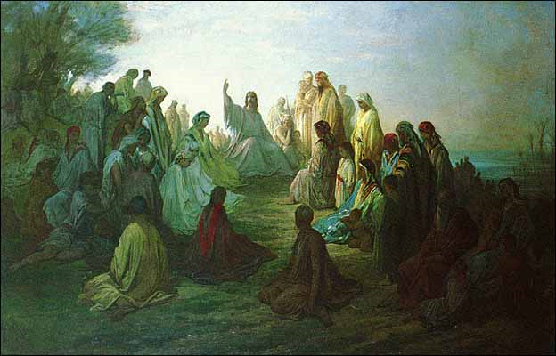
Mark 1:22 “And they were astonished at his doctrine: for he taught them as one that had authority, and not as the scribes.”
Mark 11:18 “And the scribes and chief priests heard it, and sought how they might destroy him: for they feared him, because all the people was astonished at his doctrine”
John 7:16 “Jesus answered them, and said, My doctrine is not mine, but his that sent me.”
Matt. 16:12 “Then understood they how that he bade them not beware of the leaven of bread, but of the doctrine of the Pharisees and of the Sadducees.”

Slide 33
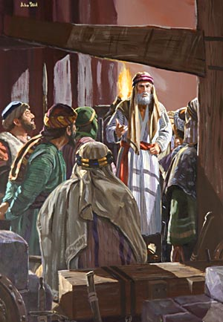
“And they (early church) continued stedfastly in the apostles' doctrine and fellowship, and in breaking of bread, and in prayers”
(Acts 2:42)

Slide 34
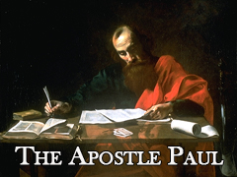
“Now I beseech you, brethren, mark them which cause divisions and offences contrary to the doctrine which ye have learned; and avoid them.” (Romans 16:17)

Slide 35
I Tim. 4:13 “Till I come, give attendance to reading, to exhortation, to doctrine.”
I Tim. 4:16 “Take heed unto thyself, and unto the doctrine; continue in them: for in doing this thou shalt both save thyself, and them that hear thee”
I Tim. 5:17 “Let the elders that rule well be counted worthy of double honour, especially they who labour in the word and doctrine.”
II Tim. 4:2-3 “Preach the word; be instant in season, out of season; reprove, rebuke, exhort with all longsuffering and doctrine. For the time will come when they will not endure sound doctrine; but after their own lusts shall they heap to themselves teachers, having itching ears.”

Slide 36
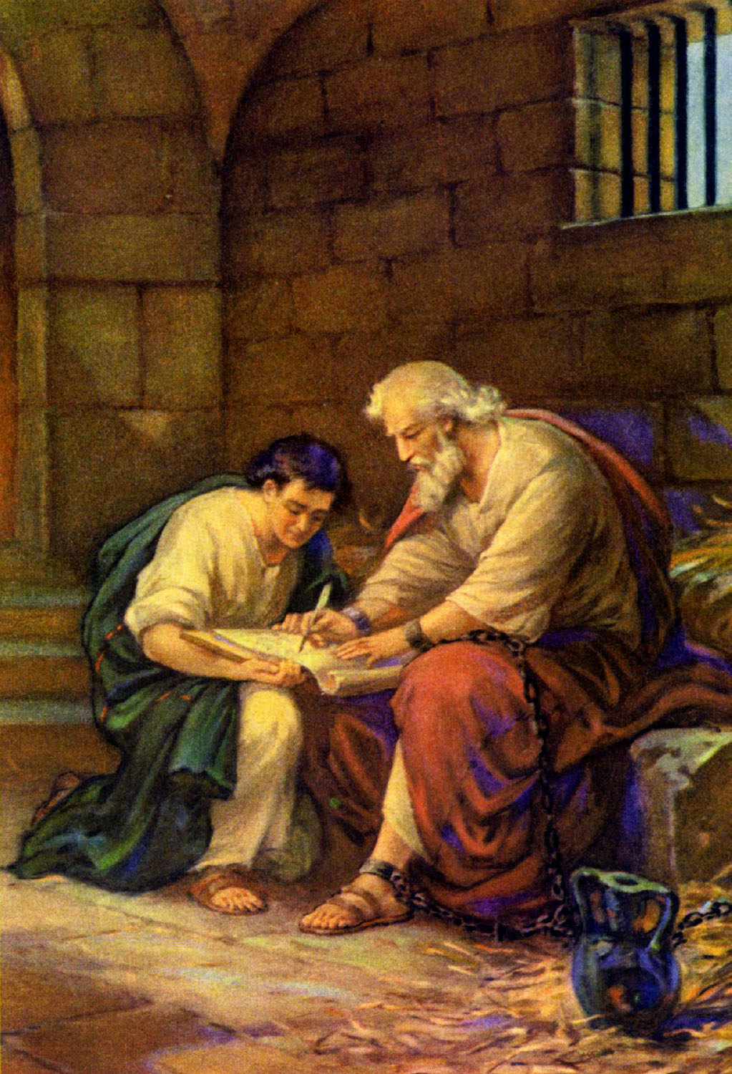
“Holding fast the faithful word as he hath been taught, that he may be able by sound doctrine both to exhort and to convince the gainsayers.” (Titus 1:9)

Slide 37
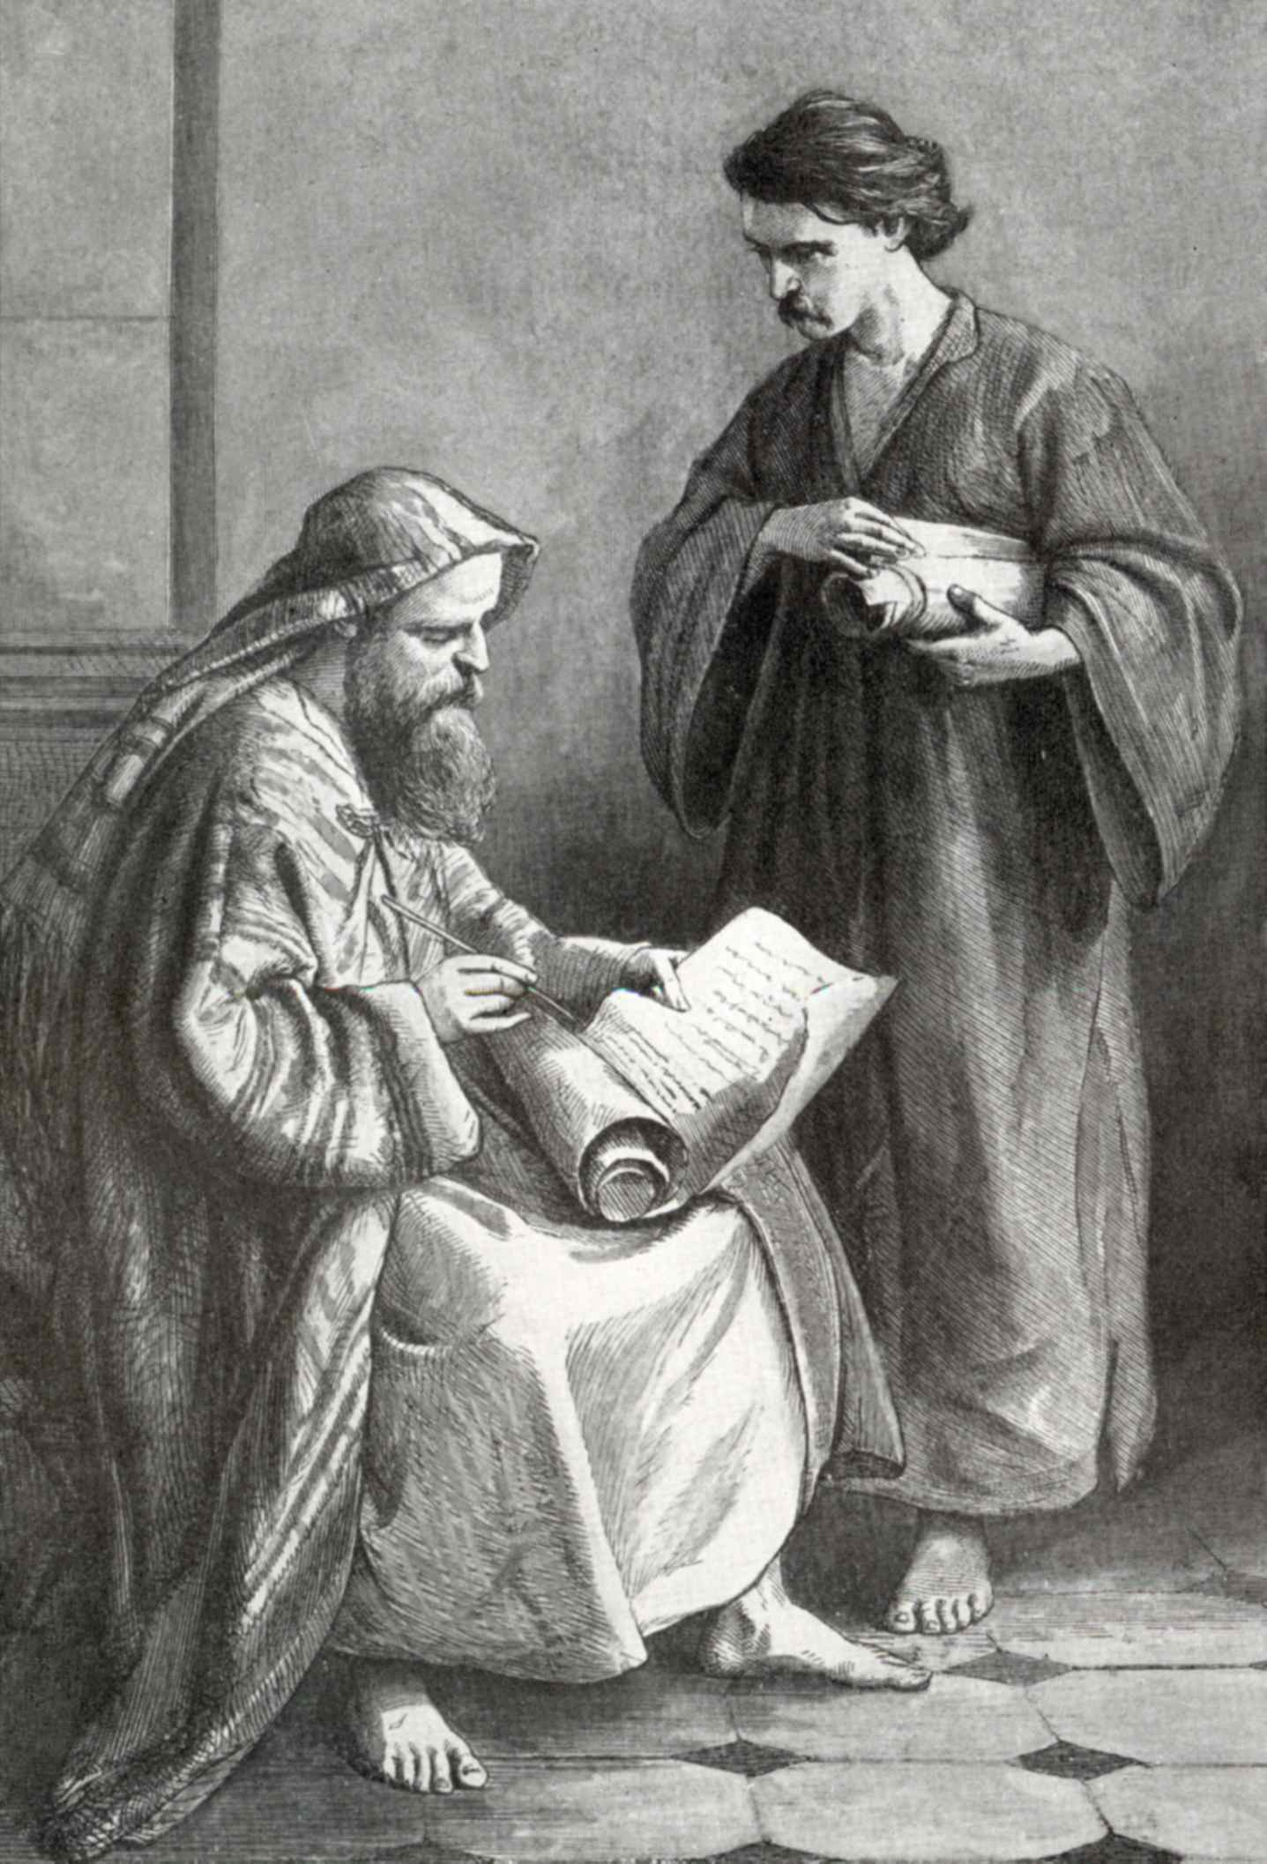
“But speak thou the things which become sound doctrine: In all things shewing thyself a pattern of good works: in doctrine shewing uncorruptness, gravity, sincerity.” (Titus 2:1,7)

Slide 38
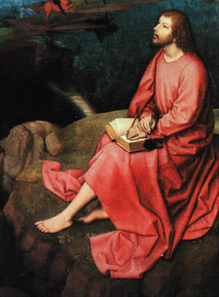
“Whosoever transgresseth, and abideth not in the doctrine of Christ, hath not God. He that abideth in the doctrine of Christ, he hath both the Father and the Son. If there come any unto you, and bring not this doctrine, receive him not into your house, neither bid him God speed.”
(II John 1:9-10)

Slide 39
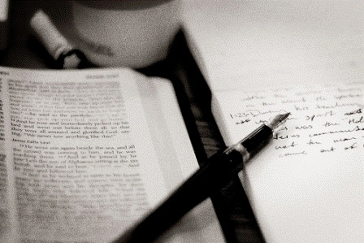
Study (Greek) = To make effort, to be diligent, to labor in study, to be eager or earnest to do something, to strive.

Slide 40
Nine Major Bible Doctrines
Bibliology – Doctrine of the Scriptures
Theology – Doctrine of God
Christology – Doctrine of Christ
Pneumatology – Doctrine of Man
Hamartiology – Doctrine of Sin
Soteriology – Doctrine of Salvation
Ecclesiology – Doctrine of the Church
Angelology – Doctrine of Angels
Eschatology – Doctrine of Prophecy

Slide 41
24 Fundamentals of the Faith
The inspiration and preservation of the Bible
The Trinity
The attributes of God – Omniscience, omnipotence, omnipresent, eternal, immutable, sovereign, holy, righteous, loving, gracious, just and truth.
The virgin birth
The deity of Christ
The resurrection of Jesus Christ
The existence of angels

Slide 42
The existence of Satan
The existence of Demons
A literal heaven
A literal hell
The depravity of man
Salvation by grace through faith apart from the works of the law
Ordinances of Baptism and the Lord’s Table
Separation from worldliness
Separation from religious apostasy

Slide 43
Autonomy of the local church – The church as the absolute right of self-government free from any interference of any hierarchy, individuals, or organization. The one and only head being the Lord Jesus Christ.
Separation of church and state
Priesthood of the believer
Soul liberty
The sovereignty of God
The pre-millennial rapture of the church
The Second Advent of Jesus Christ
The millennial reign of Jesus Christ

