Slide 1
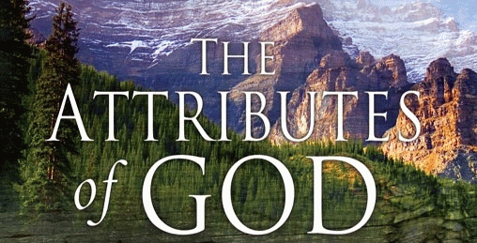
The inherent characteristics, quality's
and features of God
(Part 2)

Slide 2
An attribute of God is whatever God has revealed as being true of Himself.
Some theologians prefer the word "perfection" to that of attributes –
I John 1:5 “This then is the message which we have heard of him, and declare unto you, that God is light, and in him is no darkness at all.”
Psalms 5:4 “For thou art not a God that hath pleasure in wickedness: neither shall evil dwell with thee.”

Slide 3
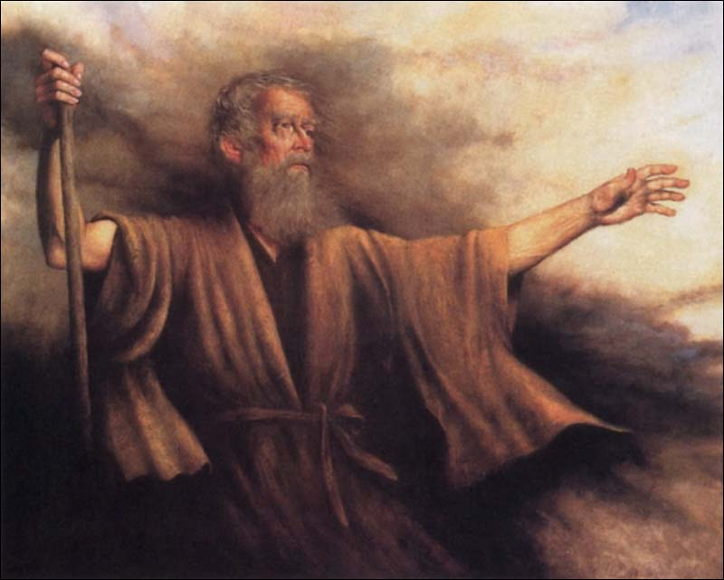
“I will publish the name of the LORD: ascribe ye greatness unto our God. He is the Rock, his work is perfect: for all his ways are judgment: a God of truth and without iniquity, just and right is he.” Deuteronomy 32:3-4

Slide 4
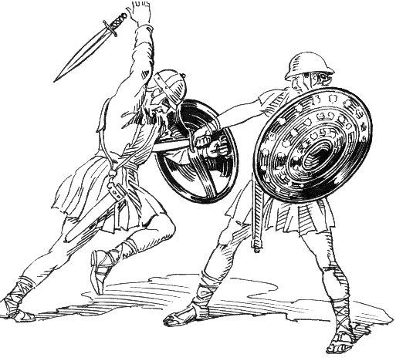
“As for God, his way is perfect: the word of the LORD is tried: he is a buckler to all those that trust in him.” Psalm 18:30

Slide 5
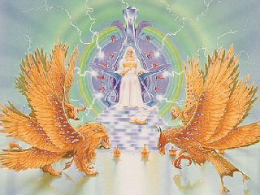
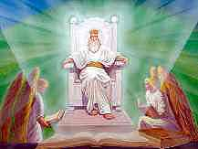
“The perfection of beauty, God hath shined.” Psalm 50:2

Slide 6
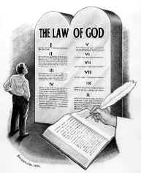
“The law of the LORD is perfect, converting the soul: the testimony of the LORD is sure, making wise the simple.” Psalm 19:7

Slide 7
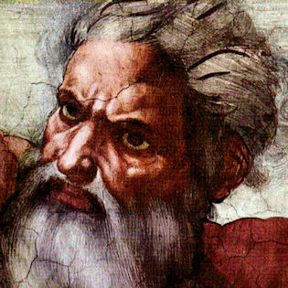
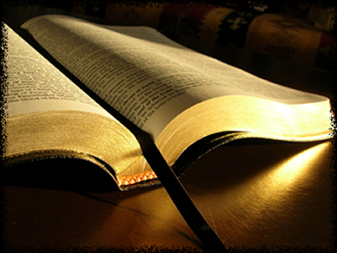
“For truly my words shall not be false: He that is perfect in knowledge is with thee.” Job 36:4

Slide 8
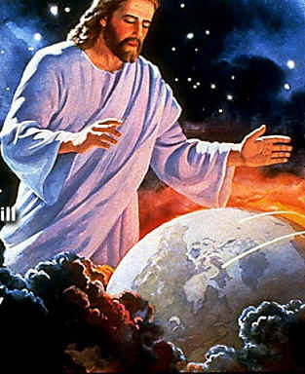
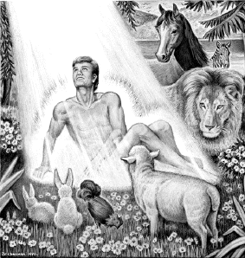
Deut. 32:4 “His work is perfect.”

Slide 9
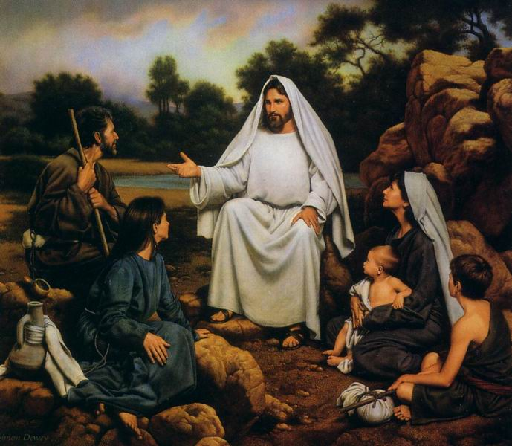
“Be ye therefore perfect, even as your Father which is in heaven is perfect.” Matthew 5:48

Slide 10
“For even hereunto were ye called: because Christ also suffered for us, leaving us an example, that ye should follow his steps.” I Peter 2:21

Slide 11
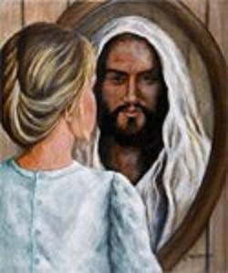
“And we know that all things work together for good to them that love God, to them who are the called according to his purpose. For whom he did foreknow, he also did predestinate to be conformed to the image of his Son.” Romans 8:28-29

Slide 12
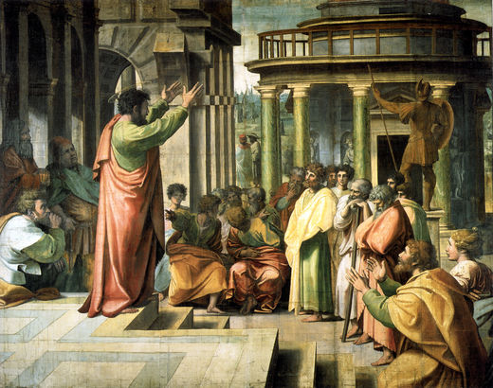
“My little children, of whom I travail in birth again until Christ be formed in you.” Gal. 4:19

Slide 13
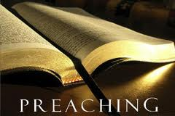
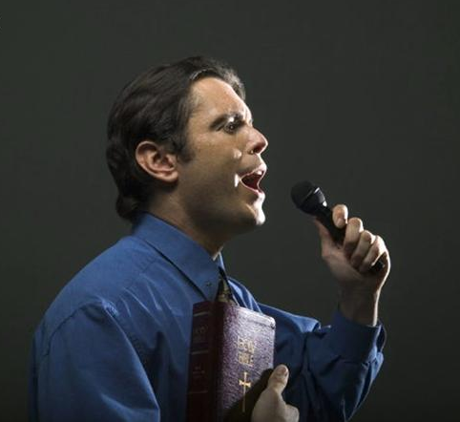
“Whom we preach, warning every man, and teaching every man in all wisdom; that we may present every man perfect in Christ Jesus.” Col. 1:28

Slide 14
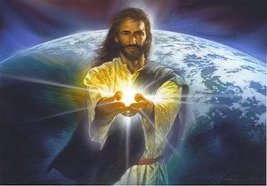
“And he gave some, apostles; and some, prophets; and some, evangelists; and some, pastors and teachers; For the perfecting of the saints, for the work of the ministry, for the edifying of the body of Christ:” Ephesians 4:11-12

Slide 16
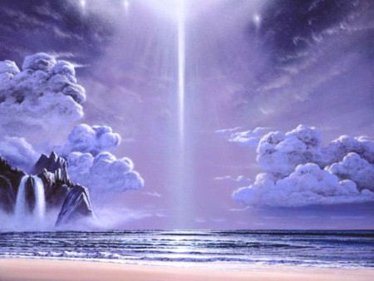
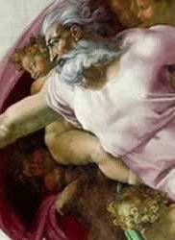
21 Attributes / Perfections of God

Slide 17
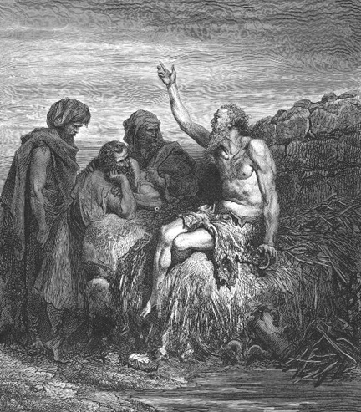
God is incomprehensible
"Canst thou by searching find out God? canst thou find out the Almighty unto perfection? It is as high as heaven; what canst thou do? deeper than hell; what canst thou know? The measure thereof is longer than the earth, and broader than the sea.” Job 11:7-9

Slide 18
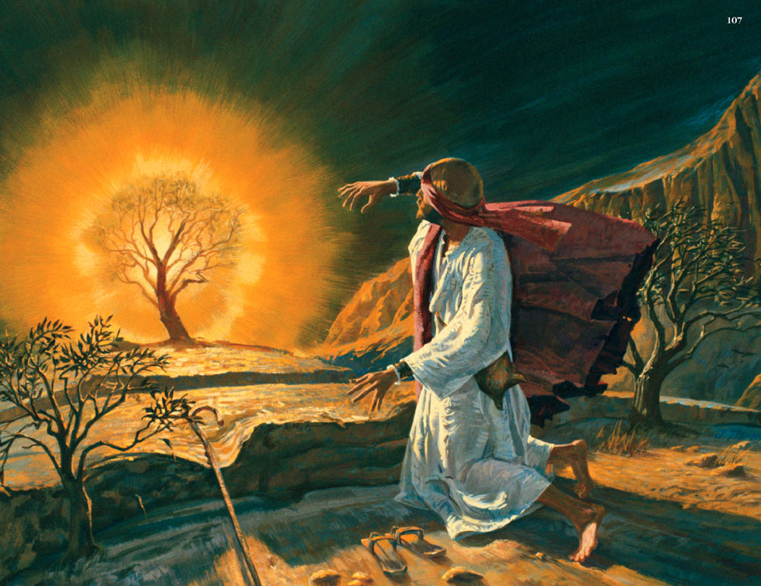
God is self-existent
"And Moses said unto God, Behold, when I come unto the children of Israel, and shall say unto them, The God of your fathers hath sent me, What is his name? What shall I say unto them? And God said unto Moses, I AM THAT I AM: and he said, Thus shalt thou say unto the children of Israel, I AM hath sent me unto you.”
Exodus 3:13-14

Slide 19
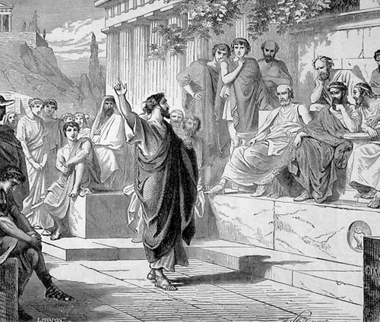
God is self-sufficient
“Neither is worshipped with men's hands, as though he needed any thing, seeing he giveth to all life, and breath, and all things.” Acts 17:25

Slide 20
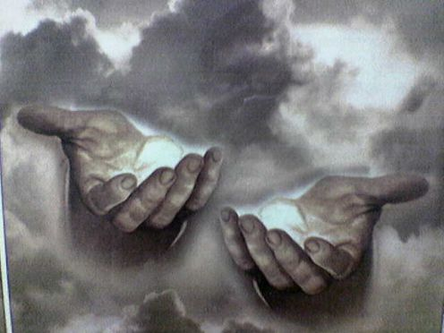
God is eternal
"The eternal God is thy refuge, and underneath are the everlasting arms: and he shall thrust out the enemy from before thee.” Deuteronomy 33:27

Slide 21
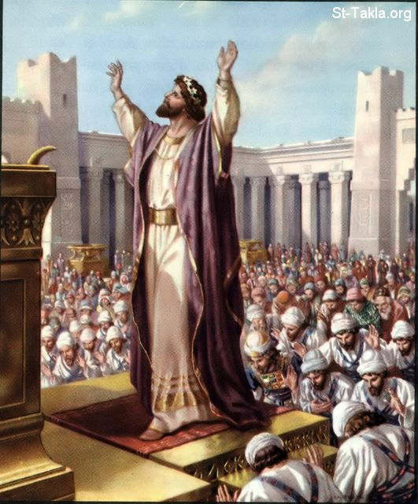
God is infinite
"And Solomon stood before the altar of the Lord in the presence of all the congregation of Israel, and spread forth his hands toward heaven: And he said…Behold, the heaven and heaven of heavens cannot contain thee; how much less this house that I have builded?”
I Kings 8:22, 23, 27

Slide 22
God is incomprehensible
God is self-existence
God is self-sufficient
God is eternal
God is infinite

Slide 23
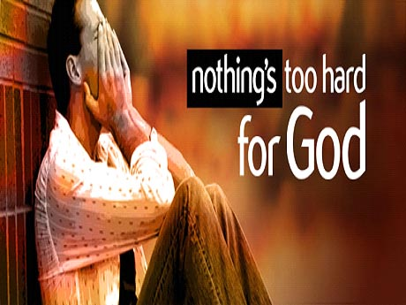
God is omnipotent
"Is any thing too hard for the Lord?”
Genesis 18:14

Slide 24
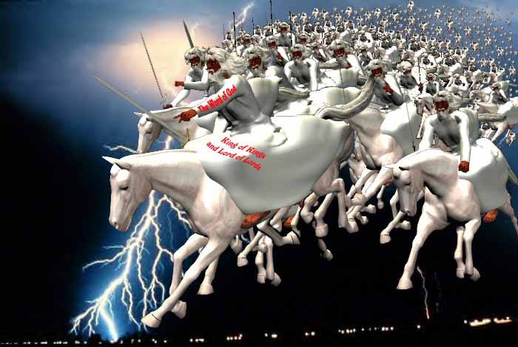
"And I heard as it were the voice of a great multitude, and as the voice of many waters, and as the voice of mighty thunderings, saying, Alleluia: for the Lord God omnipotent reigneth.” Revelation 19:6

Slide 25
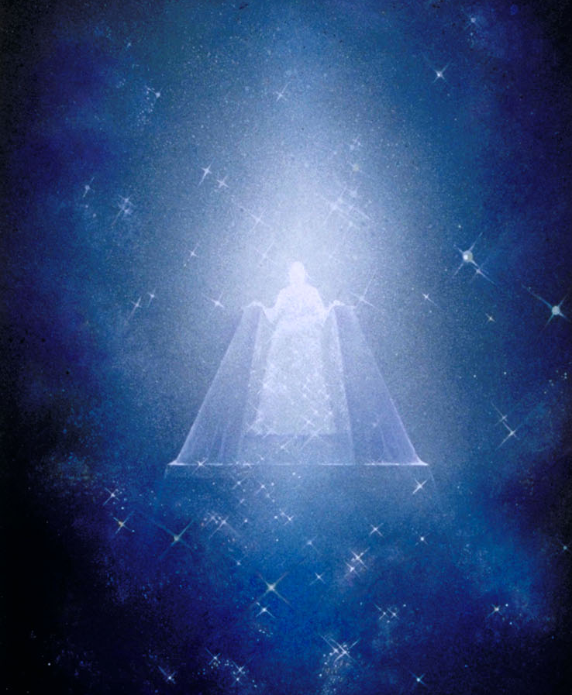
God can do anything if it does not contradict His holy and righteous nature.
God cannot lie, or steal, for these things would contradict His own nature.
Areas in which God’s omnipotence is clearly seen -

Slide 26
Over Nature

Slide 27
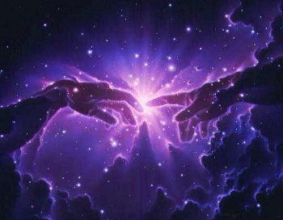
He separates light from darkness
Gen. 1:4

Slide 28
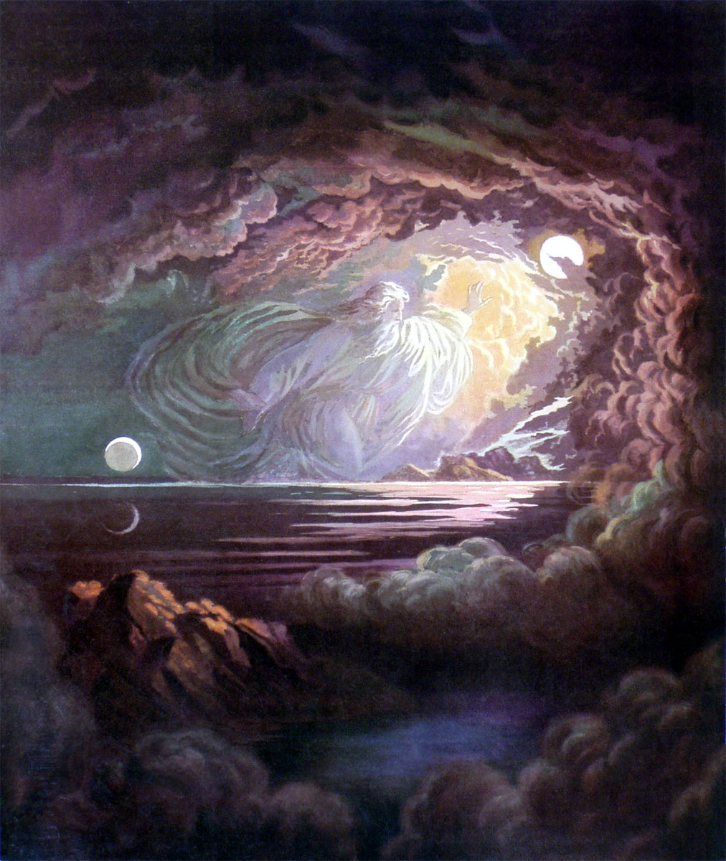
He separates the waters from the firmament (space)
Gen. 1:7

Slide 29
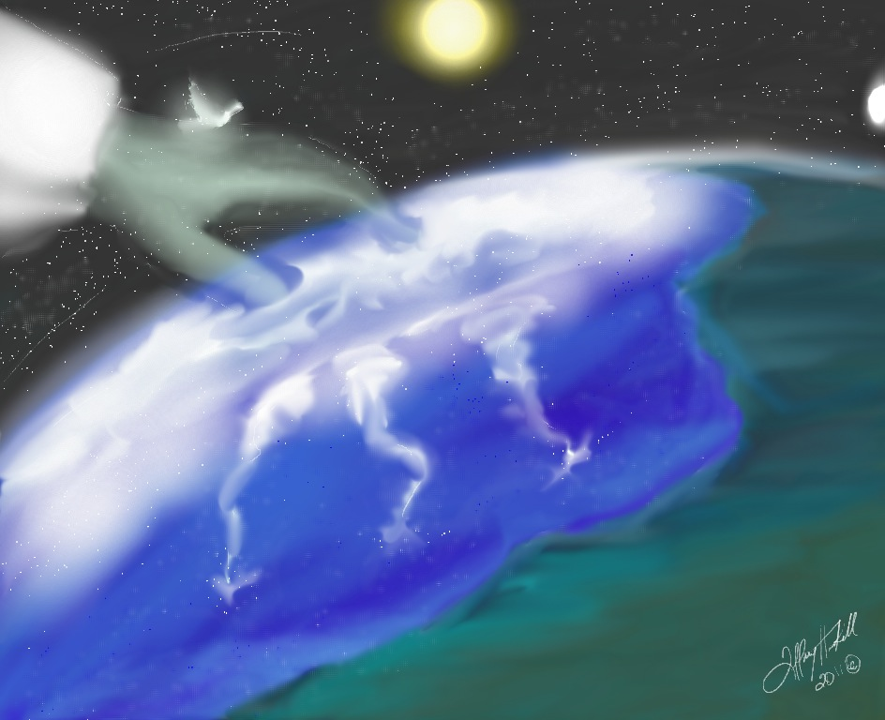
He separates the seas from the dry land
Gen. 1:10

Slide 30
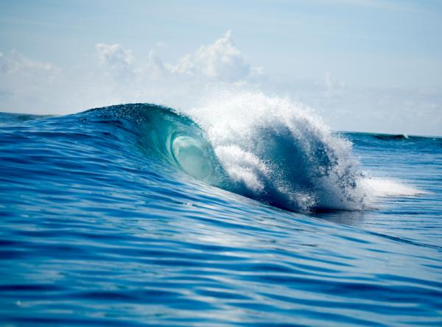
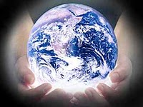
He measures oceans in His hands
Isa. 40:12

Slide 31
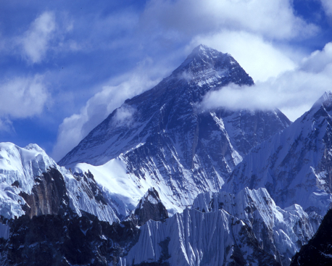
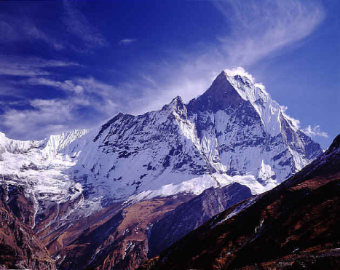
He weighs the mountains on His scale
Isa. 40:12

Slide 32
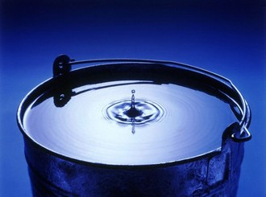
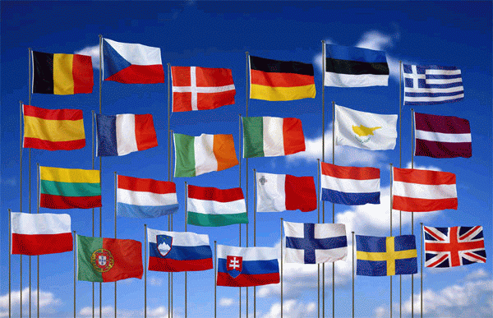
He regards nations as nothing but a drop
in the bucket
Isa. 40:15

Slide 33
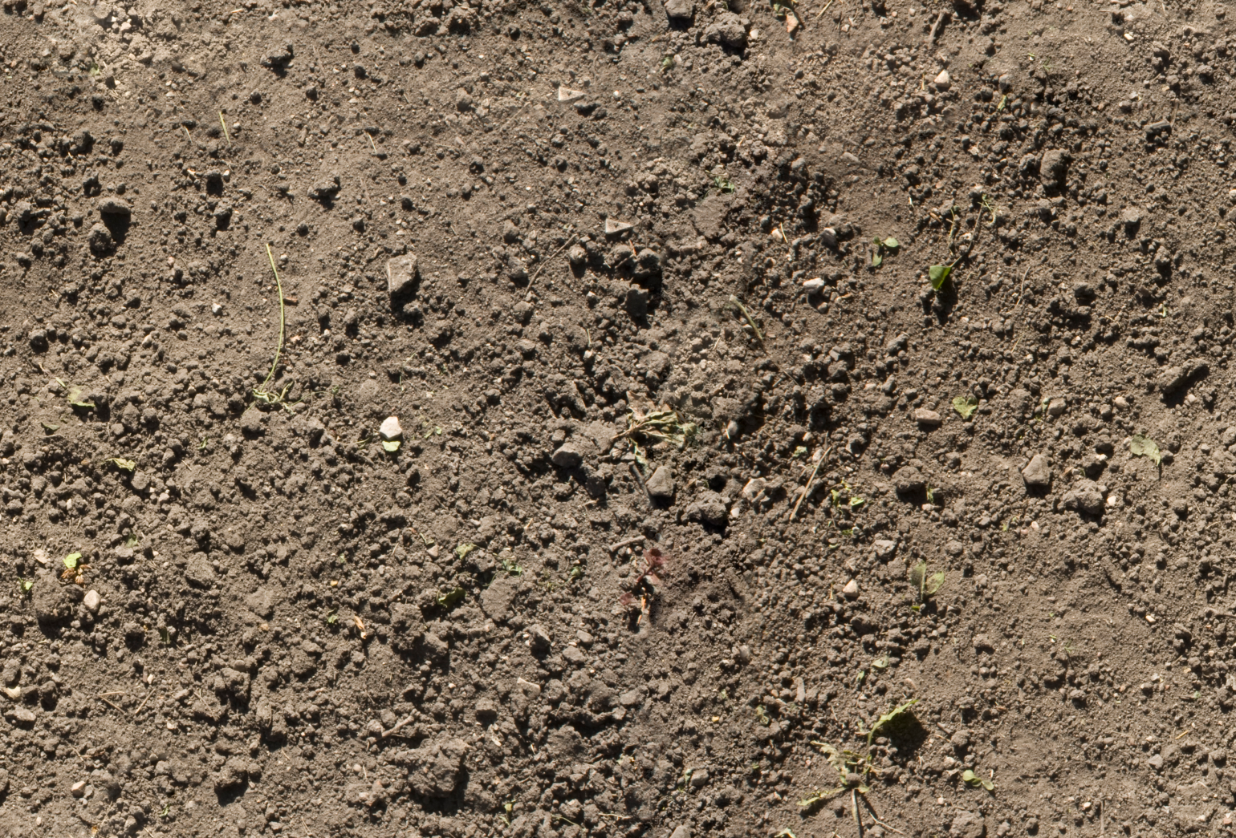
He looks upon the islands
as small particles of dirt
Isa. 40:15

Slide 34
Over Men
"The king spake, and said, Is not this great Babylon, that I have built for the house of the kingdom by the might of my power, and for the honour of my majesty? While the word was in the king’s mouth, there fell a voice from heaven, saying, O king Nebuchadnezzar, to thee it is spoken; the kingdom is departed from thee. And they shall drive thee from men, and thy dwelling shall be with the beasts of the field: they shall make thee to eat grass as oxen, and seven times shall pass over thee, until thou know that the most High ruleth in the kingdom of men, and giveth it to whomsoever he will.“ (Daniel 4:30-32)

Slide 35
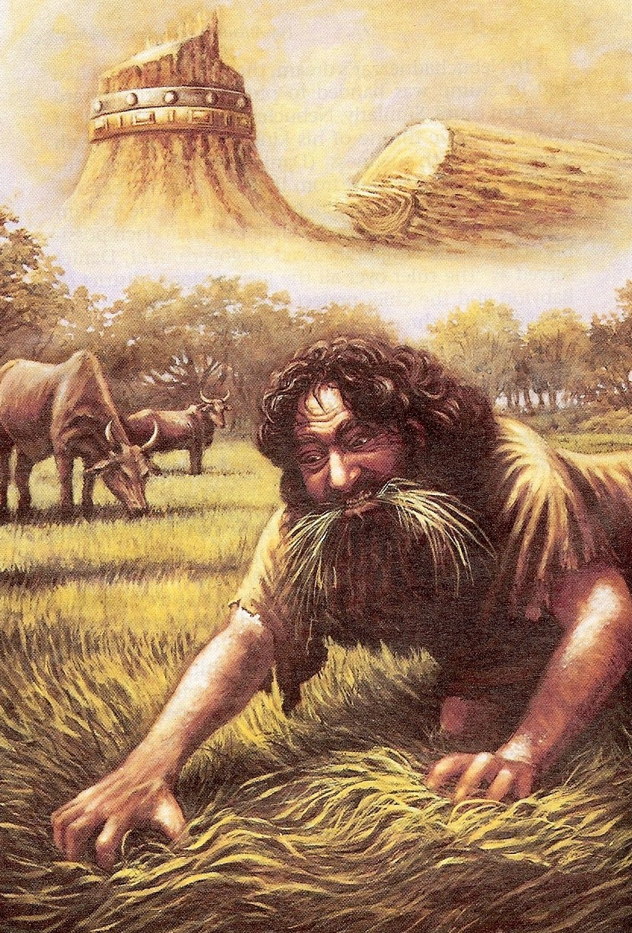
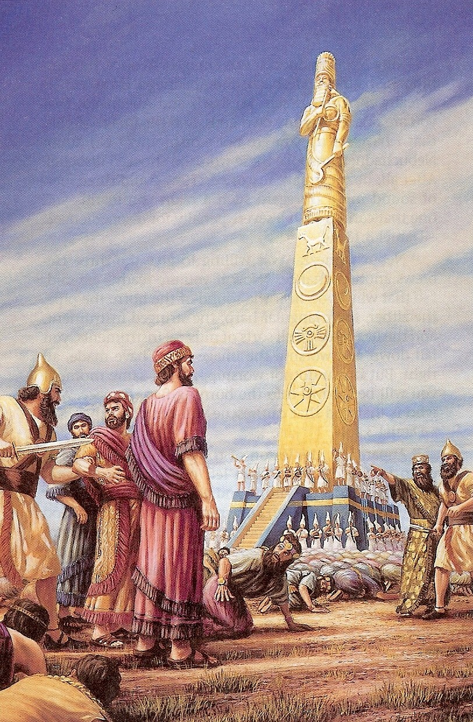

Slide 36
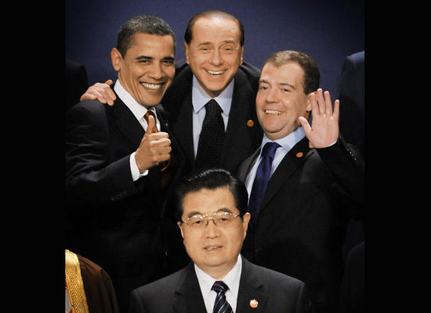
“The king's heart is in the hand of the LORD, as the rivers of water: he turneth it whithersoever he will.” Prov. 21:1

Slide 37
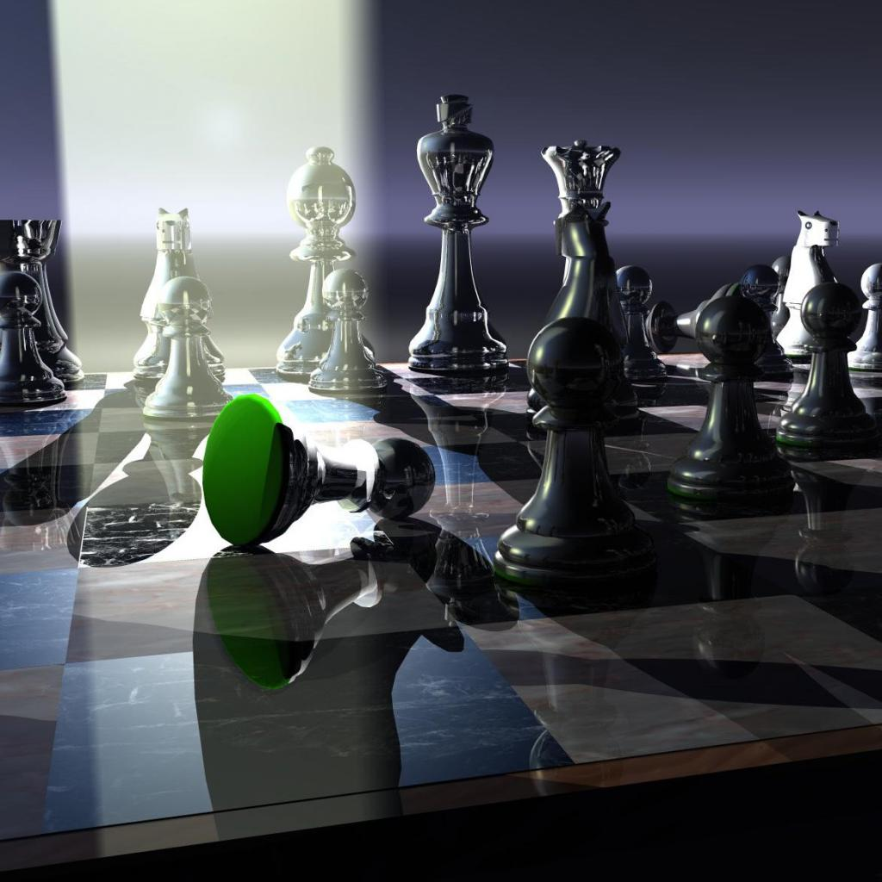
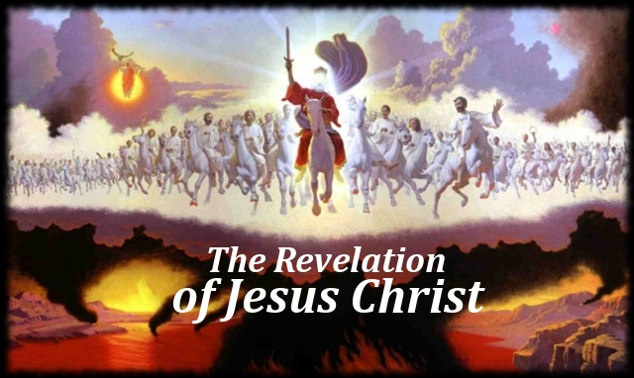

Slide 38
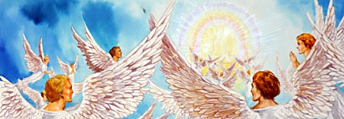
Over Angels
"Blessed the Lord, ye his angels, that excel in strength, that do his commandments, hearkening unto the voice of his word.”
Psalm 103:20

Slide 39
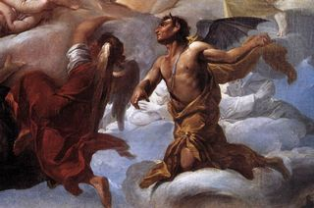
Over Satan
Job 1:12; 2:6 The first two chapters of Job deal with Satan’s accusations against the patriarch before God.
The devil then subjects Job to various fierce and fiery trials, but not before being granted the needed specific permission from the omnipotent God himself.

Slide 40
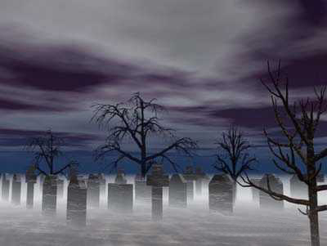
Over Death
"Forasmuch then as the children are partakers of flesh and blood, he also himself likewise took part of the same; that through death he might destroy him that had the power of death, that is, the devil; and deliver them who through fear of death were all their lifetime subject to bondage.“ Hebrews 2:14-15

Slide 41
“O death, where is thy sting? O grave, where is thy victory?…But thanks be to God, which giveth us the victory through our Lord Jesus Christ.”
I Corinthians 15:55, 57

Slide 42
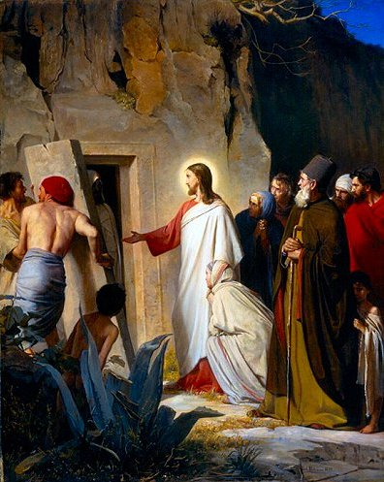

Slide 43
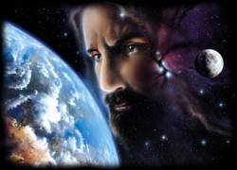
God is omnipresent
The omnipresence of God thus means He is present everywhere with his whole being at the same time.

Slide 44
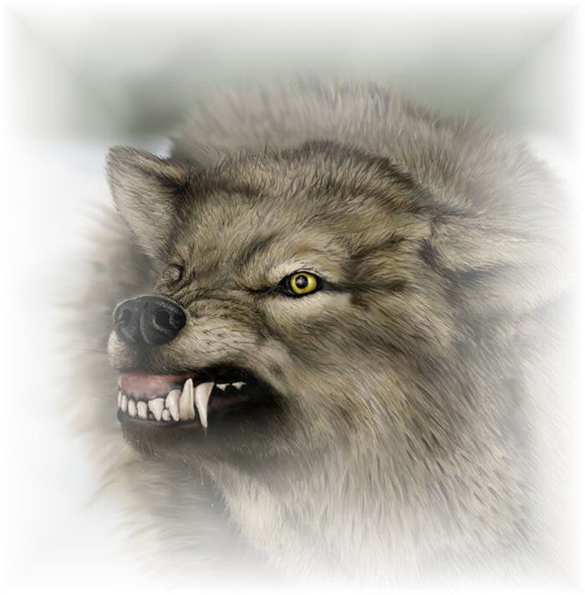
The great danger to avoid in rightly understanding this attribute is the grievous error of pantheism, which says that God is everywhere, and everything is God.

Slide 45
Paul at Mars’ hill

Slide 46
“Then Paul stood in the midst of Mars' hill, and said, Ye men of Athens, I perceive that in all things ye are too superstitious. For as I passed by, and beheld your devotions, I found an altar with this inscription, TO THE UNKNOWN GOD. Whom therefore ye ignorantly worship, him declare I unto you. God that made the world and all things therein, seeing that he is Lord of heaven and earth, dwelleth not in temples made with hands; Neither is worshipped with men's hands, as though he needed any thing, seeing he giveth to all life, and breath, and
all things.” Acts 17:22-25

Slide 47
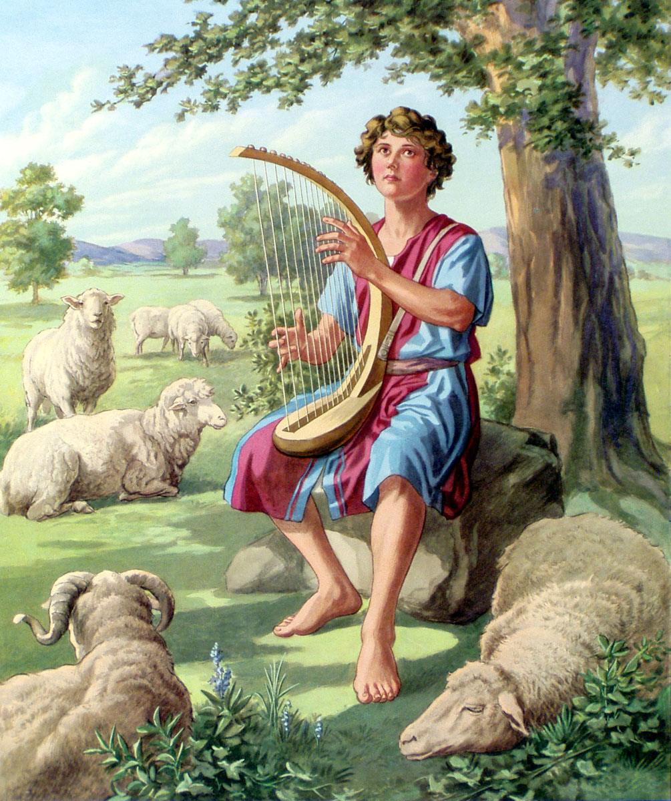

Slide 48
"Whither shall I go from thy spirit? or whither shall I flee from thy presence? If I ascend up into heaven, thou art there: if I make my bed in hell, behold, thou art there. If I take the wings of the morning, and dwell in the uttermost parts of the sea; even there shall thy hand lead me, and thy right hand shall hold me.”
Psalm 139:7-11

Slide 49
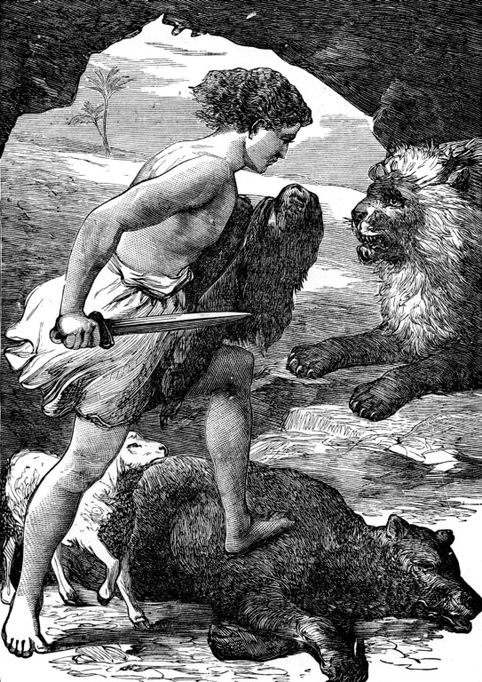
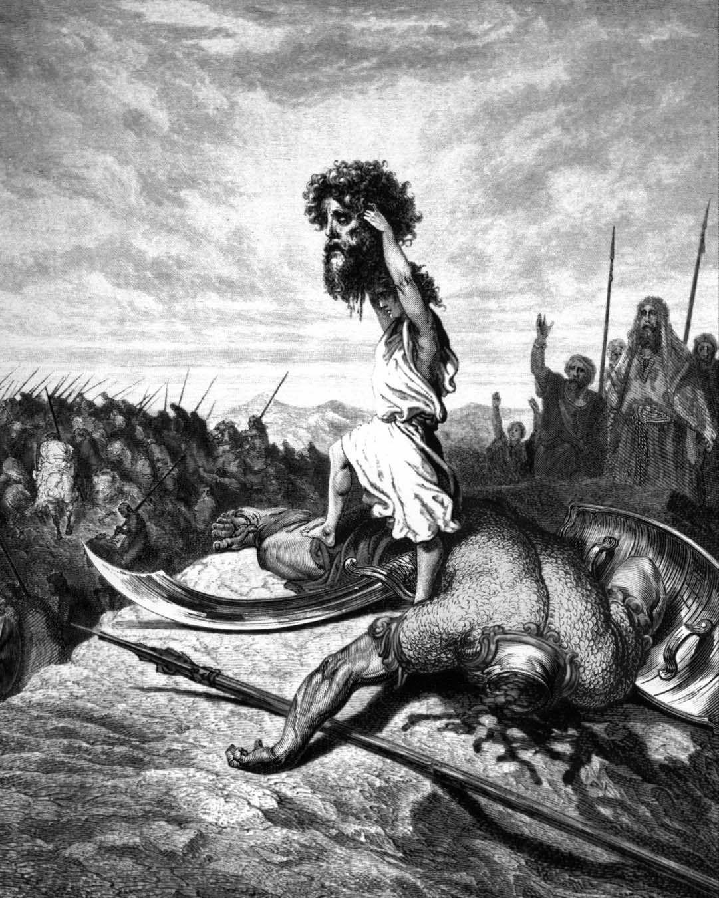

Slide 51
God is omniscient
"Great is our Lord, and of great power: his understanding is infinite.” Psalm 147:5

Slide 52
"Who hath directed the Spirit of the Lord, or being his counselor hath taught him? With whom took he counsel, and who instructed him, and taught him in the path of judgment, and taught him knowledge, and showed
to him the way of understanding?”
Isaiah 40:13-14

Slide 53
God possesses (without prior discovery of facts) complete and universal knowledge of all things past, present, and future.
He sees all things
Proverbs 15:3 "The eyes of the Lord are in every place, beholding the evil and the good."
He knows all things (the big and small of His universe)
Hebrews 4:13 "Neither is there any creature that is not manifest in his sight: but all things are naked and opened unto the eyes of him with whom we have to do."

Slide 54
“Neither is there any creature that is not manifest in his sight: but all things are naked and opened unto the eyes of him with whom we have to do.” Hebrews 4:13

Slide 55
"He telleth the number of the stars; he calleth them all by their names.” Psalm 147:4
"Are not two sparrows sold for a farthing? and one of them shall not fall on the ground without your Father. But the very hairs
of your head are
all numbered.”
Matthew 10:29-30

Slide 56
He knows our thoughts
Psalm 44:21 "Shall not God search this out? For he knoweth the secrets of the heart."
He knows our words
Psalm 139:4 "For there is not a word in my tongue, but, lo, O Lord, thou knowest it altogether."
He knows our deeds
Psalm 139:2"Thou knowest my downsitting and mine uprising."

Slide 57
He knows our sorrows
Exodus 3:7 “I know their sorrows…”
He knows our needs
Matthew 6:32 “…for your heavenly Father knoweth that ye have need of all these things.”
He knows our devotion
II Chronicles 16:9 “For the eyes of the Lord run to and fro throughout the whole earth, to shew himself strong in the behalf of them whose heart is perfect toward him.”

Slide 58
He knows our frailties
Psalm 103:14 “For he knoweth our frame; he remembereth that we are dust.”
He knows our foolishness
Psalm 69:5 “O God, thou knowest my foolishness; and my sins are not hid from thee.”
He knows His own
II Timothy 2:19 “Nevertheless the foundation of God standeth sure, having this seal, The Lord knoweth them that are his.”

Slide 59
He knows the past, present, and future
Acts 15:18 "Known unto God are all his works from the beginning of the world."
He knows what might or could have been
Matthew 11:23 "And thou, Capernaum, which art exalted unto heaven, shalt be brought down to hell: for if the mighty works, which have been done in thee, had been done in Sodom, it would have remained until this day."

Slide 60
God is incomprehensible
God is self-existence
God is self-sufficient
God is eternal
God is infinite
God is omnipotent
God is omnipresent
God is omniscient

