Slide 1
The inherent characteristics, quality's
and features of God
(Part 5)

Slide 2
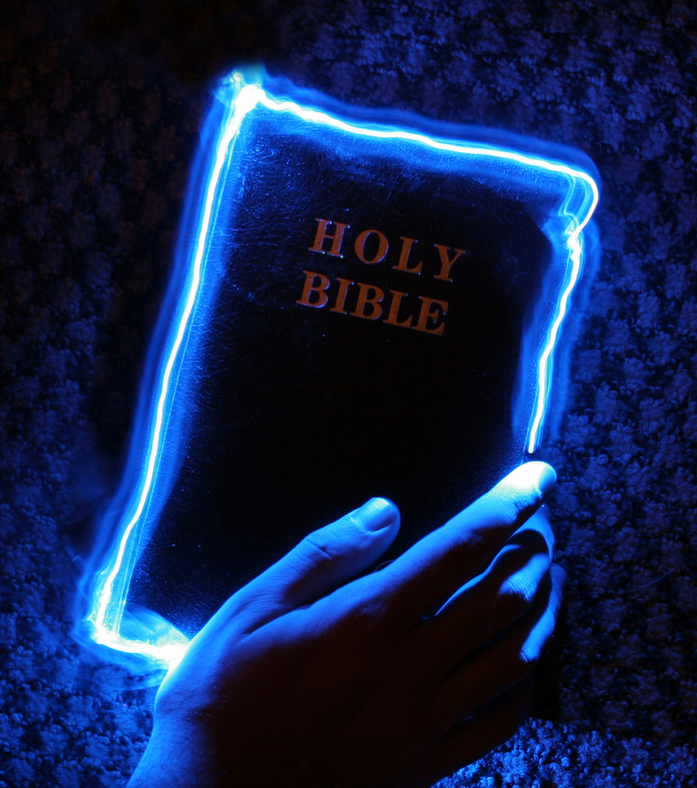
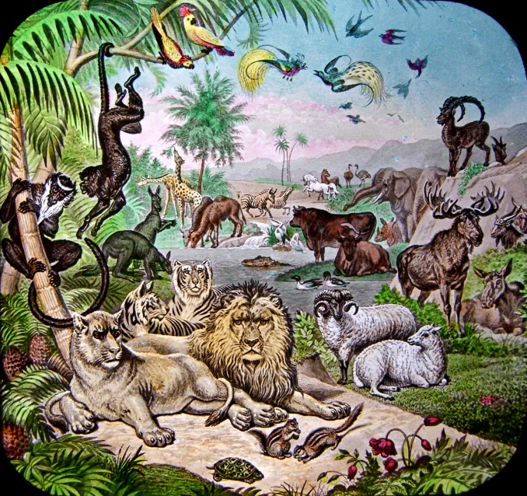
An attribute of God is whatever God has revealed as being true of Himself.

Slide 3
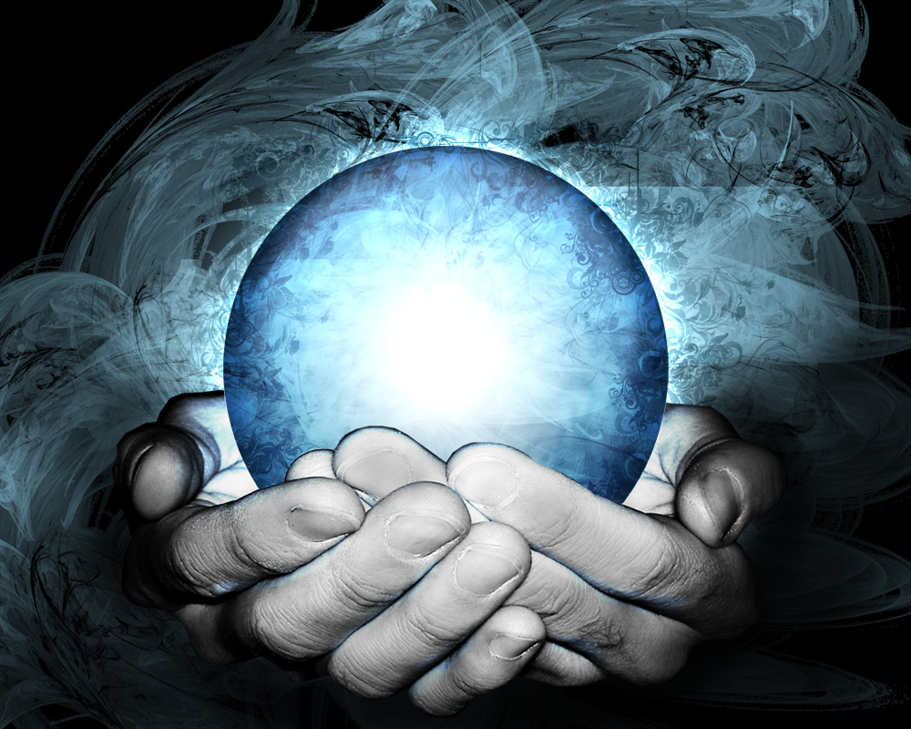
“For the invisible things of him from the creation of the world are clearly seen, being understood by the things that are made, even his eternal power and Godhead; so that they are without excuse.”
Romans 1:20

Slide 4
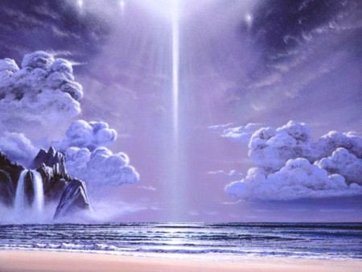
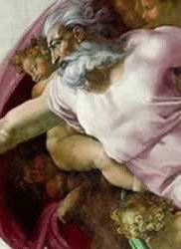
21 Attributes / Perfections of God

Slide 5
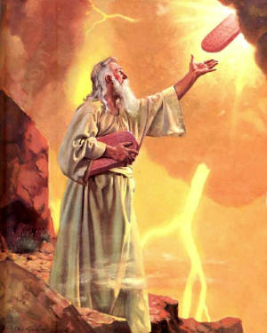
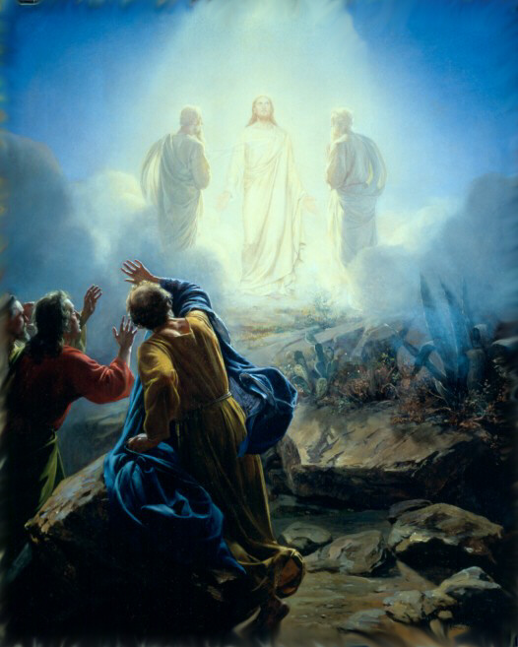
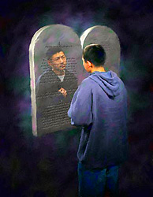
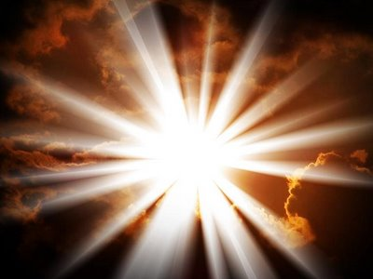
“But we all, with open face beholding as in a glass the glory of the Lord, are changed into the same image from glory to glory, even as by the Spirit of the Lord.” II Cor. 3:18

Slide 6
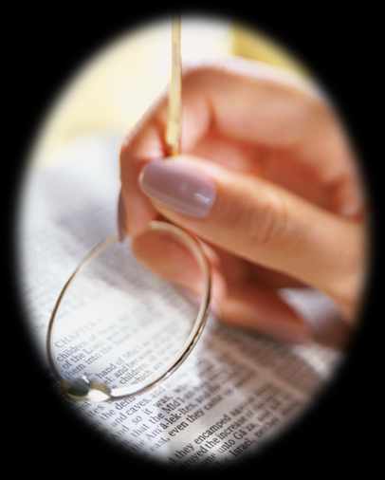

Slide 7
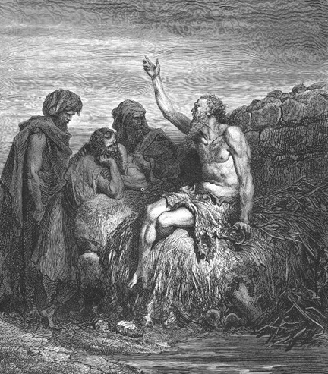
God is incomprehensible
“Canst thou by searching find out God? canst thou find out the Almighty unto perfection? It is as high as heaven; what canst thou do? deeper than hell; what canst thou know? The measure thereof is longer than the earth, and broader than the sea.” Job 11:7-9

Slide 8
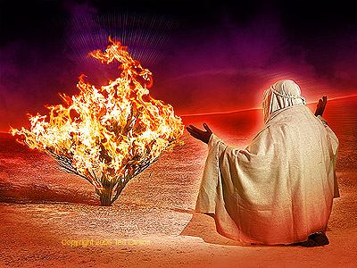
God is self-existent
"And Moses said unto God, Behold, when I come unto the children of Israel, and shall say unto them, The God of your fathers hath sent me, What is his name? What shall I say unto them? And God said unto Moses, I AM THAT I AM: and he said, Thus shalt thou say unto the children of Israel, I AM hath sent me unto you.”
Exodus 3:13-14

Slide 9
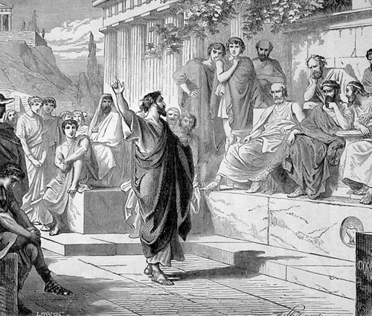
God is self-sufficient
“Neither is worshipped with men's hands, as though he needed any thing, seeing he giveth to all life, and breath, and all things.” Acts 17:25

Slide 10
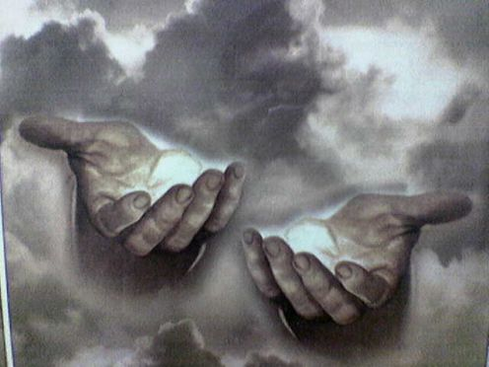
God is eternal
"The eternal God is thy refuge, and underneath are the everlasting arms: and he shall thrust out the enemy from before thee.” Deuteronomy 33:27

Slide 11
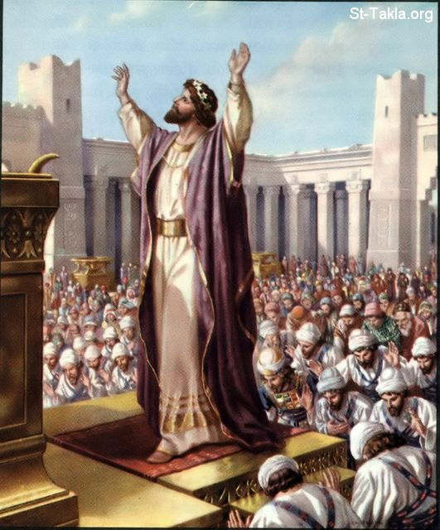
God is infinite
"And Solomon stood before the altar of the Lord in the presence of all the congregation of Israel, and spread forth his hands toward heaven: And he said…Behold, the heaven and heaven of heavens cannot contain thee; how much less this house that I have builded?”
I Kings 8:22, 23, 27

Slide 12
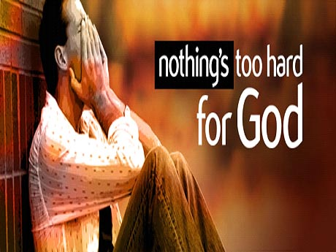
God is omnipotent
"Is any thing too hard for the Lord?” (Genesis 18:14)

Slide 13
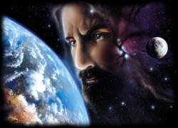
God is omnipresent
"Whither shall I go from thy spirit? or whither shall I flee from thy presence? If I ascend up into heaven, thou art there: if I make my bed in hell, behold, thou art there. If I take the wings of the morning, and dwell in the uttermost parts of the sea; even there shall thy hand lead me, and thy right hand shall hold me.”
Psalm 139:7-11

Slide 14
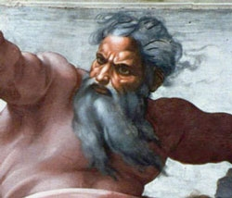
God is omniscient
"Great is our Lord, and of great power: his understanding is infinite.“ Psalm 147:5

Slide 15
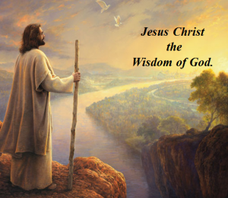
God is all wise
"To the only wise God our Saviour, be glory and majesty, dominion and power, both now and ever. Amen.” Jude 1:25

Slide 16
God is immutable “For I am the Lord, I change not.” Malachi 3:6
“Wherein God, willing more abundantly to shew unto the heirs of promise the immutability of his counsel, confirmed it by an oath: That by two immutable things, in which it was impossible for God to lie, we might have a strong consolation, who have fled for refuge to lay hold upon the hope set before us.” Hebrews 6:17-18

Slide 17
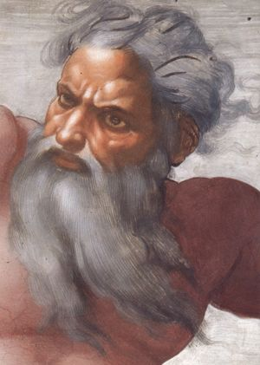
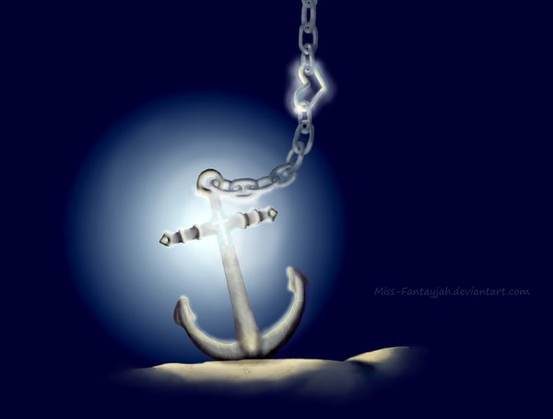
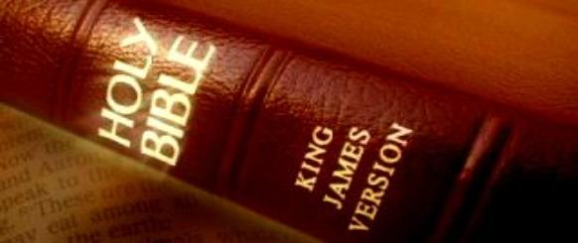

Slide 18
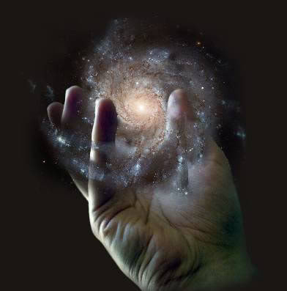
God is sovereign
"Remember the former things of old: for I am God, and there is none else; I am God, and there is none like me, declaring the end from the beginning, and from ancient times the things that are not yet done, saying, My counsel shall stand, and I will do all my pleasure: yes, I have spoken it, I will also bring it to pass; I have purposed it, I will also do it.” Isaiah 46:9-11

Slide 19
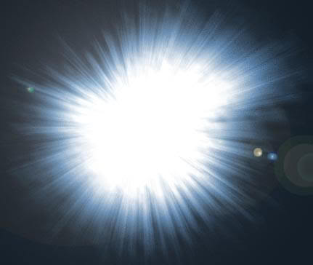
God is Light
"This then is the message which we have heard of him, and declare unto you, that God is light, and in him is no darkness at all…But if we walk in the light, as he is in the light, we have fellowship one with another, and the blood of Jesus Christ his Son cleanseth us from all sin.”
I John 1:5, 7

Slide 20
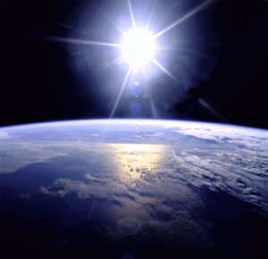
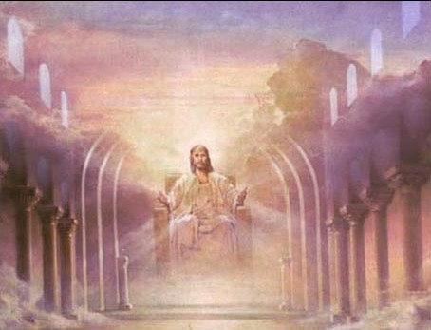
God is incomprehensible
God is self-existence
God is self-sufficient
God is eternal
God is infinite
God is omnipotent
God is omnipresent
God is omniscient
God is all wise
God is immutable
God is sovereign
God is light

Slide 21
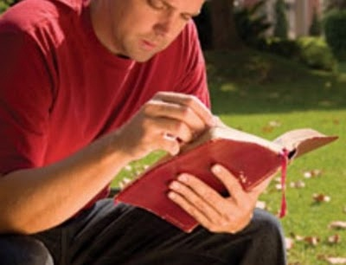
God is inscrutable
INCOMPREHENSIBLE - (Job 11:7-9)
beyond our understanding
MAN CANNOT PLUMB THE DEPTS OR LIMITS OF GOD
“For my thoughts are not your thoughts, neither are your ways my ways, saith the LORD. For as the heavens are higher than the earth, so are my ways higher than your ways, and my thoughts
than your thoughts.”
Isa. 55:8-9

Slide 22
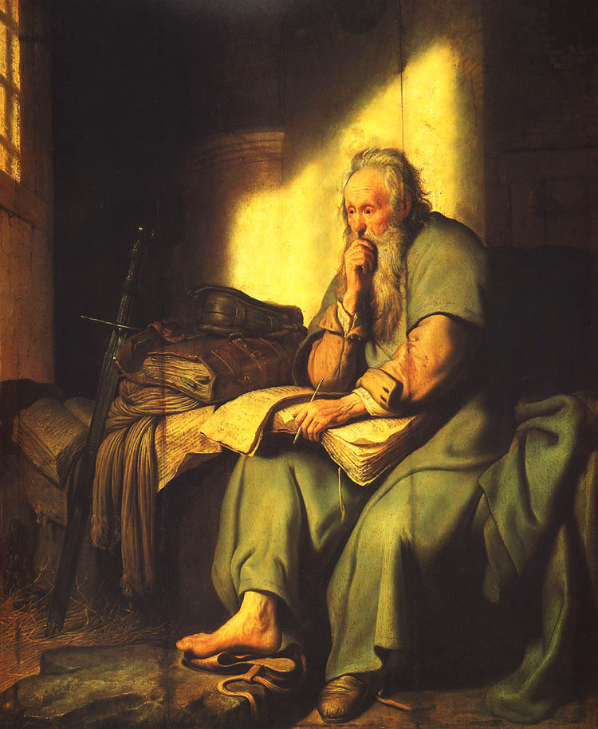
“For who hath known the mind of the Lord? or
who hath been
his counsellor?”
Rom. 11:34
“For who hath known the mind of the Lord, that he may instruct him?”
I Cor. 2:16

Slide 23
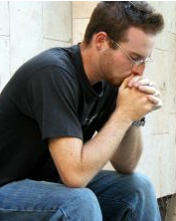
Incapable of being –
Investigated
Analyzed
Scrutinized
Impossible to be –
Understood
Mysterious
Unfathomable
"How unsearchable are his judgments, and his ways past finding out." Rom. 11:33

Slide 24
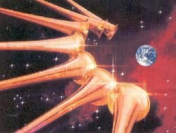
A searching question:
Why does God permit terrible things to happen?
A clue (and only a clue) to this question is seen in - Revelation 10:7 “But in the days of the voice of the seventh angel, when he shall begin to sound, the mystery of God should be finished, as he hath declared to his servants the prophets.”

Slide 25
Until the sound of that blessed trumpet, the perplexed child of God can arrive at no better conclusion than that offered by Abraham. "Shall not the Judge of all the earth do right?” Gen. 18:25

Slide 27
“Arise, and go down to the potter's house, and there I will cause thee to hear my words. Then I went down to the potter's house, and, behold, he wrought a work on the wheels. And the vessel that he made of clay was marred in the hand of the potter: so he made it again another vessel, as seemed good to the potter to make it. Then the word of the LORD came to me, saying, O house of Israel, cannot I do with you as this potter? saith the LORD. Behold, as the clay is in the potter's hand, so are ye in mine hand, O house of Israel.” Jeremiah 18:2-4 19:14

Slide 28
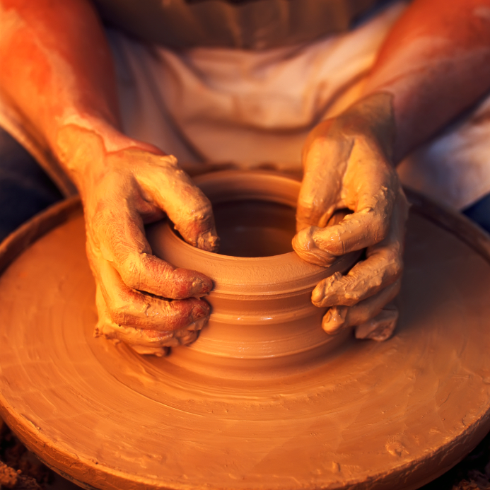
“Nay but, O man, who art thou that repliest against God? Shall the thing formed say to him that formed it, Why hast thou made me thus? Hath not the potter power over the clay, of the same lump to make one vessel unto honour, and another
unto dishonour?” Romans 9:20-21

Slide 29
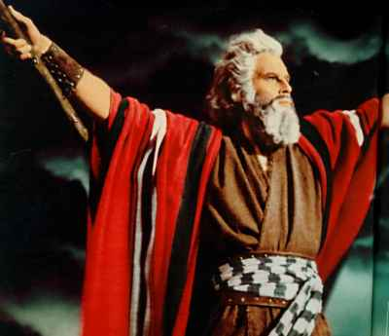
Moses: "He is the Rock, His work is perfect; for all His ways are justice; a God of truth and without iniquity, just and right is He" Deut. 32:4

Slide 30
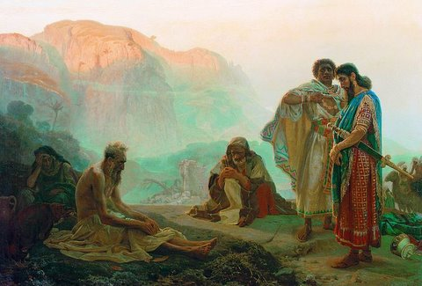
Job: "Naked came I out of my mother’s womb, and naked shall I return thither. The Lord gave and the Lord hath taken away; blessed be the name of the Lord…Though he slay me, yet will I trust in him" Job 1:21; 13:15.

Slide 31
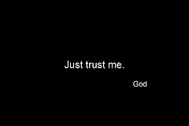
God's will may not make sense to us but does to God.
We may not have all the answers but we serve the God who does.

Slide 32
God is faithful
God’s faithfulness refers to his self-loyalty to his entire creation.
He will not (indeed, cannot) change his character nor fail to perform all he has promised.
Deuteronomy 7:9 "Know therefore that the Lord thy God, he is God, the faithful God, which keepeth covenant and mercy with them that love him and keep his commandments to a thousand generations."

Slide 33
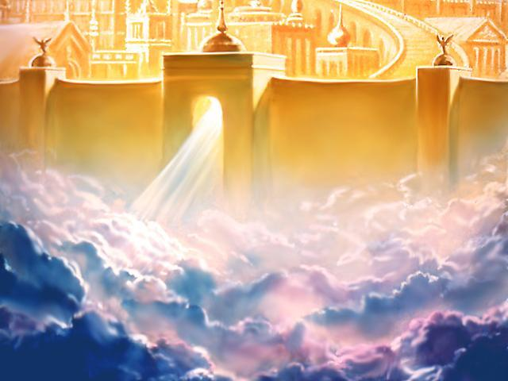
“I will sing of the mercies of the Lord for ever: with my mouth will I make known thy faithfulness to all generations. For I have said, Mercy shall be built up for ever: thy faithfulness shalt thou establish in the very heavens.” Psalm 89:1-2

Slide 34
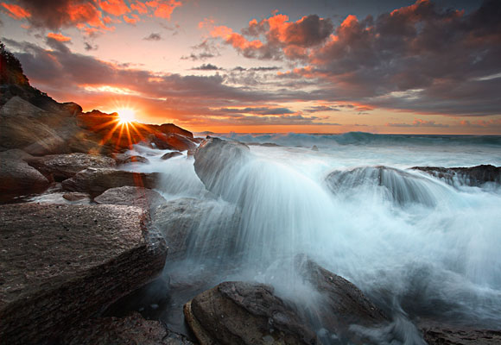
“It is of the Lord’s mercies that we are not consumed, because his compassions fail not. They are new every morning: great is thy faithfulness.”
Lamentations 3:22-23

Slide 35
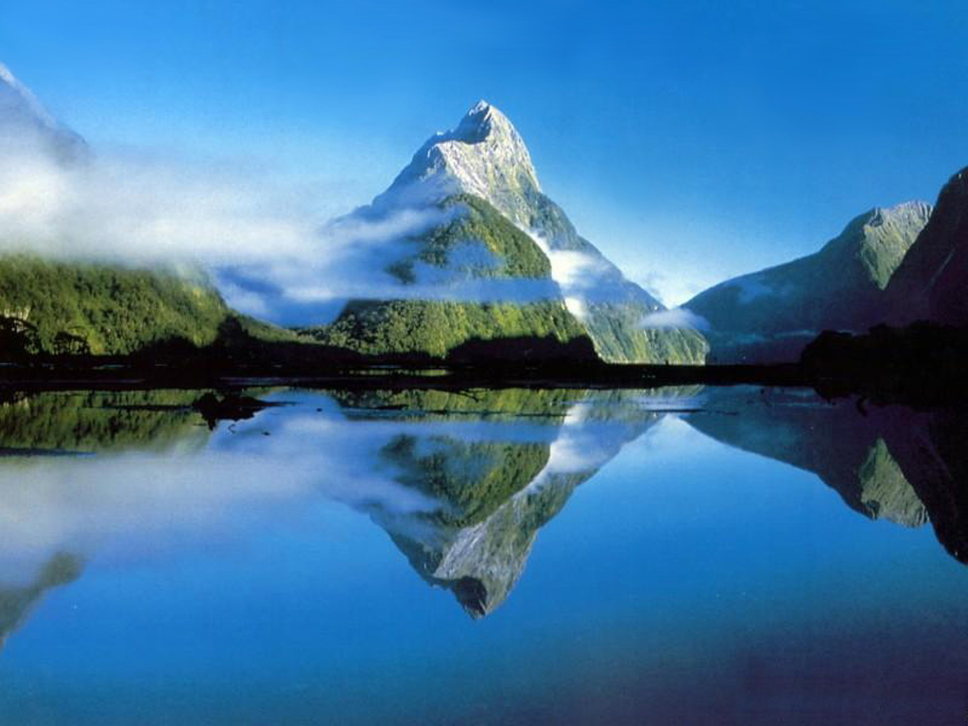
In nature
Psalm 119:90 “Thy faithfulness is unto all generations: thou hast established the earth, and it abideth.”
Colossians 1:17 “And he is before all things, and by him all things consist.”
Psalms 89:11-12 “The heavens are thine, the earth also is thine: as for the world and the fulness thereof, thou hast founded them. The north and the south thou hast created them.”

Slide 36
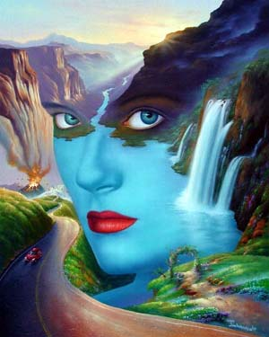
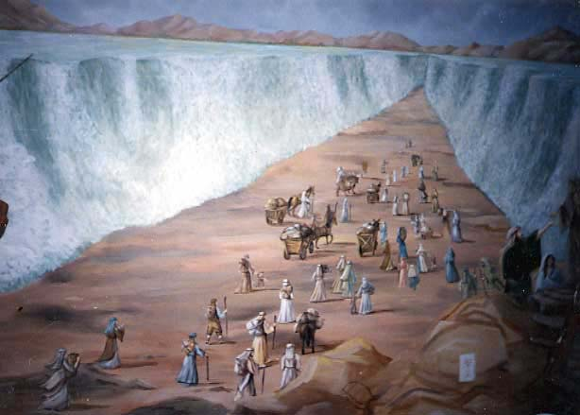
Mother Nature or God “Who controls the weather?”

Slide 37
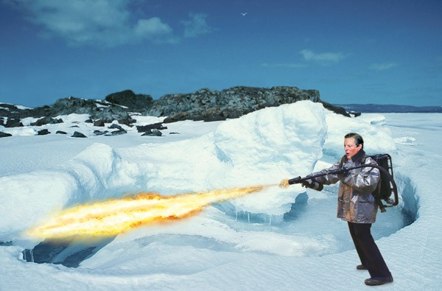
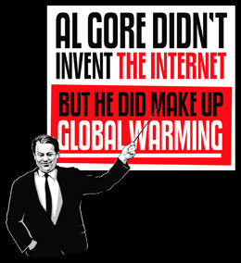
“O Timothy, keep that which is committed to thy trust, avoiding profane and vain babblings, and oppositions of science falsely so called: Which some professing have erred concerning the faith. Grace
be with thee. Amen”
I Timothy 6:20-21

Slide 38
God controls the weather.
Psalm 29:10 "The Lord sitteth upon the flood; yea, the Lord sitteth King for ever."
Psalm 107:25, 29 "For he commandeth, and raiseth the stormy wind, which lifteth up the waves thereof.... He maketh the storm a calm, so that the waves thereof are still.."
Proverbs 30:4 "Who hath gathered the wind in his fists? who hath bound the waters in a garment? who hath established all the ends of the earth? what is his name, and what is his son's name, if thou canst tell?"

Slide 39
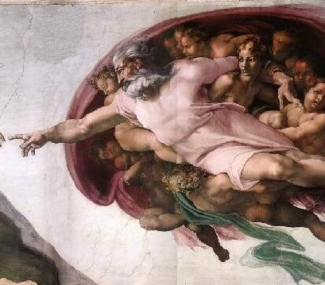
Genesis 6:5-9:19 - floods
Exodus 9:23-29 - fire
I Samuel 7:10 - thunder
Job 28:26 - lightening
Amos 4:7 - rain given and withheld from certain cities and places
Deuteronomy 11:13-15 - rain as reward for obedience
Leviticus 26:19-20 - parched earth
Nahum 1:3 - whirlwind

Slide 40
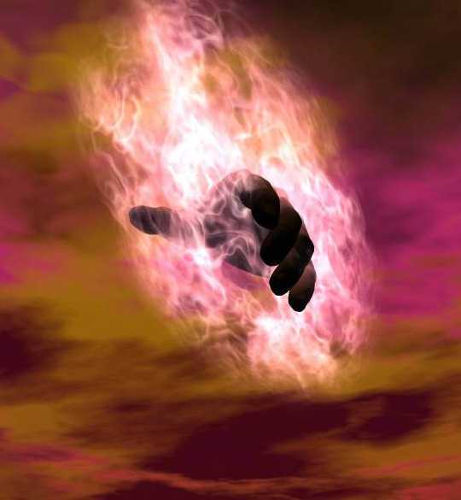
Deuteronomy 28:24 - drought as punishment for disobedience
I Samuel 12:18 – storms to get people's attention
I Kings 8:35-36 - good weather
Exodus 9:23 - bad weather
II Samuel 21:1 - famine
Hosea 13:15 - dry weather
Revelation 16:21 - hail

Slide 41
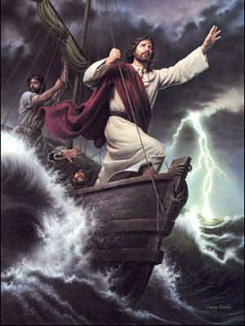
"And he arose, and rebuked the wind, and said unto the sea, Peace, be still. And the wind ceased, and there was a great calm....and [they] said ...even the wind and the sea obey him."

Slide 42
“While the earth remaineth, seedtime and harvest, and cold and heat, and summer and winter, and day and night shall not cease.” Genesis 8:22

Slide 43
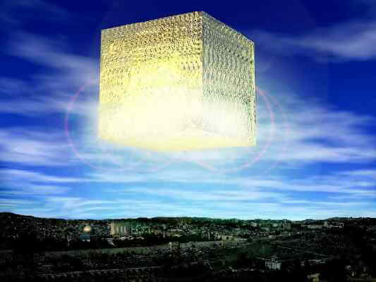
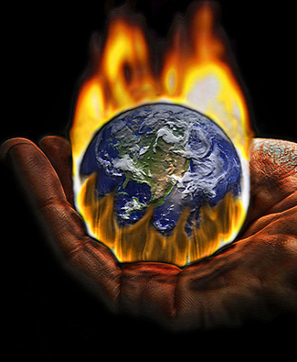
A new world is coming, when God will burn up this world and universe and create a New Heaven and New Earth (II Peter 3:10-13, Isaiah 65:17, Revelation 21)

Slide 44
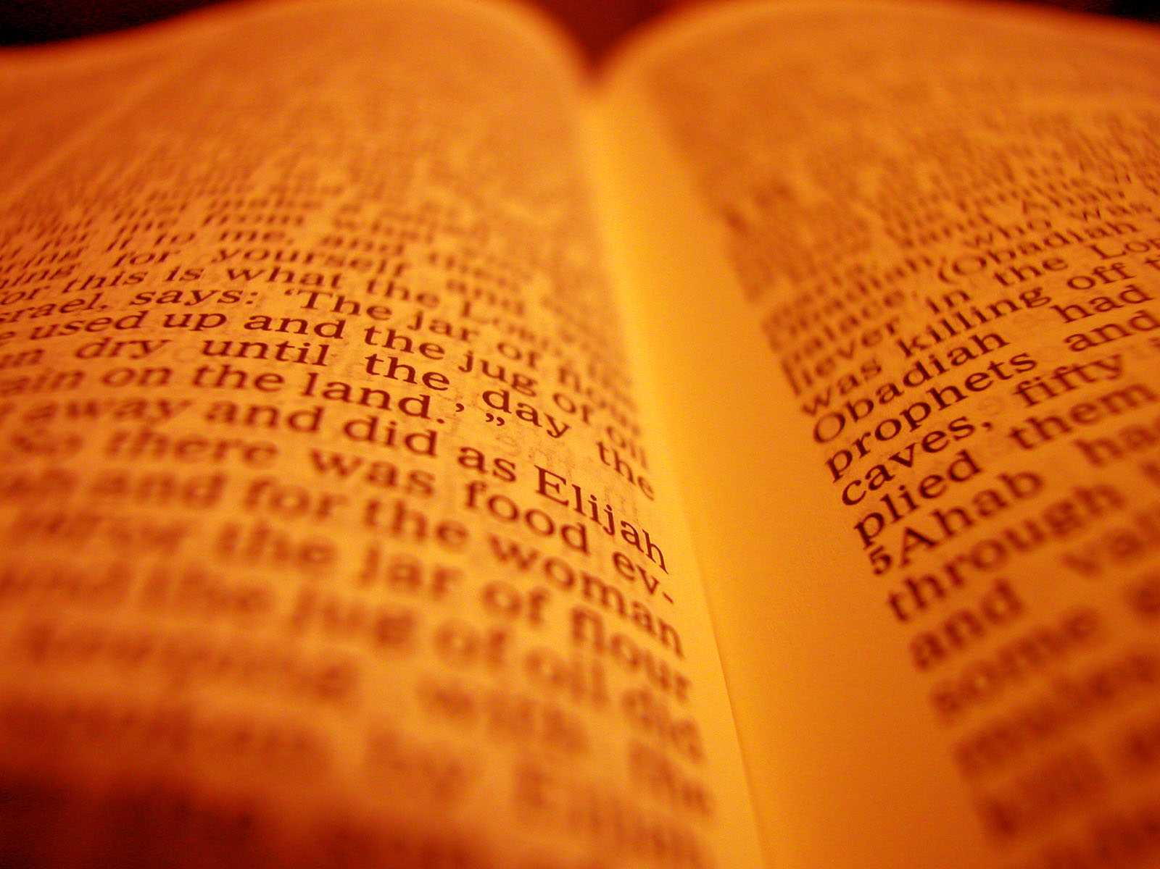
In keeping His promises
Rom. 4:21 “And being fully persuaded that, what he had promised, he was able also to perform.”
I John 2:25 “And this is the promise that he hath promised us, even eternal life.”
Titus 1:2 “In hope of eternal life, which God, that cannot lie, promised before the world began.”
Eph 2:12 “That at that time ye were without Christ, being aliens from the commonwealth of Israel, and strangers from the covenants of promise, having no hope, and without God in the world.”

Slide 45
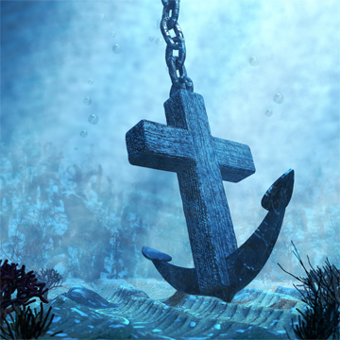
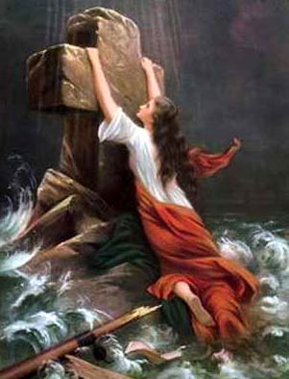
“Wherein God, willing more abundantly to shew unto the heirs of promise the immutability of his counsel, confirmed it by an oath: That by two immutable things, in which it was impossible for God to lie, we might have a strong consolation, who have fled for refuge to lay hold upon the hope set before us: Which hope we have as an anchor of the soul, both sure and stedfast.”
Hebrews 6:17-19

Slide 46
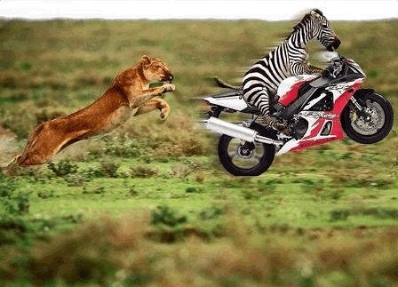
In times of temptation
“There hath no temptation taken you but such as is common to man: but God is faithful, who will not suffer you to be tempted above that ye are able; but will with the temptation also make a way to escape, that ye may be able to bear it.”
I Corinthians 10:13

Slide 47
In chastening his children
Psalm 119:75 "I know, O Lord, that thy judgments are right, and that thou in faithfulness hast afflicted me."
Hebrews 12:6 "For whom the Lord loveth he chasteneth, and scourgeth every son whom he receiveth."

Slide 48
In forgiving our sins
I John 1:9 "If we confess our sins, he is faithful and just to forgive us our sins, and to cleanse us from all unrighteousness."

Slide 50
“Blessed is he whose transgression is forgiven, whose sin is covered. Blessed is the man unto whom the LORD imputeth not iniquity, and in whose spirit there is no guile. When I kept silence, my bones waxed old through my roaring all the day long. For day and night thy hand was heavy upon me: my moisture is turned into the drought of summer. Selah. I acknowledged my sin unto thee, and mine iniquity have I not hid. I said, I will confess my transgressions unto the LORD; and thou forgavest the iniquity of my sin. Selah.” Psalm 32:1-5

Slide 51
In answering our prayers
Psalm 143:1 “Hear my prayer, O Lord, give ear to my supplications: in thy faithfulness answer me, and in thy righteousness.”
Jer. 33:3 “Call unto me, and
I will answer thee, and shew
thee great and mighty things,
which thou knowest not.”

Slide 52
In keeping us saved
“And the very God of peace sanctify you wholly; and I pray God your whole spirit and soul and body be preserved blameless unto the coming of our Lord Jesus Christ. Faithful is he that calleth you, who also will do it.”
I Thessalonians 5:23-24

Slide 53
“He that overcometh, the same shall be clothed in white raiment; and I will not blot out his name out of the book of life, but I will confess his name before my Father, and before his angels.”
Rev. 3:5

Slide 55
Great is Thy faithfulness
"Great is Thy faithfulness," O God my Father, There is no shadow of turning with Thee; Thou changest not, Thy compassions, they fail not As Thou hast been Thou forever wilt be.
Summer and winter, and springtime and harvest, Sun, moon and stars in their courses above, Join with all nature in manifold witness To Thy great faithfulness, mercy and love.

Slide 56
Pardon for sin and a peace that endureth, Thy own dear presence to cheer and to guide; Strength for today and bright hope for tomorrow, Blessings all mine, with ten thousand beside!
"Great is Thy faithfulness!" "Great is Thy faithfulness!" Morning by morning new mercies I see; All I have needed Thy hand hath provided— "Great is Thy faithfulness," Lord, unto me!

Slide 57
"God is faithful, by whom ye were called unto the fellowship of his Son Jesus Christ our Lord." I Corinthians 1:8-9

Slide 58
“Thy mercy, O LORD, is in the heavens; and thy faithfulness reacheth unto the clouds.” Psalm 36:5

Slide 59
"If we believe not, yet he abideth faithful: he cannot deny himself." II Timothy 2:13

Slide 60
Deuteronomy 7:9 "Know therefore that the Lord thy God, he is God, the faithful God, which keepeth covenant and mercy with them that love him and keep his commandments to a thousand generations."

Slide 61
God is incomprehensible
God is self-existence
God is self-sufficient
God is eternal
God is infinite
God is omnipotent
God is omnipresent
God is omniscient
God is all wise
God is immutable
God is sovereign
God is light
God is inscrutable
God is faithful

