Slide 1
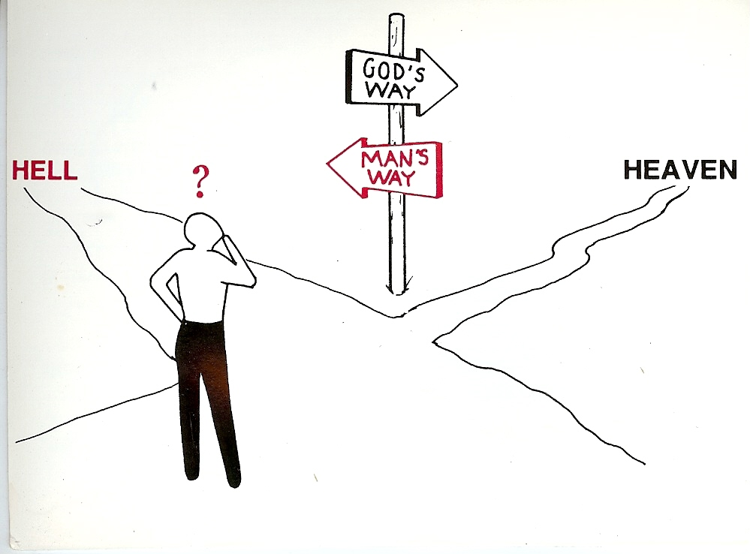
“There is a way that seemeth right unto a man, but the end thereof are the ways of death.”

Slide 2
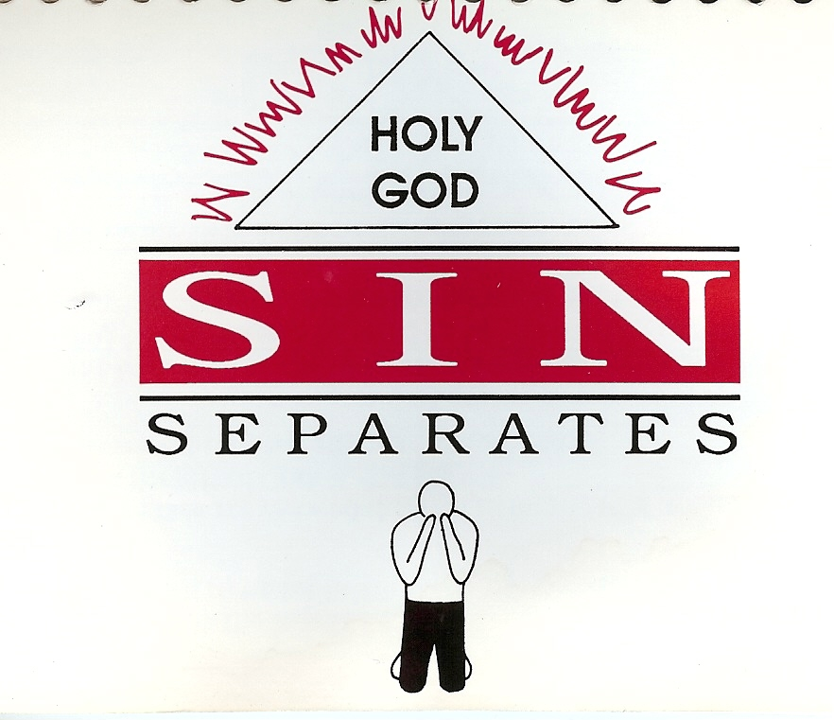

Slide 3
“For all have sinned.”

Slide 4
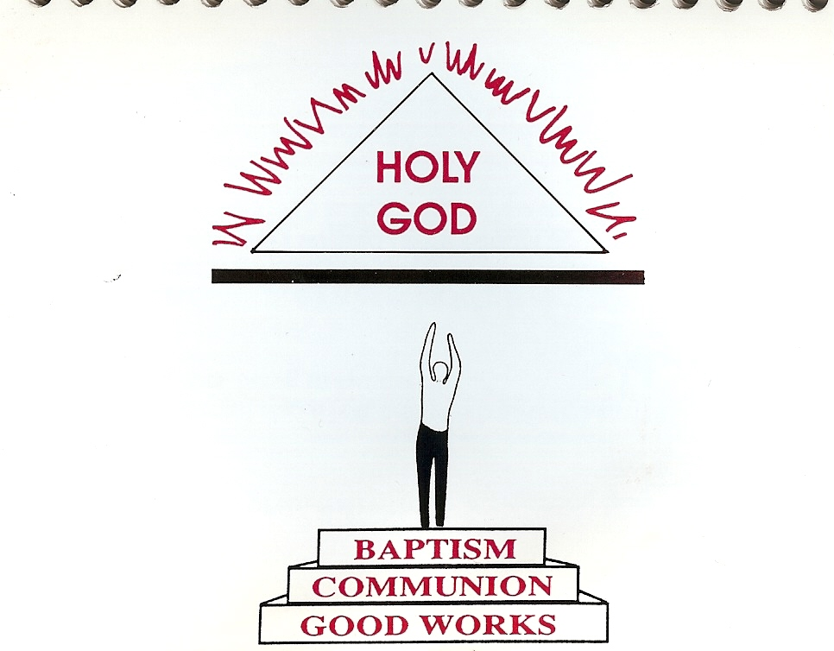

Slide 5
“Who his own self bare our sins in his own body on the tree, that we, being dead to sins, should live unto righteousness.” I Peter 2:24

Slide 6
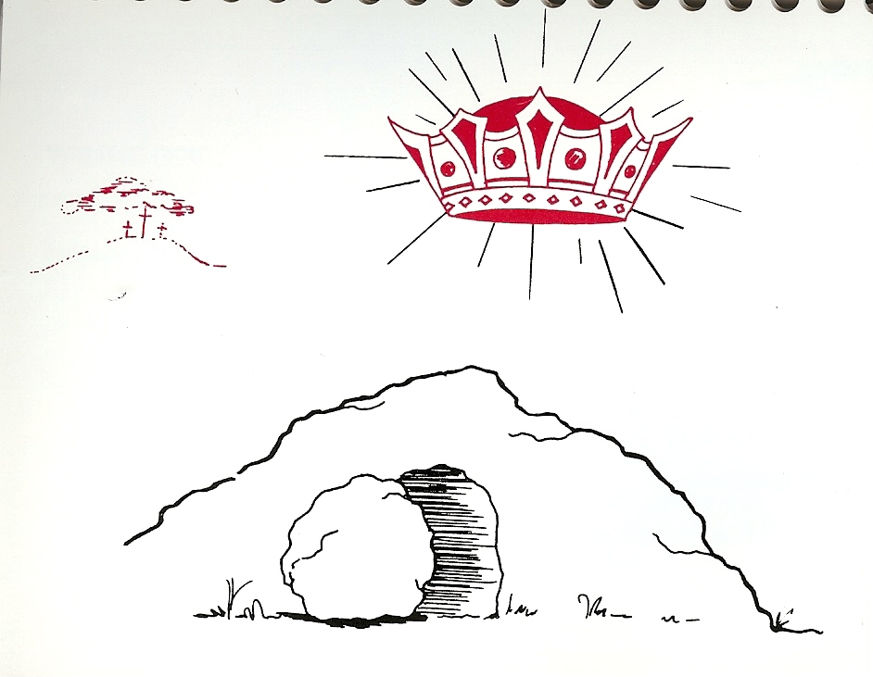
“Declared to be the Son of God with power, according to the spirit of holiness, by the resurrection from the dead.”

Slide 7
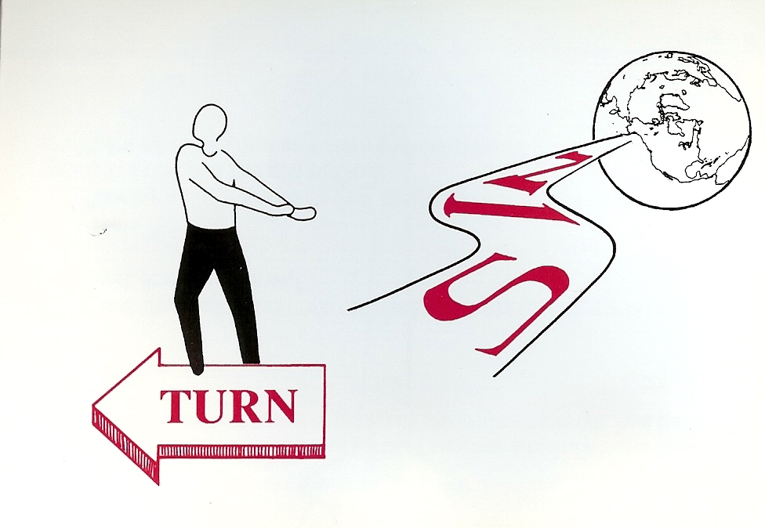
“Repent and believe the gospel”

Slide 8
“For by grace are ye saved through faith”

Slide 9
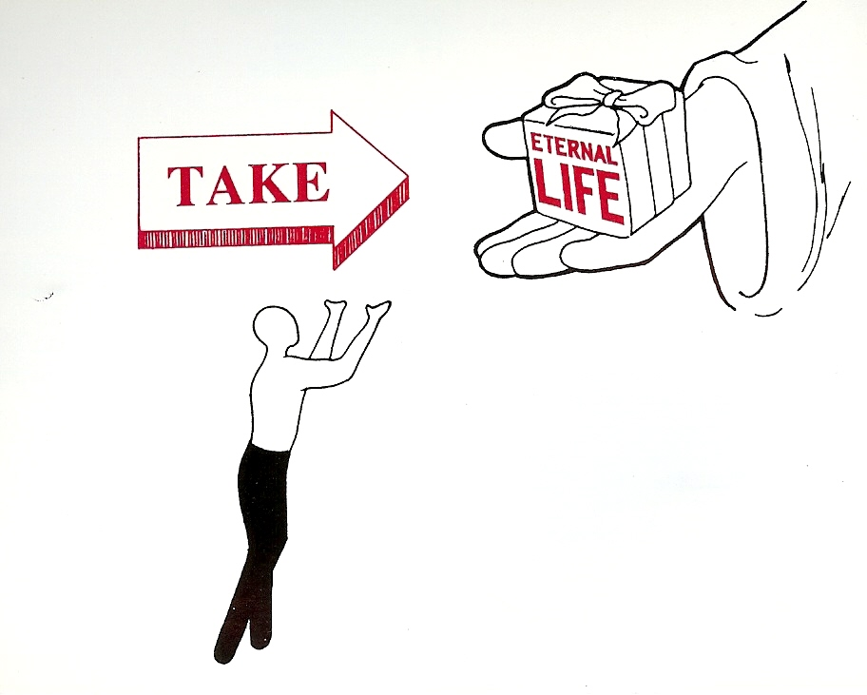
“But as many as received him, to them gave he power to become the sons of God, even to them that believe on his believe on his name.” John 1:12

Slide 10
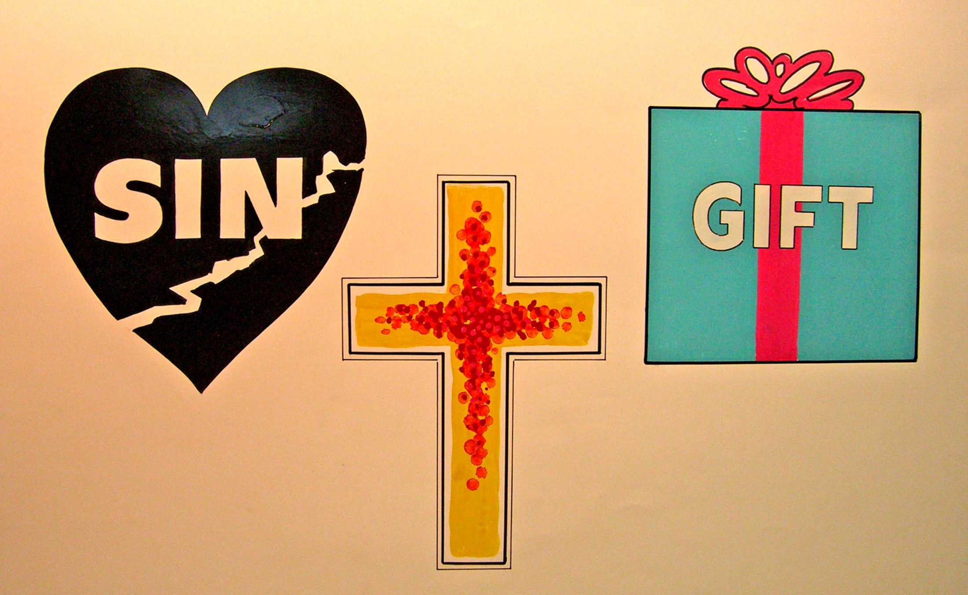

Slide 11
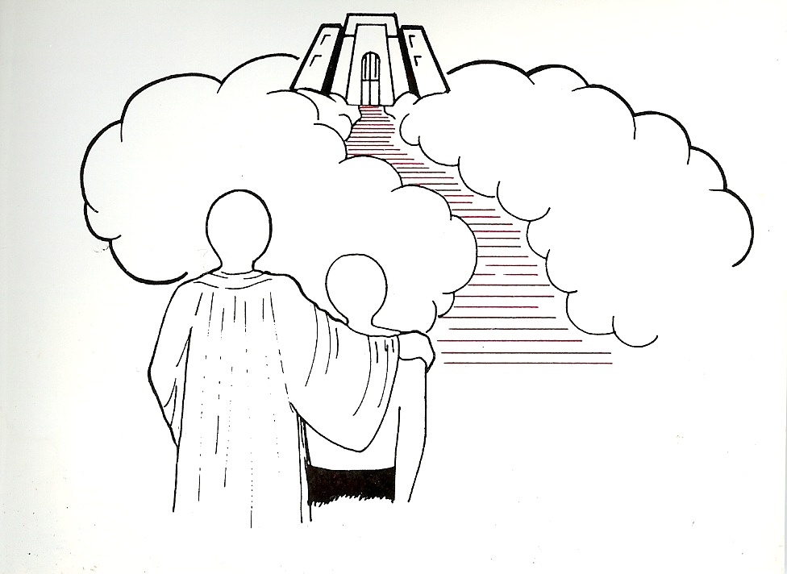
“For the wages of sin is death; but the gift of God is eternal life through Jesus Christ our Lord.” Romans 6:23

Slide 12
