Slide 1
The Doctrine of the Holy Spirit
(The Symbols of the Holy Spirit)
Part 3

Slide 3
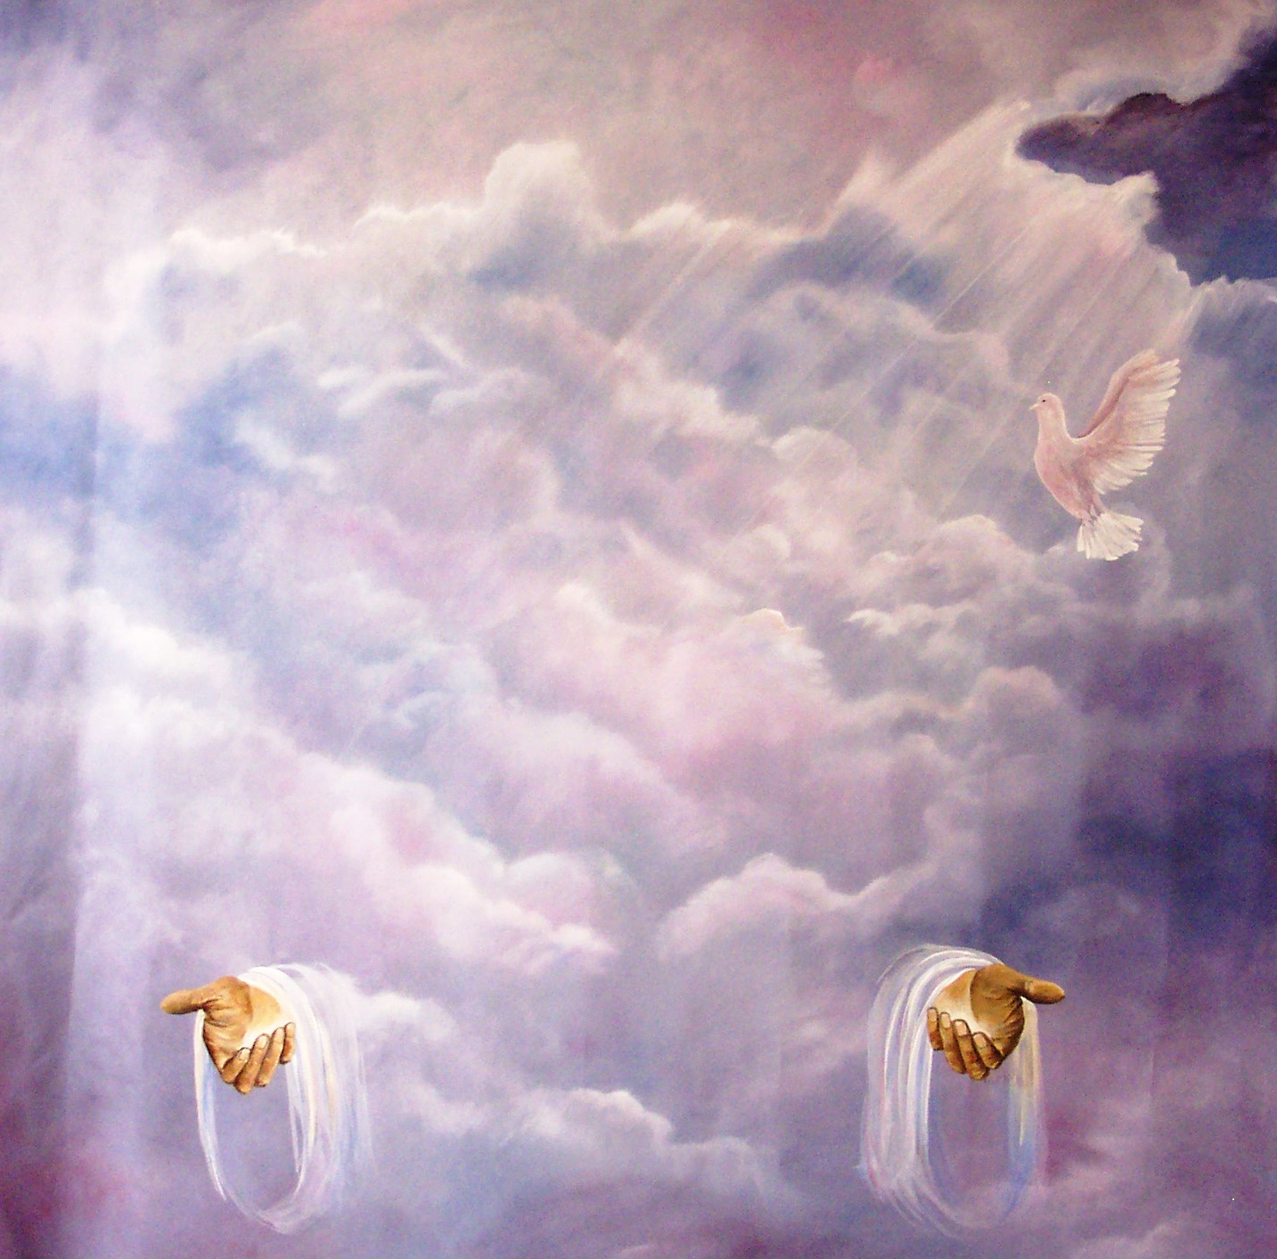
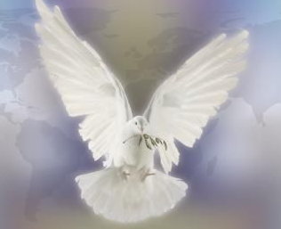
“Then Peter said unto them, Repent, and be baptized every one of you in the name of Jesus Christ for the remission of sins, and ye shall receive the gift of the Holy Ghost.” (Acts2:38)

Slide 4
In the New Testament alone there are some 261 passages which refer to the Holy Spirit. He is mentioned 56 times in the Gospels, 57 times in the book of Acts, 112 times in the Pauline epistles, and 36 times in the remaining New Testament. Total = 522

Slide 6
Because the Holy Spirit is Person you can have a personal relationship with him
Romans 8:14 “For as many as are led by the Spirit of God, they are the sons of God.”

Slide 8
I John 5:7-8 “For there are three that bear record in heaven, the Father, the Word, and the Holy Ghost: and these three are one. And there are three that bear witness in earth, the Spirit, and the water, and the blood: and these three agree in one.”

Slide 9
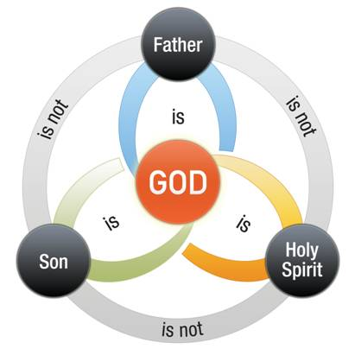

Slide 11
Spirit of God
Spirit of Christ
Eternal Spirit
Spirit of Truth
Spirit of Grace
Spirit of Glory
Spirit of Life
Spirit of Wisdom and Revelation
Spirit of Comfort
Spirit of Promise
Spirit of Holiness
Spirit of Adoption
Holy Ghost
Seven Spirits of God

Slide 12
The symbols of the Holy Spirit become essential to our gaining an understanding of who He is, what He’s like and His ministry in our lives, the Church
and the World.

Slide 13
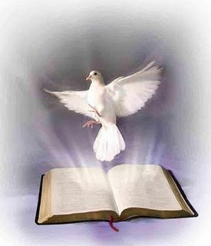
The seven designated symbols of the Holy Spirit, like the fourteen names and titles, throw light upon both his nature and mission.

Slide 14
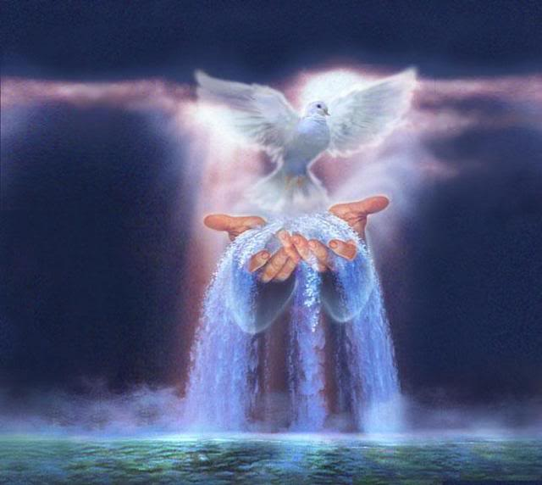
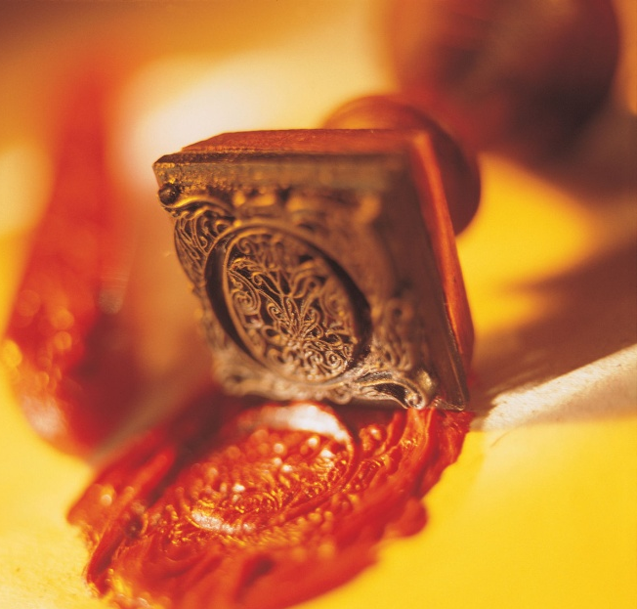
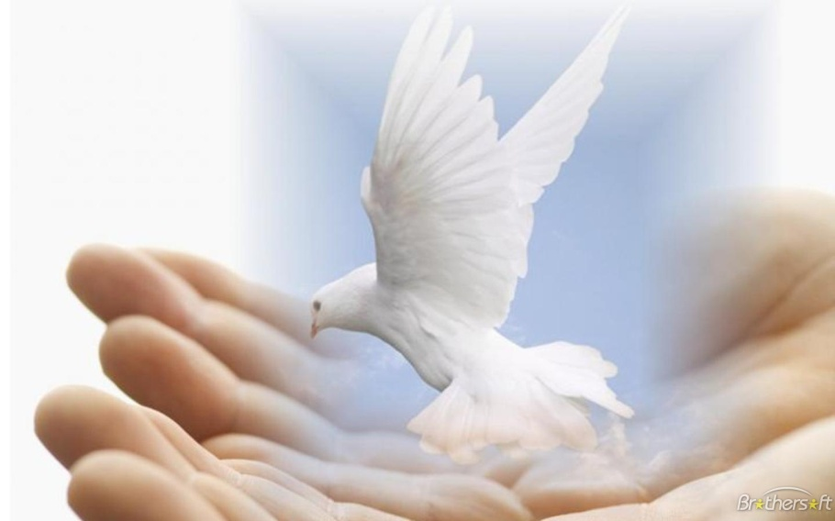
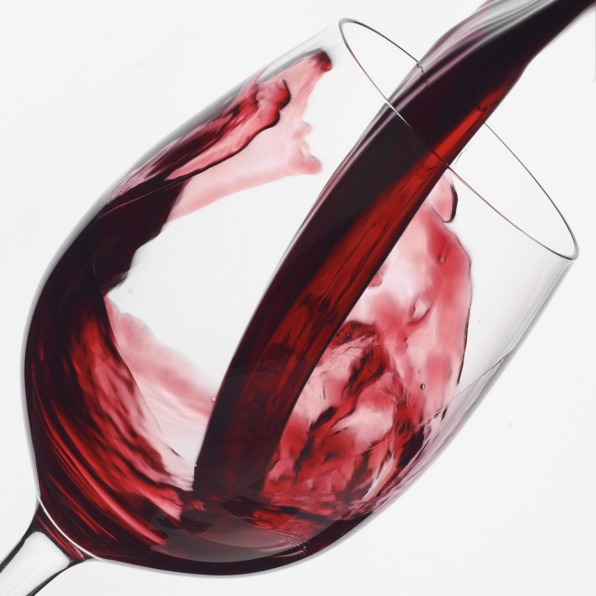
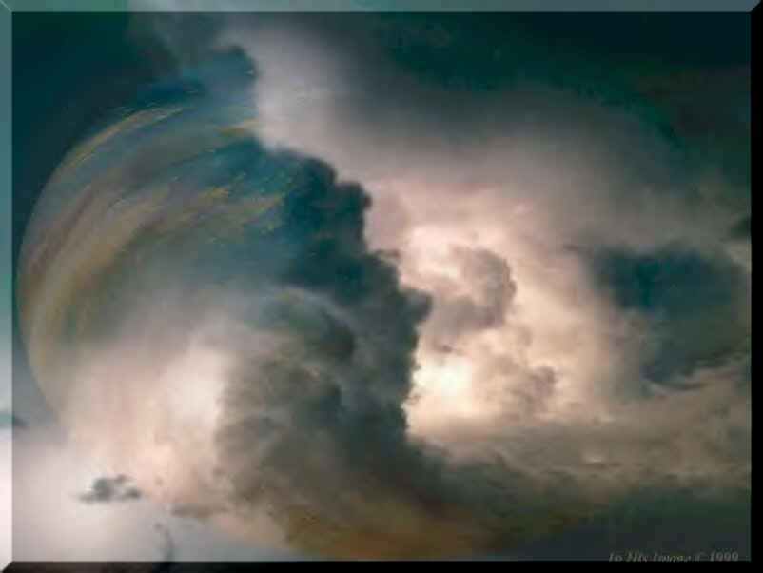
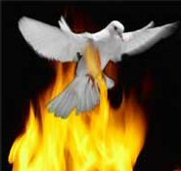

Slide 15
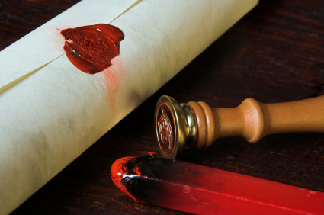
Tonight’s Message
The Holy Spirit as a Seal

Slide 16
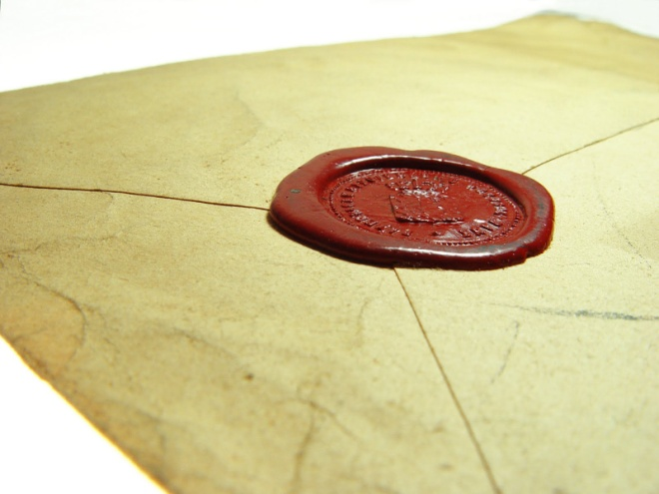
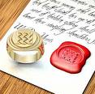
A Seal Indicating ownership, finished transaction, identification, security, genuineness, value, authority.

Slide 17
"In whom ye also trusted, after that ye heard the word of truth, the gospel of your salvation: in whom also, after that ye believed, ye were sealed with that Holy Spirit of promise." (Eph. 1:13)
"And grieve not the Holy Spirit of God, whereby ye are sealed unto the day of redemption." (Eph. 4:30)
"Who hath also sealed us, and given the earnest of the Spirit in our hearts." (II Cor. 1:22)

Slide 18
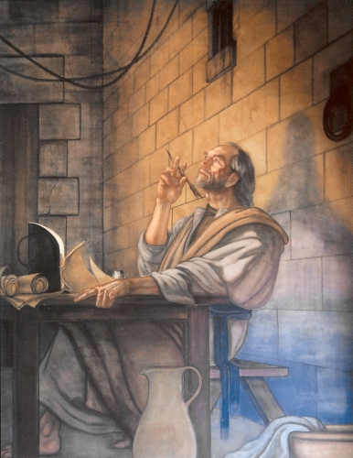
"Sealing" is an analogy used by Paul to express a truth about the present state of all believers in Jesus Christ.

Slide 19
The sealing of the Holy Spirit, is referring to the fact that all believers in Jesus Christ have the Holy Spirit dwelling in them (I Cor. 3:16), and this indwelling presence is therefore a "mark/seal" that those who have put our faith in Jesus Christ are definitively now the property of God Himself –
I Cor. 6:20; 7:23 “For ye are bought with a price: therefore glorify God in your body, and in your spirit, which are God's…Ye are bought with a price; be not ye the servants of men.”

Slide 20
The analogy uses a well-known practice in the ancient world of rolling up a document then affixing a wax seal that is then marked with a person's signet ring.

Slide 21
The seal of course could be broken easily enough, but once broken could not be reconstructed, so that few would venture to violate a seal, especially if the seal were that of a powerful person.

Slide 22
Question: Once a person is sealed by the Holy Spirit, can this seal be revoked?

Slide 23
Breaking God's seal is impossible
(II Cor. 1:21-22)
Thus our sealing by the Spirit is a comfort (John 14:16) and a guarantee that nothing can come between us and our reward, between us and our resurrection, between us and our eternal life (Heb. 5:9).
Nothing can make God loosen His grip on us (John 10:28-29), and no one in heaven and on earth is capable to break His seal on us (Rom. 8:38-39).

Slide 24
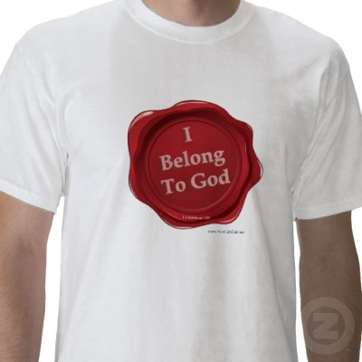

Slide 25
Eternal Salvation Verses
John 6:37 - All that the Father giveth me shall come to me; and him that cometh to me I will in no wise cast out.
John 5:24 - Verily, verily, I say unto you, He that heareth my word, and believeth on him that sent me, hath everlasting life, and shall not come into condemnation; but is passed from death unto life.

Slide 26
John 10:28 - And I give unto them eternal life; and they shall never perish, neither shall any [man] pluck them out of my hand.
John 3:16 - For God so loved the world, that he gave his only begotten Son, that whosoever believeth in him should not perish, but have everlasting life.
I John 5:13 - These things have I written unto you that believe on the name of the Son of God; that ye may know that ye have eternal life, and that ye may believe on the name of the Son of God.

Slide 27
Revelation 3:5 - He that overcometh, the same shall be clothed in white raiment; and I will not blot out his name out of the book of life, but I will confess his name before my Father, and before his angels.
Hebrews 10:14 - For by one offering he hath perfected for ever them that are sanctified.
Romans 6:23 - For the wages of sin [is] death; but the gift of God [is] eternal life through Jesus Christ our Lord.

Slide 28
John 20:31 - But these are written, that ye might believe that Jesus is the Christ, the Son of God; and that believing ye might have life through his name.
John 3:18 - He that believeth on him is not condemned: but he that believeth not is condemned already, because he hath not believed in the name of the only begotten Son of God.
Jude 1:24 - Now unto him that is able to keep you from falling, and to present [you] faultless before the presence of his glory with exceeding joy,
I John 1:9 - If we confess our sins, he is faithful and just to forgive us [our] sins, and to cleanse us from all unrighteousness.

Slide 29
Ephesians 2:8-10 - For by grace are ye saved through faith; and that not of yourselves: [it is] the gift of God: not of works, lest any man should boast.
Romans 5:1-21 - Therefore being justified by faith, we have peace with God through our Lord Jesus Christ.
John 3:36 - He that believeth on the Son hath everlasting life: and he that believeth not the Son shall not see life; but the wrath of God abideth on him.
John 1:12 - But as many as received him, to them gave he power to become the sons of God.

Slide 30
(I Peter 1:3-4)
“Blessed be the God and Father of our Lord Jesus Christ, which according to his abundant mercy hath begotten us again unto a lively hope by the resurrection of Jesus Christ from the dead, To an inheritance incorruptible, and undefiled, and that fadeth not away, reserved in heaven for you. Who are kept by the power of God through faith unto salvation ready to be revealed in the last time.”

Slide 31
80 Biblical reasons why a Believer cannot lose their Salvation

Slide 32
We can know we have eternal life – full assurance
Born again – once you are born you can not be unborn
Saved by Grace
Saved through faith apart from the works of the law (good deeds)
Salvation is the gift of God – If a gift can be taken away it is really not a gift
Preserved in Christ Jesus
Called, predestinated and elected
Under the blood of the new covenant

Slide 33
Under the blood of the new covenant
Married to Christ / bride of Christ – “When we are not faithful he remains faithful”
Sealed unto the day of redemption
Given the earnest of the Spirit
Indwelt by the abiding presents of the Holy Spirit who will never be taken away from us
God’s seed remains in us
Saved to the utter most
Eternal redemption in Christ
Reconciled to God through Christ

Slide 34
We are in Christ and Christ is in us
Christ became sin for us who knew no sin that we might become the righteousness of God in Him
Clothed in the white robs of the righteousness of Christ
Holy, blameable and unreprovable in his sight
Christ ever lives to make intercession for us
Perfected us forever
Our sin and iniquity he will remember no more
Our sin is buried in the deepest sea
Christ blotted out the hand writing of the ordinances that were against us and took it out of the way

Slide 35
Our sin was nailed to the cross
Redeemed by the blood of the lamb
We have remission of sin through the blood of Christ
We are made new creatures in Christ / regeneration
Our old man is dead / crucified with Christ
Our names are written in the Lambs book of life never to be blotted out
As far as the east is from the west so far hath he removed our transgression from us
Cleansed by the blood of Christ

Slide 36
Our sin debt was paid in full by the shed blood of Jesus Christ
Kept by the power of God
Forgiven of our past, present and future sins
We have an inheritance that is incorruptible, undefiled, and fadeth not away reserved in heaven for us
We are complete in Christ
God always causeth us to triumph in Christ
God promised that he would never leave us
God promised that he would never forsake us

Slide 37
Our life is hid with Christ in God
No longer under the curse of the law
“There is therefore now no condemnation to those who are in Christ Jesus…”
We are given the promise eternal life – (If you could lose your salvation it would not be eternal)
We will never perish
No man can pluck us from the Father’s hand
We will never be cast out
Adopted into the family of God (story of the prodigal son)

Slide 38
Justified and glorified
Sanctified in Christ Jesus
Joint heirs with Jesus Christ
Nothing can separate us from the love of God
Christ is our advocate
Christ is our propitiation
Christ death was a once-and-for-all sacrifice for sin
We have peace through the blood of his cross
Our hearts never need to be troubled
Confirmed unto the end
Translated into the kingdom of his dear son

Slide 39
Translated into the kingdom of his dear son
Seated with Christ in heavenly places
Transferred from darkness to light
From the power of Satan unto God
From death unto life
More then conquers
Overcomers
Nothing can be laid to the charge of God’s elect
We can lose the joy of our salvation but not our salvation
Believers that backslide need to be restored to fellowship not salvation

Slide 40
Even the carnal believers in Corinth were called “saints”
“Being confident of this very thing (salvation) that he which hath begun a good work in you will perform it until the day of Jesus Christ”
“Not appointed to wrath, but to obtain salvation…”
“I am persuaded that he is able to keep that which I have committed unto him against that day…”
God has pardoned all of our sin and iniquity
Salvation is of the Lord

Slide 41
The immutability of God secures our salvation – “Wherein god willing more abundantly to shew unto the heirs of promise the immutiability of his counsel, confirmed it by an oath…that we might have a strong consolation…which hope we have as a anchor of the soul, both sure and steadfast…”
If you believe you must maintain your salvation by good works or not sinning then you are placing confidence in the flesh – “Have no confidence in the flesh…”
We are the “body of Christ” – if you could lose your salvation then Christ would have to be dismembered
“Where sin abounds grace does much more abound…”

Slide 42
“And such trust have we through Christ to God-ward: Not that we are sufficient of ourselves to think any thing as of ourselves; but our sufficiency is of God…”
Jesus is the “author and finisher of our faith”
The finished work of Christ “It is finished”
Question: How can a person lose their salvation when salvation does not depend in the slightest upon human effort or merit (religion dams / Christ saves).
Salvation depends 100% upon the merits of Christ and the power of God!!!!!!!!!

Slide 43
All you need to do to lose your salvation is to lose every thing you received at the time of salvation.

Slide 44
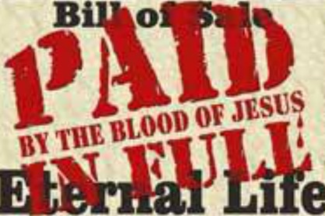

Slide 46
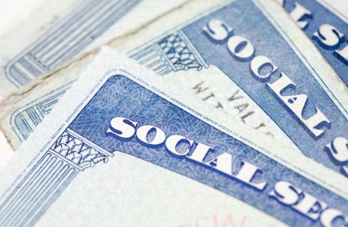

Slide 47
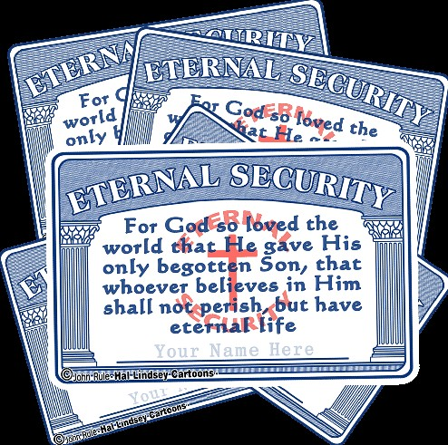

Slide 48
(Ephesians 1:13-14) “In whom ye also trusted, after that ye heard the word of truth, the gospel of your salvation: in whom also after that ye believed, ye were sealed with that holy Spirit of promise, Which is the earnest of our inheritance until the redemption of the purchased possession, unto the praise of his glory.”

