Slide 1
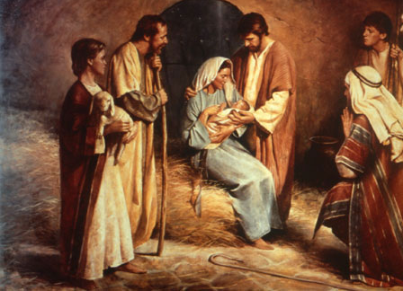
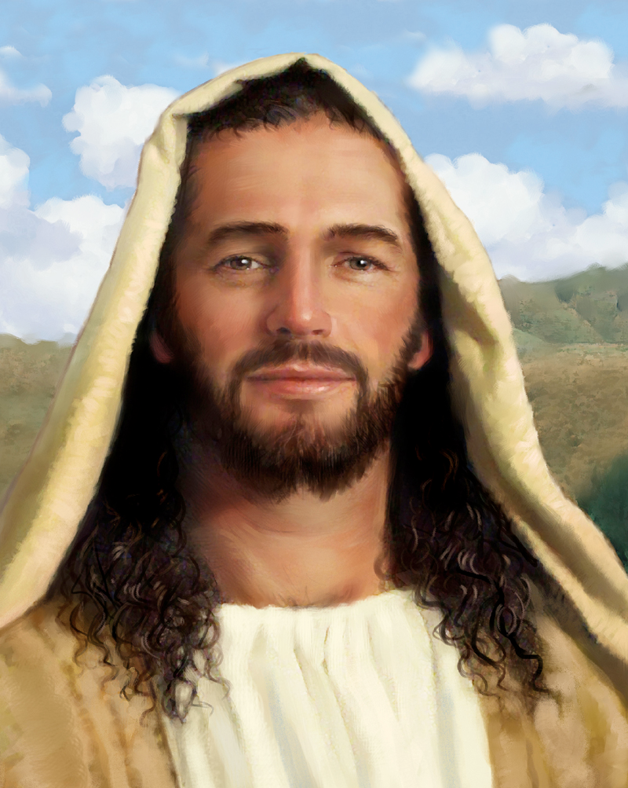
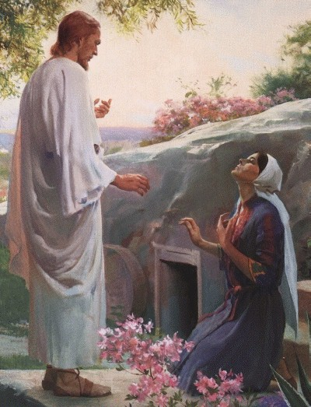
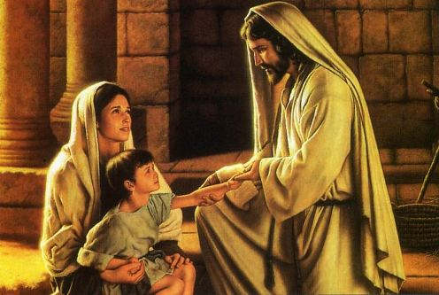
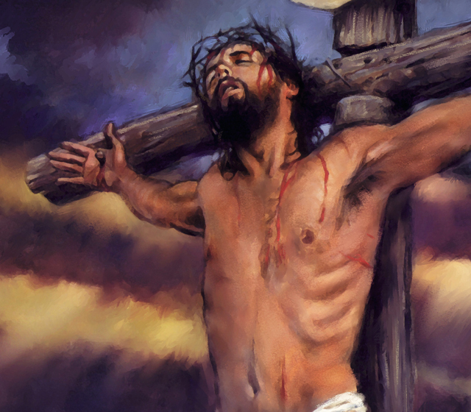
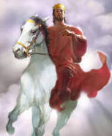
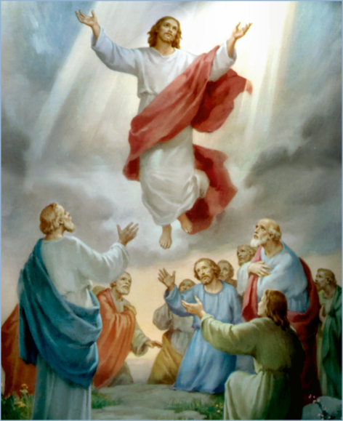
The Doctrine of Jesus Christ (Part 2)
The Old Testament ministry of Jesus Christ

Slide 2
Review

Slide 3
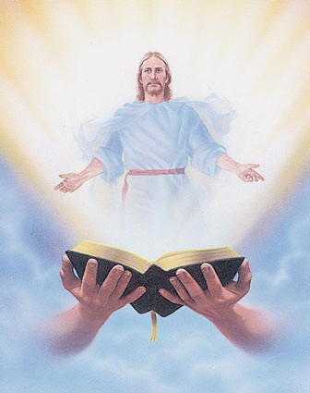
The fact of his divine preexistence
“Search the scriptures; for in them ye think ye have eternal life: and they are they which testify of me.”

Slide 4
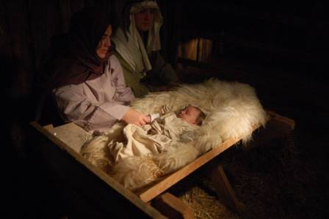
The activities of the divine preexistent Christ
What was the Savior doing prior to
his Bethlehem appearance?

Slide 5
He was creating the universe
"All things were made by him; and without him was not any thing made that was made" (John 1:3)
"For by him were all things created, that are in heaven, and that are in earth, visible and invisible, whether they be thrones, or dominions, or principalities, or powers: all things were created by him, and for him" (Col. 1:16)
"Hath in these last days spoken unto us by his Son, whom he hath appointed heir of all things, by whom also he made the world...And, thou, Lord, in the beginning hast laid the foundation of the earth; and the heavens are the works of thine hands" (Heb. 1:2, 10)

Slide 6
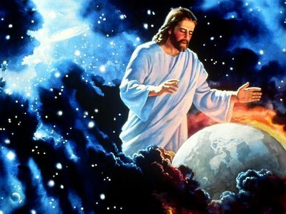

Slide 7
He was controlling his created universe
"Who being the brightness of his glory, and the express image of his person, and upholding all things by the word of his power, when he had by himself purged our sins, sat down on the right hand of the Majesty on high" (Heb. 1:3)
"And he is before all things, and by him all things consist" (Col. 1:17)
Our Lord Jesus not only put all things together, but he continues to keep all things together.

Slide 8
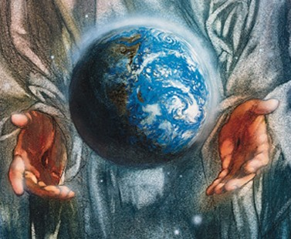

Slide 9
He was communing with the Father (John 17)
“These words spake Jesus, and lifted up his eyes to heaven, and said, Father, the hour is come; glorify thy Son, that thy Son also may glorify thee…I have glorified thee on the earth: I have finished the work which thou gavest me to do…And now, O Father, glorify thou me with thine own self with the glory which I had with thee before the world was…
(John 17:11-24)

Slide 10
That they all may be one; as thou, Father, art in me, and I in thee, that they also may be one in us: that the world may believe that thou hast sent me…I in them, and thou in me, that they may be made perfect in one; and that the world may know that thou hast sent me, and hast loved them, as thou hast loved me…Father, I will that they also, whom thou hast given me, be with me where I am; that they may behold my glory, which thou hast given me: for thou lovedst me before the foundation of the world…O righteous Father, the world hath not known thee: but I have known thee.”

Slide 11
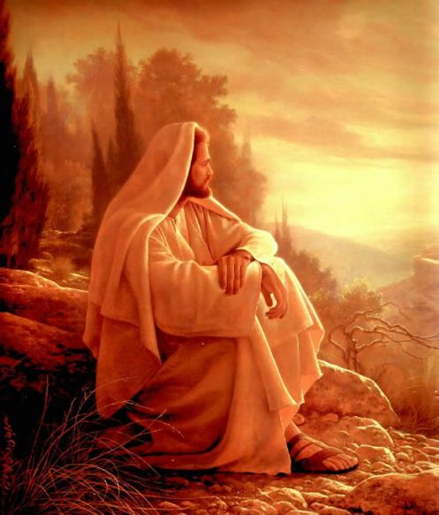

Slide 12
The Old Testament records a number of theophanies. A theophany is a pre-Bethlehem appearance of Christ.

Slide 14
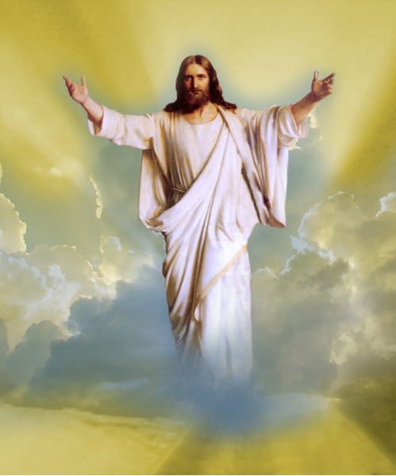
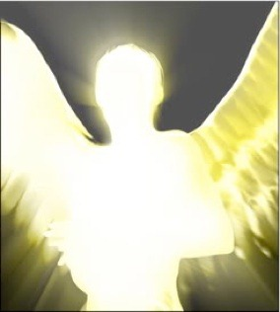
The most frequent appearance of Christ in the Old Testament
Most Bible theologians hold that the recurring appearance of the angel of the Lord in the Old Testament is to be identified with Christ himself.
This theological position is strongly suggested by two key passages.

Slide 15
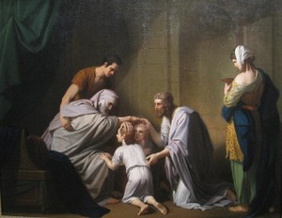
The first is found in Genesis 48:15-16 where the dying patriarch, Jacob, is blessing his two grandchildren (Ephraim and Manasseh)

Slide 16
The old founder of Israel prays

Slide 17
“And he blessed Joseph, and said, God, before whom my fathers Abraham and Isaac did walk, the God which fed me all my life long unto this day, The Angel which redeemed me from all evil, bless the lads; and let my name be named on them, and the name of my fathers Abraham and Isaac; and let them grow into a multitude in the midst of the earth.”

Slide 18
As no regular angel could ever redeem men, the angel here is actually Christ.
Titus 2:14 “Who gave himself for us, that he might redeem us from all iniquity, and purify unto himself a peculiar people, zealous of good works.”
Gal. 4:4-5 “But when the fulness of the time was come, God sent forth his Son, made of a woman, made under the law, To redeem them that were under the law, that we might receive the adoption of sons.”

Slide 19
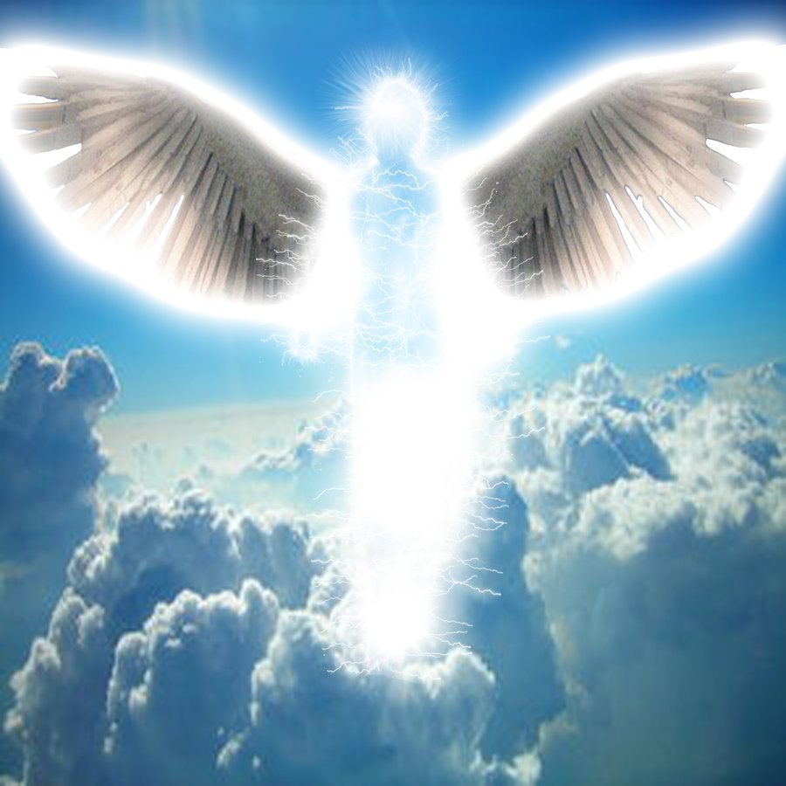
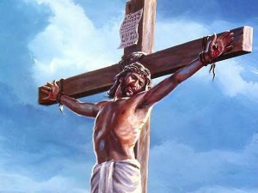

Slide 20
The second passage is found in Judges 13 where a barren couple has just learned from the angel of the Lord about the future birth of their son Samson.

Slide 21
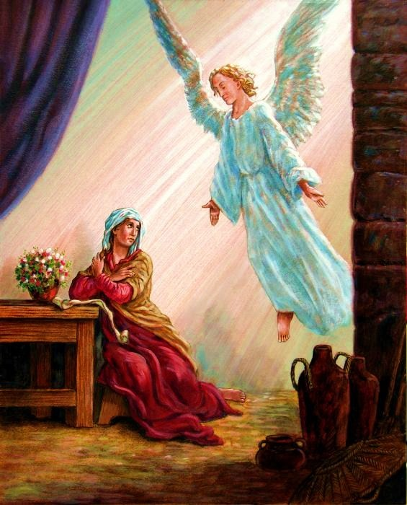
“And the angel of the LORD appeared unto the woman, and said unto her, Behold now, thou art barren, and bearest not: but thou shalt conceive, and bear a son.”

Slide 22
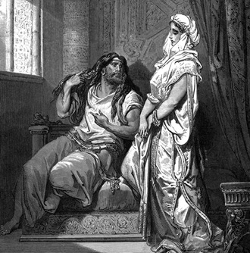
“Then the woman came and told her husband, saying, A man of God came unto me, and his countenance was like the countenance of an angel of God, very terrible: but I asked him not whence he was, neither told he me his name.”

Slide 23
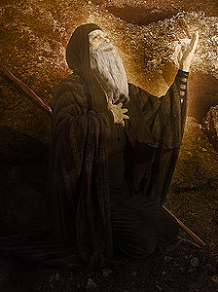
“Then Manoah intreated the LORD, and said, O my Lord, let the man of God which thou didst send come again unto us, and teach us what we shall do unto the child that shall be born.”

Slide 24
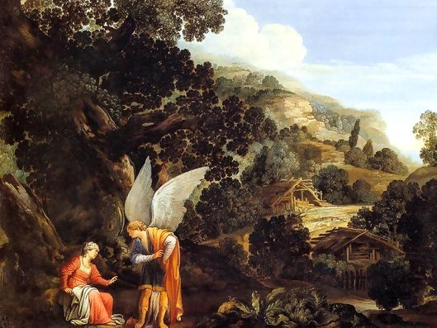
“And God hearkened to the voice of Manoah; and the angel of God came again unto the woman as she sat in the field: but Manoah her husband was not with her. And the woman made haste, and ran, and shewed her husband, and said unto him, Behold, the man hath appeared unto me, that came unto me the other day.”

Slide 25
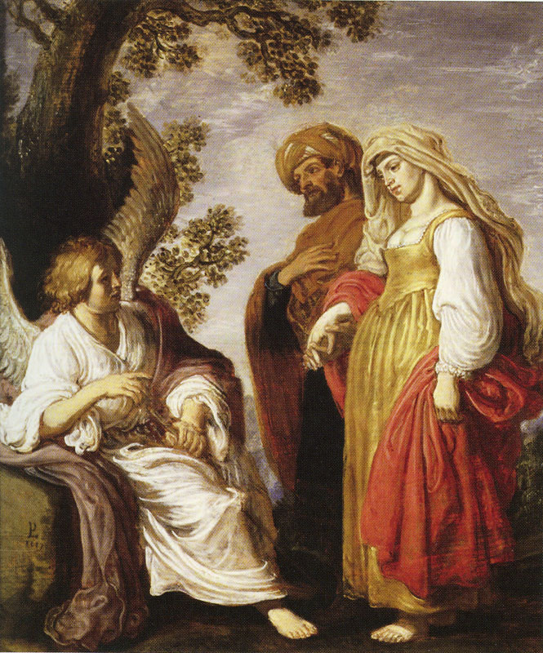
“And Manoah arose, and went after his wife, and came to the man, and said unto him, Art thou the man that spakest unto the woman? And he said, I am.”

Slide 26
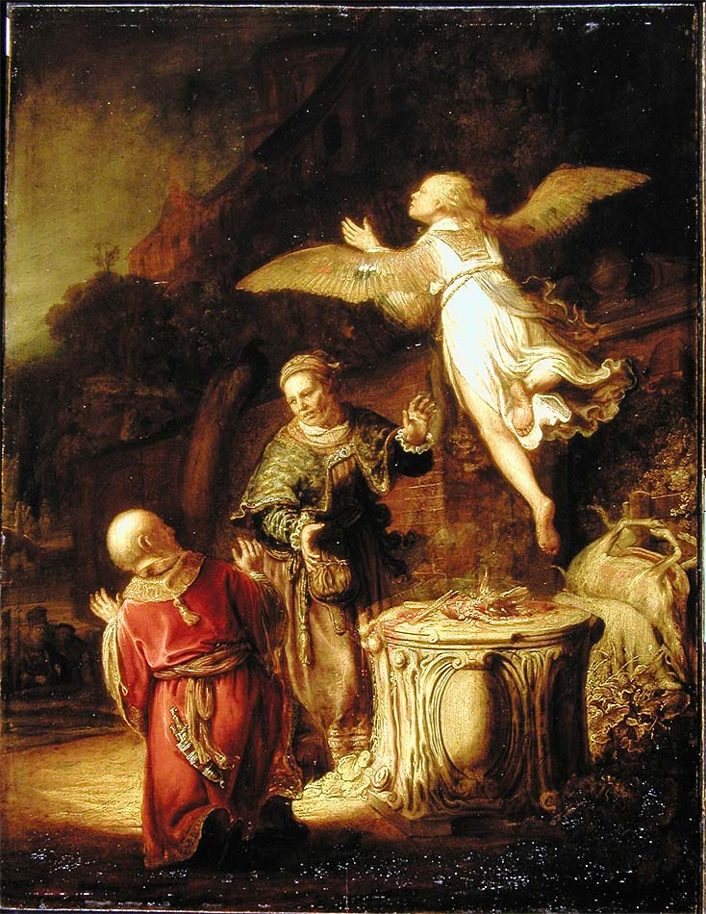
“And Manoah said, Now let thy words come to pass. How shall we order the child, and how shall we do unto him?”

Slide 27
“And Manoah said unto the angel of the LORD, I pray thee, let us detain thee, until we shall have made ready a kid for thee. And the angel of the LORD said unto Manoah, Though thou detain me, I will not eat of thy bread: and if thou wilt offer a burnt offering, thou must offer it unto the LORD. For Manoah knew not that he was an angel of the LORD. And Manoah said unto the angel of the LORD, What is thy name, that when thy sayings come to pass we may do thee honour? And the angel of the LORD said unto him, Why askest thou thus after my name, seeing it is secret?”

Slide 28
The secret is revealed in Isaiah 9:6
This word, "secret," is from the same Hebrew word found in Isaiah 9:6, where it is translated "wonderful."
"For unto us a child is born, unto us a son is given: and the government shall be upon his shoulder: and his name shall be called Wonderful, Counsellor, The mighty God, The everlasting Father, The Prince of Peace"

Slide 29
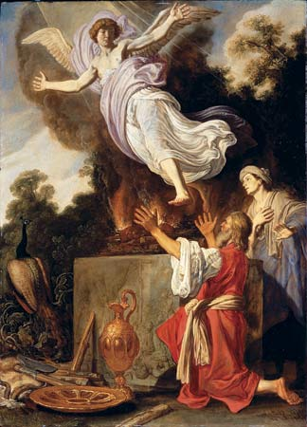
“So Manoah took a kid with a meat offering, and offered it upon a rock unto the LORD: and the angel did wondrously; and Manoah and his wife looked on.”

Slide 30
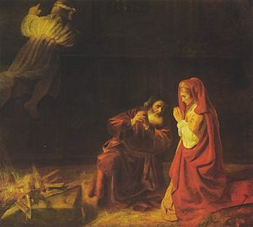
“And Manoah said unto his wife, We shall surely die, because we have seen God. But his wife said unto him, If the LORD were pleased to kill us, he would not have received a burnt offering and a meat offering at our hands, neither would he have shewed us all these things, nor would as at this time have told us such things as these.”

Slide 31
Some Old Testament Theophanies

Slide 32
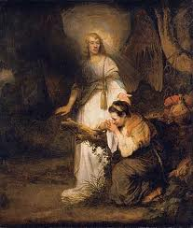
Jesus appeared to Hagar, Abraham’s Egyptian wife (Gen. 16:7-14)

Slide 33
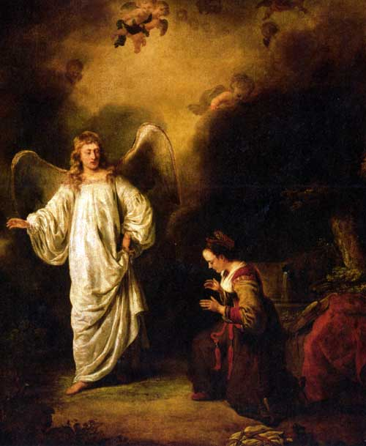
The first Biblical reference to the angel of the Lord occurs here as he tenderly ministers to a pagan and pregnant Egyptian girl.

Slide 34
“And the angel of the LORD found her by a fountain of water in the wilderness, And he said, Hagar, Sarai's maid, whence camest thou? and whither wilt thou go? And she said, I flee from the face of my mistress Sarai. And the angel of the LORD said unto her, Return to thy mistress, and submit thyself under her hands. And the angel of the LORD said unto her, I will multiply thy seed exceedingly, that it shall not be numbered for multitude.

Slide 35
And the angel of the LORD said unto her, Behold, thou art with child, and shalt bear a son, and shalt call his name Ishmael; because the LORD hath heard thy affliction. And he will be a wild man; his hand will be against every man, and every man's hand against him; and he shall dwell in the presence of all his brethren. And she called the name of the LORD that spake unto her, Thou God seest me.”

Slide 36
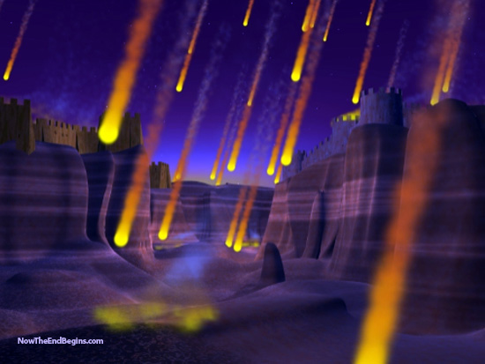
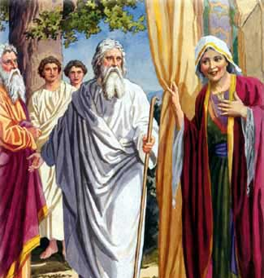
Jesus appeared to Abraham (Gen. 18:1; 22:11-13)
These two appearances came at critical times in Abraham’s life.
One (Gen. 18) concerned itself with Sarah having a son and the destruction of Sodom.

Slide 37
“And the men turned their faces from thence, and went toward Sodom: but Abraham stood yet before the LORD. And Abraham drew near, and said, Wilt thou also destroy the righteous with the wicked?” (Genesis 18:22-23)

Slide 38
50 45 40 30 20 10

Slide 39
“And the LORD went his way, as soon as he had left communing with Abraham: and Abraham returned unto his place.” (Genesis 18:33)

Slide 40
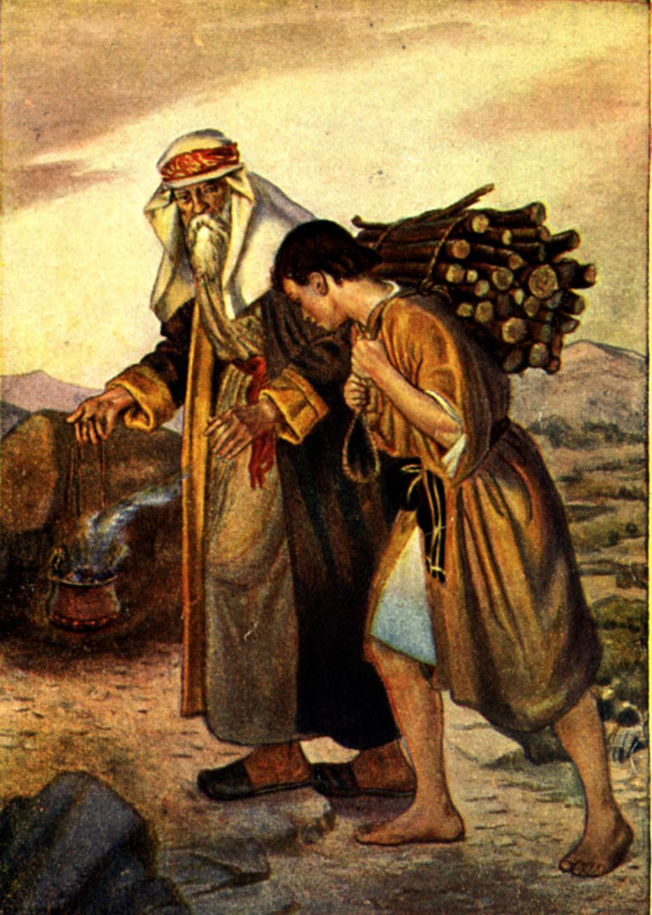
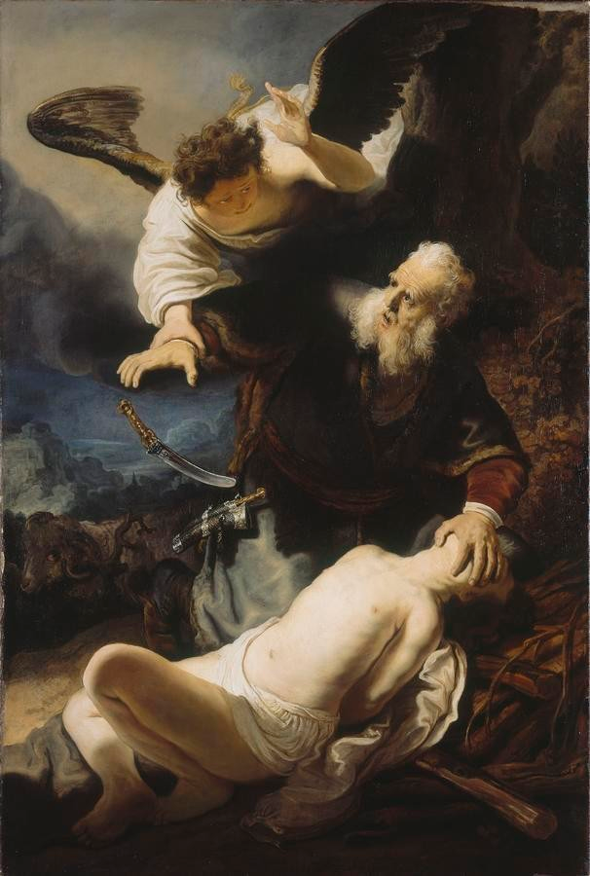
The other (Gen. 22) with the last-minute salvation of Isaac.

Slide 41
“And the angel of the LORD called unto him out of heaven, and said, Abraham, Abraham: and he said, Here am I. And he said, Lay not thine hand upon the lad, neither do thou any thing unto him: for now I know that thou fearest God, seeing thou hast not withheld thy son, thine only son from me.” (Genesis 22:11-12)

Slide 42
“And the angel of the LORD called unto Abraham out of heaven the second time, And said, By myself have I sworn, saith the LORD, for because thou hast done this thing, and hast not withheld thy son, thine only son: That in blessing I will bless thee, and in multiplying I will multiply thy seed as the stars of the heaven, and as the sand which is upon the sea shore; and thy seed shall possess the gate of his enemies.” (Genesis 22:15-17)

Slide 43
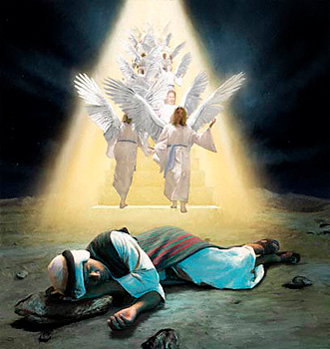
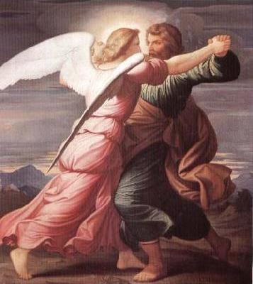
Jesus appeared to Jacob (Gen. 28:13; 32:24 32; 48:16)
Christ not only appeared to Jacob, but actually wrestled with him (See Gen. 32)
This was the same divine One he had seen standing a top a ladder some twenty years before (See Gen. 28.)

Slide 44
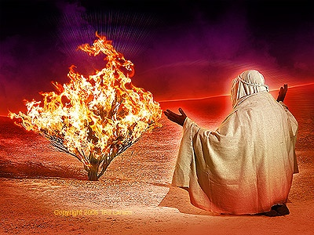
Jesus appeared to Moses (Exod. 3:2; 23:20; 33:18-23)
"And when the Lord saw that he turned aside to see, God called unto him out of the midst of the bush, and said, Moses, Moses. And he said, Here am I. And he said, Draw not near here: put off thy shoes from off thy feet, for the place whereon thou standest is holy ground" (Exod. 3:4, 5)

Slide 45
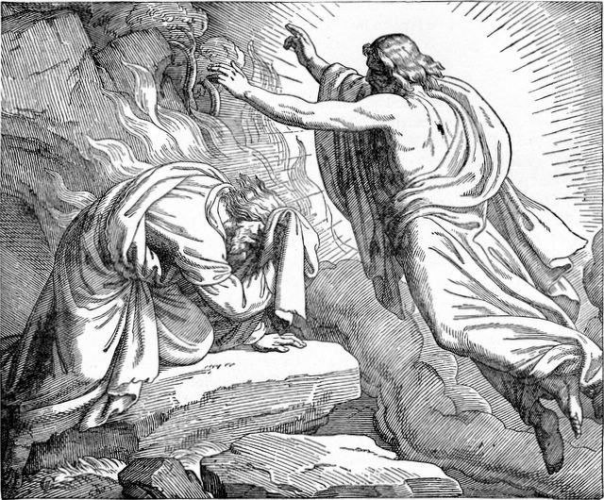
The second occasion was on the mountain

Slide 46
“Behold, I send an Angel before thee, to keep thee in the way, and to bring thee into the place which I have prepared. Beware of him, and obey his voice, provoke him not; for he will not pardon your transgressions: for my name is in him. But if thou shalt indeed obey his voice, and do all that I speak; then I will be an enemy unto thine enemies, and an adversary unto thine adversaries.”
(Exod. 23:20-22)

Slide 47
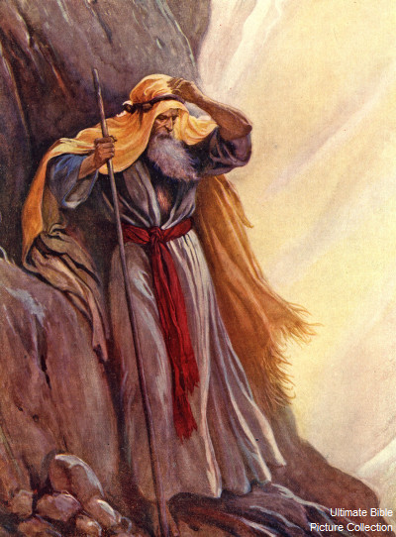
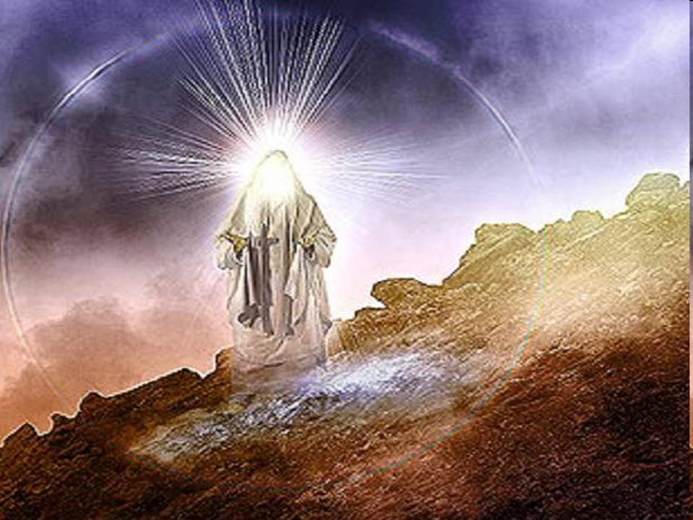
The final occasion was in the mountain
"And it shall come to pass, while my glory passeth by, that I will put thee in a clift of the rock, and will cover thee with my hand while I pass by" (Exod. 33:22)

Slide 48
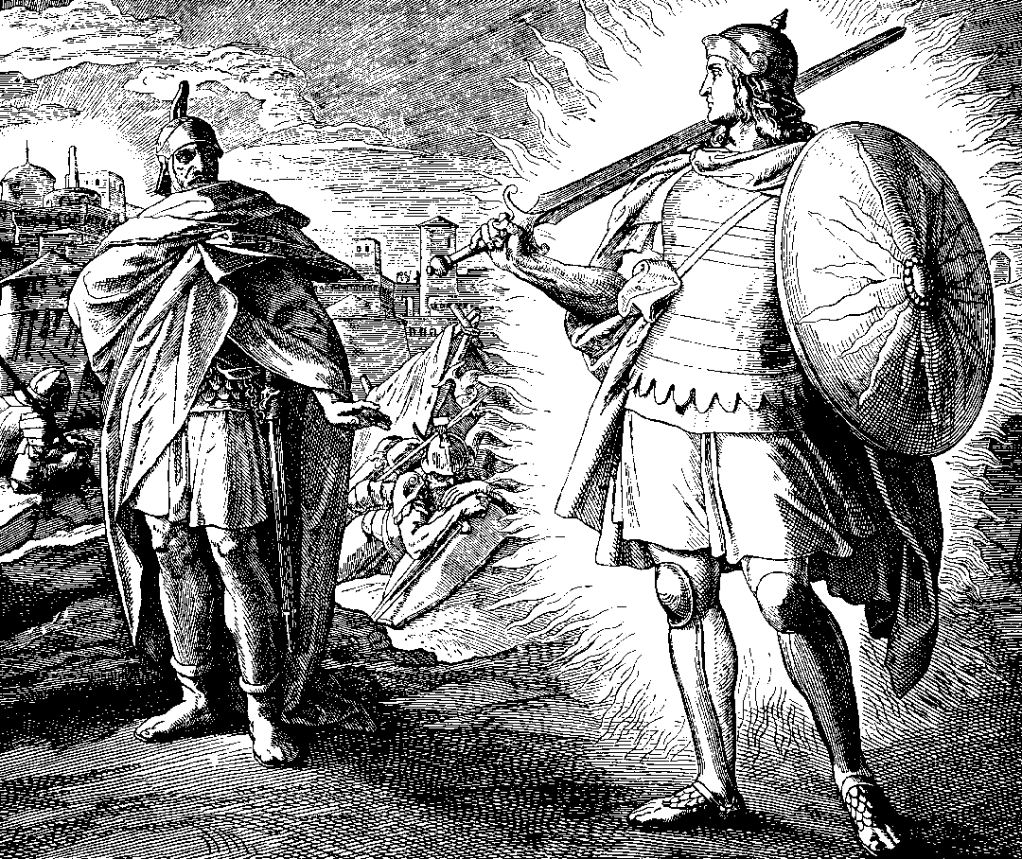
Jesus appeared to Joshua (Josh. 5:13-15)
He appears to Joshua on the eve of the battle against Jericho and introduces himself as the captain of the Lord’s host.

Slide 49
“And it came to pass, when Joshua was by Jericho, that he lifted up his eyes and looked, and, behold, there stood a man over against him with his sword drawn in his hand: and Joshua went unto him, and said unto him, Art thou for us, or for our adversaries? And he said, Nay; but as captain of the host of the LORD am I now come. And Joshua fell on his face to the earth, and did worship, and said unto him, What saith my lord unto his servant? And the captain of the LORD'S host said unto Joshua, Loose thy shoe from off thy foot; for the place whereon thou standest is holy. And Joshua did so.”
(Joshua 5:13-15)

Slide 50
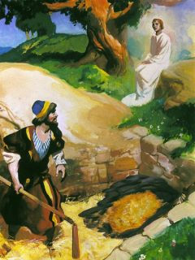
Jesus appeared to Gideon (Judges 6:11-24)
The angel of the Lord finds a very discouraged Gideon threshing wheat beside a wine press to hide it from the oppressing Midianites.

Slide 51
“And the angel of the LORD appeared unto him, and said unto him, The LORD is with thee, thou mighty man of valour…

Slide 52
And Gideon said unto him, Oh my Lord, if the LORD be with us, why then is all this befallen us? and where be all his miracles which our fathers told us of, saying, Did not the LORD bring us up from Egypt? but now the LORD hath forsaken us, and delivered us into the hands of the Midianites.

Slide 53
And the LORD looked upon him, and said, Go in this thy might, and thou shalt save Israel from the hand of the Midianites: have not I sent thee?

Slide 54
And the LORD said unto him, Surely I will be with thee, and thou shalt smite the Midianites.”

Slide 55
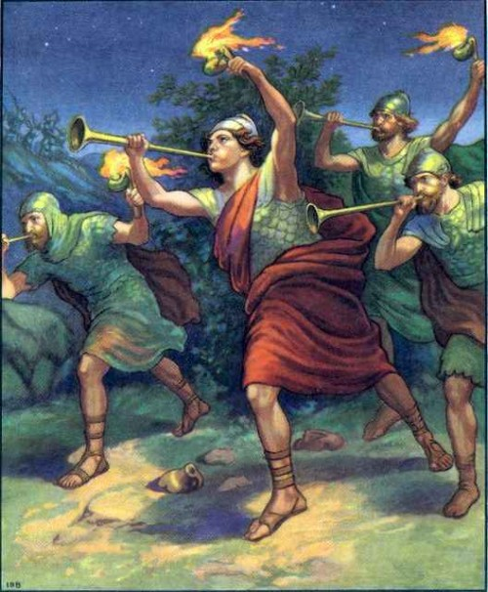

Slide 56
Jesus appeared to Isaiah (Isa. 6:1-13)

Slide 57
“In the year that king Uzziah died I saw also the Lord sitting upon a throne, high and lifted up, and his train filled the temple...Then said I, Woe is me! for I am undone; because I am a man of unclean lips, and I dwell in the midst of a people of unclean lips: for mine eyes have seen the King, the LORD of hosts...Also I heard the voice of the Lord, saying, Whom shall I send, and who will go for us? Then said I, Here am I; send me.”

Slide 58
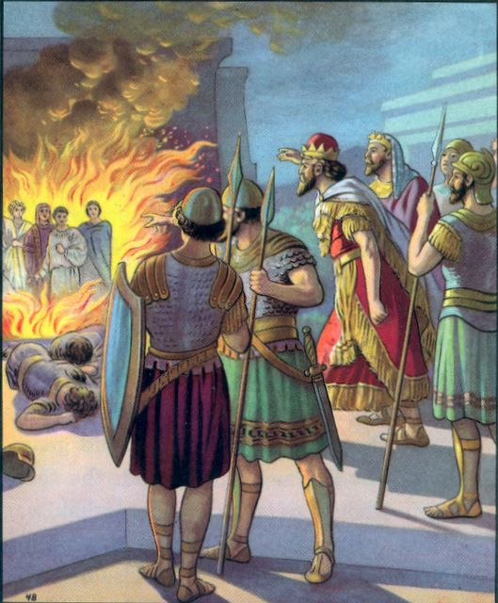
Jesus appeared to three young Hebrews in the fiery furnace (Dan. 3:25-25)
How thrilling are the astonished words of pagan king Nebuchadnezzar which accompanied this appearance.

Slide 59
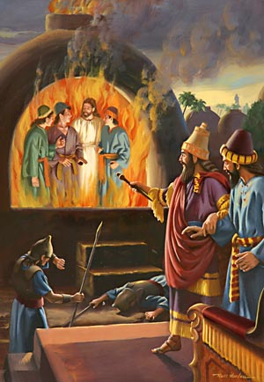
“Then Nebuchadnezzar the king was astonished, and rose up in haste, and spake, and said unto his counsellors, Did not we cast three men bound into the midst of the fire? They answered and said unto the king, True, O king. He answered and said, Lo, I see four men loose, walking in the midst of the fire, and they have no hurt; and the form of the fourth is like the Son of God.”

Slide 60
He appeared to Daniel (Dan. 6:21-22; 7:9-14)
"Then said Daniel unto the king, O king, live forever. My God hath sent his angel, and hath shut the lion’s mouth, that they have not hurt me..."
(Dan. 6:21-22)

Slide 61
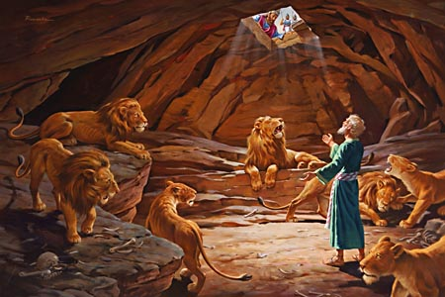

Slide 62
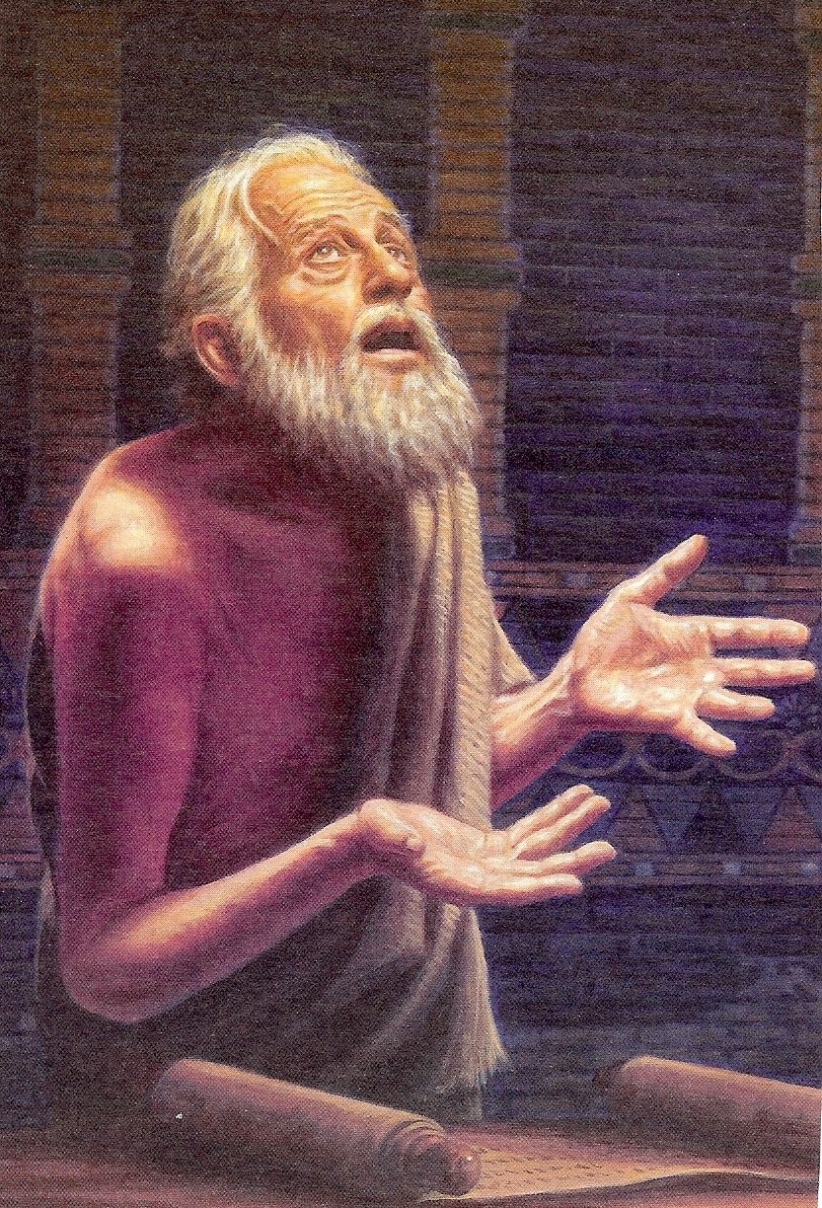

Slide 63
"I beheld till the thrones were cast down, and the Ancient of days did sit, whose garment was white as snow, and the hair of his head like the pure wool: his throne was like the fiery flame, and his wheels as burning fire. A fiery stream issued and came forth from before him: thousand thousands ministered unto him, and ten thousand times ten thousand stood before him: the judgment was set, and the books were opened. I beheld then because of the voice of the great words which the horn spake:

Slide 64
I saw in the night visions, and, behold, one like the Son of man came with the clouds of heaven, and came to the Ancient of days, and they brought him near before him. And there was given him dominion, and glory, and a kingdom, that all people, nations, and languages, should serve him: his dominion is an everlasting dominion, which shall not pass away, and his kingdom that which shall not be destroyed" (Dan. 7:9-14)

Slide 65
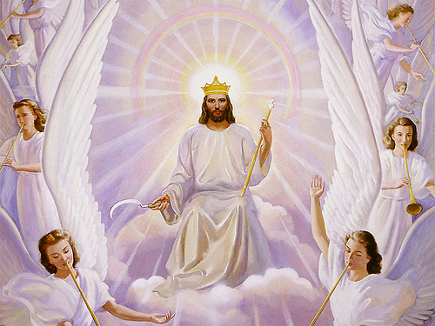

Slide 66
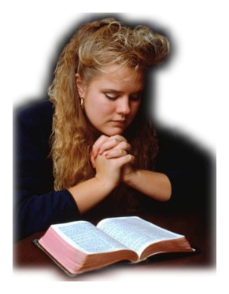
“The kingdom of God is within you.” (Luke 17:21)

