Slide 1
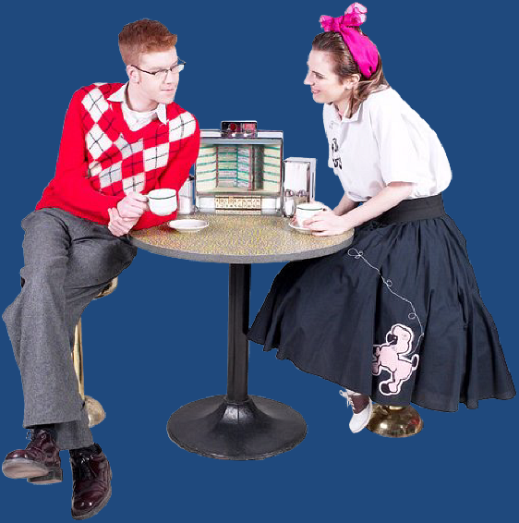
Biblical Principle of Courtship
(I Thessalonians 4:1-8)

Slide 2
Courtship versus Dating
Most people believe that dating is a necessary part of growing and finding a mate.
The world’s philosophy of dating is totally contrary to the Biblical philosophy of courtship – Colossians 2:8
With over half of all marriages ending in divorce it is clear that the world’s method does not work very well – Malachi 2:13-16; Mark 10:1-12

Slide 3
How the world’s practice of dating violates Biblical principles “Love not the world…”
Pressure to be normal – Daniel 1:8
Normal = worldly = carnal - I Corinthians 3:1-3
Normal = sensual (romantically attached to someone of the opposite sex that you are not married to) – James 3:13-18
Repeated romantic attachments – James 1: 13-16

Slide 5
The characteristics of dating (Proverbs 2, 5-7)
Pursuing
Wooing
Time alone
Romance
Intimacy
Physical
involvement
Fornication
Guilt
Breaking up
Getting hurt
Bondage (sexual)
Anger
Bitterness
Emotional scars
Damaged testimony
Marriage conflicts

Slide 6
Defrauding
(Proverbs 9:13-18)
Mental lust – Matthew 5:27-28
Flirting (attracting attention to self) – James 4:1-6
Words – Proverbs 2:16; 5:3
Dress – Proverbs 7:10
Eyes – Proverbs 6:25
Body language – Proverbs 7:10-12
Touching – I Corinthians 7:1-2
Kissing – Proverbs 7:13

Slide 7
How to determine the will of God in courtship
The focus of every young person must be on serving the Lord – (I Corinthians 7:32-33)
When God begins to stir an interest in your heart towards a young man or woman –
Look for character – “beauty is vain…” Spiritual / Carnal
Hold fast to your calling – “The calling of God is without repentance…ye are bought with a price…let every man where in he is called, therein abide with God…”

Slide 8
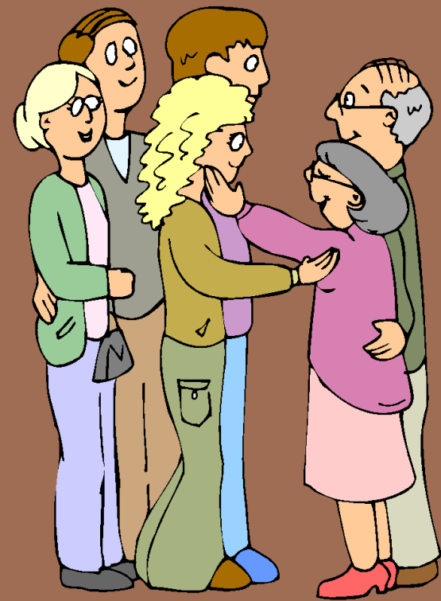
3. Receive counsel and stay under authority – Ephesians 6:1-4
Obey and honor your parents – Proverbs 1: 8-10
Submit to the authority of your pastor – Hebrews 13:7, 17
“Rebellion is as the sin of
witchcraft…Satan like
a roaring lion waketh
round about seeking
whom he may devour.”

Slide 9
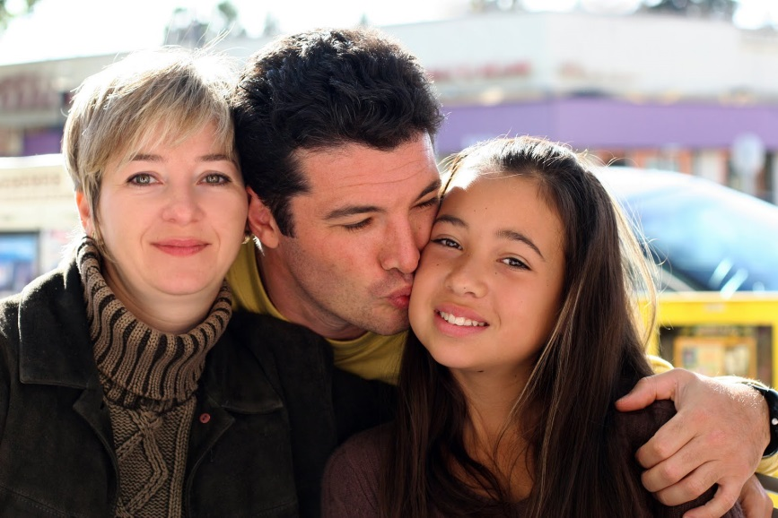
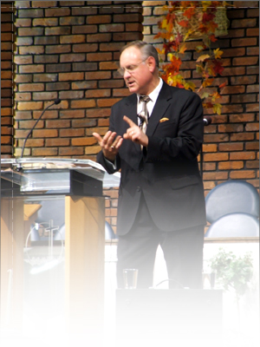
Parental and Pastoral oversight and involvement in courting will strengthen relationships and result in blessing and protection for the couple courting.

Slide 10
4. Get your heart in a condition that it has no will of its own – “Not my will but thine be done…For that ye ought to say if the Lord will, we will do this or that…”
5. Desire to do only the will of God – John 7:17
Seek God’s will through the Word – II Timothy 2:15
7. Pray for discernment – James 1:5
Note: Do not ask for a sign – (Mark 16:4)
8. Keep your heart pure – Psalms 24:3-5
Be sensitive to the promptings of the Holy Spirit - Romans 8:14
Wait for God’s timing – Psalm 37:7

Slide 11
Have a check list “Would he make a good husband for me?”
How does he respond to authority?
What are his goals?
Is he working towards those goals?
Who are his friends?
What does he talk about?
Is he financially responsible?

Slide 12
What type of entertainment does he enjoy?
How does he demonstrate his love for the Lord?
Is he faithful to church?
Does he listen to the messages?
Is he growing spiritually?
Does he serve the Lord through his local church?
Is he industrious?
Does he have a good testimony?

Slide 13
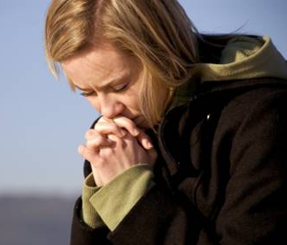
Does he have good manners?
Is he considerate of others?
Is he disposed to anger?
Does he try to involve you in sexual misconduct?
Is he physically or verbally abusive?
What kind of relationship does he have with his parents?

Slide 14
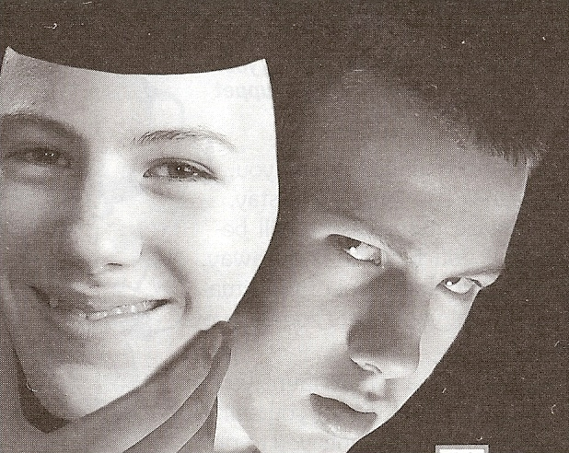
Does he use alcohol or drugs to have a good time?
Is he jealous and self-centered?

Slide 15
Have a check list “Would she make a good wife for me?”
How does she show submissiveness to her family and church?
How does she treat her family?
What is her relationship like with her father?
What does she talk about?
Is she materialistic?
Is she consumed with outward appearance and fashion?

Slide 16
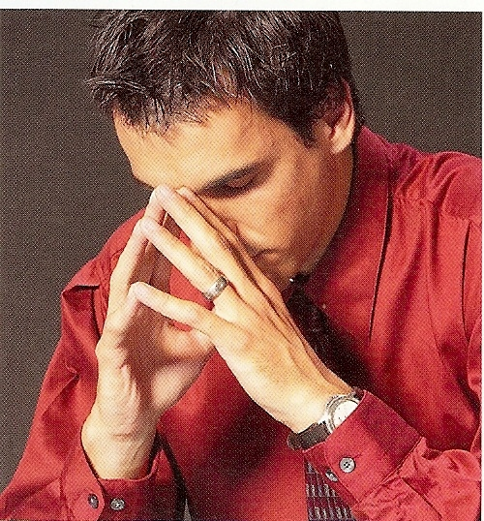
What type of entertainment does she enjoy?
How does she demonstrate her love for the Lord?
Is she faithful to church?
Does she listen to the messages?
Is she growing spiritually?
Is she industrious?
Is she financially responsible?
Does she have a good testimony?
Is she morally pure?
Does she dress modestly?

Slide 17
Is she considerate of others?
Is she contentious?
Is she verbally or physically abusive?
Is she an angry person?
Does she use alcohol or drugs to have a good time?
What kind of entertainment does she enjoy?
Is she jealous and self-centered?

Slide 19
“O magnify the LORD with me, and let us exalt his name together. “
(Psalms) 34:3
Talents
Abilities
Personality
Interest
Background
Upbringing
Family
Doctrinal beliefs
Philosophy
Standards
Convictions
Spiritual Gifts
Call of God Rom.11:29

Slide 20
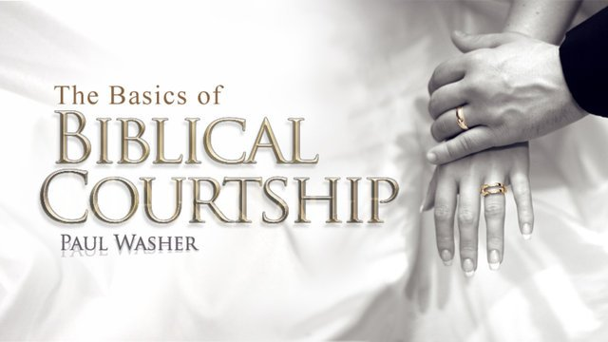

Slide 21
Preparation for Courtship
Must be old enough – I Corinthians 14:11
Must be mature enough – I Kings 2:2
Must be spiritually minded enough – Romans 8:6
Must be under authority - I Peter 5:5

Slide 22
Must be financially stable enough to
provide for his family –
“If any provide not for his
own…he hath denied the faith, and
is worse then an infidel…Prepare thy
work without, and make it fit for
thyself in the field; and afterwards
build thine house.”

Slide 25
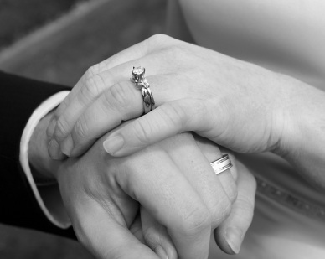
When a couple pairs off in a courting relationship, they both know that the purpose of the relationship is to consider marriage. (Psalms 34:1-3; Proverbs 18:22; Amos 3:3)

Slide 26
When a couple pairs off in a dating relationship it is the romantic linking of the couple simply to enjoy each other’s company for the present. Although marriage may be possible in the distant future, neither person is seriously considering such at the moment.

Slide 27
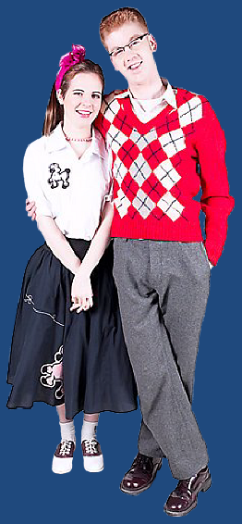
Dating is nothing more than self-gratification. (Romans 13:14; Galatians 5:6-17)

Slide 28
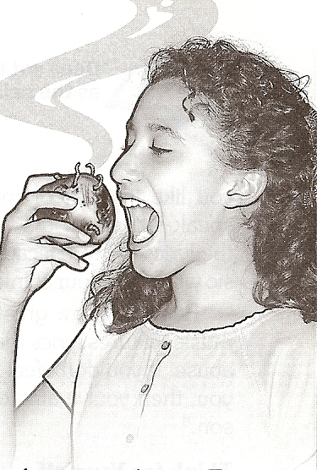
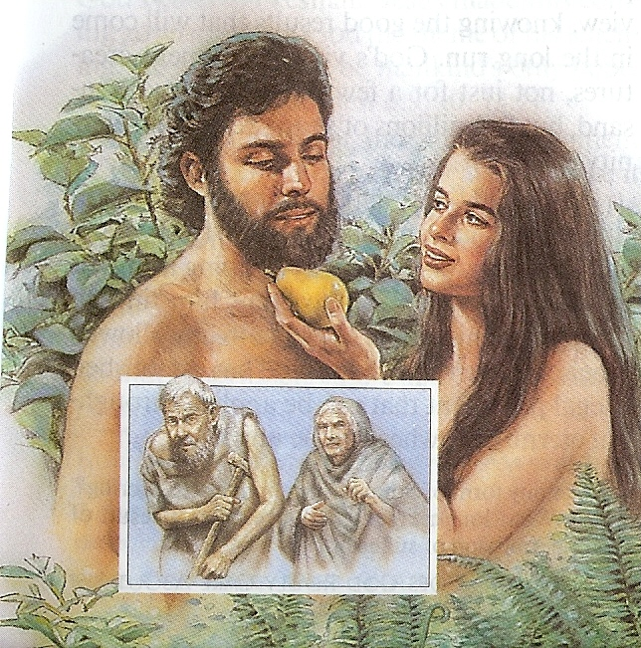

Slide 31
Five powerful temptation that must be resisted

Slide 32
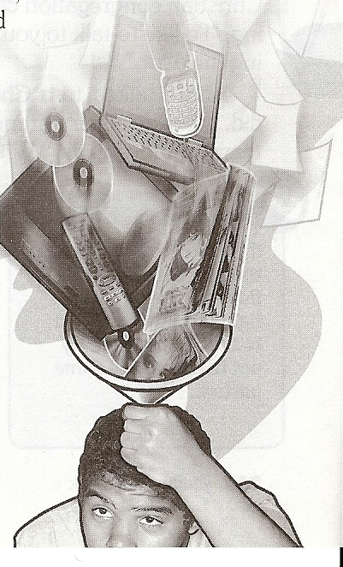
Examine your friendships – James 4:4
Shun immoral entertainment – II Corinthians 7:1
Control your thoughts – Philippians 4:8

Slide 33
Reject worldly philosophy – Colossians 2:8
Avoid physical contact – I Corinthians 7:1

Slide 34
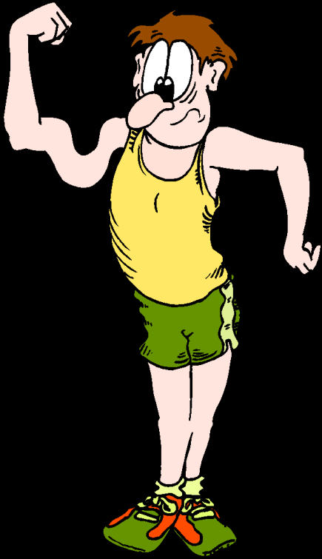
“Watch and pray, that ye enter not into temptation: the spirit indeed is willing, but the flesh
is weak.”
Matt. 26:41

Slide 35
Applying Biblical teaching to the area of dating and courtship
I reject the worldly philosophy of dating – Romans 12:1-2
I purpose not to defile my self – II Corinthians 6:14-7:1
I will guard my heat with all diligence keeping it for the one God has for me – Proverbs 4:32
I am committed to serve the Lord – I Corinthians 7:32

Slide 36
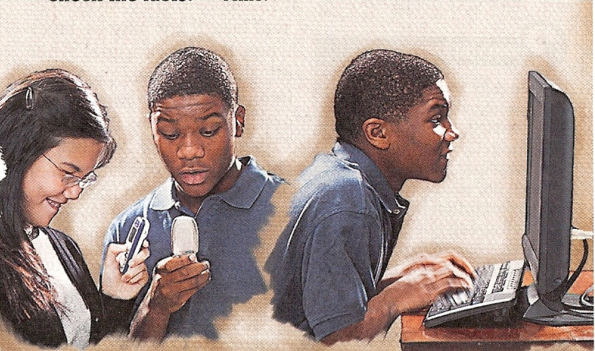
I will avoid on line dating, chat rooms, e-mail, face book, cell phone conversations, texting, etc. – I John 2:15

Slide 37
I will seek God’s will for my life –
Ephesians 5:17
I will surrender my right to choose
my life’s partner to God – Proverbs
6:20:20-24
I will receive the permission and
blessing of my parents before
courting – Ephesians 6:1-4

Slide 38
I will reserve courting for when I am old
enough, mature enough, spiritual enough
and financially stable enough to provided
for a family – Proverbs 24:27
I will build Godly standards into my
courting relationship – “Make no
provision for the flesh.”
I will not encourage others to date –
I Corinthians 15:33

