Slide 1
What God Looks for in a Leader

Slide 2
“For the LORD seeth not as man seeth; for man looketh on the outward appearance, but the LORD looketh on the heart.”
I Samuel 16:7

Slide 3
God Chooses the Least “Estimation of my Prestige”

Slide 4
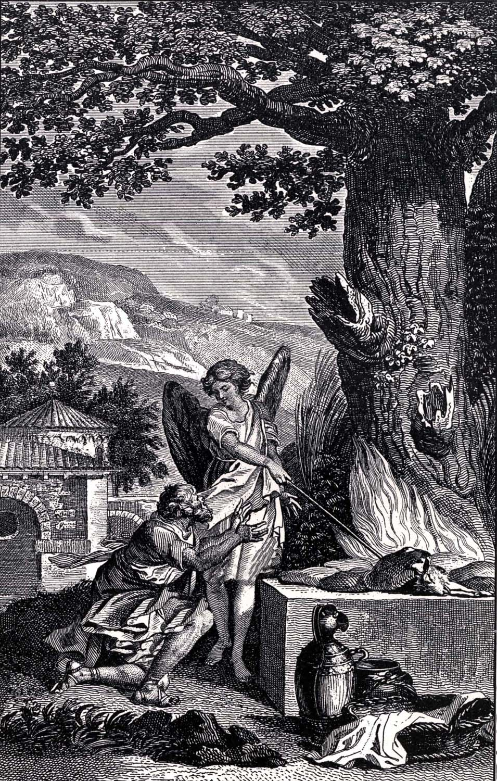
Gideon
“And he said unto him, Oh my Lord, wherewith shall I save Israel? behold, my family is poor in Manasseh, and I am the least in my father's house.” Judges 6:15

Slide 5
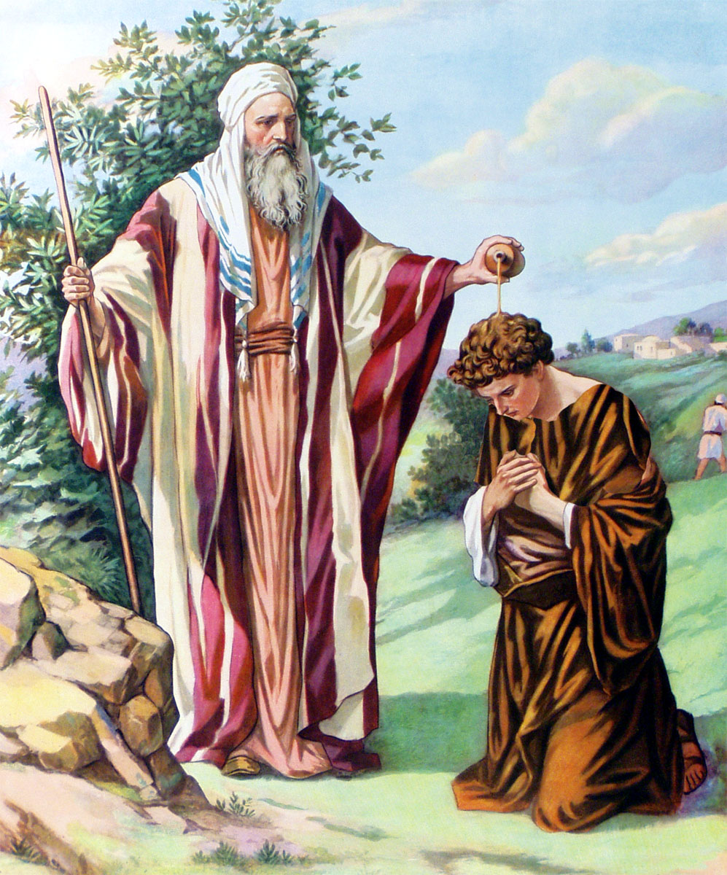
Saul
“And Saul answered and said, Am not I a Benjamite, of the smallest of the tribes of Israel? and my family the least of all the families of the tribe of Benjamin? wherefore then speakest thou so to me?” I Samuel 9:21

Slide 6
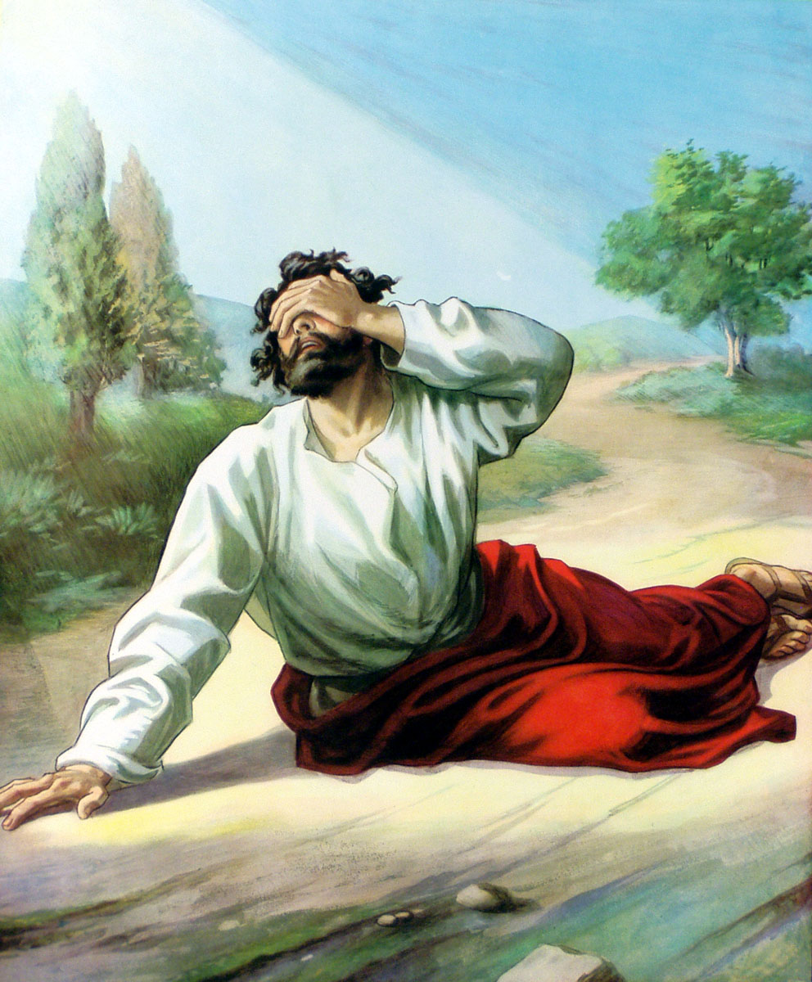
Paul
“For I am the least of the apostles, that am not meet to be called an apostle, because
I persecuted the
church of God.”
I Corinthians 15:9

Slide 7
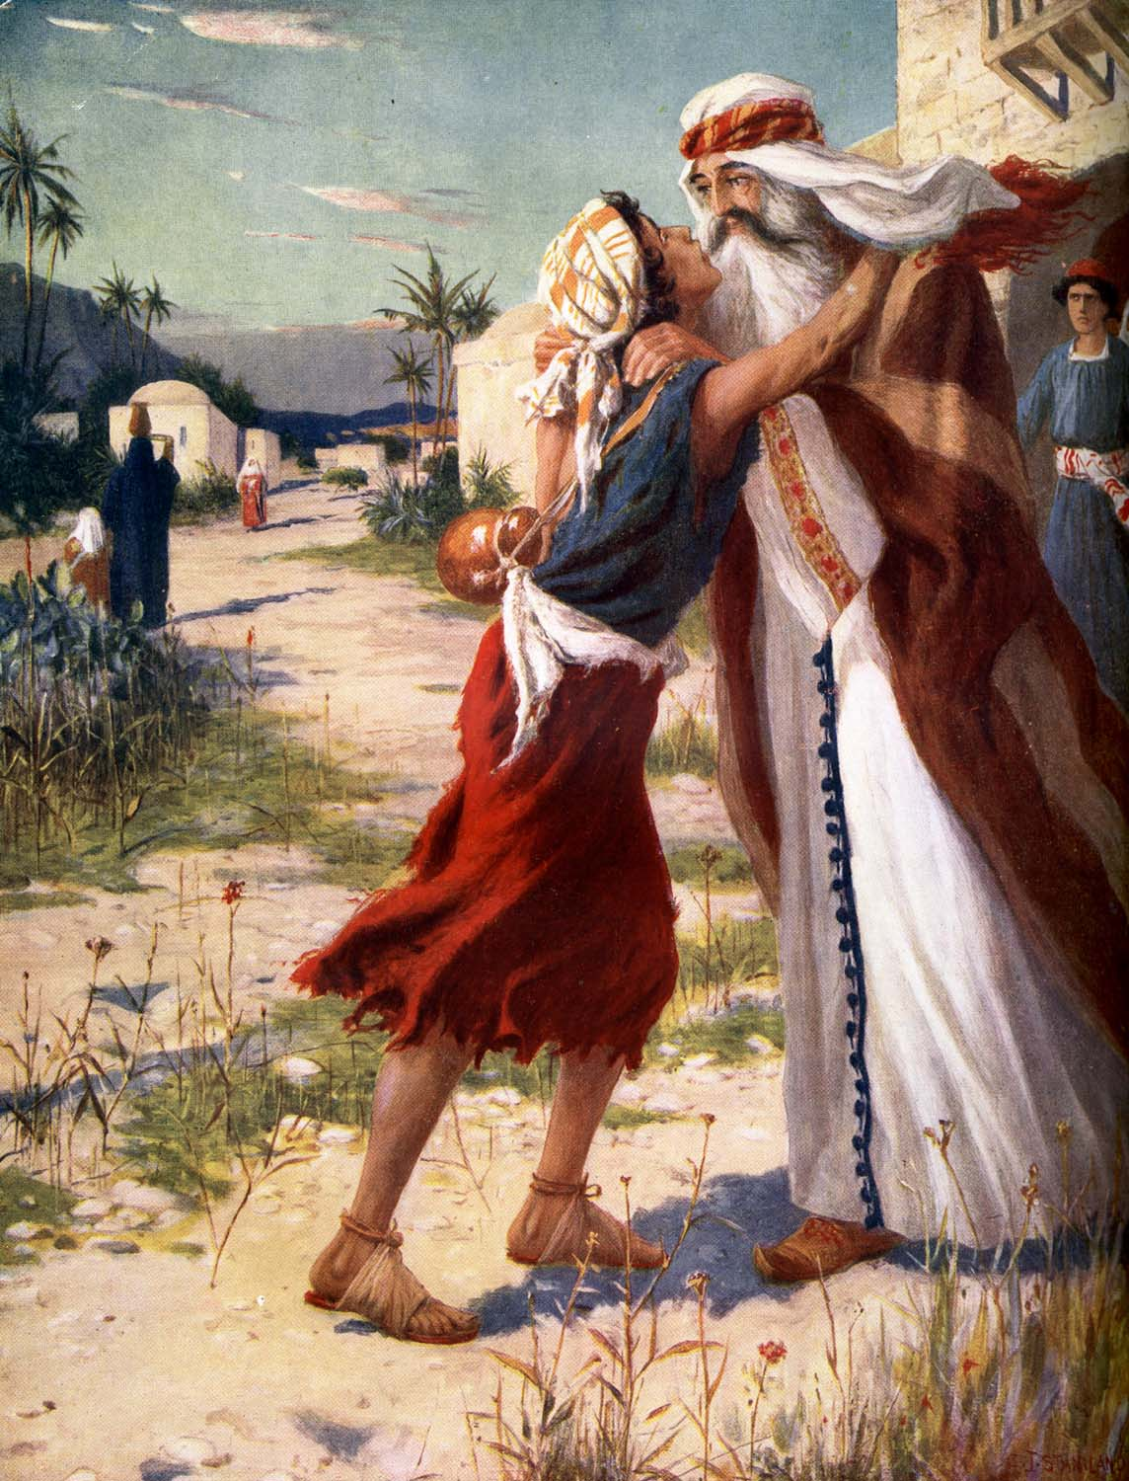
Prodigal Son
“And am no more worthy to be called thy son: make me as one of thy hired servants. And he arose, and came to his father. But when he was yet a great way off, his father saw him, and had compassion, and ran, and fell on his neck, and kissed him. And the son said unto him, Father, I have sinned against heaven, and in thy sight, and am no more worthy to be called thy son.” Luke 15:19-21

Slide 8
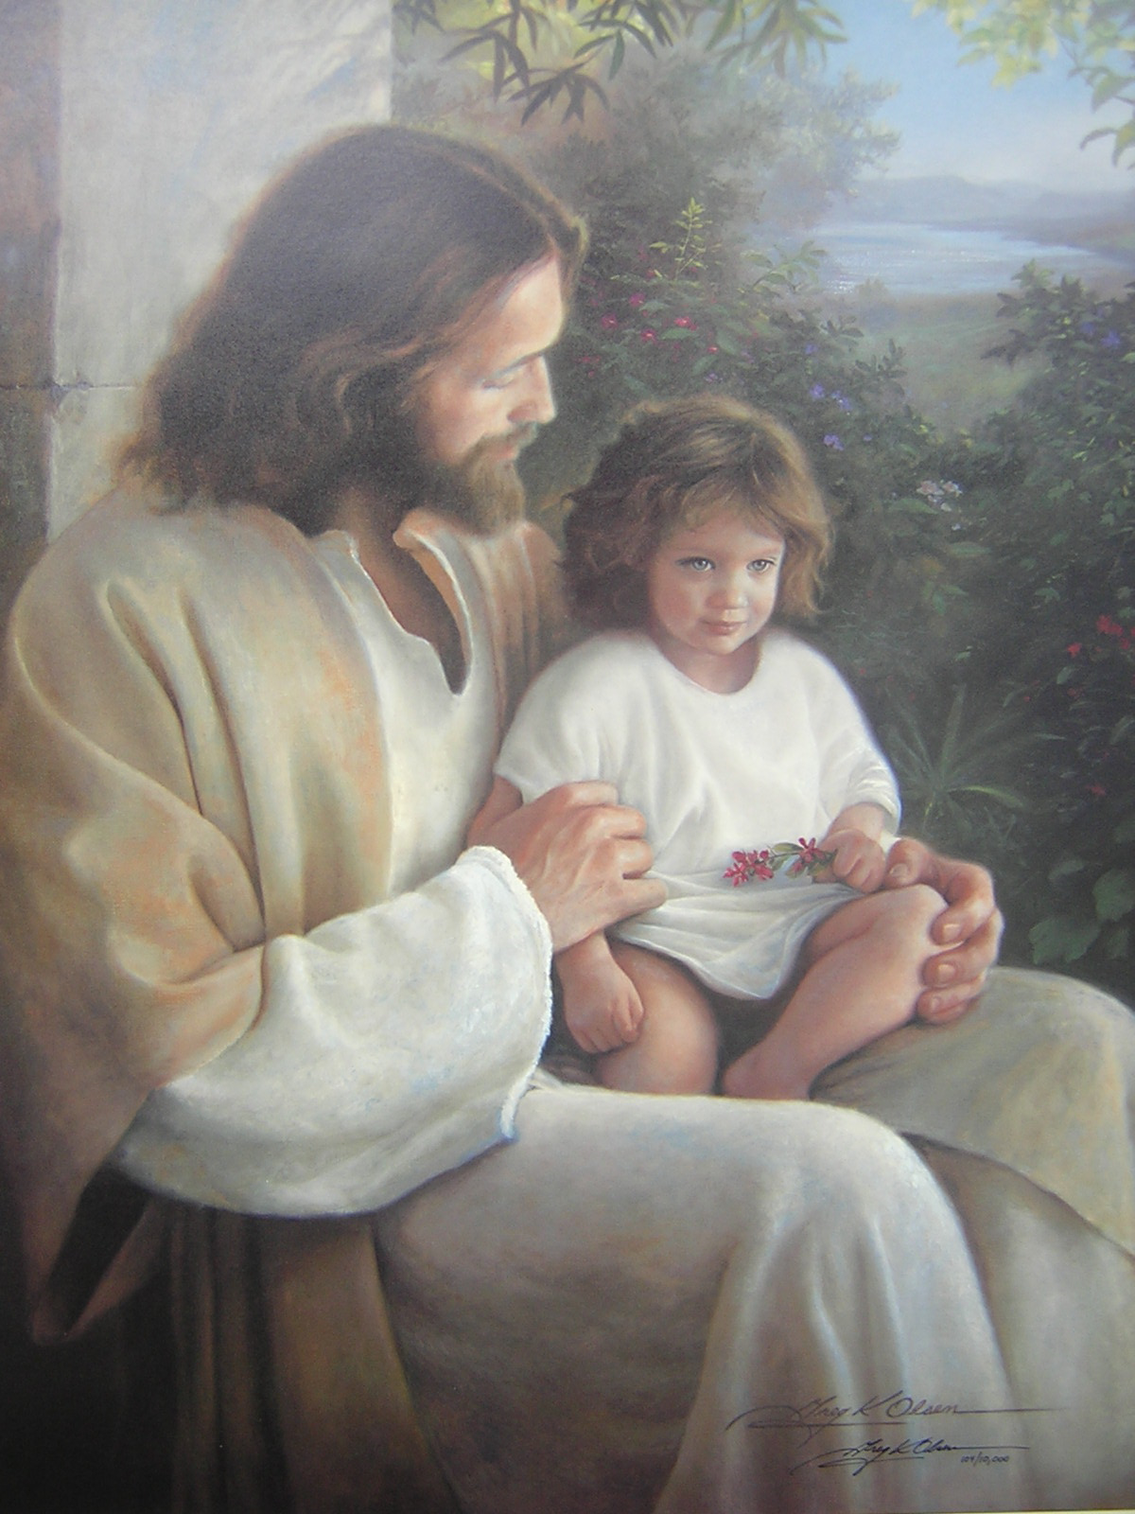
“And said unto them, Whosoever shall receive this child in my name receiveth me: and whosoever shall receive me receiveth him that sent me: for he that is least among you all, the same shall be great.” Luke 9:48

Slide 9
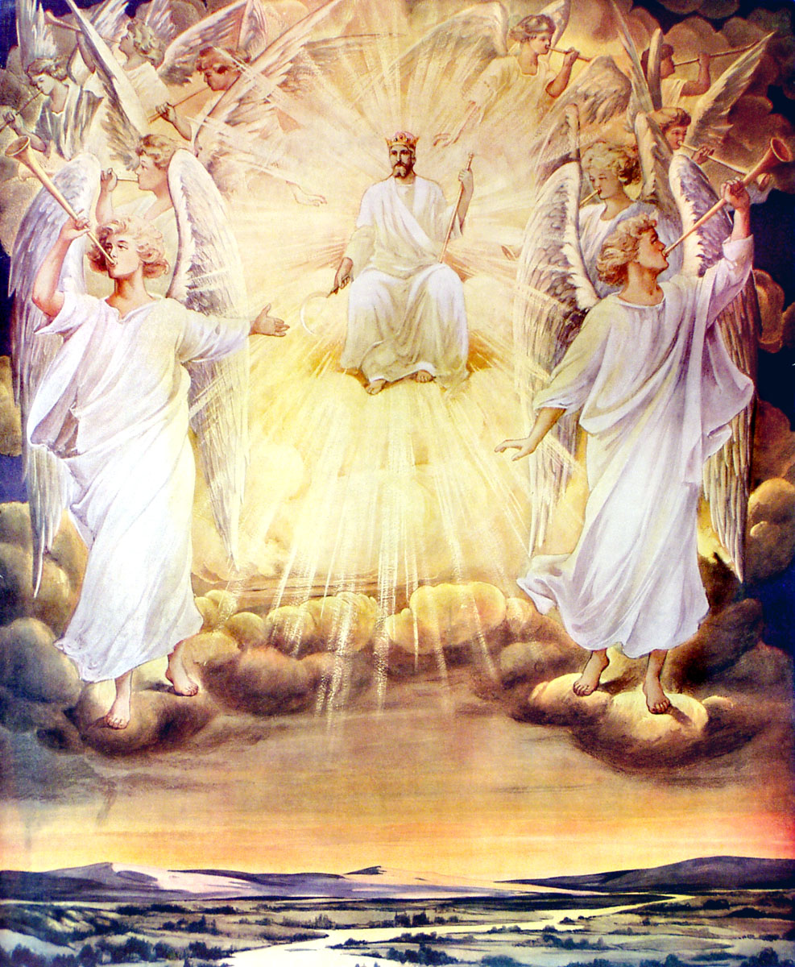
The Least Qualify for Special Benefits
“When the Son of man shall come in his glory, and all the holy angels with him, then shall he sit upon the throne of his glory: And before him shall be gathered all nations: and he shall separate them one from another, as a shepherd divideth his sheep from the goats: And he shall set the sheep on his right hand, but the goats on the left…

Slide 10
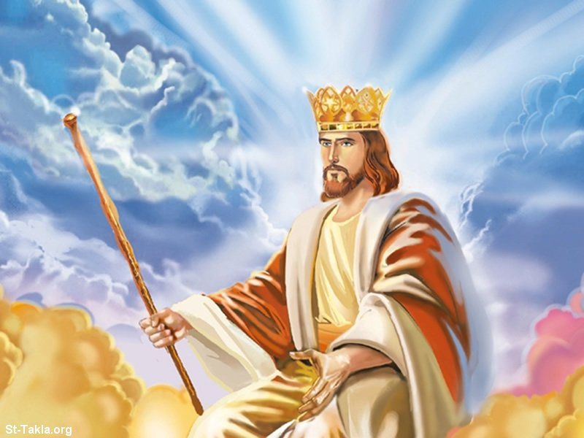
Then shall the King say unto them on his right hand, Come, ye blessed of my Father, inherit the kingdom prepared for you from the foundation of the world…And the King shall answer and say unto them, Verily I say unto you, Inasmuch as ye have done it unto one of the least of these my brethren, ye have done it unto me.” Matthew 25:31-34, 40

Slide 11
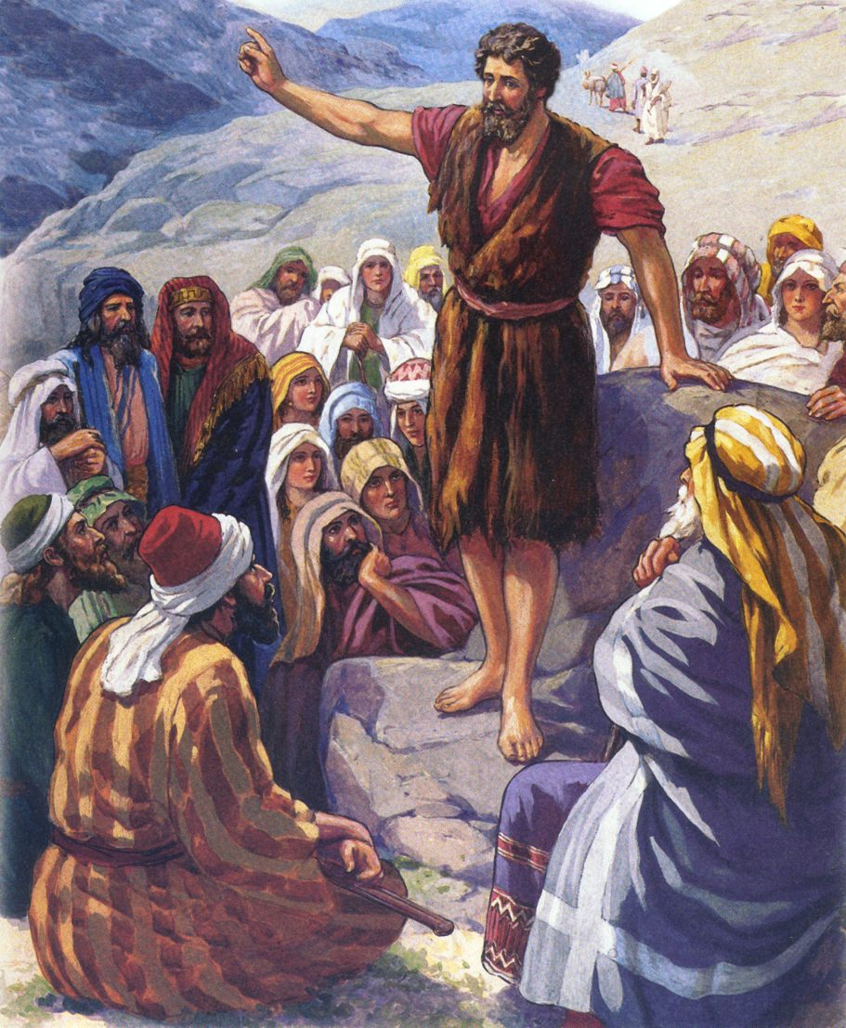
The Least Shall be the Greatest
“For I say unto you, Among those that are born of women there is not a greater prophet than John the Baptist: but he that is least in the kingdom of God is greater than he.” Luke 7:28

Slide 12
God Chooses the Littlest
“Estimation of my Power”

Slide 13
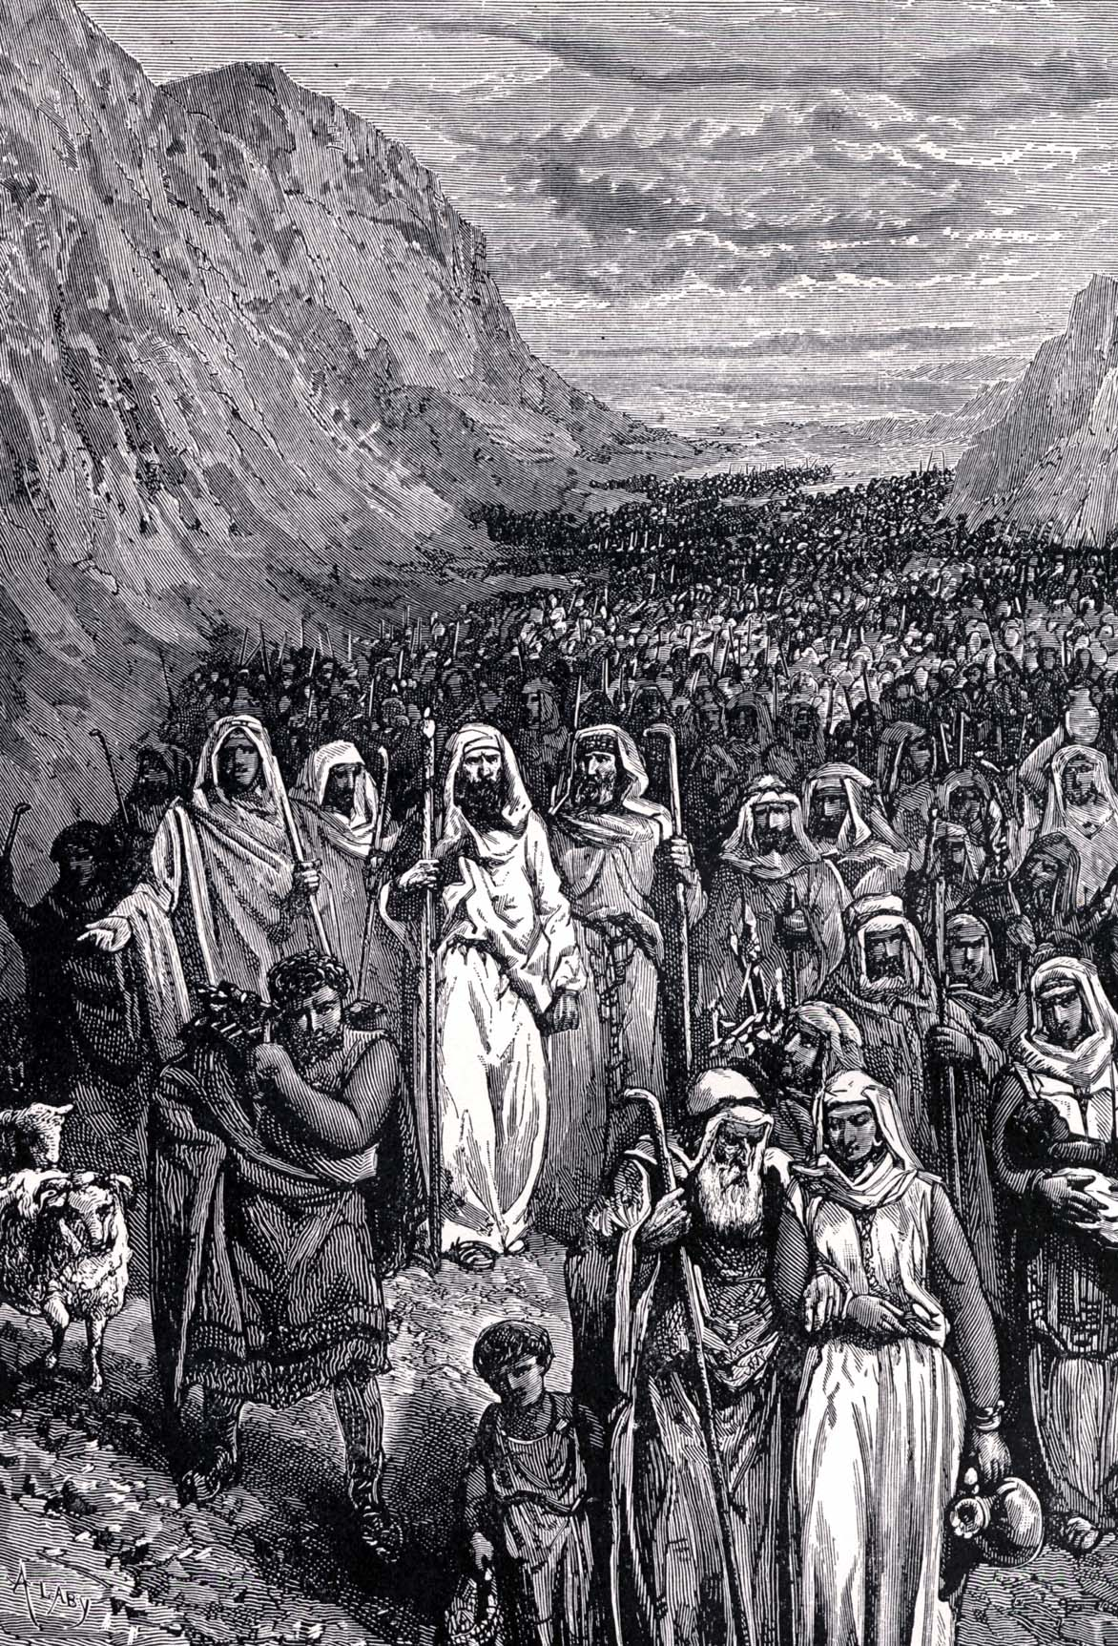
Nation of Israel
“The LORD did not set his love upon you, nor choose you, because ye were more in number than any people; for ye were the fewest of all people” Deuteronomy 7:7

Slide 14
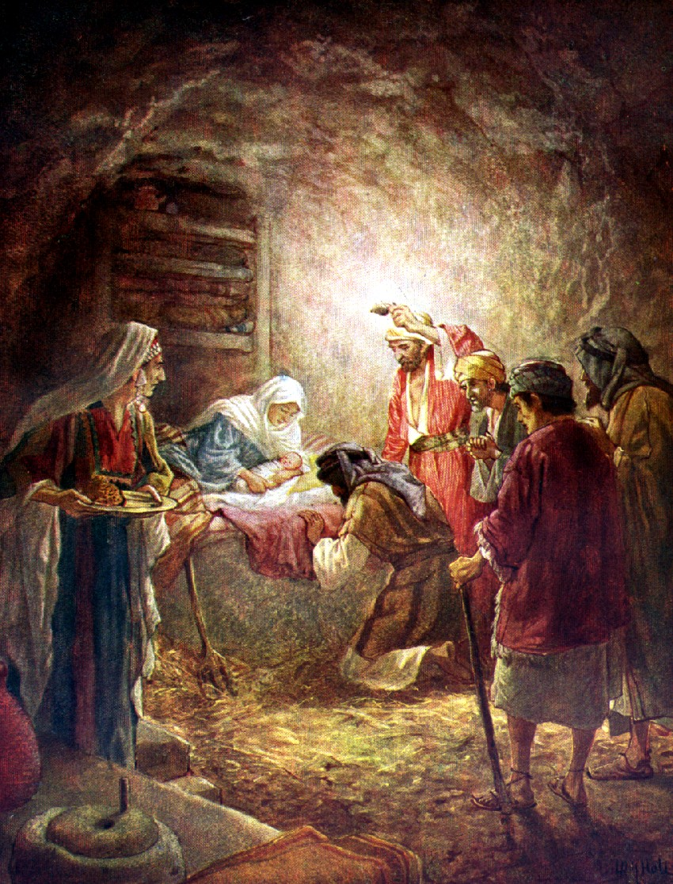
Bethlehem
“But thou, Bethlehem Ephratah, though thou be little among the thousands of Judah, yet out of thee shall he come forth unto me that is to be ruler in Israel; whose goings forth have been from of old, from everlasting.” Micah 5:2

Slide 15
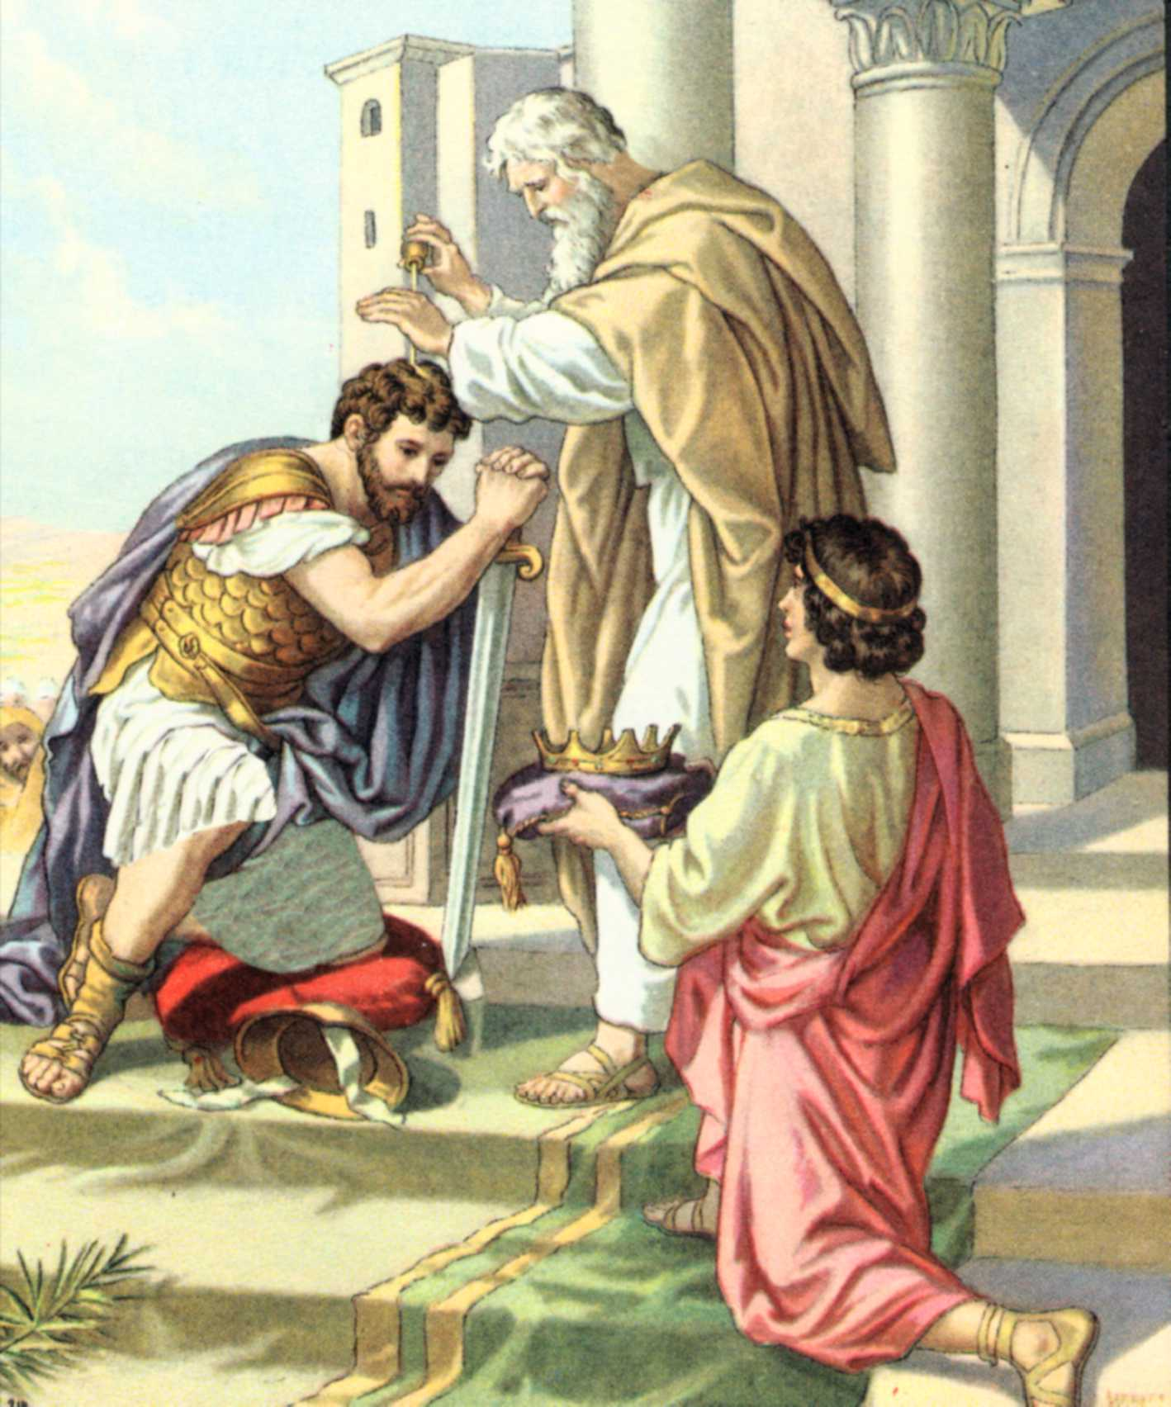
Saul
“And Samuel said, When thou wast little in thine own sight, wast thou not made the head of the tribes of Israel, and the LORD anointed thee king over Israel?” I Samuel 15:17

Slide 16
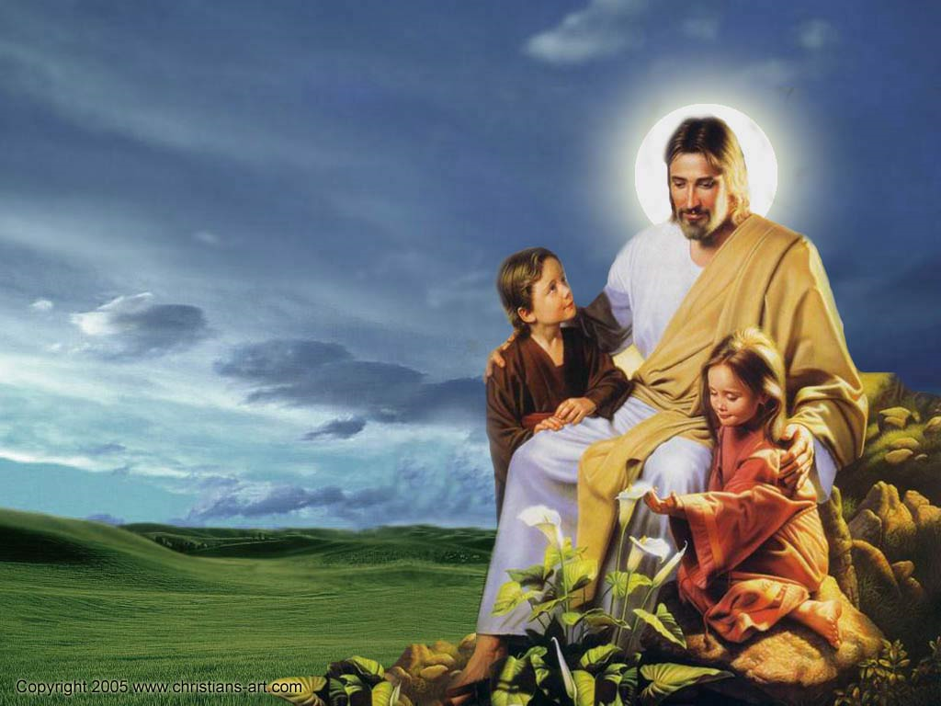
Little Children
“Whosoever therefore shall humble himself as this little child, the same is greatest in the kingdom of heaven.”
Matthew 18:4

Slide 17
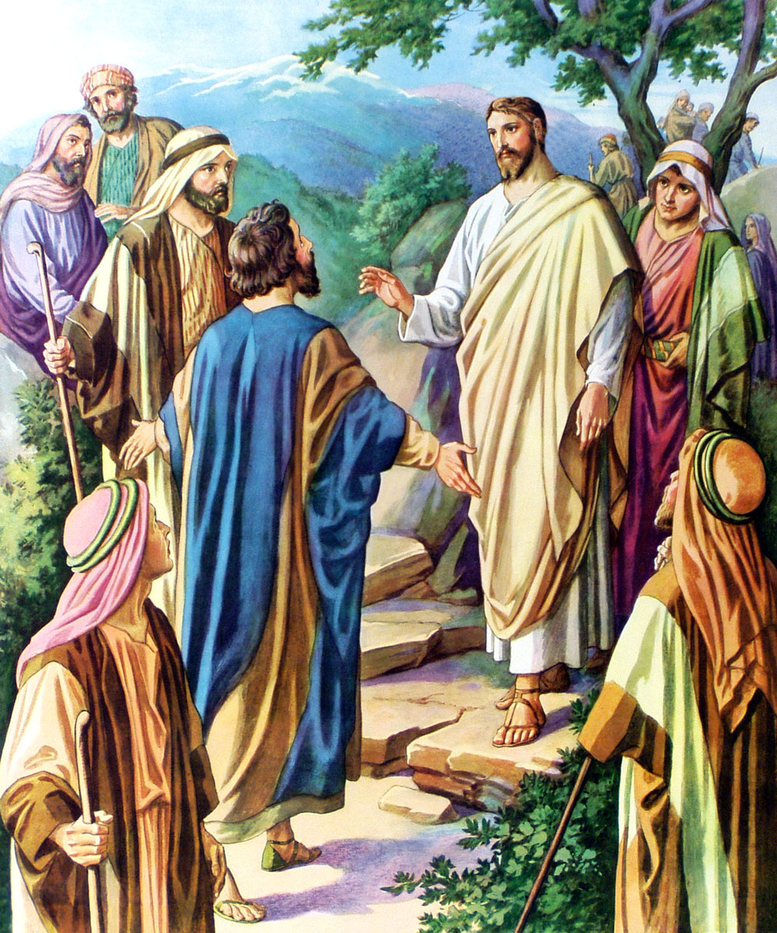
Disciples
“Little children, yet a little while I am with you. Ye shall seek me: and as I said unto the Jews, Whither I go, ye cannot come; so now I say to you.” John 13:33

Slide 18
God Chooses the Last
“Estimation of my Position”

Slide 19
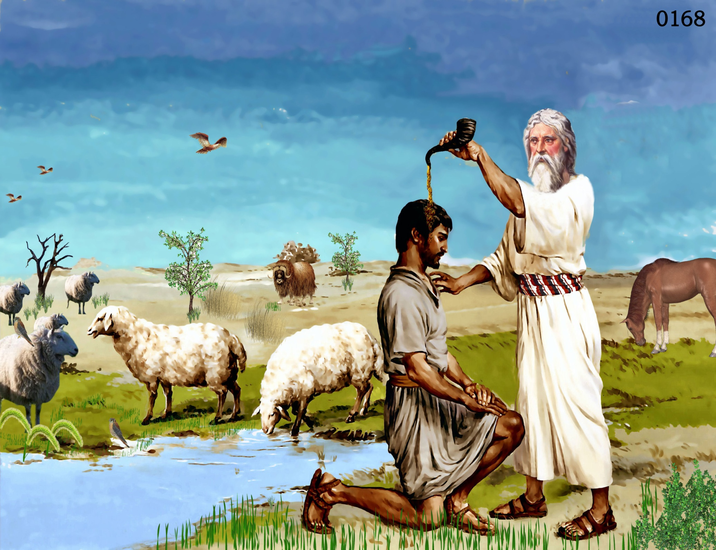
David
“But the LORD said unto Samuel, Look not on his countenance, or on the height of his stature; because I have refused him: for the LORD seeth not as man seeth; for man looketh on the outward appearance, but the LORD looketh on the heart…And Samuel said unto Jesse, The LORD hath not chosen these…And Samuel said unto Jesse, Are here all thy children? And he said, There remaineth yet the youngest, and, behold, he keepeth the sheep. And Samuel said unto Jesse, Send and fetch him: for we will not sit down till he come hither. And he sent, and brought him in…And the LORD said, Arise, anoint him: for this is he.” I Samuel 16:7-12

Slide 20
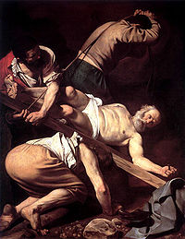
The Apostles
“For I think that God hath set forth us the apostles last, as it were appointed to death: for we are made a spectacle unto the world, and to angels, and to men.” I Corinthians 4:9

Slide 21
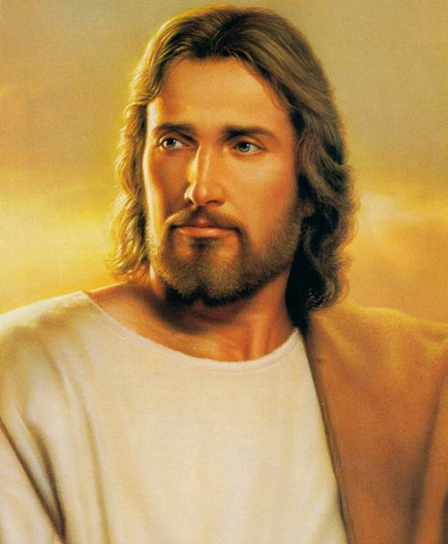
“But many that are first shall be last; and the last shall be first.”
Matthew 19:30

Slide 22
Never Allow your Heart to be Lifted up with Pride!

Slide 23
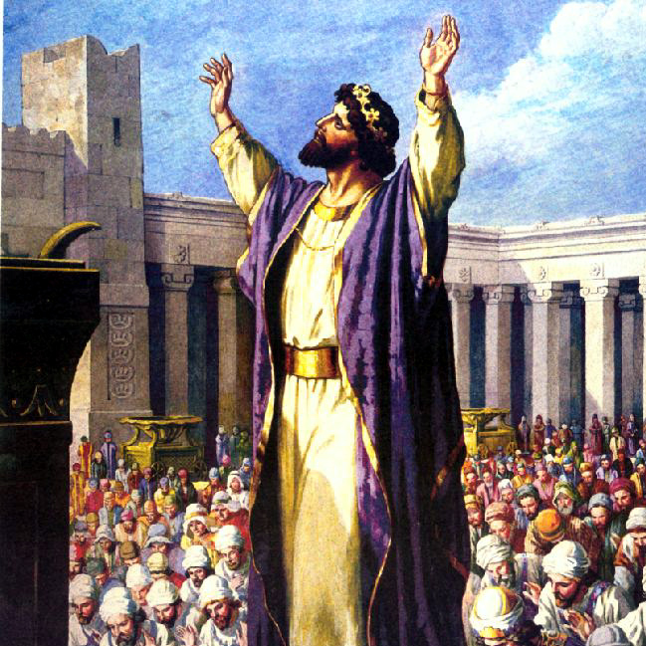
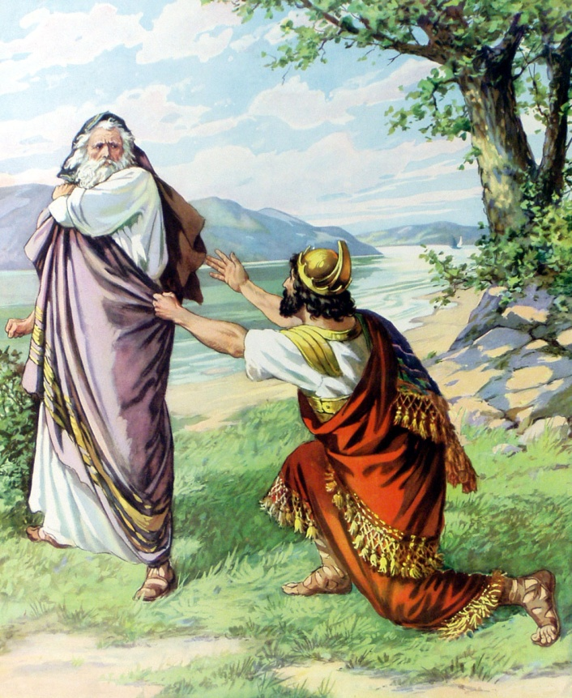
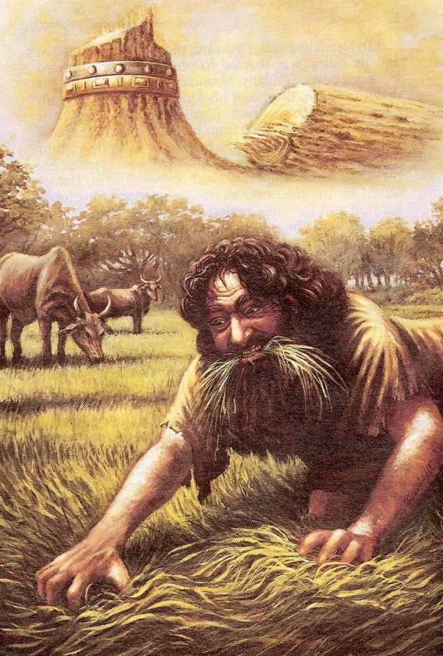
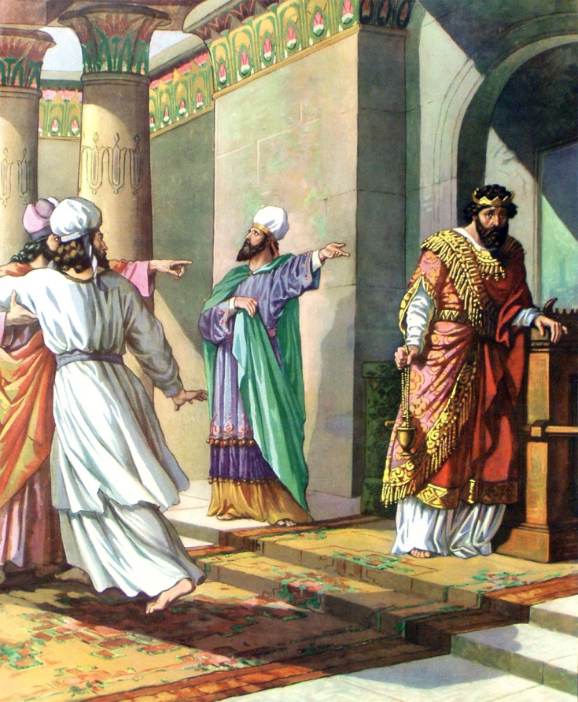
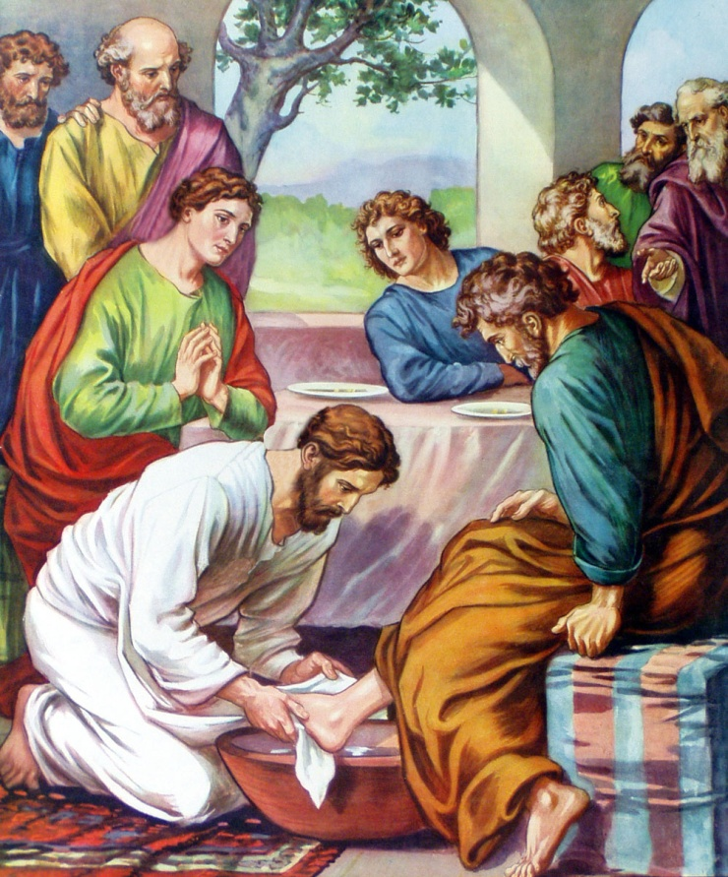
Solomon – Eccl. 1-2, 11-12
Saul – I Sam. 15:17-23
Nebuchadnezzar – Daniel 4:30-37
Uzziah – II Chro. 26:16, 21
The Disciples – Luke 22:23-27

Slide 24
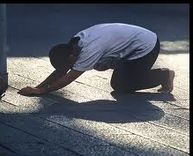
“Humble yourselves in the sight of the Lord,
and he shall lift you up.”
James 4:10

Slide 25
Five qualities of a great leader (I Corinthians 16:13-14)
Watch
Stand fast in the faith
Quit you like men
Be strong
Let all things be done with charity

