Slide 1
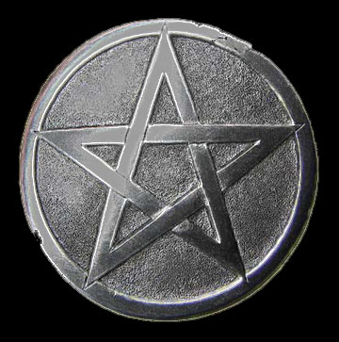
How to Turn the Heart of a Rebel
Iniquity
Gross immorality; injustice; wickedness.
“For rebellion is as the sin of witchcraft, and stubbornness
is as iniquity
and idolatry.”
(I Sam. 15:23)

Slide 2
(Proverbs 24:3-4) “Through wisdom is an house builded; and by understanding it is established: And by knowledge shall the chambers be filled with all precious and pleasant riches.”

Slide 3
Wisdom - The quality or state of being wise; knowledge of what is true or right coupled with just judgment as to action; discernment, or insight.
Understanding – The ability to comprehend; the capacity to apprehend; to grasp mentally
Knowledge - Acquaintance with facts, truths, or principles, as from study or investigation; skills acquired by a person through experience or education.

Slide 4
Keeping the Hearts of Your Children
The Key to Raising Godly Children

Slide 5
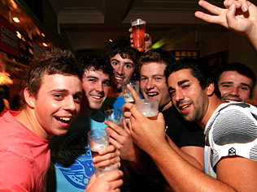
Four big dangers for the heart
1. The heart can be lost - Colossians 3:19-21
2. The heart can be drawn away - Acts 20:30
3. The heart can become hardened - Hebrews 3:13
4. The heart can be stolen - II Samuel 15:6

Slide 6
Seek to understand your child “Fathers, provoke not your children to anger, lest they be discouraged.” Col. 3:21
Your child can be provoked to wrath
By comparing them to others.
By making them feel inferior.
By constant criticism or demanding perfection.
By having too high expectations.
By not communicating enough with them.
By spending to much time at work, outside. interest, personal hobbies and interest, etc. . .

Slide 7
The most important ingredient needed to raise godly children
Proverbs 23:26 “My son, give me thine heart.”
Malachi 4:6 “And he shall turn the heart of the fathers to the children, and the heart of the children to their fathers, lest I come and smite the earth with a curse.”

Slide 8
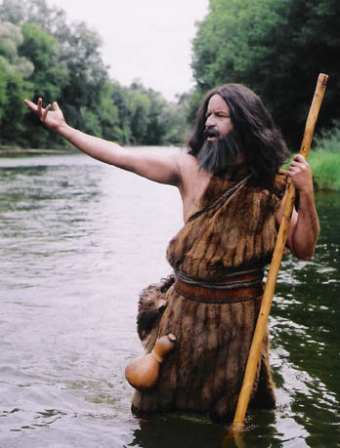
(Luke 1:17)
“And he (John the Baptist) shall go before him (Jesus) in the spirit and power of Elijah…
to turn the hearts of the fathers to the children…
and the disobedient (that’s the children)
to the wisdom of the just (that’s what parents are supposed to be)…
to make ready a people prepared for the Lord.”

Slide 9
If you do lose your child’s heart, then quickly find out where and when you lost it and put into action a plan to get the heart back NO MATTER WHAT IT TAKES!

Slide 10
Rebellion is not Normal
One of Satan’s biggest lies to parents is that “some adolescent rebellion is to be expected out of every teenager.”
Since rebellion is normal and expected, then you do not have to deal with it.
Rebellion is sin and exposes a child to the realm, power, and control of Satan - I Samuel 15:23

Slide 11
Steps needed to turn around the heart of a rebel
Parents must first acknowledge to God and their child that they have lost their child’s heart and sincerely seek forgiveness of both God and the child - Luke 1:17
Parents must examine their own lives to make sure they are dedicated to God and walking in fellowship with God - Psalm 139:23
Parents with sin in their own life will find it difficult or impossible to deal with sin in their child’s life - Proverbs 28:13-14

Slide 12
Rebellious Children must be Separated from Negative Influences (Proverbs 13:20; I Corinthians 15:33)
Friends - This would include boyfriends / girlfriends, as well as any family members not in agreement with the parents spiritual objectives - II Corinthians 6:14 -7:1
Satan will keep ground in a rebel’s life if there is anything left where he can hold ground - Ephesians 4:27

Slide 13
Television
Radio
Bad music
CD’s
I Pods
Magazines
Cars
Cell phone
Computers
Lots of love!
No trust

Slide 14
Everything Bad must be Replaced with that which is Good
“Flee also youthful
lusts: but follow righteousness, faith, charity, peace, with them that call on the Lord out of a pure heart.” II Timothy 2:22

Slide 15
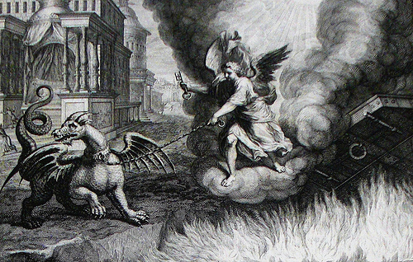
Parents must earnestly pray that God would bind all demonic powers that may be influencing their child.
Mark 3:27 “No man can enter into a strong man's house, and spoil his goods, except he will first bind the strong man; and then he will spoil his house.”

Slide 16
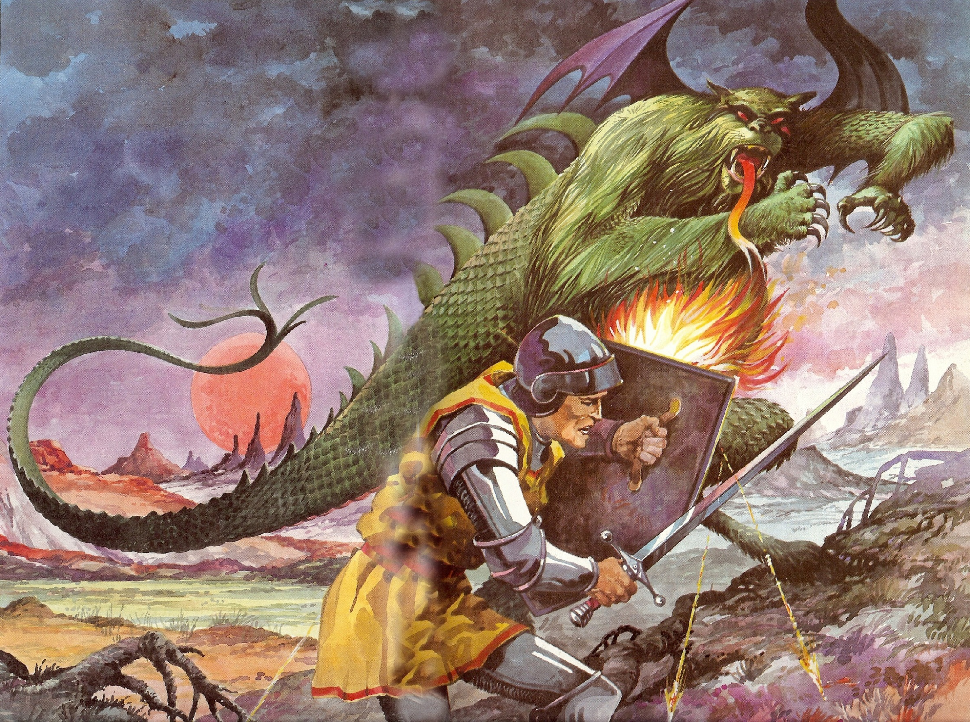
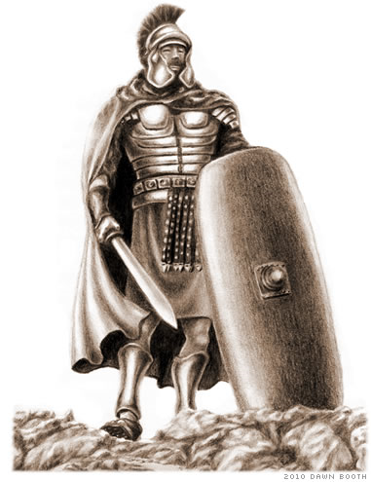
When ever you are dealing with rebellion, you are dealing with Satanic powers (Eph. 6:10-12)

Slide 17
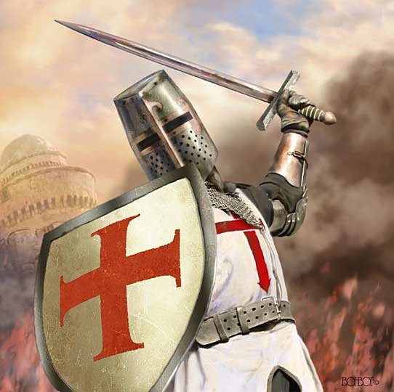
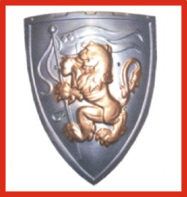
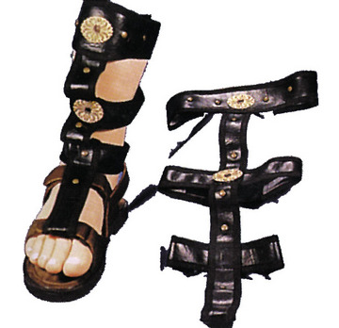
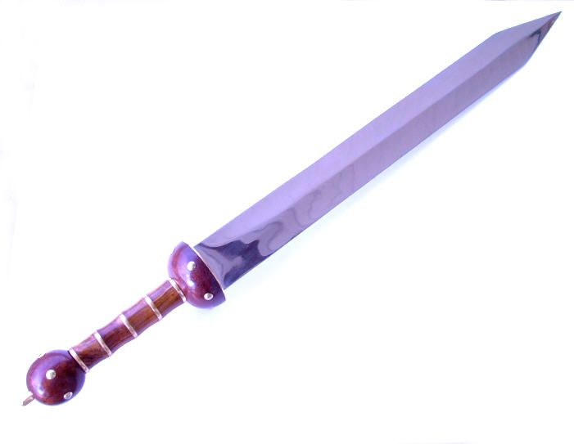
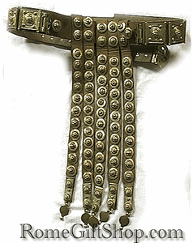
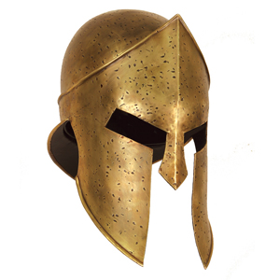
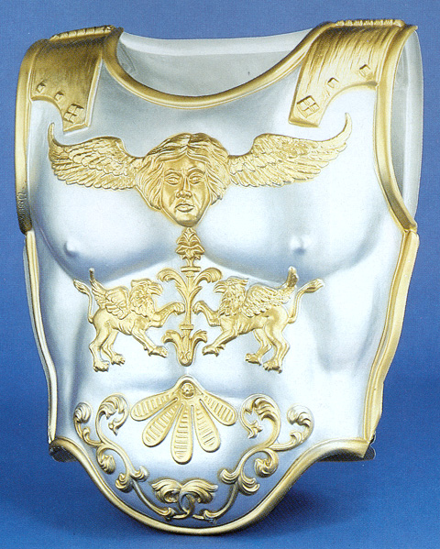

Slide 18
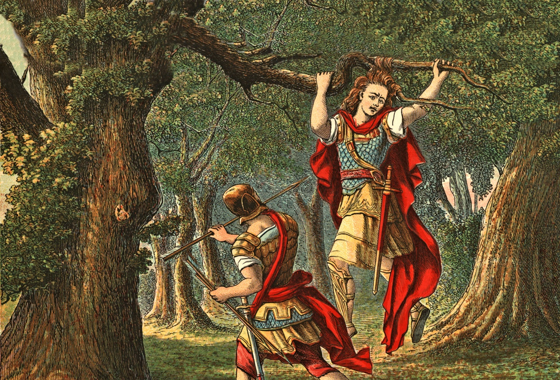
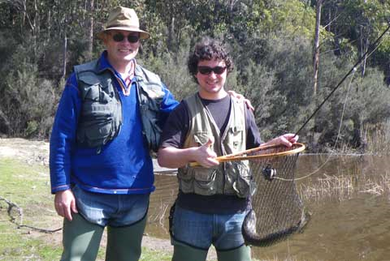
Parents must not follow their natural inclinations to push away from the child, but instead must draw closer to the child (Example David and Absalom)
Parents need to spend a lot of time with the rebellious child. They should talk, work, teach, play, pray, study, share Scripture, etc. (Deut. 6:5-9)

Slide 19
The child must be continually praised for even the smallest display of any character trait - I Peter 2:14
Personal praise – Prov. 29:2
Public praise – Prov. 31:31
10 parts praise for 1 part correction!

Slide 20
Parents must continually humble themselves and ask their child’s forgiveness when God brings failures to light (I Peter 5:6)

Slide 21
I was wrong for _____________will you please forgive me.
Anger
Criticism
Neglect
Inconsistencies
Failing to communicate
Lack of love
Lack of praise and appreciation
etc.

Slide 22
Parents must be ready to help the child deal with bitterness – Heb. 12:15
Parents must be willing accept and forgive their child as the child begins to open up and share previously hidden sins and failures - II Cor. 2:7 “So that contrariwise ye ought rather to forgive him, and comfort him, lest perhaps such a one should be swallowed up with overmuch sorrow.”
Rebels often disclose very shocking things!

Slide 23
Parents must be committed to following God’s principles and refuse to yield to pressure (Daniel 1:8)
1. Pressure from the child
2. Pressure from personal friends
3. Pressure from church members
4. Pressure from relatives (grandparents)

Slide 24
Parents must be committed to long range change and not a “quick-fix” (Matthew 12:43-45)
“Love suffereth long…Seeketh not her…Love bears all things…Love never falls...”

