Slide 1
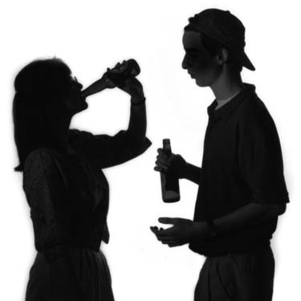
Drinking Right or Wrong? “A Biblical Perspective”

Slide 2
Three passages used to support drinking of alcohol
1. Paul’s exhortation to Timothy to “...[take] a little wine...” - I Timothy 5:23
Paul had just finished establishing the qualifications for a Pastor in I Timothy 3:1-7.
Among the qualifications “…not given to wine.”
Now Paul tells Timothy only to drink wine “…for thy stomach’s sake and thine often infirmities.”

Slide 3
2. Solomon’s proverb concerning the use of wine and strong drink as a sedative to ease pain and suffering - Proverbs 31:6-7
“Give strong drink unto him that is ready to perish (dying), and wine unto those that be of heavy hearts (suffering) Let him drink, and forget his poverty, and remember his misery no more.”
These verses do not condone intoxication but indicates the medicinal use of alcohol in ancient times.

Slide 4
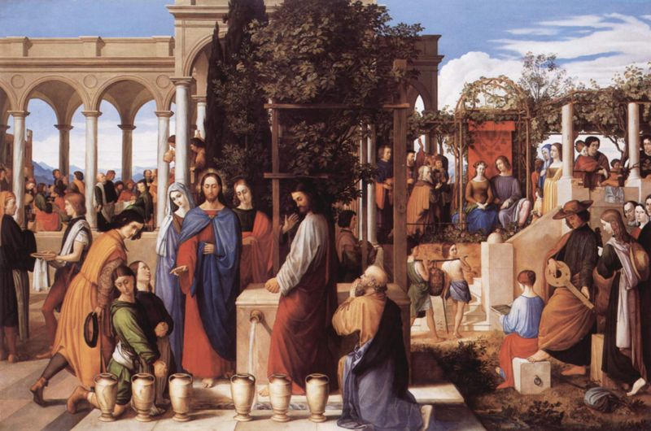
3. Jesus TURING the water into wine - John 2:1-11
oinos (Greek) - means = juice of grapes. It was even used to refer to grapes still hanging on the vine “hanging wine”
Grape jelly
Fermented wine
Unfermented wine
Good: “Best Wines” - New or fresh wine

Slide 5
His holy nature - Hebrews 7:26
His holy appearance, character, and speech - Matthew 27:23-24
He would not contradict Scripture - Habakkuk 2:15; Matthew 5:17-18; I Thessalonians 5:22
He was a priest (Hebrews 2:17) and priests were commanded not to drink wine - Leviticus 10:9-11
He was a king (John 19:19) and kings were forbidden to drink wine - Proverbs 31:4-5
He came to seek and to save the lost (Luke 19:10) and drinking keeps people from being saved - I Corinthians 6:9-11

Slide 6
He did not come to send people to hell; hell had to be enlarged because of DRINKING - Isaiah 5:11-14
He did not come to cast a stumbling block before anyone; a person who gives another wine causes them to stumble - Romans 14:21
He did not make fermented wine at the wedding feast, he made “good wine” - John 2:10
He would not have received glory by making drunk people drunker - John 2:11

Slide 7
HE NEVER WOULD HAVE PLACED A TEMPTATION BEFORE PEOPLE – James 1:13-16
HE NEVER WOULD HAVE CREATED SOMETHING TO BE DRUNK SOCIALLY THAT HAS THE POTENTIAL OF KEEPING MEN OUT OF THE KINGDOM OF GOD – I Corinthians 6:10
HE NEVER WOULD HAVE IGNORED THE SCRIPTURAL PROHIBITION, WARNINGS, AND STATEMENTS CONCERNING THE DRINKING OF ALCOHOL -

Slide 8
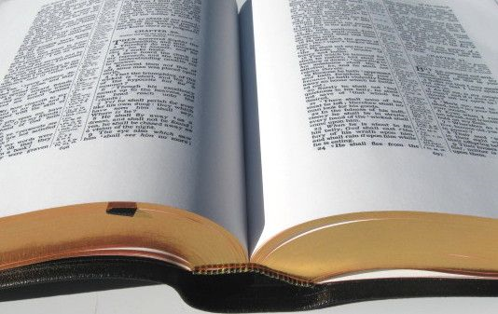
75 Biblical Warnings

Slide 9
1. Genesis 9:20-26
2. Genesis 19:30-38
3. Genesis 27:25
4. Leviticus 10:9
5. Numbers 6:3
6. Deuteronomy 21:20
7. Deuteronomy 29:2-6
8. Judges 13:4, 7, 14
9. I Samuel 1:14-15
10. I Samuel 25:32-38
11. II Samuel 11:13
12. II Samuel 13:28-29
13. I Kings 16:8-10
14. I Kings 20:12-21
15. Esther 1:5-12
16. Job 1:18-19
17. Proverbs 4:17
18. Proverbs 20:1
19. Proverbs 21:17
20. Proverbs 23:21
21. Proverbs 23:29-30
22. Proverbs 23:31
23. Proverbs 23:32
24. Proverbs 23:33

Slide 10
25. Proverbs 23:33
26. Proverbs 23:34
27. Proverbs 23:35
28. Proverbs 23:35
Proverbs 31:4-5
Proverbs 31:6-7
31. Ecclesiastes 2:3
32. Ecclesiastes 10:17
33. Isaiah 5:11-12
34. Isaiah 5:22
35. Isaiah 22:13
36. Isaiah 24:9
37. Isaiah 28:1
38. Isaiah 28:3
39. Isaiah 28:7
40. Isaiah 28:7
41. Isaiah 28:7
42. Isaiah 28:7
43. Isaiah 56:9-12
44. Jeremiah 35:5,6,8,14
45. Ezekiel 44:21
46. Daniel 1:5, 8, 16; 10:3
47. Daniel 5:1
48. Daniel 5:2, 23
49. Daniel 5:3
50. Daniel 5:5-9, 25-28

Slide 11
51. Hosea 3:1
52. Hosea 4:11
53. Hosea 7:5
54. Joel 1:5
Joel 3:356.
Amos 2:8
57. Amos 2:12
58. Amos 4:1
59. Amos 6:6
60. Nahum 1:10
61. Habakkuk 2:5
62. Habakkuk 2:15
63. Habakkuk 2:16
64. Matthew 24:48-51
65. Luke 1:15
66. Luke 12:45
67. Luke 21:34
68. Romans 13:13
69. Romans 14:21
70. I Corinthians 6:10
71. I Corinthians 11:25
72. Galatians 5:12
73. Ephesians 5:18
74. I Thessalonians 5:7
75. I Timothy 3:3, 8, 11, 12

Slide 12
QUESTIONS THAT MUST BE ANSWERED TO DETERMINE IF DRINKING ALCOHLIC BEVERAGE IS THE RIGHT CHOICE.

Slide 13
is my drinking NECESSARY?
In Biblical times it may have been somewhat necessary to drink wine.
NOTE: Today however due to refrigeration, beverages can be kept without fermenting and we have an endless variety of non-alcoholic beverages to choose from.
Drinking wine is not a necessity, it is a preference.

Slide 14
is drinking the best choice?
God gives us the freedom of choice.
Many Christians however do not determine what is the best choice.
To understand what the best choice would be in the question to drink or not to drink, let’s look at God’s standard for leadership.
Abstinence for the Old Testament Priesthood - Leviticus 10:8-11
Abstinence for kings and princes - Proverbs 31:4-7
Abstinence for Nazirite Vow - Numbers 6:1-3
Abstinence for pastors (elders) - I Timothy 3:3

Slide 15
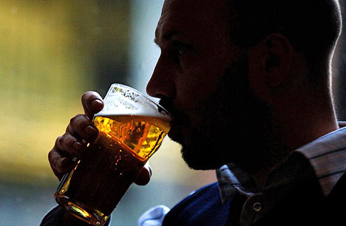
Even the slightest drinking impairs one’s thinking and lowers alertness to spiritual danger - I Peter 5:8-9
Christians are priestS, and the Bible forbids priestS to drink - Leviticus 10:9-10; I Peter 2:9
Christians are not to be controlled by liquor - Ephesians 5:18

Slide 16
Christians are not to touch the unclean thing - II Corinthians 6:14 - 7:1
CHRISTIANS are to abstain from every form of evil and the appearance of evil - I Thessalonians 5:22
Wine is a mocker and a deceiver - Proverbs 20:1
No man who drinks alcohol knows exactly where it will lead.

Slide 17
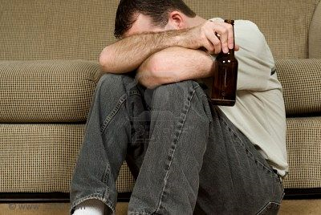
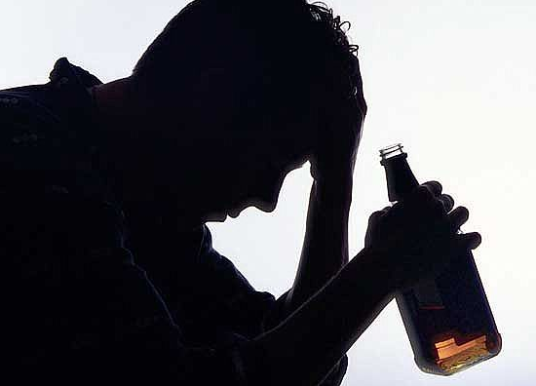
is it habit forming?
Principle of Scripture is “Do not allow yourself to come under the power or control of anything that could cause you to fall into sin” - I Corinthians 6:9-12
If we want to avoid sin, we should also want to avoid those things which promote sin.

Slide 18
STATISTICAL EVIDENCE
1. Mental Destruction - One-fourth of all patients admitted into mental hospitals have alcoholic problems.
2. 35 million Alcoholics in the United States.
3. Physical Destruction - Alcohol causes Sclerosis of the liver, destruction of brain cells, balloning of the veins, thinning of the blood, and physical defects in unborn children.
4. Physical death - Drivers under the influence of liquor were responsible for 50% of all auto deaths.

Slide 19
is it potentially destructive?
Biblical examples:
1. Ephesians 5:18 “. . . be not drunk with wine, wherein is excess. . .” The word “excess” in the Greek is asotia and means to be “hopelessly and incurably sick”.
NOTE: Drinking leads to drunkenness, which leads to hopeless sickness and destruction.
2. Proverbs 20:1 - “Wine is a mocker, strong drink is raging...” - Proverbs 4:17; 21:17; 23:21; 23:32-35
3. Genesis 9:20-26 - Drinking leads to immorality

Slide 20
4. Genesis 19:30-35 - Drinking leads to incest.
5. Deuteronomy 21:20 - Drinking leads to gluttony, rebellion, disobedience to parents, and a dissolute life.
6. Isaiah 28:7 - Drinking leads to perversion and corruption.
7. Joel 1:5; 3:3 - Drinking leads to addition
8. Amos 2:8, 12; 4:1; 6:6 - Drinking leads to debauchery.
9. Habakkuk 2:15 - Drinking leads to judgment.

Slide 21
is it offensive to others?
The principle of Scripture is “If you think something is acceptable, but someone else is offended by it, avoid it.” - Romans 14:13-21; I Corinthians 8:9
II Corinthians 6:3 “Giving no offence in any thing, that the ministry be not blamed.”

Slide 22
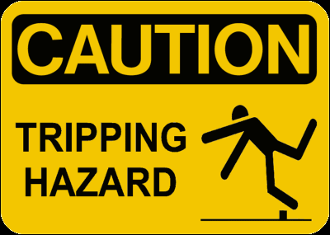
COULD IT BE A STUMBLING BLOCK?
Romans 14:13 “Let us not therefore judge one another any more: but judge this rather, that no man put a stumblingblock or an occasion to fall in his brother's way.”

Slide 23
will it harm my Christian testimony?
If people are going to see the reality of Christ living His life through us “... for me to live is Christ. . .Christ liveth in me...” it is important to follow the principle of I Corinthians 10:31-33.
“Whether therefore ye eat, or drink, or whatsoever ye do, do all to the glory of God. Give none offence, neither to the Jews, nor to the Gentiles, nor to the church of God: Even as I please all men in all things, not seeking mine own profit, but the profit of many, that they may be saved.”

Slide 24
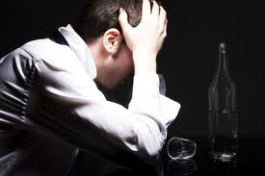
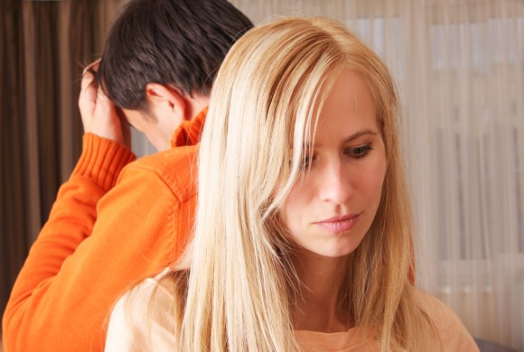
Alcoholism is not a disease but a sin
Alcoholism is a sin that needs to be confessed as sin and dealt with as sin - Proverbs 28:13-14
The reason it has been classified as a disease is because of its effect on the body.

Slide 25
Are you absolutely certain that it is right to drink?
Romans 14:23 “...he that doubteth is damned… because...whatsoever is not of faith is sin.”
The Holy Spirit works through our consciences to convict us and lead us (Romans 9:1).
If you cannot do something with a completely free conscience, believing with all your heart that it is right to do - DON’T DO IT!!! - Romans 14:21-23.

Slide 26
[ 1 ] Romans 13:13 -“Let us walk honestly, as in the day; not in rioting and drunkenness, not in chambering and wantonness, not in strife and envying.”
[ 2 ] Galatians 5:17 - “For the flesh lusteth against the Spirit, and the Spirit against the flesh: and these are contrary the one to the other: so that ye cannot do the things that ye would.”
[ 3 ] I Corinthians 6:10 -“Nor thieves, nor covetous, nor drunkards, nor revilers, nor extortioners, shall inherit the kingdom of God.”
[ 4 ] I Peter 4:3 -“For the time past of our life may suffice us to have wrought the will of the Gentiles, when we walked in lasciviousness, lusts, excess of wine, revellings, banqueting, and abominable idolatries.”

Slide 27
[ 5 ] I Thessalonians 5:6-7 -“Therefore let us not sleep, as do others; but let us watch and be sober. For they that sleep sleep in the night; and they that be drunken are drunken in the night.”
[ 6 ] Deuteronomy 21:20 -“And they shall say unto the elders of his city, This our son is stubborn and rebellious, he will not obey our voice; he is a glutton, and a drunkard.”
[ 7 ] Proverbs 4:17 - “For they eat the bread of wickedness, and drink the wine of violence.”
[ 8 ] Proverbs 21:17 -“He that loveth pleasure shall be a poor man: he that loveth wine and oil shall not be rich.”

Slide 28
[ 9 ] Proverbs 23:19-21, 29-35 -“Hear thou, my son, and be wise, and guide thine heart in the way. Be not among winebibbers; among eaters of flesh: For the drunkard and the glutton shall come to poverty: and drowsiness shall clothe a man with rags…Who hath woe? who hath sorrow? who hath contentions? who hath babbling: who hath redness of eyes? They that tarry long at the wine; they that go to seek mixed wine. Look not thou upon the wine when it is red, when it giveth his colour in the cup, when it moveth itself aright. At the last it biteth like a serpent, and stingeth like an adder. Thine eyes shall behold strange women, and thine heart shall utter perverse things. Yea, thou shalt be as he that lieth down in the midst of the sea, or as he that lieth upon the top of a mast. They have stricken me, shalt thou say, and I was not sick; they have beaten me, and I felt it not: when shall I awake: I will seek it yet again.”

Slide 29
[10] Isaiah 5:11 -“Woe unto them that rise up early in the morning, that they may follow strong drink; that continue until night, till wine inflame them!”
[11] Isaiah 28:7 -“But they also have erred through wine, and through strong drink are out of the way; the priest and the prophet have erred through strong drink, they are swallowed up of wine, they are out of the way through strong drink; they err in vision, they stumble in judgment.”
12] Isaiah 56:11-12 -“Yea, they are greedy dogs which can never have enough, and they are shepherds that cannot understand: they all look to their own way, every one for his gain, from his quarter. Come ye, say they, I will fetch wine, and we will fill ourselves with strong drink; and tomorrow shall be as this day, and much more abundant.”

Slide 30
[13] hosea 4:11 - “Whoredom and wine and new wine, take away the heart.”
[14] Amos 2:8, 12 -“And they lay themselves down upon clothes laid to pledge by every altar, and they drink the wine of the condemned in the house of their god. But ye gave the Nazarites wine to drink; and commanded the prophets, saying, Prophesy not.”
[15] Amos 4:1 - “Hear this word, ye kine of Bashan, that are in the mountain of Samaria, which oppress the poor, which crush the needy, which say to their masters, Bring, and let us drink.”
[16] Amos 6:6 - “That drink wine in bowls, and anoint themselves with the chief ointments: but they are not grieved for the affliction of Joseph.”

Slide 31
