Slide 1
Qualities of a Man of God
Prov. 20:6 “Most men will proclaim every one his own goodness: but a faithful man who can find?”
Prov. 28:20 “A faithful man shall abound with blessings.”

Slide 2
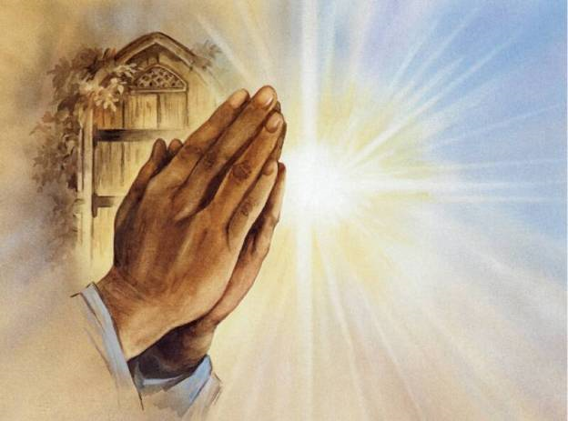
1. Saved – Titus 3:5
Prayer of Salvation - (Romans 10:9-13)
“Thank you, God, for loving me, a sinner, and for sending Your Son to pay the penalty of my sin. Right now I put my trust in His death and resurrection for my salvation and receive the eternal life that You offer me through Him. Thank you for hearing this prayer, cleansing me of all my sin through Christ’s blood, and accepting me now as your child. Teach me and direct me through Your Word and Your Spirit to discover Your purpose for my life. Amen.”

Slide 3
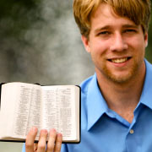
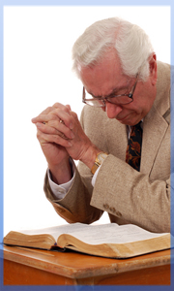
2. Seeks the Lord – II Chron. 26:5 “And he (Uzziah) sought God in the days of Zechariah, who had understanding in the visions of God: and as long as he sought the LORD, God made him to prosper.”
Bible reading
Memorization
Meditation
Study

Slide 4
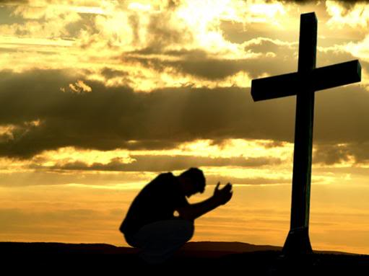
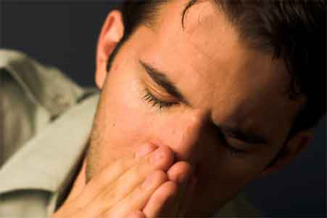
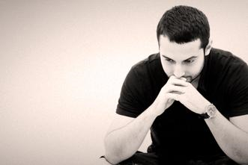
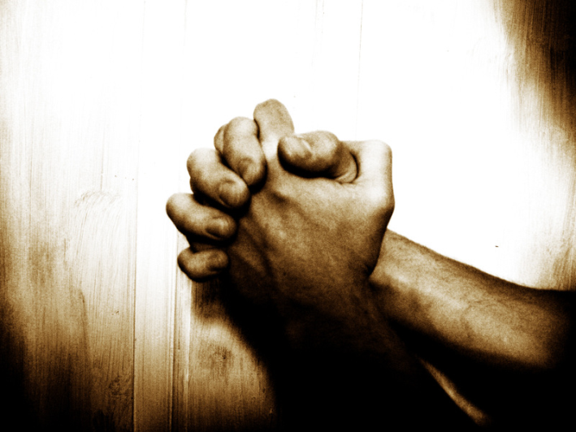
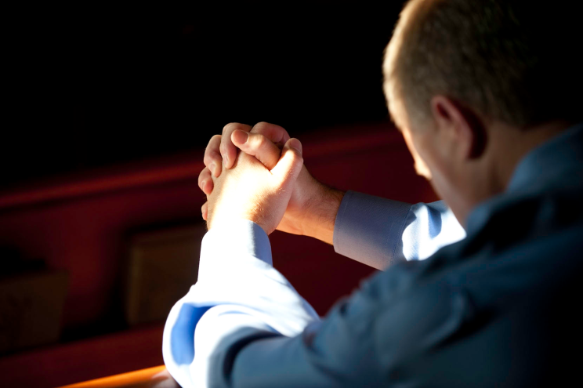
3. Prayer – “And he spake a parable unto them to this end, that men ought always to pray, and not to faint.” Luke 18:1
Worship
Confession
Seeking God’s will
Request for needs
Intercession

Slide 5
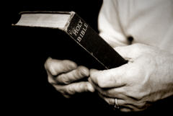
4. Wise - Sons of Issachar
“And of the children of Issachar, which were men that had understanding of the times, to know what Israel ought to do.” (I Chron. 12:32)

Slide 6
5. Pure heart –
Ps 24:4 “He that hath clean hands, and a pure heart; who hath not lifted up his soul unto vanity, nor sworn deceitfully.”
I Tim.1:5 “Now the end of the commandment is charity out of a pure heart, and of a good conscience, and of faith unfeigned.”
II Tim. 2:22 “Flee also youthful lusts: but follow righteousness, faith, charity, peace, with them that call on the Lord out of a pure heart.”
I Pet. 1:22 “Seeing ye have purified your souls in obeying the truth through the Spirit unto unfeigned love of the brethren, see that ye love one another with a pure heart fervently.”

Slide 7
6. Humble – Prov. 29:23 “A man's pride shall bring him low: but honor shall uphold the humble in spirit.”
I Peter 5:6 “Humble yourselves therefore under the mighty hand of God, that he may exalt you in due time.
Strife – James 3:16
Division / Discord – Prov. 6:19
Argumentation – I Tim. 6:4
Judgmental / Critical Spirit – Matt. 7:1
Offensive – Phil. 1:10
Power and Control – III John

Slide 8
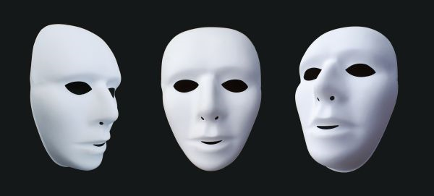
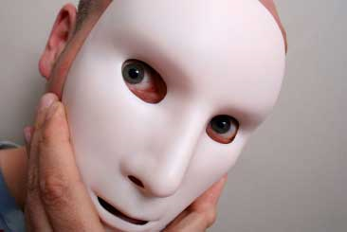
7. Not a hypocrite –
Matt. 23:28 “Even so ye also outwardly appear righteous unto men, but within ye are full of hypocrisy and iniquity.”

Slide 9
8. Loves the Lord -

Slide 10
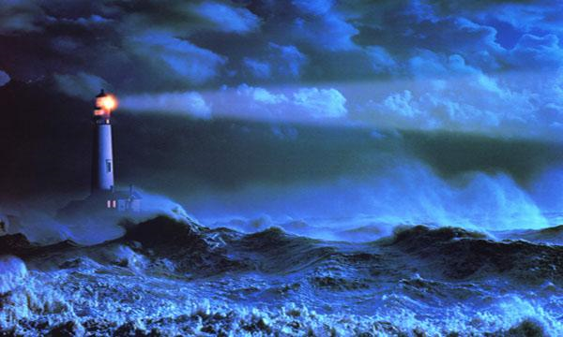
9. Obedient to the Word of God – II Cor. 10:6 “And having in a readiness to revenge all disobedience, when your obedience is fulfilled.”
“Thy word is a lamp unto my feet, and a light unto my path.” (Psalms 119:105)

Slide 11
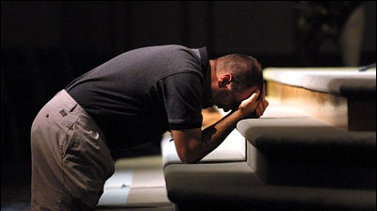
10. Strives for perfection – Heb. 13:21 “Make you perfect in every good work to do his will, working in you that which is wellpleasing in his sight, through Jesus Christ; to whom be glory for ever and ever. Amen.”
Teachable spirit – I Thess. 2:13
Christ likeness – Phil. 1:20
Growing Christian – I Peter. 2:2
Continually adds to his faith – II Peter 1:5

Slide 12
11. Scripturally based standards and convictions – I Cor. 16:13-14 “Watch ye, stand fast in the faith, quit you like men, be strong. Let all your things be done with charity. ”
Held with out a critical and judgmental spirit
Held without pride/self-righteousness
Held out of a love for the Lord
Held out of a desire to live - “soberly, righteously, and godly in this present world.”
Held in grace - II Tim. 2:1 “Thou therefore, my son, be strong in the grace that is in Christ Jesus.”

Slide 13
12. Good husband – Eph. 5:23; Col. 3:19
Nurture
Cherish
Protect – I Peter 3:5-6

Slide 14
13. Good father – Eph. 6:4; Col. 3:21
Example
Teacher
Protector

Slide 15
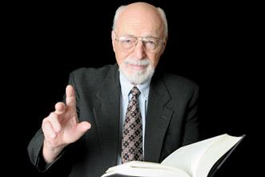
14. Faithful to his local church – Heb. 10:25, 13:7, 17
Attendance
Service
Giving
Supports the pastor
Teaching
Convictions
Standards
Goals
Vision

Slide 16
15. Truthful – Exod. 18:21; Eph. 4:15
Man of his word
Praise
Encouragement
Edification
Guards his mouth
Gossip
Slander
Evil reports

Slide 17
16. Spirit filled – Eph. 5:18 “And be not drunk with wine, wherein is excess; but be filled with the Spirit.”

Slide 18
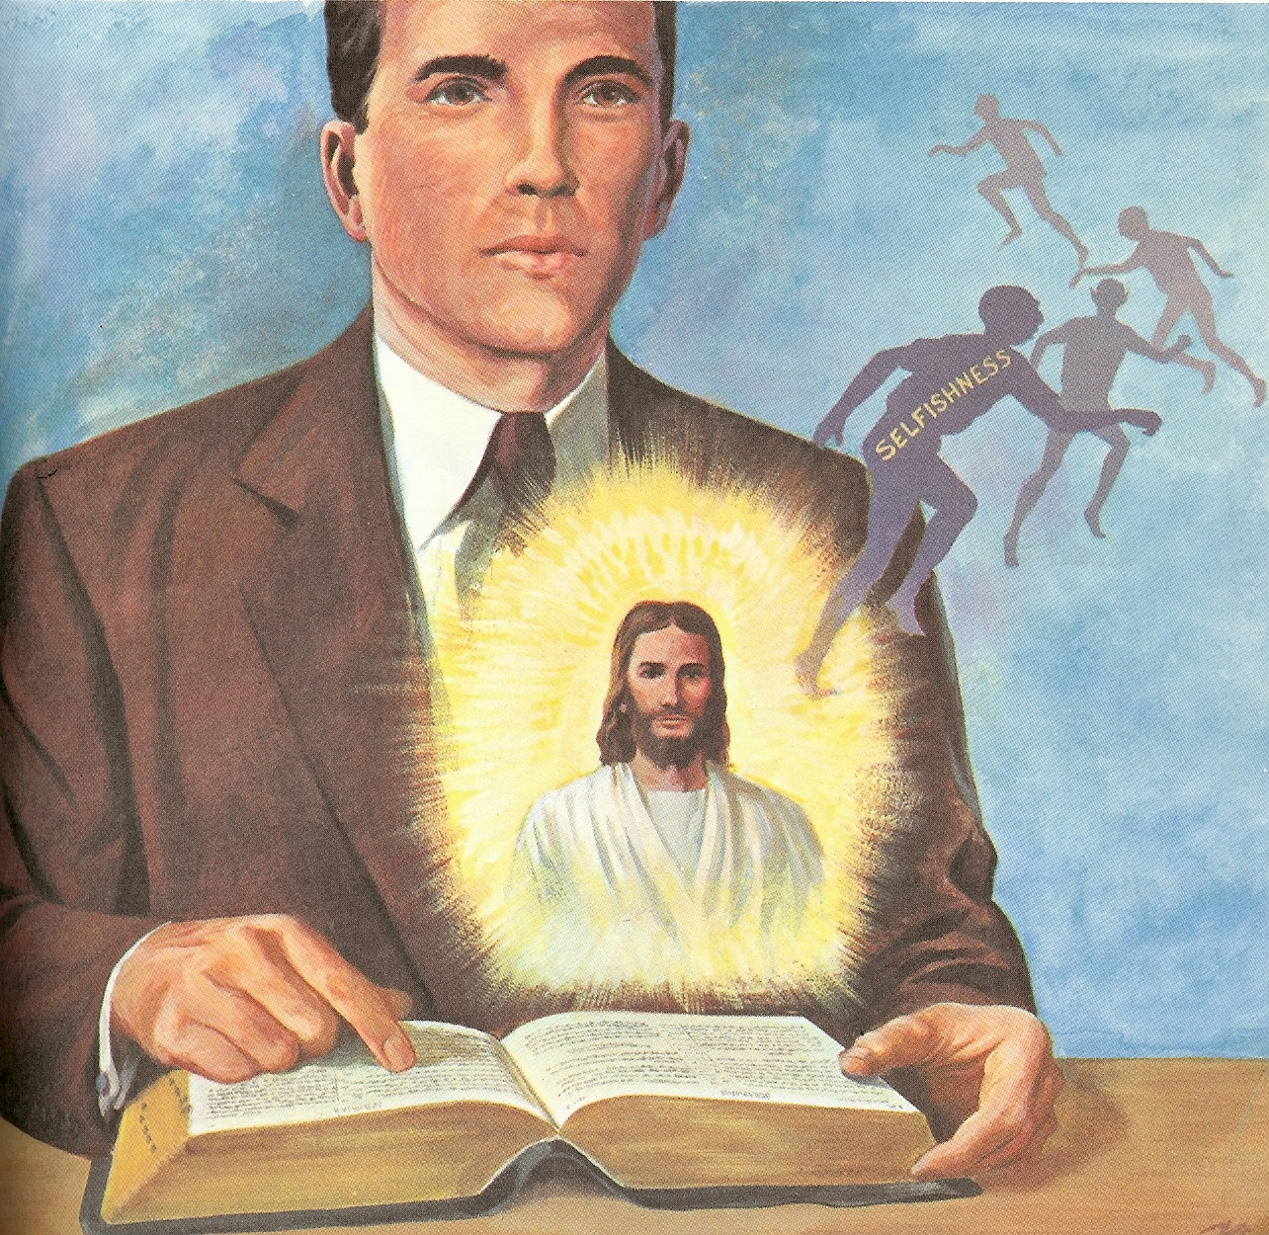
How to be Filled with the Holy Spirit

Slide 19
1. Purpose to live a holy life – I Thess. 4:1-8
2. Yield yourself to the Lord – Rom. 6, 12:1-2
3. Renew your mind daily – Eph. 4:23-24
4. Make no provision for the flesh – Rom.13:14
5. Flee temptation – II Tim. 2:22
6. Resist Satan by continual submission to God – Jam. 4:6-10
7. Do not give place to the devil – Eph. 4:27-30 (bitterness, immorality, covetousness)

Slide 20
8. Keep your thoughts centered on things above – Phil. 4:6-8
9. Set your affections on things above – Col. 3:1-4
Keep your sin confessed – Prov. 28: 13-14
Keep your conscience clear – Acts 24:16
Obey the promptings of the Holy Spirit – Rom. 8:14

Slide 21
13. Avoid quenching and grieving the
Holy spirit – I Thess. 5:19, Eph. 4:25-31
14. Ask God to fill you with the Holy Spirit –
Luke 11:15
The Holy Spirit is called the “Spirit of Grace” Heb. 10:29
“God gives grace to the humble…”

Slide 22
17. Morally pure – I Tim. 5:22 “…keep thyself pure.”
Resist immoral temptations
Proper relationship with women
Looking down and looking away
Avoiding places of temptation
Filter on internet
Avoiding suggestive talk and jokes
Maintaining a good relationship with your wife

Slide 23
Faithful Men
Saved
Seeks the Lord
Wise
Prayer
Pure in heart
Humble
Not a hypocrite
Loves the Lord
Obedient to the Word of God
Strives for perfection
Standards and convictions based in Scripture
Good husband
Good father
Faithful to church
Truthful
Spirit filled
Morally pure

