Slide 1
Six Purposes of Marriage (Part 5)
Companionship
Enjoyment
Fruitfulness
Completeness
Protection
Typify Christ’s relationship with His Church

Slide 2
1# Companionship
True companionship grows out of a oneness of spirit – “Can two walk together, except they be agreed?” (Amos 3:3) “Every kingdom divided against itself is brought to desolation; and every city or house divided against itself shall not stand.” (Matt. 12:25)
“Behold, how good and how pleasant it is for brethren to dwell together in unity!” (Psalm 133:1)

Slide 3
Companionship Will Only be Realized When Love is Being Expressed –
At the heart of every human being is the desire to be love by another (Matt. 22:37-39; John 15:12; I John 3:11)
Marriage is designed by God to meet that need (Gen. 2:18-25; Eph. 5:22-31; Col. 3:18-19; Titus 2:4)
There are five primary way to communicate love to your mate.
Words of Affirmation / Quality Time / Receiving of Gifts / Acts of Service / Physical Touch

Slide 4
2# Enjoyment
“Marriage is honorable in all, and the bed undefiled: but whoremongers and adulterers God will judge .” (Heb. 13:4)
Honorable = of great worth or value
Bed = martial bed
Undefiled = to be kept unsoiled / pure
Whoremongers (pornos) = fornicators
Adulterers = unfaithfulness after marriage
God will Judge!

Slide 5
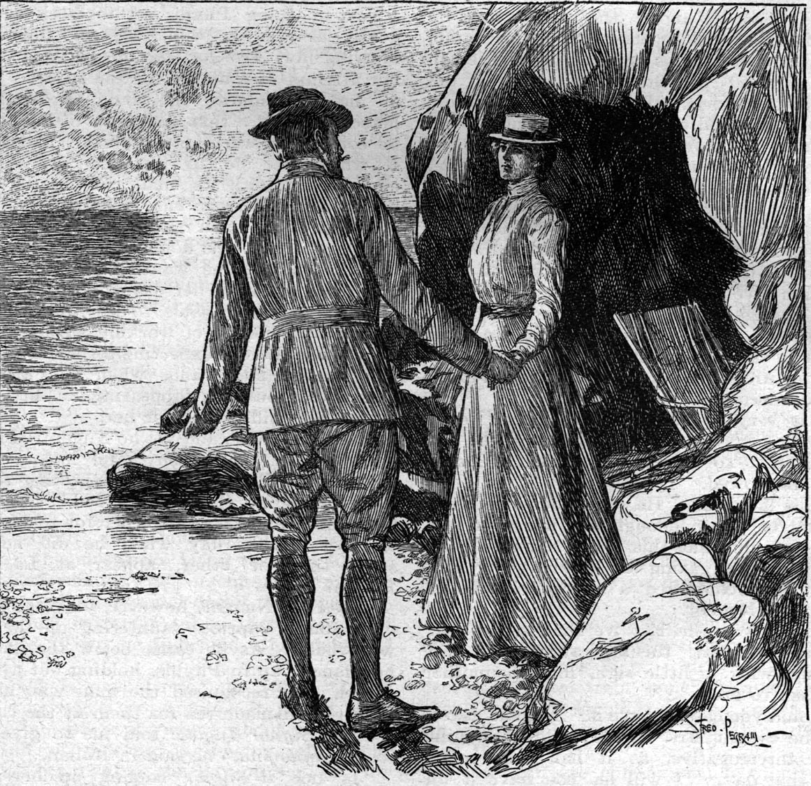
The Principle Behind Enjoyment is Self-control
(Galatians 5:22-23)
Laws of Purification for Women (Leviticus 12, 15; Ezek. 18:5-6)

Slide 6
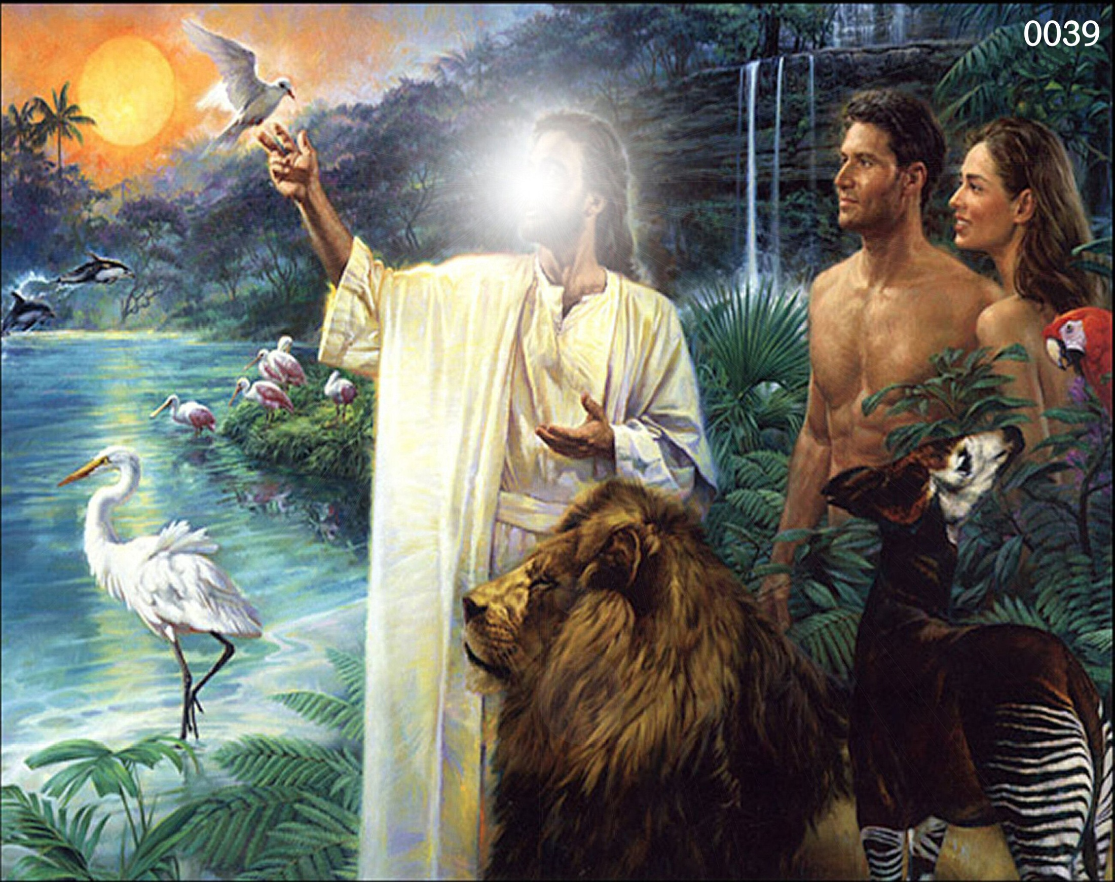
3# Fruitfulness
“So God created man in his own image, in the image of God created he him; male and female created he them. And God blessed them, and God said unto them, Be fruitful, and multiply, and replenish the earth, and subdue it: and have dominion over the fish of the sea, and over the fowl of the air, and over every living thing that moveth upon the earth.” (Gen. 1:26-28)
Fruitful = To make increase
Multiply = Increase with exceeding abundance
Replenish = Fill up the world to overflowing

Slide 7
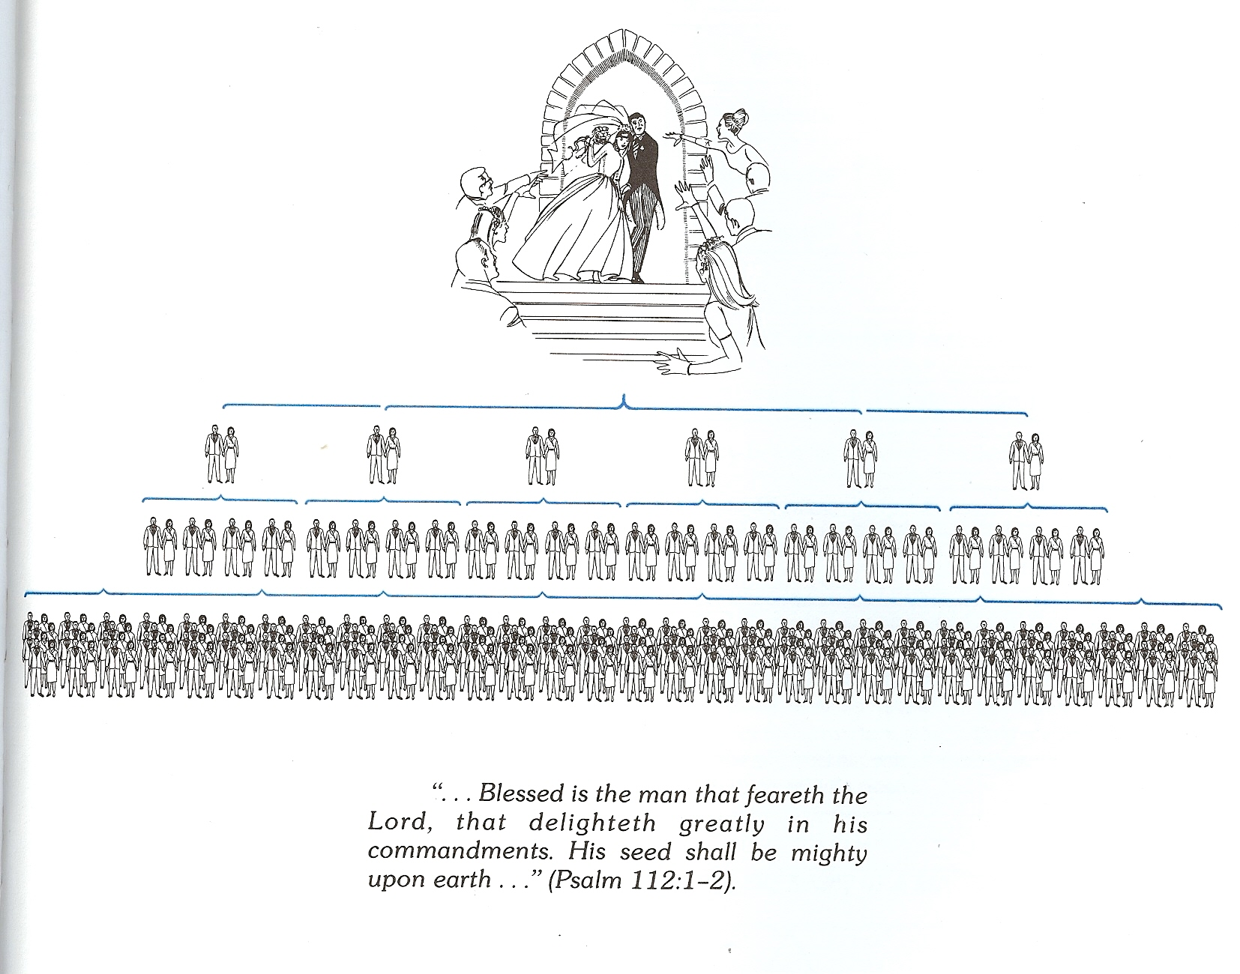
“Thy wife shall be as a fruitful vine by the sides of thine house: thy children like olive plants round about thy table. Behold, that thus shall the man be blessed that feareth the LORD.”
“Lo, children are an heritage of the LORD: and the fruit of the womb is his reward. As arrows are in the hand of a mighty man; so are children of the youth. Happy is the man that hath his quiver full of them: they shall not be ashamed, but they shall speak with the enemies in the gate.”

Slide 8
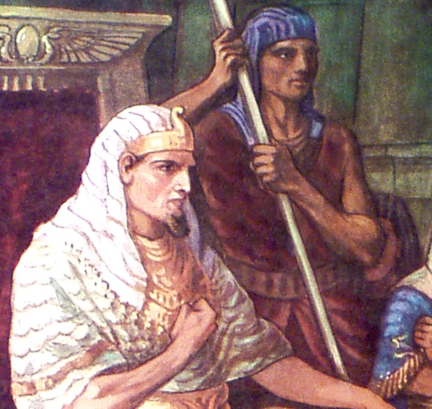
“And he said unto his people, Behold, the people of the children of Israel are more and mightier than we: Come on, let us deal wisely with them; lest they multiply.”

Slide 9
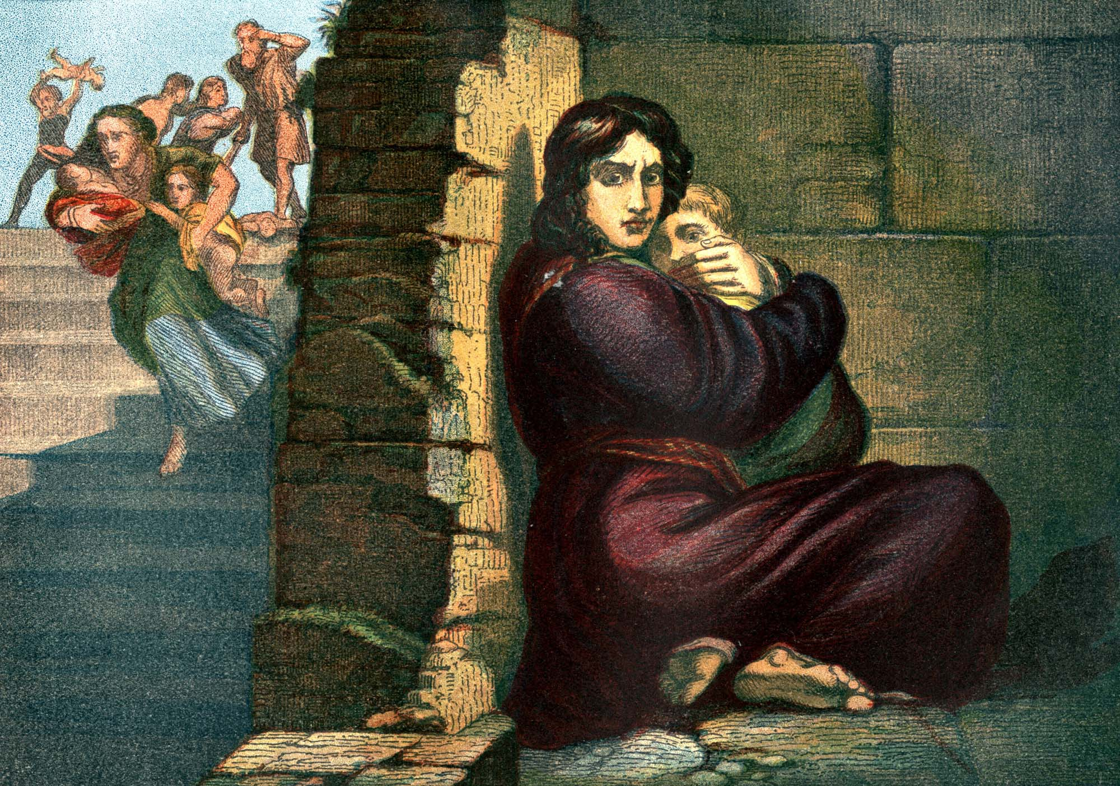
“And he said, When ye do the office of a midwife to the Hebrew women, and see them upon the stools; if it be a son, then ye shall kill him: but if it be a daughter, then she shall live. But the midwives feared God, and did not as the king of Egypt commanded them, but saved the men children alive.”

Slide 10
Recognize that it is the Lord who
opens and closes the womb
God closes the womb – I Samuel 1:5 “The Lord shut up her womb.”
God opens the womb – Genesis 30:22 “And God remembered Rachel, and God hearkened to her, and opened her womb.”

Slide 11
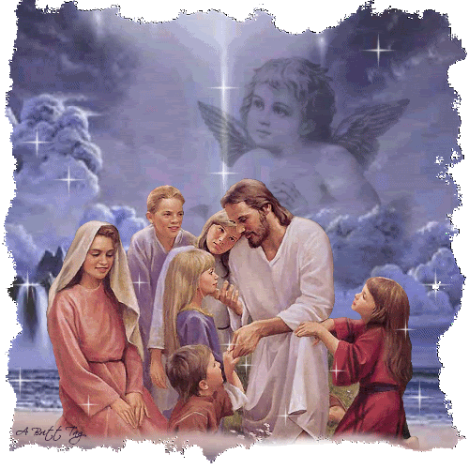
Do you love children the way Jesus loves children?

Slide 12
4# Completeness God designed Eve to complete that which was lacking in Adam’s life
“For Adam there was not found an help meet for him. And the LORD God caused a deep sleep to fall upon Adam, and he slept: and he took one of his ribs, and closed up the flesh instead thereof; And the rib, which the LORD God had taken from man, made he a woman, and brought her unto the man. And Adam said, This is now bone of my bones, and flesh of my flesh: she shall be called Woman, because she was taken out of Man. Therefore shall a man leave his father and his mother, and shall cleave unto his wife: and they shall be one flesh.”

Slide 13
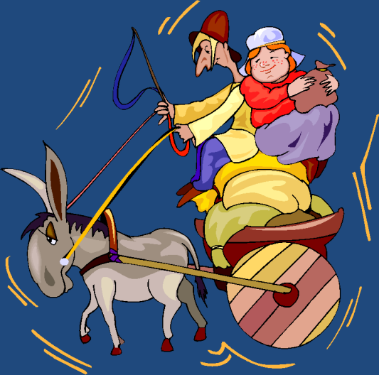
“O magnify the LORD with me, and let us exalt his name together.”
(Psalms 34:3)
Talents
Abilities
Personality
Interest
Background
Upbringing
Family
Doctrinal beliefs
Philosophy
Standards
Convictions
Spiritual Gifts
Call of God – Rom.11:29

Slide 14
“Likewise, ye husbands, dwell with them according to knowledge, giving honour unto the wife, as unto the weaker vessel, and as being heirs together of the grace of life; that your prayers be not hindered.”
Completeness is promoted by a servant’s spirit – Gal. 5:13
Completeness is deepened by helping each other physically, emotionally, spiritually – Gal. 6:2
Completeness can never be achieved until there is spiritual oneness – Phil. 2:2
Completeness grows through prayer – I Pet. 3:7

Slide 15
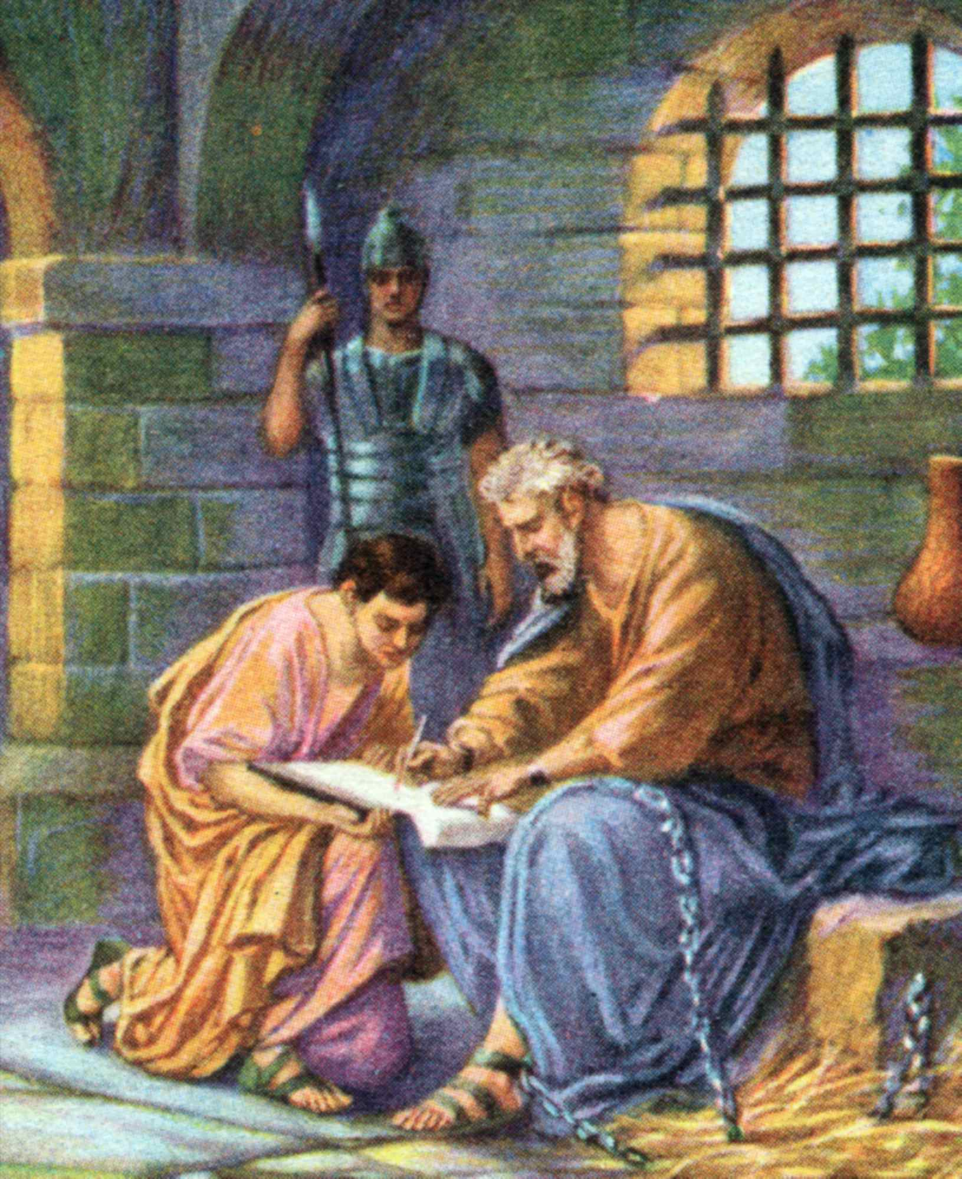
“Epaphras, who is one of you, a servant of Christ, saluteth you, always labouring fervently for you in prayers, that ye may stand perfect and complete in all the will of God.” (Col. 4:12)

Slide 16
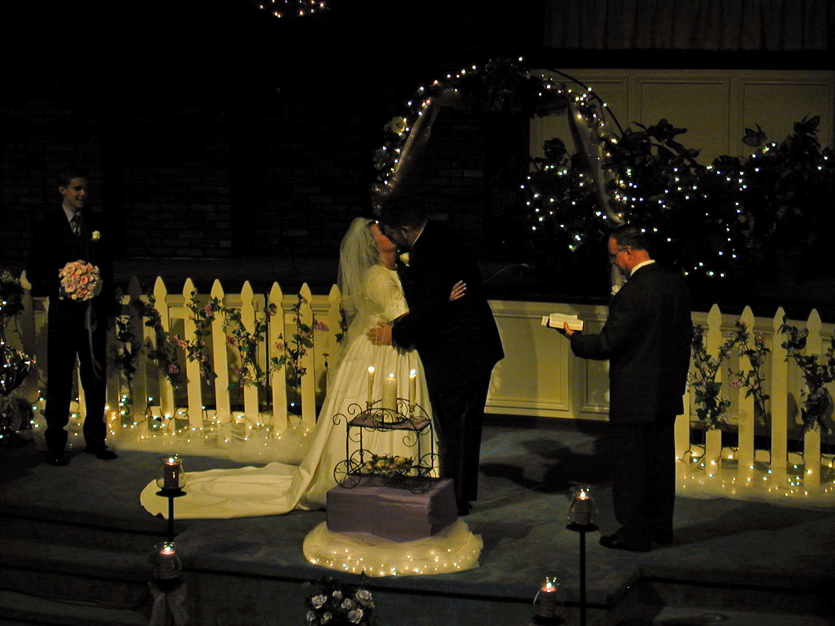
“Stand fast in one spirit, with one mind striving together for the faith of the gospel.”
(Phil. 12:27)

Slide 17
5# Protection
I charge you (man) and you (woman) before God who knows the secrets of all men’s hearts and to whom one day you will stand and give an account, that these vows once made may never be broken except by death.

Slide 18
To the man: Do you now take this woman, whose hand you hold to be your lawful wedded wife. Do you solemnly promise, before God and these witnesses, that you will love, honor, and cherish her, in sickness and in health, for richer, for poorer, for better for worse, and that forsaking all others for her alone, you will faithfully perform to her all the duties which a husband owes to a wife, so long as you both shall live? Do you promise to faithfully provide for her needs, protect her from danger and lead her spiritually?

Slide 19
To the woman: Do you now take this man, whose hand you hold to be your lawful wedded husband. Do you solemnly promise, before God and these witnesses, that you will love, honor and obey him, in sickness and in health, for richer for poorer, for better for worse, and that forsaking all others for him alone, you will faithfully perform to him all the duties which a wife owes to a husband, so long as you both shall live? Do you promise to faithfully reverence him, pray for him and be a safe haven for him to come home to?

Slide 20
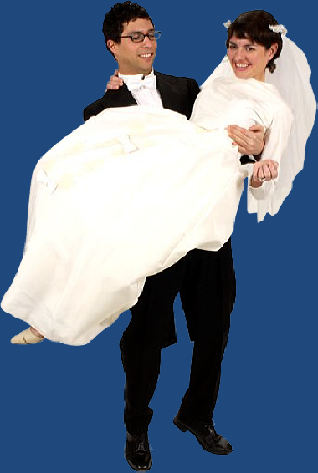
The man - I ____ take thee _____ to be my wedded wife, to have and to hold from this day forward, for better or for worse, for richer for poorer, in sickness and in health, to love and to cherish, till death do us part, according to God’s holy ordinance, and thereto I give my pledge.

Slide 21
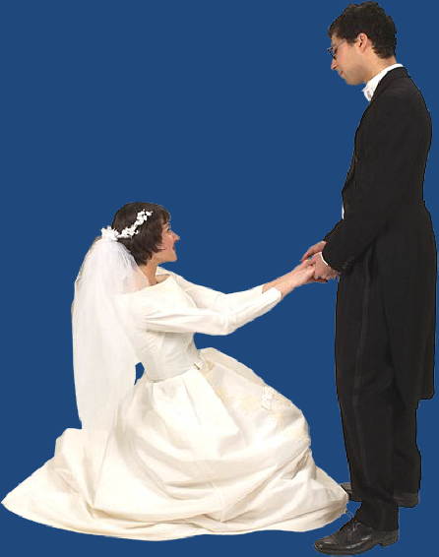
The woman – I _____take thee _____ to be my wedded husband, to have and to hold from this day forward, for better or for worse, for richer, for poorer, in sickness and in health, to love and to cherish, till death do us part, according to God’s holy ordinance and thereto I give my pledge.

Slide 22
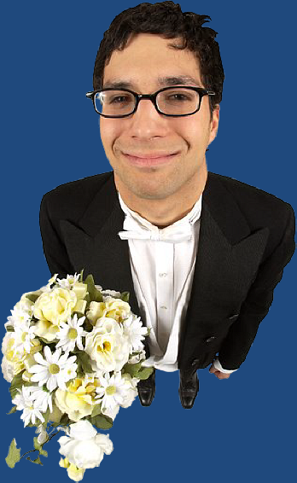
The Husband’s Vow
When a man enters into the marriage covenant, he is thereby pledging his strength, resources, and life to the wife as long as he is alive –
The Promise -
Love
Honor
Cherish

Slide 23
In Sickness
In Health
For Richer
For Poorer
For Better
For Worse
Forsaking all others for her alone
Faithfully perform to her all the duties which a husbands owes to a wife
So long as you shall live

Slide 24
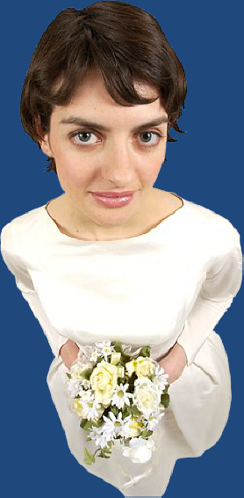
The Wife’s Vow
When a woman enters into the marriage covenant, she is thereby pledging her strength, resources, and life to the husband as long as she is alive –
The Promise -
Love
Honor
Obey

Slide 25
In Sickness
In Health
For Richer
For Poorer
For Better
For Worse
Forsaking all others for him alone
Faithfully perform to him all the duties which a wife owes to a husband
So long as you shall live

Slide 26
Six Purposes of Marriage (Part 5)
Companionship
Enjoyment
Fruitfulness
Completeness
Protection
Typify Christ’s relationship with His Church

Slide 27
5# Protection
I charge you (man) and you (woman) before God who knows the secrets of all men’s hearts and to whom one day you will stand and give an account, that these vows once made may never be broken except by death.

Slide 28
The Husband’s Responsibility and The Wife’s Responsibility

Slide 29
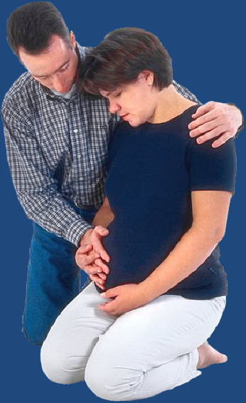
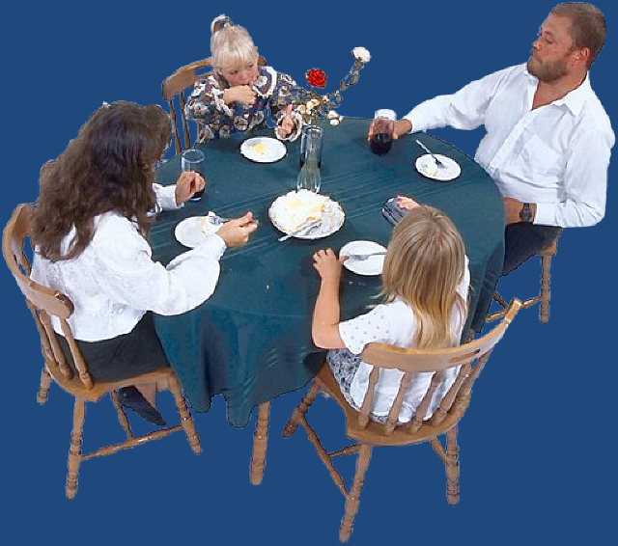
Husband’s Duty
Emotional
Provide protection for his wife – I Cor. 11:3
Provide protection for his family – Eph. 6:1-4
Spiritual
Physical

Slide 30
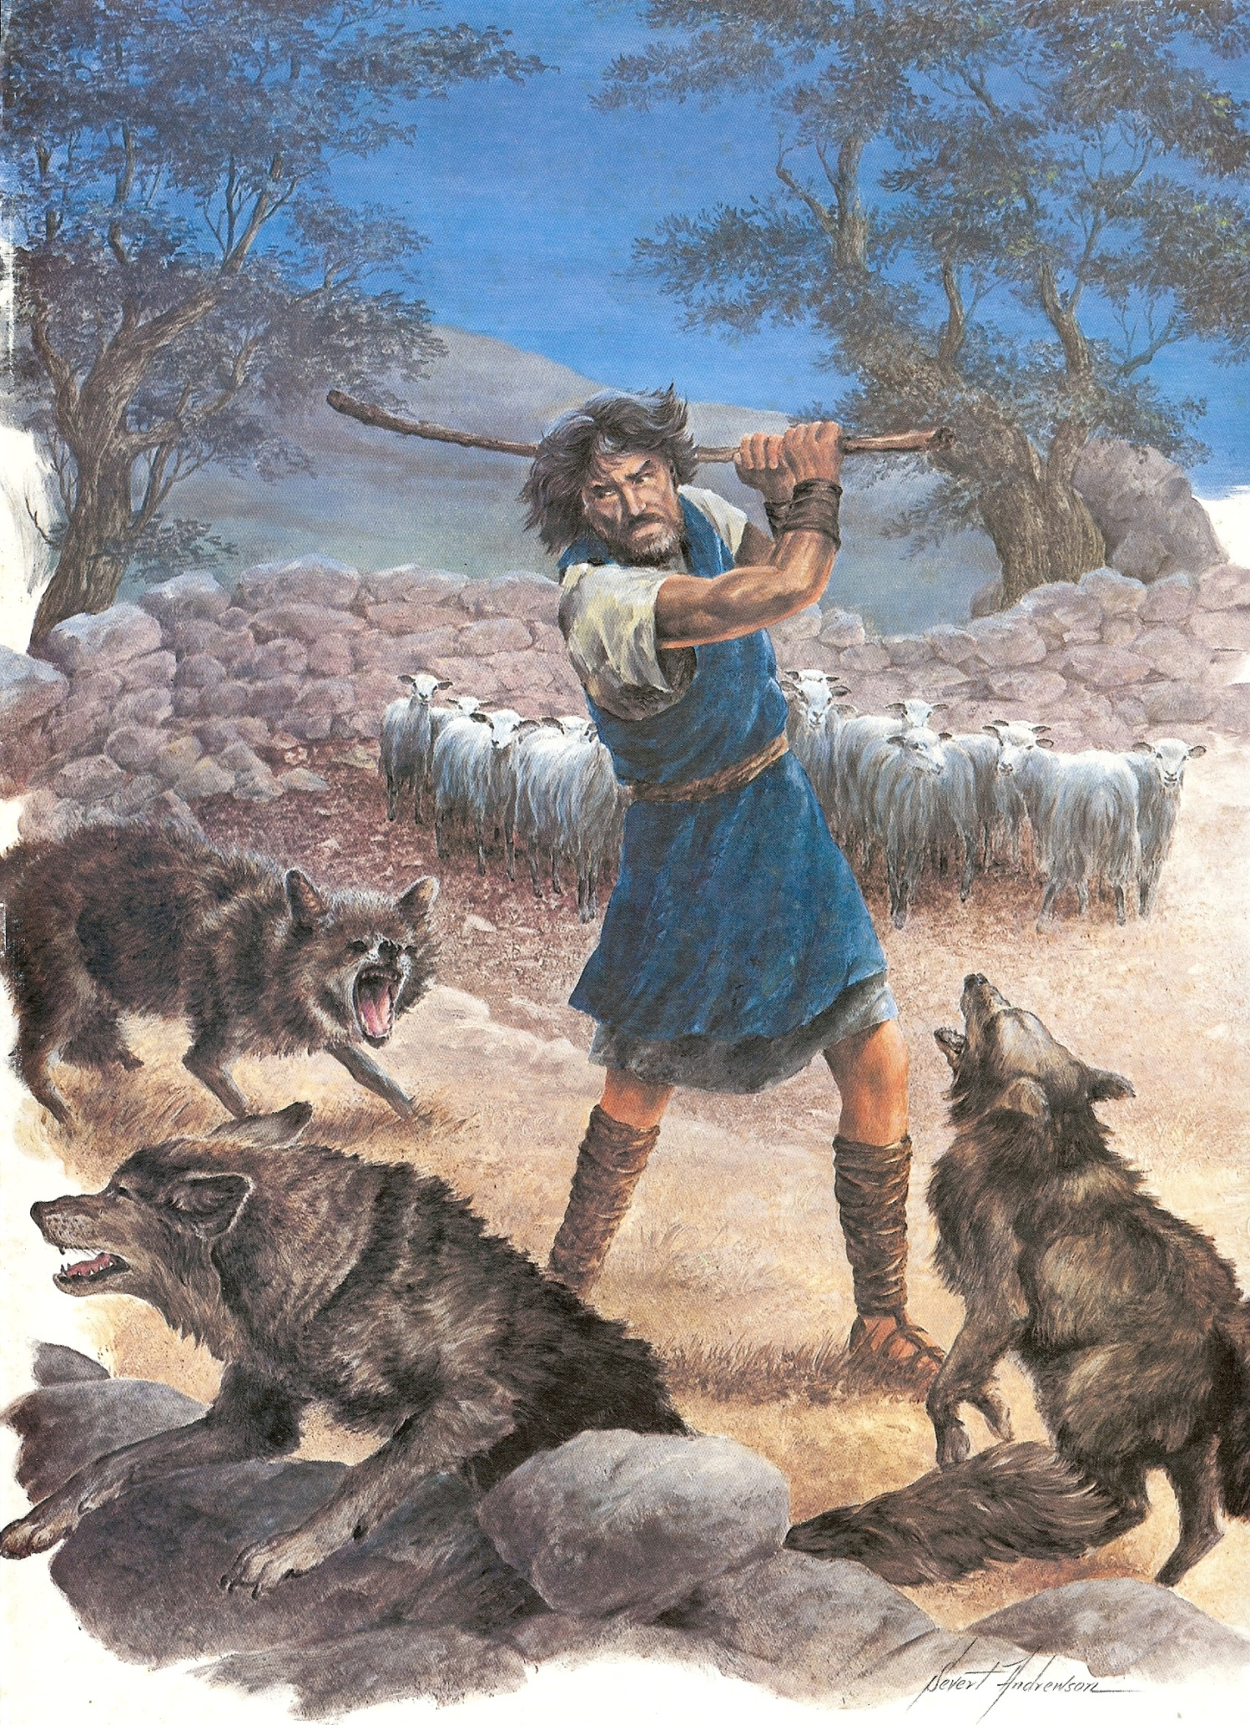
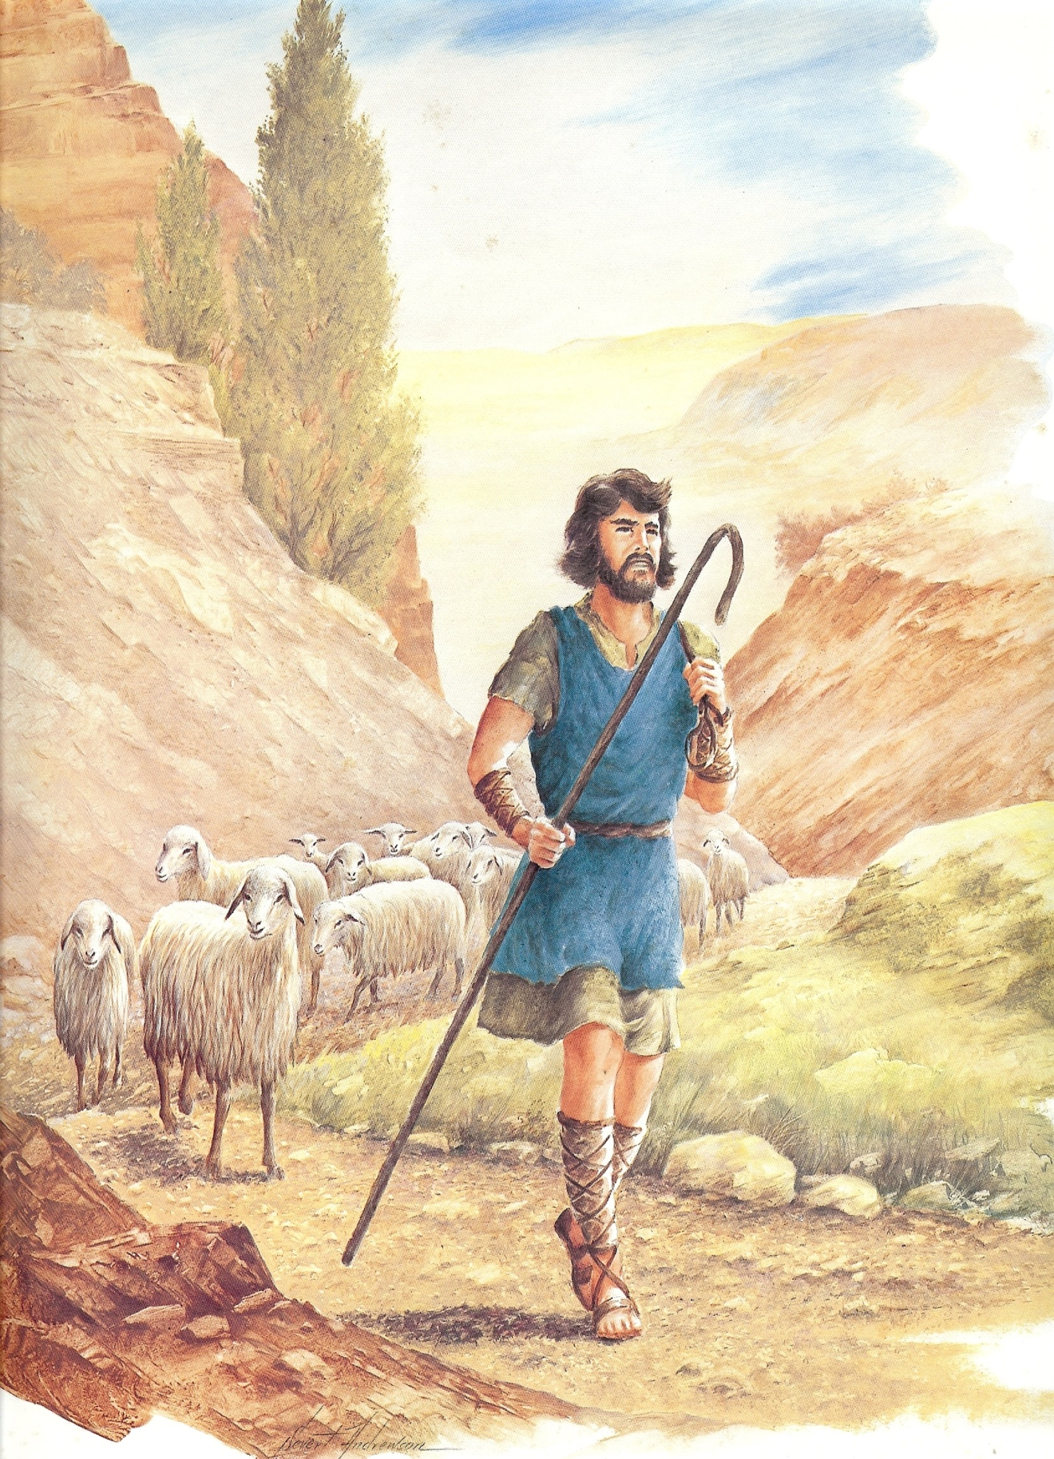
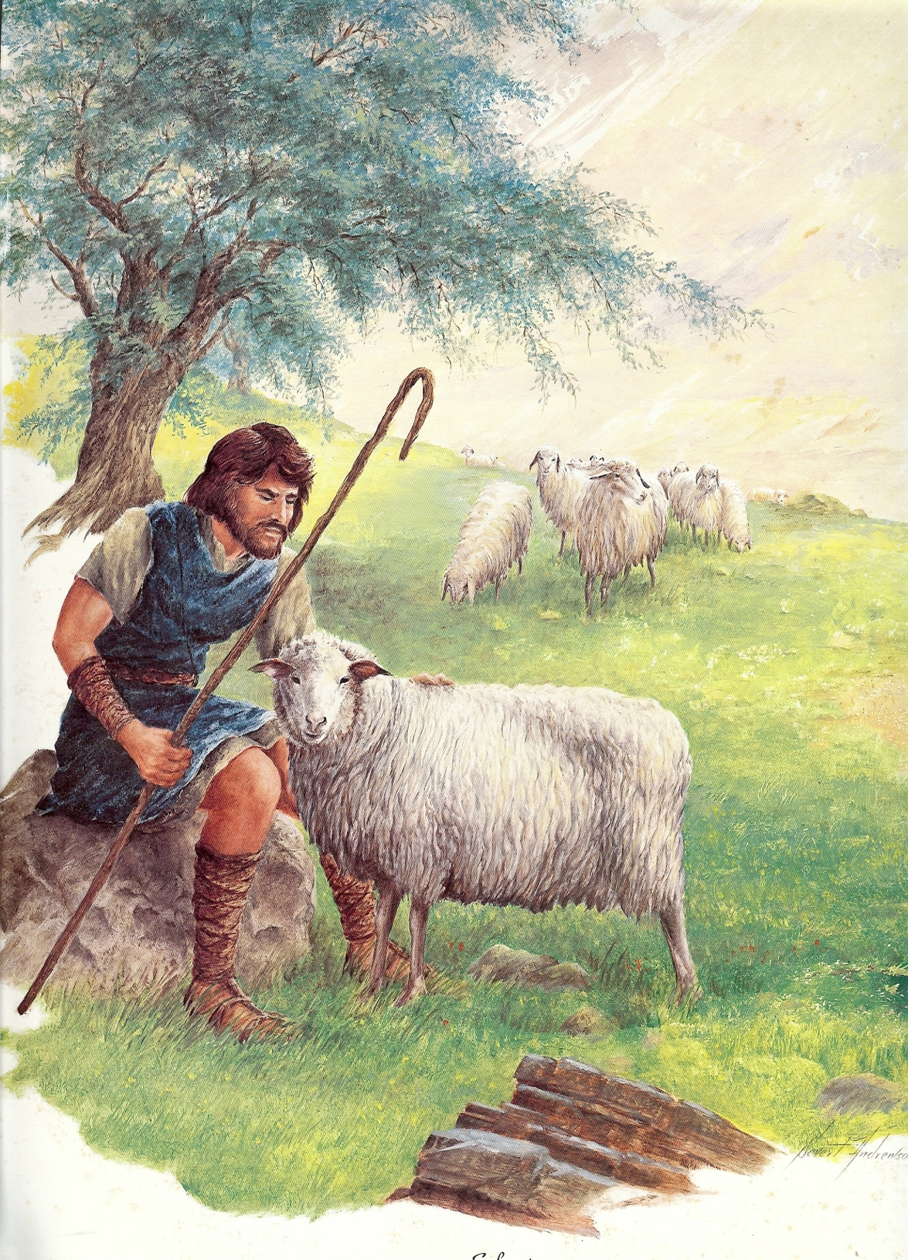

Slide 31
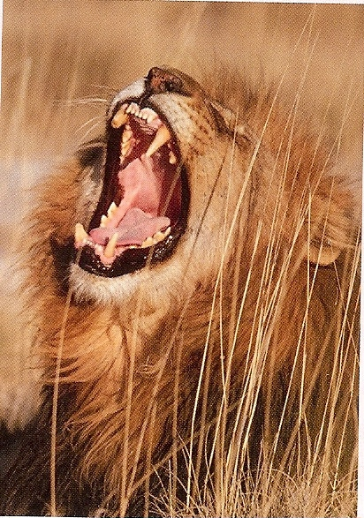
God Almighty
(I Timothy 6:15)
Satan
Destruction (John 10:10)
God Given
Authority
(Romans 13:1)
“Be sober, be vigilant; because your adversary the devil, as a roaring lion,
walketh about, seeking whom he may devour.” (I Peter 5:8)
I Corinthians 11:3
Colossians 3:18

Slide 32
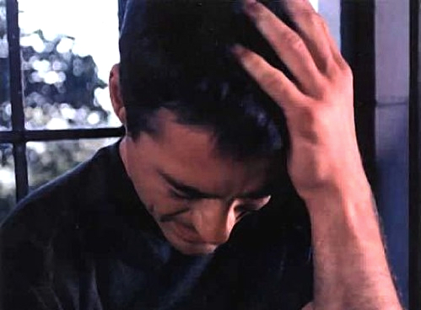
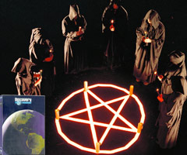
“For rebellion is as the sin of witchcraft, and stubbornness is as iniquity and idolatry.” I Sam. 15:23
“An evil man seeketh only rebellion: therefore a cruel messenger shall be sent against him.” Prov. 17:11

Slide 33
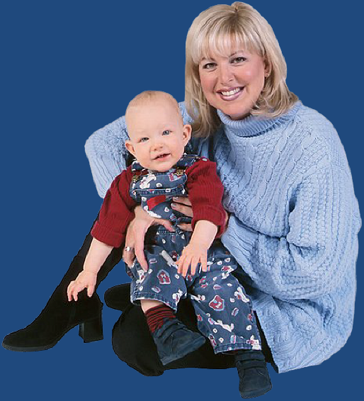
Wife’s Duty
Help-meet to her husband – Gen. 2:16
Protect her children – I Tim. 5:14
Don’t protect them from the consequences of their sin – Gal. 6:7-8
Don’t protect them from the chastisement of the Lord – Heb. 12:5-11

Slide 34
Benefits of Getting Under Authority
Things will go well for you – Eph. 6:2-3
You will have a long life – Eph. 6:1-3
You will bring delight to the Lord – Col. 3:20
You will avoid the fear of condemnation – Rom. 13:3
You will maintain a good conscience – Rom. 13:5
You will obtain a good report – Heb. 13:17

Slide 35
You will receive an eternal reward – Col. 3:23-24
You will receive God’s approval, praise and blessing – I Peter 2:13-14, 18-20
You will not blaspheme God or His Word – I Tim. 6:1
You will receive clear direction – Prov. 6:20-22
You will be protected from evil – Prov. 6:23-24
You will gain discernment – Prov. 15:5
You will escape the destruction of pride – I Tim. 6:2-4

Slide 36
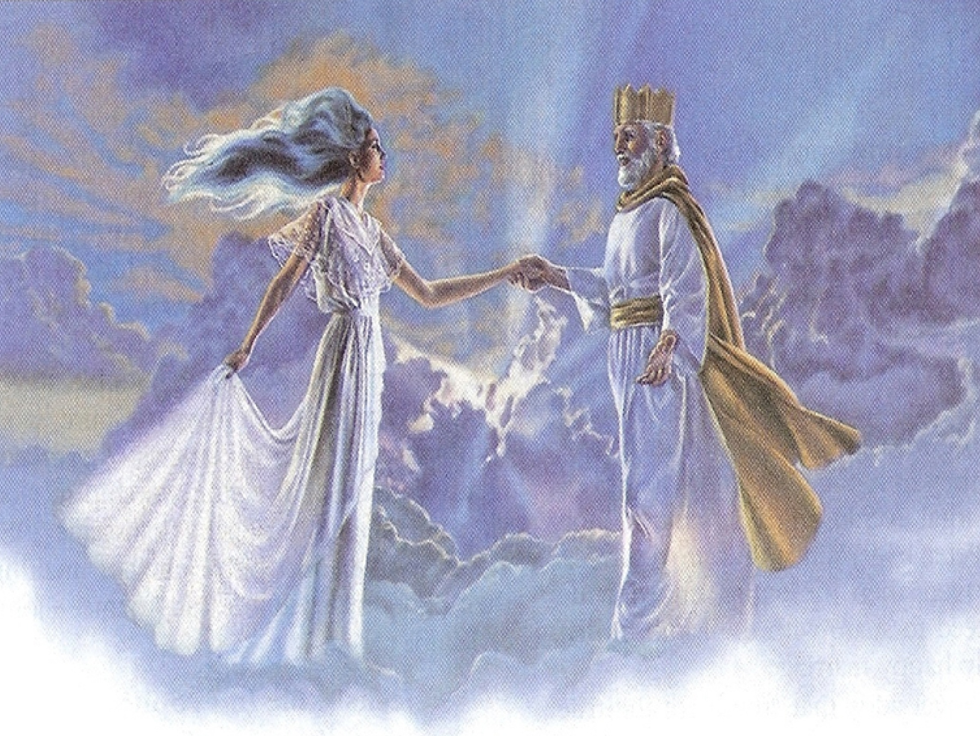
Typify Christ’s relationship with His Church

