Slide 1
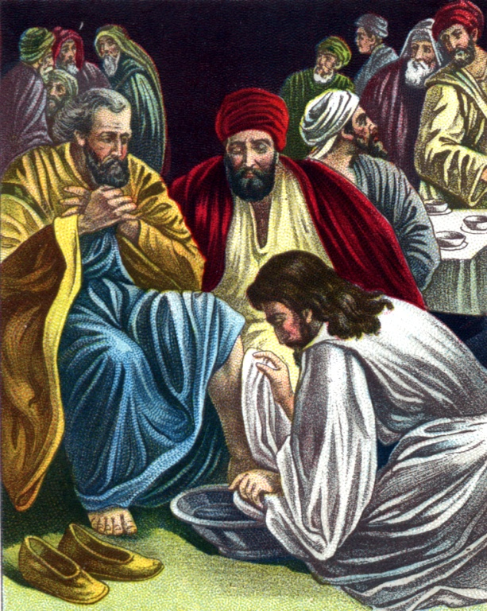
How to Walk with God “Becoming a Humble Servant” (Luke 22:24-30) (Part 6)

Slide 2
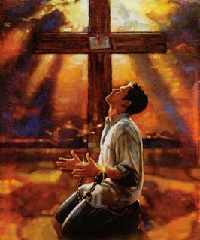
How to walk with God
“Brokenness”
(Part 1)

Slide 3
“C” is a bent “I” “yet not I, but Christ…”

Slide 4
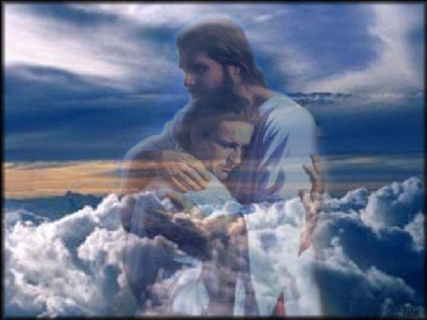
How to Walk with God
“The way of fellowship”
(Part 2)

Slide 5
“If we say that we have fellowship with him, and walk in darkness, we lie, and do not the truth.” (I John 1:6)
“God is faithful, by whom ye were called unto the fellowship of his Son Jesus Christ our Lord.”
(I Cor. 1:9)

Slide 6
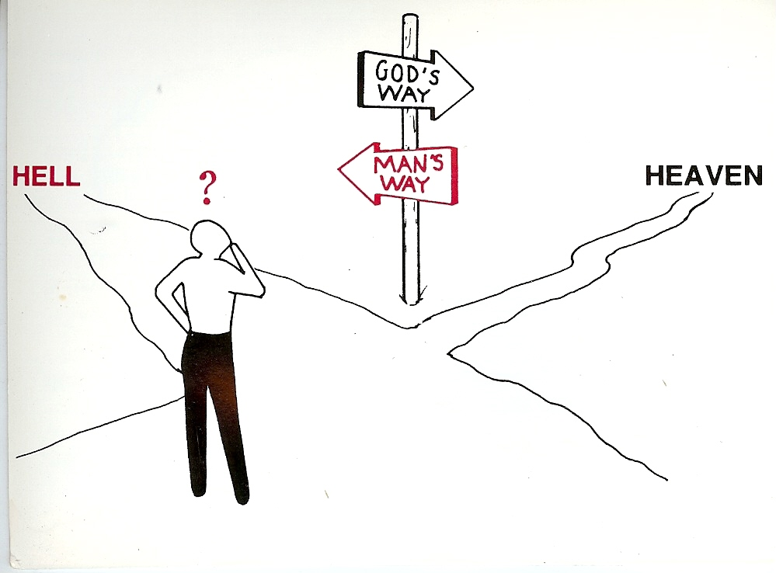
How to Walk with God “Walking on the Road of Holiness” (Part 3)
Unrighteousness
Righteousness

Slide 7
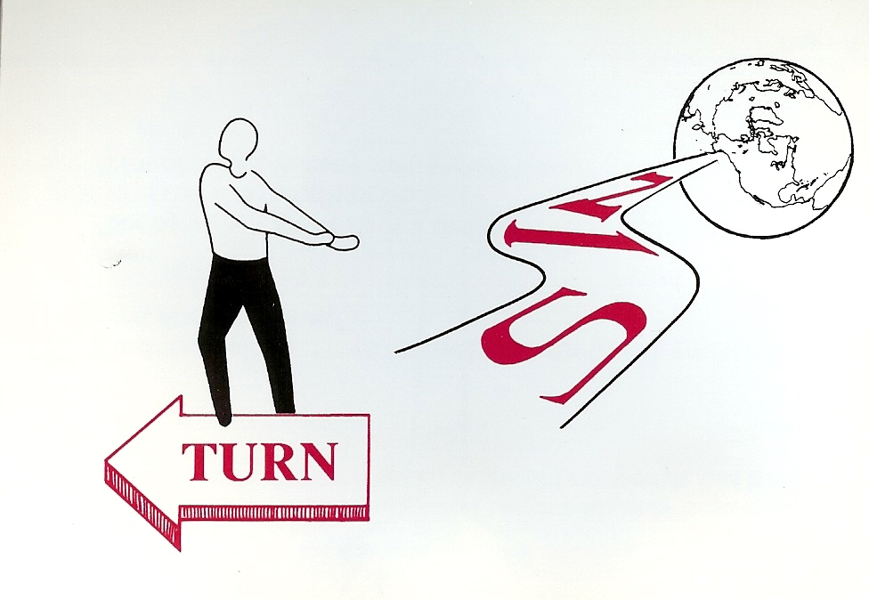
“And an highway shall be there, and a way, and it shall be called The way of holiness; the unclean shall not pass over it.”
(Isaiah 35:8)
Holiness

Slide 8
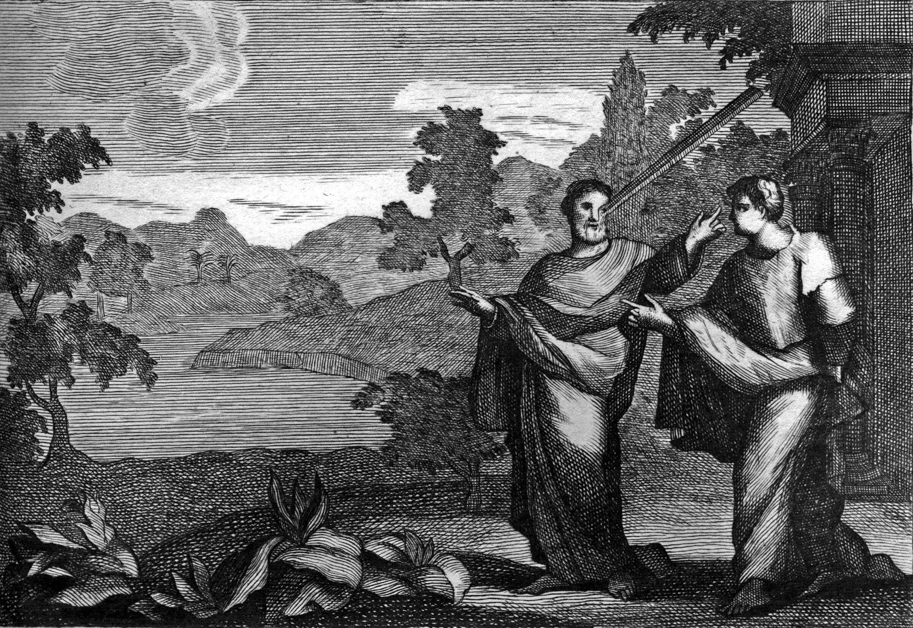
How to walk with God “Removing the beam from your eyes”
(Part 4)

Slide 9
How to Walk with God “Avoidance of Sin” and “Adherence to Biblical Standards” (Part 5)
“Whosoever committeth sin transgresseth also the law: for sin is the transgression of the law.” (I John 3:4)

Slide 10
How to Walk with God “Becoming a Humble Servant” (Luke 22:24-30) (Part 6)

Slide 11
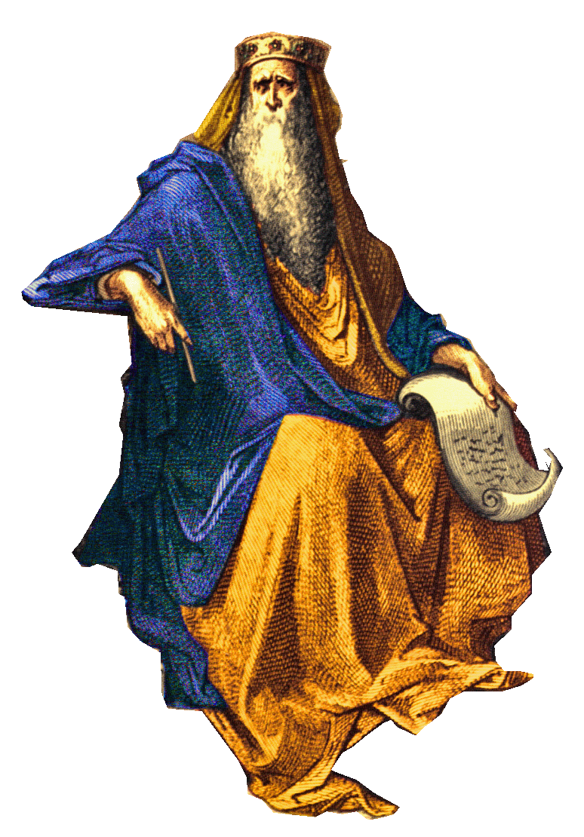
The Desire of Man (Christian and Non-Christian)
(Ecclesiastes)
“Then said I in my heart, as it happeneth to the fool, so it happeneth even to me…therefore I hated life…vanity and vexation of spirit…”
Prestige
Power
Influence
Authority
Wealth
Recognition
Popularity

Slide 12
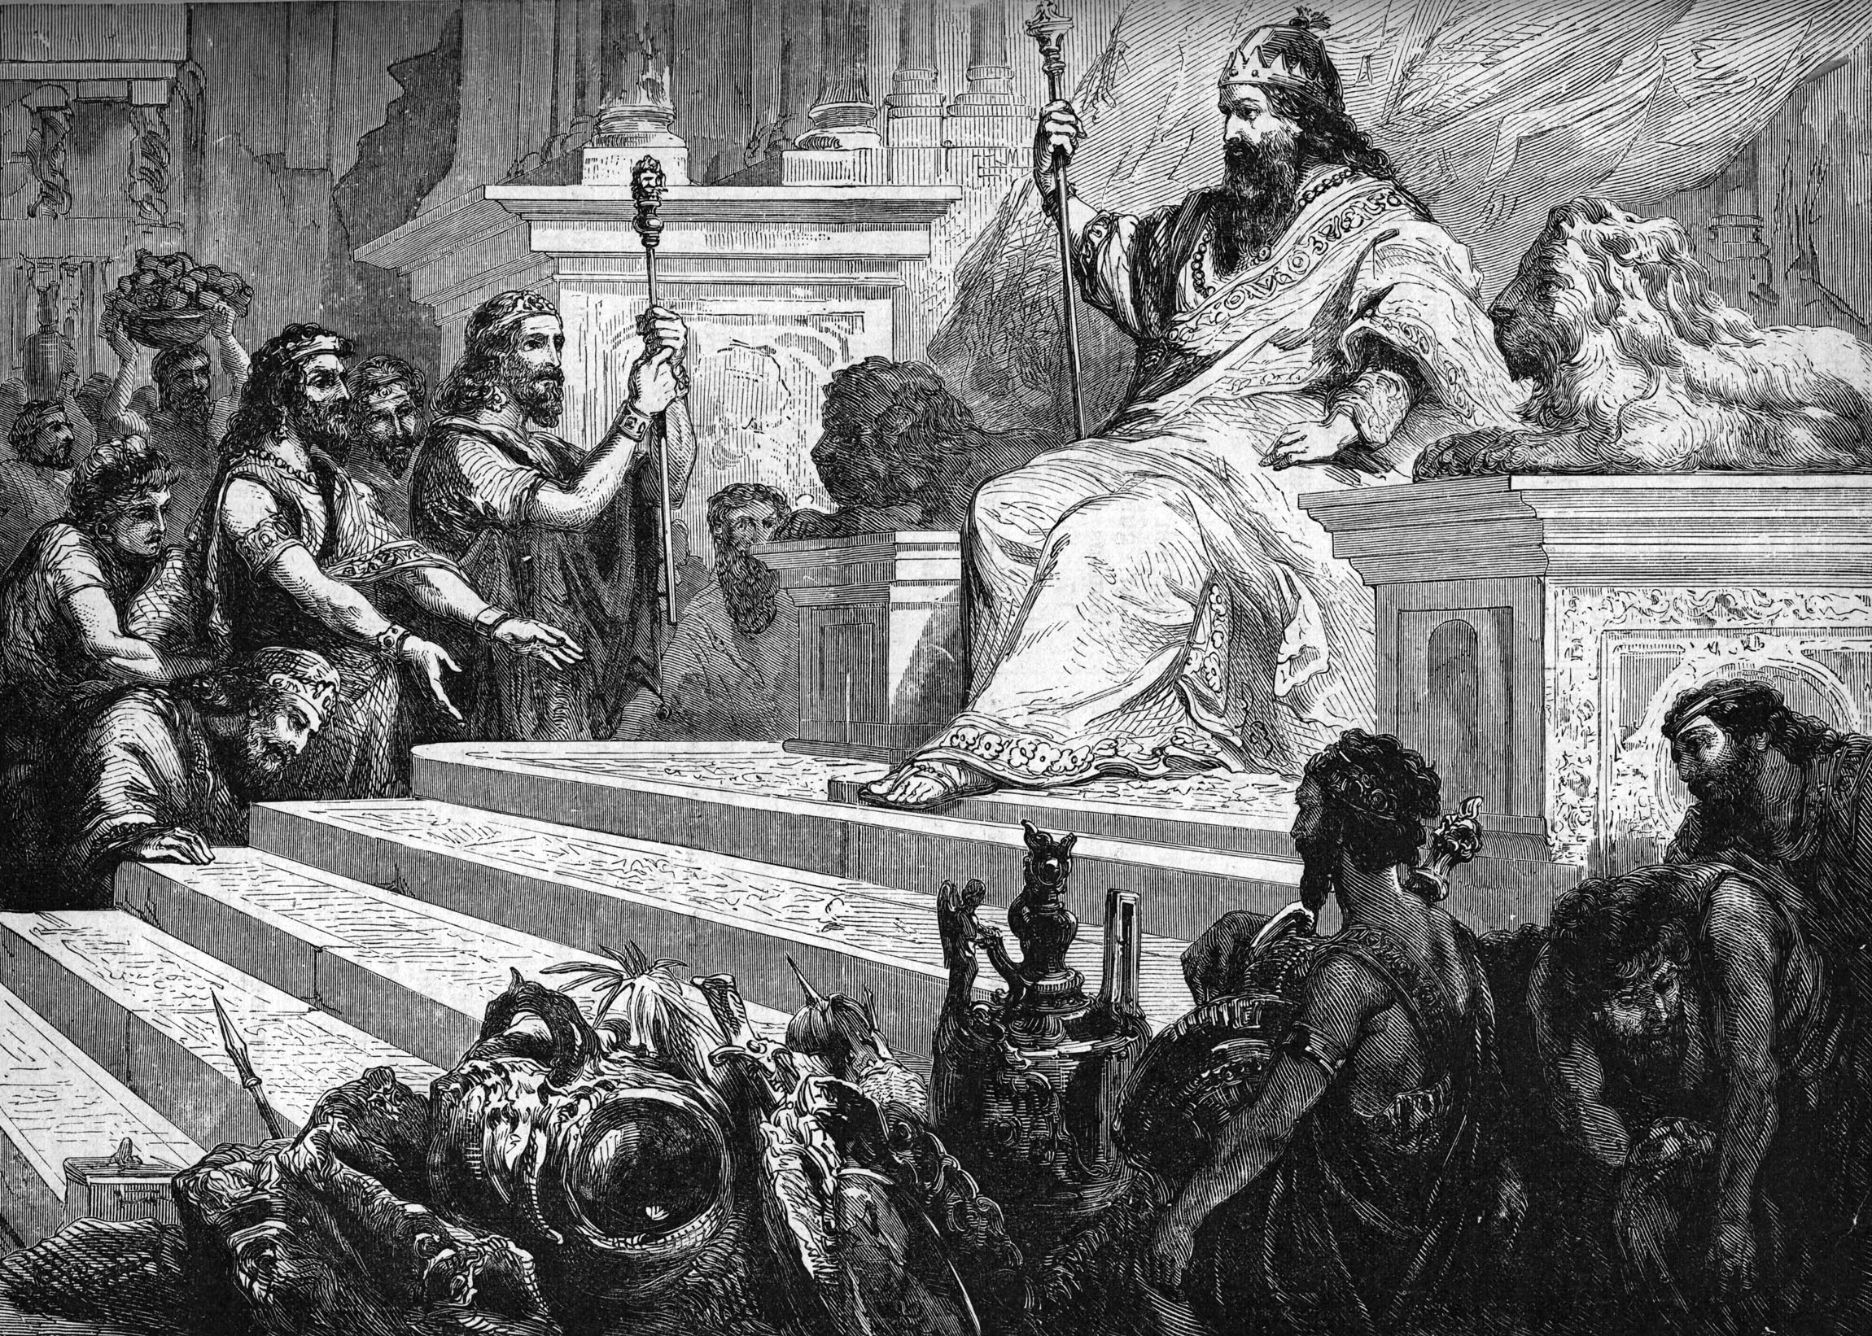
“I got me servants and maidens, and had servants born in my house; also I had great possessions of great and small cattle above all that were in Jerusalem before me. I gathered me also silver and gold, and the peculiar treasures of kings…I was great, and increased more than all that were before me in Jerusalem.”

Slide 13
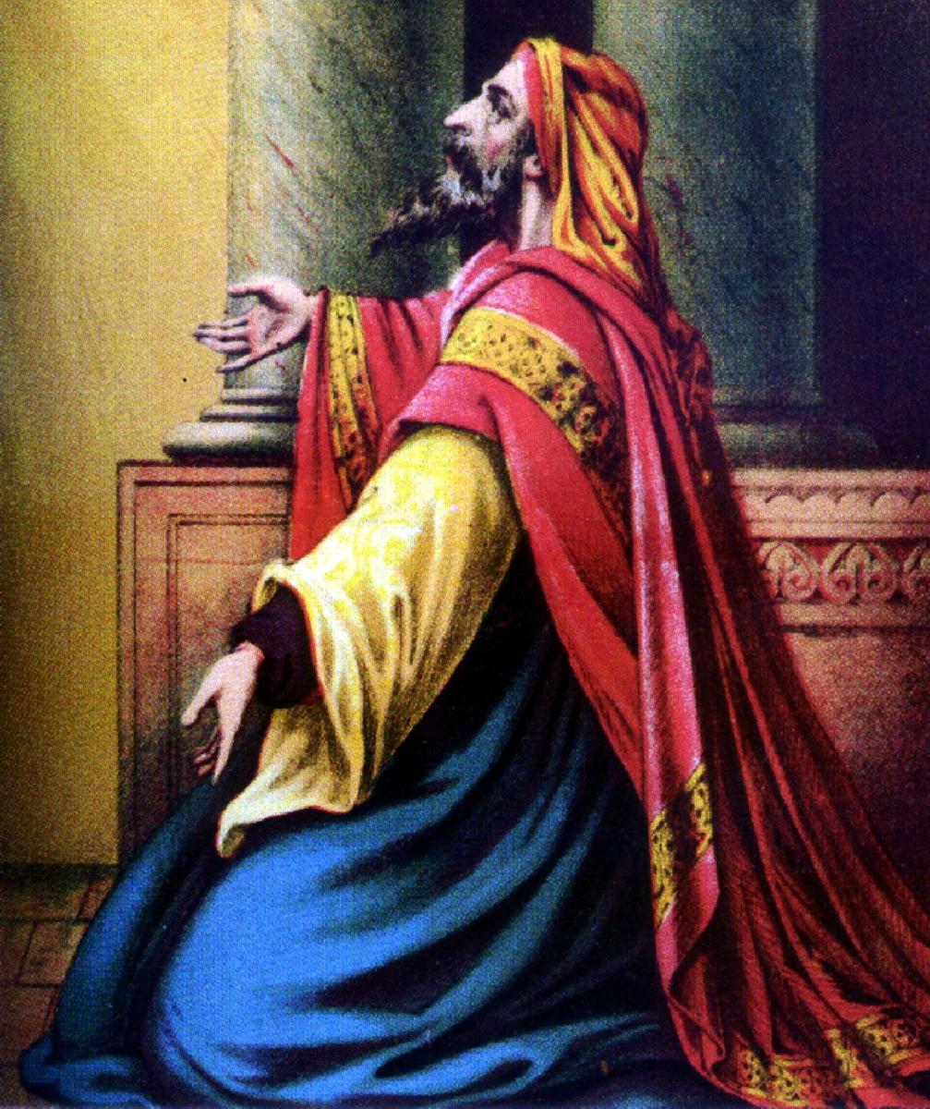
“And whatsoever mine eyes desired I kept not from them, I withheld not my heart from any joy; for my heart rejoiced in all my labour: and this was my portion of all my labour. Then I looked on all the works that my hands had wrought, and on the labour that I had laboured to do: and, behold, all was vanity and vexation of spirit, and there was no profit under the sun.”

Slide 14
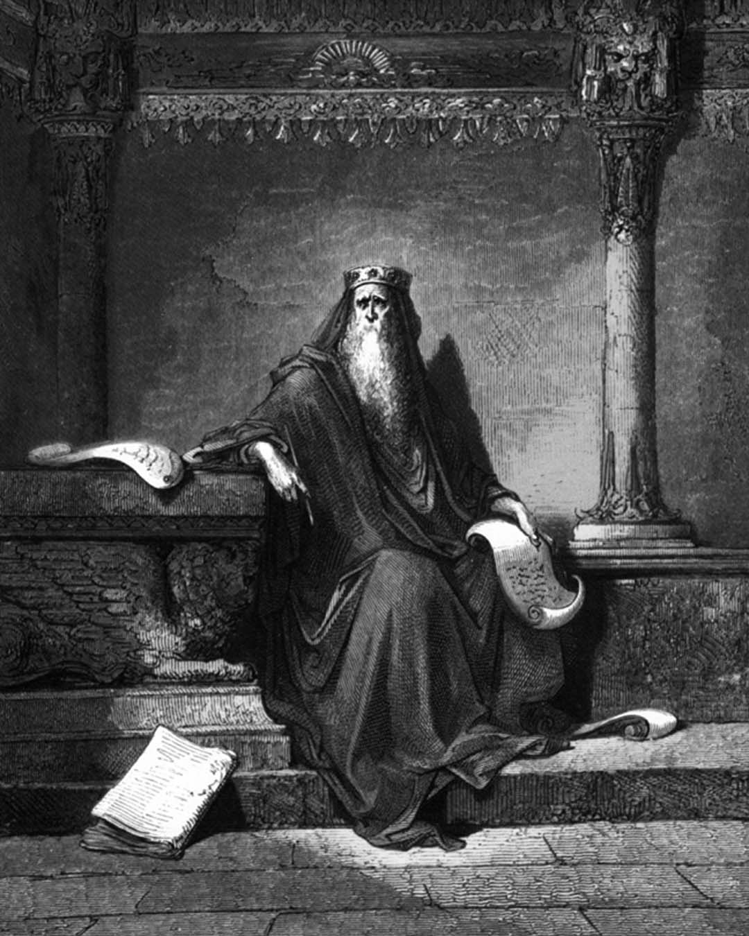
“Remove sorrow from thy heart…Fear God and keep His commandments.”

Slide 15
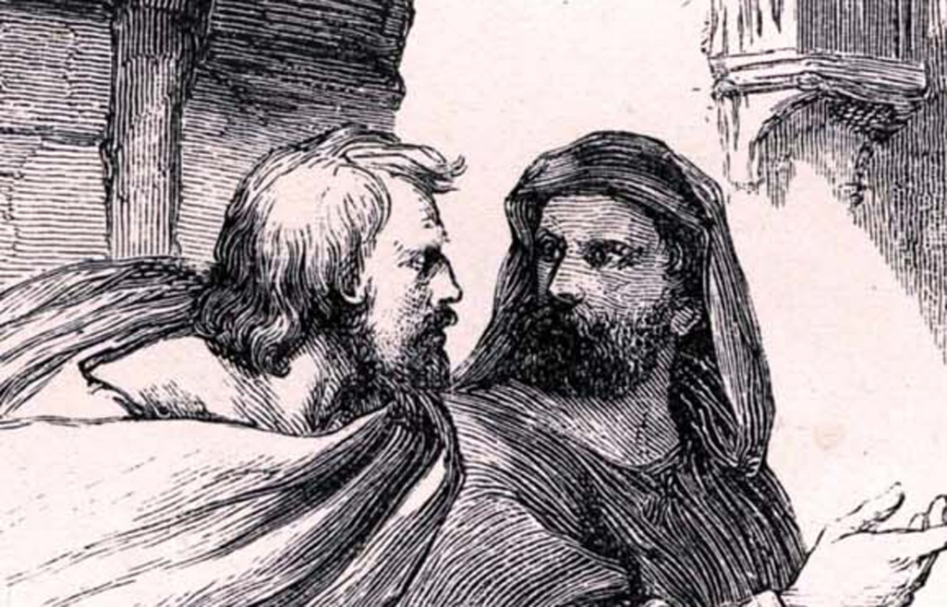
The Disciples were Engaged in a Power Struggle “Who was going to be the greatest in the Kingdom of Christ.”
“And there was also a strife among them, which of them should be accounted the greatest.”

Slide 16
World’s View of Greatness “Beware lest any man spoil you through philosophy…”
1. Greatness = Holding positions of authority and influence – “Lording over people…”
Pride of life (big shot / king of the hill)
Control other people and their lives
Be in charge
Master = boss!
These things make a person feel important, greater value, more intelligent and honorable
Jesus - “Ye shall not be so…”

Slide 17
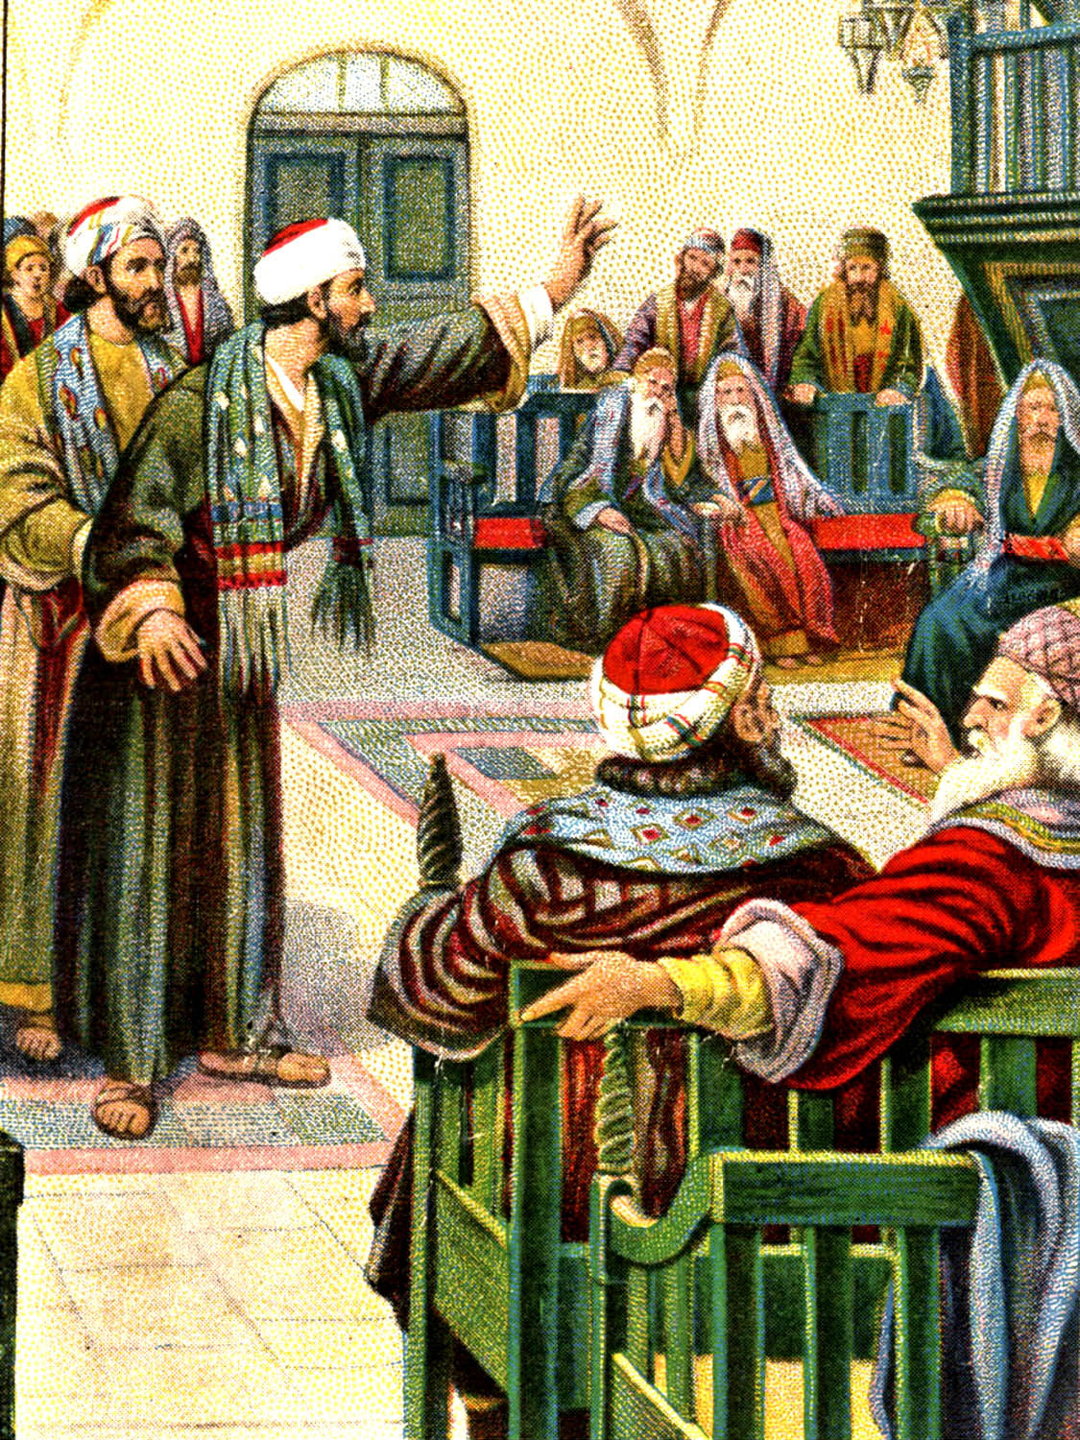
God Ordained Authority (Romans 13:1-8)
Home - Eph. 5:21-6:4
Government – I Peter 2:11-17
Work – Eph. 6:5-9
Church – Heb. 13:7, 17
The disciples would rule with Christ in His Kingdom on earth – Luke 22:29-30
If you are in a position of authority you must always maintain an attitude of being a servant!

Slide 18
2. Greatness – Having others serve you
Jesus rejected this philosophy –
“For whether is greater, he that sitteth at meat, or he that serveth? is not he that sitteth at meat? but I am among you as he that serveth.”
“But ye shall not be so: but he that is greatest among you, let him be as the younger; and he that is chief, as he that doth serve.”

Slide 19
Have the attitude of the youngest –
* Taking the last seat
* Assuming the lowest position
Have the attitude of a “servant” not a “chief” – “He that is chief, as he that doth serve.” (Matt. 23:6-12)
Have the attitude of Jesus Christ - “I am among you as he that serveth.” “I came not to be ministered unto but to minister.”
* We must always be thinking like Christ – Phil. 2:1-15

Slide 20
3. Greatness - Having wealth (prosperity)
Wealth = position
Wealth = influence
Wealth = acceptance/friends
Wealth = control
Wealth = security
Wealth = happiness
Wealth = benefactor

Slide 21
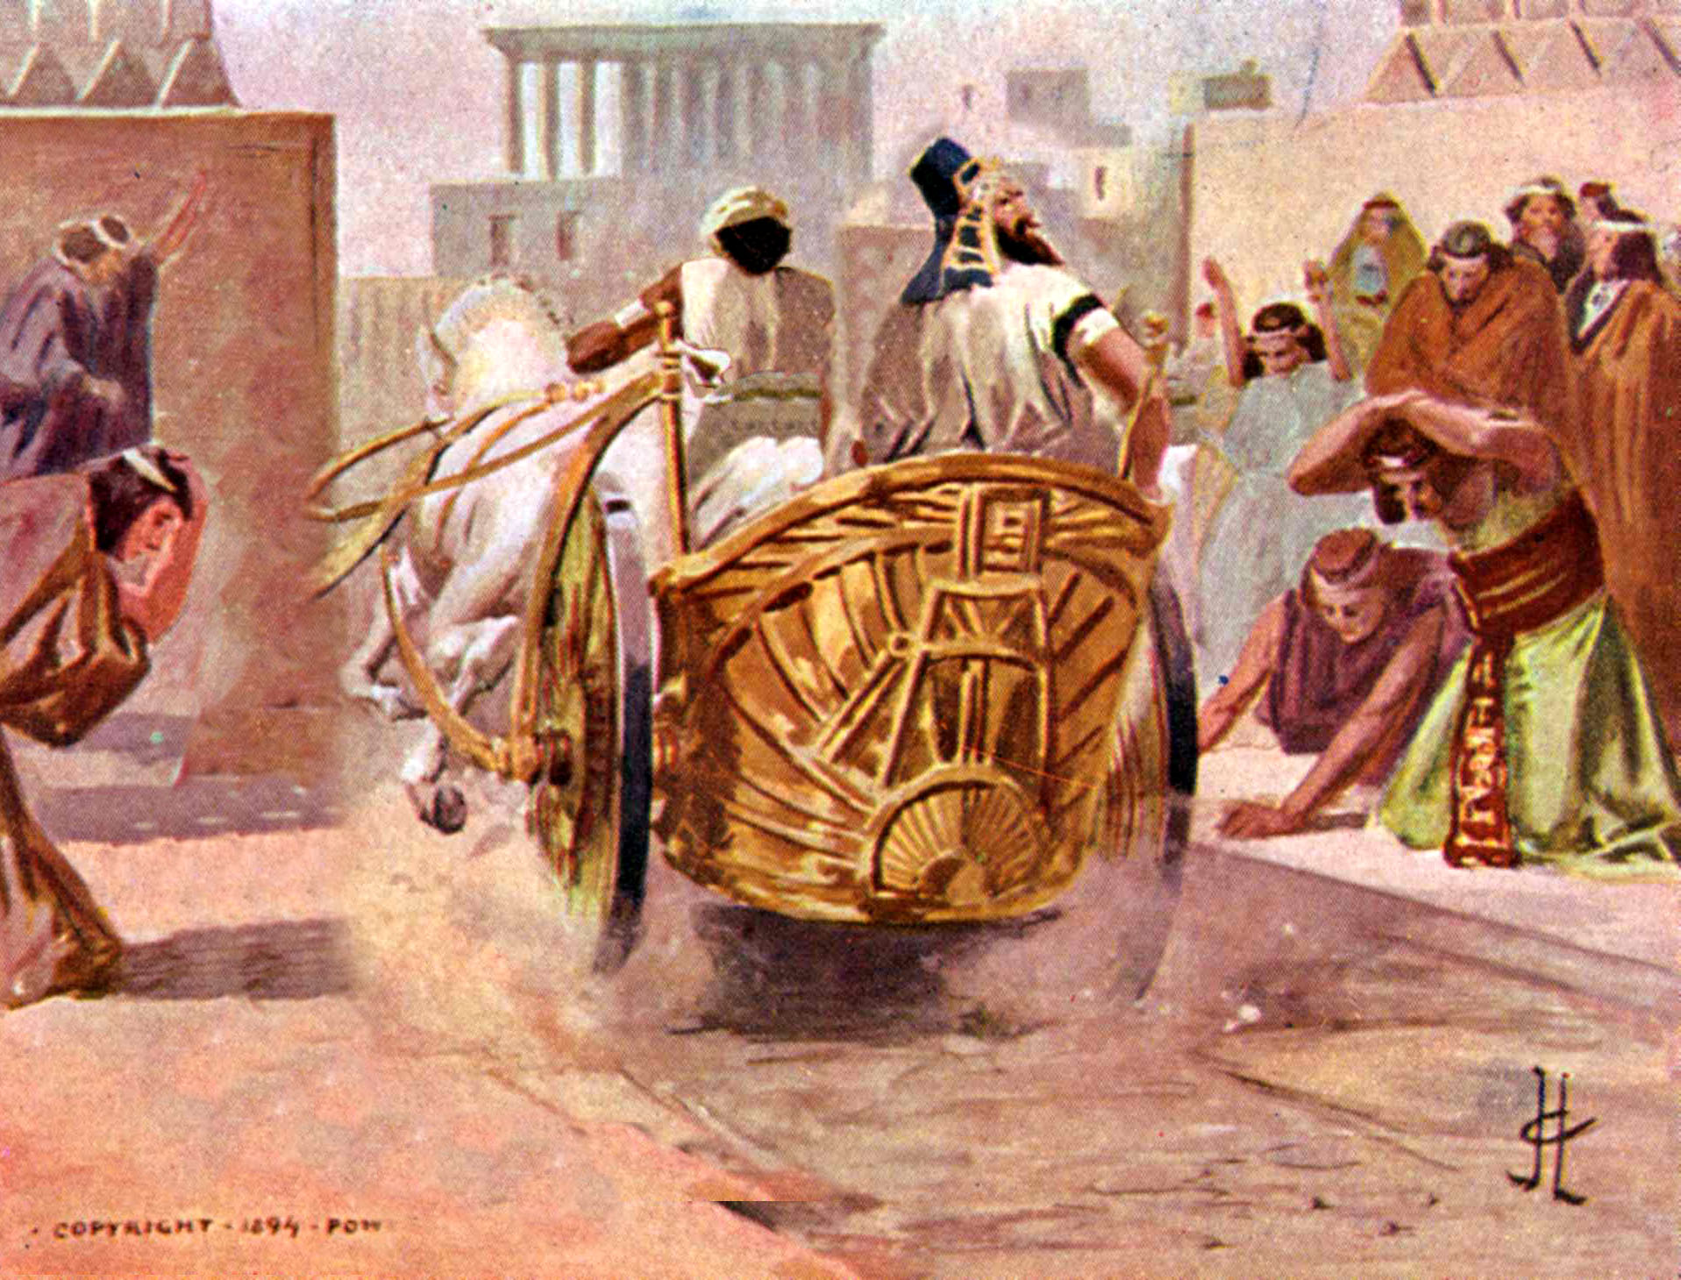
Benefactor – “A person recognized for his great wealth and ability to make large contributions to the needs of others. He receives great honor and recognition for his generosity.”
Benefactors can be held in such high regard that they almost become an object of worship.

Slide 22
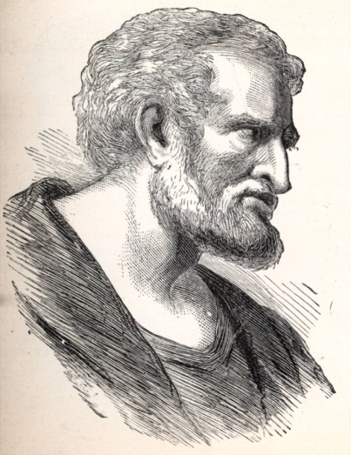
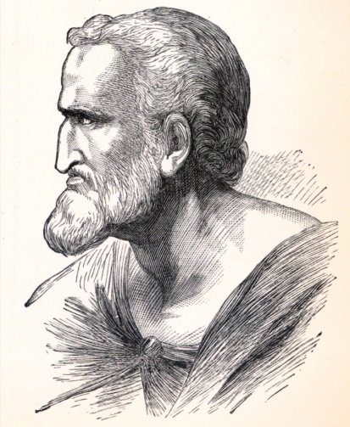
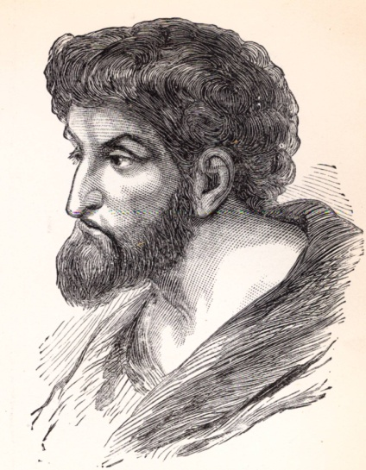
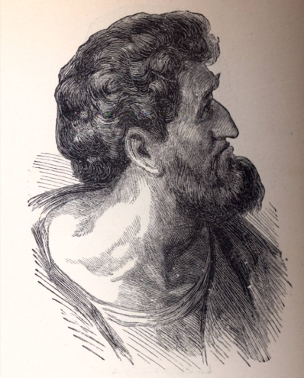
The Disciples’ Attitudes
Arguments
Strife
Jealousy
Division
“For ye are yet carnal: for whereas there is among you envying, and strife, and divisions, are ye not carnal, and walk as men?” (I Cor. 3:3)

Slide 23
How can I be the younger?
How can I be a servant?
How can I be like Christ?

