Slide 1
When God Seems to be Silent
“Then shall they cry unto the LORD, but he will not hear them: he will even hide his face from them at that time.” Mic. 3:4

Slide 2
“Then shall they call upon me, but I will not answer; they shall seek me early, but they shall not find me.” Prov. 1:28

Slide 3
God’s Promise
Jer. 29:13-14 “And ye shall seek me, and find me, when ye shall search for me with all your heart. And I will be found of you, saith the LORD.”
Psalms 91:15 “He shall call upon me, and I will answer him: I will be with him in trouble; I will deliver him, and honour him.”
Isa. 65:24 “And it shall come to pass, that before they call, I will answer; and while they are yet speaking, I will hear.”
Jer. 33:3 “Call unto me, and I will answer thee, and shew thee great and mighty things, which thou knowest not.”

Slide 4
Psalms 50:15 “Call upon me in the day of trouble: I will deliver thee, and thou shalt glorify me.”
2 Sam. 22:3 “The God of my rock; in him will I trust: he is my shield, and the horn of my salvation, my high tower, and my refuge, my saviour; thou savest me from violence.”
Psalms 28:7 “The LORD is my strength and my shield; my heart trusted in him, and I am helped: therefore my heart greatly rejoiceth; and with my song will I praise him.”
Psalms 62:8 “Trust in him at all times; ye people, pour out your heart before him: God is a refuge for us.”

Slide 5
God’s Silence
Job 34:29 “When he hideth his face, who then can behold him? whether it be done against a nation, or against a man only.”
Psalms 28:1 “Unto thee will I cry, O LORD my rock; be not silent to me: lest, if thou be silent to me, I become like them that go down into the pit.”
Psalms 83:1 “Keep not thou silence, O God: hold not thy peace, and be not still, O God.”
Psalm 35:22 “O LORD: keep not silence: O Lord, be not far from me.”

Slide 6
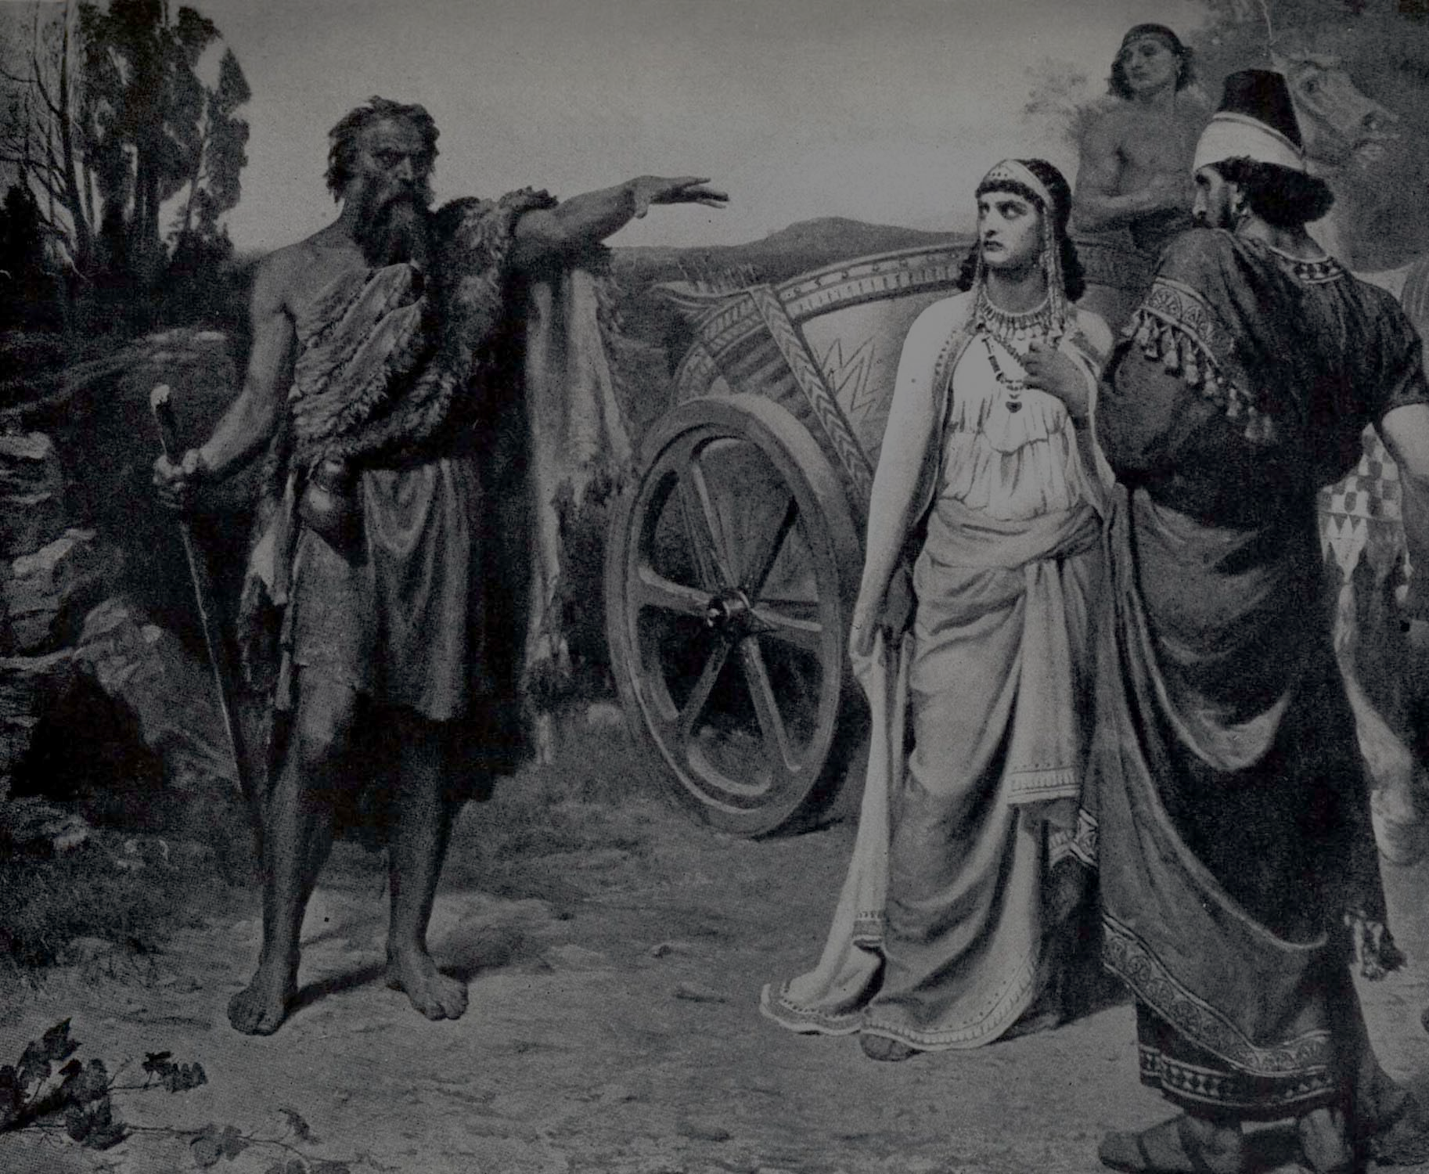
“Ahab did more to provoke the LORD God of Israel to anger than all the kings of Israel that were before him…And Elijah said to Ahab, As the LORD God of Israel lives, before whom I stand, there shall not be dew nor rain these years, except at my word.” (1 Kings 16:33, 17:1)

Slide 7
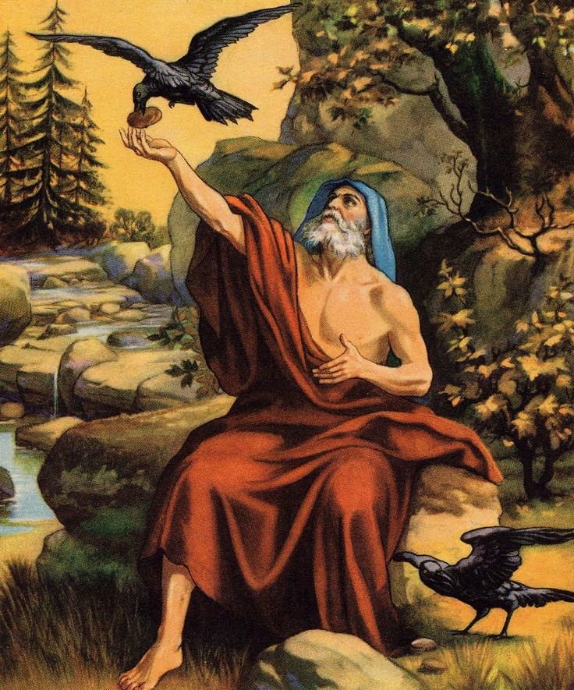
(1 Kings 17:2-3) “And the word of the LORD came to him, saying, get thee hence, and turn thee eastward and hide thyself by the Brook Cherith, that is before Jordan.”

Slide 8
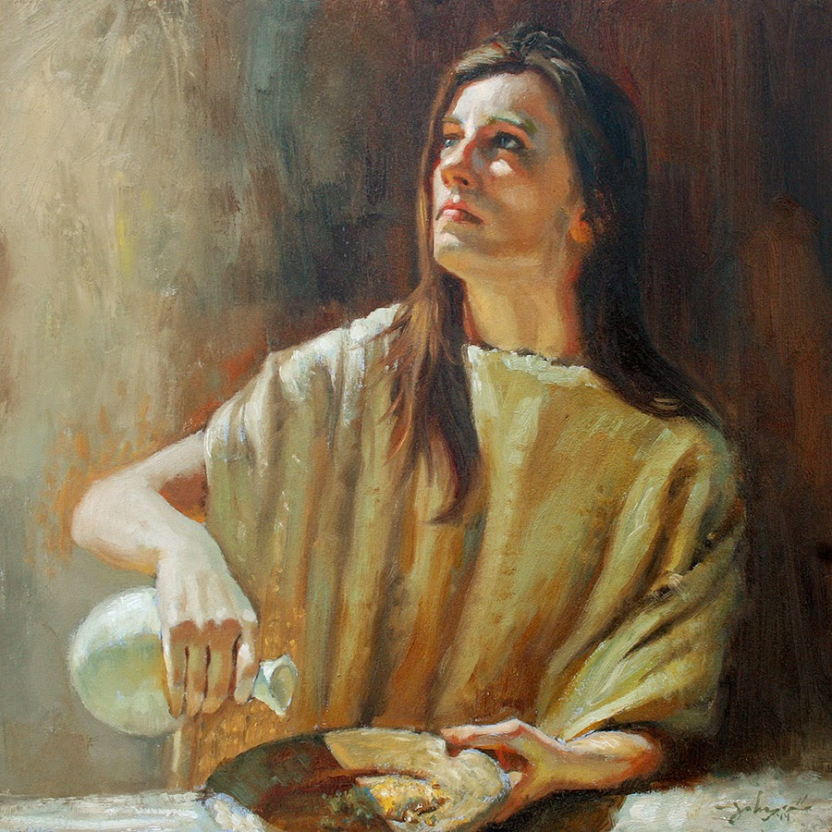
“And the word of the LORD came unto him, saying, Arise, get thee to Zarephath, which belongeth to Zidon, and dwell there: behold, I have commanded a widow woman there to sustain thee.” (1 Kings 17:8-9)

Slide 9
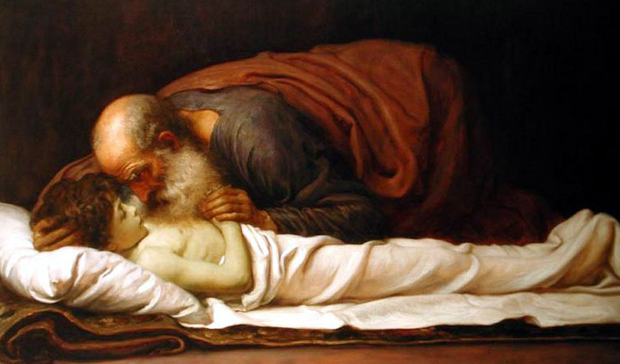
“And it came to pass after these things, that the son of the woman, fell sick; and his sickness was so sore, that there was no breath left in him…And the LORD heard the voice of Elijah; and the soul of the child came into him again, and he revived.” (1 Kings 17:17,22)

Slide 10
God’s Silence in Elijah’s Life

Slide 11
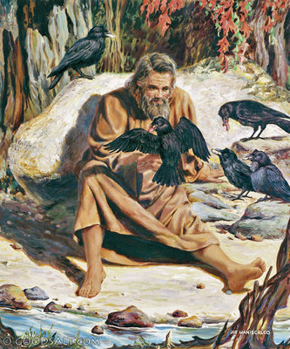
Imagine you had been faithfully serving…God is using you…you are in constant communication with Him…and then suddenly…every thing goes silent.

Slide 12
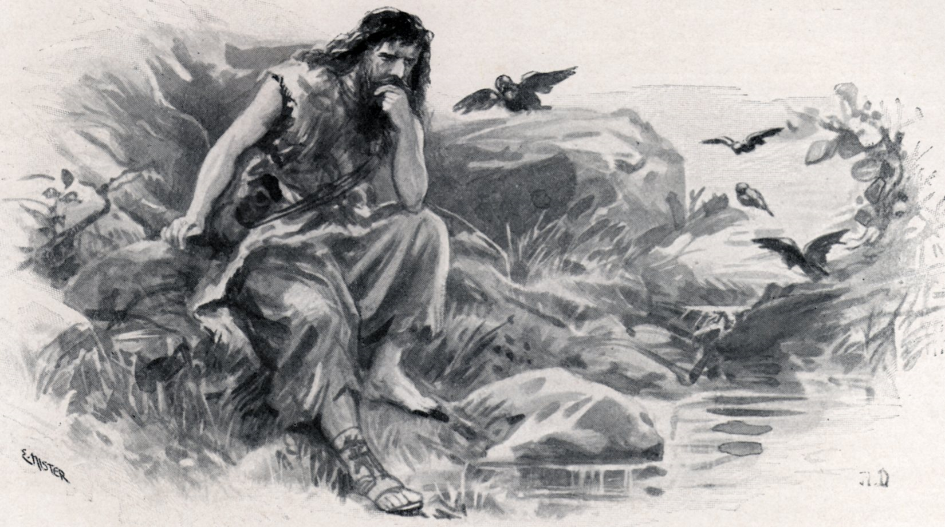
3 years of silence

Slide 13
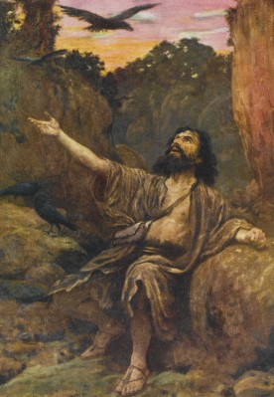
Elijah continued to hold on by faith, but God said nothing.

Slide 14
Elijah continued to hold on by faith, but God said nothing. God was apparently inactive.

Slide 15
Elijah continued to hold on by faith, but God said nothing. God was apparently inactive. He was not speaking at all to His great servant Elijah during this time.

Slide 16
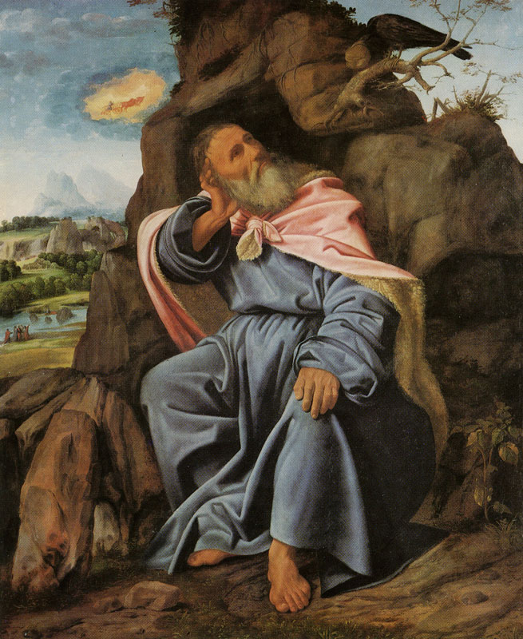
Finally God Speaks

Slide 17
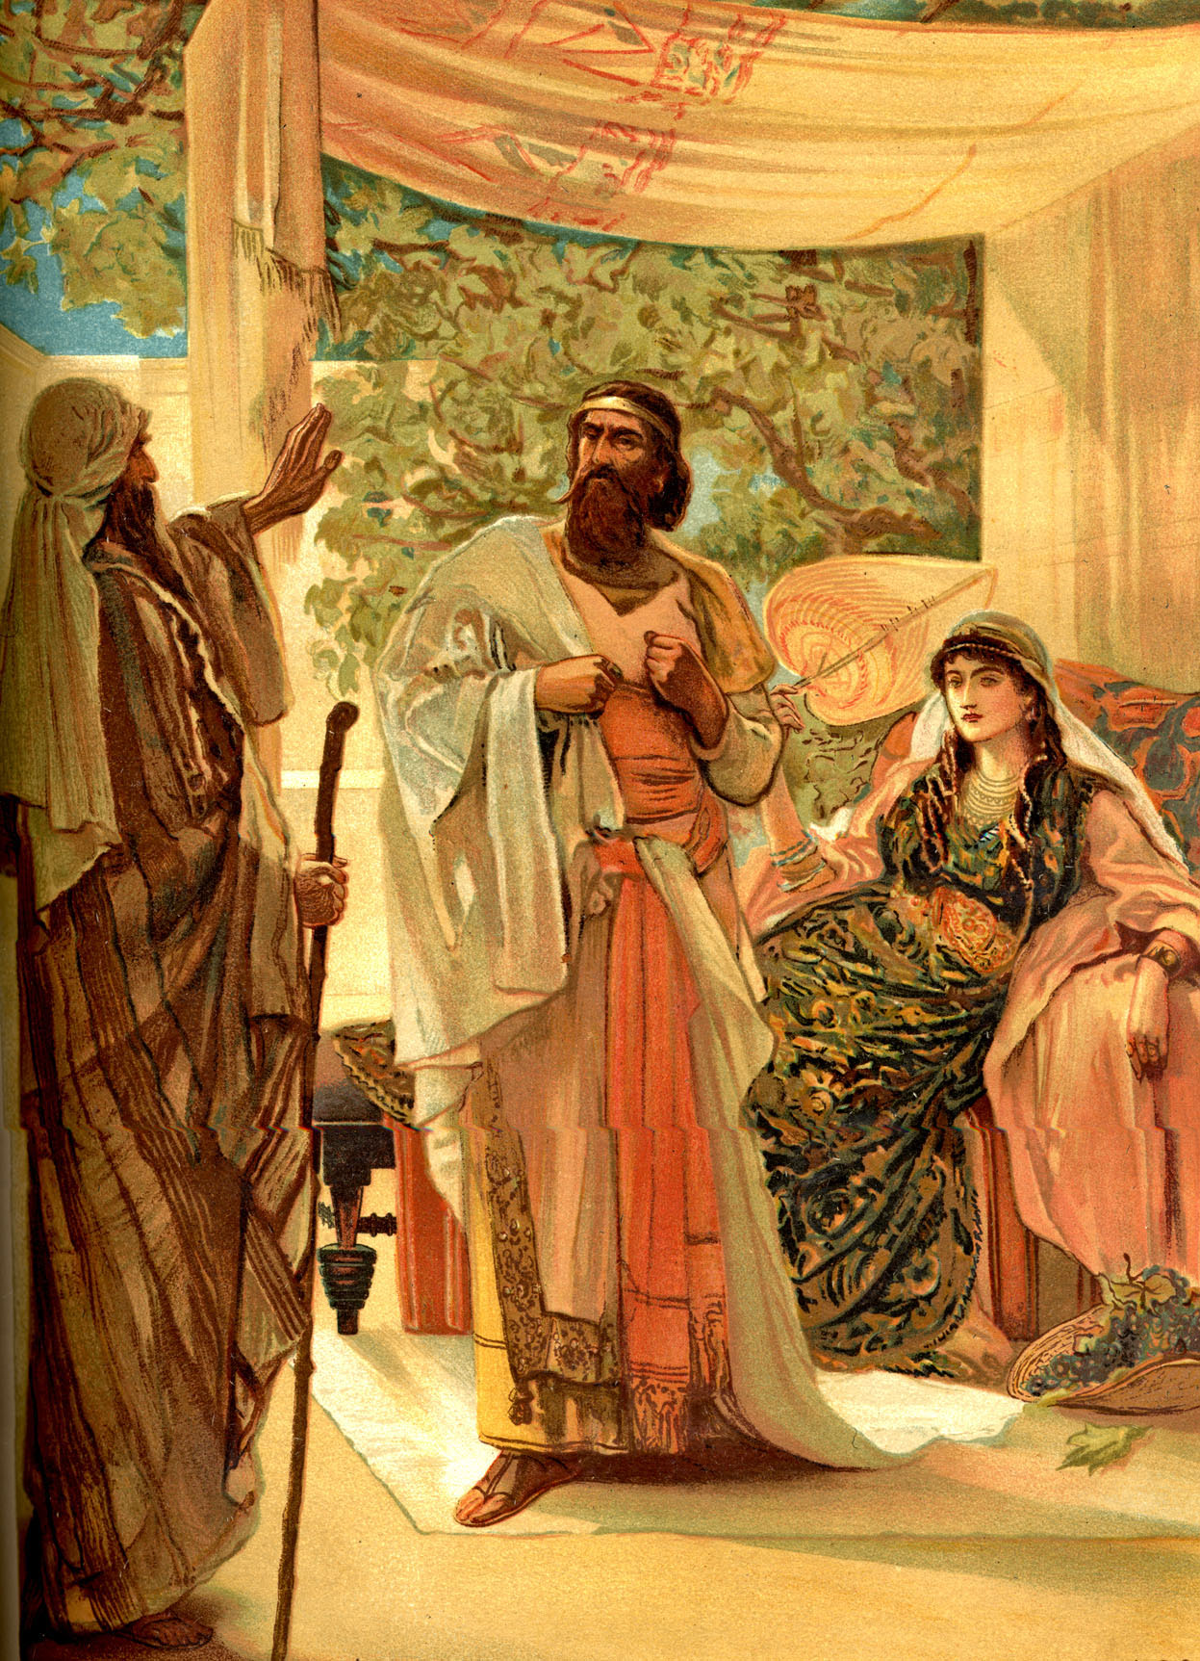
(1 Kings 18:1) “And it came to pass after many days, that the word of the LORD came to Elijah in the third year, saying, Go, shew thyself unto Ahab; and I will send rain upon the earth.”

Slide 18
Have you ever felt like God was giving you the silent treatment?
Have you prayed and asked Him for direction, but there was no answer.
Have you listened for His voice, but He did not respond.
Have you ever wondered if you had some how missed hearing His voice.
Have you ever thought that God has abandoned you. (which He never would do!)

Slide 19
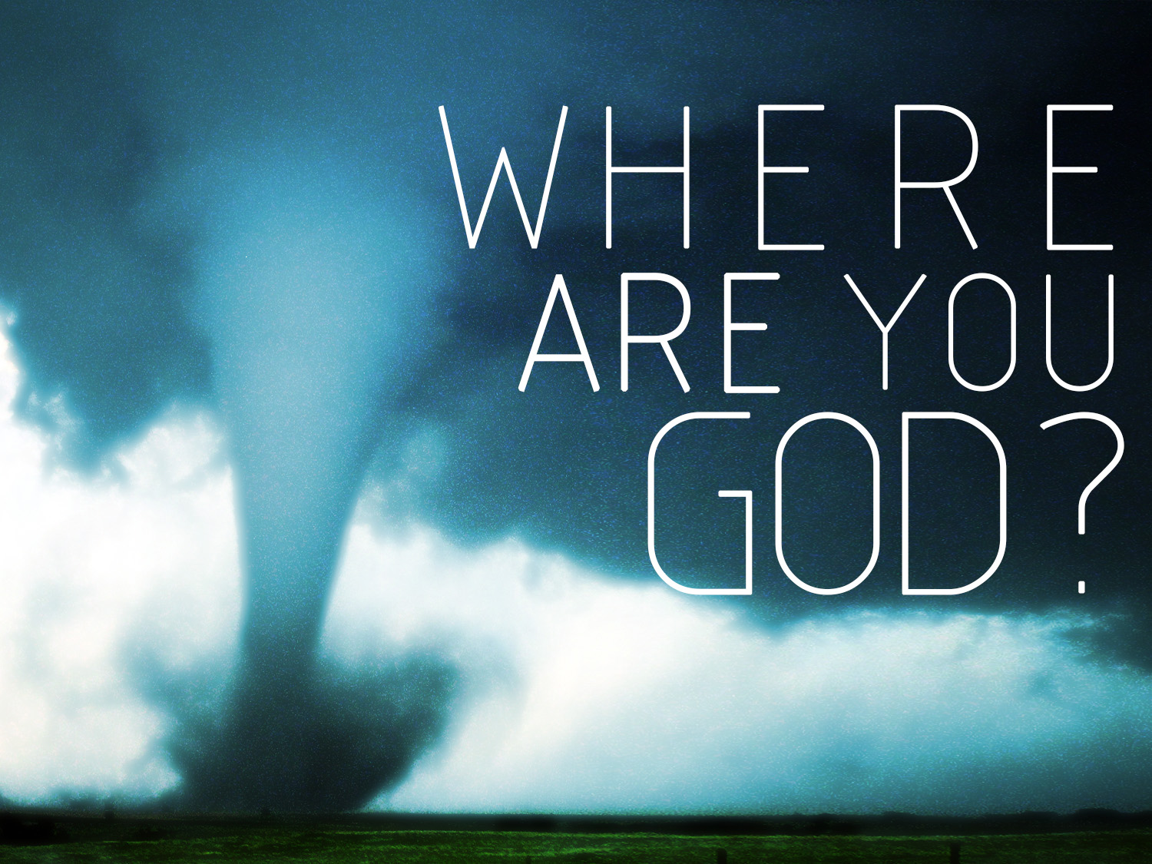
It can be very disheartening when you need God and are seeking God, but you don’t seem to be hearing from Him.

Slide 20
Lazarus (John 11)
“Therefore his sisters sent unto him, saying, Lord, behold, he whom thou lovest is sick. When Jesus heard that, he said, This sickness is not unto death, but for the glory of God, that the Son of God might be glorified thereby. Now Jesus loved Martha, and her sister, and Lazarus. When he had heard therefore that he was sick, he abode two days still in the same place where he was.”

Slide 21
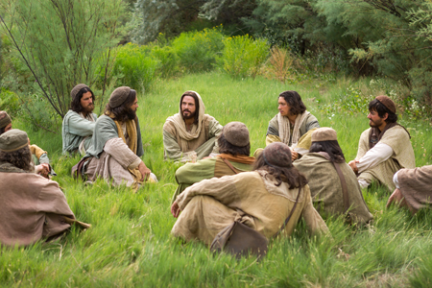
“Then said Jesus unto them plainly, Lazarus is dead. And I am glad for your sakes that I was not there, to the intent ye may believe; nevertheless let us go unto him.”

Slide 22
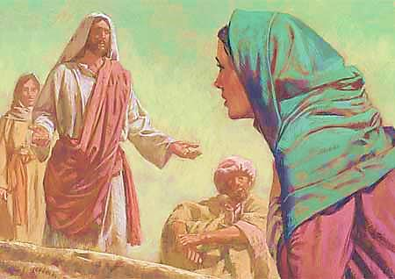
“Then when Jesus came, he found that he had lain in the grave four days already…Then Martha, as soon as she heard that Jesus was coming, went and met him: but Mary sat still in the house. Then said Martha unto Jesus, Lord, if thou hadst been here, my brother had not died.”

Slide 23
“Jesus saith unto her, Thy brother shall rise again. Martha saith unto him, I know that he shall rise again in the resurrection at the last day. Jesus said unto her, I am the resurrection, and the life: he that believeth in me, though he were dead, yet shall he live: And whosoever liveth and believeth in me shall never die. Believest thou this? .”

Slide 24
“She saith unto him, Yea, Lord: I believe that thou art the Christ, the Son of God, which should come into the world. And when she had so said, she went her way, and called Mary her sister secretly, saying, The Master is come, and calleth for thee.”

Slide 25
“When Mary was come where Jesus was, and saw him, she fell down at his feet, saying unto him, Lord, if thou hadst been here, my brother had not died... Jesus said, Take ye away the stone. Martha, the sister of him that was dead, saith unto him, Lord, by this time he stinketh: for he hath been dead four days.”

Slide 26
“When Mary was come where Jesus was, and saw him, she fell down at his feet, saying unto him, Lord, if thou hadst been here, my brother had not died... Jesus said, Take ye away the stone. Martha, the sister of him that was dead, saith unto him, Lord, by this time he stinketh: for he hath been dead four days.”

Slide 27
“Jesus saith unto her, Said I not unto thee, that, if thou wouldest believe, thou shouldest see the glory of God? Then they took away the stone from the place where the dead was laid.”

Slide 28
Instead of running to meet Lazarus need, Jesus waits and is silent. Yet, it was for a very good reason. When Jesus finally did go to see Lazarus, He glorified God by raising Lazarus from the dead.

Slide 29
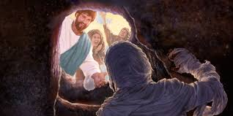
“And when he thus had spoken, he cried with a loud voice, Lazarus, come forth. And he that was dead came forth, bound hand and foot with graveclothes.”

Slide 30
“And his face was bound about with a napkin. Jesus saith unto them, Loose him, and let him go.”

Slide 31
“Then many of the Jews which came to Mary, and had seen the things which Jesus did, believed on him.”

Slide 32
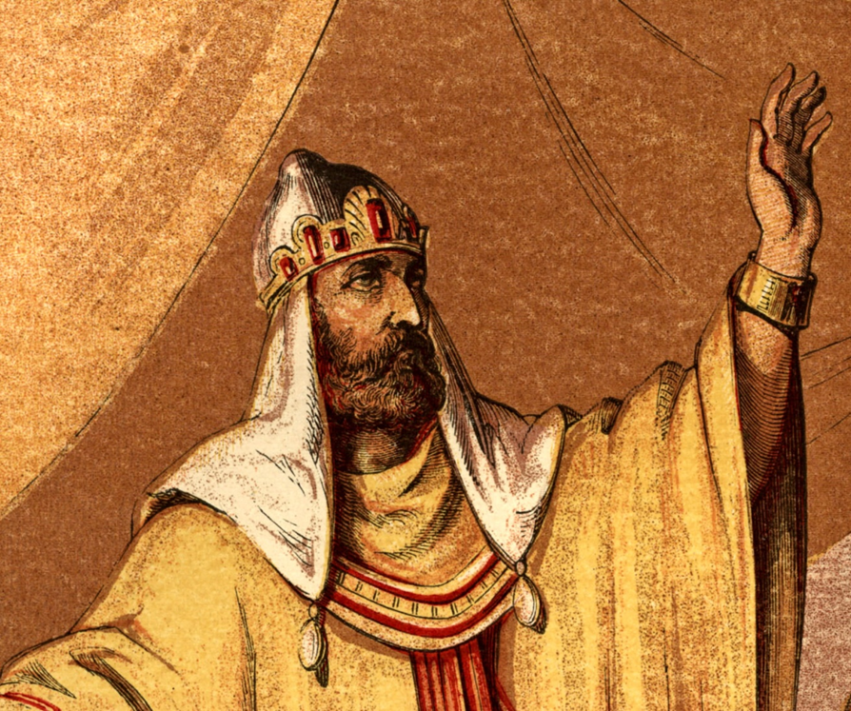
“My God, my God, why hast thou forsaken me? why art thou so far from helping me, and from the words of my roaring? O my God, I cry in the daytime, but thou hearest not.” (Psalms 22:1-2)

Slide 33
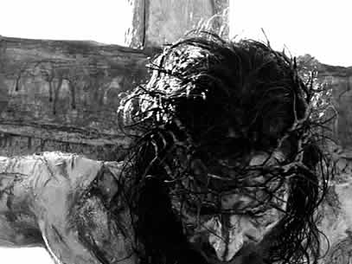
“And about the ninth hour Jesus cried with a loud voice, saying, Eli, Eli, lama sabachthani? that is to say, My God, my God, why hast thou forsaken me?” (Matt. 27:46)

Slide 34
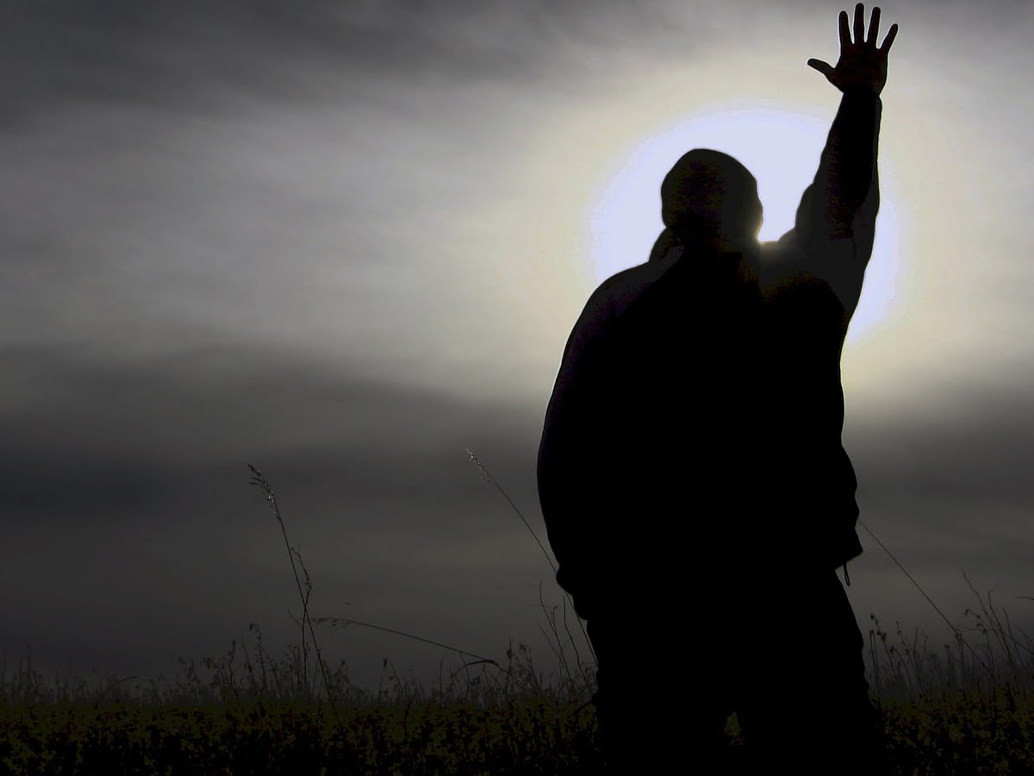
How do you respond when God is Silent?
Do you think that He has lost interest in you?
Do you feel as if He’s distant and unreachable?
Do you have a difficult time understanding why He would be silent when you need Him so badly?
Do you persevere in seeking Him even though you are not hearing from Him?
Do you become discouraged and quit on God?
Do you turn to the world for help in your time of need?

Slide 35
(John 21) “Simon Peter saith unto them, I go a fishing. They say unto him, We also go with thee. They went forth, and entered into a ship immediately; and that night they caught nothing.”

Slide 36
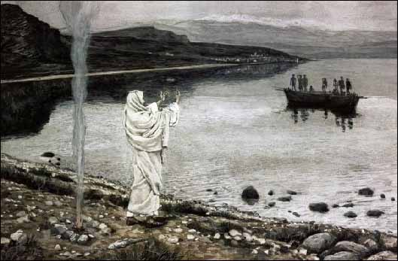

Slide 37
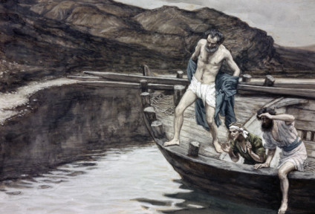

Slide 38
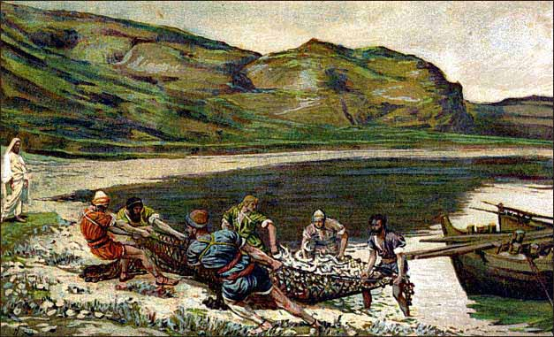

Slide 39
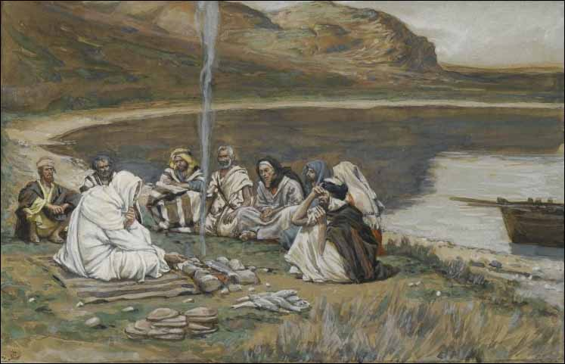

Slide 40
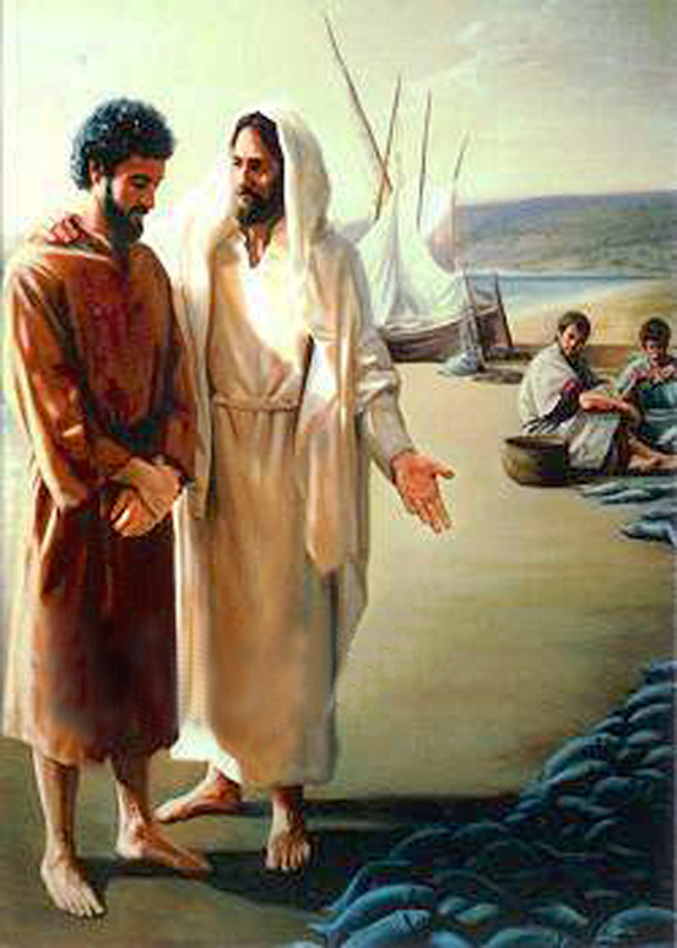
“So when they had dined, Jesus saith to Simon Peter, Simon, son of Jonas, lovest thou me more than these”
(John 21:15)

Slide 41
When God seems to be silent He has a reason for His silence.
Eph. 1:11 “In whom also we have obtained an inheritance, being predestinated according to the purpose of him who worketh all things after the counsel of his own will.”
Although we may not understand or comprehend God’s silence He has a good purpose in it – Romans 8:28
God will teach you things you never imagined through His silence if you will persevere.
Some synonyms for perseverance are: diligence, endurance, persistence, steadfastness, waiting and patience.

Slide 42
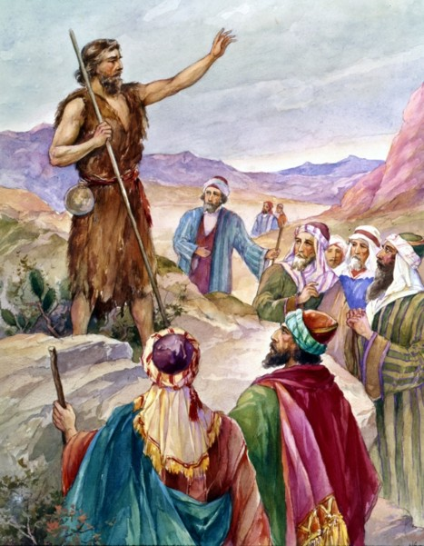
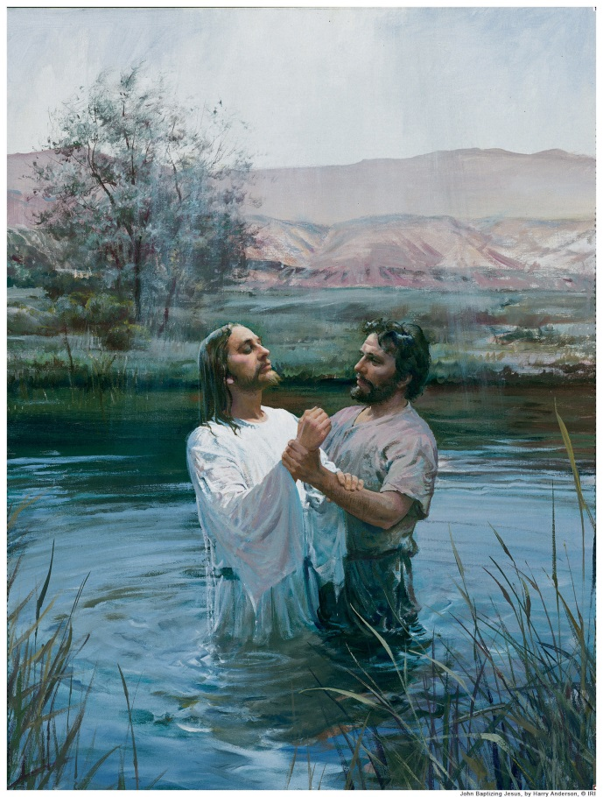
God was silent for 400 years between the last prophet of the Old Testament (Malachi) and the New Testament prophet (John the Baptist)

Slide 43
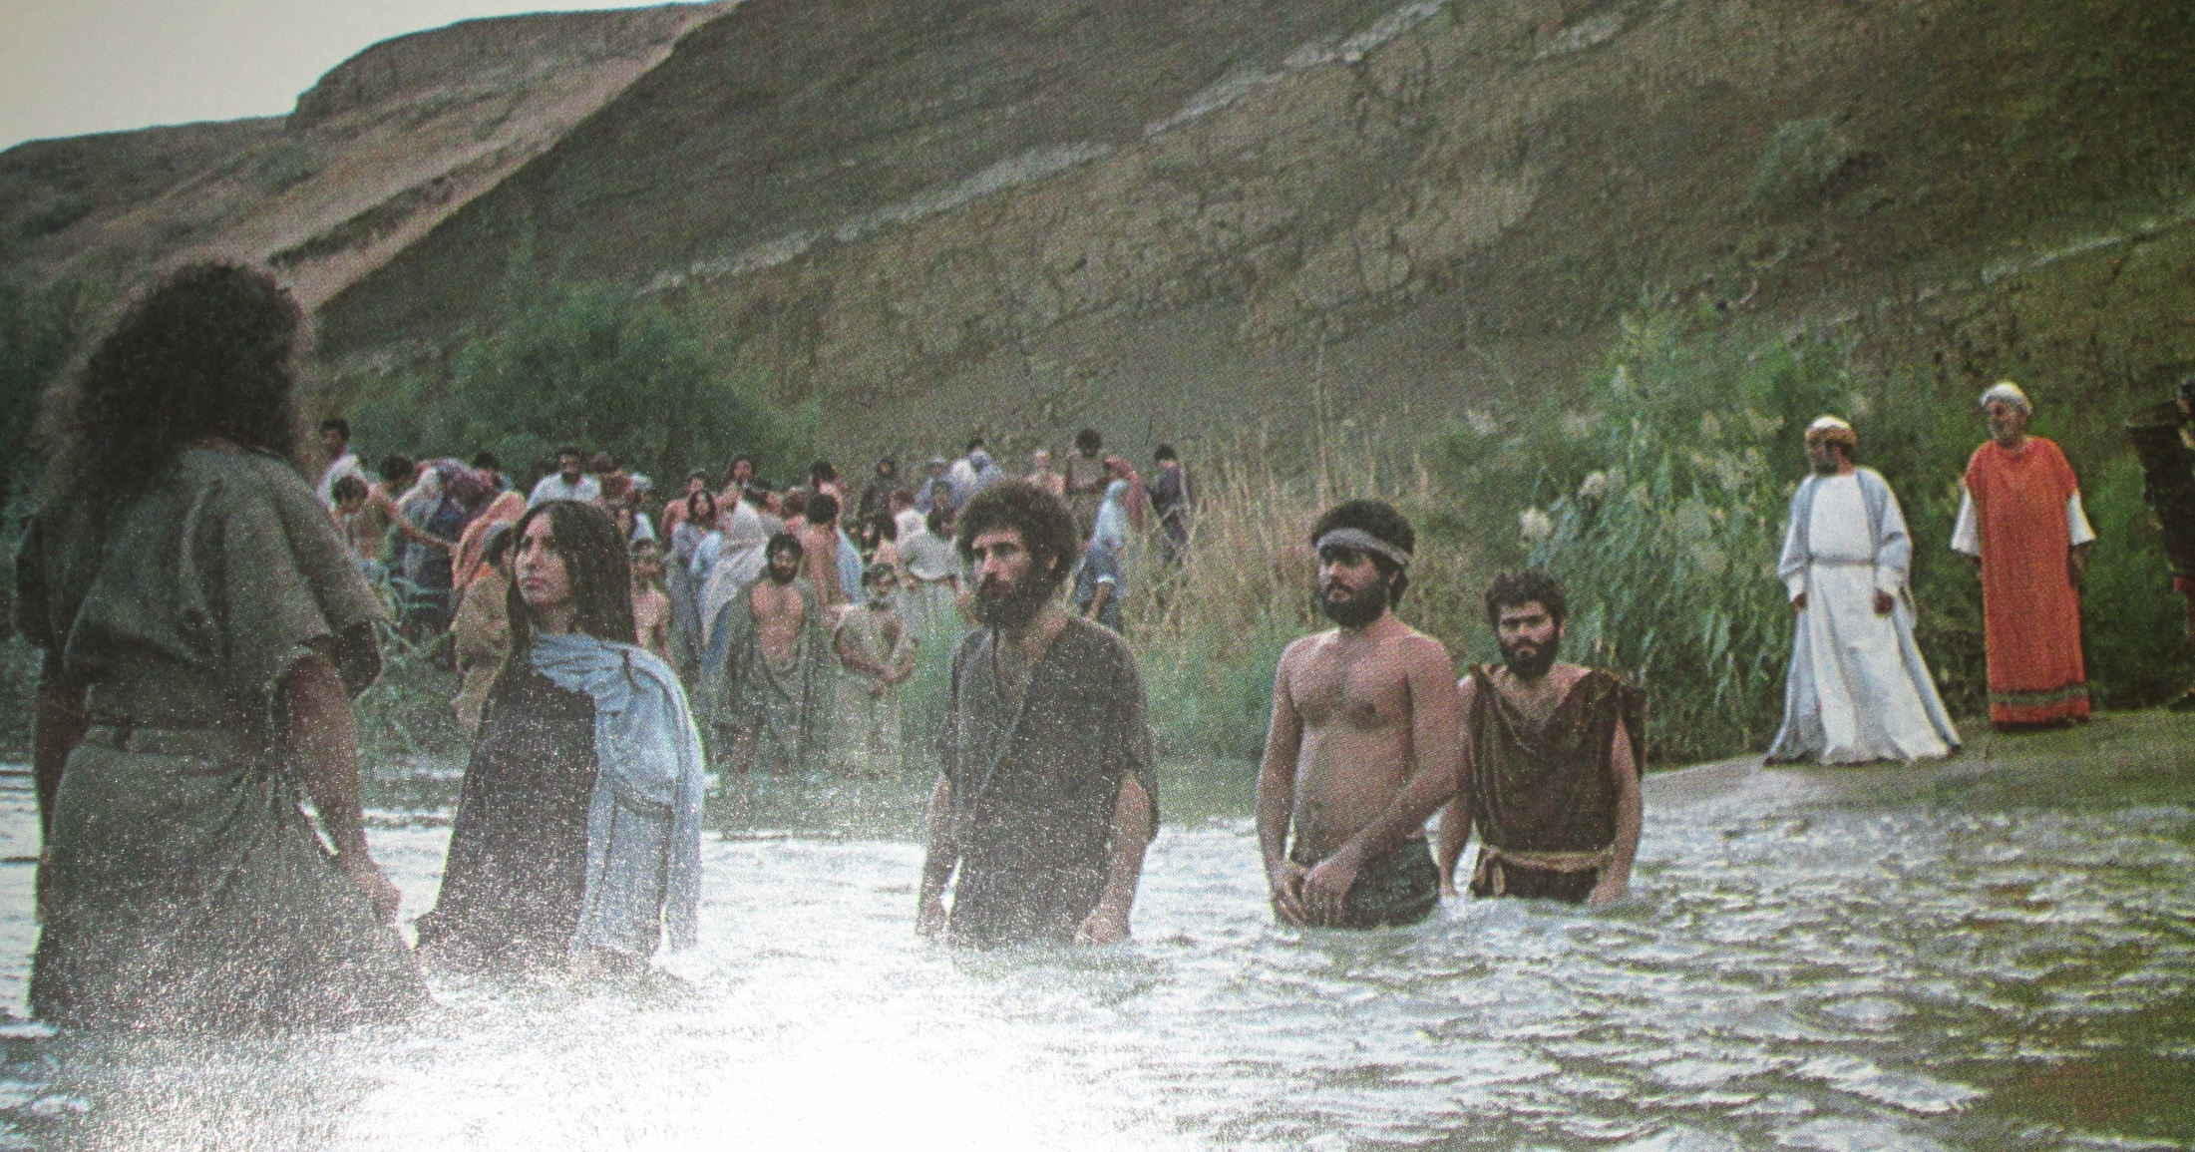
After 400 years of waiting Israel was ready to hear God’s voice.

Slide 44
Eight suggestions on how to respond when God seems to be silent.
Confess and forsake all known sin – Prov. 1:28
Continue to seek Him – Word and Prayer
Don’t run ahead of the Lord
Walk by faith
Make a decision – “I am not going back to the world…”
Refuse to fear
Embrace God’s Sovereignty
Be ready to hear when God speaks

Slide 45
Some times, God is speaking but we are not listening.
Remember God is teaching us to trust Him during times of silence.
Distinguish God’s voice from all the other voices telling you what you should do.
Don’t stop praying.
Persevere in prayer.
God’s silence does not mean that He’s inactive.
Keep your emotions in check.

Slide 46
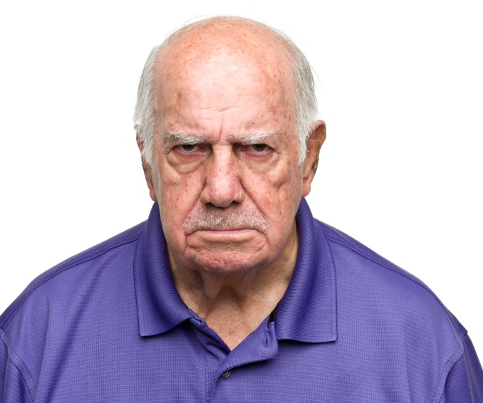
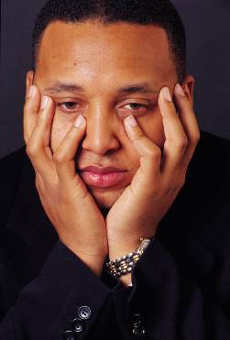
Don’t allow yourself to become
fearful
angry
disappointed
confused

Slide 47
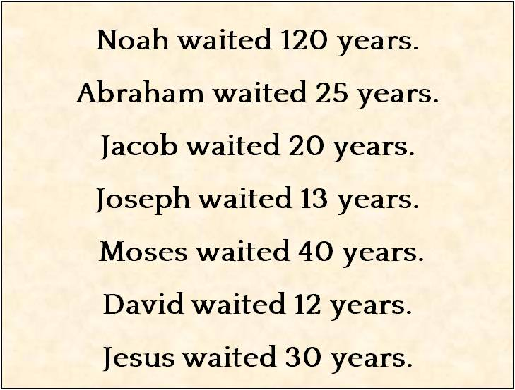
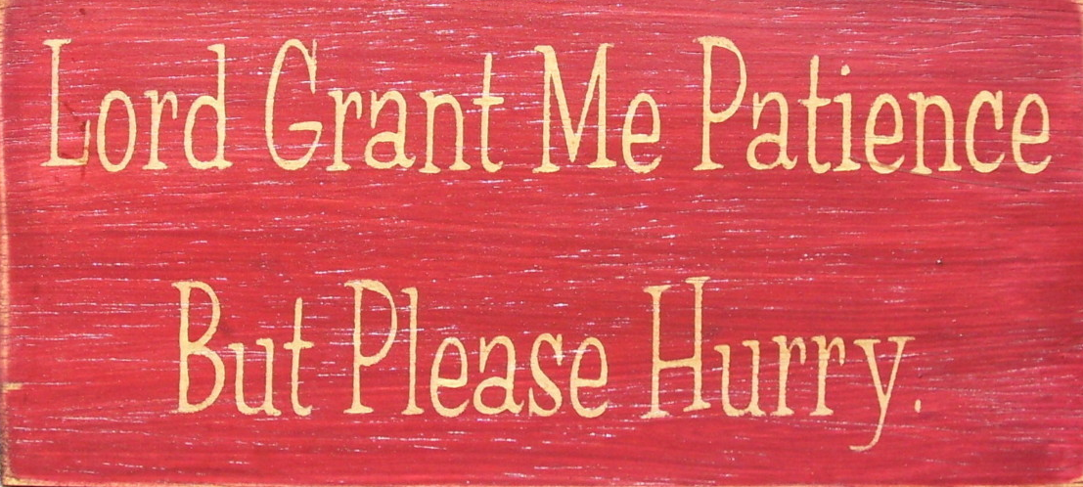

Slide 48
Has God been silent lately? If so He is raising your Christian life to a new level.

Slide 49
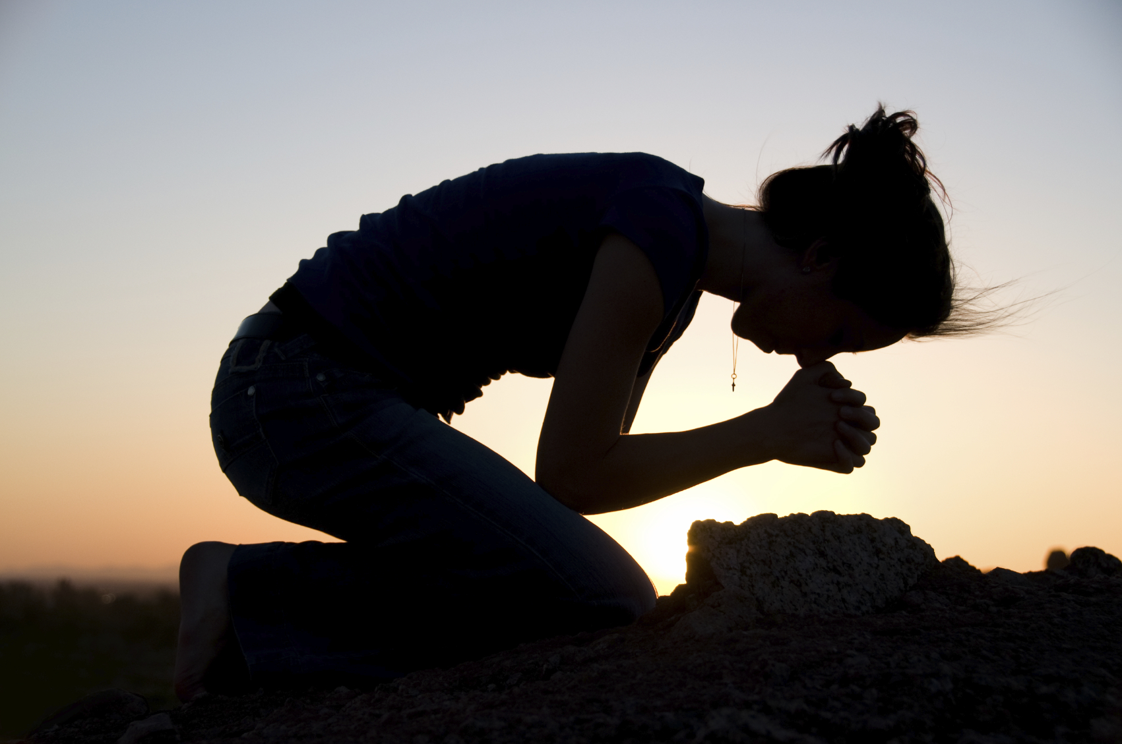
Stay humble before your Almighty God.

Slide 50
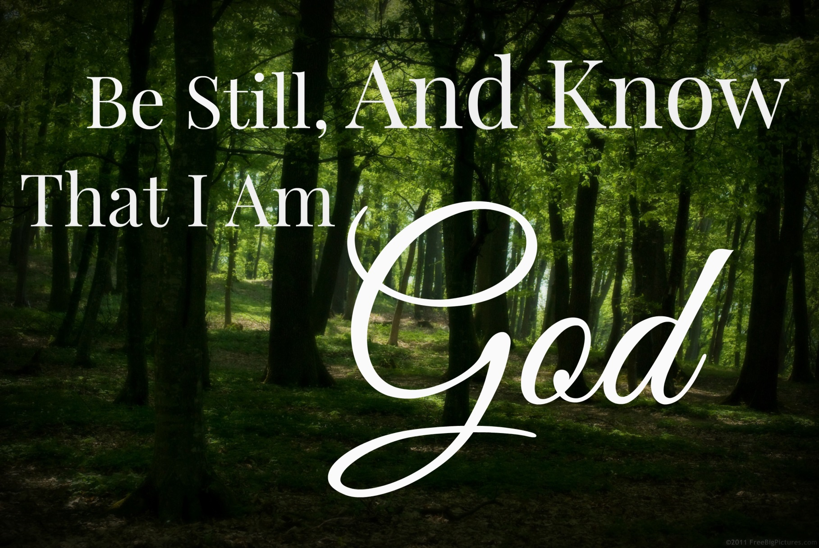
Be silent before Him and be willing to hear and obey when He speaks.

Slide 51
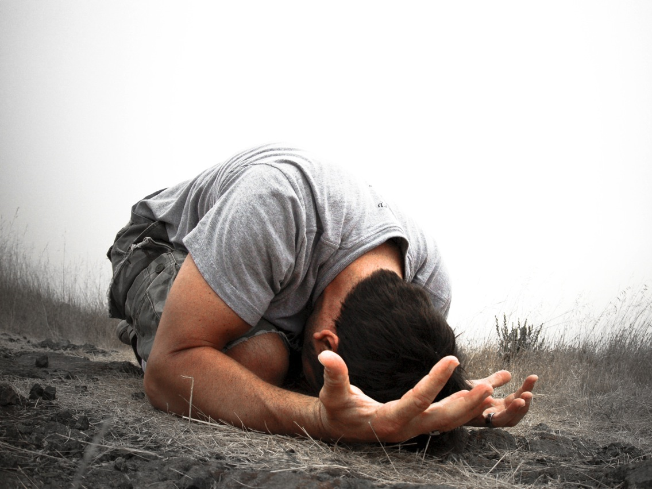
Heavenly Father, sometimes I think You either aren’t listening or don’t care about my circumstances. Help me choose to praise You and remember that You use every situation for my ultimate good. In Jesus’ name I pray. Amen.

