Slide 1
The Revelation of Jesus Christ
A study of the book
of Revelation

Slide 2
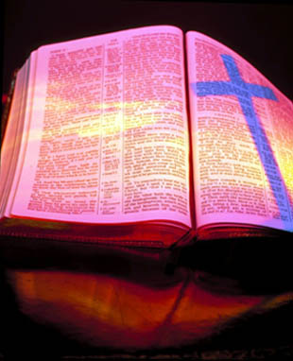
Revelation 17:1-19:10
“The Apostate Church”
“The Great Whore”

Slide 3
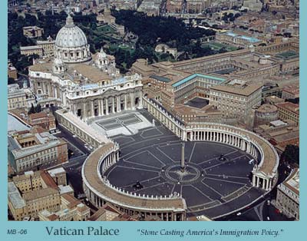
The Apostate Church “The identity of the great whore”
Revelation 17:1-19:10

Slide 4
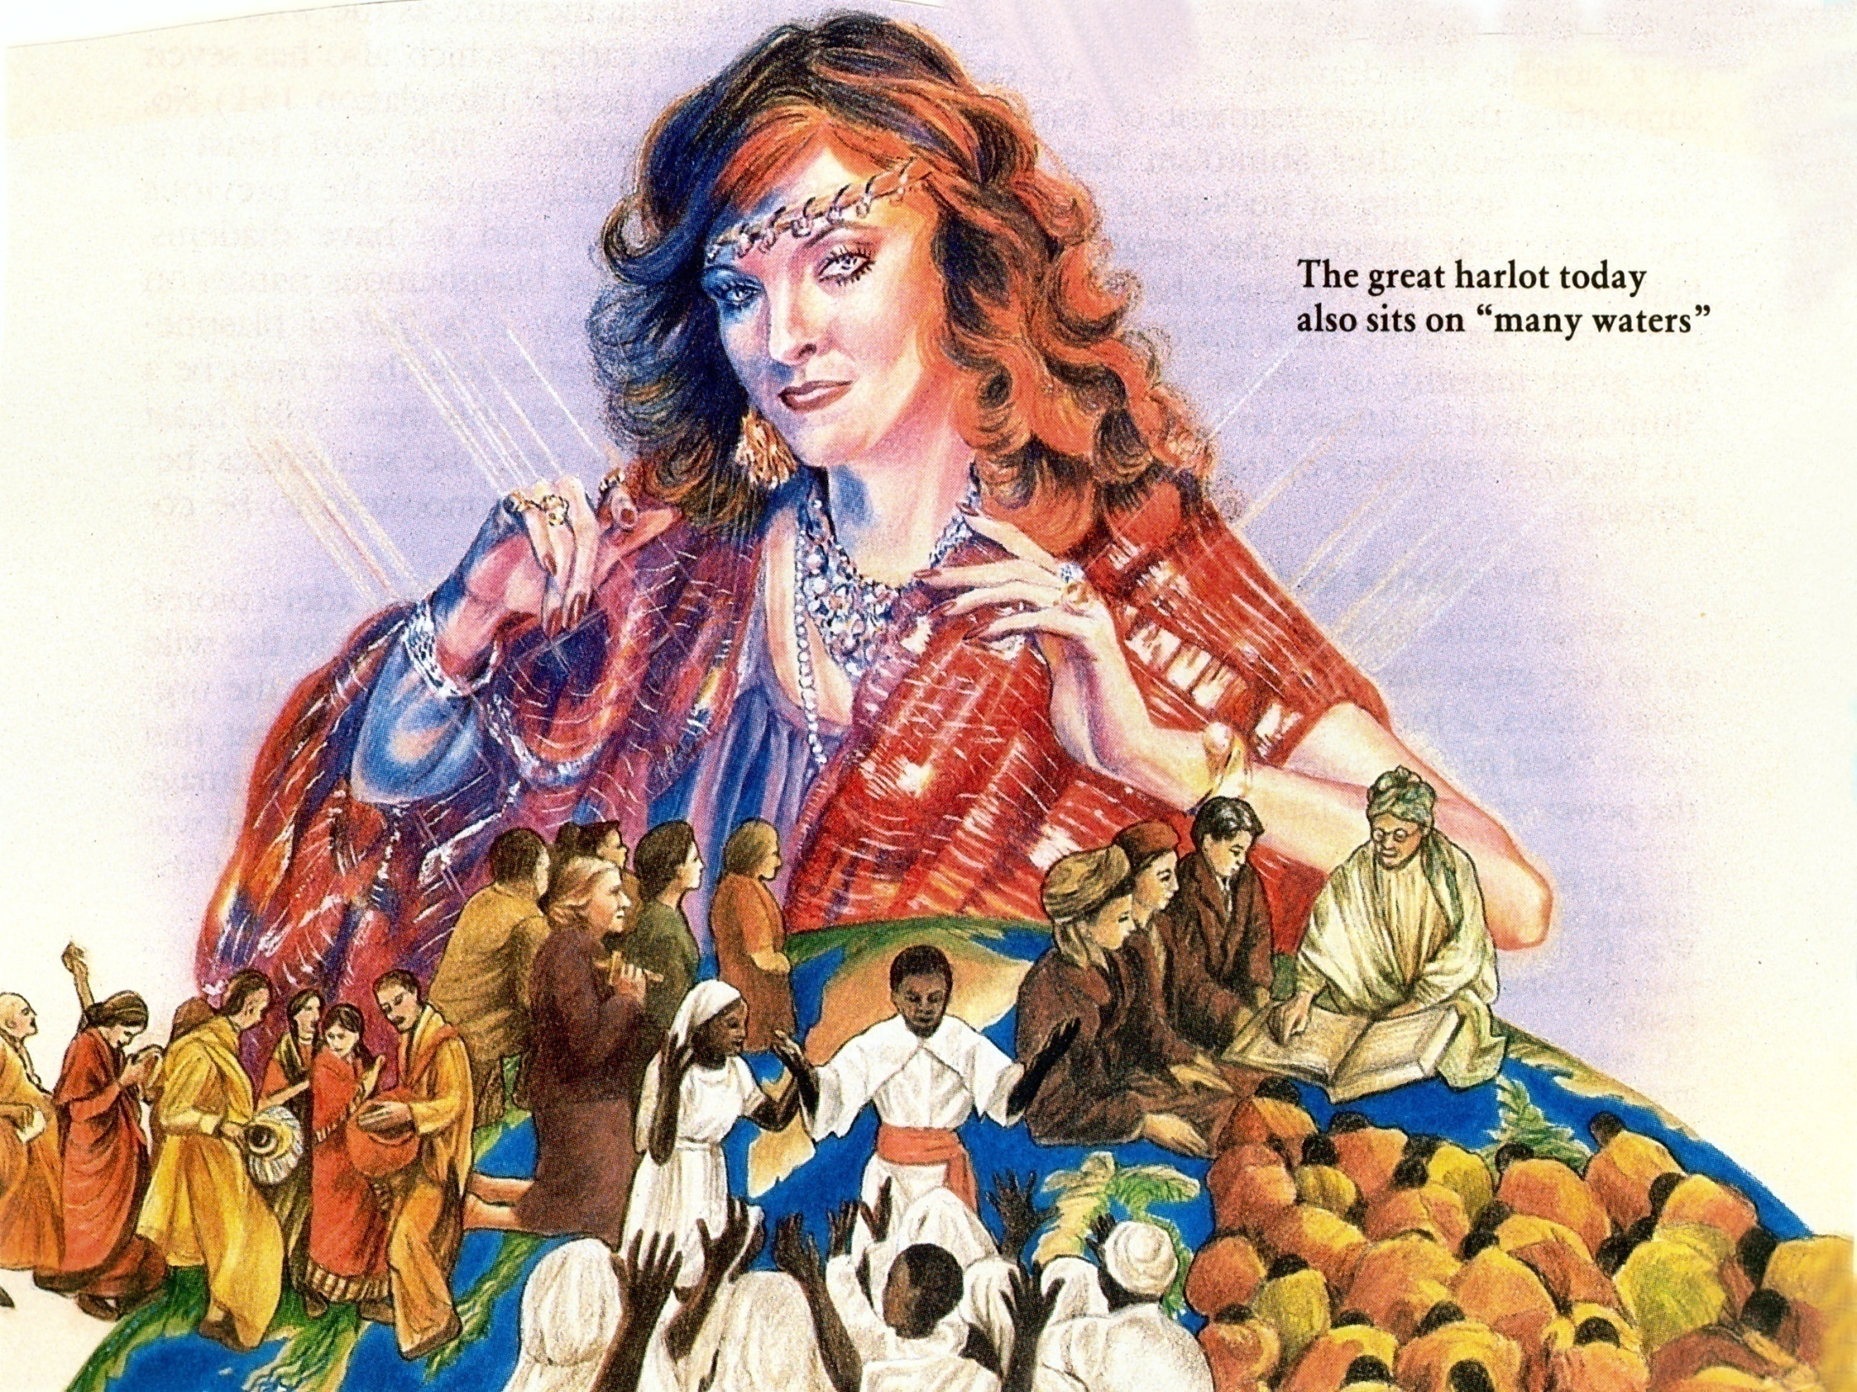
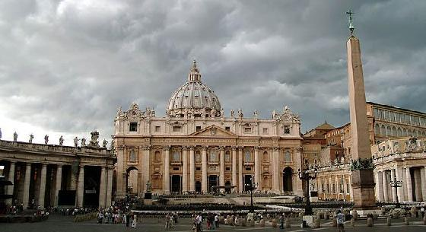
“And he said unto me, the waters which thou sawest, where the whore sitteth, and peoples, and multitudes, and nations and tongues.” (Revelation 17:15)
Catholic = Universal

Slide 5
“And there came one of the seven angels which had the seven vials, and talked with me, saying unto me, Come hither; I will shew unto thee the judgment of the great whore that sitteth upon many waters.”

Slide 6
“With whom the kings of the earth have committed fornication, and the inhabitants of the earth have been made drunk with the wine of her fornication.”

Slide 7
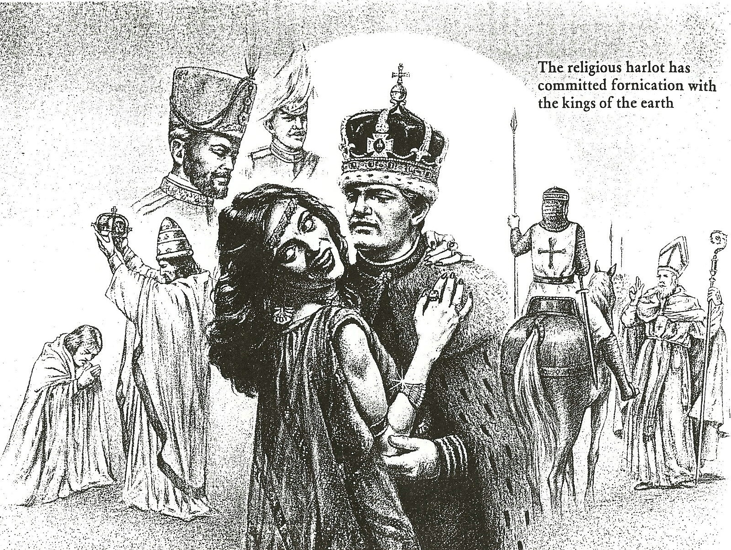

Slide 8
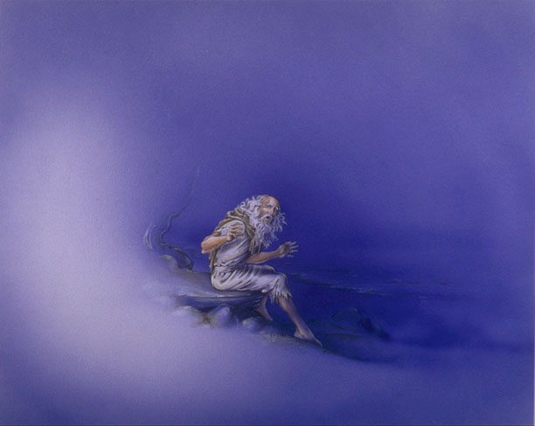
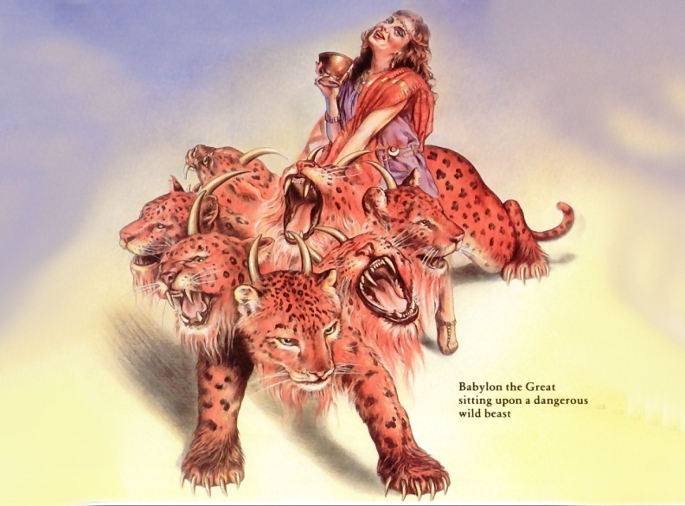
“So he carried me away in the spirit into the wilderness: and I saw a woman sit upon a scarlet coloured beast, full of names of blasphemy, having seven heads
and ten horns.”

Slide 9
“And the woman was arrayed in purple and scarlet colour, and decked with gold and precious stones and pearls, having a golden cup in her hand full of abominations and filthiness of her fornication.”

Slide 11
“And I saw the woman drunken with the blood of the saints, and with the blood of the martyrs of Jesus: and when I saw her, I wondered with great admiration.”

Slide 13
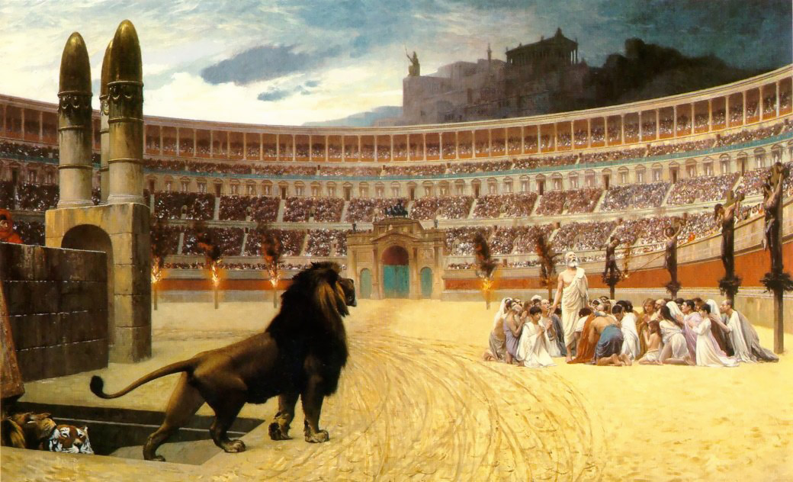
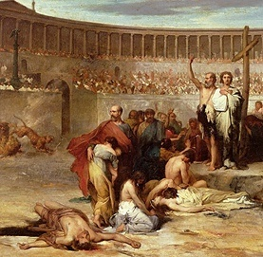
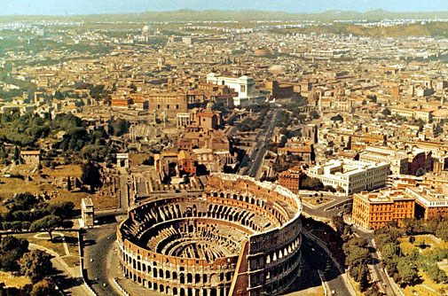
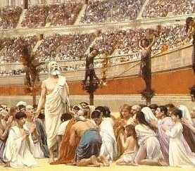

Slide 15
“And the woman was arrayed in purple and scarlet colour, and decked with gold and precious stones and pearls, having a golden cup in her hand full of abominations and filthiness of her fornication.”

Slide 16
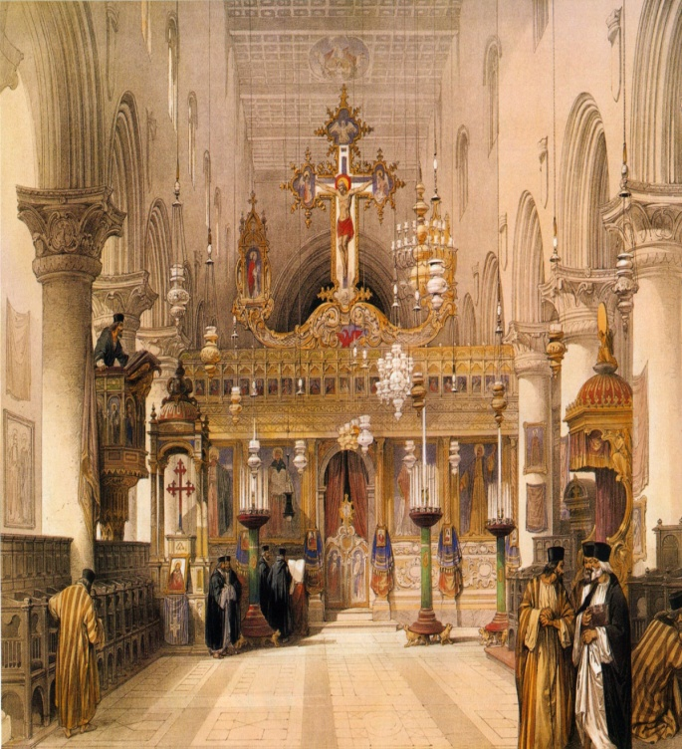
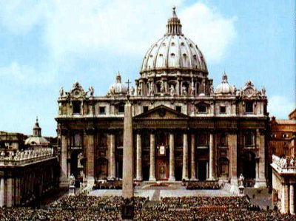
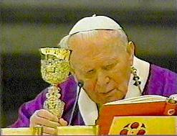
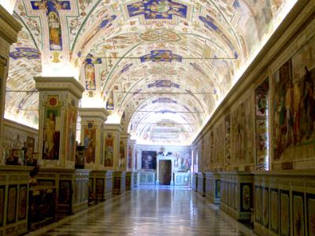
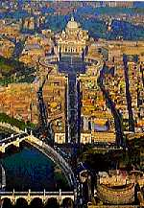
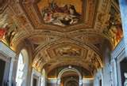

Slide 17
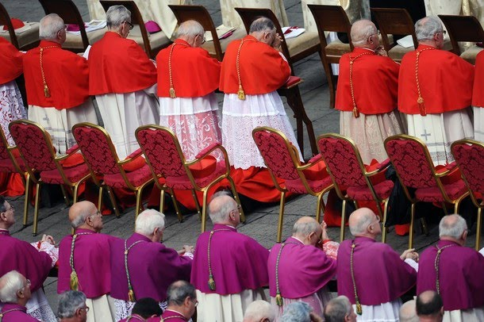
“And the woman was arrayed in purple and scarlet colour.”

Slide 18
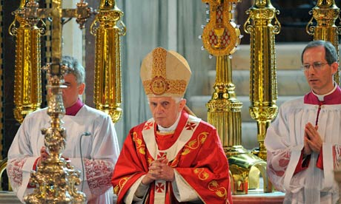
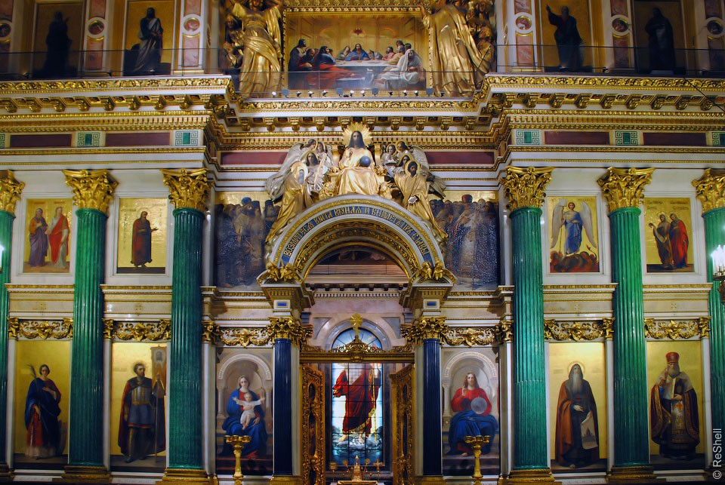
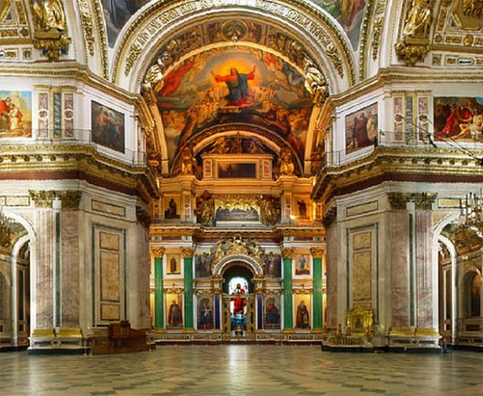
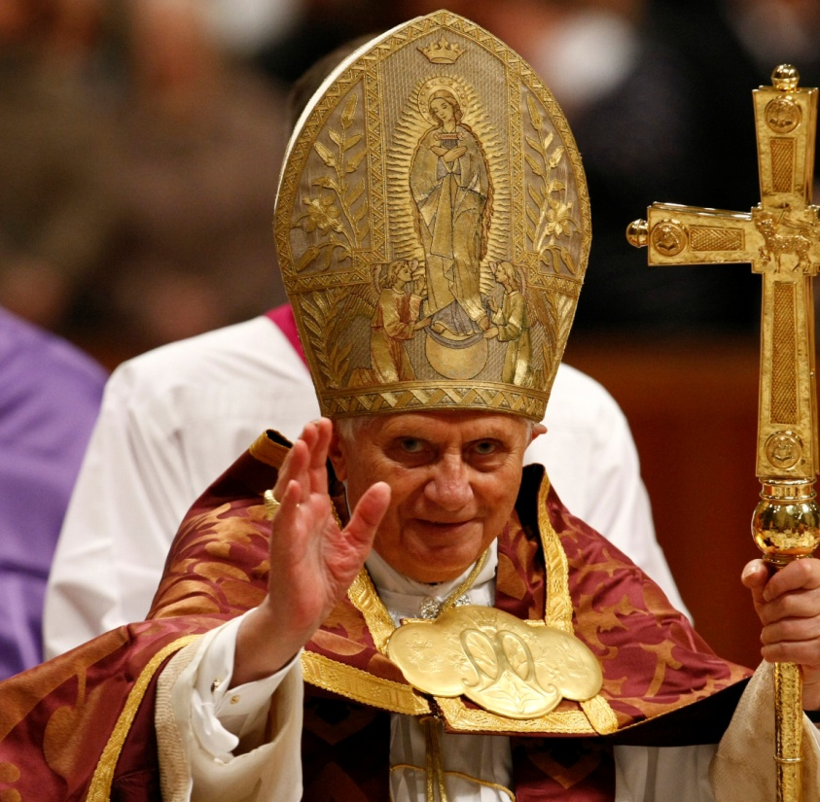
“And decked with gold and precious stones and pearls.”

Slide 19
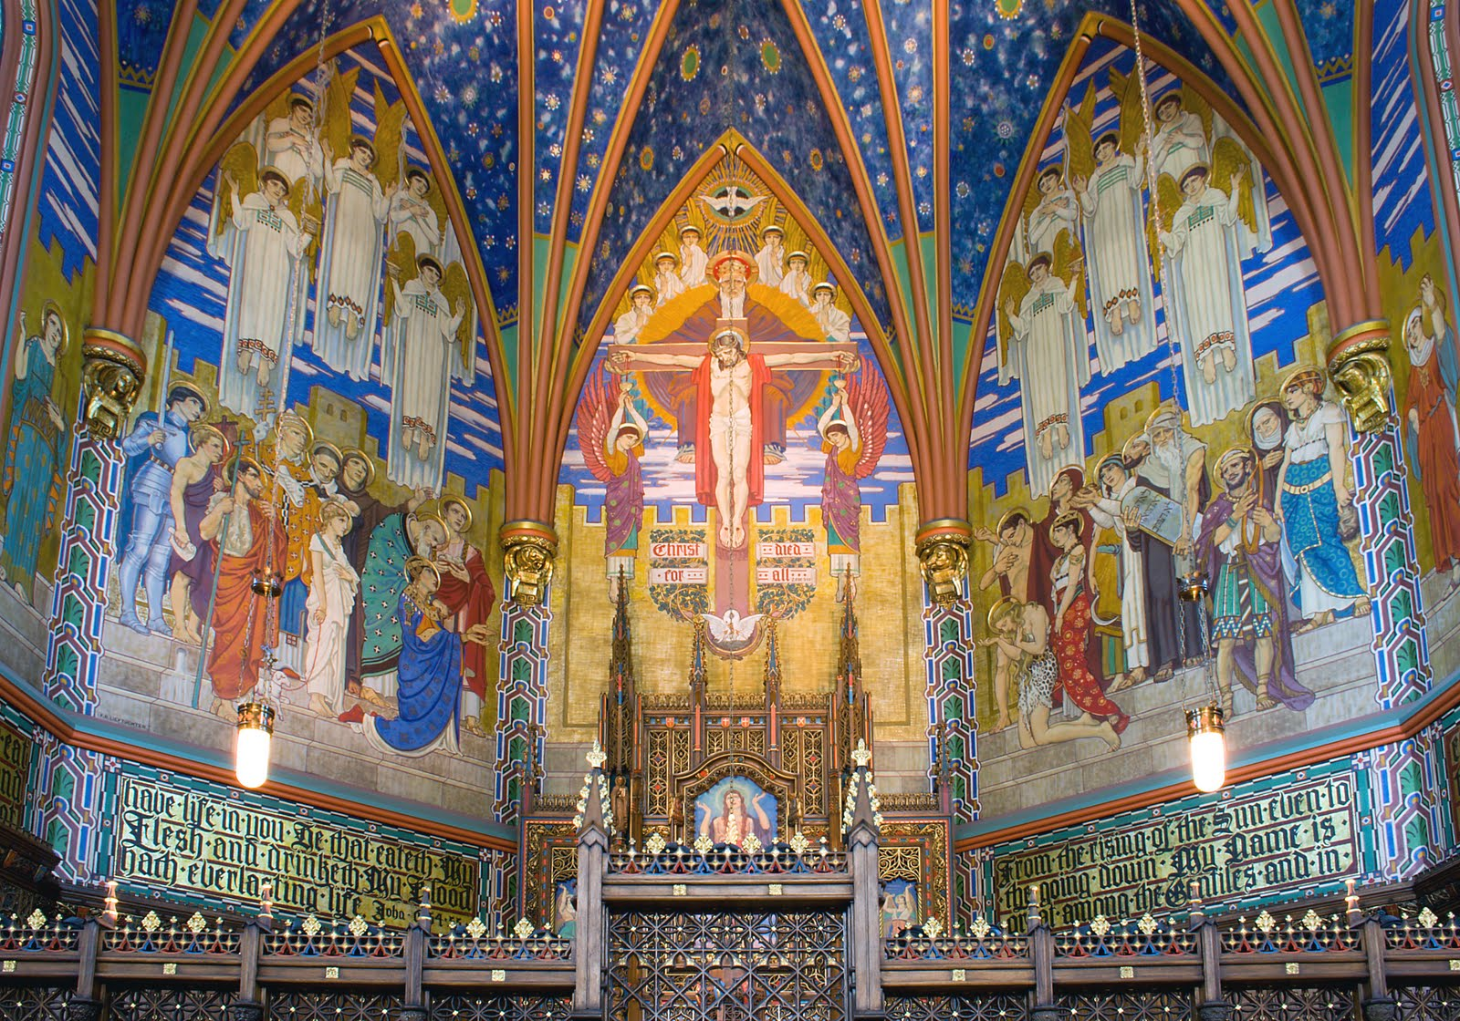

Slide 20
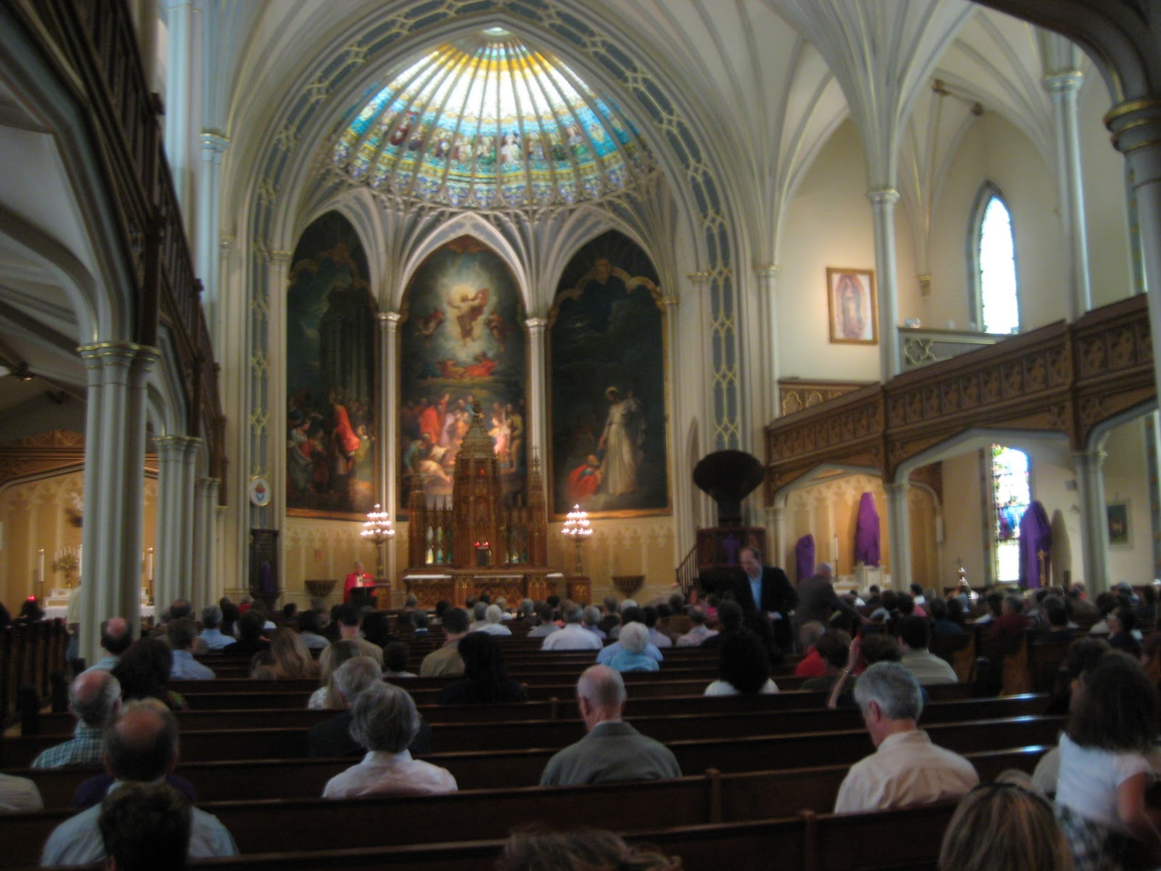

Slide 21
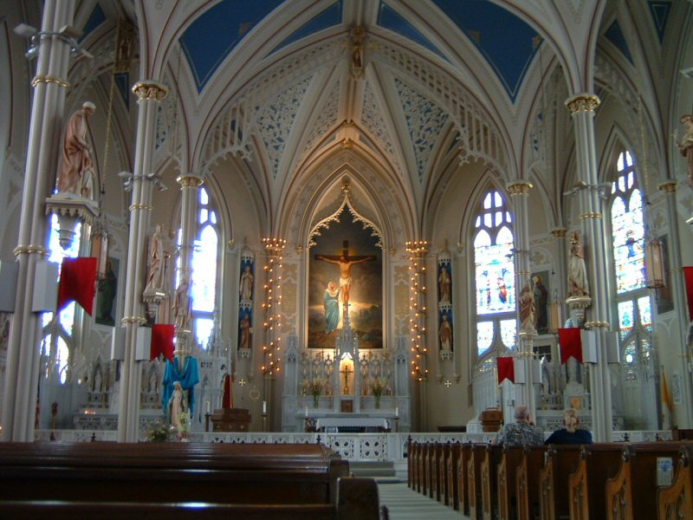

Slide 22
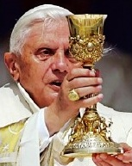
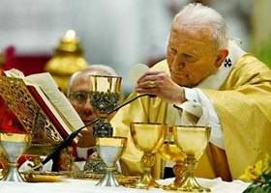
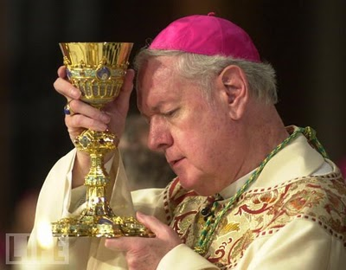
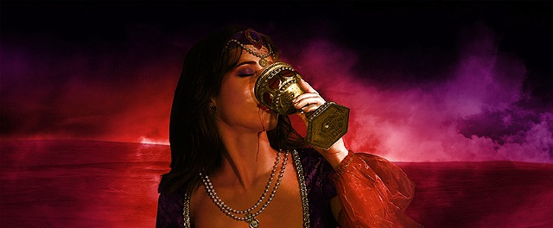
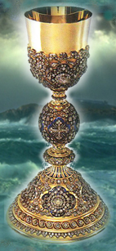
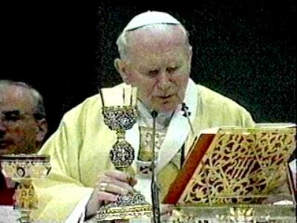
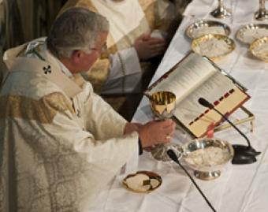

Slide 23
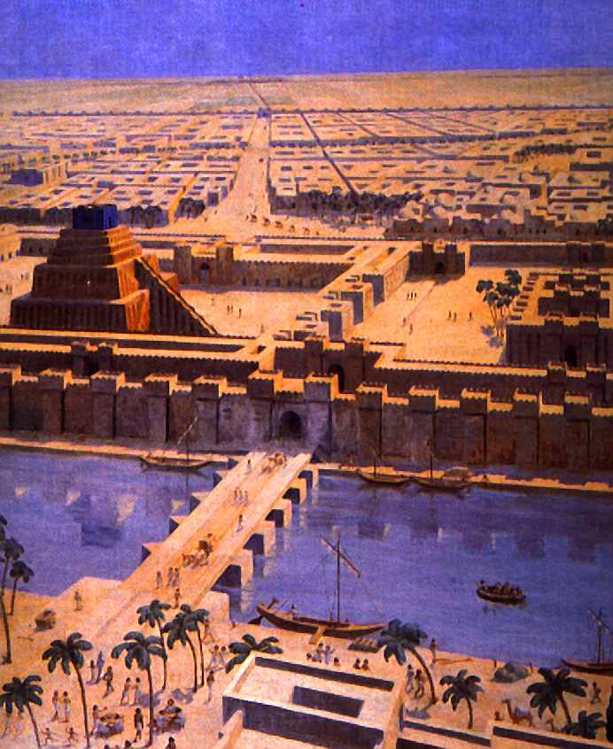
“Mystery, Babylon the Great” .

Slide 24
“And upon her forehead was a name written, Mystery, Babylon the Great, the Mother of Harlots and Abominations of the Earth.”

Slide 25
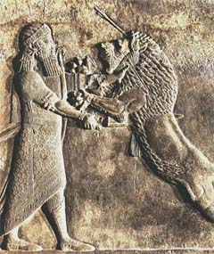
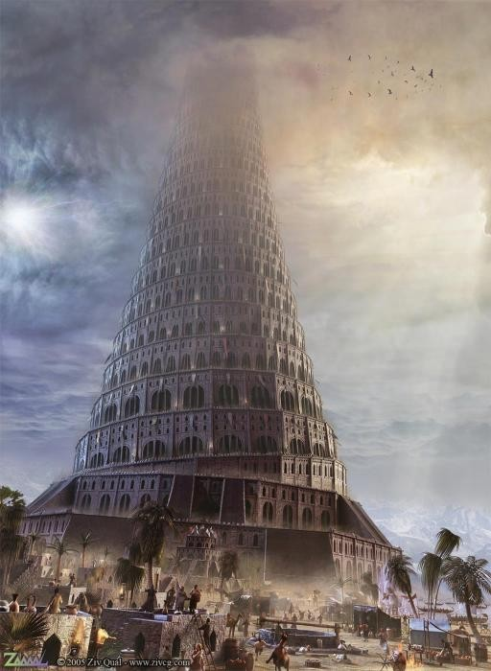

Slide 26
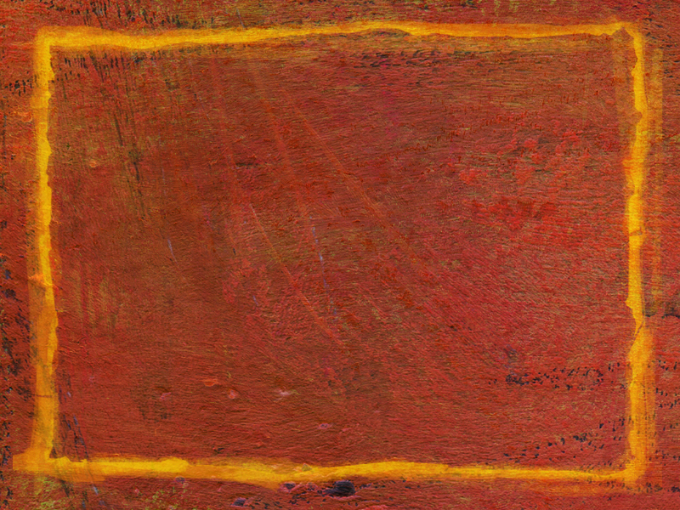
Nimrod and the Tower of Babel (Genesis 10-11)
Nimrod was the great grandson of Noah, the grandson of Ham, the son of Cush
Powerful leader – “Mighty in the earth…”
Mighty hunter
Builder – “From that land (Babylon) he went to Assyria and built Nineveh…”
Visionary – “Desired to expand his empire.” (Genesis 10:10-11)

Slide 27
The whole earth had one language
The people lived together as a whole civilization (communal living leads to sinful behavior)
Under the leadership of Nimrod the people built a city and tower – Fame, power, unity, security, one great world empire
A tower was built for religious worship – One world religion
The tower represented – A stairway to heaven (built by their own effort, works, man-made)
Symbol of false religion

Slide 28
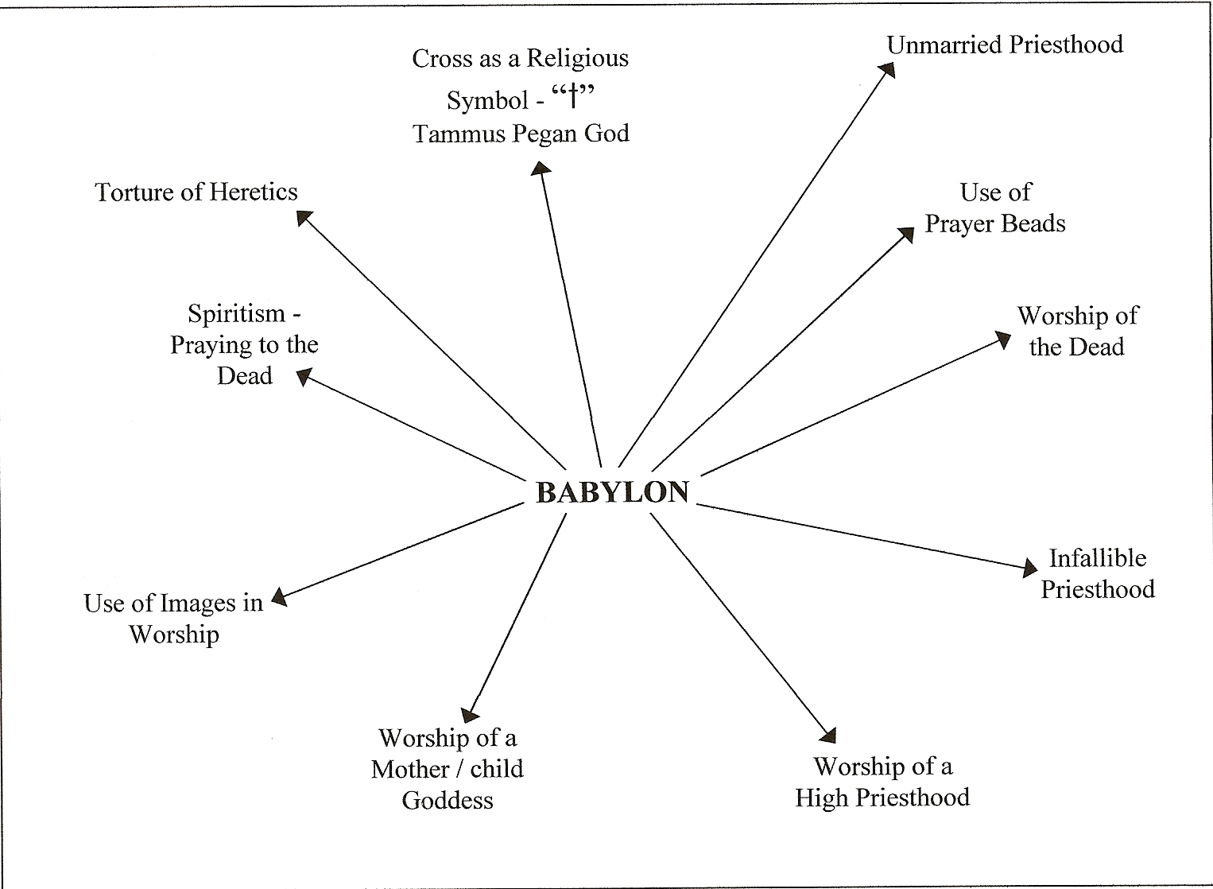
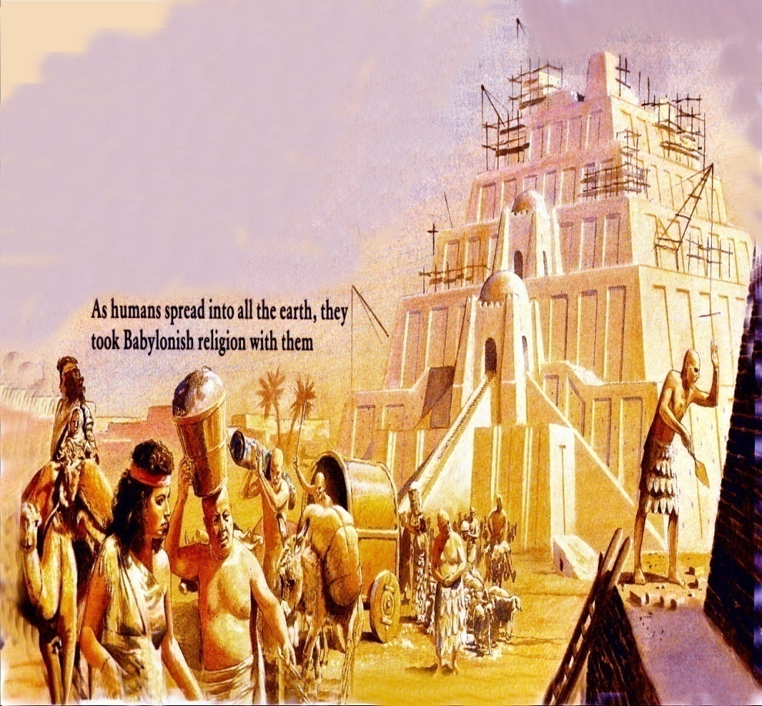

Slide 29
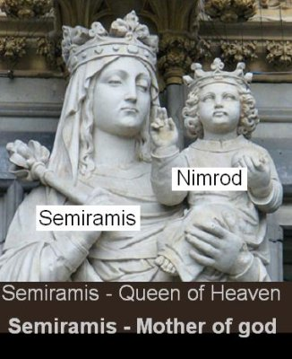

Slide 30
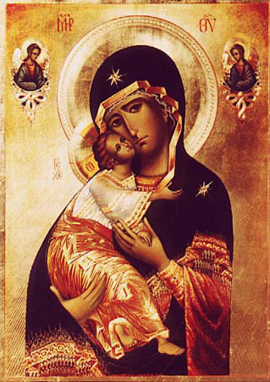
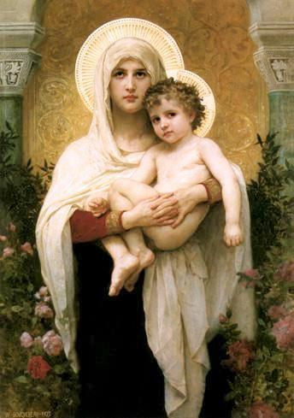
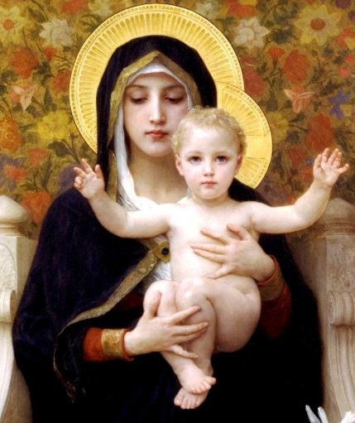
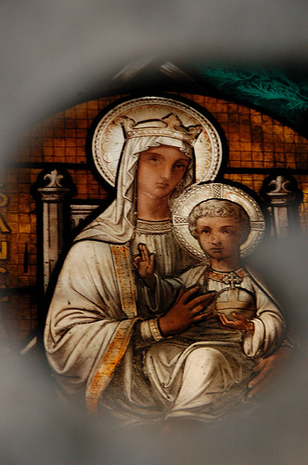
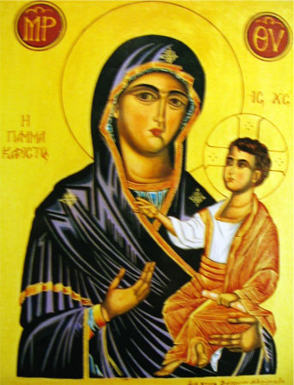
“Worship of a Mother/Child goddess”

Slide 31
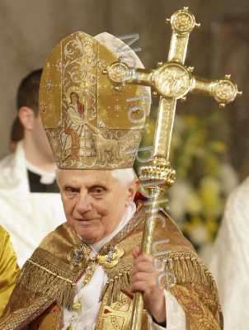
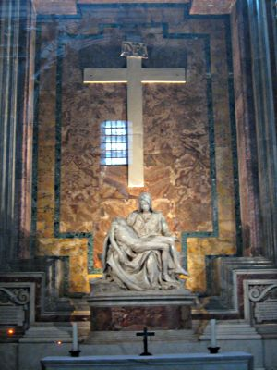
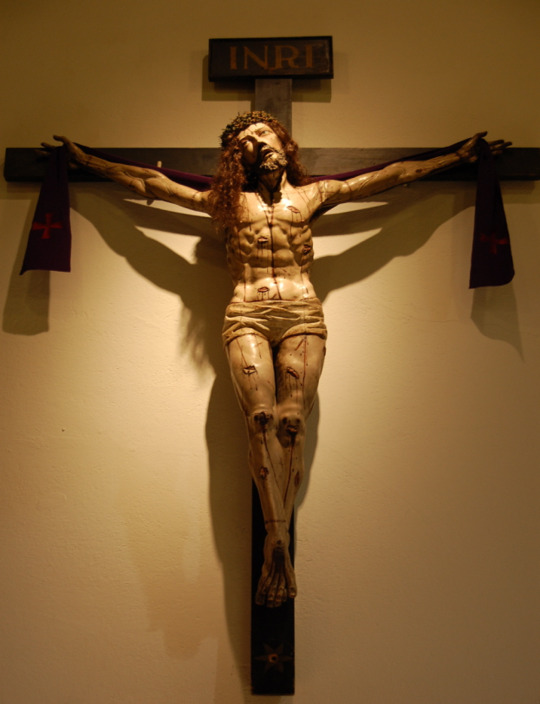
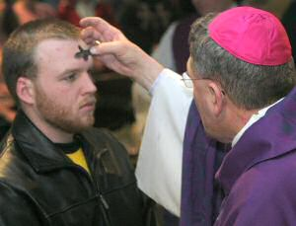
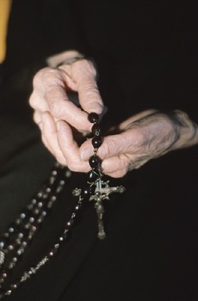
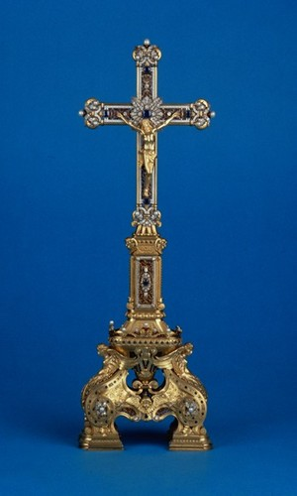
Cross as a religious symbol in worship

Slide 32
Unmarried Priesthood

Slide 33
The use of prayer beads

Slide 34
Worship of the dead

Slide 35
Infallible Priesthood

Slide 36
The Worship of a High Priest

Slide 37
Images used in worship (Idols)

Slide 38
Use of pagan symbols in worship

Slide 42
Spiritism Praying to the dead

Slide 43
Torture of Heretics “Drunk with the blood of the saints.”
Torture of Heretics

Slide 44
“And the angel said unto me, Wherefore didst thou marvel? I will tell thee the mystery of the woman, and of the beast that carrieth her, which hath the seven heads and ten horns.”

Slide 47
“The beast that thou sawest was, and is not; and shall ascend out of the bottomless pit, and go into perdition: and they that dwell on the earth shall wonder, whose names were not written in the book of life from the foundation of the world, when they behold the beast that was, and is not, and yet is.”

Slide 49
“…and his deadly wound was healed: and all the world wondered after the beast…”

Slide 51
“…shall ascend out of the bottomless pit…"
Satan will raise up the Anti-Christ as his false messiah and give him worldwide rule – (Revelation 11:7; 13:3-4)
The rule and policies of the Anti-Christ will be promoted by the False Prophet and the Apostate Church – (Revelation 13:11-18; 17:3)

Slide 52
“He (False Prophet) causeth the earth and them that dwell therein to worship the first beast (Anti-Christ), whose deadly wound was healed…”

Slide 56
“And goeth into perdition…” “And the beast was taken and with him the false prophet…these both were cast alive into a lake of fire burning with brimstone.” (Revelation 19:20)

Slide 57
“And here is the mind which hath wisdom. The seven heads are seven mountains, on which the woman sitteth.”

Slide 58
Revelation 17:9

Slide 59
“Seven mountains, on which the woman (whore / false church) sitteth…” Mountain (Greek – oros) = To rise or lift above itself above the plain, a hill.

Slide 61
Revelation 17:9
“And here is the mind which hath wisdom. The seven heads are the seven mountains (Rome is the only city in the world that is designated as “The lofty city of seven hills)
…on which the woman (harlot = false apostate church = Roman Catholic Church)
…sitteth (reigns as queen) .” – Revelation 17: 18-19

Slide 62
Revelation 17:10
“And there are seven kings (Roman Empire);
…five are fallen (Julius Caesar, Tiberius, Caligula, Claudius and Nero),
…and the other is (Domitian),
…and the other is yet to come (Anti-Christ – little horn of Daniel 7:7-8, 20-28),
…and when he cometh, he must continue a short space .” (3 ½ years – Daniel 7:23-26; Revelation 11:2, 12:6, 13:5-6)

Slide 63
Revelation 17:11
“And the beast was (alive), and is not (dead),
…even he is the eighth (a king that was, and is not, and yet is) – Revelation 17:8
…and is of the seven (“and is one of the seven” / Kings of the Roman Empire)
…and goeth into perdition.” (Lake of Fire – Revelation 19:20)

Slide 64
Revelation 17:12
“And the ten horns which thou sawest are the ten kings (ten toes of iron mixed with clay in Nebuchadnezzar’s vision – Daniel 2:41-43 / the ten horned beast of Daniel’s vision – Daniel 7:7-8),
…which have received no kingdom as yet (have not united in power);
…but receive power (authority)
…as kings, one hour (period of time – Revelation 3:10),
…with the beast…” (Anti-Christ)

Slide 65
Revelation 17:13
“These have one mind (united),
…and shall give their power (authority)
…and strength unto the beast (Anti-Christ).”

Slide 66
Revelation 17:14
“These shall make war with the Lamb (Jesus Christ – Psalms 2),
…and the Lamb shall overcome them: for He is the Lord of lords and the King of kings,
…and they that are with him are called, and chosen, and faithful .” (church – Revelation 19:11-20)

Slide 67
Revelation 17:12-14

Slide 69
“These shall make war with the Lamb and the Lamb shall overcome them: for He is the Lord of lords and the King of kings, and they that are with him are called, and chosen, and faithful .”

Slide 71
“Why do the heathen rage, and the people imagine a vain thing? The kings of the earth set themselves, and the rulers take counsel together, against the LORD, and against his anointed, saying, Let us break their bands asunder, and cast away their cords from us. He that sitteth in the heavens shall laugh: the Lord shall have them in derision. Then shall he speak unto them in his wrath, and vex them in his sore displeasure. Yet have I set my king upon my holy hill of Zion. I will declare the decree: the LORD hath said unto me, Thou art my Son; this day have I begotten thee. Ask of me, and I shall give thee the heathen for thine inheritance, and the uttermost parts of the earth for thy possession. Thou shalt break them with a rod of iron; thou shalt dash them in pieces like a potter's vessel. Be wise now therefore, O ye kings: be instructed, ye judges of the earth. Serve the LORD with fear, and rejoice with trembling. Kiss the Son, lest he be angry, and ye perish from the way, when his wrath is kindled but a little. Blessed are all they that put their trust in him.” (Psalms 2:1-12)

Slide 73
“And he saith unto me, The waters which thou sawest, where the whore sitteth, are peoples, and multitudes, and nations, and tongues .”

Slide 74
Catholic = Universal

Slide 75
Revelation 17:15

Slide 76
Revelation 17:16-18

Slide 77
“And the ten horns which thou sawest upon the beast, these shall hate the whore, and shall make her desolate and naked, and shall eat her flesh, and burn her with fire. For God hath put in their hearts to fulfill his will, and to agree, and give their kingdom unto the beast, until the words of God shall be fulfilled. And the woman which thou sawest is that great city, which reigneth over the kings of the earth.”

Slide 80
“For God hath put in their hearts to fulfill his will.”

Slide 81
Revelation 18:1 “And after these things I saw another angel come down from heaven, having great power; and the earth was lightened with his glory.”

Slide 82
“I saw an angel having great power… and he cried mightily with a strong voice, saying…”

Slide 83
“Babylon the great is fallen…”

Slide 84
“…the habitation of devils, and every foul spirit…”

Slide 85
“For all nations have drunk of the wine of the wrath of her fornication.”

Slide 86
“The kings of the earth have committed fornication with her…”

Slide 87
“The merchants of the earth are waxed rich through the abundance of her delicacies…”

Slide 88
“Come out of her, my people, that ye be not partakers of her sins…”

Slide 89
“And I heard another voice from heaven saying, come out of her my people…” (Revelation 18:4)
“Mark them which cause divisions and offenses contrary to the doctrine which ye have learned; and avoid them.”
“Be not ye therefore partakers with them.”
“Come out from among them and be ye separate saith the Lord.”
“Have no fellowship with the unfruitful works of darkness.”

Slide 90
“Her sins have reached unto heaven…”

Slide 91
Revelation 18:6-9

Slide 92
“Reward her even as she rewarded you, and double unto her double according to her works: in the cup which she hath filled fill to her double. How much she hath glorified herself, and lived deliciously, so much torment and sorrow give her: for she saith in her heart, I sit a queen, and am no widow, and shall see no sorrow.”

Slide 93
Therefore shall her plagues come in one day, death, and mourning, and famine; and she shall be utterly burned with fire: for strong is the Lord God who judgeth her.”

Slide 94
“And the kings of the earth, who have committed fornication and lived deliciously with her, shall bewail her, and lament for her, when they shall see the smoke of her burning.”

Slide 95
“Standing afar off for the fear of her torment, saying, Alas, alas, that great city Babylon, that mighty city! for in one hour is thy judgment come. And the merchants of the earth shall weep and mourn over her; for no man buyeth their merchandise any more: And the merchants of the earth shall weep and mourn over her…”

Slide 96
“And saying, Alas, alas, that great city, that was clothed in fine linen, and purple, and scarlet, and decked with gold, and precious stones, and pearls! For in one hour so great riches is come to nought. And every shipmaster, and all the company in ships, and sailors, and as many as trade by sea, stood afar off,

Slide 97
And cried when they saw the smoke of her burning, saying, What city is like unto this great city! And they cast dust on their heads, and cried, weeping and wailing, saying, Alas, alas, that great city, wherein were made rich all that had ships in the sea by reason of her costliness! for in one hour is she made desolate.”

Slide 98
“Rejoice over her, thou heaven, and ye holy apostles and prophets; for God hath avenged you on her.”
Heaven rejoices over the judgment of the whore

Slide 99
“And a mighty angel took up a stone like a great millstone, and cast it into the sea, saying, Thus with violence shall that great city Babylon be thrown down, and shall be found no more at all.”

Slide 101
“And the voice of harpers, and musicians, and of pipers, and trumpeters, shall be heard no more at all in thee.”

Slide 102
“No craftsman, of whatsoever craft he be, shall be found any more in thee…”

Slide 107
“The light of a candle shall shine no more at all in thee…”

Slide 108
“The voice of the bridegroom and of the bride shall be heard no more at all in thee…”

Slide 109
“For by thy sorceries were all nations deceived.”

Slide 110
“In her was found the blood of the prophets, and of saints, and of all that were slain upon the earth.”

Slide 112
Revelation 19:1-3 “And after these things I heard a great voice of much people in heaven, saying, Alleluia; Salvation, and glory, and honour, and power, unto the Lord our God.”

Slide 113
“True and righteousness are thy judgments: for he hath judged the great whore, which did corrupt the earth…”

Slide 114
“And her smoke rose up forever and ever…”

Slide 115
Revelation 19:4 “And the four and twenty elders and the four beasts fell down and worshipped God that sat on the throne, saying, Amen; Alleluia.”

Slide 116
“Praise our God, all ye His servants…”

Slide 117
“And I heard as it were the voice of a great multitude, and as the voice of many waters…saying, Alleluia: for the Lord God omnipotent reigneth. Let us rejoice and be glad…” (Revelation 19:6-7)

Slide 118
“And I heard as it were the voice of a great multitude…as the voice of mighty thunderings, saying, Alleluia: for the Lord God omnipotent reigneth. Le t us rejoice and be glad…” (Revelation 19:6-7)

Slide 119
“And to her was granted that she should be arrayed in fine linen, clean and white: for the fine linen is the righteousness of saints.”

Slide 121
“And he saith unto me, Write, Blessed are they which are called unto the marriage supper of the Lamb. And he saith unto me, These are the true sayings of God.”

Slide 123
“Whosoever will my come…”

Slide 124
“And I fell at his feet to worship him.”

Slide 125
“And he said unto me, See thou do it not: I am thy fellowservant, and of thy brethren that have the testimony of Jesus: worship God: for the testimony of Jesus is the spirit of prophecy.”

