Slide 1
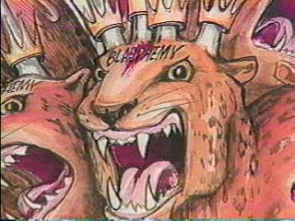
Daniel’s Vision of the Character of the Anti-Christ Daniel 11:36-45

Slide 2
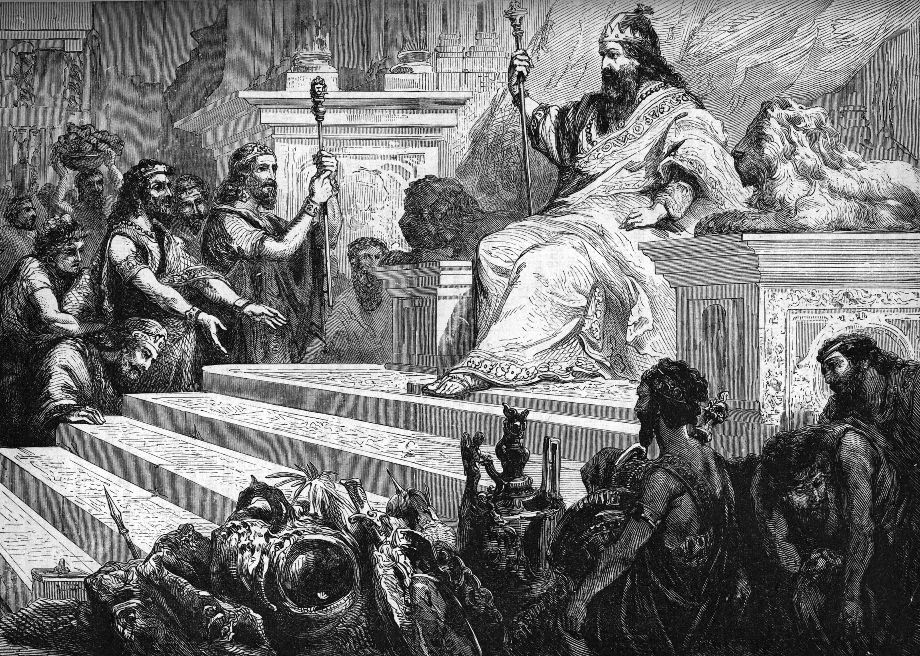
Daniel 10:1-21

Slide 3
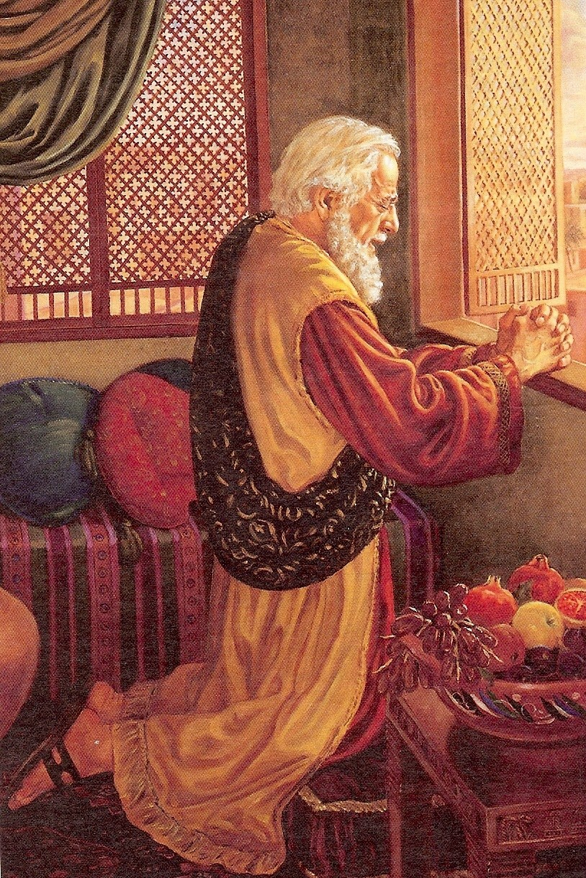

Slide 4
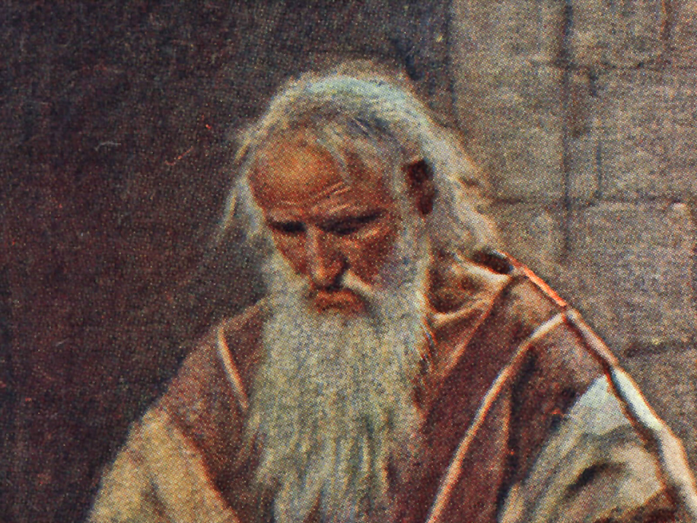

Slide 5
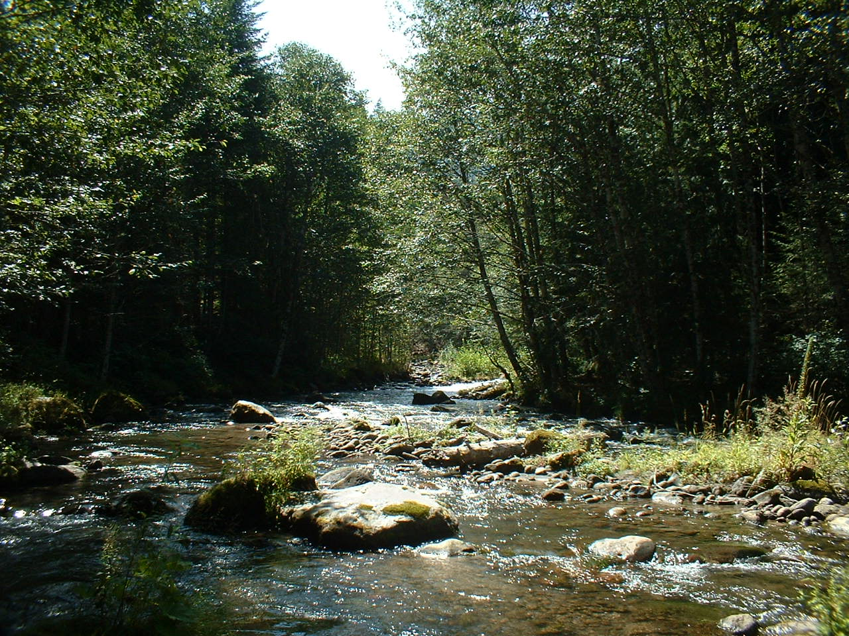
Gabriel (Daniel 8:16, 9:21)

Slide 6
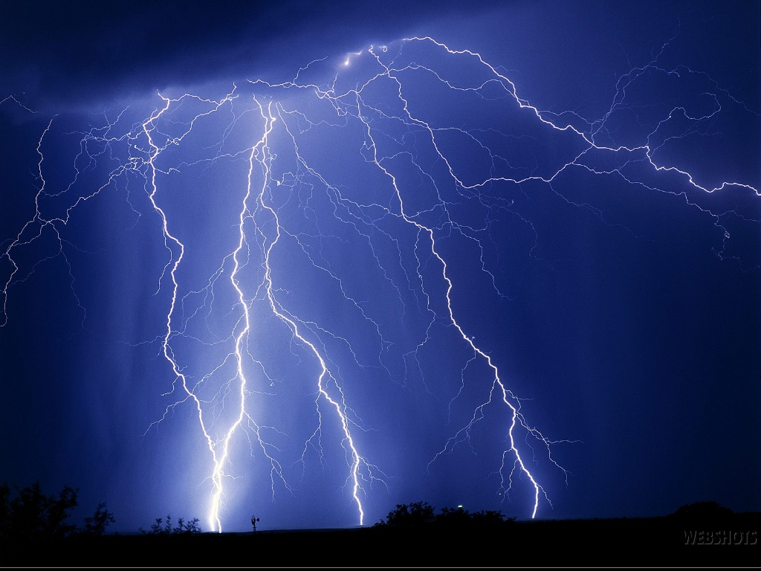
“The voice of his words like the voice of a multitude…a great quaking fell upon them, so that they fled to hide themselves…”

Slide 7
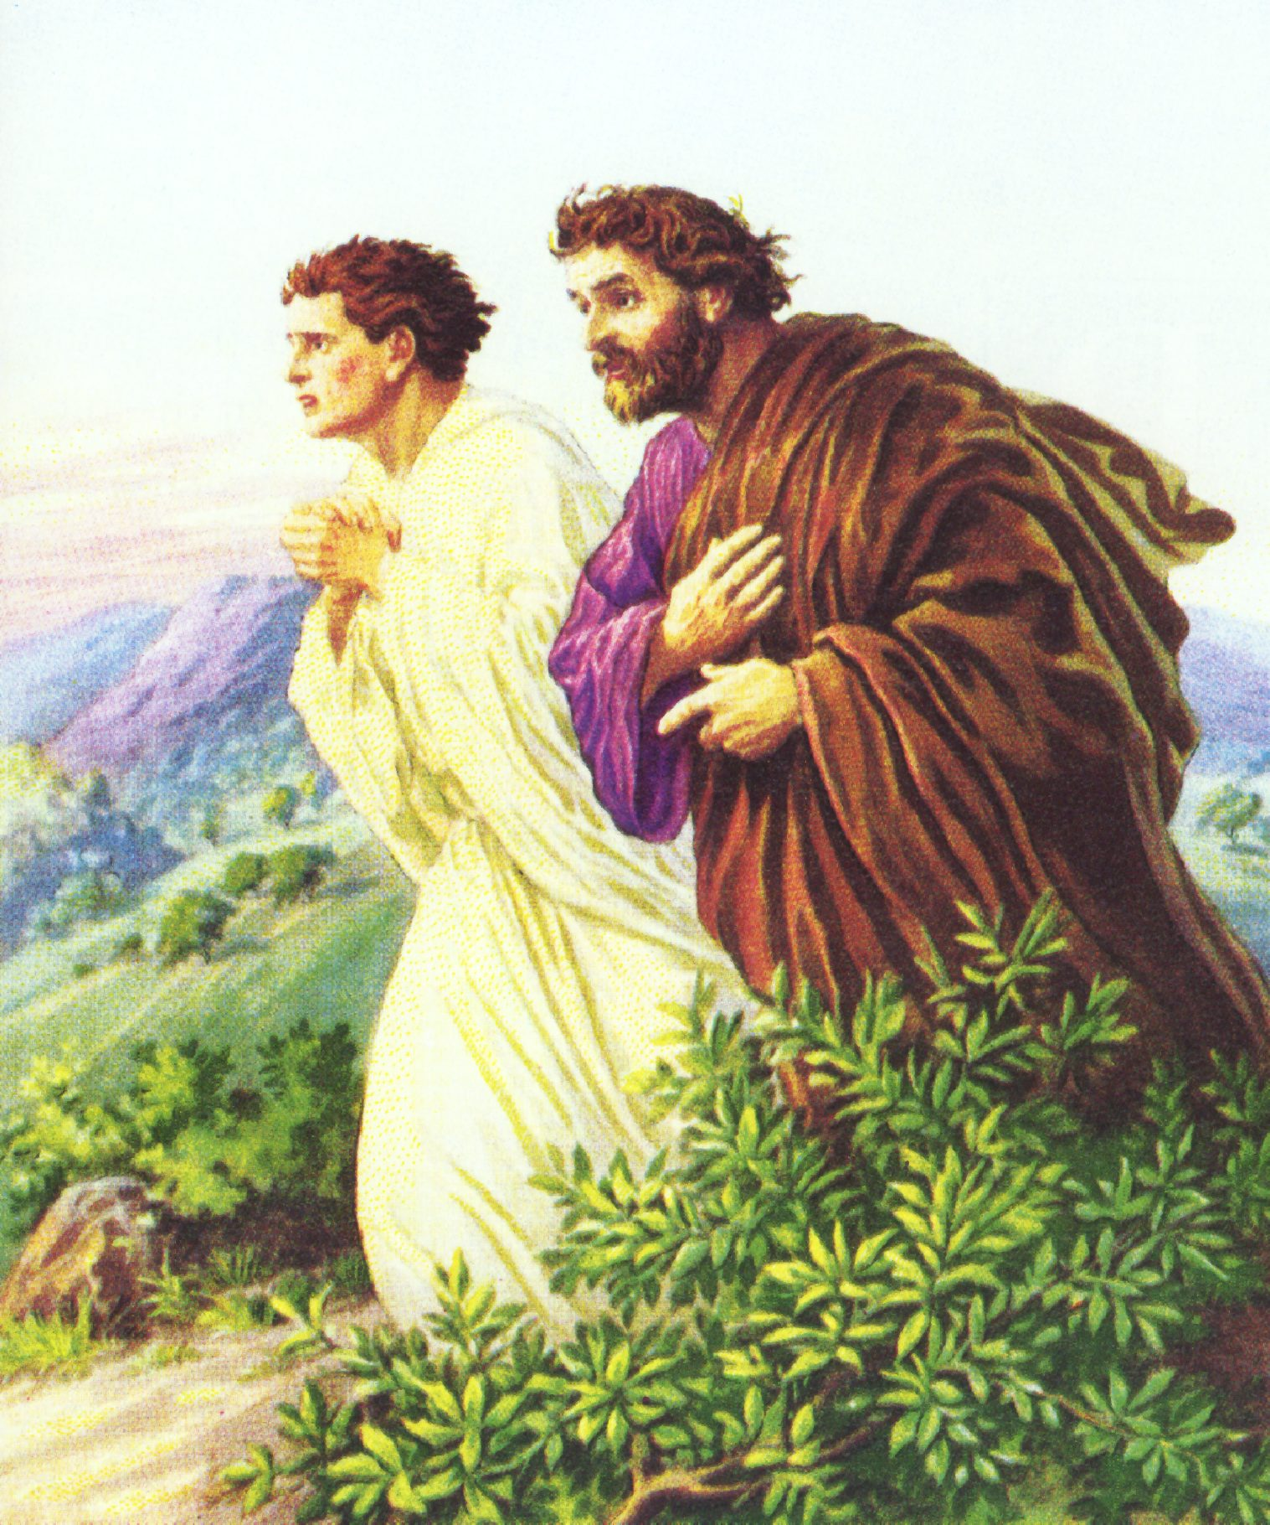

Slide 8
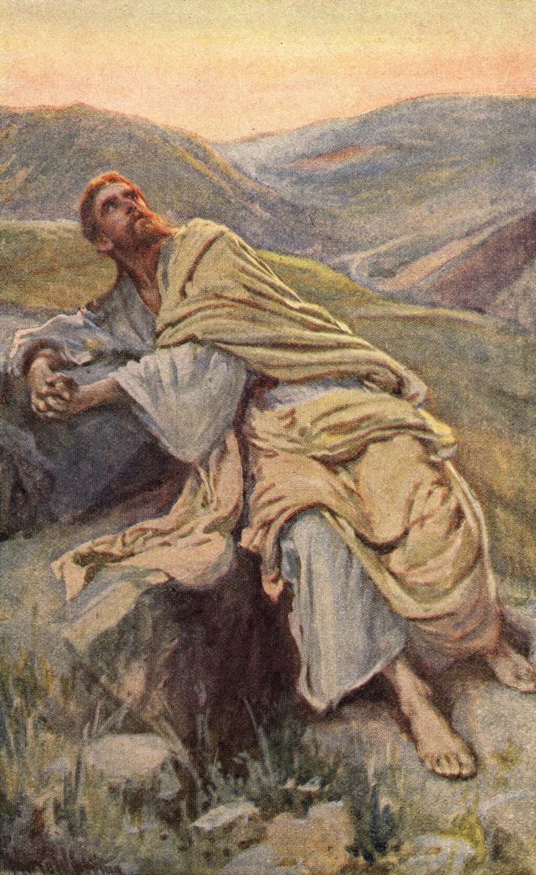

Slide 9
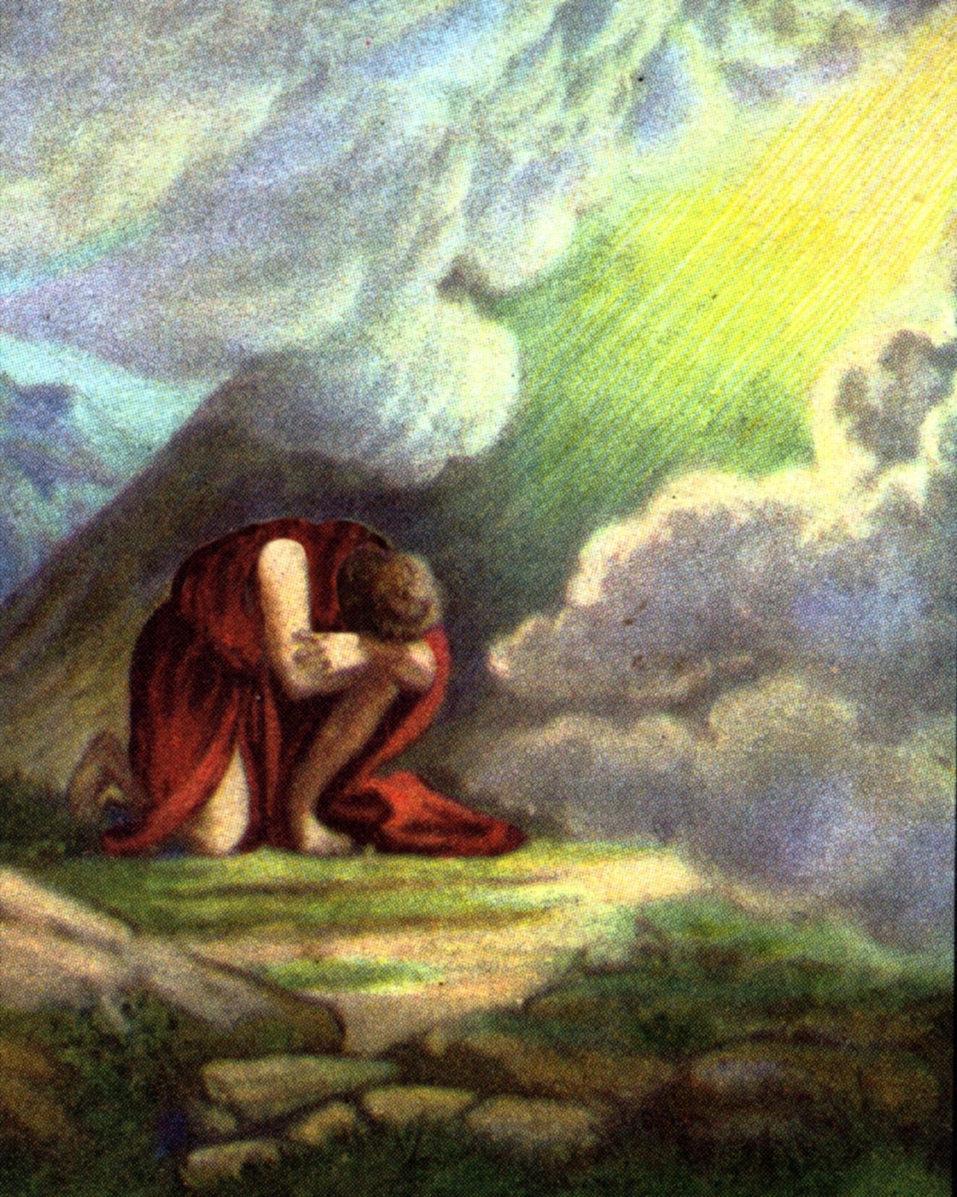

Slide 10
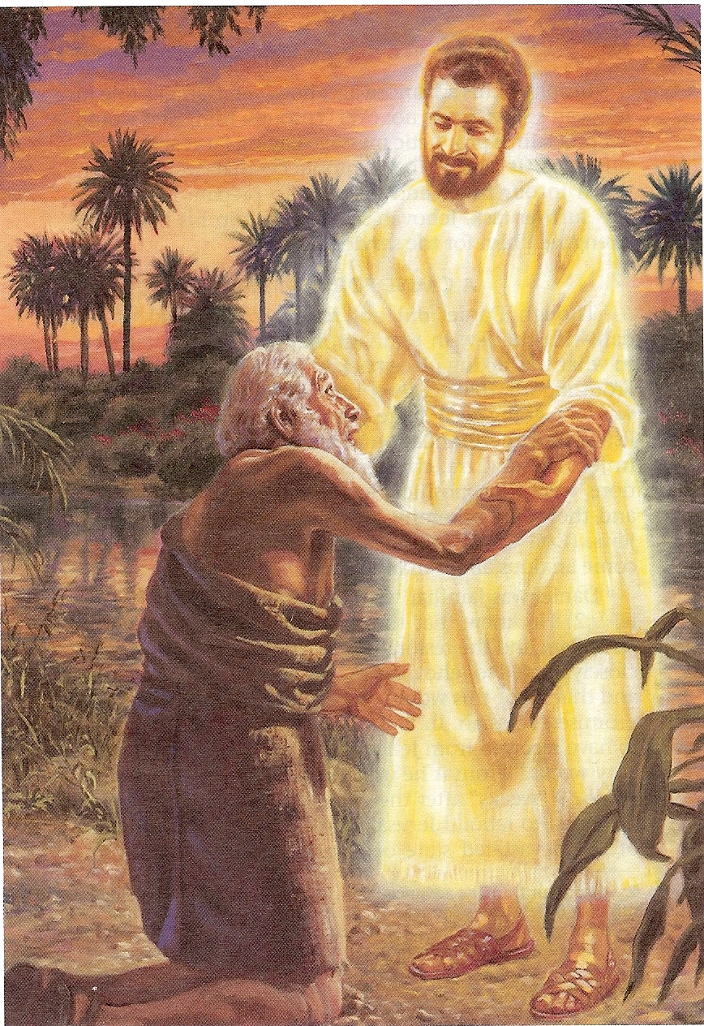

Slide 11
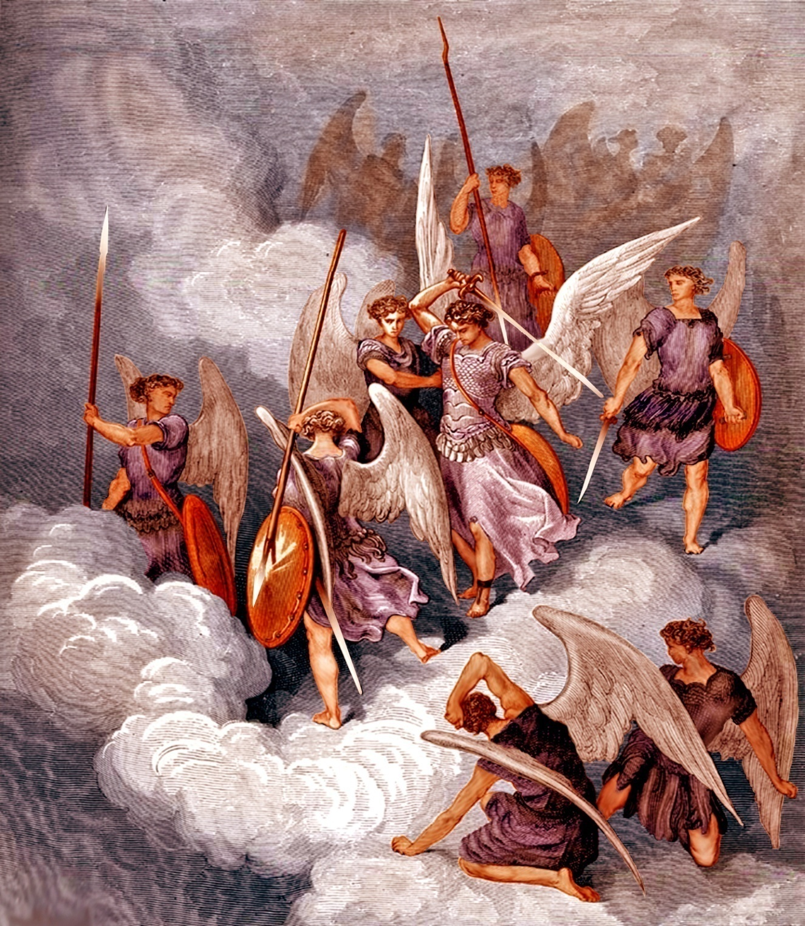

Slide 12
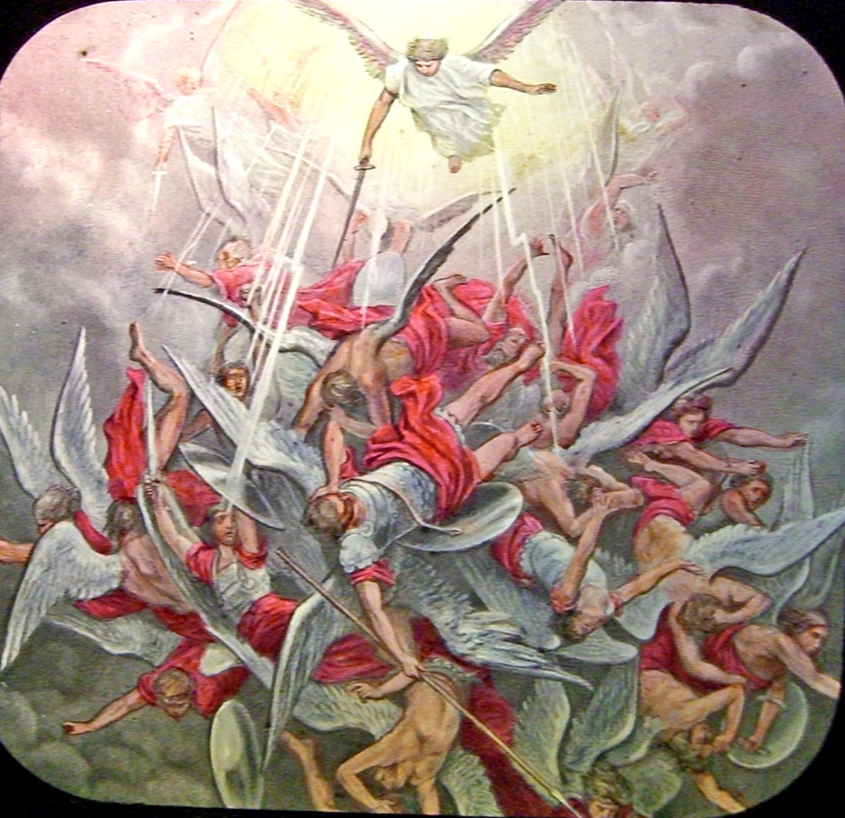

Slide 13
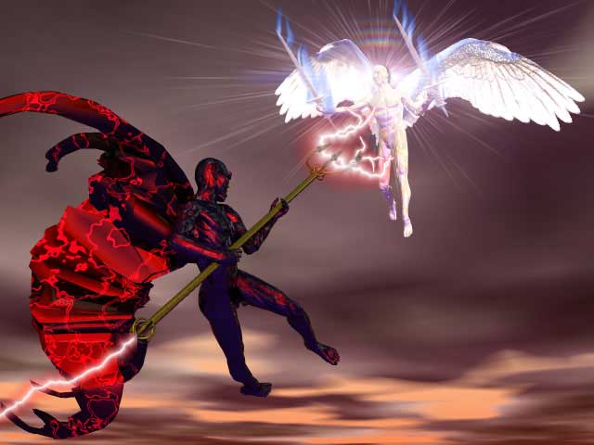
Michael the Archangel
The Prince of the
Kingdom of Persia

Slide 14
Archangels
Meaning = The first or highest (Daniel 10:13, 12:1)
Only two archangels mentioned by name Gabriel (Daniel 8:16) and Michael
(Revelation 12:1)
Lucifer (Satan) is a fallen Archangel - (Isaiah 14; Ezekiel 28)

Slide 15
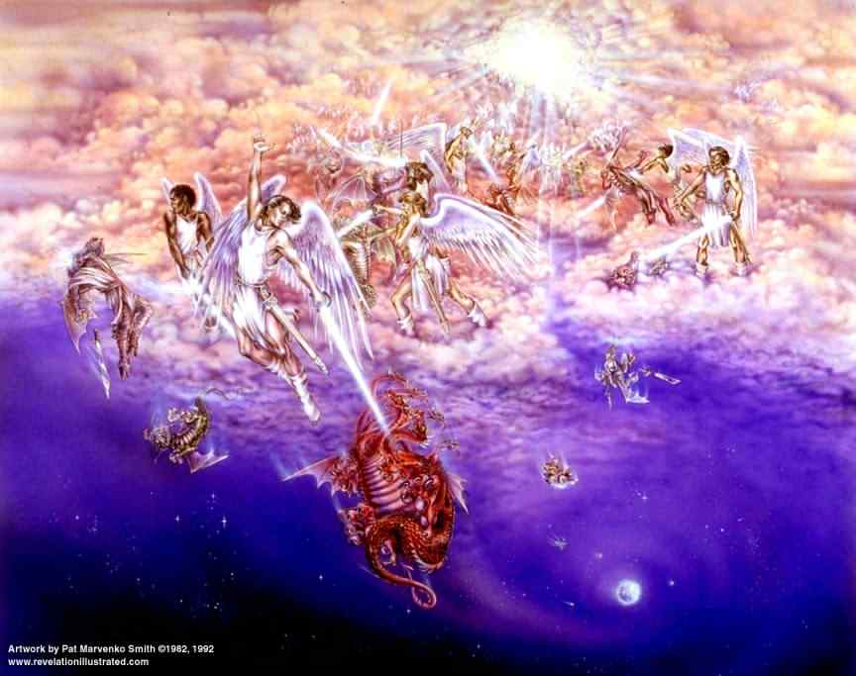
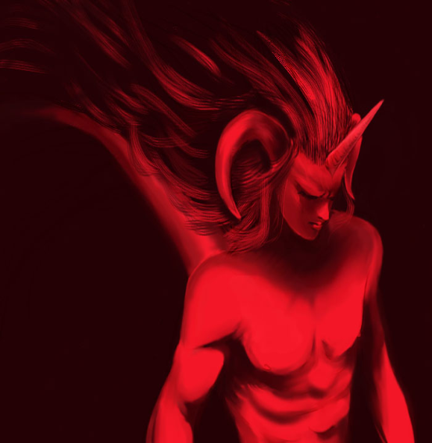

Slide 16
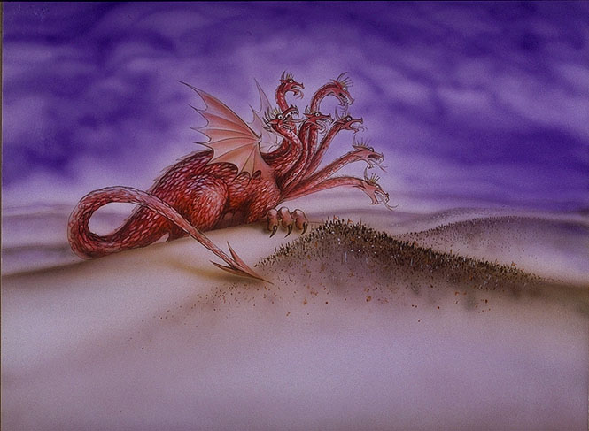
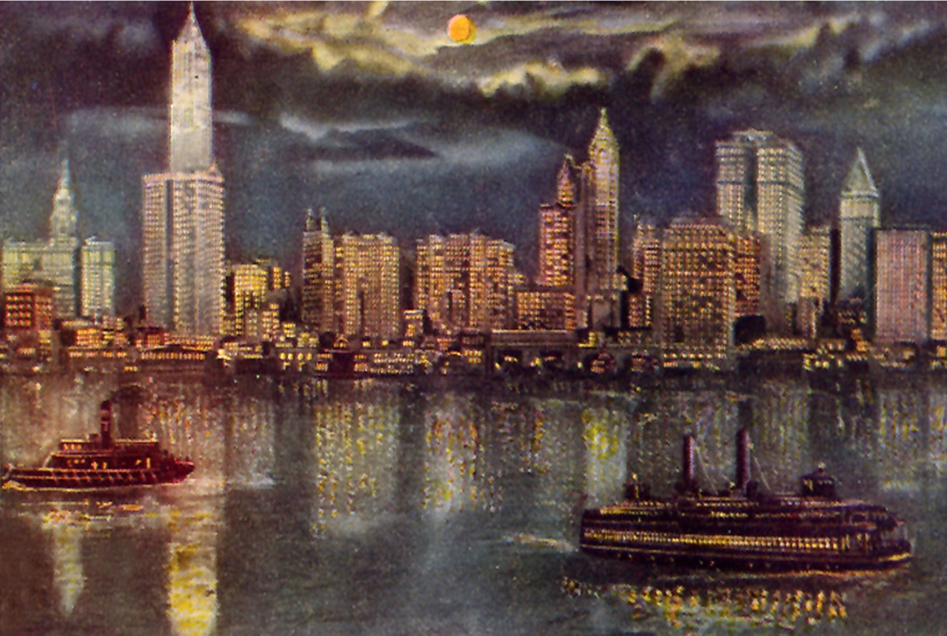
“IN WHOM THE GOD OF THIS WORLD HATH BLINDED THE MINDS OF THEM WHICH BELIEVE NOT.”
“In time past ye walked according to the course of this world, according to the prince of he power of he air, the spirit that now worketh in the children of disobedience.”

Slide 17
“Be strong in the Lord, and in the power of his might. Put on the whole armor of God, that ye may be able to stand against the wiles of the devil. For we wrestle not against flesh and blood, but against principalities, against powers, against the rulers of the darkness of this world…”

Slide 18
“For the weapons of our warfare are not carnal, but mighty through God to the pulling down of strongholds.”

Slide 19
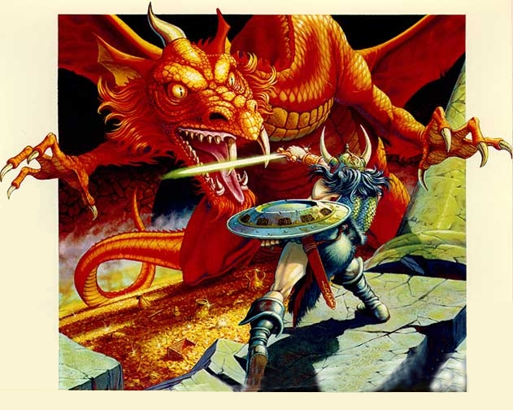

Slide 20
“He touched my lips: then I opened my mouth and spake…”

Slide 21
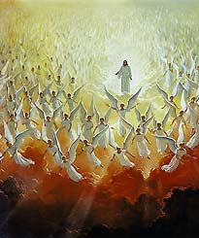
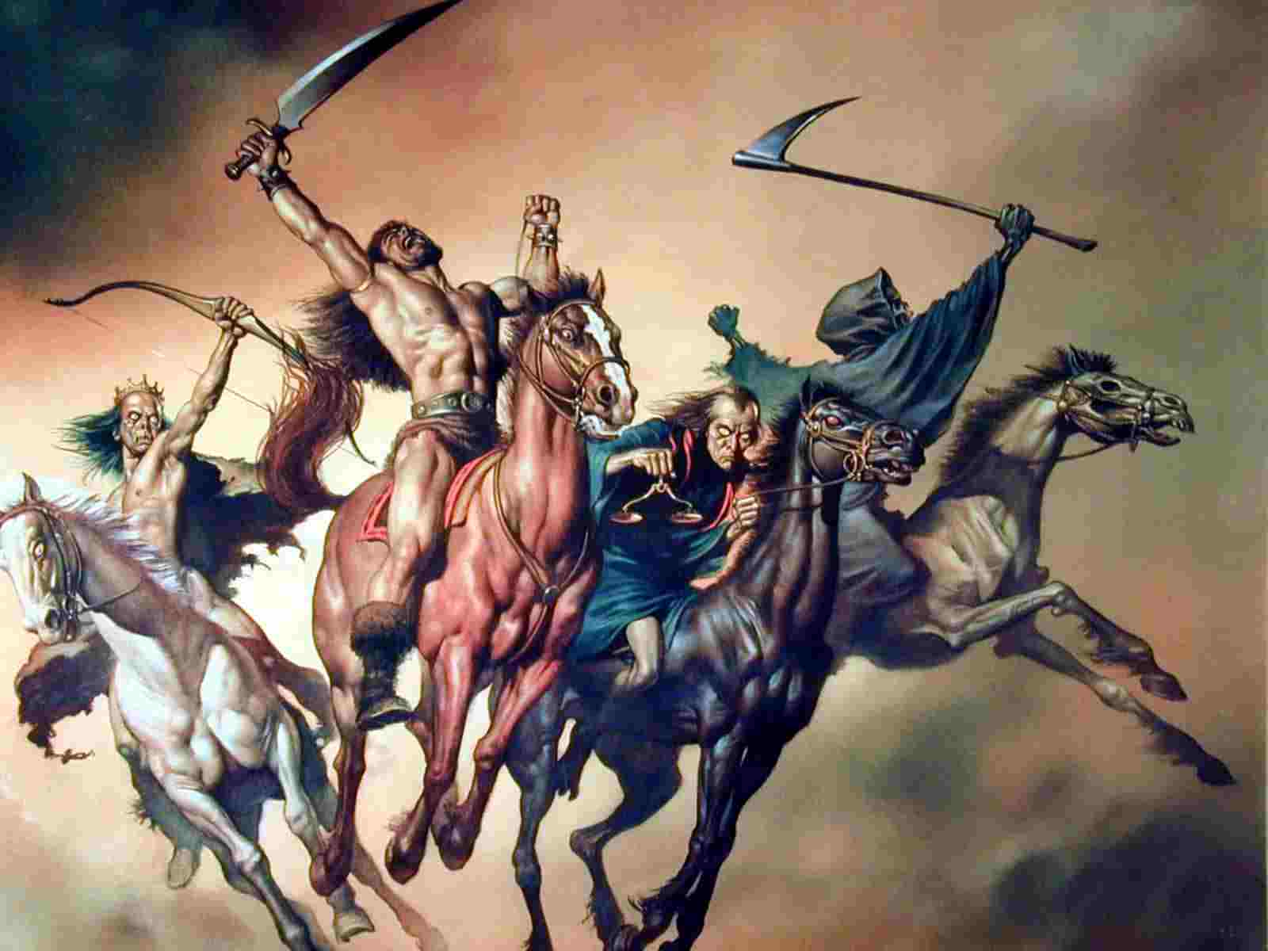
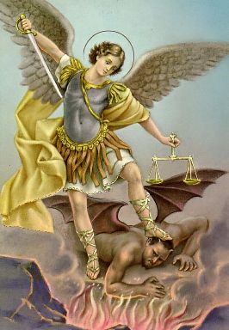
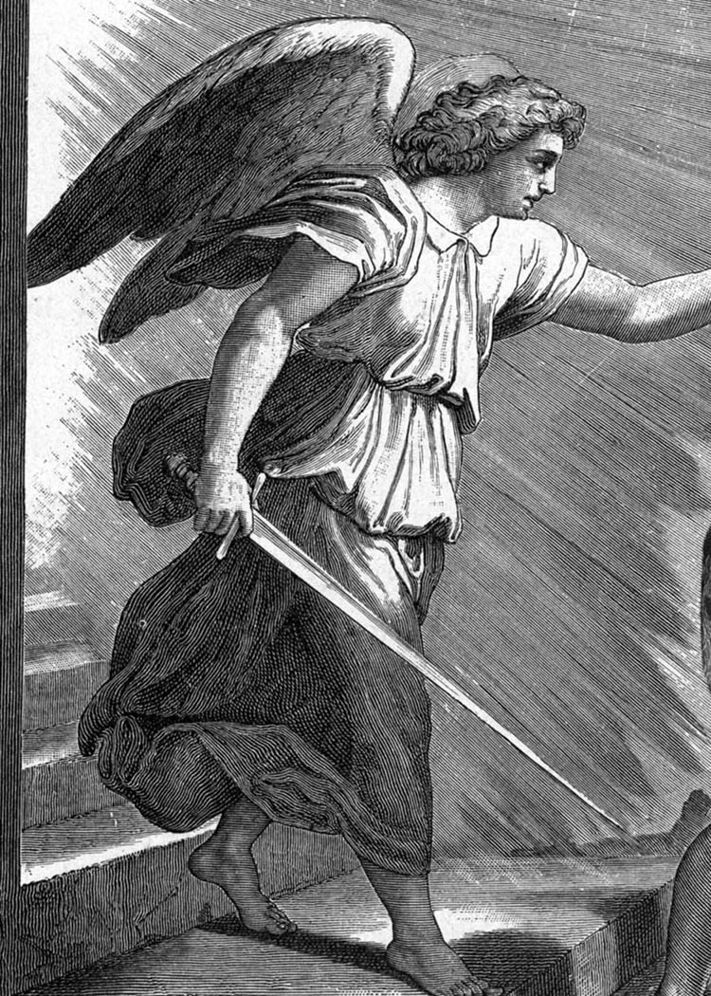
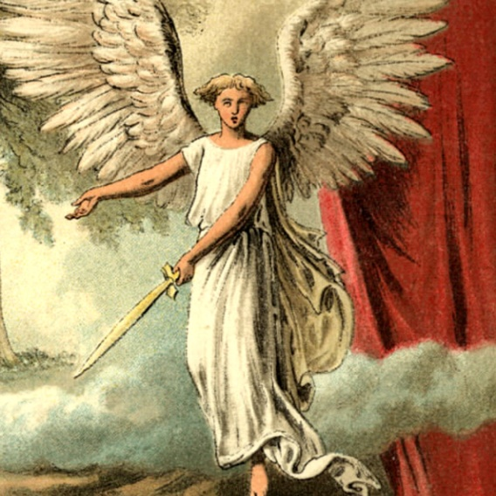

Slide 22
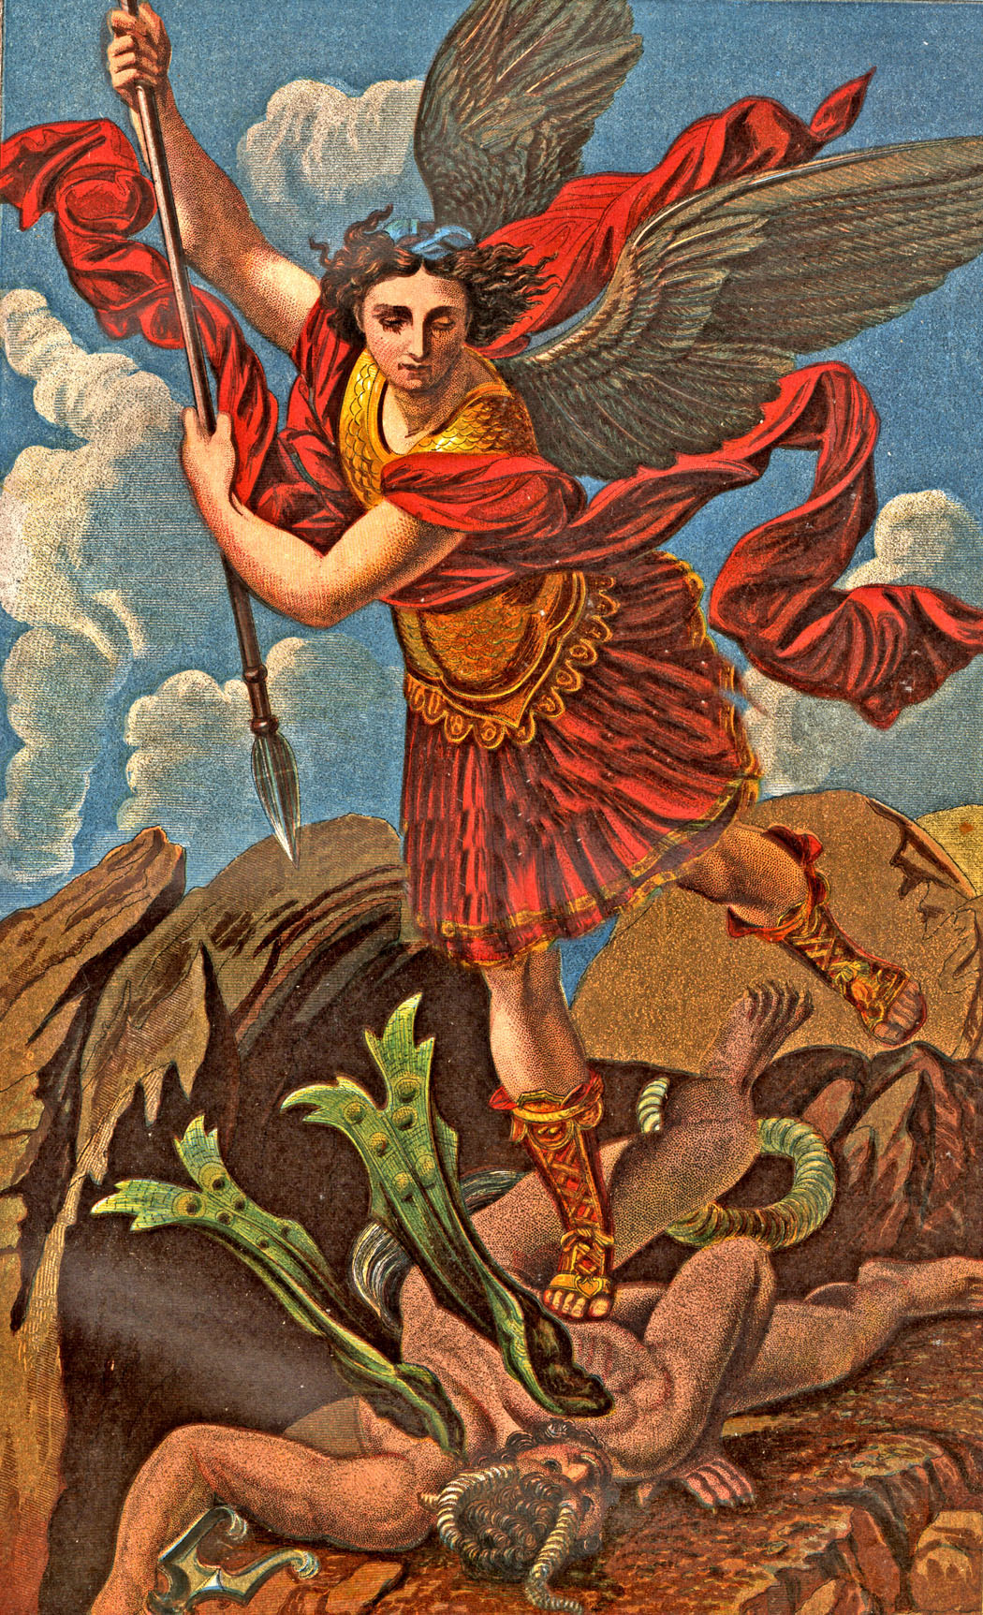
“And there was a war in heaven: Michael and his angels fought against the dragon; and the dragon fought and his angels, and prevailed not…”

Slide 23
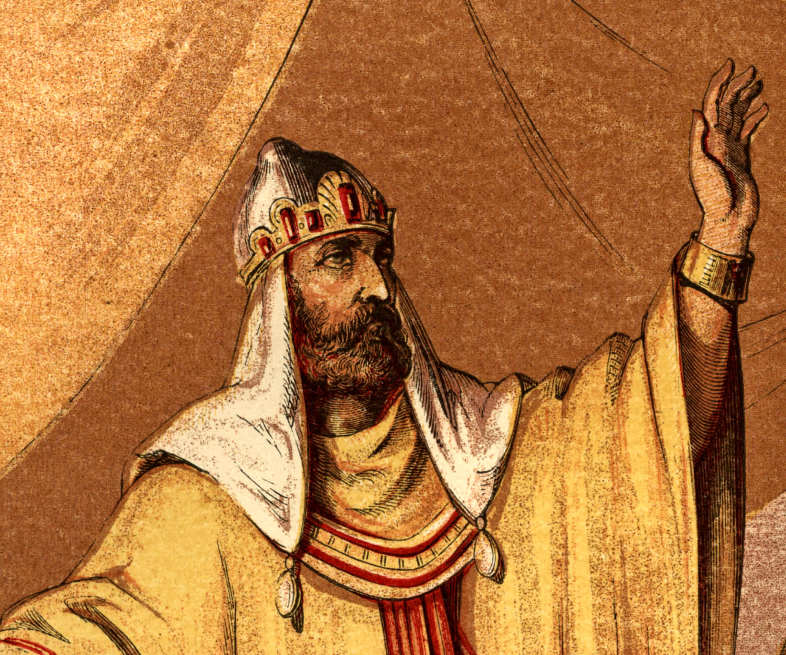
Daniel 11:1

Slide 24
“By me kings reign…by me princes rule, and nobles, even all the judges of the earth…” (Proverbs 8:15-16) “For there is no power but of God: The powers that be are ordained of God…” (Romans 13:1)

Slide 25
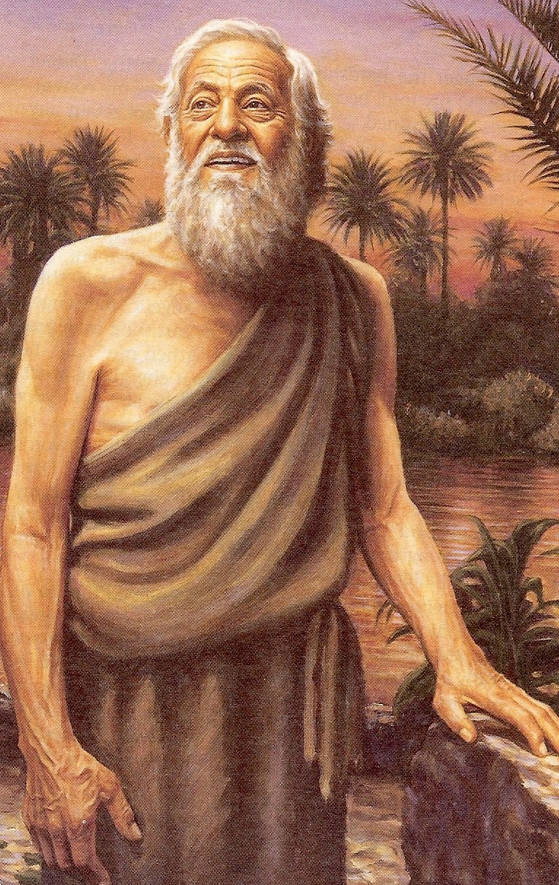
Daniel 11:2-35 Daniel foresees the rise and fall of several world empires prior to the rise and fall of the final world power ruled by the king of fierce countenance - (Anti-Christ)

Slide 26
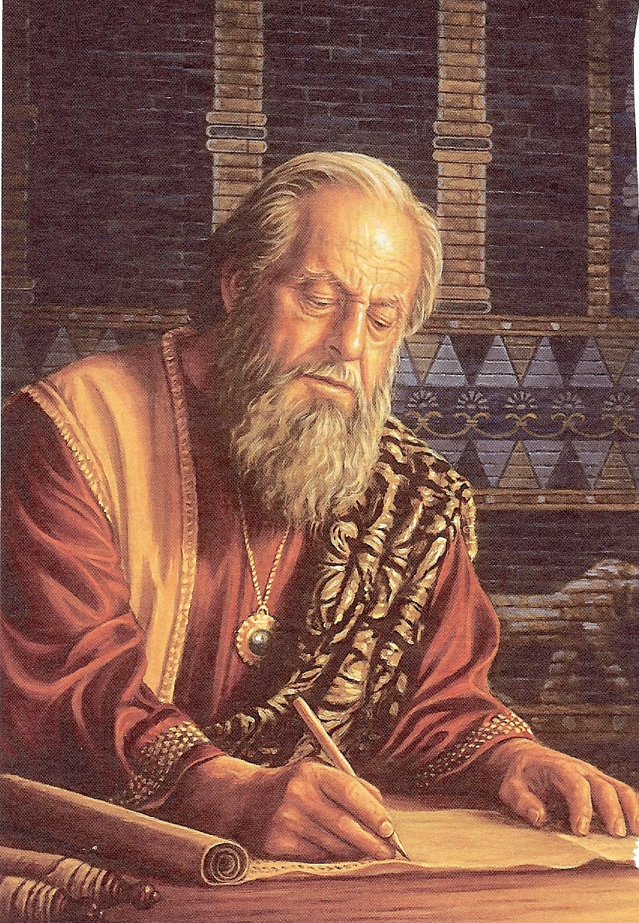
Bible Prophecy History in Advance

Slide 27
Rise and fall of future world empires
Media-Persia empire – Presently ruled by Cyrus
Three more kings were to “stand up yet” (come to power in the Media-Persia empire)
1# Ahasuerus – 529 – 522 B.C.
2# Artaxerxes – 522 – 521 B.C.
3# Darius – 521 – 485 B.C.

Slide 28
4# Xerxes son of Darius – 485 – 465 B.C.
Very rich and powerful – more power and wealth then all the kings before him put together
Built a vast and powerful armies
Sought to expand his kingdom
Stirred up the Persians against the Grecians
480 B.C. invaded Greece but was unsuccessful in conquering it

Slide 29
Prophecy leaps ahead 150 years into the future
Alexander the Great king of Greece – 336 - 323B.C.
In 13 years conquered the known world
After his death his kingdom was divided among his four generals
War breaks out between the kingdoms of the north (Syria) and south (Egypt)
Daniel sees God’s people (Israel) caught in the middle of these wars

Slide 30
Bondage, destruction, persecution and suffering would be imposed upon Israel by the gentile nations
It would be “many days…” before Israel would be a free nation – (1948)
The last world ruler mentioned in Daniel’s vision was -
"Antiochus Epiphanes” (Syrian)

Slide 31
Antiochus Epiphanes Type of the future Anti-Christ
Vile, evil and wicked person
Great politician
Obtains his kingdom through peace and flatteries
Break his covenants (treaties)
Mighty warrior conquering many strongholds
His spoils, wealth and power greatly increase
Pollutes the sanctuary and takes away the daily sacrifice

Slide 32
Takes away the daily sacrifice
Sets himself up as a god to be worshiped – “abomination that maketh desolate…”
God’s people will stand up against him and be strong
He will hate the people of God and “many shall fall by the sword, and by flame, and by captivity…”

Slide 33
The Anti-Christ “The time of the Anti-Christ”
Vision involves the “Latter days” – Daniel 10:14-15
Vision is at the “Time of the end” – Daniel 12:4, 9
Vision takes place during the “Tribulation Period” – Daniel 12:1, 7

Slide 34
The Anti-Christ “The names of the Anti-Christ”
Little horn – Daniel 7:7-8, 8:8-10
False Christ – Matthew 24:24
Man of sin – II Thessalonians 2:3
Son of Perdition – II Thessalonians 2:3
Beast – Revelation 13:1-2
Wicked one – II Thessalonians 2:8
Anti-Christ – I John 2:18

Slide 35
The Anti-Christ “The time of his rule”
Time of trouble – Daniel 12:1
Tribulation – Revelation 6-19
Time of the end – Daniel 12:9 = This is the period of time just before the second coming of Jesus Christ to establish His Millennial Kingdom – Revelation 19-20

Slide 36
The Anti-Christ “His character” (Daniel 8:23-26, 11:36-45)
King (great political leader)
Willful king (forceful dictator)
King of fierce countenance
Highly intelligent
Great in power (authority)
Skillful in battle
Prosperous (wealthy)
Practices (does whatever he wants)

Slide 37
Successful economic policies
Prideful king – “shall exalt himself, and magnify himself above every god…”
Blasphemous king
Greedy king
Honors the god of force
Warfare is high on his priority list
Spends vast amounts of money on his war machine
Appoint s political leaders and divides the land for personal gain

Slide 38
Does not regard the God of his fathers
Does not regard any god
Acknowledges a strange god (Satan)
No desire for women
Anti-Christ and the 10 Nation Federation will be attacked by King of the south (Egypt and African armies) and the King of the north (Russia and other Arab countries)
Anti-Christ will defeat these countries – “He shall enter into the countries, and shall overflow and passover…”

Slide 39
Anti-Christ will seize Palestine – “He shall enter also into the glorious land…”
Many will be overthrown
Israel’s army and air force will be crushed by the Anti-Christ
Large numbers will be killed when Anti-Christ invades
Jewish people will find that their former friend has now become their greatest enemy
Edom, Moab and Ammon will escape (temporally) out of the hand of the Anti-Christ (Jordan)

Slide 40
Anti-Christ will exercise the “Abomination of Desolation”
Anti-Christ continues to conquer towards the south – Egypt, Libya, and Ethiopia (Northeastern Africa)
Anti-Christ will increase in wealth and strength
Anti-Christ goes forth to fight invading armies from the east and north
China and allies from the east attack after the drying up of the Euphrates River

Slide 41
Russia and allies from the north will regroup and attack a second time
Anti-Christ locates his position between the seas in the glorious holy mountain (Seas = Mediterranean Sea and the Dead Sea / Holy mountain = Jerusalem)
Anti-Christ comes to his end at the battle of Armageddon and none shall help him – Revelation 14:14-20, 15:12-16, 17:12-14, 19:11-21

Slide 42
Daniel 7:26-27 “But the judgment shall sit, and they shall take away his dominion, to consume and to destroy it unto the end. And the kingdom and dominion, and greatness of the kingdom under the whole heaven, shall be given to the people of the saints of the most High, whose kingdom is an everlasting kingdom, and all dominions shall served and obey Him.”
Daniel 8:25 “…but he shall be broken without hand…”
Daniel 11:36 “He shall prosper till the indignation be accomplished; for that is determined shall be done…”

Slide 43
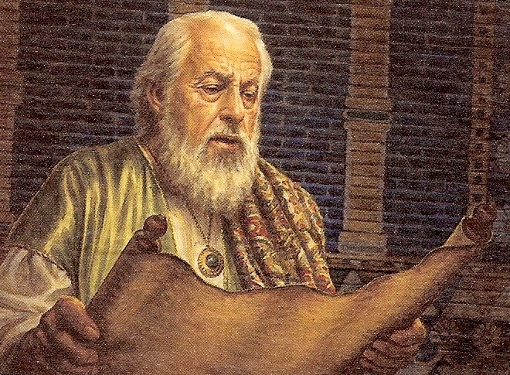
“I will show thee the truth…O Daniel, shut up the words, and seal the book, even to the time of the end…for the words are closed up and sealed till the time of the end.”

Slide 44
