Slide 1
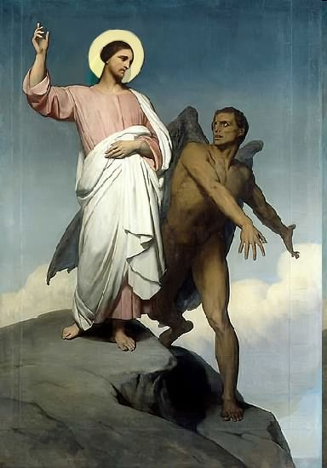

Slide 2
Topics to be studied
His existence
His origin
His fall
His personality
His names
His activities (Part 9)
His location – present and future
Our victory over him

Slide 4
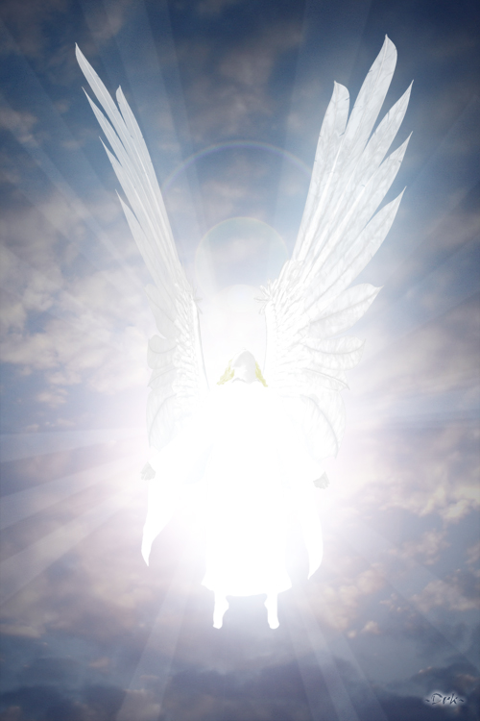
How does Satan imitate God?

Slide 5
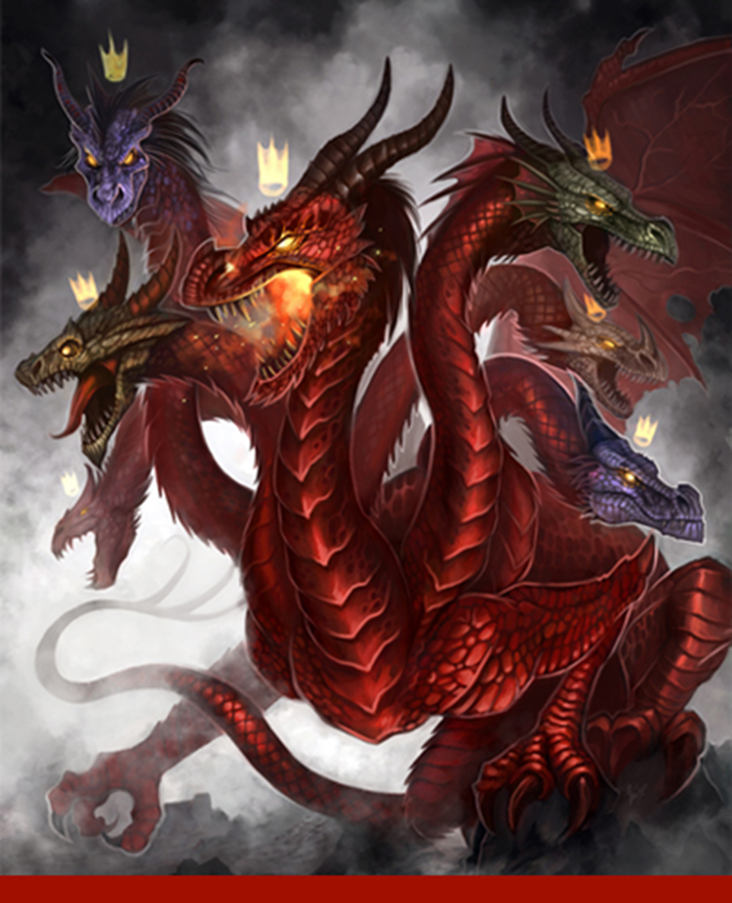
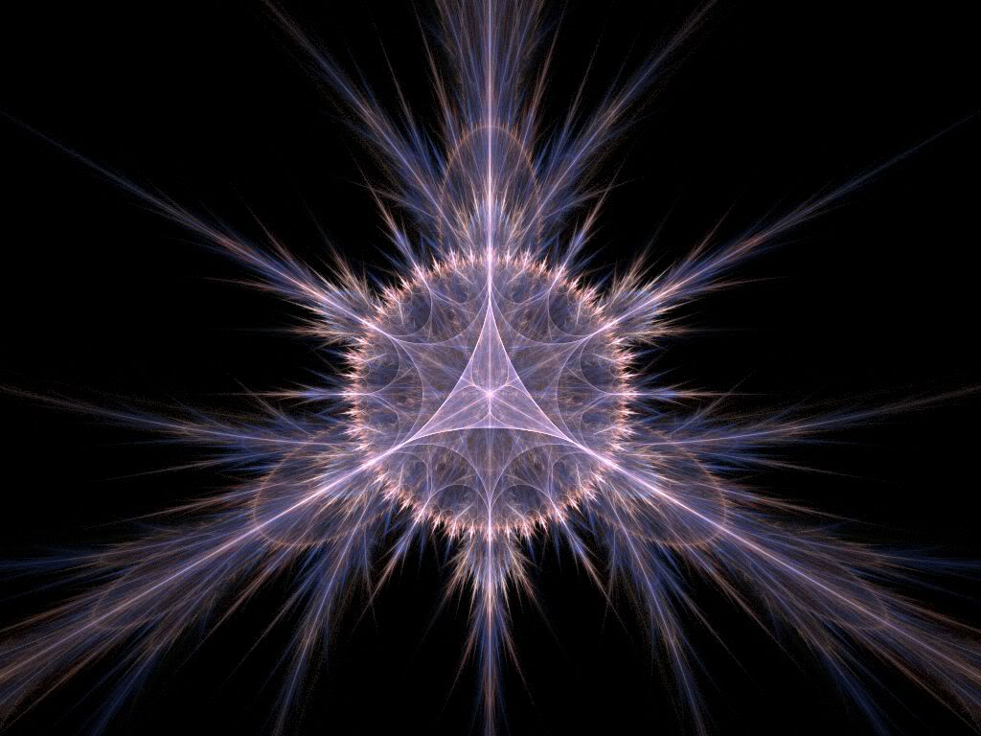
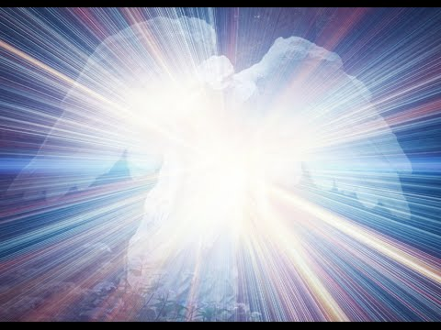
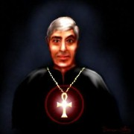
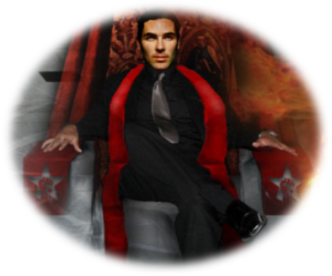
Satan has a false trinity

Slide 6
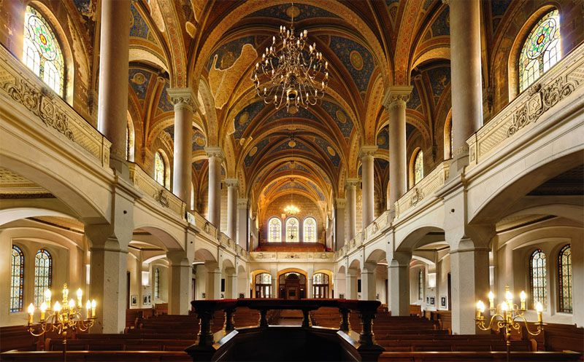
He has his synagogues
"I know thy works, and tribulation, and poverty, (but thou art rich) and I know the blasphemy of them which say they are Jews, and are not,
but are the synagogue of Satan" (Rev. 2:9)

Slide 7
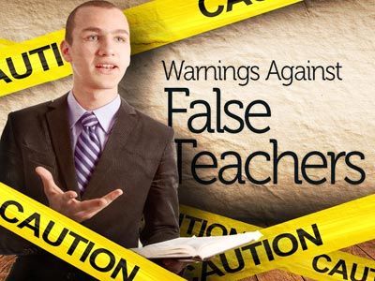
Satan has prophets and teachers
(2 Peter 2:1) “But there were false prophets also among the people, even as there shall be false teachers among you, who privily shall bring in damnable heresies, even denying the Lord that bought them, and bring upon themselves swift destruction.”

Slide 8
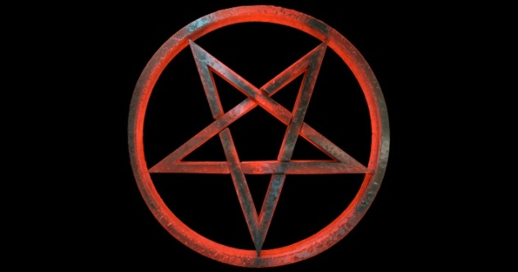
Satan has his doctrines
"Now the Spirit speaketh expressly, that in the latter times some shall depart from the faith, giving heed to seducing spirits, and doctrines of devils"
(1 Tim. 4:1)

Slide 9
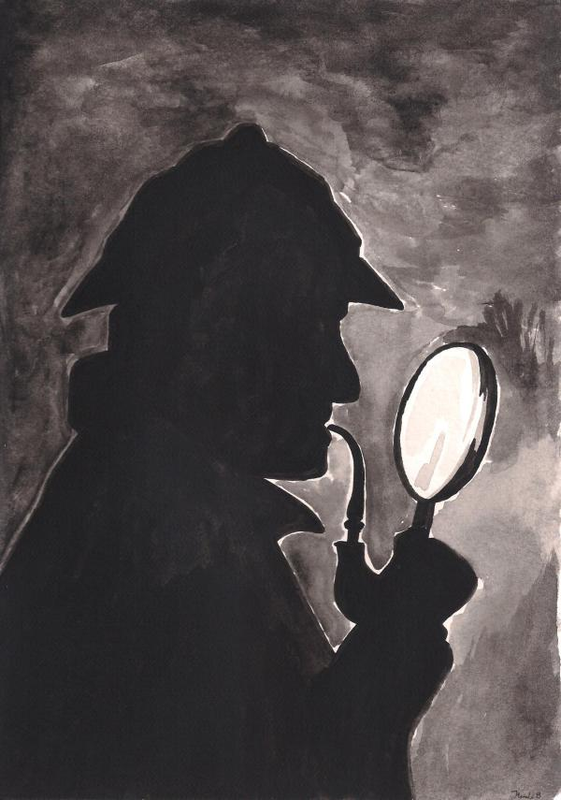
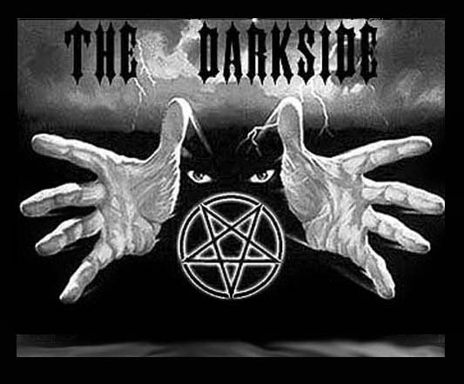
Satan has his mysteries
"For the mystery of iniquity doth already work: only he who now letteth will let, until he be taken out of the way.”
(2 Thess. 2:7)

Slide 10
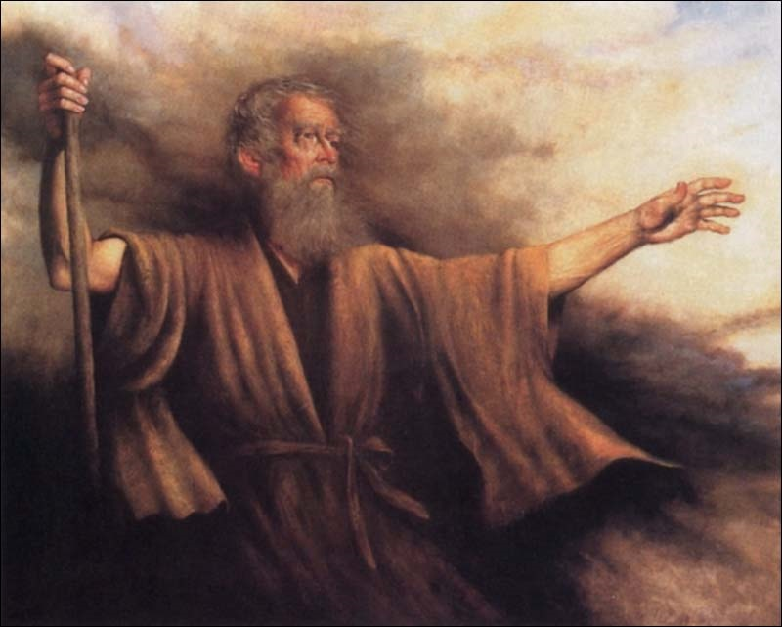
Biblical Warning Concerning Occult Involvement (Deuteronomy 18:9-13)
“When thou art come into the land which the LORD thy God giveth thee, thou shalt not learn to do after the abominations of those nations. There shall not be found among you any one that…For all that do these things are an abomination unto the LORD: and because of these abominations the LORD thy God doth drive them out from before thee. Thou shalt be perfect with the LORD thy God.”

Slide 11
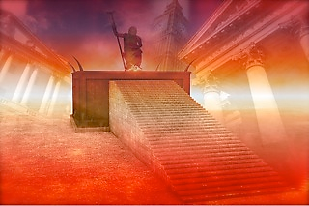
Satan has a throne
"I know thy works, and where thou dwellest, even where Satan’s seat is: and thou holdest fast my name, and hast not denied my faith, even in those days wherein Antipas was my faithful martyr, who was slain among you, where Satan dwelleth." (Rev. 2:13)

Slide 12
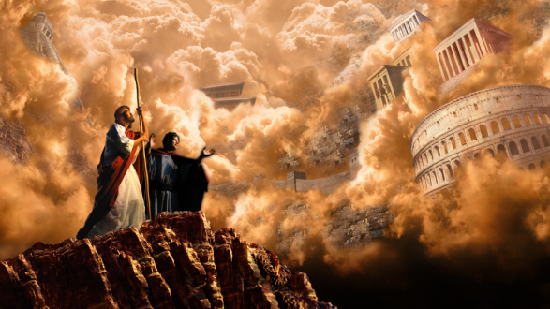
Satan has his kingdoms

Slide 13
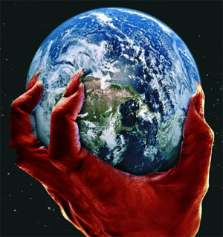
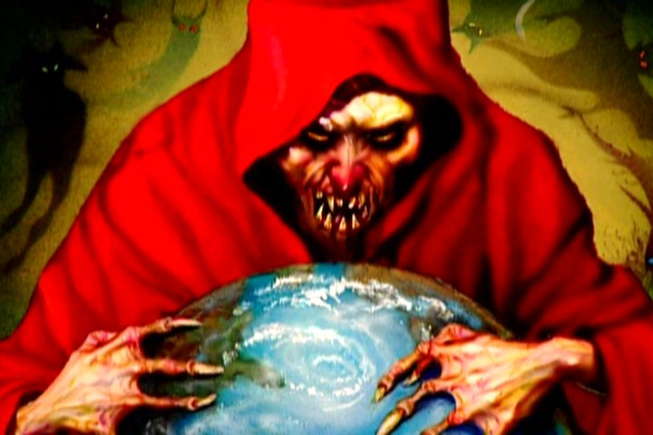
II Cor. 4:4 “In whom the god of this world hath blinded the minds of them which believe not, lest the light of the glorious gospel of Christ, who is the image of God, should shine unto them.”
Eph 2:2 “Wherein in time past ye walked according to the course of this world, according to the prince of the power of the air, the spirit that now worketh in the children of disobedience.”
John 14:30 “Hereafter I will not talk much with you: for the prince of this world cometh, and hath nothing in me.”

Slide 14
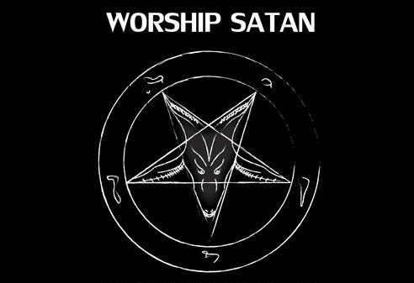
Satan desires Worship

Slide 15
“All these things will I give thee, if thou wilt fall down and worship me.”

Slide 16
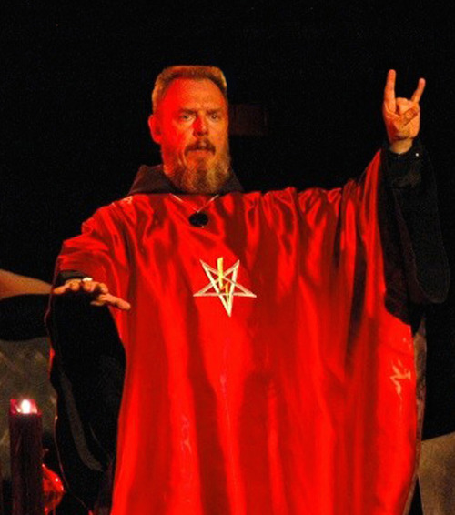
Satan has his worshipers

Slide 17
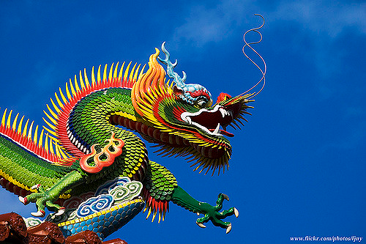
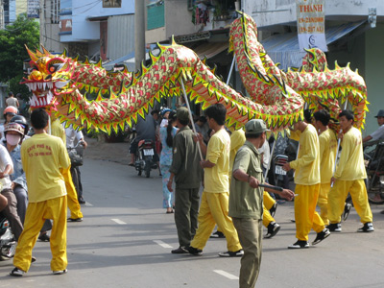
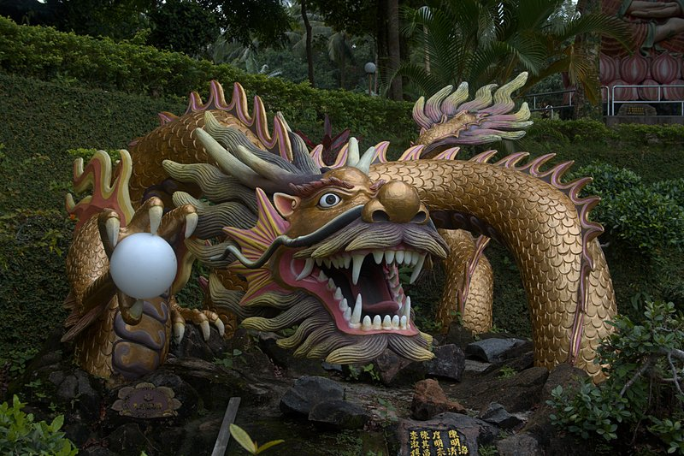
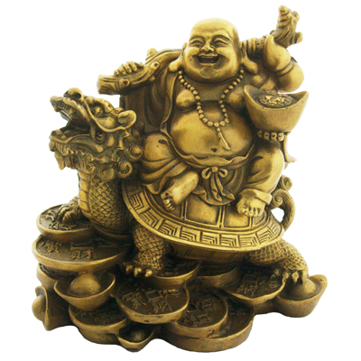
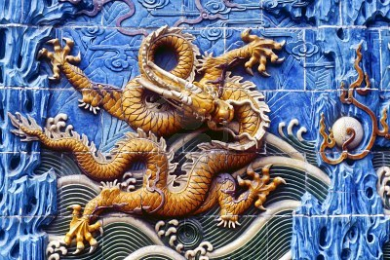
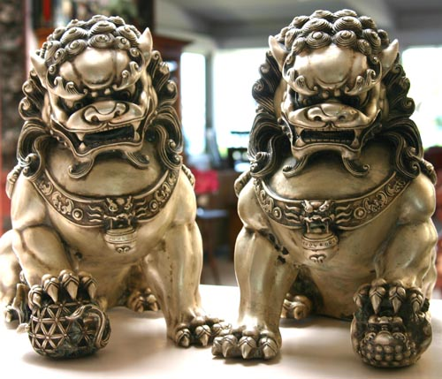
"And they worshipped the dragon which gave power unto the beast: and they worshipped the beast, saying, Who is like unto the beast? who is able to make war with him?" (Rev. 13:4)

Slide 18
Satan has Ministers

Slide 19
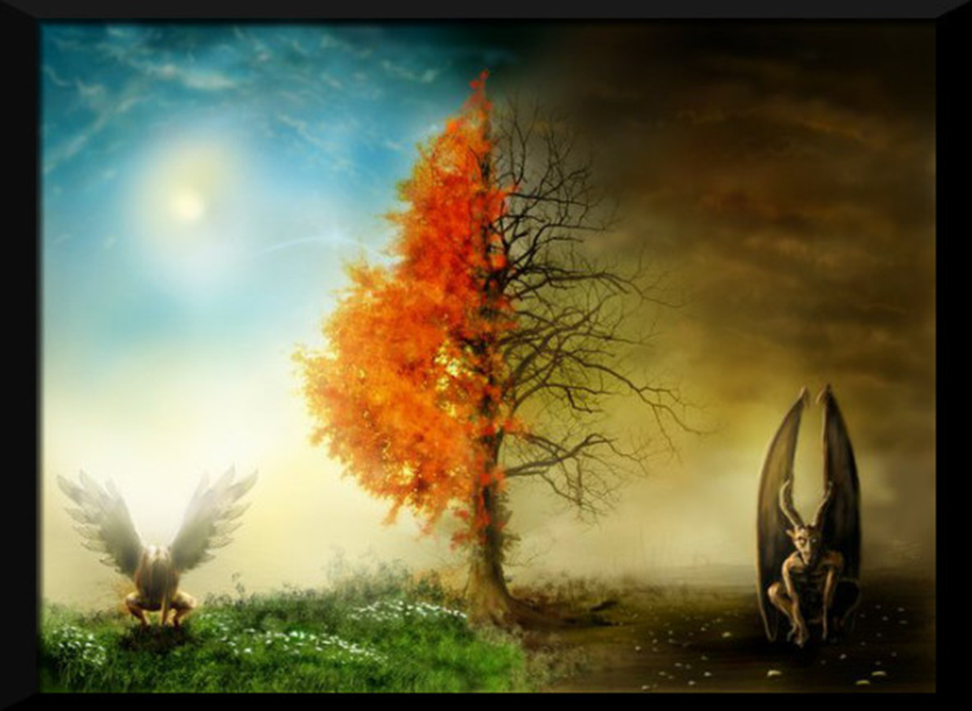
Angel of Light
Ruler of Darkness

Slide 20
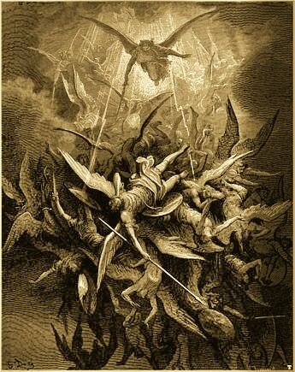
Satan has his angels
"And there was war in heaven: Michael and his angels fought against the dragon; and the dragon fought and his angels." (Rev. 12:7)

Slide 21
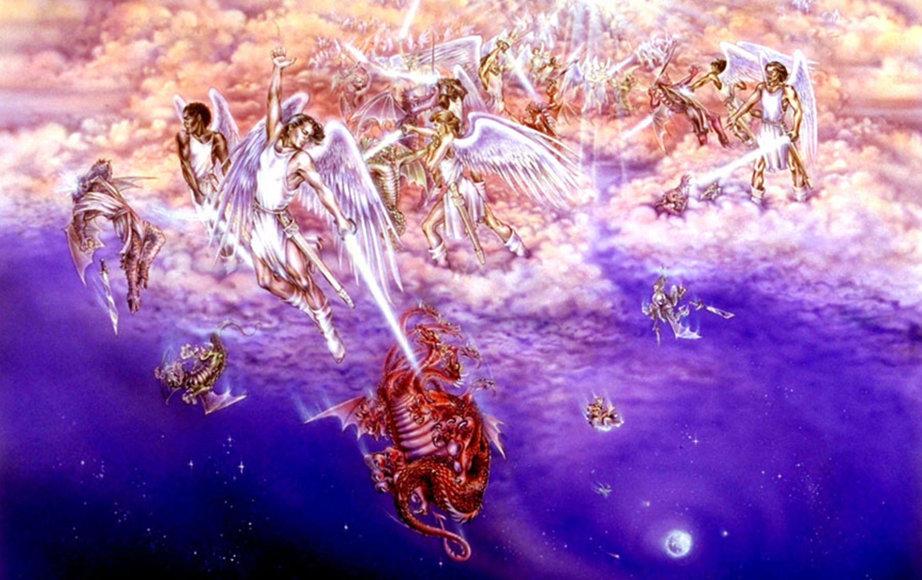
“Tail drew a third part of the stars of heaven, and did cast them to the earth…”

Slide 22
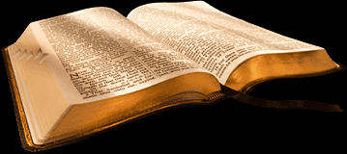
Satan and his miracles
(Matthew 24:24)
“For there shall arise false Christs, and false prophets, and shall shew great signs and wonders; insomuch that, if it were possible, they shall deceive the very elect.”
(1 John 4:1)
“Beloved, believe not every spirit, but try the spirits whether they are of God: because many false prophets are gone out into the world.”

Slide 23
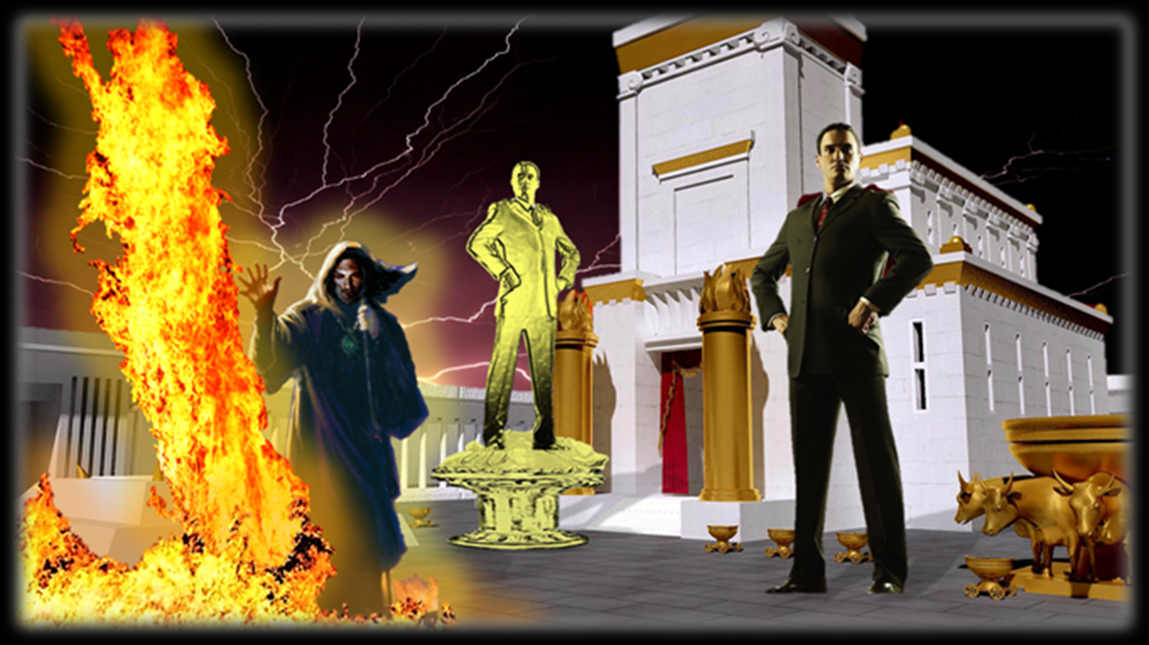
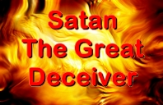

Slide 25
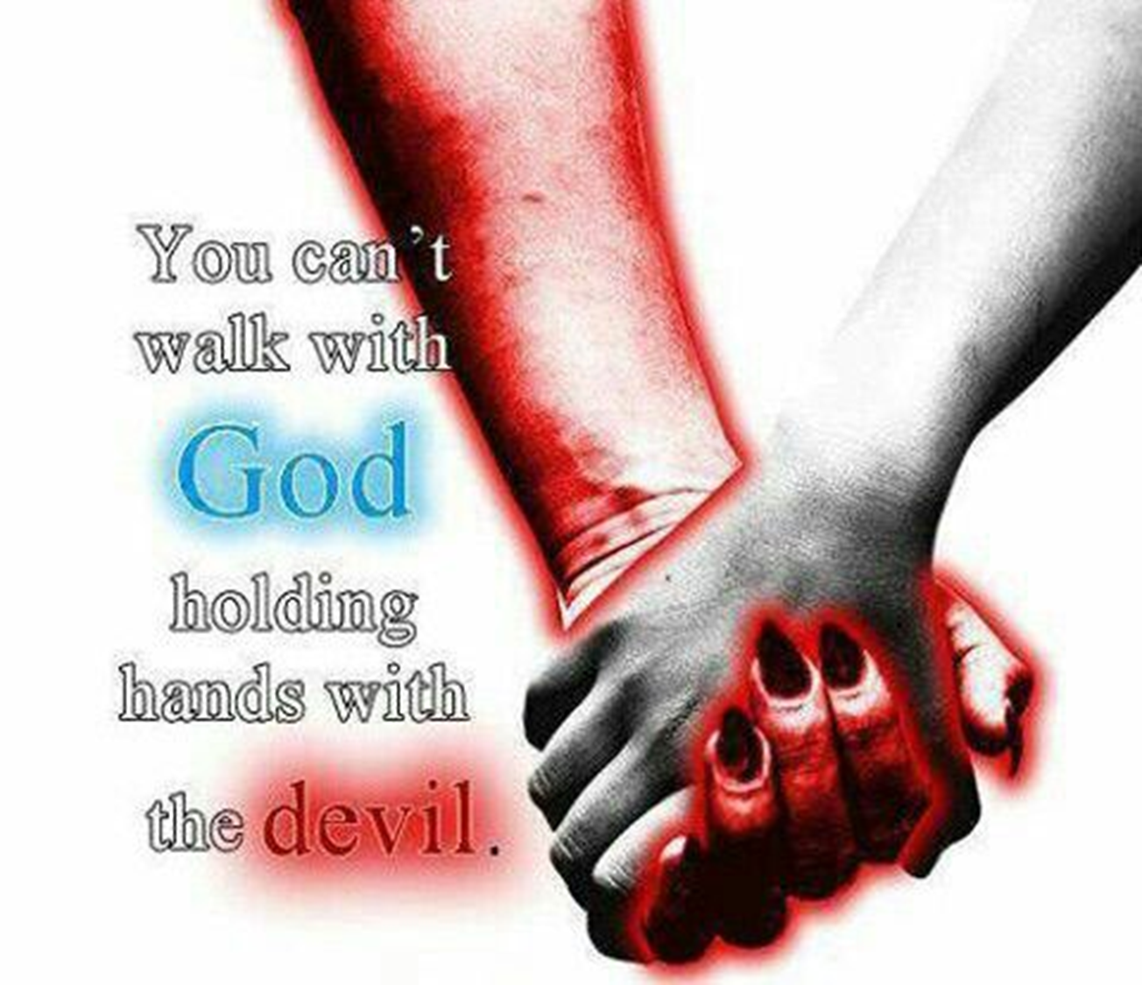
Satan has his fellowships

Slide 26
Can a Christian Fellowship with the Devil?
"But I say, that the things which the Gentiles sacrifice, they sacrifice to devils, and not to God: and I would not that ye should have fellowship with devils." (1 Cor. 10:20)
“And have no fellowship with the unfruitful works of darkness, but rather reprove them.” (Eph. 5:11)
“Neither give place to the devil.” (Eph. 4:27)

Slide 27
1 John1:6 “If we say that we have fellowship with him, and walk in darkness, we lie, and do not the truth.” 2 Cor. 6:14 “Be ye not unequally yoked together with unbelievers: for what fellowship hath righteousness with unrighteousness? and what communion hath light with darkness?” 1 Cor. 10:21 “Ye cannot drink the cup of the Lord, and the cup of devils: ye cannot be partakers of the Lord's table, and of the table of devils.”

Slide 28
How does a Christian fellowship with Devils? “Shall the throne of iniquity have fellowship with thee.” (Psalm 94:20)
Worldly sinful life-style
Worldly mindness
Worldly activities
Carnal life
Immoral involvements
Carnal music
Covetousness
Evil thoughts
Profanity
Selfishness
Self-centered
Unequal yoke with unbelievers
Drunkenness
Gossip/Slander
Evil reports
Rebellion
Strife
Effeminate

Slide 29
Disobedient to parents
Disobedient to authority
Disrespectful
Sexual immorality
Ungrateful
Complaining
Condemning
Critical
Judgmental
Murmuring
Envious
Jealously
Deceitful
Filthy conversation
Dishonest
Lying
Stealing
Hatred
Anger
Bitterness
Pride
Arrogance
Boasting
Unfaithfulness
Unloving
Division/Disunity
Idolatry
Involvement in the occult

Slide 31
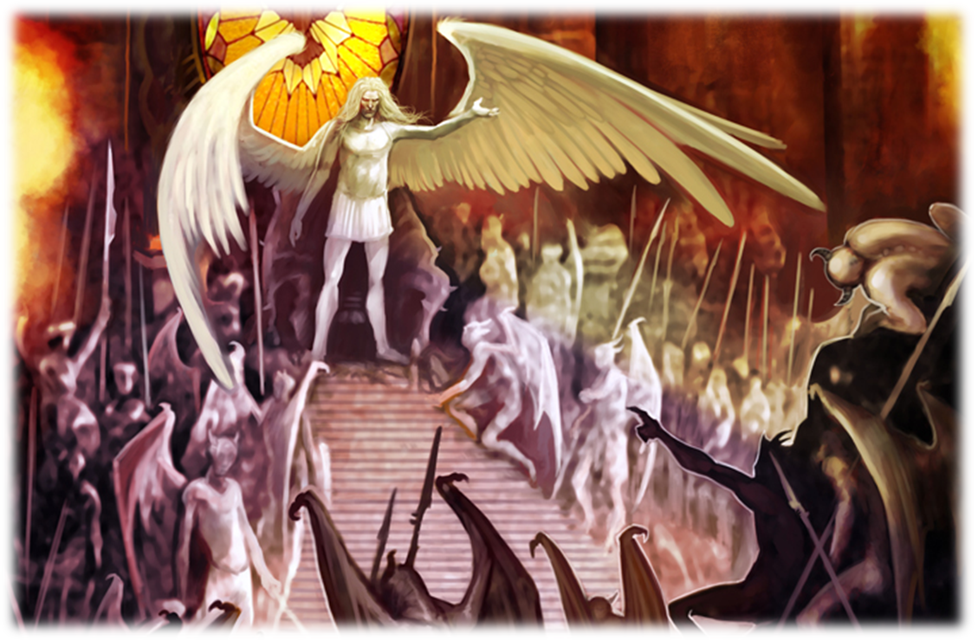
Satan has an army

Slide 32
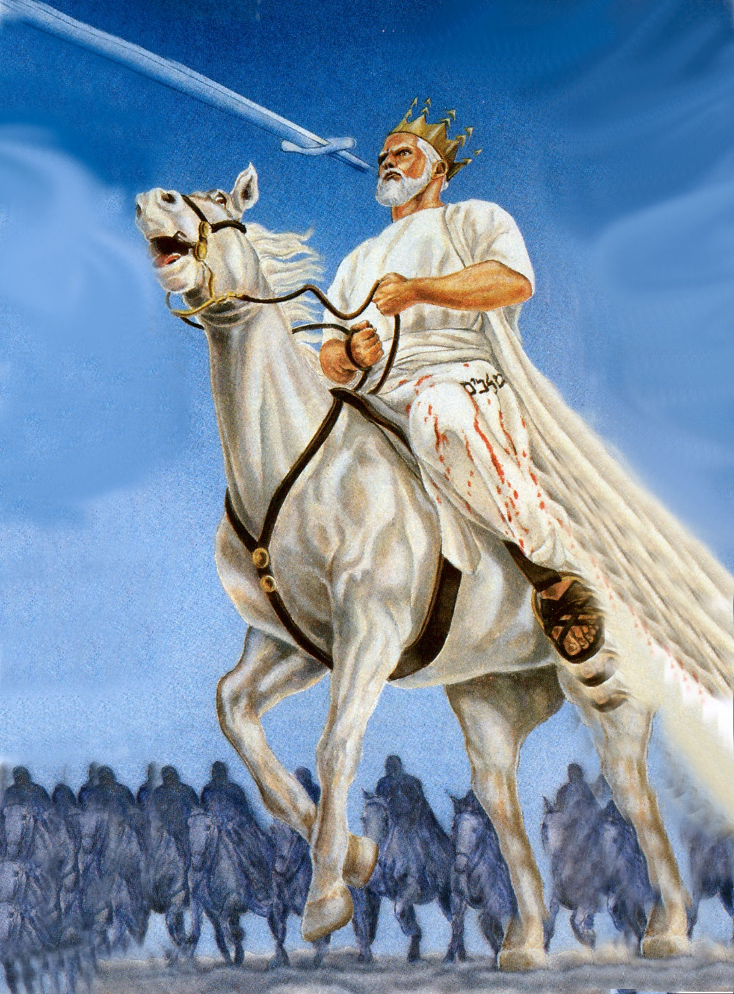
“And he was clothed with a vesture dipped in blood: and his name is called The Word of God.” (Rev. 19:13)

Slide 33
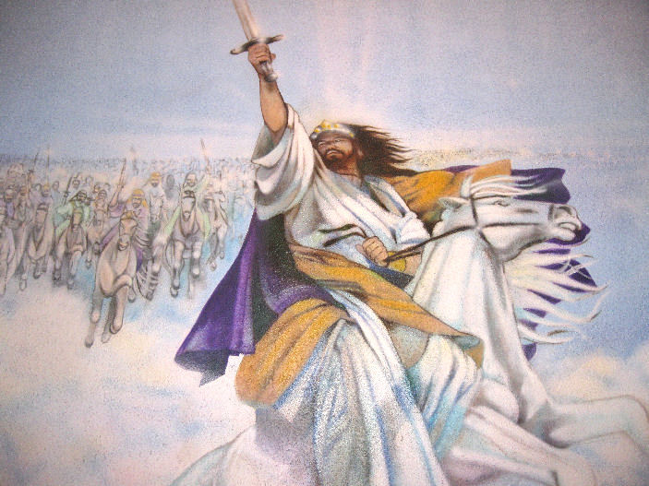
“And the armies which were in heaven followed him upon white horses, clothed in fine linen, white and clean. And out of his mouth goeth a sharp sword, that with it he should smite the nations: and he shall rule them with a rod of iron: and he treadeth the winepress of the fierceness and wrath of Almighty God.” (Revelation 19:14-15)

Slide 34
“Tail drew a third part of the stars of heaven…”

Slide 35
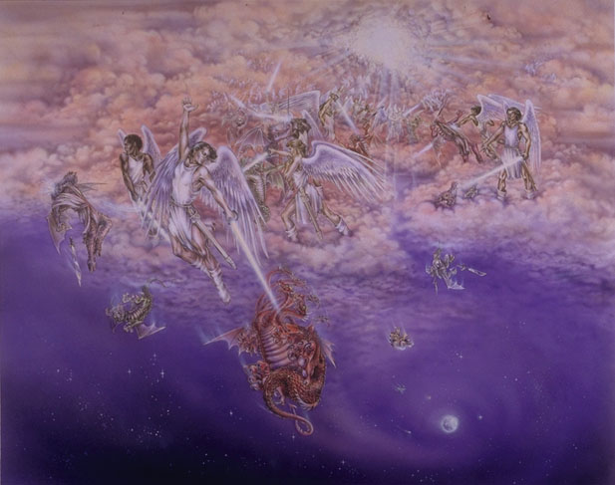
“And there was war in heaven: Michael and his angels fought against the dragon; and the dragon fought and his angels, And prevailed not; neither was their place found any more in heaven. And the great dragon was cast out, that old serpent, called the Devil, and Satan, which deceiveth the whole world: he was cast out into the earth, and his angels were cast out with him.”

Slide 36
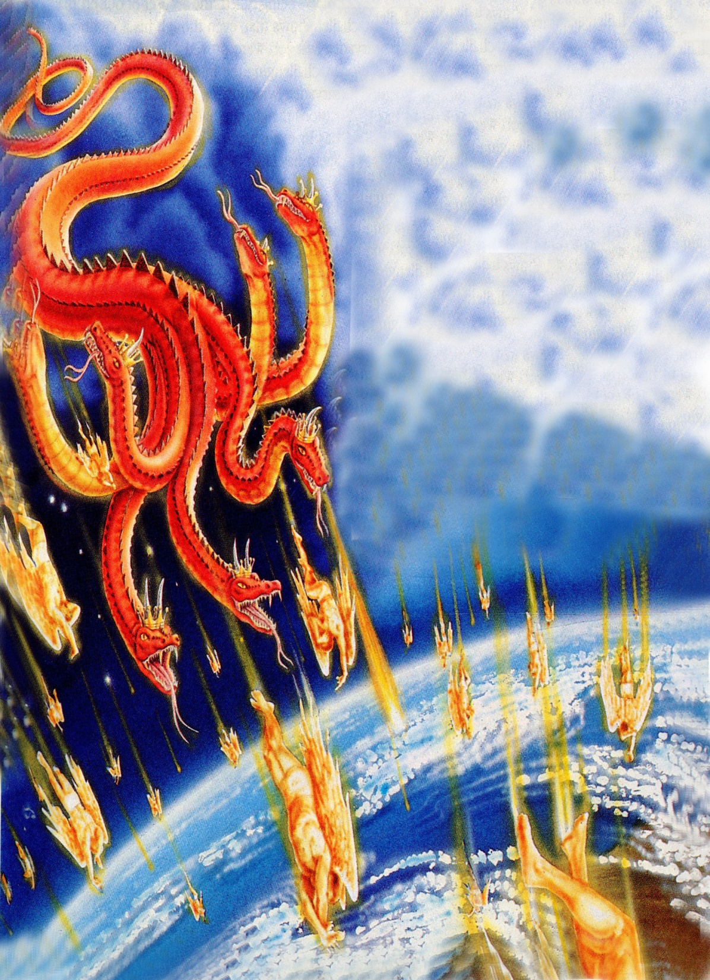
“And did cast them to the earth…”

Slide 37
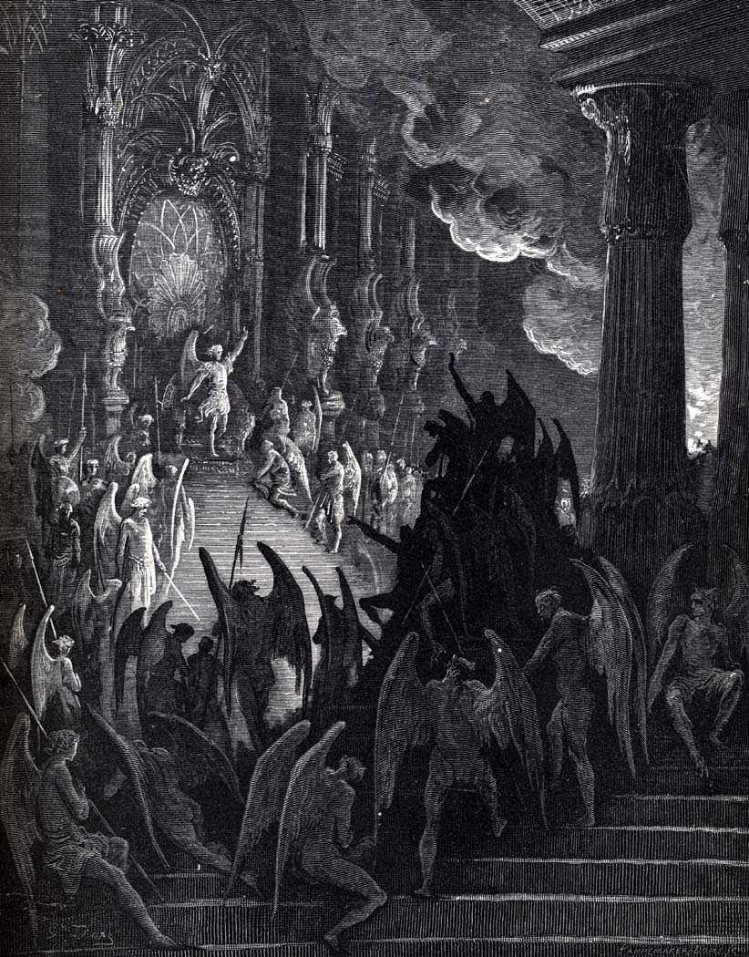
“For we wrestle not against flesh and blood, but against principalities, against powers, against the rulers of the darkness of this world, against spiritual wickedness in high places.” (Ephesians 6:12)

Slide 38
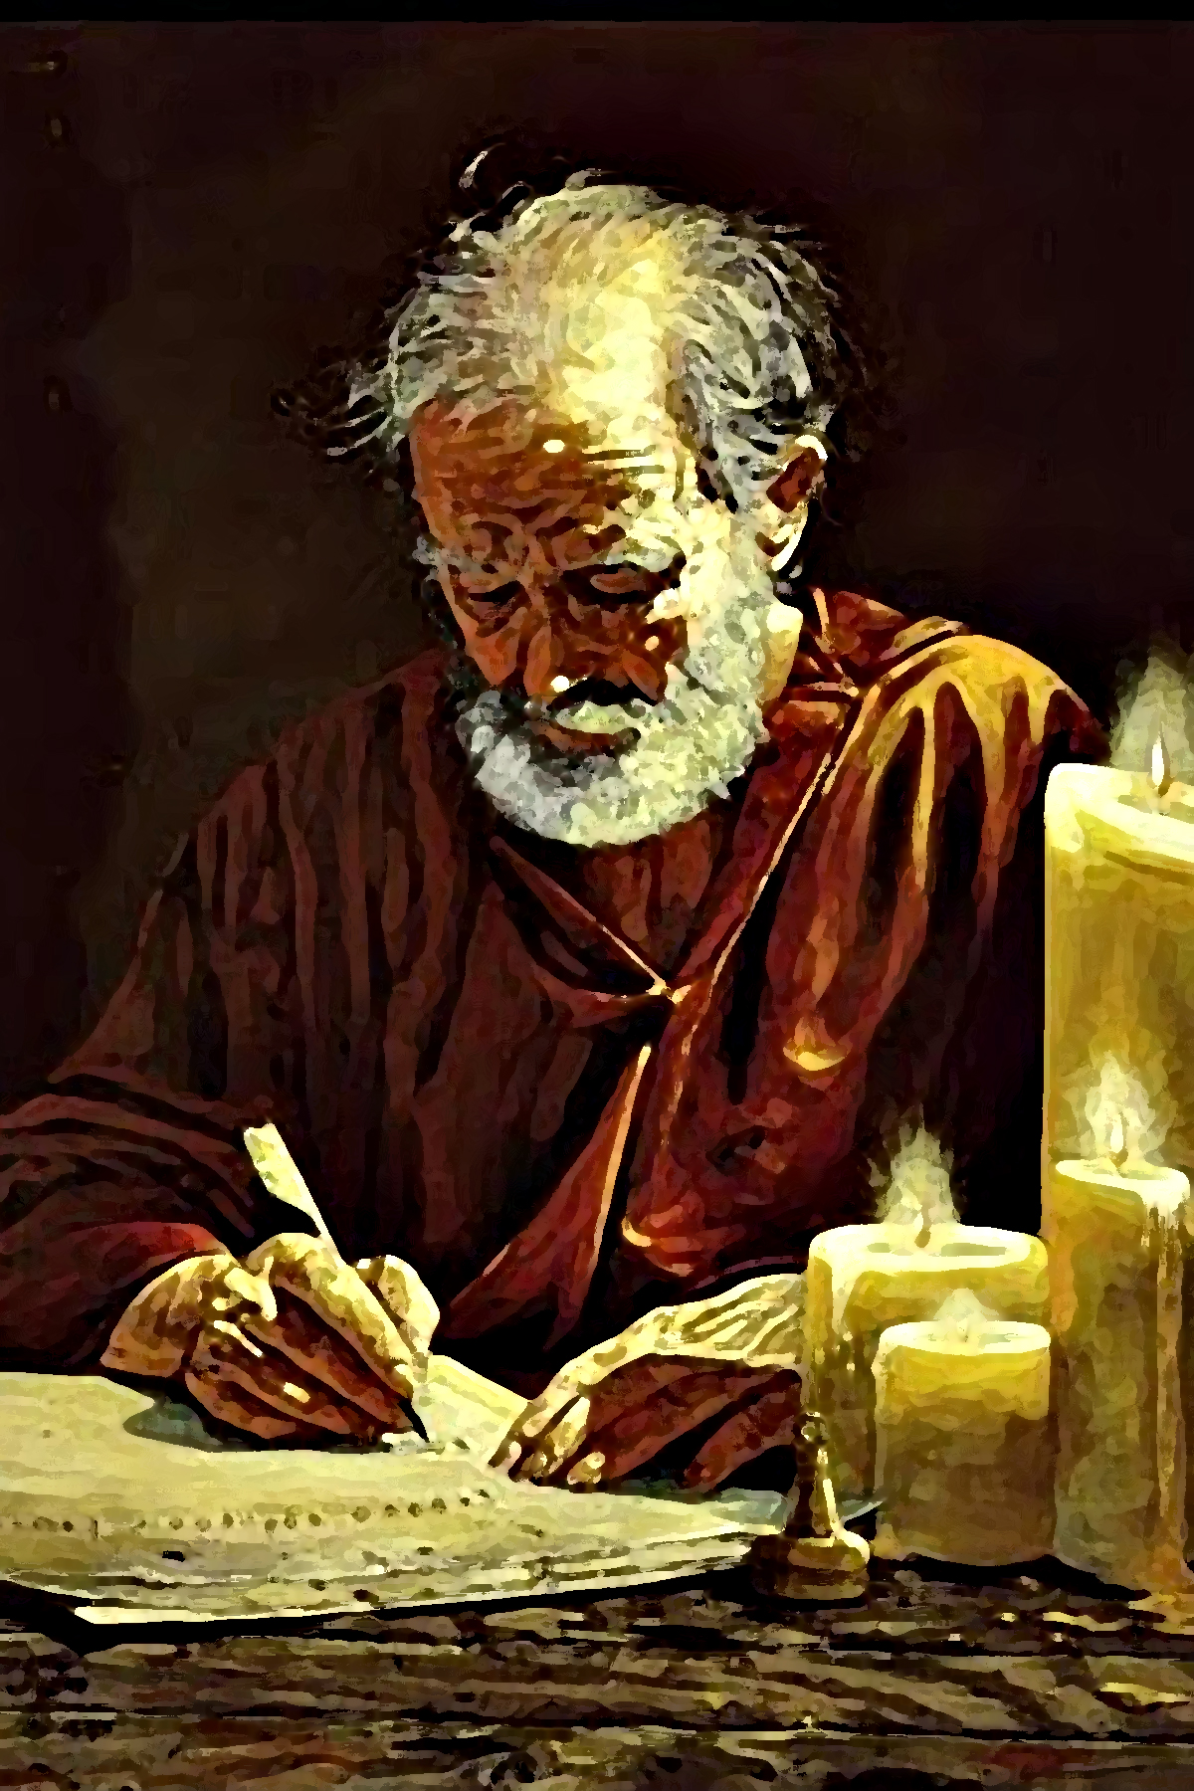
Paul presents a divine revelation he received from the Holy Spirit that describes how Satan’s kingdom has been militarily aligned.

Slide 39
Paul mentions that at the top of this list, is a group of evil spirits called “principalities.” This ancient (Greek) word depicts individual demons who hold the highest position of rank and authority in Satan’s army!
Satan's Generals

Slide 40
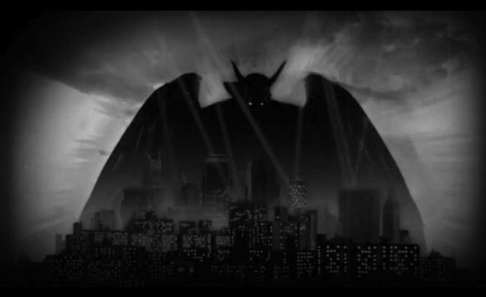
A Principality holds an appointed position of authority, or jurisdiction over a territory. These principalities are ruling demon spirits possessing executive authority and governmental rule in the world.

Slide 41
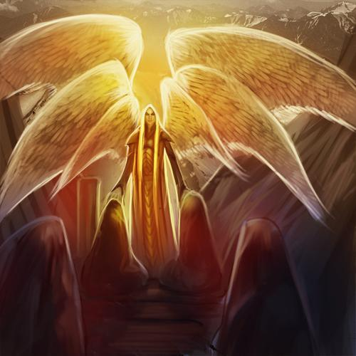
Satan the Prince of Demons
This title is found in Matthew 12:24 and Luke 11:15, and obviously shows his authority over all other demons.
“But some of them said, He casteth out devils through Beelzebub the chief of the devils.”

Slide 42
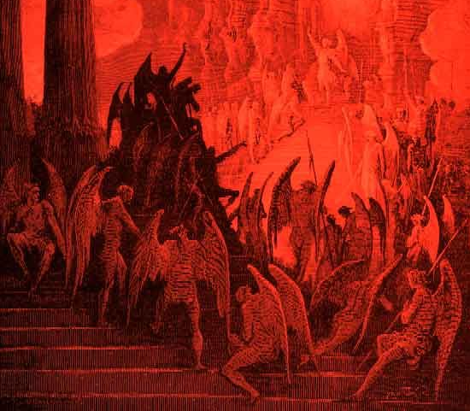
Paul goes on to tell us that below principalities is a second group of evil beings he refers to as “powers.” This word “powers” denotes delegated authority. This describes a lower, second-level group of evil beings — demon spirits — who have received delegated authority from Satan to carry out all manner of evil in whatever way he desires to do it. These evil forces are second in command in Satan’s kingdom of darkness.

Slide 43
These (powers) are an organization of demons (evil angels) ruling in the kingdoms of the world that oppose God and the truth of God’s Word over which Satan is the chief prince and ruler.

Slide 45
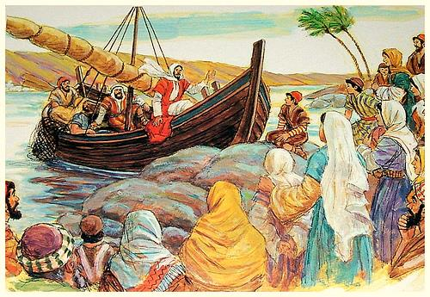
“And great multitudes were gathered together unto him, so that he went into a ship, and sat; and the whole multitude stood on the shore…”

Slide 46
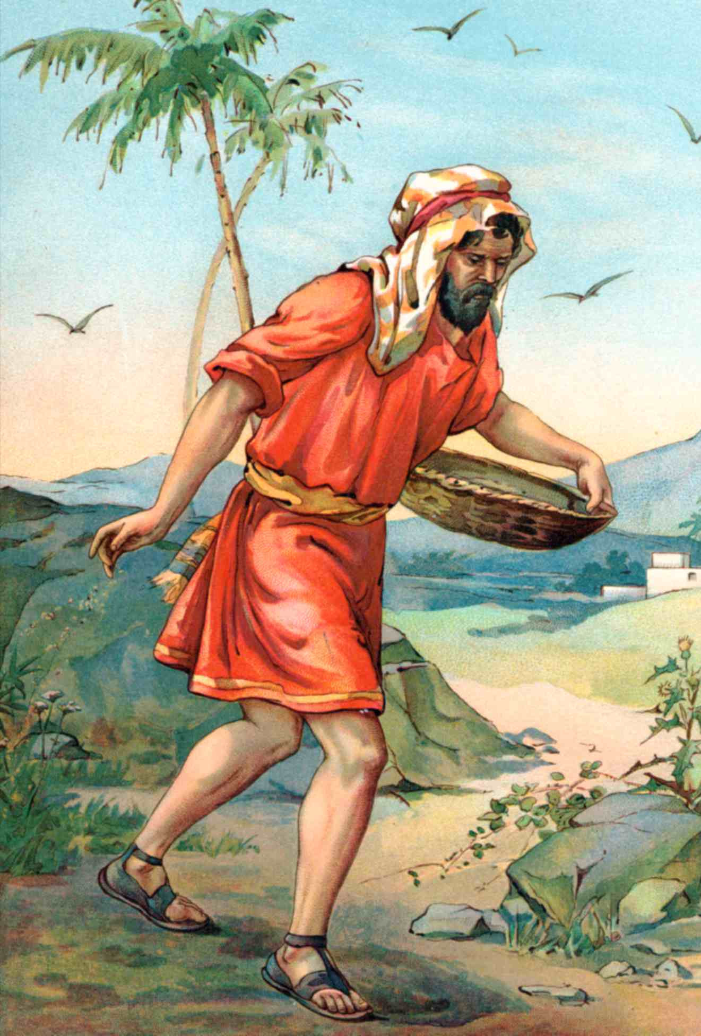
“And he (Jesus) spake many things unto them in parables, saying, Behold, a sower went forth to sow…”

Slide 47
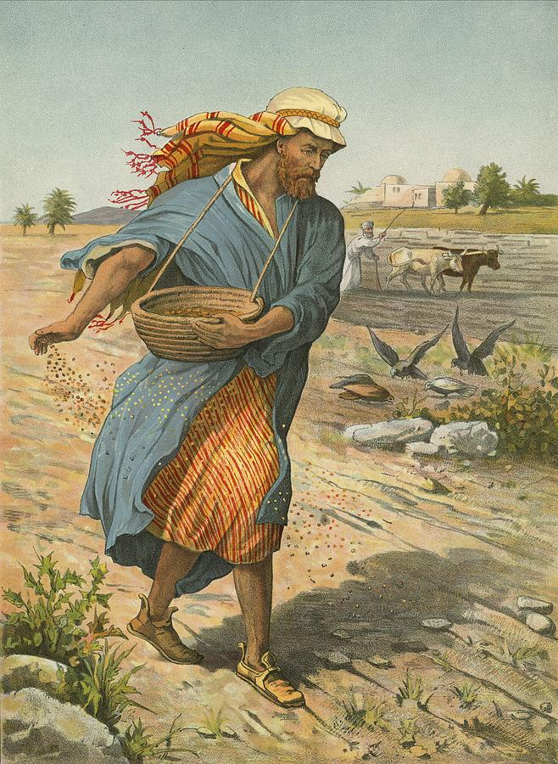
“And when he sowed, some seeds fell by the way side...”

Slide 48
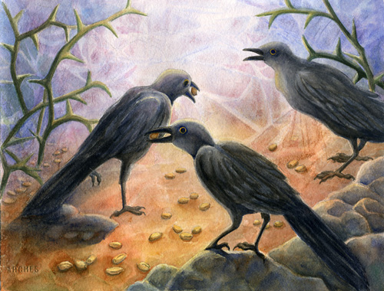
“…and the fowls came and devoured them up.”

Slide 49
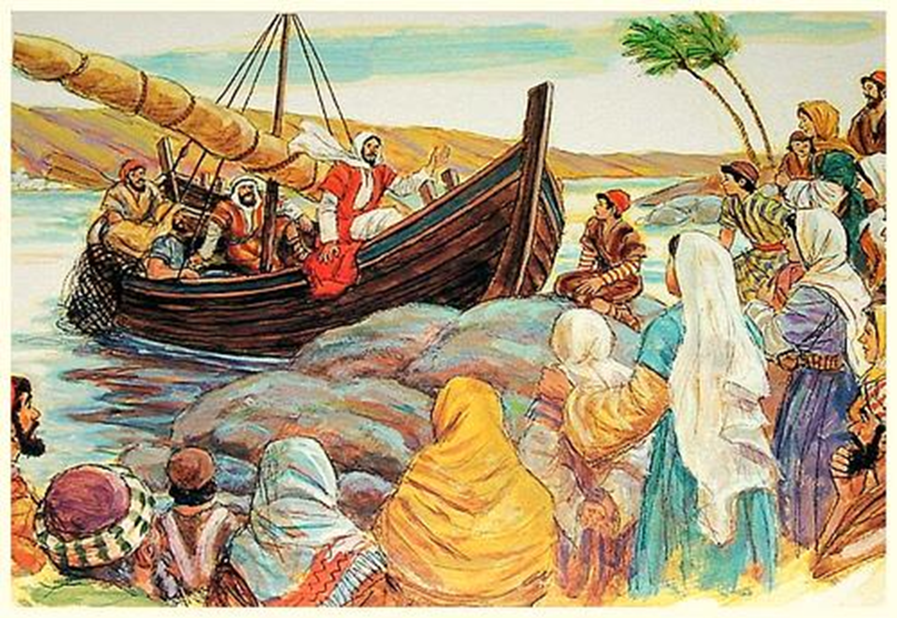
“Hear ye therefore the parable of the sower…When any one heareth the word of the kingdom, and understandeth it not, then cometh the wicked one, and catcheth away that which was sown in his heart.”

Slide 50
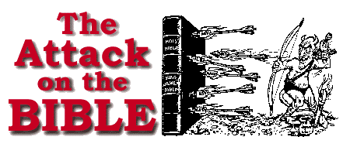

Slide 51
(Genesis 3:1)
“Now the serpent was more subtil than any beast of the field which the LORD God had made. And he said unto the woman, Yea, hath God said…”

Slide 52
How does Satan attack the Bible?

Slide 53
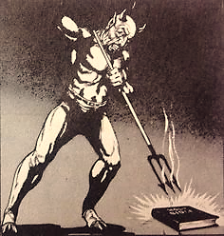
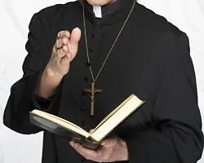
Secular humanistic education
Liberalism in Christian colleges and universities
Proliferation of Bible translations
Liberalism in Christian churches
Secularism in society
Mocking by unbelievers
Christians not living out their faith

Slide 54
Three Jackson churches hold joint-service to welcome LGBT community August 15, 2016
Music rang through of Cascades park in Jackson Sunday morning. The First Congregational Church of Jackson, Saint John's United Church of Christ, and the Universalist Unitarian Church of East Liberty joined together to celebrate all people, including those in the LGBT community.

Slide 55
MARRIAGE POLICY: FBC Marriage is the union of one man and one woman as ordained by God. It was first instituted by God in the early chapters of Genesis (Gen. 2:21-25) and codified in the Levitical law (Lev. 20-21). The Old Testament prophets compared it to the relationship between God and his people (Jer. 3:14) and examples of a one man one woman marital union are seen throughout the Old Testament books of the Law, History, Poetry, Major and Minor Prophets. In the New Testament Jesus explained that God’s original design for marriage was between a man and a woman until death (Matt.19:1-12; Mark 10:1-12). Several New Testament Epistles give explicit instructions concerning this union (Eph.5:22-33; Col. 3:18-19; I Tim. 3:2; Titus 1:6).

Slide 56
There are fifteen scriptural terms which identify, describe, and condemn the sin of homosexuality: 1. Sodomy – Genesis 19:4-10; Deuteronomy 23:17-18; I Kings 14:24-15:12 2. Abomination – Leviticus 18:22; Deuteronomy 22:5 3. Vile Affections – Romans 1:26-27 4. Burning with lust – Romans 1:27 5. Dishonoring the Body – Romans 1:24 6. Wickedness – Genesis 13:13; 19:7; Judges 19:23 7. Violating Nature – Romans 1:26 8. Shameful Lust – Romans 1:27 9. Lusting after Strange Flesh – Jude 7 10. Filthy Dreamers – Jude 7-8 11. Abusers of themselves – I Corinthians 6:9 12. Effeminate – I Corinthians 6:9 13. Inordinate Affections – Colossians 3:5-6 14. Defilers of Themselves – I Timothy 1:9-10 15. Reprobate – (Mind void of judgment) – Romans 1:28

Slide 57
Marriage is a typology of Christ and the Church (Eph. 5:23-24). As such, the Church views marriage as a profound spiritual institution established by God. Due to the importance of marriage in the biblical witness, this church adopts the following policy. 1. There shall be no same gender marriages performed at Fellowship Baptist Church. 2. Only duly appointed pastoral staff shall officiate at marriage ceremonies conducted on church property. 3. Pastoral staff serving the church shall be dismissed and their ordination revoked for officiating a same gender marriage ceremony.

Slide 58
C.H. Spurgeon: "Brethren, we shall not adjust our Bible to the age, but the age to the Bible."

Slide 59
A man’s morality will dictate his theology.

Slide 60
Paul now mentions “the rulers of the darkness of this world.”
This amazing phrase is taken from the word kosmokrateros and is a compound of the words kosmos and kratos. The word kosmos denotes order or arrangement, whereas the word kratos has to do with raw power.
Thus, the compounded word kosmokrateros depicts raw power that has been harnessed
and put into rank or order.

Slide 61
The word kosmokrateros was used to picture military training camps where young men were assembled, trained, and turned into a mighty army. These young men were like raw power when they first arrived in the training camp. However, as the military training progressed and the new recruits were taught discipline and order, all that raw manpower was converted into an organized, disciplined army. This is the word Paul now uses in his description of Satan’s kingdom.

Slide 62
What does it mean?

Slide 63
It tells us that Satan is so serious about doing damage to the human race and that he deals with demon spirits as though they are troops!
He puts them in rank and file, gives them orders and assignments, and then sends them out like military soldiers.

Slide 64
Just as men in a human army are equipped and trained in their methods of destruction, so, too, are these demon spirits.

Slide 65
Once these demons are trained and ready to start their assault, Satan sends them forth to do their devious work against humanity.

Slide 66
Paul makes reference to this dispatch of evil spirits when he writes next about “spiritual wickedness in high places.”
Notice that the Bible says our battle is against wickedness in high places.
Deut. 33:29 “Happy art thou, O Israel: who is like unto thee, O people saved by the LORD, the shield of thy help, and who is the sword of thy excellency! and thine enemies shall be found liars unto thee; and thou shalt tread upon their high places.”
High place - Colossians 1:16 “For by him were all things created, that are in heaven, and that are in earth, visible and invisible, whether they be thrones, or dominions, or principalities, or powers: all things were created by him, and for him.”

Slide 67
High Place?
Elevated place – 1 Sam.13:6
Mountain or hill – 2 Sam. 1:25
Place where false god’s were worshiped – Num.22:14
Place of authority – Isa. 58:14
Dwelling place of those in authority - 2 Kings 23:19
Place where people looked to for worship, direction, guidance, acceptance in life. (Mentioned 117 times in the Old Testament)

Slide 68
2 Chron. 15:17 “But the high places were not taken away out of Israel: nevertheless the heart of Asa was perfect all his days.”

Slide 69
1 Kings 22:42- 43 “Jehoshaphat was thirty and five years old when he began to reign; and he reigned twenty and five years in Jerusalem. And he walked in all the ways of Asa his father; he turned not aside from it, doing that which was right in the eyes of the LORD: nevertheless the high places were not taken away.”

Slide 70
2 Kings 18:1-7 “Now it came to pass that Hezekiah the son of Ahaz king of Judah began to reign. Twenty and five years old was he when he began to reign; and he reigned twenty and nine years in Jerusalem. And he did that which was right in the sight of the LORD, according to all that David his father did. He removed the high places, and brake the images, and cut down the groves, and brake in pieces the brasen serpent that Moses had made: for unto those days the children of Israel did burn incense to it: He trusted in the LORD God of Israel; so that after him was none like him among all the kings of Judah, nor any that were before him. For he clave to the LORD, and departed not from following him, but kept his commandments, which the LORD commanded Moses. And the LORD was with him; and he prospered whithersoever he went forth.”

Slide 71
“Ye shall utterly destroy all the places, wherein the nations which ye shall possess served their gods, upon the high mountains, and upon the hills, and under every green tree.”

Slide 72
Today’s High Places
Me-ism
Government
Education
Humanism
Greed/Materialism
Sexual immorality
Entertainment
Style/fashion
Music
Family
Friends
Boy friend / Girl friend
Secularism
Religion
False religion
Positions of power
Influence
Authority
Wealth
Indulgence

Slide 73
“See, I have this day set thee over the nations and over the kingdoms, to root out, and to pull down, and to destroy, and to throw down, to build, and to plant.”
(Jer. 1:10)

Slide 74
The word “wickedness” depicts something that is
evil, sinful, immoral, base, mean, morally wrong, bad, iniquitous, corrupt, vile, erring, foul, outrageous, abominable, depraved, reprehensible, hateful, detestable, despicable, odious, contemptible, horrible, heinous, murderous, unscrupulous.
Psalms 101:3 “I will set no wicked thing before mine eyes: I hate the work of them that turn aside; it shall not cleave to me.”

Slide 75
This tells us the ultimate aim of Satan’s dark domain: These evil spirits are sent forth to afflict humanity.

Slide 76
Satan uses all these evil forces in his attacks against mankind. Nevertheless, as believers we have far more authority and power than the devil and his forces. You and I have the Greater One living within us! As members of the Church of Jesus Christ, we are loaded with power. The Church has no shortage of power, nor is it deficient in God-given authority. We have more power and more authority than all these evil forces combined!

Slide 78
1 John 4:4 Ye are of God, little children, and have overcome them: because greater is he that is in you, than he that is in the world.
1 John 5:4 For whatsoever is born of God overcometh the world: and this is the victory that overcometh the world, even our faith.
1 John 5:5 Who is he that overcometh the world, but he that believeth that Jesus is the Son of God?
John 12:46 I am come a light into the world, that whosoever believeth on me should not abide in darkness.
1 John 2:14 I have written unto you, fathers, because ye have known him that is from the beginning. I have written unto you, young men, because ye are strong, and the word of God abideth in you, and ye have overcome the wicked one.

Slide 79
“For though we walk in the flesh, we do not war after the flesh: For the weapons of our warfare are not carnal, but mighty through God to the pulling down of strongholds.” (II Corinthians 10:3-4)

Slide 80
Eph. 6:10-18 “Finally, my brethren, be strong in the Lord, and in the power of his might. Put on the whole armour of God, that ye may be able to stand against the wiles of the devil. For we wrestle not against flesh and blood, but against principalities, against powers, against the rulers of the darkness of this world, against spiritual wickedness in high places. Wherefore take unto you the whole armour of God, that ye may be able to withstand in the evil day, and having done all, to stand. Stand therefore, having your loins girt about with truth, and having on the breastplate of righteousness; And your feet shod with the preparation of the gospel of peace; Above all, taking the shield of faith, wherewith ye shall be able to quench all the fiery darts of the wicked. And take the helmet of salvation, and the sword of the Spirit, which is the word of God: Praying always with all prayer and supplication in the Spirit.”

Slide 81
Our weapons and defenses
Loins gird about with TRUTH
Breastplate of RIGHTEOUSNESS
Feet shod with preparation of the GOSPEL
Helmet of SALVATION
Sword of the Spirit, which is the WORD OF GOD
Shield of FAITH
PRAYING in the Spirit

Slide 83
What the church lacks is order and discipline.
We must learn to see ourselves as the army of God – Ps. 68:11
We must view the local church as the training center where we are taught to do spiritual warfare – Col. 1:28
We must heed the call of Jesus and be dispatched into this dark world to preach the Gospel and to drive these evil forces from people’s lives – Eph. 1:19
We must buckle down and begin to view ourselves as the troops of Jesus Christ - 2 Tim.2:3

Slide 84
“No man that warreth entangleth himself with the affairs of this life; that he may please him who hath chosen him to be a soldier.”

Slide 85
I am a soldier in the army of my God. The Lord Jesus Christ is my commanding officer. The Holy Bible is my code of conduct. Faith, prayer, and the Word are my weapons of warfare. I have been taught by the Holy Spirit, trained by experience, tried by adversity and tested by fire. I am a volunteer in this army, and I am enlisted for eternity. I will either retire in this army at the Rapture or die in this army; but I will not get out, sell out, be talked out, or pushed out. I am faithful, reliable, capable and dependable. If my God needs me, I am there. If He needs me in the Sunday school, to teach the children, work with the youth, help adults or just sit and learn, He can use me because I am there! I am a soldier. I am not a baby.

Slide 86
I do not need to be pampered, petted, primed up, pumped up, picked up or pepped up. I am a soldier. No one has to call me, remind me, write me, visit me, entice me, or lure me. I am a soldier. I am not a wimp. I am in place, saluting my King, obeying His orders, praising His name, and building His kingdom! No one has to send me flowers, gifts, food, cards, candy or give me handouts. I do not need to be cuddled, cradled, cared for, or catered to. I am committed. I cannot have my feelings hurt bad enough to turn me around. I cannot be discouraged enough to turn me aside. I cannot lose enough to cause me to quit. When Jesus called me into this army, I had nothing. If I end up with nothing, I will still come out ahead. I will win. My God has and will continue to supply all of my needs. I am more than a conqueror.

Slide 87
I will always triumph. I can do all things through Christ. Devils cannot defeat me. People cannot disillusion me. Weather cannot weary me. Sickness cannot stop me. Battles cannot beat me. Money cannot buy me. Governments cannot silence me and hell cannot handle me. I am a soldier. Even death cannot destroy me. For when my commander calls me from this battlefield, He will promote me to Captain and then allow me to rule with Him. I am a soldier in the army, and I'm marching claiming victory. I will not give up. I will not turn around. I am a soldier, marching heaven bound. Here I stand! Will you stand with me?

Slide 88
Satan has a false trinity
Satan has his synagogues
Satan has prophets and teachers
Satan has his doctrines
Satan has his mysteries
Satan has a throne
Satan has a kingdom
Satan has worshipers
Satan has ministers
Satan has angels
Satan has miracles
Satan has fellowship
Satan has an army

