Slide 1
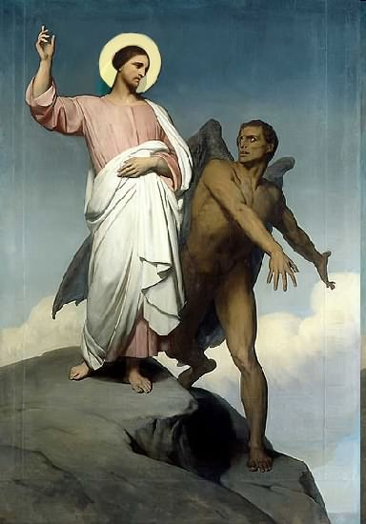

Slide 2
Topics to be studied
His existence
His origin
His fall
His personality
His names
His activities (Part 13)
His location – present and future
Our victory over him

Slide 4
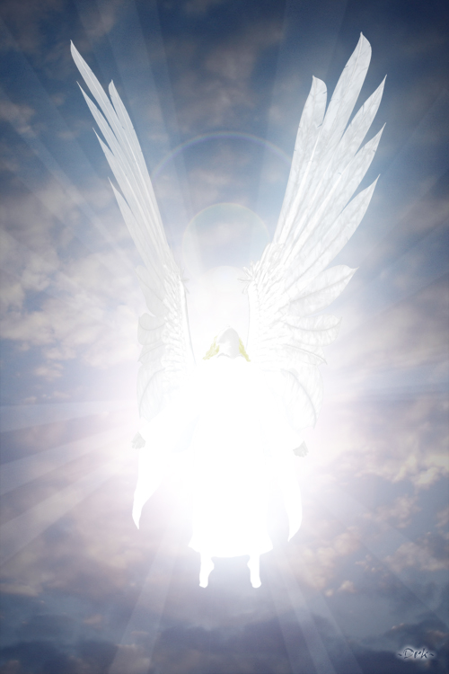
Satan imitates God?

Slide 5
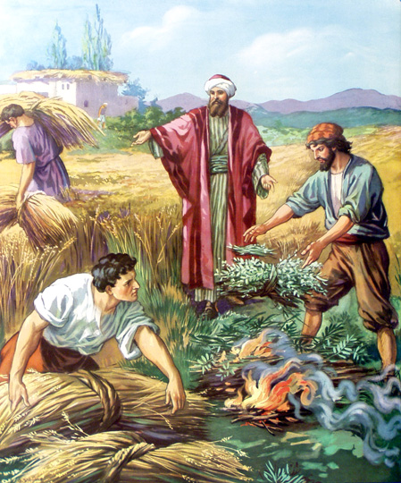
Matthew 13:24-42
Satan sows tares among God’s wheat

Slide 6
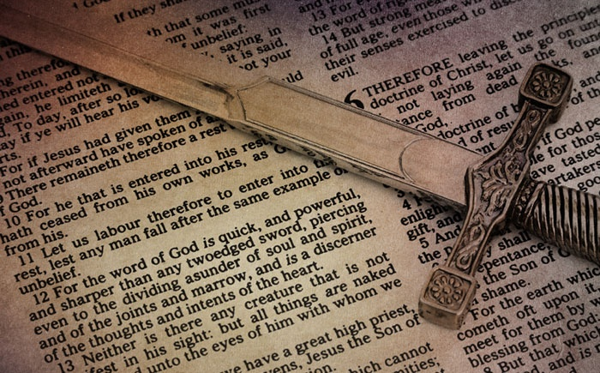
Satan perverts the Word of God (Part 3)

Slide 7
Why Satan hates the Word of God
1. Because GOD wrote it “All Scripture is given by inspiration of God”
2. Because it is true “Thy Word is Truth”
3. Because it saves souls (1 Peter 1:23)
4. Because it changes lives (John 8:32)
5. Satan is a LIAR and the father of lies (John 8:44)
6. Satan can’t stand the truth, because everything he does is based upon deception (2 Thess. 2:8-11)
7. And the truth of the Bible exposes him for who he is and how he operates

Slide 8
Satan twist and corrupts the Word of God

Slide 9
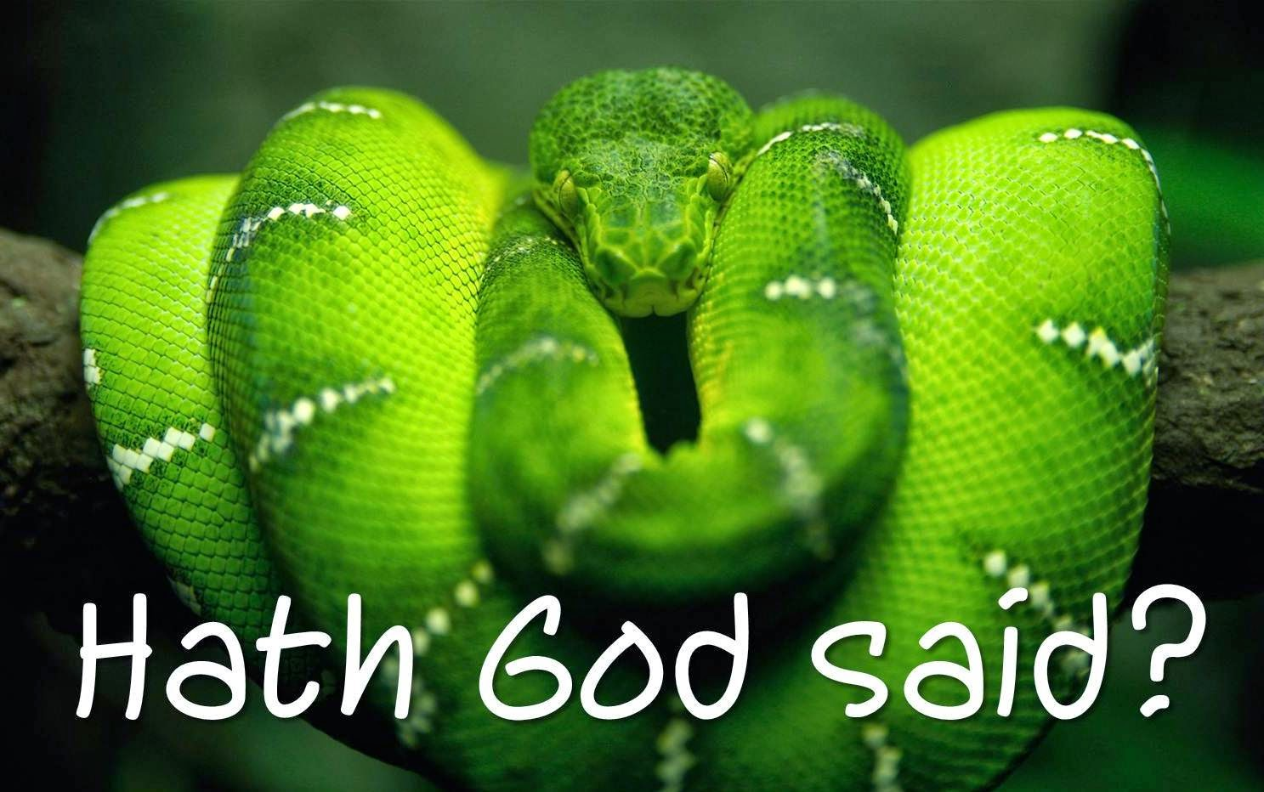
How Satan perverts the Word of God
1. Causing it to be mistranslated.
2. Causing it to be misinterpreted.
3. Causing it to be taken out of context.
4. Overstressing one side of a doctrine and ignoring the other side.
5. Under stressing certain doctrines.

Slide 10
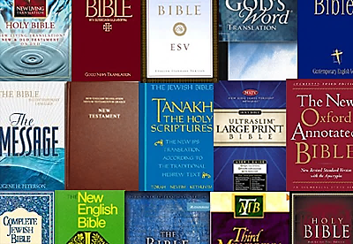
1. Satan causes God’s Word to be mistranslated

Slide 11
“For God is not the author of confusion, but of peace, as in all churches of the saints.” ( 1 Cor. 14:33)

Slide 12
Satan does not want you to believe in the perseveration of the inspired Scriptures
“The words of the Lord are pure words: as silver tried in a furnace of earth, purified seven times. Thou shalt keep them, O Lord, thou shalt preserve them from this generation forever…The counsel of the Lord standeth forever, the thoughts of his heart to all generations…His truth endureth to all generations…forever, O Lord, thy word is settled in heaven, thy faithfulness is unto all generations…The grass withereth, the flower fadeth, but the word of our God shall stand forever…but the word of the Lord endureth forever…”
“For verily I say unto you. Till heaven and earth pass, one jot or one tittle shall in no wise pass from the law, till all be fulfilled…Heaven and earth shall pass away but my words shall not pass away…It is easier for heaven and earth to pass, than one tittle of the law to fail...The scriptures cannot be broken…”

Slide 13
“You don’t have the inspired, infallible, inerrant, preserved Word of God.”

Slide 14
2. Satan causes God’s Word to be misinterpreted (2 Peter 1:15-21; 2:1-3)
“Moreover I will endeavour that ye may be able after my decease to have these things always in remembrance. For we have not followed cunningly devised fables, when we made known unto you the power and coming of our Lord Jesus Christ, but were eyewitnesses of his majesty. For he received from God the Father honour and glory, when there came such a voice to him from the excellent glory, This is my beloved Son, in whom I am well pleased. And this voice which came from heaven we heard, when we were with him in the holy mount.”

Slide 15
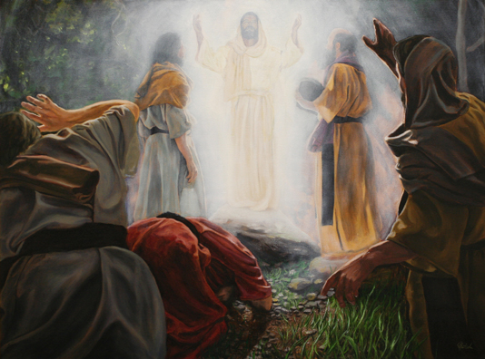

Slide 16
“We have also a more sure word of prophecy; whereunto ye do well that ye take heed, as unto a light that shineth in a dark place, until the day dawn, and the day star arise in your hearts.”

Slide 17
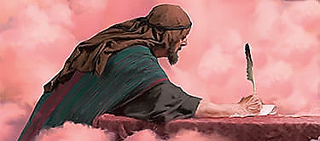
“Knowing this first, that no prophecy of the scripture is of any private interpretation. For the prophecy came not in old time by the will of man: but holy men of God spake as they were moved by the Holy Ghost.”

Slide 18
“Knowing this first, that no prophecy of the scripture is of any private interpretation.”

Slide 19
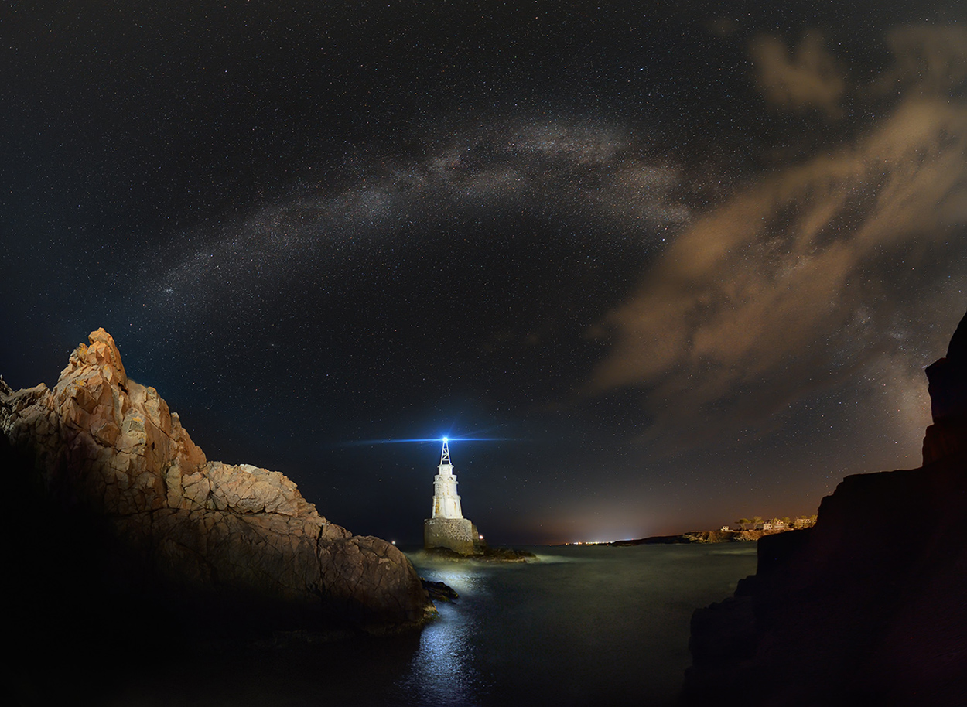
Verse 19 - The prophecies found in the Bible are true, and shine like a light in darkness.

Slide 20
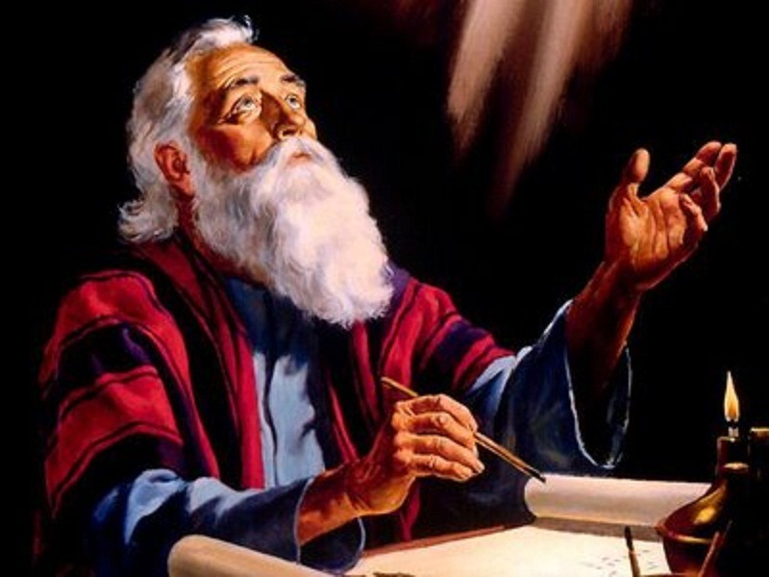
Verse 20 - None of the prophecy, or interpretation of prophecy recorded in Scriptures were devised by the prophet himself.

Slide 21
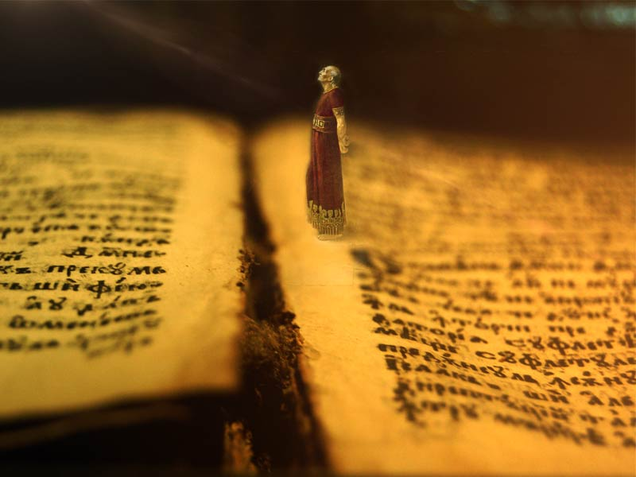
Verse 20 - While the prophet wrote the prophecy, he is not the author of either the prophecy or the interpretation of it.

Slide 22
Verse 21 - The Holy Spirit is both author and interpreter of prophecies in the Bible, not the prophet.

Slide 23
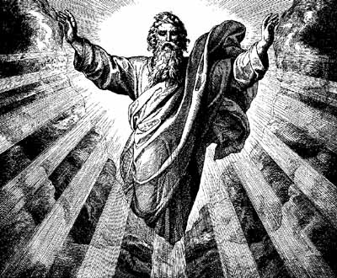
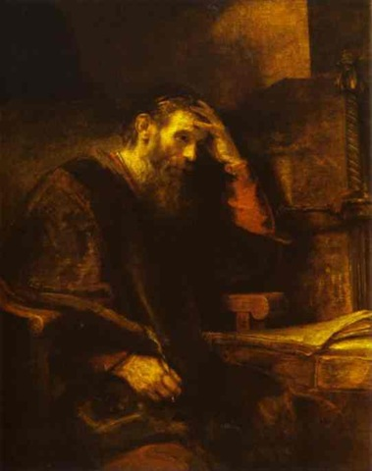
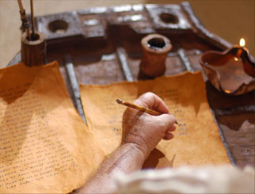
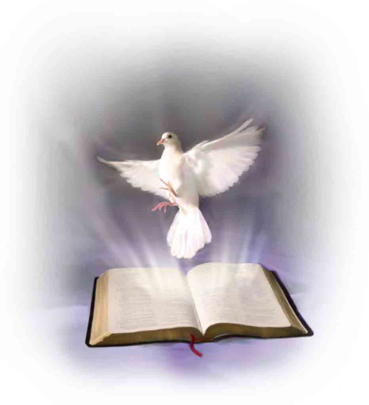
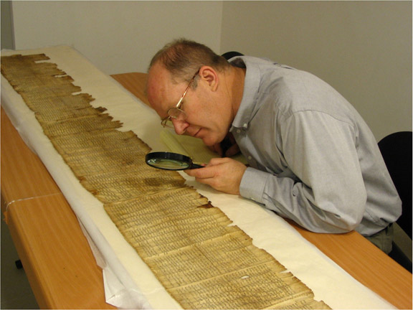
Revelation
Inspiration
Preservation
Illumination
Matt.16:10--17 ; John 16:13;
Eph. 1:17-18; II Cor. 4:1-6

Slide 24
Warnings concerning false prophets and their handling of Scripture (Chapter 2:1-3)

Slide 25
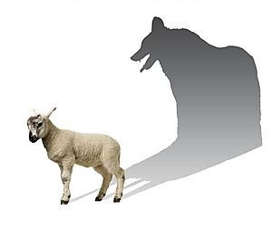
“But there were false prophets also among the people, even as there shall be false teachers among you, who privily shall bring in damnable heresies, even denying the Lord that bought them, and bring upon themselves swift destruction. And many shall follow their pernicious ways.”
Pernicious = Harmful, damaging, destructive, injurious, hurtful, detrimental, dangerous, adverse, unhealthy, unfavorable, bad, evil, wicked, malignant, poisonous.

Slide 26
“By reason of whom the way of truth shall be evil spoken of. And through covetousness shall they with feigned words make merchandise of you: whose judgment now of a long time lingereth not, and their damnation slumbereth not.”
Feigned = fabricate, alter, change

Slide 27
Beware of those who would twist the meaning of Scripture on doctrinal issues. The only way to know for sure when this is happening is to be well educated in the Scriptures yourself. 2 Tim 2:15 “Study to show thyself approved unto God, a workman that needeth not to be ashamed, rightly dividing the word of truth.” 2 Tim 2:16 “But shun profane and vain babblings: for they will increase unto more ungodliness.”

Slide 28
The reason why Scriptures are of no private
interpretation is because Scriptures witness
(The Scriptures - Bears record, confirm, support and
interpret other Scriptures in the Bible.)

Slide 29
No Scripture in the Bible can have its own private interpretation.

Slide 30
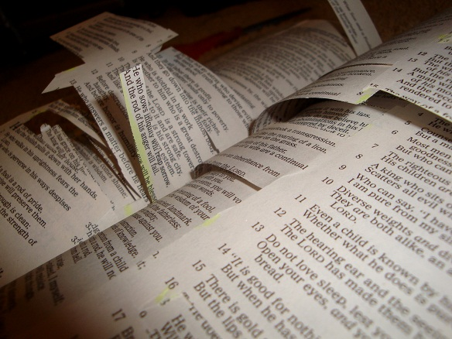
We can’t give the Scripture our own private interpretation.

Slide 31
We can’t take a Scripture and make it say what you want it to say.

Slide 32
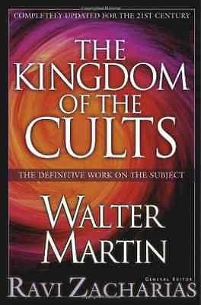
This is what the cults do!

Slide 33
There must always be another Scripture to support your interpretation.

Slide 34
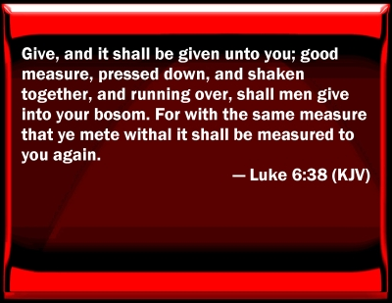
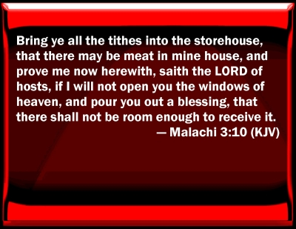
Although there are verses in the Bible that can interpret themselves, there will always be other verses that will support and confirm the interpretation of those verses.

Slide 35
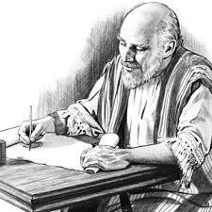
The Holy Spirit gave the Scripture through holy men who transcribed it (2 Peter 1:21)
2 Timothy 3:16-17
“All scripture is given by inspiration of God, and is profitable for doctrine, for reproof, for correction, for instruction in righteousness: That the man of God may be perfect, throughly furnished unto all good works.”

Slide 36
The Holy Spirit Guards His
Words zealously
“Thou shalt not add thereto nor diminish from it…add thou not unto his words…if any man shall add unto these things, God shall add unto him the plagues that are written in this book. And if any man shall take away from the words of the book of this prophecy, God shall take away his part out of the book of life and out of the holy city from the things which are written in this book…”

Slide 37
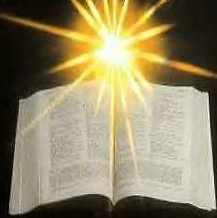
The Holy Spirit gives Illumination of Scripture (Matt.16:10-17 ; John 16:13; Eph. 1:17-18; II Cor. 4:1-6)
(1 John 2:27)
“But the anointing which ye have received of him abideth in you, and ye need not that any man teach you: but as the same anointing teacheth you of all things, and is truth, and is no lie, and even as it hath taught you, ye shall abide in him.”

Slide 38
“For flesh and blood hath not revealed it unto thee, but my Father which is in heaven…The Holy Ghost, he shall teach you all things and bring all things to your remembrance…When the Spirit of Truth is come he will guide you into all truth…that the God of our Lord Jesus Christ the Father of glory may give unto you the spirit of wisdom and revelation in the knowledge of him. The eyes of your understanding being enlightened…But God hath revealed them unto us by his Spirit for the spirit searches all things yea the deep things of God.”

Slide 39
“Now we have received not the spirit of the world, but the Spirit which is of God: that we might know the things that are freely given to us of God. Which things also we speak not in the words which man’s wisdom teacheth, but which the Holy Ghost teacheth; comparing spiritual things with spiritual…If our gospel be hid it is hid to them that are lost. In whom the god of this world hath blinded the minds of that which believe not…For God commanded the light to shine out of darkness hath shined in our hearts to give the light of the knowledge of the glory of God in the face of Jesus Christ…Hereby know we the spirit of truth and the spirit of error.”

Slide 40
How Satan perverts the Word of God
1. Causing it to be mistranslated.
2. Causing it to be misinterpreted.
Next week:
3. Causing it to be taken out of context.
4. Overstressing one side of a doctrine and ignoring the other side.
5. Under stressing certain doctrines.

