Slide 1
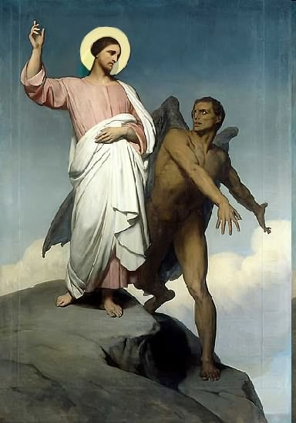

Slide 2
Topics to be studied
His existence
His origin
His fall
His personality
His names
His activities (Part 15)
His location – present and future
Our victory over him

Slide 4
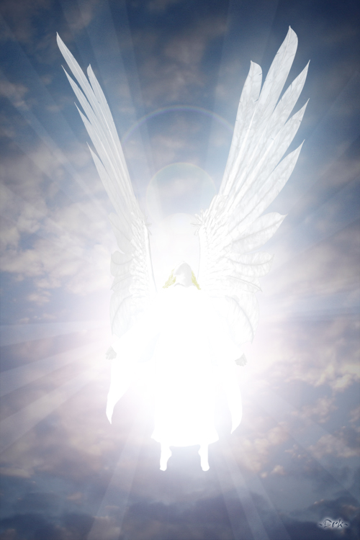
Satan imitates God?

Slide 5
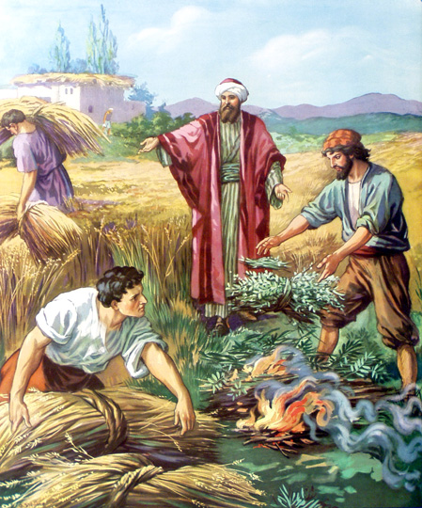
Matthew 13:24-42
Satan sows tares among God’s wheat

Slide 6
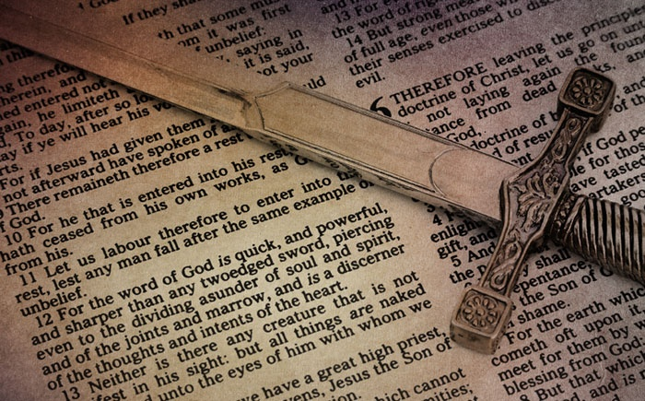
Satan perverts the Word of God (Part 5)

Slide 7
Why Satan hates the Word of God
1. Because GOD wrote it “All Scripture is given by inspiration of God”
2. Because it is true “Thy Word is Truth”
3. Because it saves souls (1 Peter 1:23)
4. Because it changes lives (John 8:32)
5. Satan is a LIAR and the father of lies (John 8:44)
6. Satan can’t stand the truth, because everything he does is based upon deception (2 Thess. 2:8-11)
7. And the truth of the Bible exposes him for who he is and how he operates

Slide 8
Satan twist and corrupts the Word of God

Slide 9
Satan does not want you to believe in the perseveration of the inspired Scriptures
“The words of the Lord are pure words: as silver tried in a furnace of earth, purified seven times. Thou shalt keep them, O Lord, thou shalt preserve them from this generation forever…The counsel of the Lord standeth forever, the thoughts of his heart to all generations…His truth endureth to all generations…forever, O Lord, thy word is settled in heaven, thy faithfulness is unto all generations…The grass withereth, the flower fadeth, but the word of our God shall stand forever…but the word of the Lord endureth forever…”

Slide 10
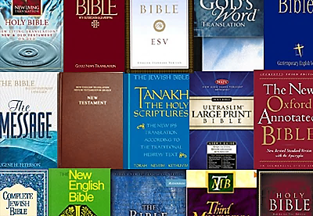
1. Satan causes God’s Word to be mistranslated

Slide 11
“For God is not the author of confusion, but of peace, as in all churches of the saints.” ( 1 Cor. 14:33)

Slide 12
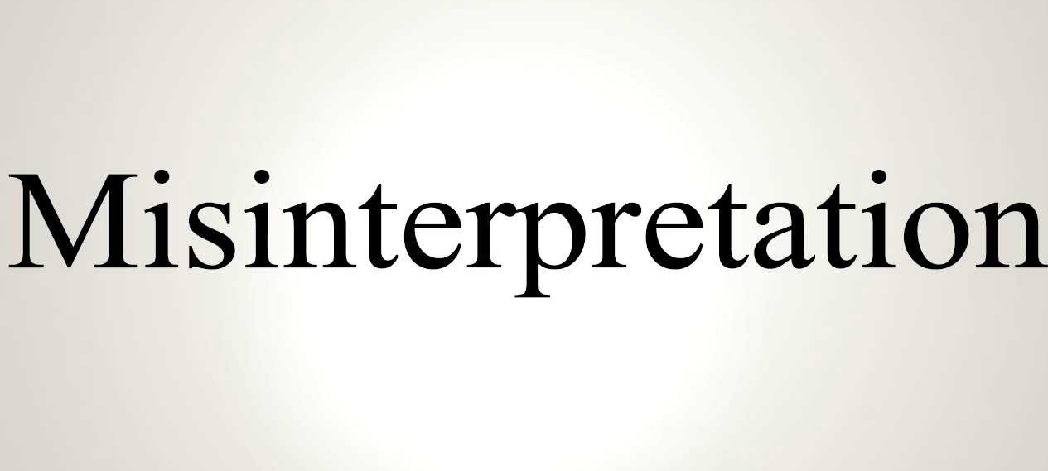
2. Satan causes God’s Word to be misinterpreted (2 Peter 1:15-21)
“Moreover I will endeavour that ye may be able after my decease to have these things always in remembrance. For we have not followed cunningly devised fables.”

Slide 13
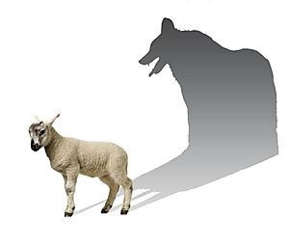
“But there were false prophets also among the people, even as there shall be false teachers among you, who privily shall bring in damnable heresies, even denying the Lord that bought them, and bring upon themselves swift destruction. And many shall follow their pernicious ways.”
Pernicious = Harmful, damaging, destructive, injurious, hurtful, detrimental, dangerous, adverse, unhealthy, unfavorable, bad, evil, wicked, malignant, poisonous.

Slide 14
“By reason of whom the way of truth shall be evil spoken of. And through covetousness shall they with feigned words make merchandise of you: whose judgment now of a long time lingereth not, and their damnation slumbereth not.”
Feigned = fabricate, alter, change

Slide 15
“Knowing this first, that no prophecy of the scripture is of any private interpretation.”

Slide 16
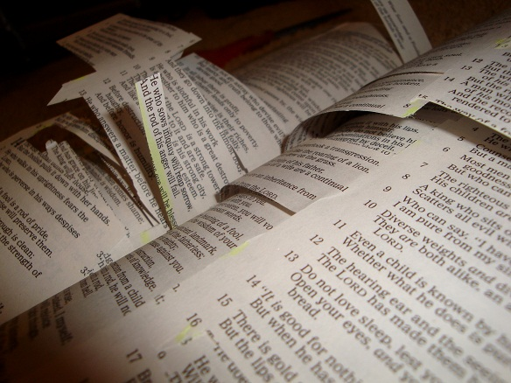
3. Satan causes God’s Word to be taken out of Context

Slide 17
Understanding context begins five basic principles of interpretation
1. literal meaning (what it says) – When the plain sense makes sense seek no other sense.
2. Figurative or symbolic meaning (figure of speech, especially a metaphor; metaphorical and not literal) – Book of the Revelation / Lord’s Table
3. Historical setting (the events of the passage, to whom is it addressed, and how was understood at that time)
4. Grammar (How are the words used in the sentence and paragraph within which they are found. What does the word mean as used in its context)
5. Comparative interpretation (comparing the verse with other parts of Scripture for a fuller meaning)

Slide 18
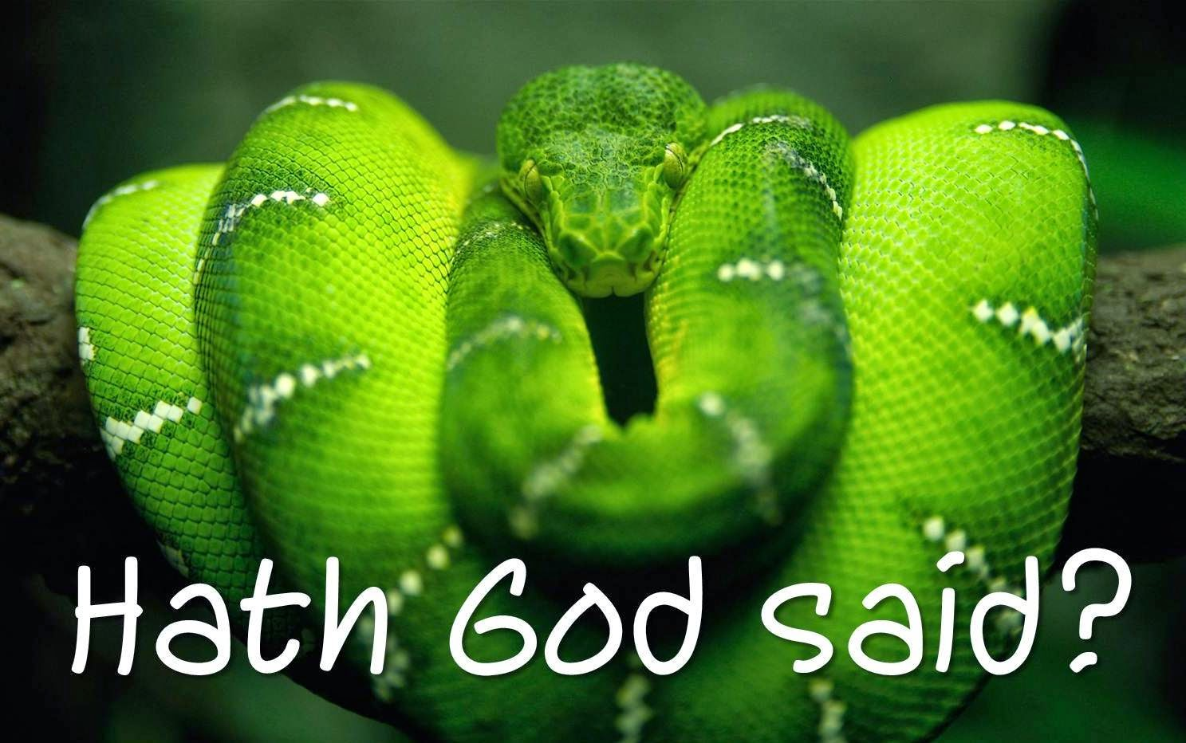
How Satan perverts the Word of God
1. Causing it to be mistranslated.
2. Causing it to be misinterpreted.
3. Causing it to be taken out of context.
Tonight:
4. Overstressing one side of a doctrine and ignoring the other side.
5. Under stressing certain doctrines.

Slide 19
4. Satan perverts the Word of God by overstressing one side of a doctrine and ignoring the other side

Slide 20
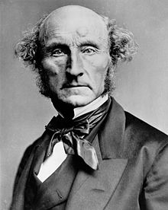
“He who knows only his own side of the case, knows little of that. His reasons may be good, and no one may have been able to refute them. But if he is equally unable to refute the reasons on the opposite side; if he does not so much as know what they are, he has no ground for preferring his opinion.”
John Stuart Mill
has been called "the most influential English-speaking philosopher of the nineteenth century."

Slide 21
Examples of overstressing one side of a doctrine and ignoring the other side

Slide 22
SALVATION BY FAITH VERSUS SALVATIN BY WORKS

Slide 23
Salvation faith
“For by grace are ye saved through faith; and that not of yourselves: it is the gift of God. Not of works…” (Eph. 2:8-9)

Slide 24
“What doth it profit, my brethren, though a man say he hath faith, and have not works? can faith save him? Ye see then how that by works a man is justified, and not by faith only.”
(James 2:14, 24)
Salvation by works

Slide 25
Salvation by faith
Evidenced by works

Slide 27
(James 2:14-24) “What doth it profit, my brethren, though a man say he hath faith, and have not works? can faith save him? …Even so faith, if it hath not works, is dead, being alone. Yea, a man may say, Thou hast faith, and I have works: shew me thy faith without thy works, and I will shew thee my faith by my works Thou believest that there is one God; thou doest well: the devils also believe, and tremble. But wilt thou know, O vain man, that faith without works is dead? Was not Abraham our father justified by works, when he had offered Isaac his son upon the altar? Seest thou how faith wrought with his works, and by works was faith made perfect? And the scripture was fulfilled which saith, Abraham believed God, and it was imputed unto him for righteousness: and he was called the Friend of God. Ye see then how that by works a man is justified, and not by faith only.”

Slide 28
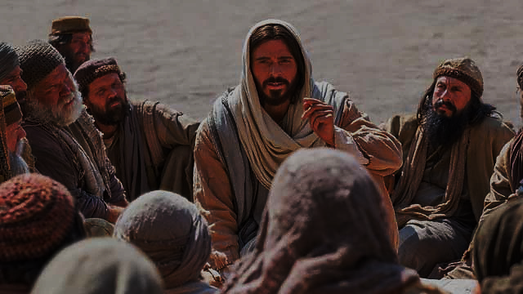
(Matthew 7:16-23) “Ye shall know them by their fruits. Do men gather grapes of thorns, or figs of thistles? Even so every good tree bringeth forth good fruit; but a corrupt tree bringeth forth evil fruit. A good tree cannot bring forth evil fruit, neither can a corrupt tree bring forth good fruit. Every tree that bringeth not forth good fruit is hewn down, and cast into the fire. Wherefore by their fruits ye shall know them. Not every one that saith unto me, Lord, Lord, shall enter into the kingdom of heaven; but he that doeth the will of my Father which is in heaven. Many will say to me in that day, Lord, Lord, have we not prophesied in thy name? and in thy name have cast out devils? and in thy name done many wonderful works? And then will I profess unto them, I never knew you: depart from me, ye that work iniquity.”

Slide 29
(Ephesians 2:8-10)
“For by grace are ye saved through faith; and that not of yourselves: it is the gift of God: Not of works, lest any man should boast. For we are his workmanship, created in Christ Jesus unto good works, which God hath before ordained that we should walk in them.”

Slide 30
SEPARATION FROM THE WORLD VERSES FELLOWSHIP WITH THE WORLD
(1 Corinthians 5:9-10)
“I wrote unto you in an epistle not to company with fornicators: Yet not altogether with the fornicators of this world, or with the covetous, or extortioners, or with idolaters; for then must ye needs go out of the world.”
(1 John 2:15-17)
“Love not the world, neither the things that are in the world. If any man love the world, the love of the Father is not in him. For all that is in the world, the lust of the flesh, and the lust of the eyes, and the pride of life, is not of the Father, but is of the world.”

Slide 31
(2 Cor. 6:17)
“Wherefore come out from among them, and be ye separate, saith the Lord, and touch not the unclean thing; and I will receive you.”

Slide 32
“Come out from among them and be ye separate”

Slide 33
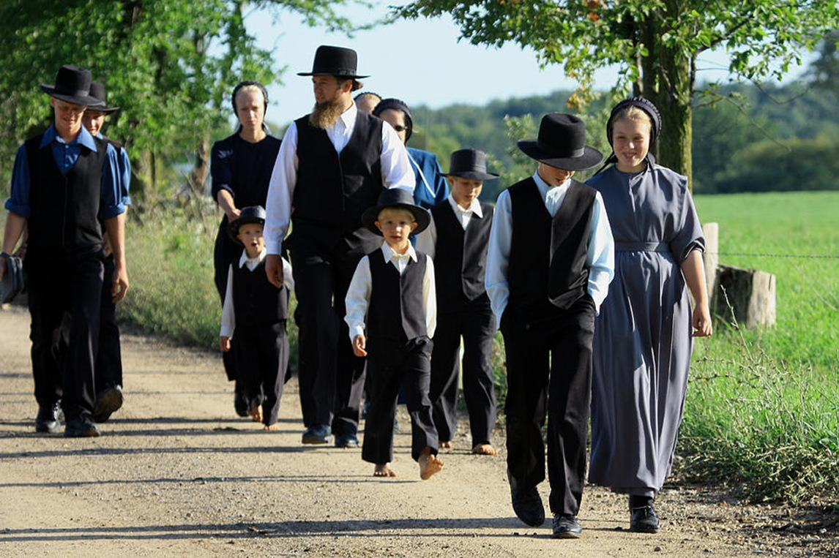

Slide 34
“Go ye into all the world”

Slide 35
“I am made all things to all men, that I might by all means save some.”

Slide 36
“Come out from among them and be ye separate”
“Go ye into all the world”

Slide 37
(1 Corinthians 9:20-22, 27) “And unto the Jews I became as a Jew, that I might gain the Jews; to them that are under the law, as under the law, that I might gain them that are under the law; To them that are without law, as without law, (being not without law to God, but under the law to Christ,) that I might gain them that are without law. To the weak became I as weak, that I might gain the weak: I am made all things to all men, that I might by all means save some…But I keep under my body, and bring it into subjection: lest that by any means, when I have preached to others, I myself should be a castaway.”

Slide 38
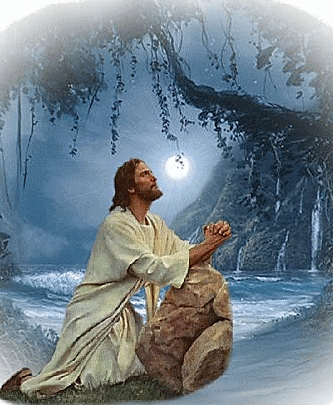
(John 17:15-16) “I pray not that thou shouldest take them out of the world, but that thou shouldest keep them from the evil. They are not of the world, even as I am not of the world.”

