Slide 1
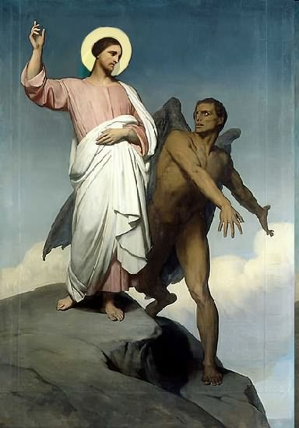

Slide 2
Topics to be studied
His existence
His origin
His fall
His personality
His names
His activities (Part 16)
His location – present and future
Our victory over him

Slide 4
Satan imitates God?

Slide 5
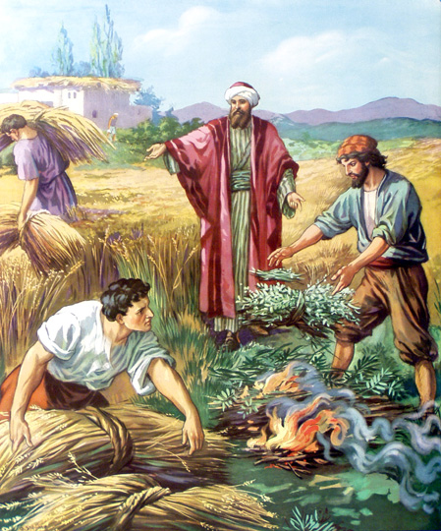
Matthew 13:24-42
Satan sows tares among God’s wheat

Slide 6
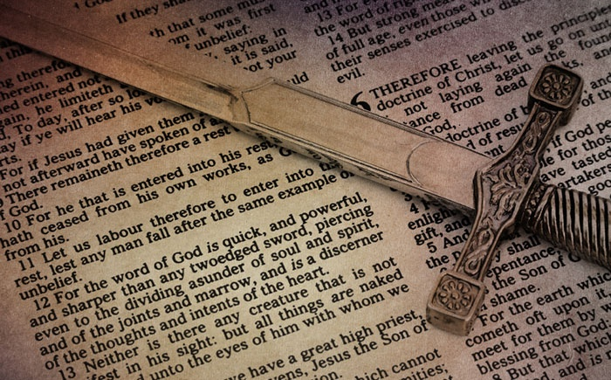
Satan perverts the Word of God (Part 6)

Slide 7
Why Satan hates the Word of God
1. Because GOD wrote it “All Scripture is given by inspiration of God”
2. Because it is true “Thy Word is Truth”
3. Because it saves souls (1 Peter 1:23)
4. Because it changes lives (John 8:32)
5. Satan is a LIAR and the father of lies (John 8:44)
6. Satan can’t stand the truth, because everything he does is based upon deception (2 Thess. 2:8-11)
7. And the truth of the Bible exposes him for who he is and how he operates

Slide 8
Satan twist and corrupts the Word of God
(2 Peter 3:16-18) “As also in all his epistles, speaking in them of these things; in which are some things hard to be understood, which they that are unlearned and unstable wrest, as they do also the other scriptures, unto their own destruction. Ye therefore, beloved, seeing ye know these things before, beware lest ye also, being led away with the error of the wicked, fall from your own stedfastness. But grow in grace, and in the knowledge of our Lord and Saviour Jesus Christ. To him be glory both now and for ever. Amen”
(2 Corinthians 2:17) “For we are not as many, which corrupt the word of God: but as of sincerity, but as of God, in the sight of God speak we in Christ.”

Slide 9
Satan does not want you to believe in the perseveration of the inspired Scriptures
“The words of the Lord are pure words: as silver tried in a furnace of earth, purified seven times. Thou shalt keep them, O Lord, thou shalt preserve them from this generation forever…The counsel of the Lord standeth forever, the thoughts of his heart to all generations…His truth endureth to all generations…forever, O Lord, thy word is settled in heaven, thy faithfulness is unto all generations…The grass withereth, the flower fadeth, but the word of our God shall stand forever…but the word of the Lord endureth forever…”

Slide 10
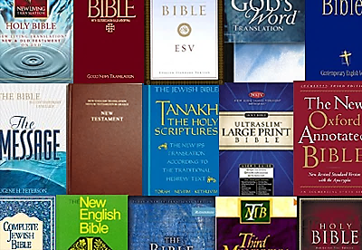
1. Satan causes God’s Word to be mistranslated

Slide 11
2. Satan causes God’s Word to be misinterpreted (2 Peter 1:15-21)
“Moreover I will endeavour that ye may be able after my decease to have these things always in remembrance. For we have not followed cunningly devised fables.”

Slide 12
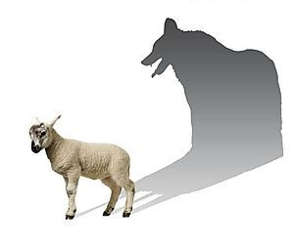
“But there were false prophets also among the people, even as there shall be false teachers among you, who privily shall bring in damnable heresies, even denying the Lord that bought them, and bring upon themselves swift destruction. And many shall follow their pernicious ways.”
Pernicious = Harmful, damaging, destructive, injurious, hurtful, detrimental, dangerous, adverse, unhealthy, unfavorable, bad, evil, wicked, malignant, poisonous.

Slide 13
“By reason of whom the way of truth shall be evil spoken of. And through covetousness shall they with feigned words make merchandise of you: whose judgment now of a long time lingereth not, and their damnation slumbereth not.”
Feigned = fabricate, alter, change

Slide 14
“Knowing this first, that no prophecy of the scripture is of any private interpretation.”

Slide 15
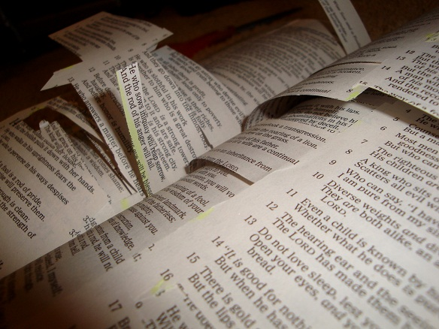
3. Satan causes God’s Word to be taken out of Context

Slide 16
Understanding context begins five basic principles of interpretation
1. literal meaning (what it says) – When the plain sense makes sense seek no other sense.
2. Figurative or symbolic meaning (figure of speech, especially a metaphor; metaphorical and not literal) – Book of the Revelation / Lord’s Table
3. Historical setting (the events of the passage, to whom is it addressed, and how was understood at that time)
4. Grammar (How are the words used in the sentence and paragraph within which they are found. What does the word mean as used in its context)
5. Comparative interpretation (comparing the verse with other parts of Scripture for a fuller meaning)

Slide 17
How Satan perverts the Word of God
1. Causing it to be mistranslated.
2. Causing it to be misinterpreted.
3. Causing it to be taken out of context.
Tonight message continued:
4. Overstressing one side of a doctrine and ignoring the other side.
5. Under stressing certain doctrines.

Slide 18
4. Satan perverts the Word of God by overstressing one side of a doctrine and ignoring the other side

Slide 19
Examples of overstressing one side of a doctrine and ignoring the other side

Slide 20
SALVATION BY FAITH VERSUS SALVATIN BY WORKS

Slide 21
Salvation faith
“For by grace are ye saved through faith; and that not of yourselves: it is the gift of God. Not of works…” (Eph. 2:8-9)

Slide 22
“What doth it profit, my brethren, though a man say he hath faith, and have not works? can faith save him? Ye see then how that by works a man is justified, and not by faith only.”
(James 2:14, 24)
Salvation by works

Slide 23
Salvation by faith
Evidenced by works

Slide 24
SEPARATION FROM THE WORLD VERSES FELLOWSHIP WITH THE WORLD
(1 Corinthians 5:9-10)
“I wrote unto you in an epistle not to company with fornicators: Yet not altogether with the fornicators of this world, or with the covetous, or extortioners, or with idolaters; for then must ye needs go out of the world.”
(1 John 2:15-17)
“Love not the world, neither the things that are in the world. If any man love the world, the love of the Father is not in him. For all that is in the world, the lust of the flesh, and the lust of the eyes, and the pride of life, is not of the Father, but is of the world.”

Slide 25
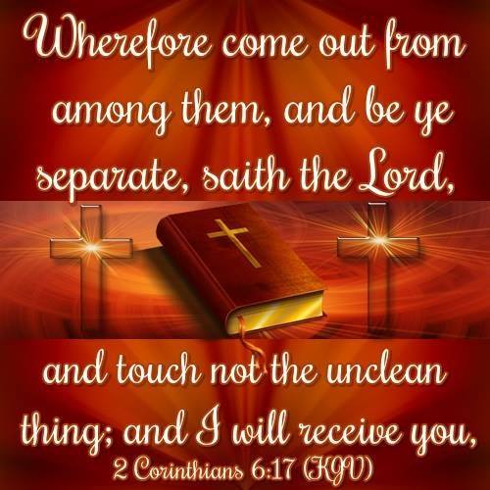

Slide 26
“Come out from among them and be ye separate”

Slide 27
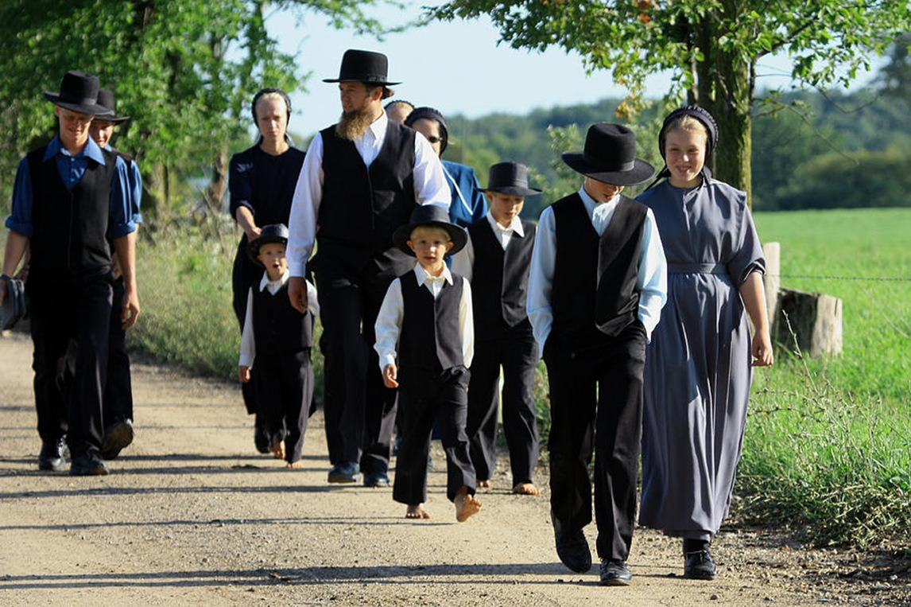

Slide 28
“Go ye into all the world”

Slide 29
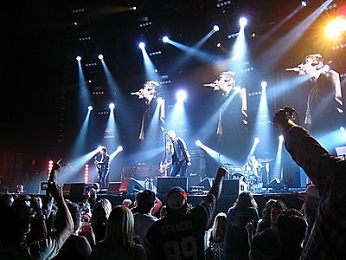

Slide 30
“In the world but not of the world” (John 17)
“Come out from among them and be ye separate”
“Go ye into all the world”

Slide 31
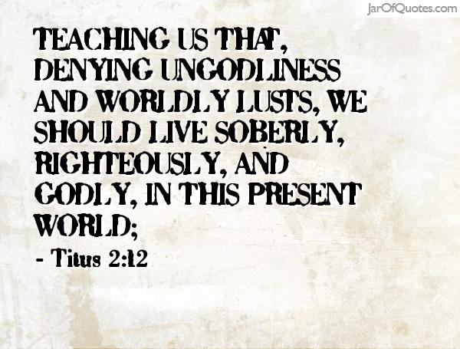

Slide 34
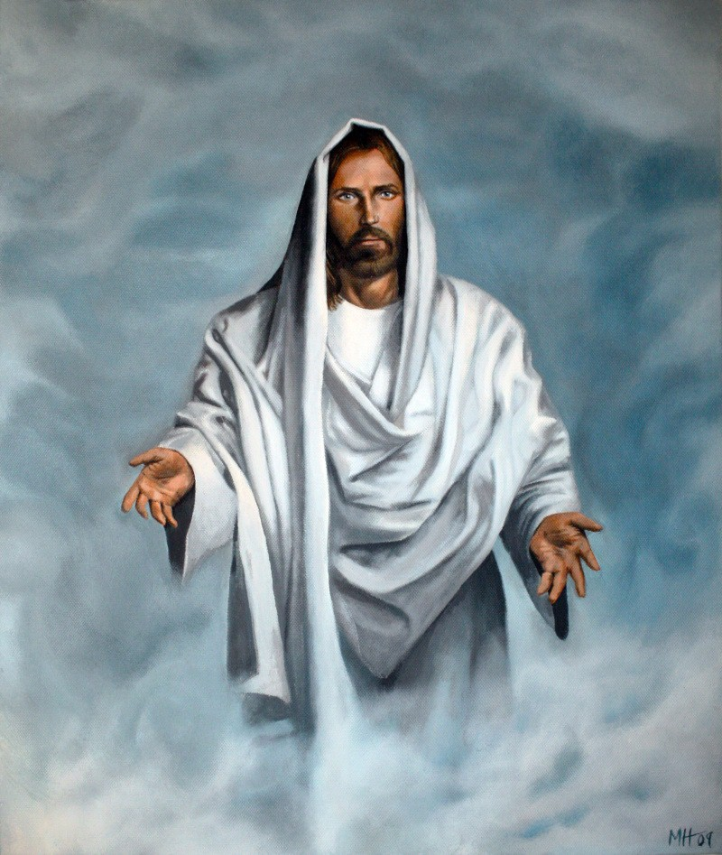
THE HUMANITY OF CHRIST “Son of man” VERSUS THE DEITY OF CHRIST “Son of God”
“I and my Father are one.”
(John 10:33)
“The Jews answered him, saying, For a good work we stone thee not; but for blasphemy; and because that thou, being a man, makest thyself God.”
(John 14:9) “Jesus saith unto him, Have I been so long time with you, and yet hast thou not known me, Philip? he that hath seen me hath seen the Father; and how sayest thou then, Shew us the Father?”

Slide 35
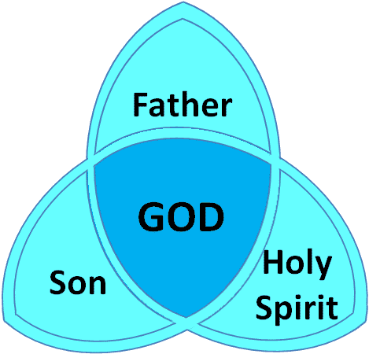
I John 5:7 “For there are three that bear record in heaven, the Father, the Word, and the Holy Ghost: and these three are one.”

Slide 36
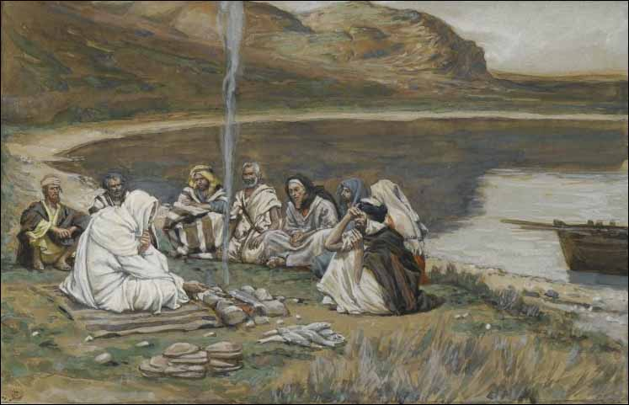
(Matthew 8:20) “And Jesus saith unto him, The foxes have holes, and the birds of the air have nests; but the Son of man hath not where to lay his head.”

Slide 37
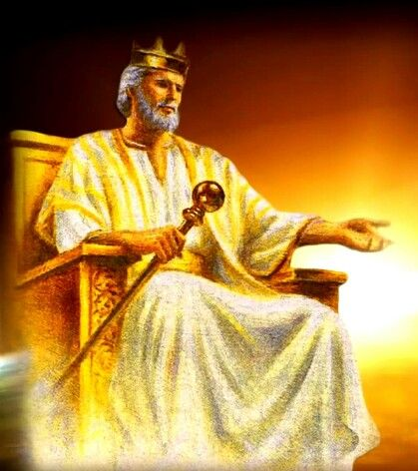
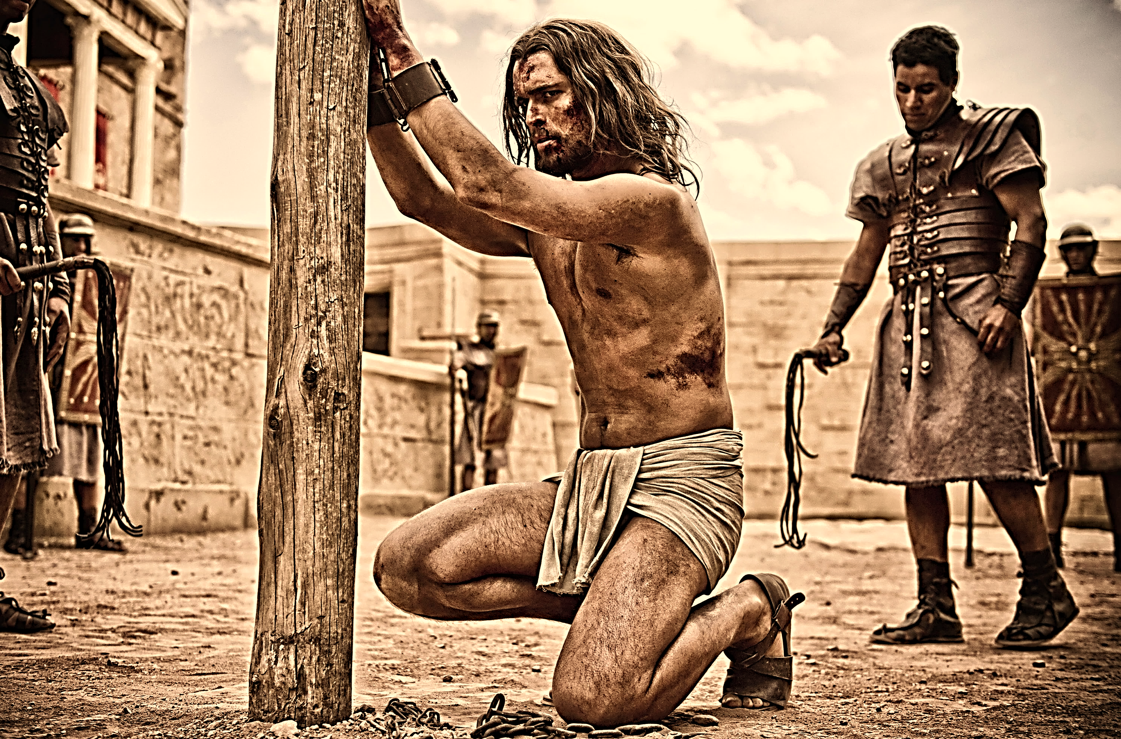
85 times Jesus is called the “son of man” 46 times Jesus is called the “son of God”
100% the “son of man” 100% the “son of God”

Slide 38
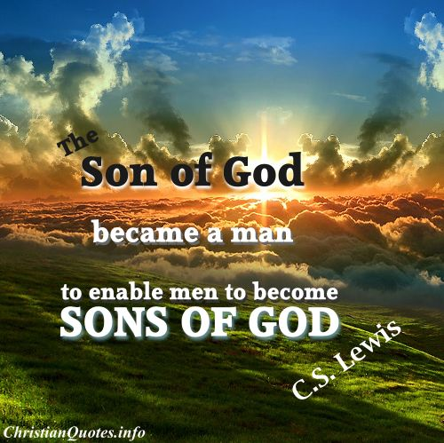

Slide 39
“Deity of Christ”

Slide 40
“Humanity of Christ”

Slide 41
“Humanity of Christ”
“Deity of Christ”

Slide 42
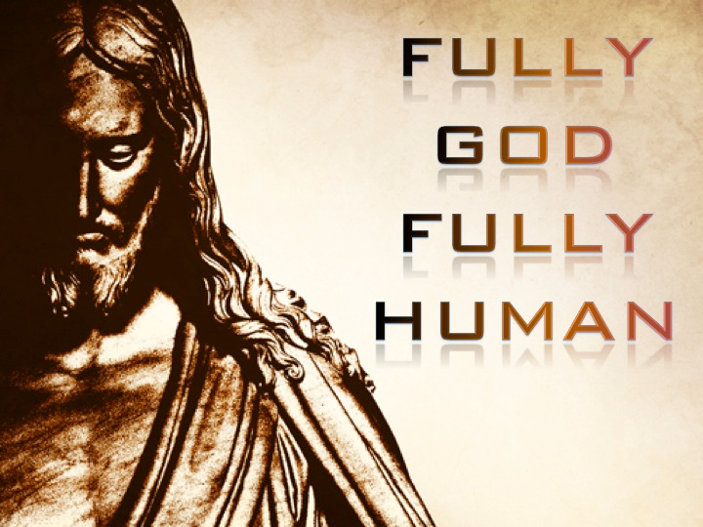

Slide 43
GOD'S SOVEREIGNTY VERSUS MAN'S FREE WILL
(Ephesians 1:4-5) “According as he hath chosen us in him before the foundation of the world, that we should be holy and without blame before him in love: Having predestinated us unto the adoption of children by Jesus Christ to himself, according to the good pleasure of his will.”
(1 Peter 1:2)
“Elect according to the foreknowledge of God the Father, through sanctification of the Spirit, unto obedience and sprinkling of the blood of Jesus Christ.”
(John 1:12)
“But as many as received him, to them gave he power to become the sons of God, even to them that believe on his name.”
MIND OF GOD
MAN'S FREE WILL
GOD'S SOVEREIGNTY

Slide 44
“Sovereignty of God”

Slide 45
“Free will of man”

Slide 46
MIND OF GOD
“Free will of man”
“Sovereignty of God”

Slide 48
“Sovereignty of God”

Slide 49
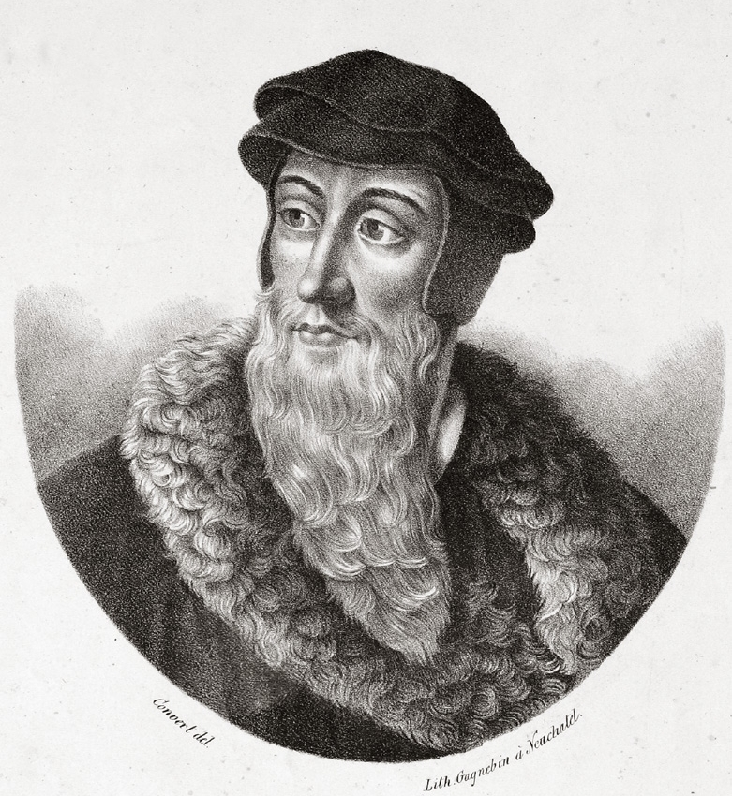
John Calvin (July 10, 1509 – May 27, 1564)

Slide 50
Born and raised Roman Catholic.
He was a Frenchman with a gifted intellect that his father thought would be best suited for the field of law.
Left law school and began to study Roman Catholic theology.
Calvin broke with the Roman Church and was thrown in prison several times for his opposition to Roman Catholic doctrine.
Became the head of the evangelical party in France less than a year after his professed conversion to Christ.
Calvin witnessed his fellow evangelical's tongue cut out and men burned at the stake for their faith.
On one occasion Calvin was rescued from hanging, by several evangelicals who dragged him away.
In 1536, at the age of 27, he wrote the Institutes of the Christian Religion, the most influential book besides the Bible in the progress of the Reformation.

Slide 51
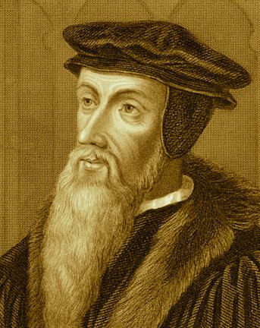
Calvin became a strong and out spoken opponent of Roman Catholic theology.
Major leader of the Protestant Reformation.
Opposed the Catholic churches teaching of “salvation through works” with his doctrine of “predestination.”
Man in his fallen state can in no way merit salvation.
Man is so completely and totally depraved that he possesses no ability (will) to receive the salvation of God apart from the regenerating work of the Holy Spirit.

Slide 52
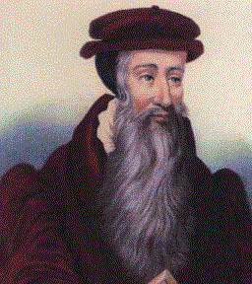
“Regeneration is necessary before one can believe and receive the gospel.” Regeneration is a result of believing and receiving the gospel – (Titus 3:5-9)
“Repent, and be baptized every one of you in the name of Jesus Christ for the remission of sins, and ye shall receive the gift of the Holy Ghost.” Acts 2:38

Slide 53
John Calvin was a minister in France during the Protestant Reformation. Calvin was important in forming Christian theory called Calvinism during the 1500's. Calvinism is a Protestant theological system and an approach to the Christian life. Today, it refers to the doctrines and practices of the Reformed churches of which Calvin was an early leader. It is best known for its doctrines of predestination and total depravity, stressing the absolute sovereignty of God. Calvin believed that God willed eternal damnation for some people and eternal salvation for others. A person’s eternal destination is predetermined.

Slide 54
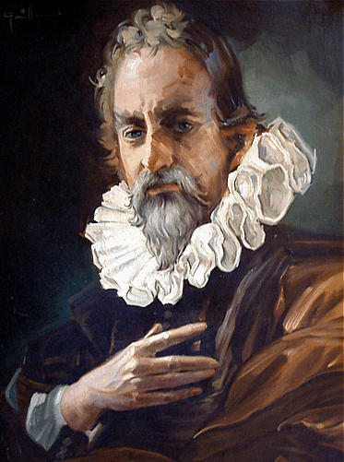
"We call predestination God’s eternal decree, by which He determined what He willed to become of each man. For all are not created in equal condition; rather, eternal life is ordained for some, eternal damnation for others."

Slide 55
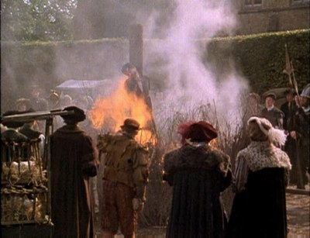
On October 27, 1553 John Calvin, the founder of Calvinism, had Michael Servetus, a protestant and respected Spanish physician, burned at the stake outside of Geneva for his doctrinal disagreements with Calvin.

Slide 56
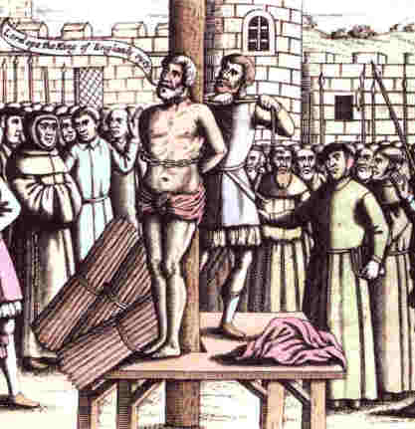
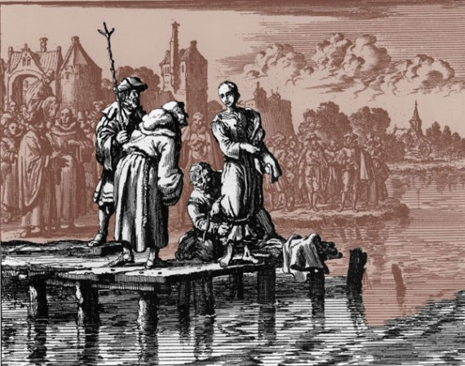
From 1541 to 1546, John Calvin caused 58 people to be executed and seventy six exiled. His victims ranged in age from 16 to 80. The most common capital offense was the opposition to infant baptism.

Slide 57
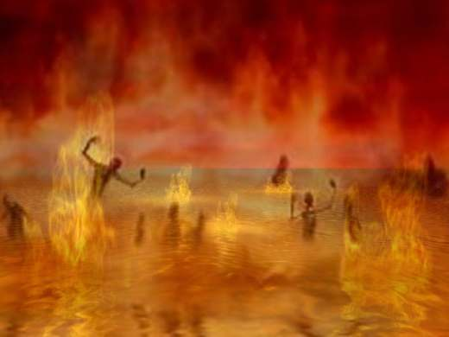
“…ye know that no murderer hath eternal life abiding in him...” I John 3:15

Slide 58
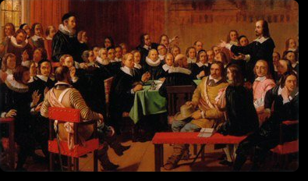
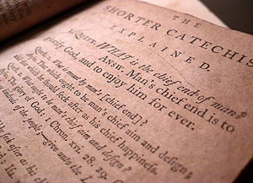
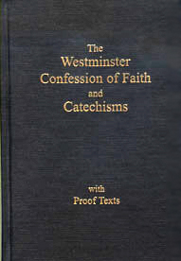
THE WESTMINSTER CONFESSION OF FAITH
God's Eternal Decree
Written in the 1646 by English
and Scottish clergymen

Slide 59
I. God from all eternity, did, by the most wise and holy counsel of His own will, freely, and unchangeably ordain whatsoever comes to pass.
II. Although God knows whatsoever may or can come to pass upon all supposed conditions; yet has He not decreed anything because He foresaw it as future, or as that which would come to pass upon such conditions.

Slide 60
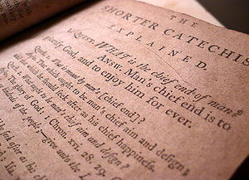
III. By the decree of God, for the manifestation of His glory, some men and angels are predestinated unto everlasting life; and others foreordained to everlasting death.

Slide 61
V. Those of mankind that are predestinated unto life, God, before the foundation of the world was laid, according to His eternal and immutable purpose, and the secret counsel and good pleasure of His will, has chosen, in Christ, unto everlasting glory, out of His mere free grace and love, without any foresight of faith.
“Elect according to the foreknowledge of God the Father.” I Peter 1:2
“For whom he did foreknow, he also did predestinate…” Rom. 8:29

Slide 62
VII. The rest of mankind God was pleased, according to the unsearchable counsel of His own will, whereby He extends or withholds mercy, as He pleases, for the glory of His sovereign power over His creatures, to pass by; and to ordain them to dishonor and wrath for their sin, to the praise of His glorious justice.

Slide 63
“Say unto them, As I live, saith the Lord GOD, I have no pleasure in the death of the wicked; but that the wicked turn from his way and live: turn ye, turn ye from your evil ways; for why will ye die.” (Ezek. 33:11)

Slide 64
Calvinism

Slide 65
Calvinism teaches that some men are predestinated to Heaven and others are predestinated to Hell. It is strictly God’s choice and man can not change it. In other words, the elect can not become non-elect and the non-elect can not become elect (saved). The non-elect are damned to hell with no chance of escaping. It is strictly God’s sovereign choice. Man has no will in the matter.

Slide 66
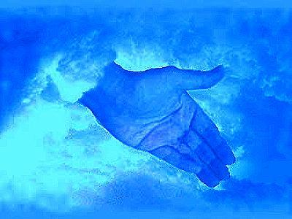
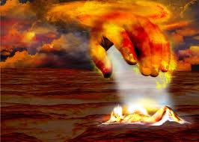
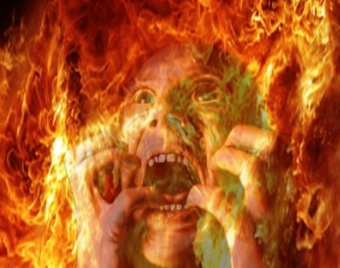

Slide 67
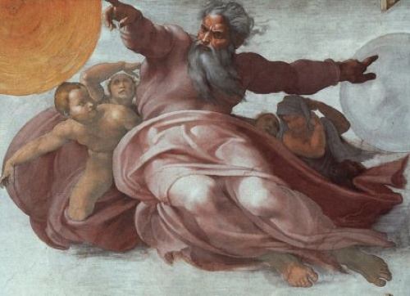
You are non-elect, doomed to hell with no choice on your part.
Is this the mercifully gracious God of the Bible or is this the false god of John Calvin?

Slide 70
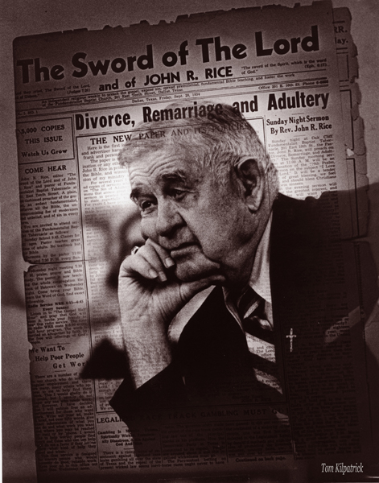
John Calvin, a great theologian, was right in saying that people are saved by grace alone and kept by grace alone. But the teaching that some people, by the foreordained plan of God, are predestined to be saved and some are predestined to be lost, and that their destinies were settled before they were born, is a wicked heresy contrary to the Bible, that dishonors God and has done incalculable harm.

Slide 71
5. Satan perverts the Word of God by under stressing certain doctrines

Slide 72
Inspiration and Preservation of the Holy Scriptures
Deity of Christ
Justification by Grace through Faith
Ministry of the Holy Spirit
Holy living
Obedience to God’s commandments
Separation from worldliness
Bible study
Prayer and meditation
Reality of Hell - Literal eternal Lake of Fire
The importance of the Local Church
God’s design for marriage
Permanency of marriage
God’s design for the family
Evangelism of the lost
Missions
Eternal focus in life vs. Temporal focus
Sin – Unchanging moral absolutes

Slide 73
25 Historical Fundamentals of the Faith
1. The inspiration and preservation of the Bible
2. The Trinity
3. The attributes of God – omniscience, omnipotence, omnipresent, eternal, immutable, sovereign, holy, righteous, loving, gracious, just and truth.
4. The virgin birth
5. The deity of Christ
6. The resurrection of Jesus Christ
7. The existence of angels
8. The existence of demons
9. The existence of Satan
10. A literal heaven
11. A literal hell
12. The depravity of man
13. Salvation by grace through
14. Ordinances of Baptism and the Lord’s Table
15. Separation from worldliness
16. Separation from religious apostasy
17. Autonomy of the local church –
The church as the absolute right of self-government free from any interference of any hierarchy, individuals, or organization. The one and only head being the Lord Jesus Christ.
18. Separation of church and state
19. Priesthood of the believer
20. Soul liberty
21. The sovereignty of God
22. The free will of man
23. The pre-millennial rapture of the church
24. The Second Advent of Jesus Christ
25. The millennial reign of Jesus Christ

Slide 74
“Biblical Doctrine”

Slide 75
“Exhortation”

Slide 76
“Biblical Doctrine”
“Exhortation”

Slide 77
“Whom we preach, warning every man, and teaching every man in all wisdom; that we may present every man perfect in Christ Jesus.” (Col. 1:28)

Slide 78
“Teaching”

Slide 79
“Preaching”

Slide 80
“Teaching”
“Preaching”

Slide 81
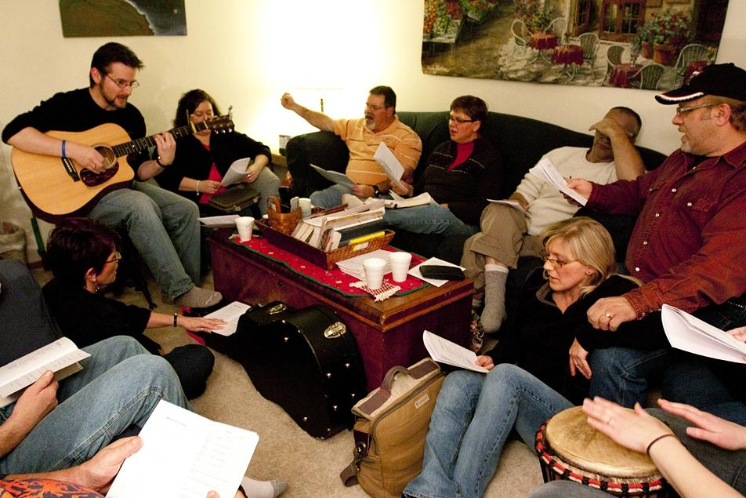

Slide 82
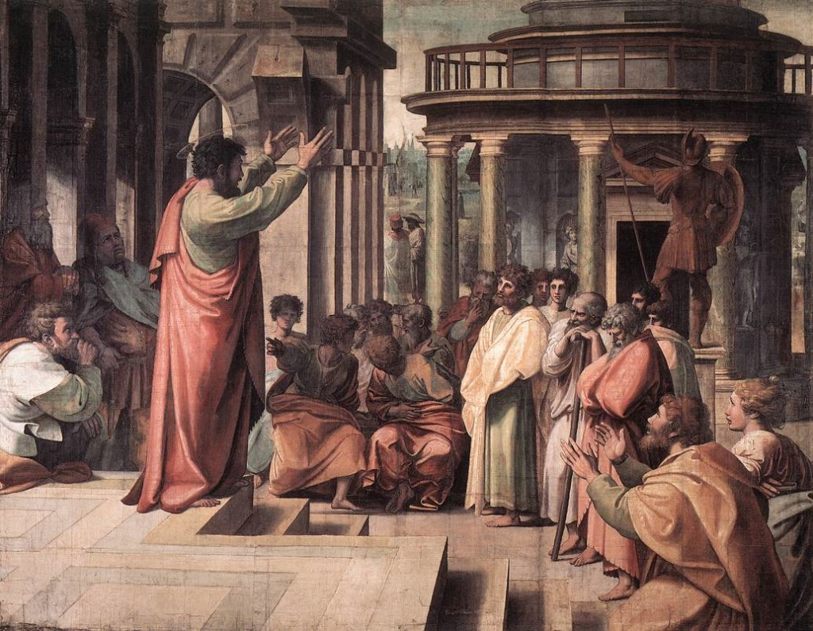
“For I have not shunned to declare unto you all the counsel of God.”

Slide 83
How Satan perverts the Word of God
1. Causing it to be mistranslated.
2. Causing it to be misinterpreted.
3. Causing it to be taken out of context
4. Overstressing one side of a doctrine and ignoring the other side.
5. Under stressing certain doctrines.

