Slide 1
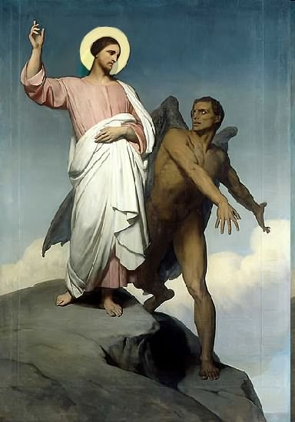

Slide 2
Topics to be studied
His existence
His origin
His fall
His personality
His names
His activities (Part 18)
His location – present and future
Our victory over him

Slide 4
Satan imitates God?

Slide 5
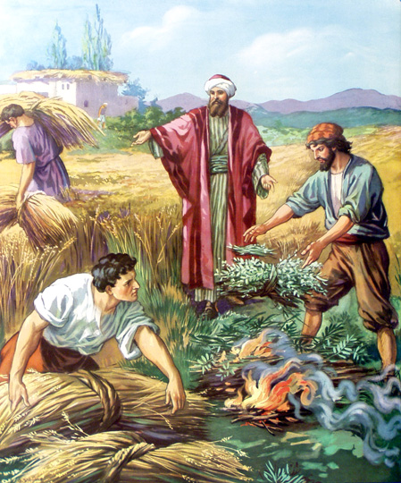
Matthew 13:24-42
Satan sows tares among God’s wheat

Slide 6
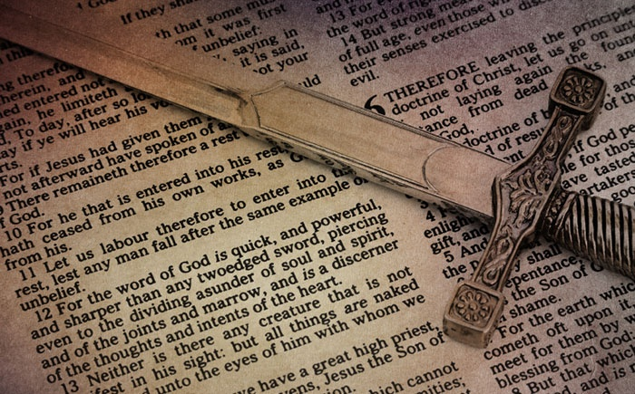
Satan perverts the Word of God

Slide 7
Satan lays snares for men
“And that they may recover themselves out of the snare of the devil, who are taken captive by him at his will.”
(2 Tim. 2:26)

Slide 8
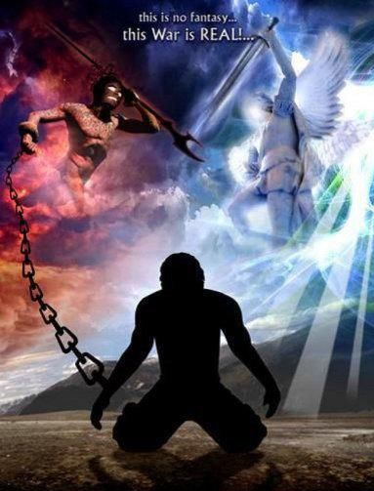
Satan hinders the work of the ministry
(1 Thessalonians 2:17-18) “But we, brethren, being taken from you for a short time in presence, not in heart, endeavored the more abundantly to see your face with great desire. Wherefore we would have come unto you, even I Paul, once and again; but Satan hindered us.”

Slide 9
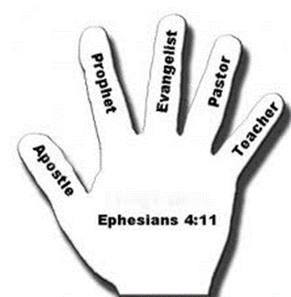
(Ephesians 4:11-13) “And he gave some, apostles; and some, prophets; and some, evangelists; and some, pastors and teachers; For the perfecting of the saints, for the work of the ministry, for the edifying of the body of Christ: Till we all come in the unity of the faith, and of the knowledge of the Son of God, unto a perfect man, unto the measure of the stature of the fullness of Christ.”

Slide 10
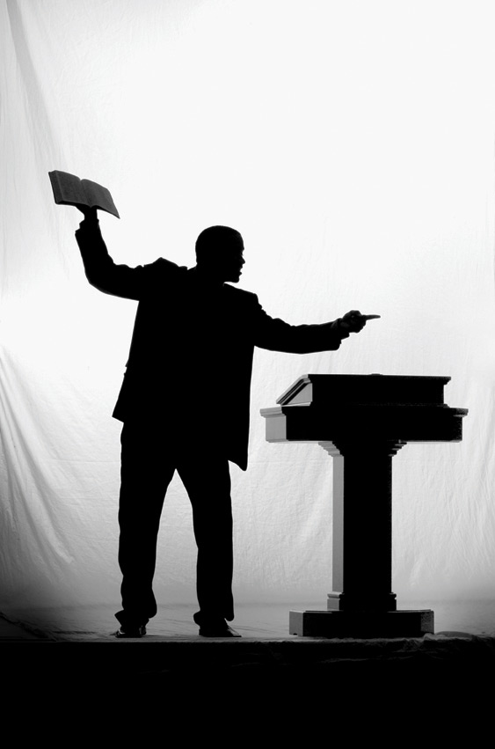
The Ministry of the Pastor

Slide 11
[ 1 ] Admonish - I Thessalonians 5:12
[ 2 ] EDIFY - I Corinthians 14:3
[ 3 ] EXHORT - I Corinthians 14:3
[ 4 ] Comfort - I Corinthians 14:3
[ 5 ] preach - Colossians 1:28
[ 6 ] warn- Colossians 1:28
[ 7 ] teach - Colossians 1:28
[ 8 ] reprove - II Timothy 4:2
[ 9 ] Rebuke - II Timothy 4:2
[10] charge - I Timothy 1:3
[11] counsel - Proverbs 11:14
[12] doctrine - Titus 1:9
[13] correction - II Timothy 3:16
[14] instruction - II Timothy 3:16

Slide 12
[ 1 ] Admonish - I Thessalonians 5:12
[ 2 ] EDIFY - I Corinthians 14:3
[ 3 ] EXHORT - I Corinthians 14:3
[ 4 ] Comfort - I Corinthians 14:3
[ 5 ] preach - Colossians 1:28
[ 6 ] warn- Colossians 1:28
[ 7 ] teach - Colossians 1:28
[ 8 ] reprove - II Timothy 4:2
[ 9 ] Rebuke - II Timothy 4:2
[10] charge - I Timothy 1:3
[11] counsel - Proverbs 11:14
[12] doctrine - Titus 1:9
[13] correction - II Timothy 3:16
[14] instruction - II Timothy 3:16

Slide 13
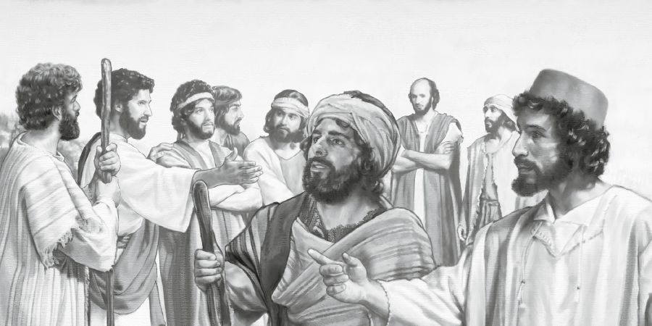
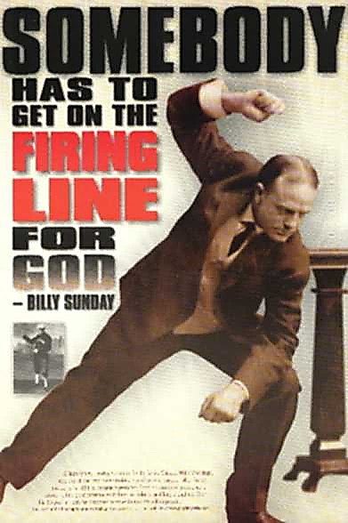

Slide 14
Those who do the least usually criticize the most

Slide 15
Every believer is to be involved the work of the ministry
(1 Peter 4:10)
“As every man hath received the gift, even so minister the same one to another, as good stewards of the manifold grace of God.”
(1 Corinthians 4:1-2)
“Let a man so account of us, as of the ministers of Christ, and stewards of the mysteries of God. Moreover it is required in stewards, that a man be found faithful.”

Slide 17
Though Satan is in principle defeated (1 John 4:4), we still need to be delivered from this present evil world which is controlled by the “god of this world” (Satan) –
“Who gave himself for our sins, that he might deliver us from this present evil world, according to the will of God and our Father: To whom be glory for ever and ever. Amen.” (Gal 1:4)
We must “fight” … “For we wrestle not against flesh and blood, but against principalities, against powers, against the rulers of the darkness of this world, against spiritual wickedness in high places. Wherefore take unto you the whole armor of God, that ye may be able to withstand in the evil day, and having done all, to stand. Stand therefore” (Eph. 6:12-14)

Slide 18
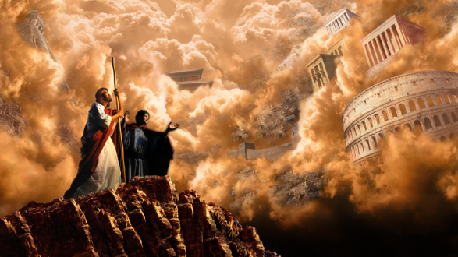
Just as in the days of Jesus, the kingdom of Satan focuses most of its activity on hindering the advancement of the kingdom of God – Matt. 4 “The temptation of Christ”

Slide 19
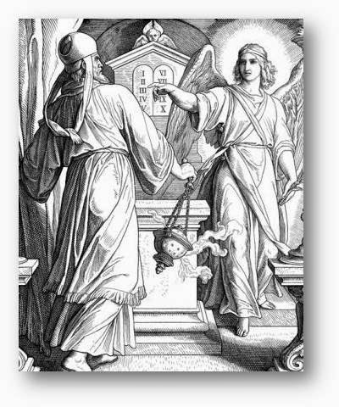
When the church is advancing God’s kingdom, the kingdom of darkness will be at work and on the attack against such a church: Zechariah 3:1 “And he shewed me Joshua the high priest standing before the angel of the LORD, and Satan standing at his right hand to resist him.”

Slide 20
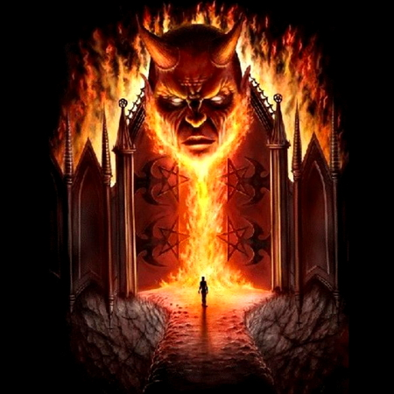
God’s Promise
Remember Jesus’ promise in Matthew 16:18 “I will build my church, and the gates of hell shall not prevail against it.”

Slide 21
The church at Smyrna (Revelation 2:10) “Fear none of those things which thou shalt suffer: behold, the devil shall cast some of you into prison, that ye may be tried; and ye shall have tribulation ten days: be thou faithful unto death, and I will give thee a crown of life.”

Slide 22
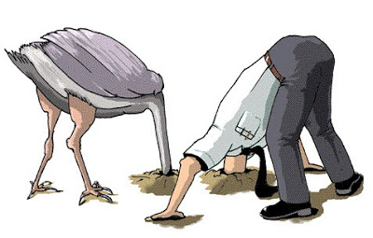
So many Christians are totally ignorant of how Satan operates in the world, their own personal lives, their families and the church: “But he turned, and said unto Peter, Get thee behind me, Satan: thou art an offence unto me: for thou savourest not the things that be of God, but those that be of men.” (Matthew 16:23)
“Now I would not have you ignorant, brethren…”
“I would not have you ignorant.”
“But, beloved, be not ignorant…”
“But I would not have you to be ignorant, brethren…”
“Lest Satan should get an advantage of us: for we are not ignorant of his devices.”

Slide 23
(2 Corinthians 6:1-2, 4) “We then, as workers together with him, beseech you also that ye receive not the grace of God in vain…Giving no offence in any thing, that the ministry be not blamed: But in all things approving ourselves as the ministers of God.”

Slide 24
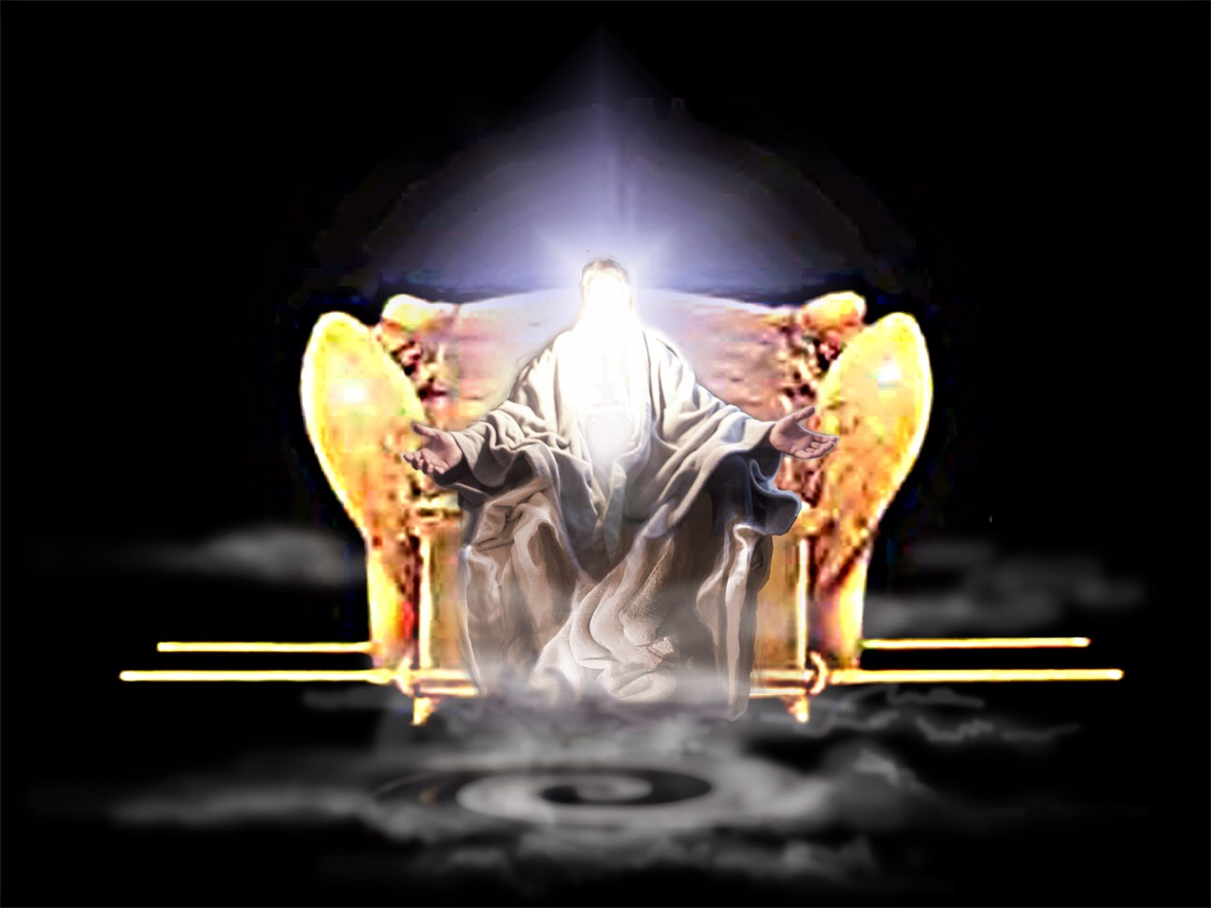
Has Satan used you to hinder the work of the ministry?

Slide 25
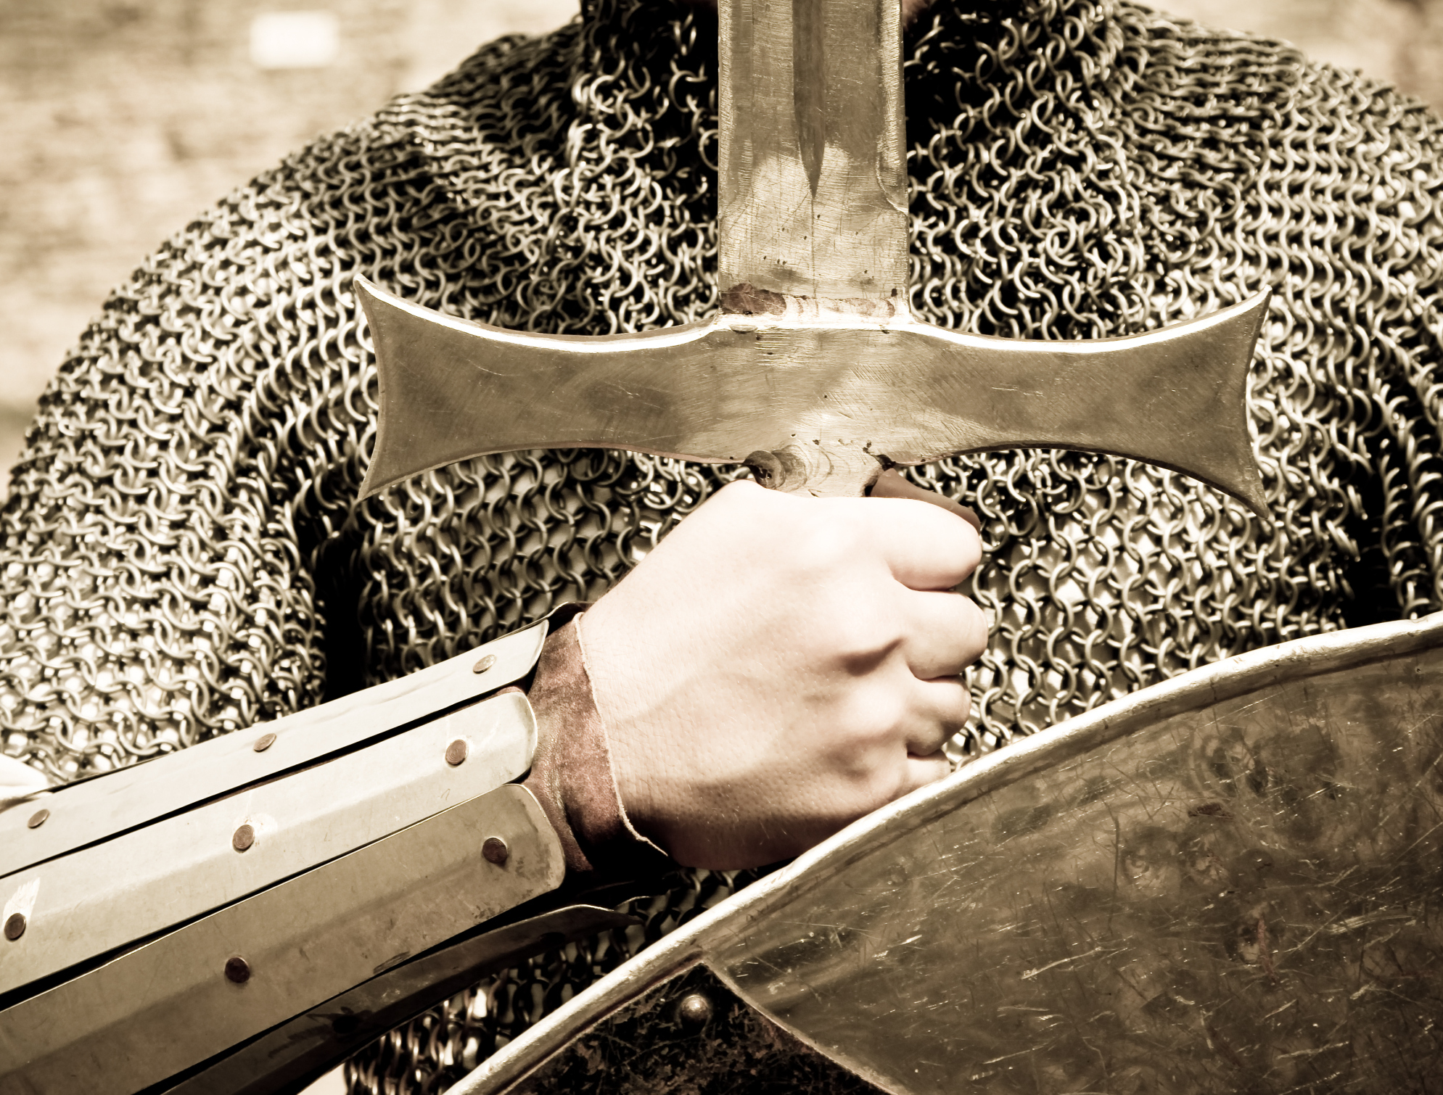
How Satan hinders the work of the ministry

Slide 26
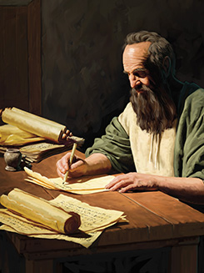
(1 Thessalonians 2:17-18) “But we, brethren, being taken from you for a short time in presence, not in heart, endeavored the more abundantly to see your face with great desire. Wherefore we would have come unto you, even I Paul, once and again; but Satan hindered us.”

Slide 27
The inability of Paul to visit the new Church at Thessalonica was not because of a lack of desire. He prayed hard to visit them - “For your sakes, before our God, night and day, praying exceedingly that we might see your face.” [1 Thessalonians 3:9-10].
He wanted, he wished, he longed to visit them but Satan hindered him from going.
We do not know what the hindrance was but whatever it was it was effective in keeping Paul from visiting these new believers who were in great need of discipleship.
Satan the master of all evil was watching intently the ministry of the Apostle seeking and succeeding in hindering him.

Slide 28
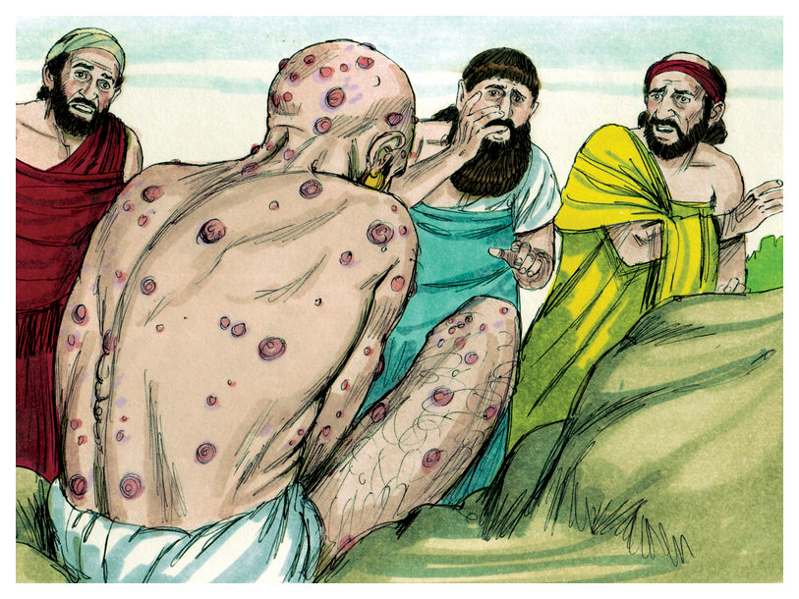
Job
Job was buffeted, and beat, and bruised, hurt, and ruined by Satan [Job 1:13-19].
His sorrows did not end until he was cast in the ash heap, deprived of health, children, home, and property.
Satan did it [Job 1:6-12, 2:1-7]

Slide 29
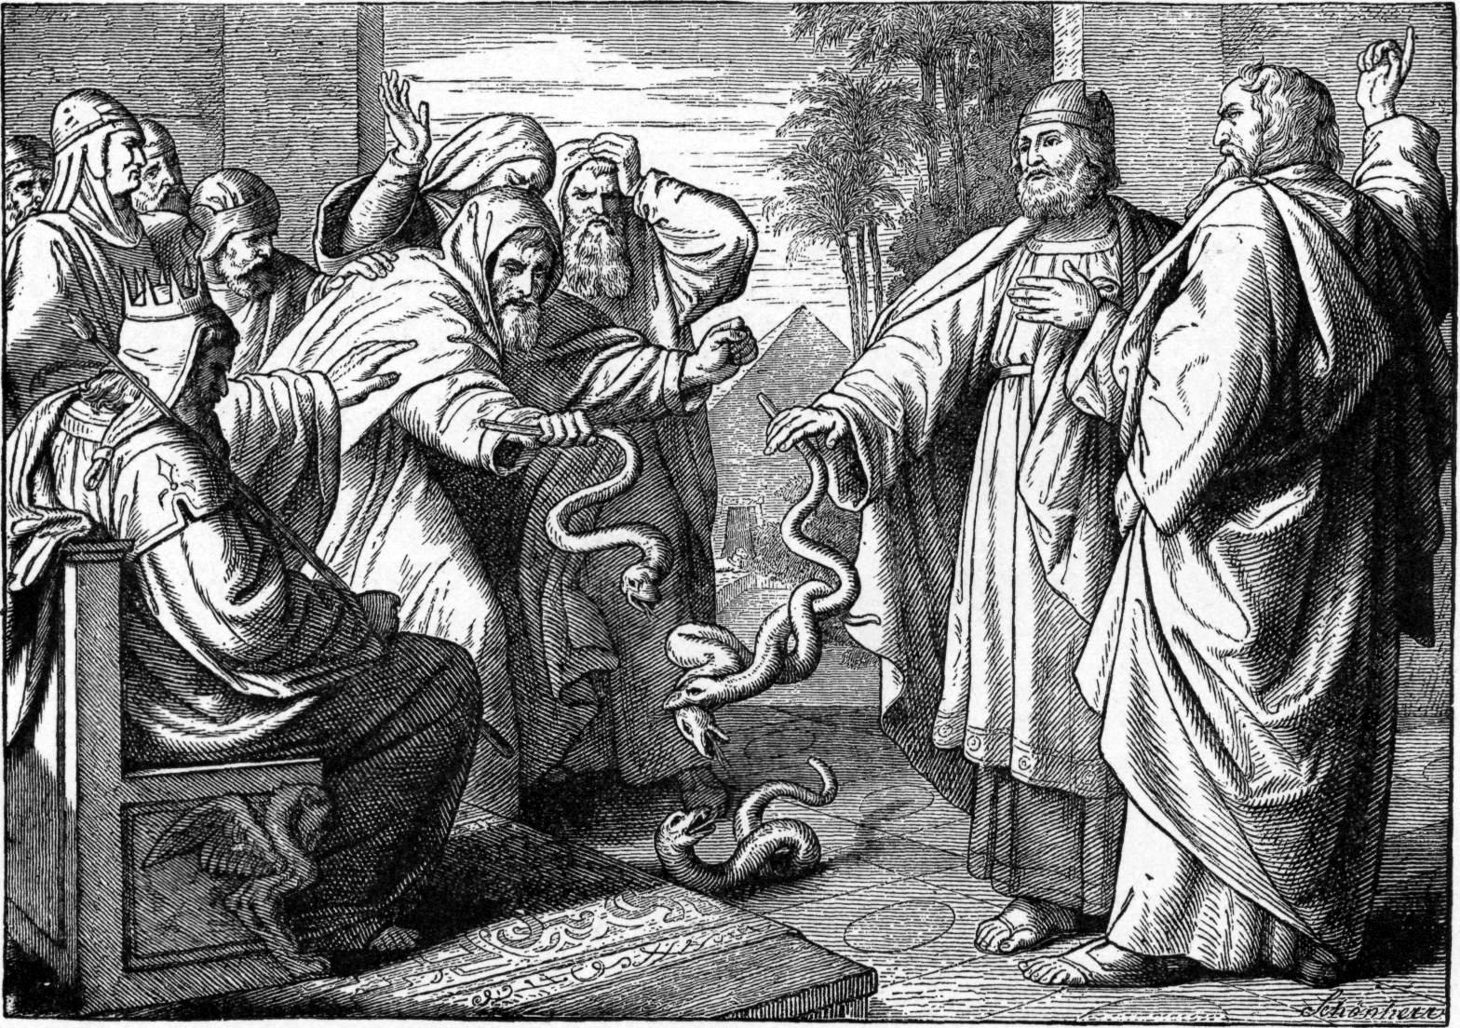
Moses
When Moses stood to lead God’s people, Jannes and Jambres stood up to oppose him: They were the messengers of Satan. [Exodus 7:11; 2 Timothy 3:8]

Slide 30
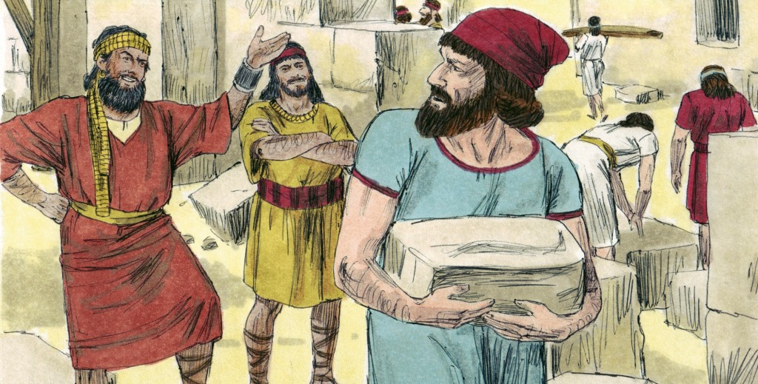
Nehemiah
When Nehemiah put his hand to the work of building up the wall of Jerusalem laboring and toiling to restore the city of God, there was Sanballat and Tobiah who sought to hinder him: They were the messengers of Satan. [Nehemiah 4:7-8]

Slide 31
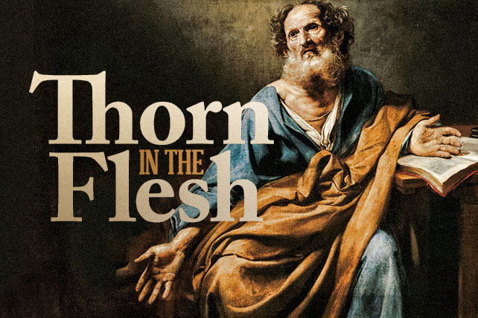

Slide 32
“And lest I should be exalted above measure through the abundance of the revelations, there was given to me a thorn in the flesh, the messenger of Satan to buffet me, lest I should be exalted above measure. For this thing I besought the Lord thrice, that it might depart from me. And he said unto me, My grace is sufficient for thee: for my strength is made perfect in weakness. Most gladly therefore will I rather glory in my infirmities, that the power of Christ may rest upon me. Therefore I take pleasure in infirmities, in reproaches, in necessities, in persecutions, in distresses for Christ's sake: for when I am weak, then am I strong.” (2 Corinthians 12:7-10)

Slide 33
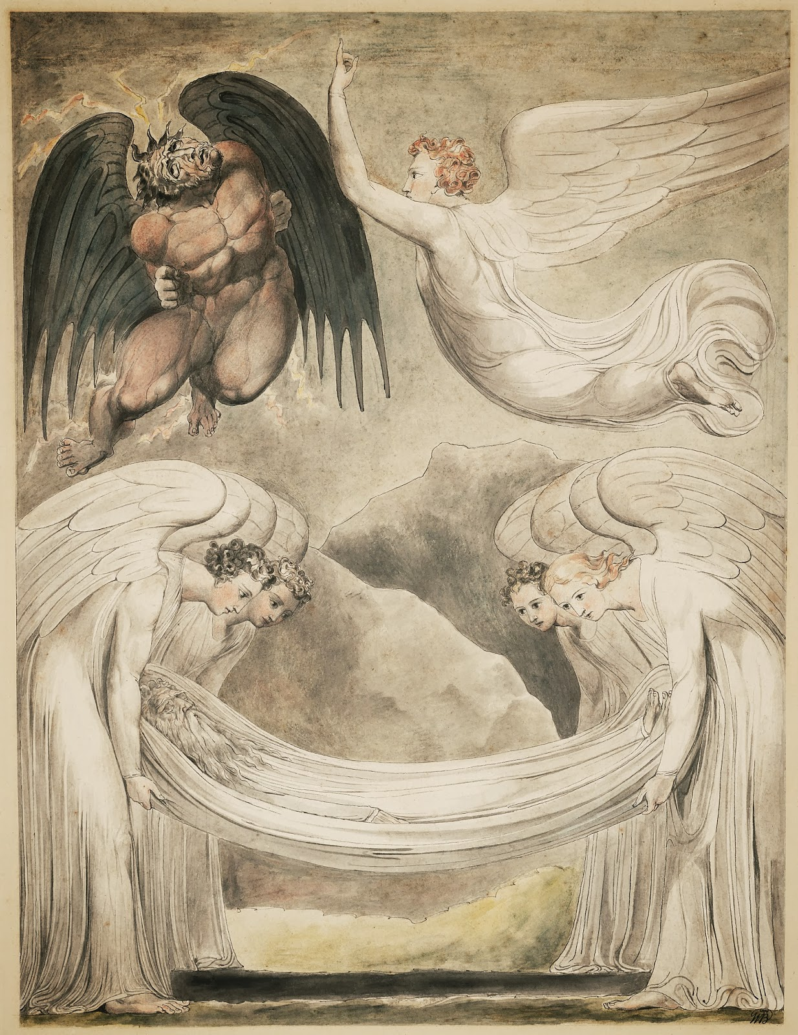
Michael the archangel
“Yet Michael the archangel, when contending with the devil he disputed about the body of Moses, durst not bring against him a railing accusation, but said, The Lord rebuke thee.”
[Jude 1:9]

Slide 34
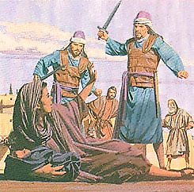
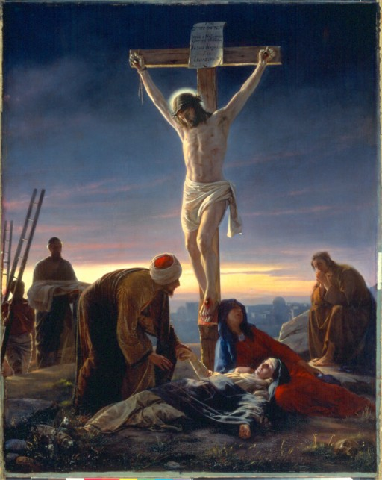
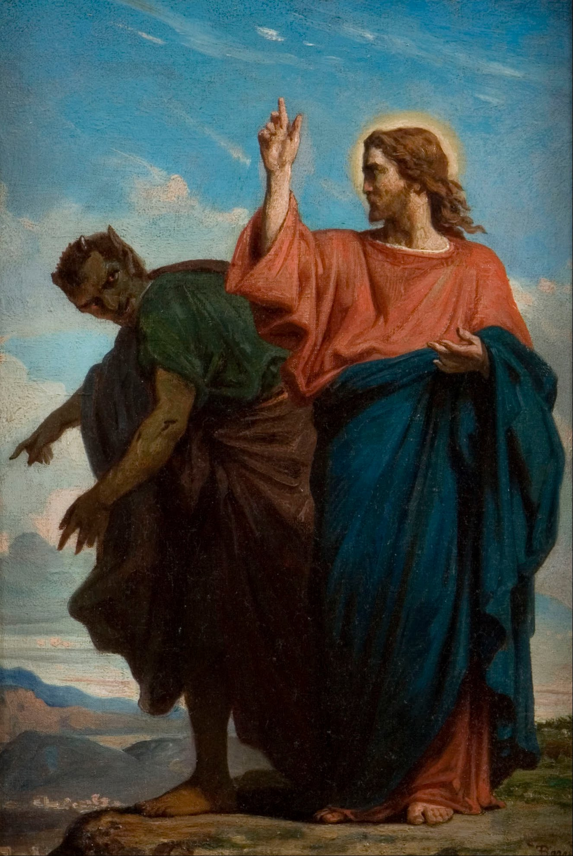
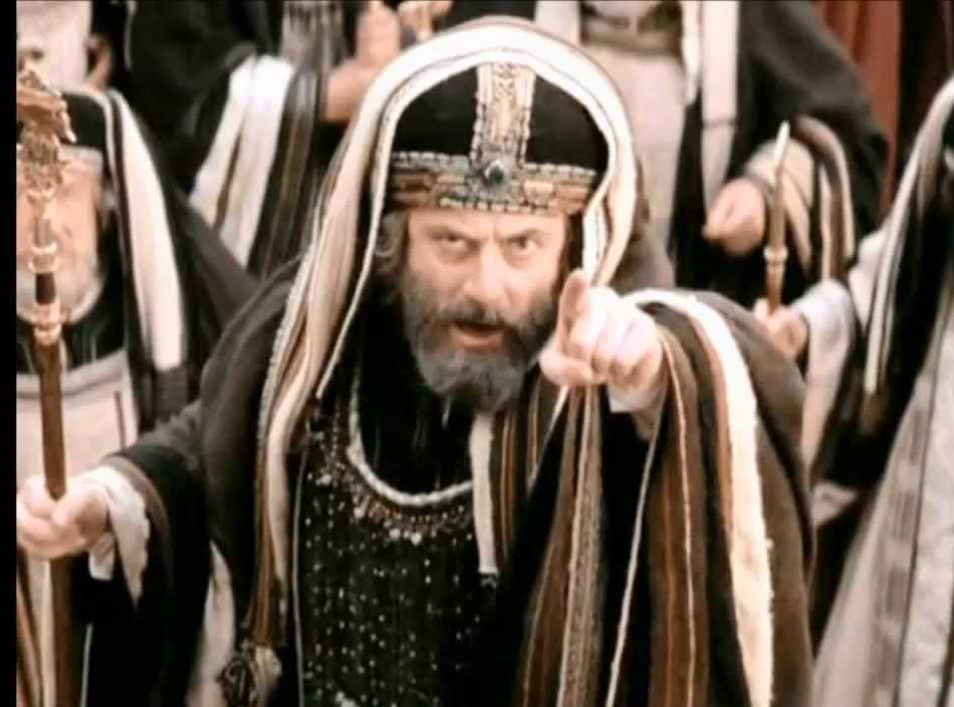
Jesus Satan the fierce adversary of Christ opposed the ministry of the Lord Jesus
He stood over His manger with a bloody sword.
When Jesus entered into His ministry, there in the wilderness Satan sought to tempt Him away
from His mission [Luke 4:1-12].
Then it says: “And Satan left Him for a season” [Luke 4:13].
Throughout Jesus ministry, He was attacked over and over again by the Sadducee, and Pharisee, and Herodian, and Zealot.
Finally he was forsaken by His own Disciples.

Slide 35
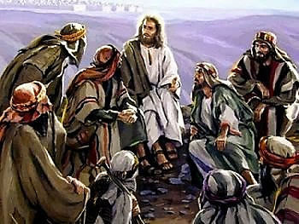
(Luke 6:26) “Woe unto you, when all men shall speak well of you! for so did their fathers to the false prophets.”
(John 15:18-19) “If the world hate you, ye know that it hated me before it hated you. If ye were of the world, the world would love his own: but because ye are not of the world, but I have chosen you out of the world, therefore the world hateth you.”

Slide 36
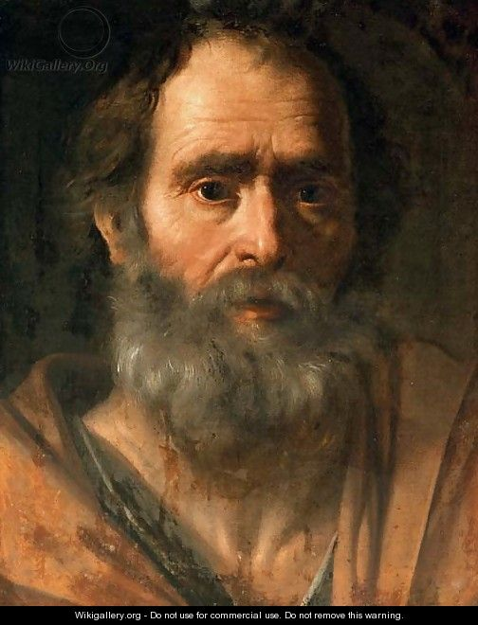
“Having a good conscience; that, whereas they speak evil of you, as of evildoers, they may be ashamed that falsely accuse your good conversation in Christ.” (1 Peter 3:16)

Slide 37
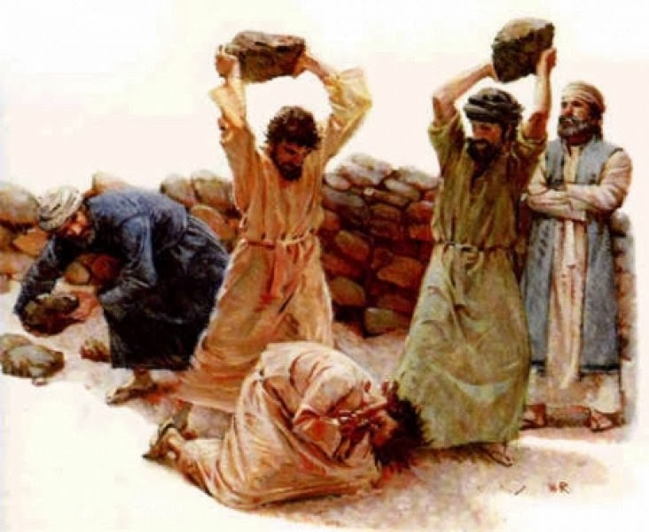
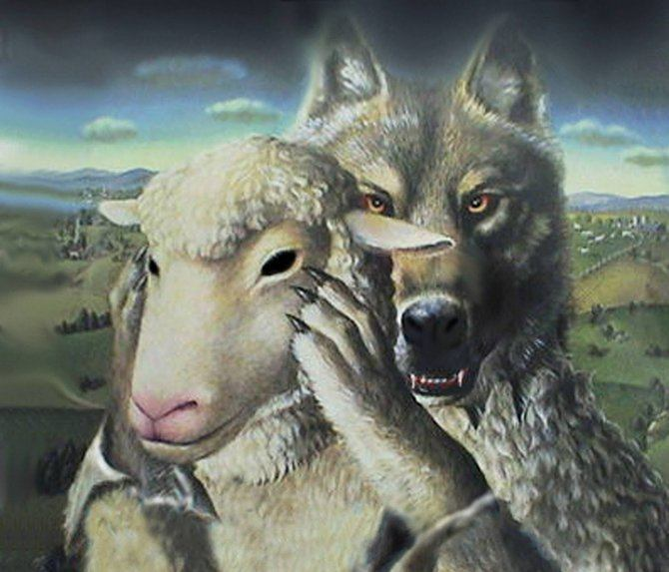
The early Church
The account of the early (infant) Church in the book of Acts records Satan hindering it, fighting and warring against it by persecution which begin with the stoning of Stephen –
(see Acts chapter 7)
When persecution failed, Satan attacked the early church through heresy, false teachers, false doctrine and divisions.
[1 Corinthians 1:10-12; Galatians 1:6-9]

Slide 38
Satan also sought to hinder the work of the ministry in the Church at Corinth through encouraging the toleration of sin
within the Church body.
“It is reported commonly that there is fornication among you, and such fornication as is not so much as named among the Gentiles, that one should have his father's wife. And ye are puffed up, and have not rather mourned, that he that hath done this deed might be taken away from among you. For I verily, as absent in body, but present in spirit, have judged already, as though I were present, concerning him that hath so done this deed, In the name of our Lord Jesus Christ, when ye are gathered together, and my spirit, with the power of our Lord Jesus Christ, To deliver such an one unto Satan for the destruction of the flesh, that the spirit may be saved in the day of the Lord Jesus. Your glorying is not good. Know ye not that a little leaven leaveneth the whole lump?

Slide 39
Purge out therefore the old leaven, that ye may be a new lump, as ye are unleavened. For even Christ our Passover is sacrificed for us: Therefore let us keep the feast, not with old leaven, neither with the leaven of malice and wickedness; but with the unleavened bread of sincerity and truth. I wrote unto you in an epistle not to company with fornicators: Yet not altogether with the fornicators of this world, or with the covetous, or extortioners, or with idolaters; for then must ye needs go out of the world. But now I have written unto you not to keep company, if any man that is called a brother be a fornicator, or covetous, or an idolater, or a railer, or a drunkard, or an extortioner; with such an one no not to eat. For what have I to do to judge them also that are without? do not ye judge them that are within? But them that are without God judgeth. Therefore put away from among yourselves that wicked person.”

Slide 40
Examples of how Satan hinders the work of the ministry

Slide 41
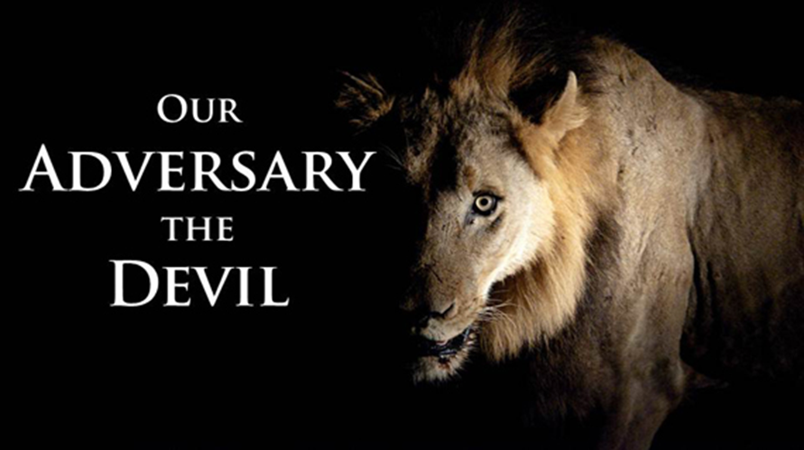
Pride – I Tim. 3:7
Bad Spirit / Disgruntled / Dissatisfied / Discontented – Col. 3:8
Complaints – Phil. 2:14
Gossip / Slander / Spreading evil reports – 2 Cor. 6:8
Division – Rom. 16:17-20
Wolves – Acts 20:29
Tares - Matt. 13:25
Lack of vision – Acts 16:10
Lack of burden – Gal. 6:20
Lack of service – Col. 3:20

Slide 42
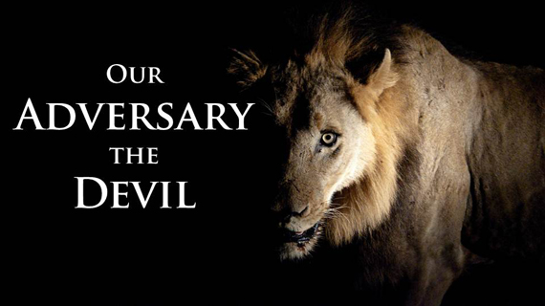
Lack of faithfulness – 1 Cor. 4:2
Lack of giving – 2 Cor. 8-10
Lack of prayer – Dan. 10:13
Lack of love / compassion / mercy – Eph. 4:32
Worldliness / Carnality – 1 Cor. 3:1-10
Immorality – 1 Cor. 5:1-11
False teaching – 2 Peter 2:1-22
Compromise – 2 Thess. 2:15
Confusion – James 3:16
Jealousy – Prov. 6:34
Bitterness – Heb. 12:15

Slide 43
Lack of commitment – Luke 9:62
Corruption – Gal. 6:8
Distraction – 2 Tim. 2:4
Discouragement - 1 Thess. 3:5
Sin in the body – Gal. 5:9
Toleration of sin in the body – 2 Thess. 2:14
Opposition to preaching – Matt. 13:19
False accusation against the pastor – 1 Tim 3:7, 1 Thess. 5:13-14
Etc.

Slide 44
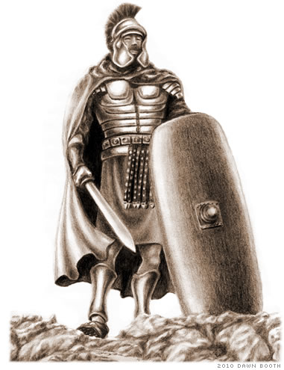
We must stand in opposition to Satan’s hindrances
Resist the Devil – James 4:7
Confront those who sow discord – Prov. 6:14-16
Put on the whole Armor of God – Eph. 6:10-18
Walk in obedience – 2 Cor. 10:6
Live out our Faith – Gal. 2:20
Stay in the Word – Psalm 119
Meditate on Scripture – Psalm 119
Be fervent Prayer – James 5:16
Fast – Isa. 58:6
Mutual edification and encouragement – 1 Thess. 5:11
Stay faithful to God and His Church – Heb. 10:23

