Slide 1
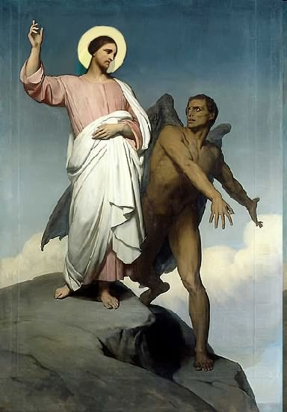

Slide 2
Topics to be studied
His existence
His origin
His fall
His personality
His names
His activities (Part 24)
His location – present and future
Our victory over him

Slide 4
Satan imitates God?

Slide 5
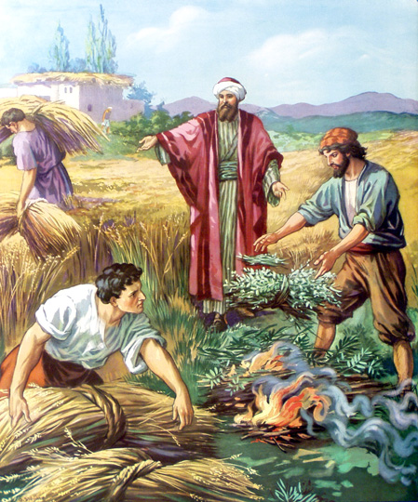
Matthew 13:24-42
Satan sows tares among God’s wheat

Slide 6
Satan perverts the Word of God
“For we are not as many, which corrupt the word of God.”
(2 Cor. 2:17)

Slide 7
Satan lays snares for men
“And that they may recover themselves out of the snare of the devil, who are taken captive by him at his will.”
(2 Tim. 2:26)

Slide 8
Satan hinders the work of the ministry
(1 Thessalonians 2:17-18) “But we, brethren, being taken from you for a short time in presence, not in heart, endeavoured the more abundantly to see your face with great desire. Wherefore we would have come unto you, even I Paul, once and again; but Satan hindered us.”

Slide 9
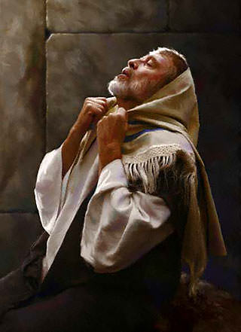
Satan resists the prayers of God’s servants
“Then said he unto me, Fear not, Daniel: for from the first day that thou didst set thine heart to understand, and to chasten thyself before thy God, thy words were heard, and I am come for thy words. But the prince of the kingdom of Persia (Satan) withstood me one and twenty days: but lo, Michael, one of the chief princes, came to help me; and I remained there with the kings of Persia.” (Dan. 10:12-13)

Slide 10
Satan blinds men from the truth of God’s Word
“Having the understanding darkened, being alienated from the life of God through the ignorance that is in them, because of the blindness
of their heart.”
(Eph. 4:18)

Slide 11
Satan steals the Word of God from human hearts
"When any one heareth the word of the kingdom, and understandeth it not, then cometh the wicked one, and catcheth away that which was sown in his heart. This is he which received seed by the way side." (Matt. 13:19)
“The thief cometh not, but for to steal, and to kill, and to destroy.”

Slide 12
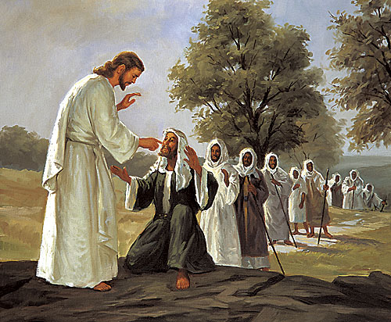
Satan afflicts men with physical and mental illness
“How God anointed Jesus of Nazareth with the Holy Ghost and with power: who went about doing good, and healing all that were oppressed of the devil; for God was with him.”
(Acts 10:38).

Slide 13
Satan deceives men
1 Timothy 2:13-14 “For Adam was first formed, then Eve. And Adam was not deceived, but the woman being deceived was in the transgression.”

Slide 14
Satan’s two greatest weapons

Slide 15
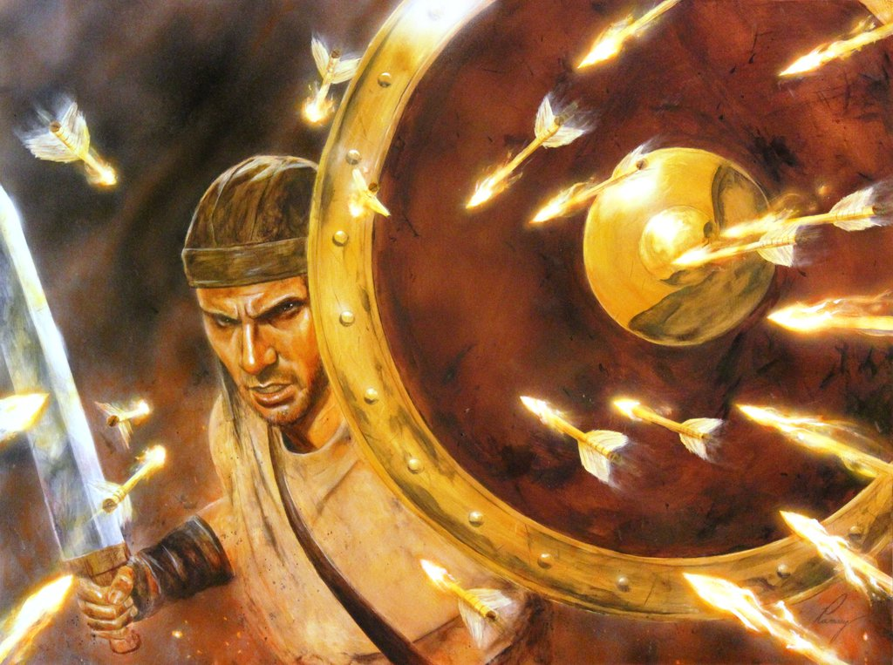
“Above all, taking the shield of faith, wherewith ye shall be able to quench all the fiery darts of the wicked.”
(Eph. 6:16)

Slide 16
Deception

Slide 17
Temptation

Slide 18
The best way to avoid temptation is not to be deceived

Slide 19
Deut. 11:16 “Take heed to yourselves, that your heart be not deceived.”
Luke 21:8 “And he said, Take heed that ye be not deceived.”
1 Cor. 6:9 “Be not deceived.”
1 Cor. 15:33 “Be not deceived.”
Gal. 6:7 “Be not deceived.”

Slide 20
How to guard against Satan’s Deceptions
Attending a Fundamental Bible preaching church – Jude 3-4
Read, Study, Memorize and Meditate on Scripture – 2 Tim. 2:15
Reject false teaching “Try the spirits” – 1 John 4:1
Get a Biblical education – Jer. 10:2
Adopt the wisdom of God / Biblical world view – Jam. 3:13-18
Develop godly friendships – Prov. 17:17
Do not follow the crowd – Prov. 1:7-33
Recognize Satanic blessing – Ps. 73:1-28
Refuse to fulfill the desires of the flesh and of the mind – I Cor. 15:31
Spiritually minded – Rom. 8:6

Slide 24
Because we live in a fallen world and have a fleshly nature, temptations are an unavoidable part of life – Romans 7:14-25 Satan along with his principalities and powers are extremely skilled at presenting temptation to us in such a way that we are become deceived concerning the consequences of not resisting temptation – “Be not deceived.”

Slide 25
Satan is trying his best to defeat us through temptation – But within the Word of God are powerful promises which will assure us victory over every temptation. “There hath no temptation taken you but such as is common to man: but God is faithful, who will not suffer you to be tempted above that ye are able; but will with the temptation also make a way to escape, that ye may be able to bear it.” (1 Cor. 10:13)

Slide 26
“Blessed [is] the man that endureth temptation: for when he is tried, he shall receive the crown of life, which the Lord hath promised to them that love him.” (James 1:12)

Slide 27
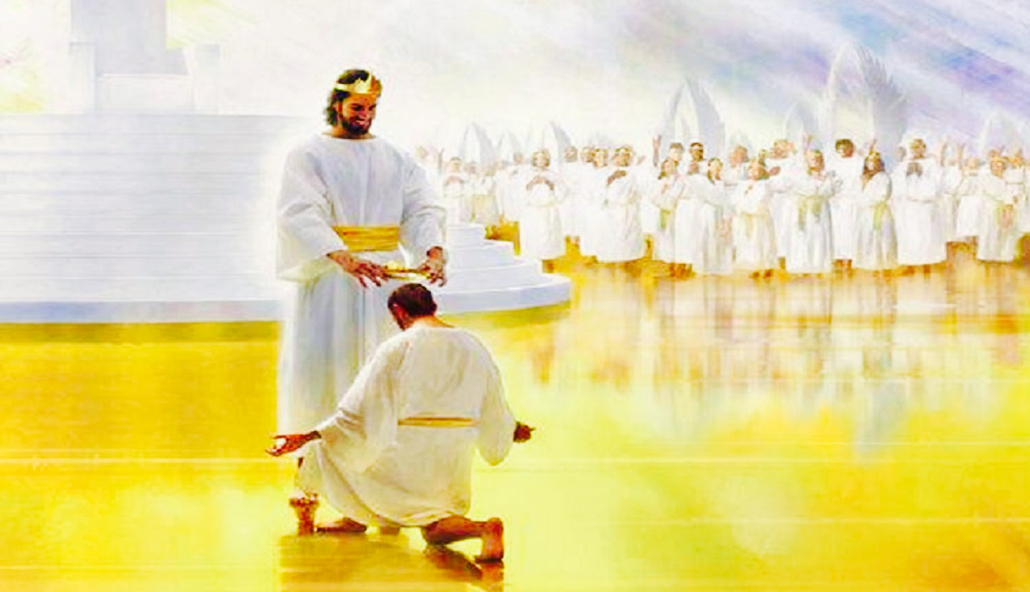
“While we look not at the things which are seen, but at the things which are not seen: for the things which are seen are temporal; but the things which are not seen are eternal.” (2 Cor. 4:18)

Slide 28
Don’t forfeit eternal rewards for temporal pleasure
“The pleasures of sin for a season.”
“Great is your reward in heaven.”

Slide 29
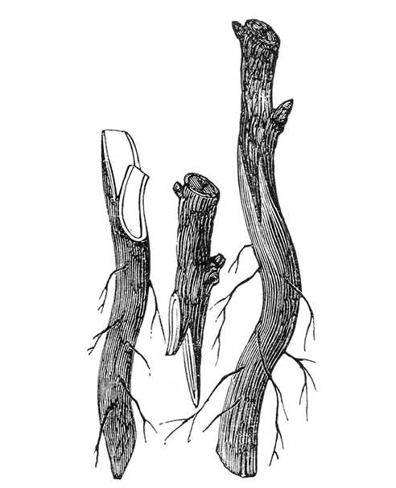
With each temptation we need to find the particular verses which apply to our individual temptation – “Lust, anger, bitterness, dishonesty, impatience, fear, worry, anxiety, immorality covetousness, pride, hardness, laziness, selfishness, etc.”
James 1:21
“Receive with meekness the engrafted word, which is able to save your souls.”

Slide 30
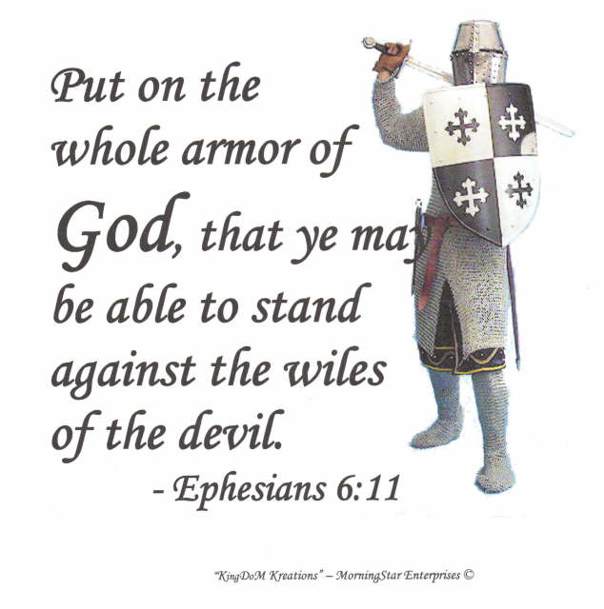
“For though we walk in the flesh, we do not war after the flesh: For the weapons of our warfare are not carnal, but mighty through God to the pulling down of strong holds. Casting down imaginations, and every high thing that exalteth itself against the knowledge of God, and bringing into captivity every thought to the obedience of Christ.” (2 Cor. 10:3-5)

Slide 31
Satan doesn’t use the same enticements (temptations) on all of us, but instead, he customizes his temptations in order to appeal to our individual weaknesses – 2 Cor. 12:9

Slide 32
We will all face varied temptations throughout our lives – 1 Cor. 10:13
We may overcome some of them, but the devil is always ready with new ones -
In order to consistently live in victory, we need to build a wall of truth around ourselves to protect us from those temptations.

Slide 33
When our minds are filled with Scripture, “Let the word of Christ dwell in you richly in all wisdom.” We will have the power to respond as God would have us to respond to temptation.
Each time we successfully fend off a temptation with God’s Word, our faith is strengthened and we become stronger because of God faithfulness – 1 Cor. 10:13

Slide 35
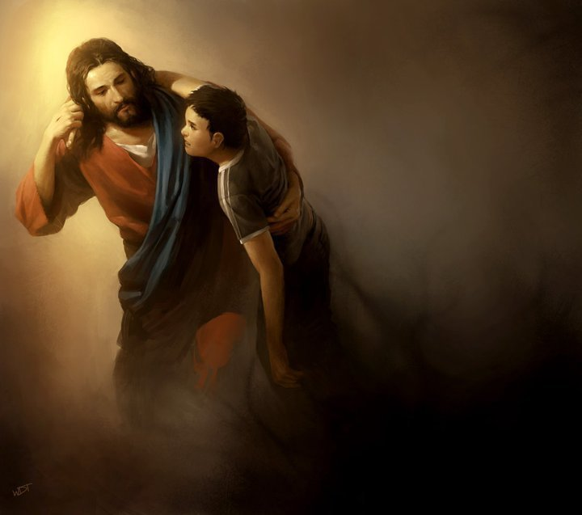
We never walk through temptations alone because the Lord lives inside us – “I will dwell in them…I will never leave you…”
God will give us the strength to resist temptations when we cling to His Word and use it to defeat the tempter – “…strengthen with might by his Spirit in the inner man.”

Slide 36
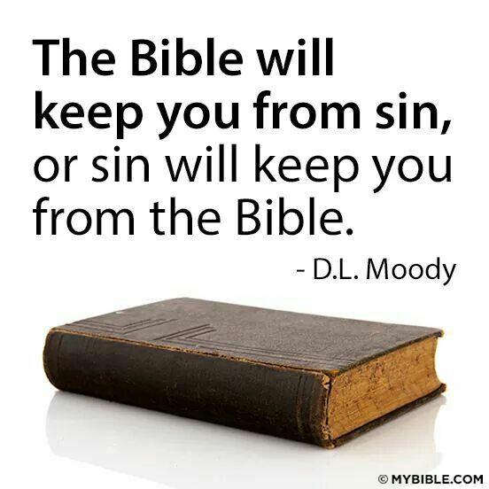

Slide 37
(1 Peter 2:21) “For even hereunto were ye called: because Christ also suffered for us, leaving us an example, that ye should follow his steps.”

Slide 38
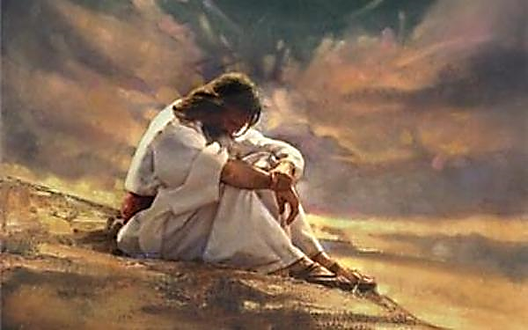
How did Jesus deal with temptation?

Slide 39
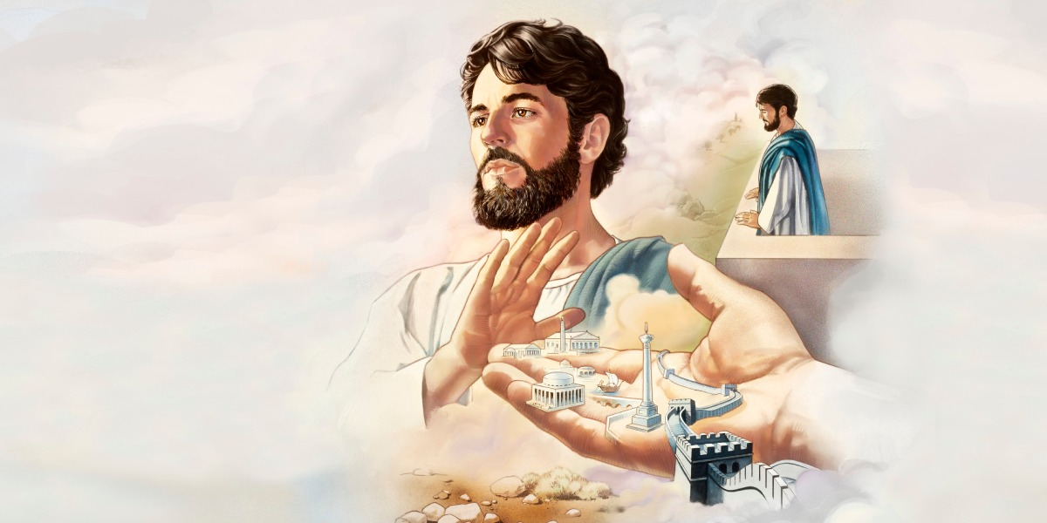
“And when the tempter came to him, he said, If thou be the Son of God, command that these stones be made bread.”

Slide 40
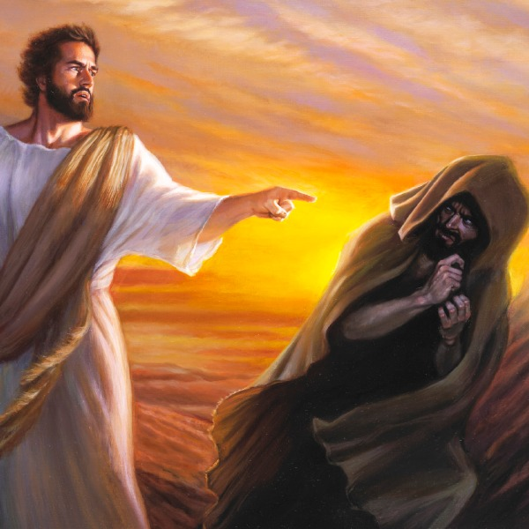
“But he answered and said, It is written, Man shall not live by bread alone, but by every word that proceedeth out of the mouth of God.”

Slide 41
“Then the devil taketh him up into the holy city, and setteth him on a pinnacle of the temple, And saith unto him, If thou be the Son of God, cast thyself down: for it is written, He shall give his angels charge concerning thee: and in their hands they shall bear thee up, lest at any time thou dash thy foot against a stone.”

Slide 42
“Jesus said unto him, It is written again, Thou shalt not tempt the Lord thy God.”

Slide 43
“Again, the devil taketh him up into an exceeding high mountain, and sheweth him all the kingdoms of the world, and the glory of them; And saith unto him, All these things will I give thee, if thou wilt fall down and worship me.”

Slide 44
“Then saith Jesus unto him, Get thee hence, Satan: for it is written, Thou shalt worship the Lord thy God, and him only shalt thou serve.” (Matthew 4:1-11)

Slide 45
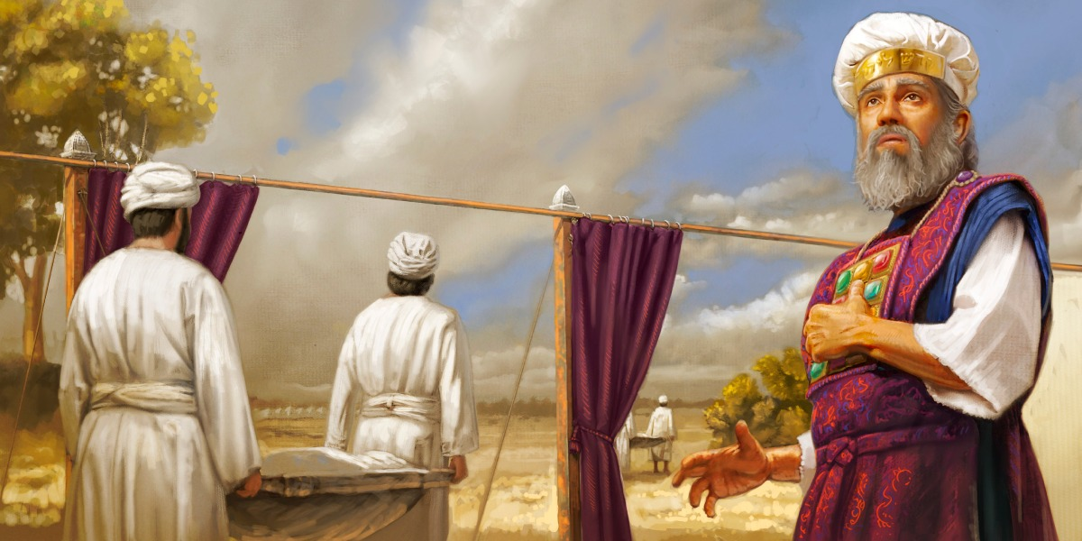
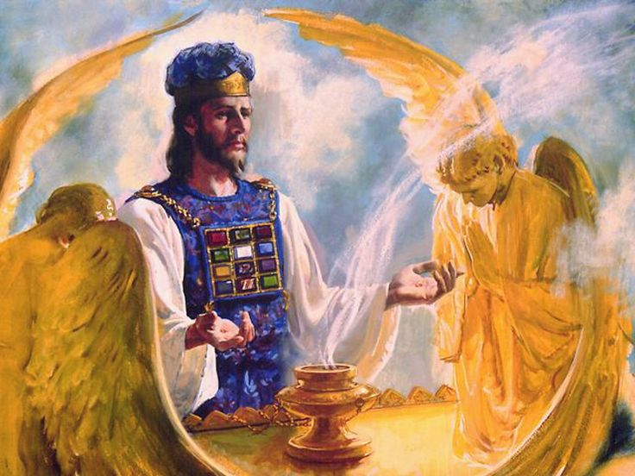
“For we have not an high priest which cannot be touched with the feeling of our infirmities; but was in all points tempted like as we are, yet without sin.” (Hebrews 4:15)

Slide 46
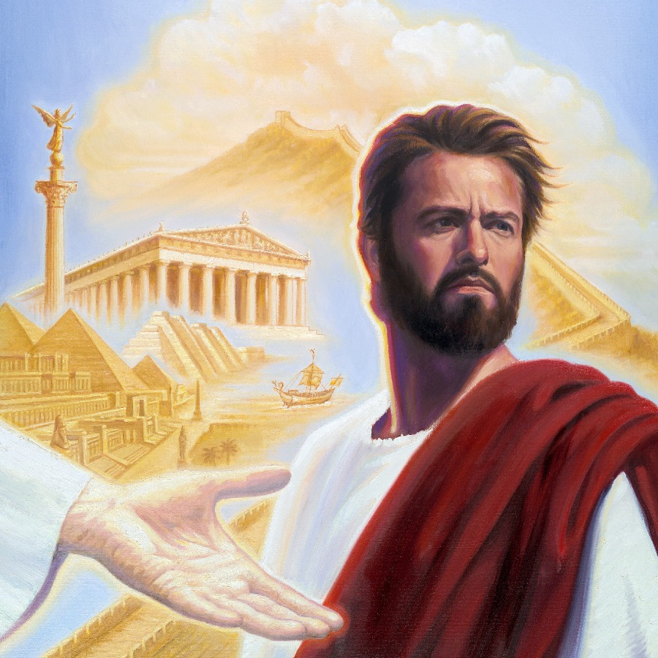
The means of Satan’s temptations (see Gen. 3:1-6 and compare with Matthew 4:1-11)

Slide 47
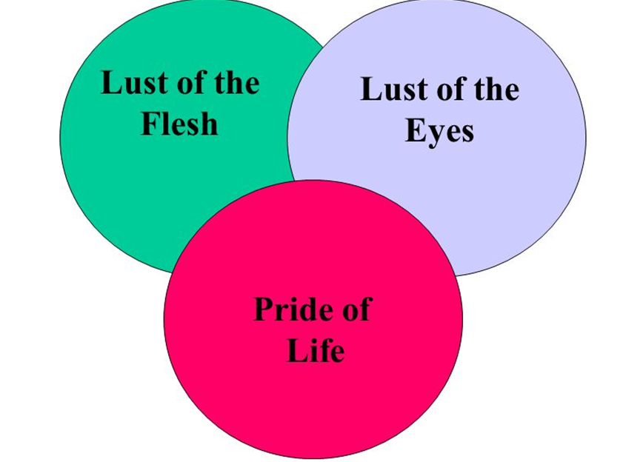
1# “Lust of the flesh” – Turn these stones into bread / saw that the tree was good for food.
2# “Lust of the eyes’ – Showeth him the kingdoms of the world / saw the tree that it was pleasant to the eyes.
3# “Pride of life” – Cast thy self down / saw that the tree was able to make one wise…ye shall be as god’s.

Slide 48
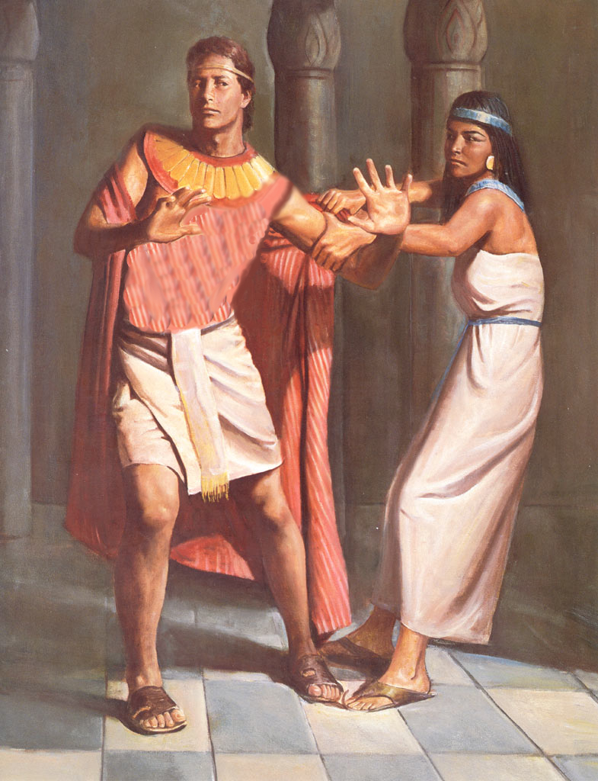
Important truth to remember
Don’t place yourself in the way of temptation - That’s foolish - “But thou, O man of God, flee these things; and follow after righteousness, godliness, faith, love, patience, meekness… Flee fornication… flee from idolatry… Flee also youthful lusts…”
Don’t enter into temptation to see if you are strong enough to handle it - That’s just stupid!
Run away, get out of there!!!

Slide 49
“Flee also youthful lusts: but follow righteousness, faith, charity, peace, with them that call on the Lord out of a pure heart.” (2 Timothy 2:22)

Slide 50
(James 1:13-16)
“Let no man say when he is tempted, I am tempted of God: for God cannot be tempted with evil, neither tempteth he any man: But every man is tempted, when he is drawn away of his own lust, and enticed. Then when lust hath conceived, it bringeth forth sin: and sin, when it is finished, bringeth forth death. Do not err, my beloved brethren.”

Slide 51
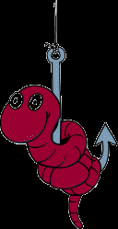
The progression of Satan’s temptation (James 1:13-16) Six deadly D’s of the Devil!
1. Desire – “Every man is tempted when he is drawn away in his own lust…”
2. Deception – “and enticed…”
3. Deliberation – “then when lust is conceived…”
4. Disobedience – “it bringeth forth sin…”
5. Development – “and sin, when it is finished
6. Destruction – “bringeth forth death…”
Exhortation – “Do not err, my beloved brethren…”

Slide 52
“Watch and pray, that ye enter not into temptation: the spirit indeed is willing, but the flesh is weak…Pray that ye enter not into temptation.”

Slide 53
Satan’s Desire and Goal in Temptation

Slide 54
Draw us away from the will of God into sin – (see 1 Thess. 4:1-8; 1 John 2:15-17)
Destroy us (see John 10:10)
Testimony
Health
Emotional health
Finances
Relationship
Family
Purpose in life
Effectiveness
Productivity
Ministries
Church

Slide 55
Ten Principles For Overcoming Temptations
Anticipate Temptations - Matthew 26:41
Understand Where Temptations Will Attack You - James 1:14-15
Resist by Running - Proverbs 14:16
Look For God's Escape - 1 Corinthians 10:13
Find An Accountability Partner - James 5:16
Avoid the appearance of evil – 1 Thessalonians 5:22
Refuse to fear – 365 “fear nots”
Avoid evil friendships – Proverbs 1:10-33
Memorize, meditate, and quote Scripture – “It is written…”
10. Cry out to God - Psalm 50:15

Slide 56
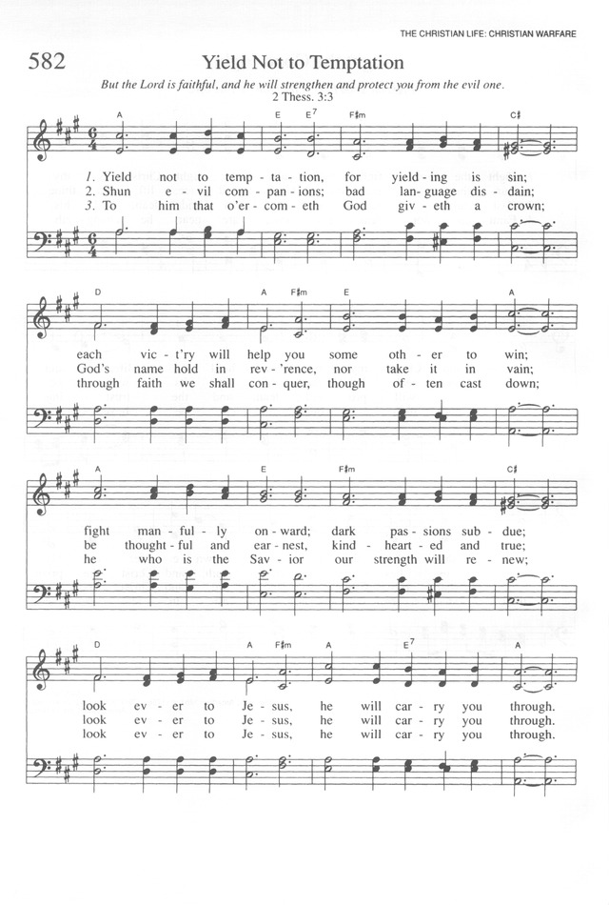

Slide 57
Yield not to temptation, for yielding is sin; Each vict’ry will help you some other to win; Fight manfully onward, dark passions subdue; Look ever to Jesus, He’ll carry you through.

Slide 58
Shun evil companions, bad language disdain, God’s name hold in rev’rence, nor take it in vain; Be thoughtful and earnest, kindhearted and true; Look ever to Jesus, He’ll carry you through.

Slide 59
To him that o’ercometh, God giveth a crown, Through faith we will conquer, though often cast down; He who is our Savior, our strength will renew; Look ever to Jesus, He’ll carry you through.

Slide 60
Refrain: Ask the Savior to help you, Comfort, strengthen, and keep you; He is willing to aid you, He will carry you through.

