Slide 1
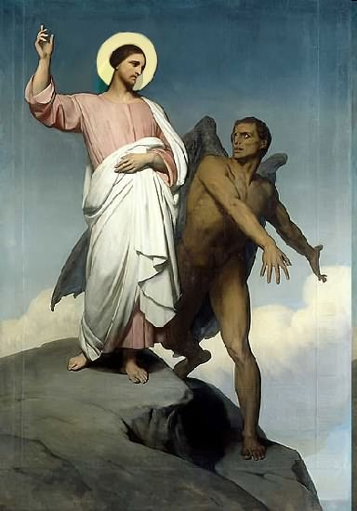

Slide 2
Topics to be studied
His existence
His origin
His fall
His personality
His names
His activities (Part 3)
His location – present and future
Our victory over him

Slide 4
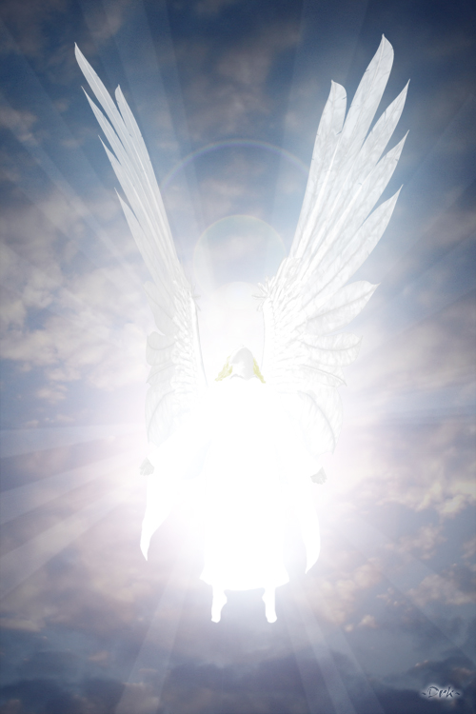
How does Satan imitate God?

Slide 5
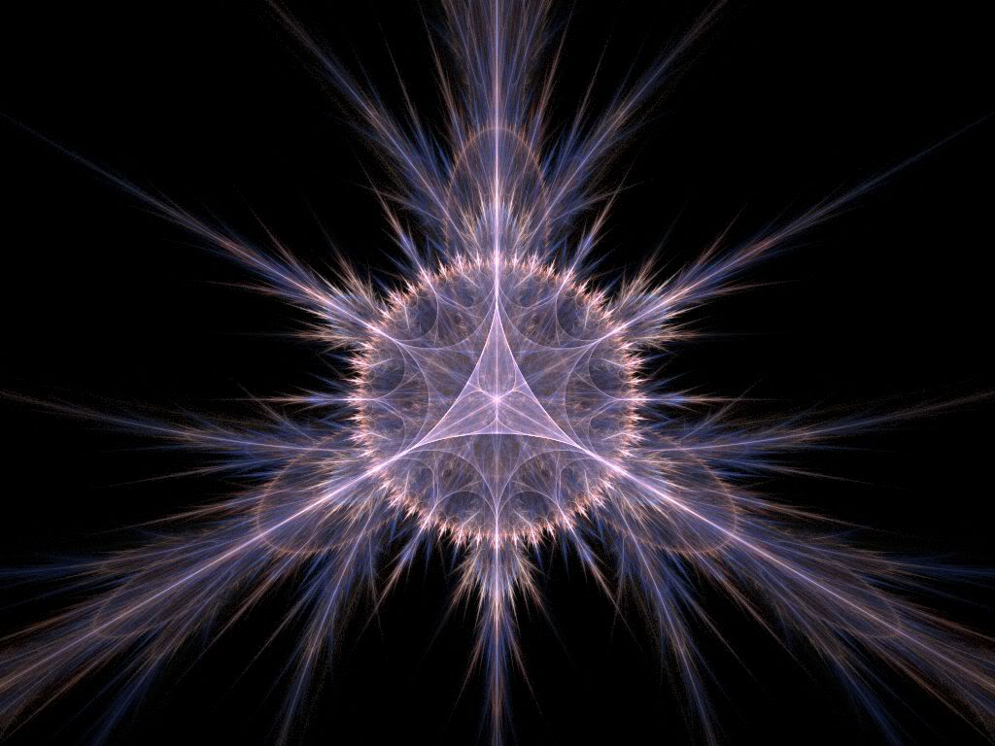
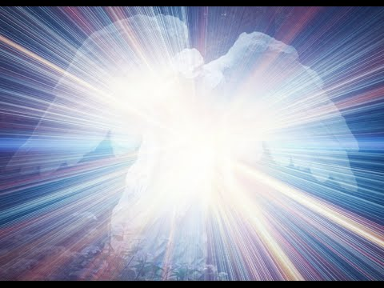
Satan has a false trinity

Slide 6
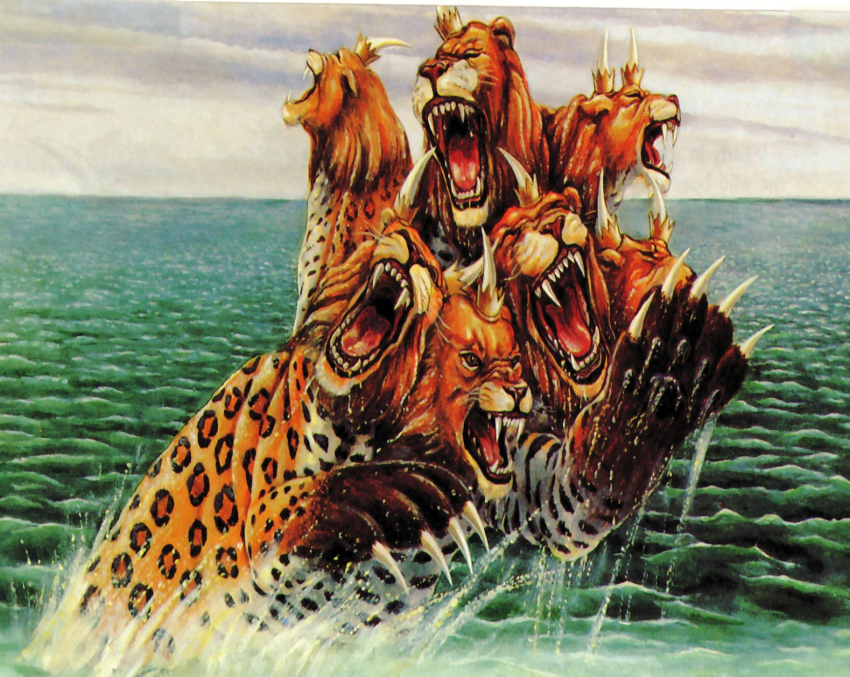
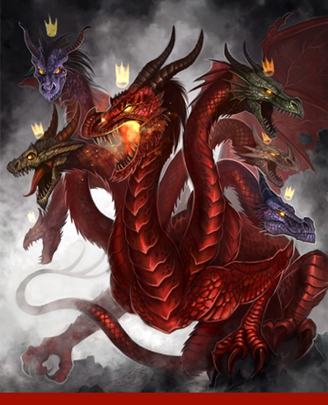
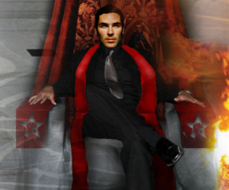
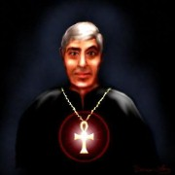
In this terrible trinity. Satan assumes the part of the Father; the antichrist is likened to the Son; and the false prophet is assigned the role of the Holy Spirit.

Slide 7
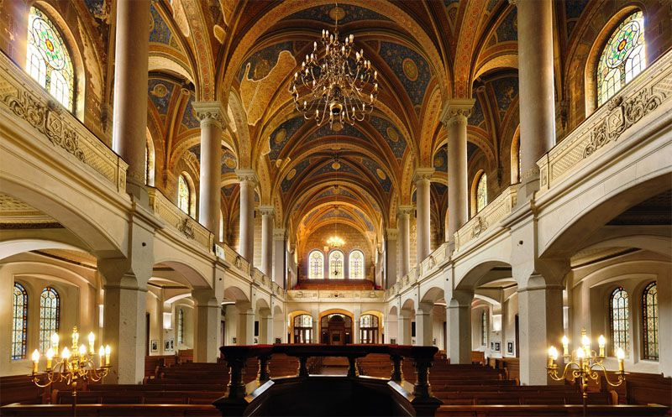
He has his synagogues

Slide 8
"I know thy works, and tribulation, and poverty, (but thou art rich) and I know the blasphemy of them which say they are Jews, and are not, but are the synagogue of Satan" (Rev. 2:9)
Synagogue (SIN-uh-gahg)
From a Greek root meaning "assembly." The most widely accepted term for a Jewish house of worship. The Jewish equivalent of a church, mosque or temple.

Slide 9
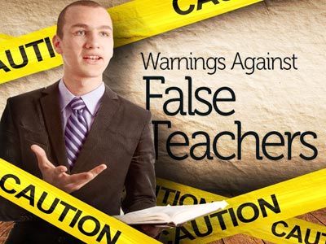
Satan has teachers

Slide 10
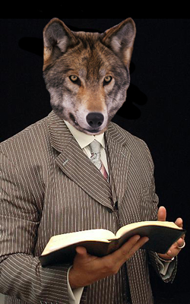
(2 Peter 2:1) “But there were false prophets also among the people, even as there shall be false teachers among you, who privily shall bring in damnable heresies, even denying the Lord that bought them, and bring upon themselves swift destruction.”

Slide 11
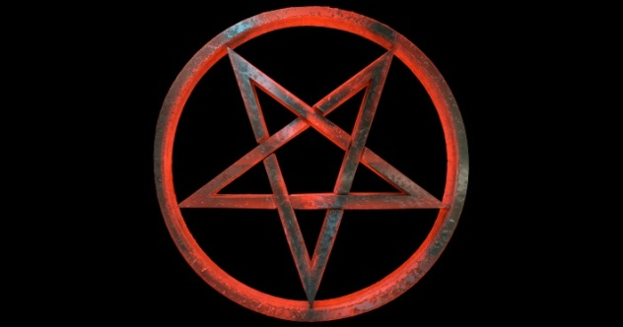
Satan has his doctrines

Slide 12
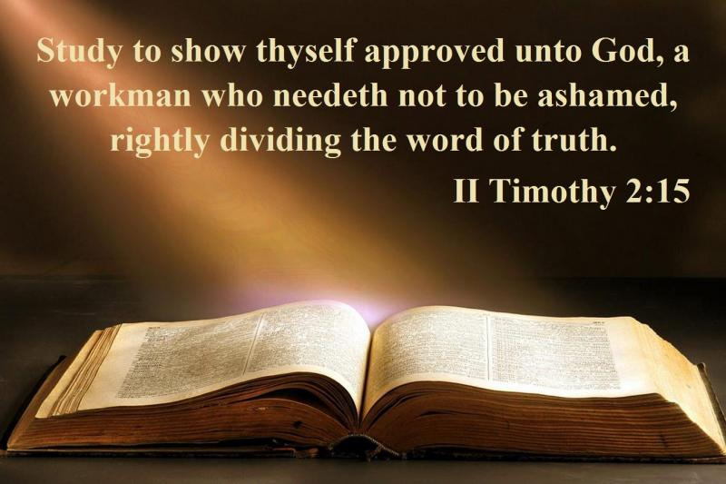
"Now the Spirit speaketh expressly, that in the latter times some shall depart from the faith, giving heed to seducing spirits, and doctrines of devils" (1 Tim. 4:1)
Satanic doctrine would be any teaching contrary to the Bible!

Slide 13
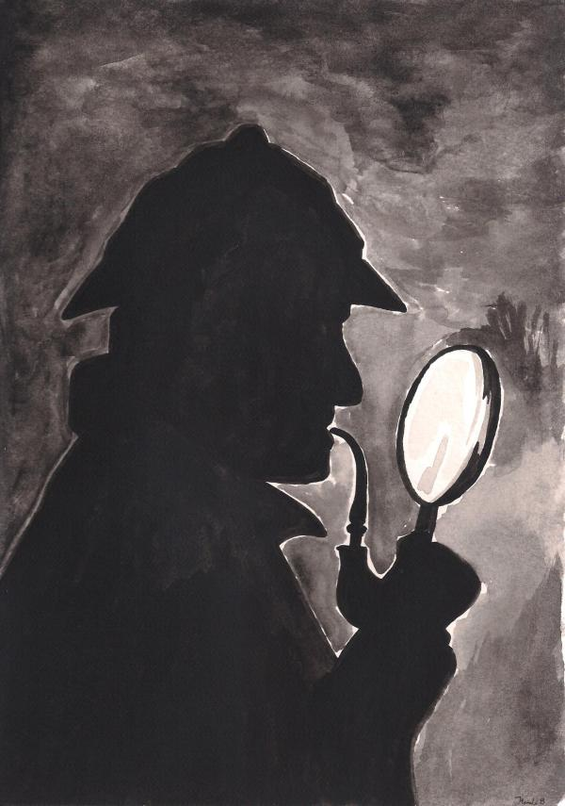
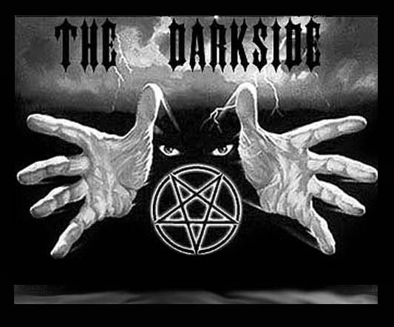
Satan has his mysteries
"For the mystery of iniquity doth already work: only he who now letteth will let, until he be taken out of the way“
(2 Thess. 2:7).

Slide 14
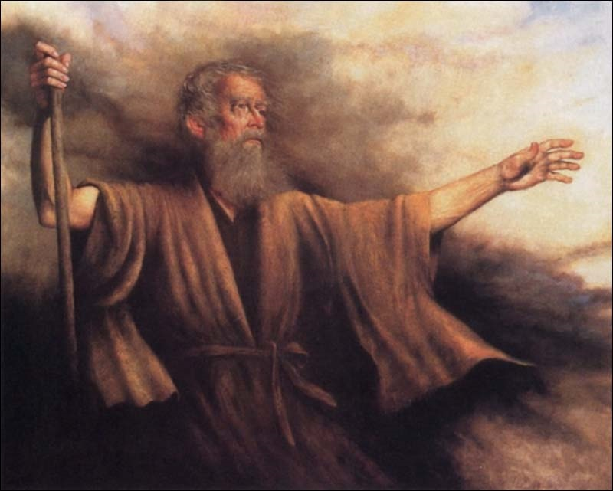
Biblical Warning Concerning Occult Involvement (Deuteronomy 18:9-13)
“When thou art come into the land which the LORD thy God giveth thee, thou shalt not learn to do after the abominations of those nations. There shall not be found among you any one that…For all that do these things are an abomination unto the LORD: and because of these abominations the LORD thy God doth drive them out from before thee. Thou shalt be perfect with the LORD thy God.”

Slide 15
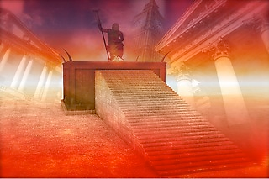
Satan has a throne

Slide 16
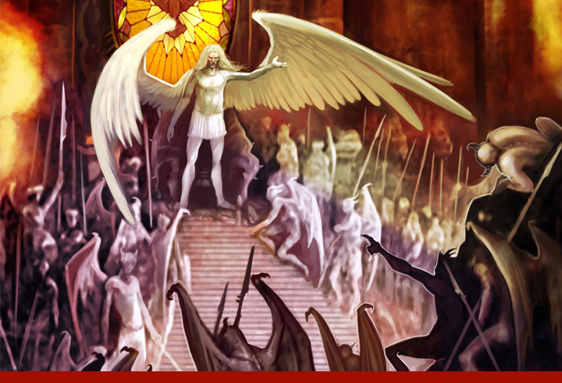
"I know thy works, and where thou dwellest, even where Satan’s seat is: and thou holdest fast my name, and hast not denied my faith, even in those days wherein Antipas was my faithful martyr, who was slain among you, where Satan dwelleth." (Rev. 2:13)

Slide 17
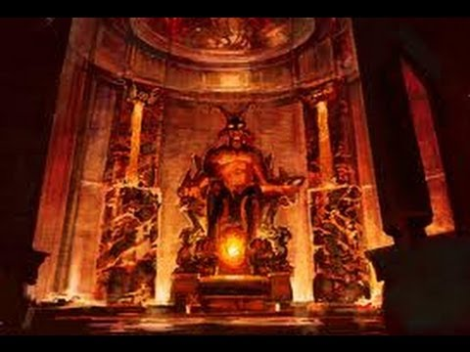
“…and where thou dwellest, even where Satan's seat is.”

Slide 18
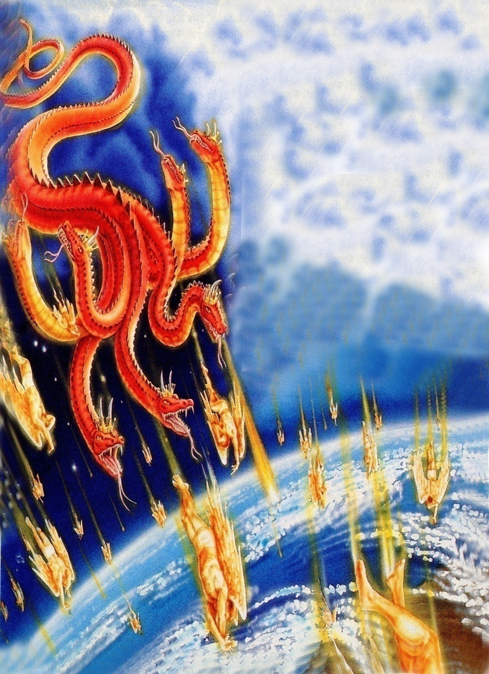
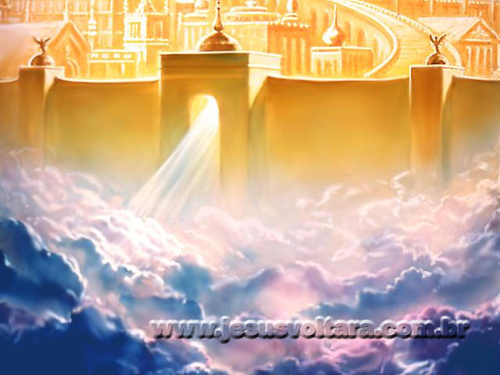
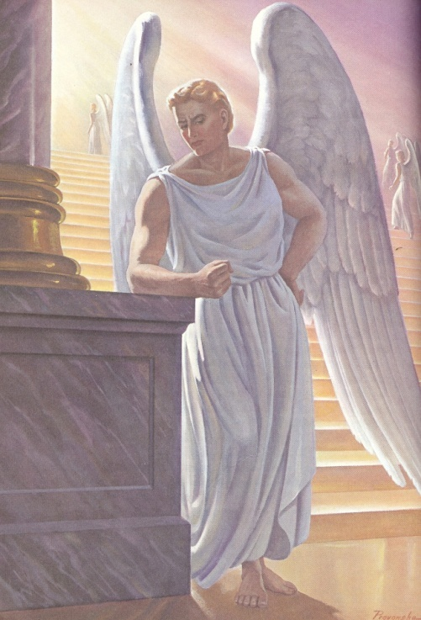
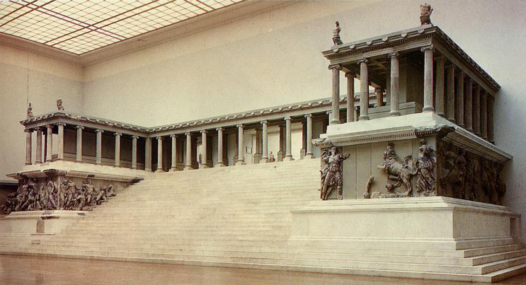
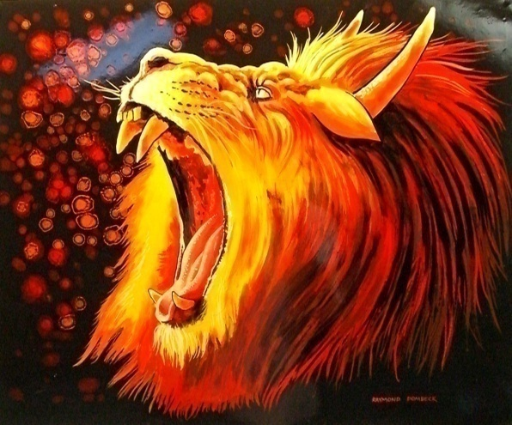

Slide 19
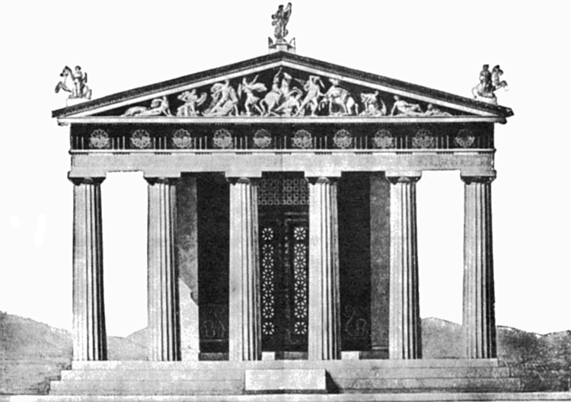
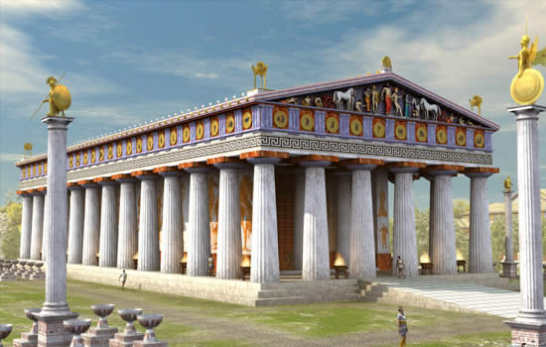
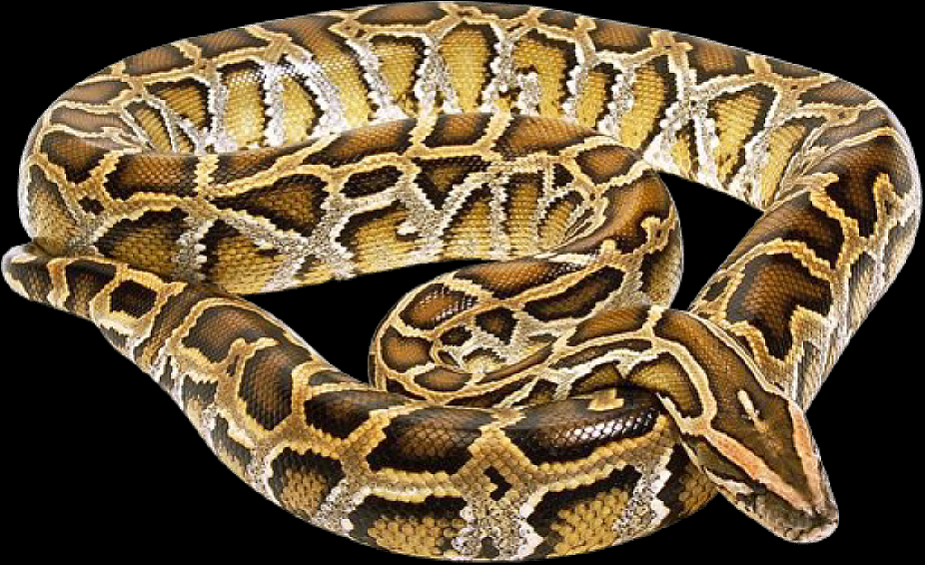
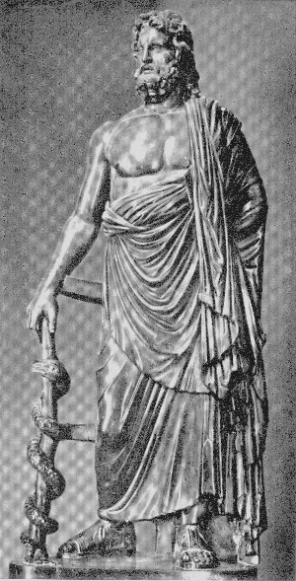
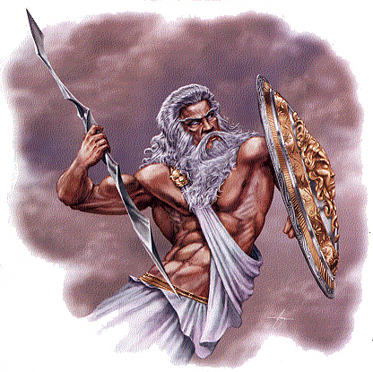
Pagan temples of Pergamos Zeus – symbol of a serpent
“That old serpent, which is the Devil, and Satan.”

Slide 20
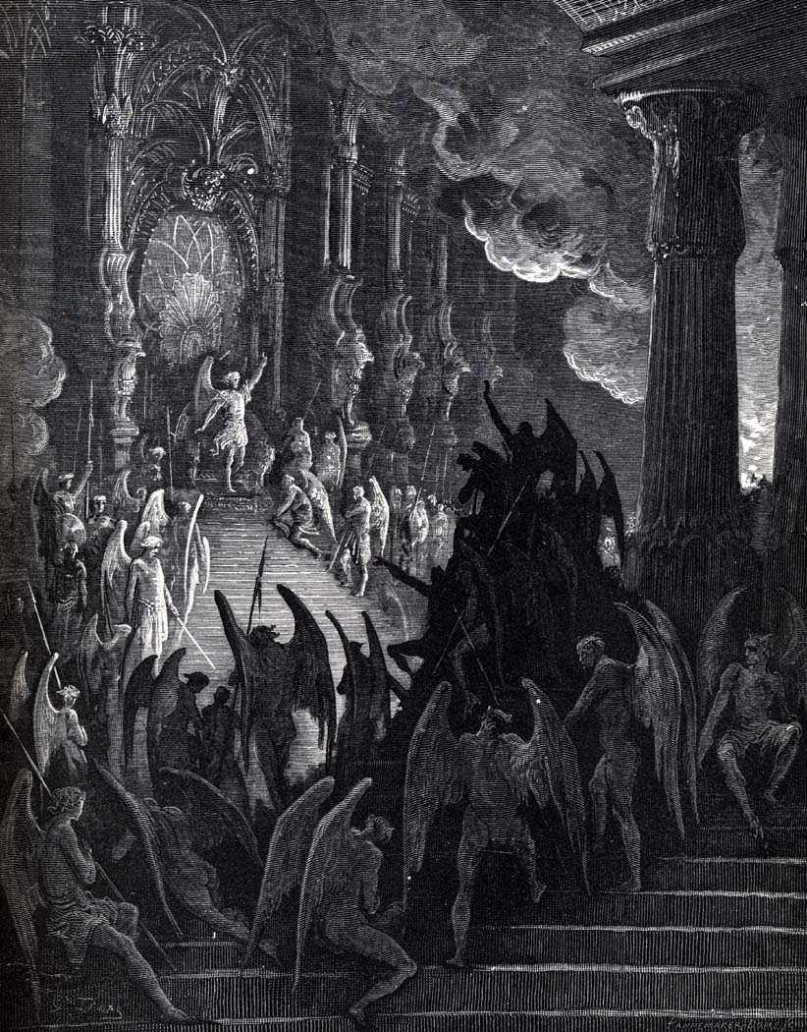
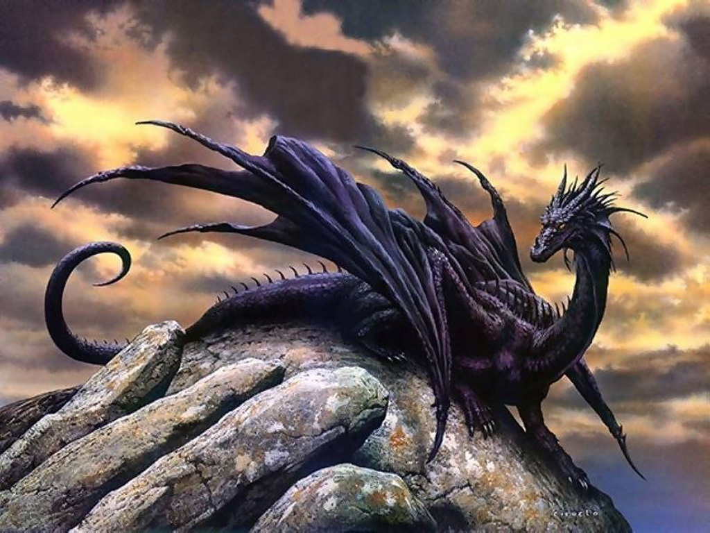
“For we wrestle not against flesh and blood, but against principalities, against powers, against the rulers of the darkness of this world, against spiritual wickedness {wicked spirits} in high places.” ( Eph 6:12)

Slide 21
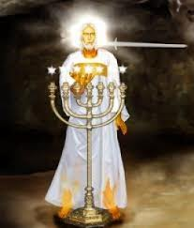
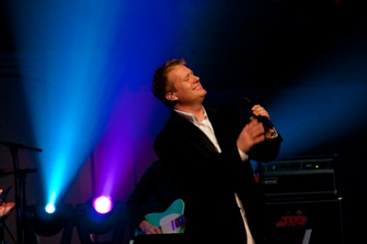
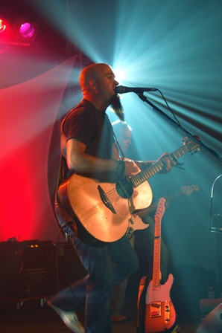
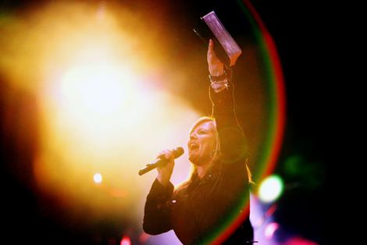
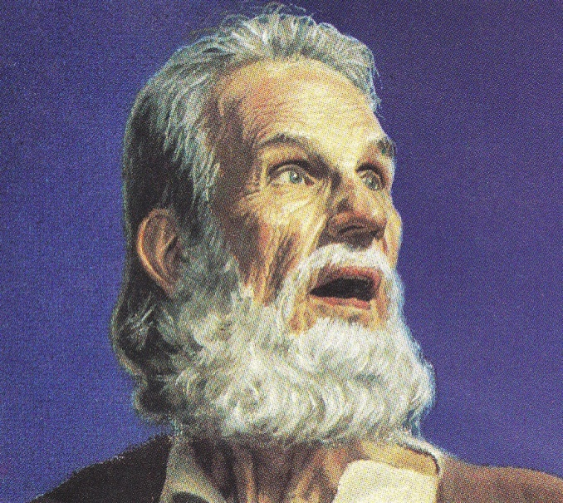
Pergamos
“The worldly church”
(Satan’s influence on the Church)

Slide 22
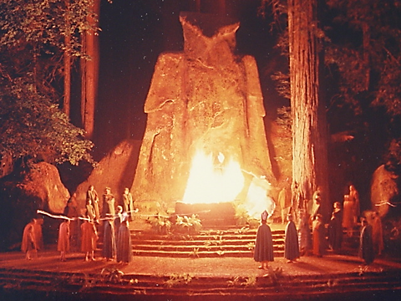
“Thou hast there them that hold the doctrine of Balaam, who taught Balac to cast a stumblingblock before the children of Israel, to eat things sacrificed unto idols, and to commit fornication.”

Slide 23
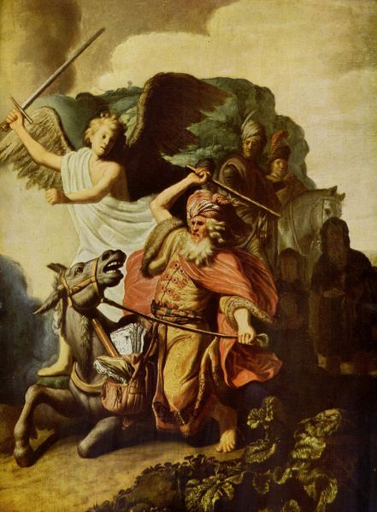
Doctrine of Balaam
The Mixture of Religion and Worldliness

Slide 24
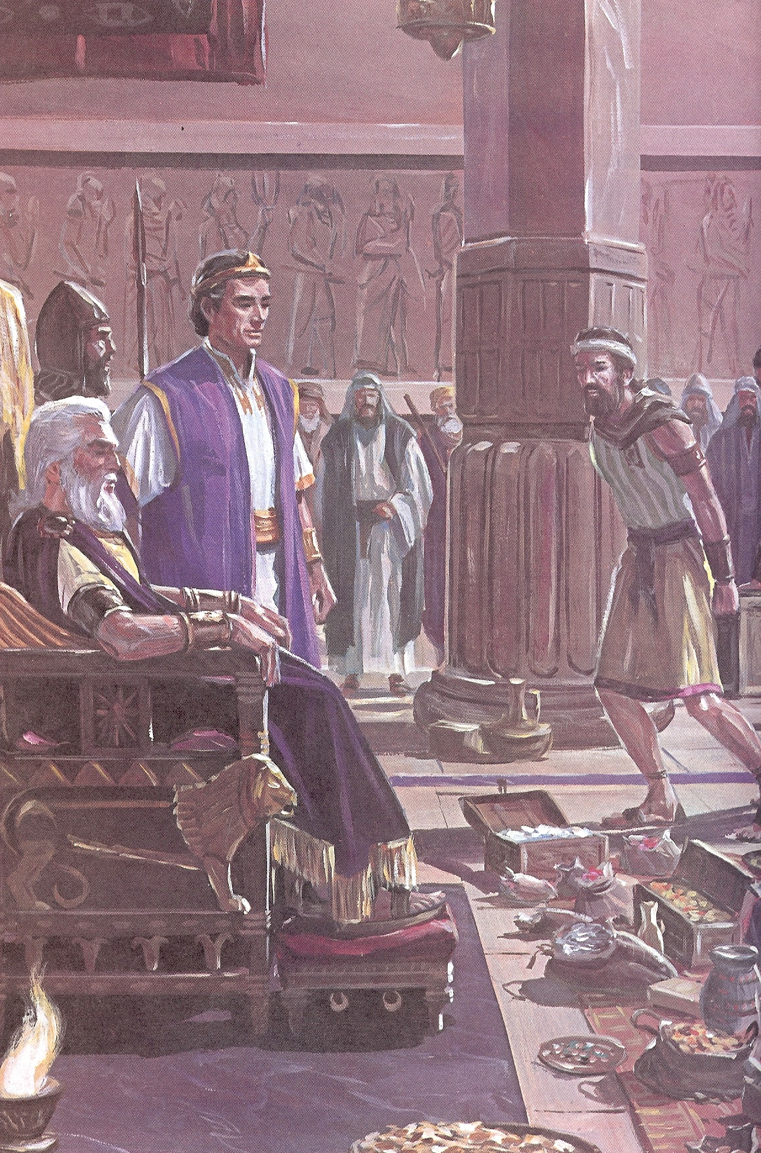
“I will promote thee thee unto very great honor, and I will do whatsoever thou sayest unto me: come therefore, I pray thee, curse me this people.”

Slide 25
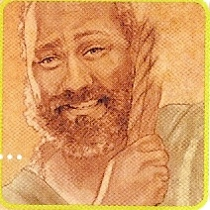
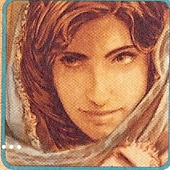
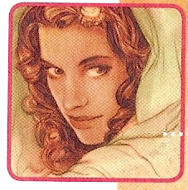
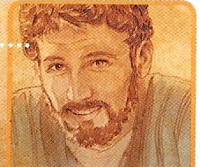
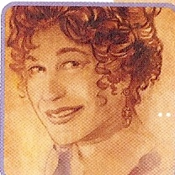
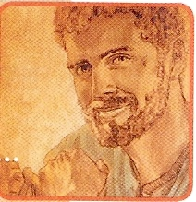

Slide 26
“Behold, these caused the children of Israel, through the counsel of Balaam, to commit trespass against the Lord, and there was a plague among the congregation of the Lord.” (Num. 31:16)

Slide 27
“So hast thou also them that hold the doctrine of the Nicolaitans, which thing I hate.”

Slide 28
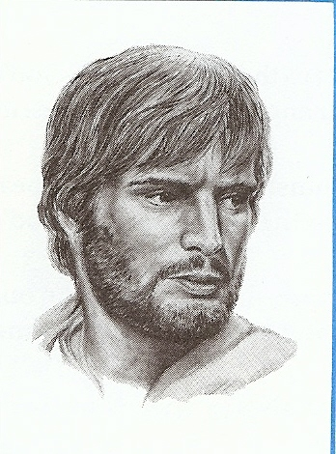
Doctrine of the Nicolaitans
Christ did away with the Old Testament Law and instituted the Christian Law of Liberty.
Believers are eternally secure, thus how they live their lives is not important.
It is only the soul that is important to God. What you do with your body is not.

Slide 29
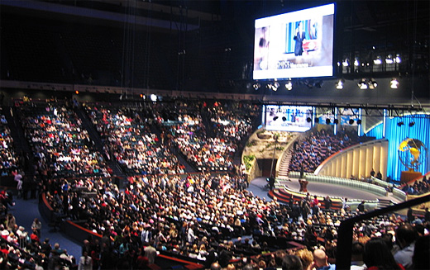
Followers of Nicolas taught –
Christians can live however they want.
Christians are “under grace”
- They can live a sinful life-style
because they are forgiven of their
sin.
- They can enjoy the pleasures of sin
without consequence.

Slide 30
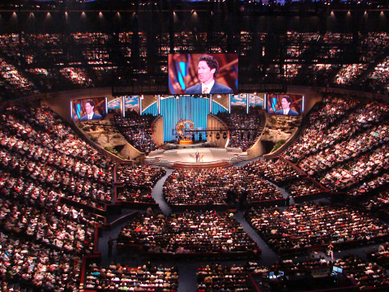
How does a church become Worldly?

Slide 31
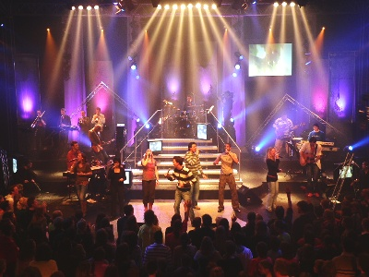
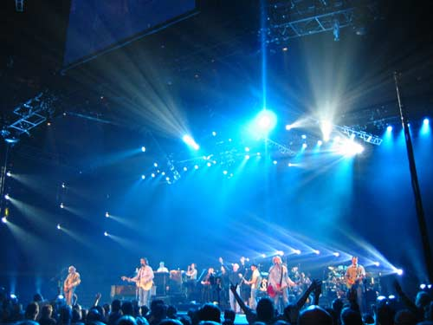
The church and its members begin to participate in worldly functions and activities.
The church and its members allowed worldly activities to take place in the church and in the homes of its members.
The church begins to accept people into membership who have not truly repented and turned from the world to Christ.
The church and its members allowed false teaching and preaching in the church.

Slide 33
Satan has his kingdom

Slide 34
II Cor. 4:4 “In whom the god of this world hath blinded the minds of them which believe not, lest the light of the glorious gospel of Christ, who is the image of God, should shine unto them.”
Eph 2:2 “Wherein in time past ye walked according to the course of this world, according to the prince of the power of the air, the spirit that now worketh in the children of disobedience.”
John 14:30 “Hereafter I will not talk much with you: for the prince of this world cometh, and hath nothing in me.”

Slide 35
“And God blessed them, and God said unto them, Be fruitful, and multiply, and replenish the earth, and subdue it: and have dominion over the fish of the sea, and over the fowl of the air, and over every living thing that moveth upon the earth.” (Genesis 1:28)

Slide 36
"Now the serpent was more subtile than any beast of the field which the Lord God had made. And he said unto the woman, Yea, hath God said, Ye shall not eat of every tree of the garden?" (Gen. 3:1)

Slide 37
"And when the woman saw that the tree was good for food, and that it was pleasant to the eyes, and a tree to be desired to make one wise, she took of the fruit thereof and did eat…”

Slide 38
“…and gave also unto her husband with her; and he did eat."
(Gen. 3:6)

Slide 39
(I Tim. 2:14) “And Adam was not deceived, but the woman being deceived was in the transgression.”

Slide 40
“The Consequences of the Fall”

Slide 42
(Matthew 4:8-9)
“Again, the devil taketh him up into an exceeding high mountain, and sheweth him all the kingdoms of the world, and the glory of them; And saith unto him, All these things will I give thee, if thou wilt fall down and worship me.”

Slide 43
The Seven Sealed Book (Revelation 5:1-14)

Slide 44
“And I saw in the right hand of him that sat on the throne a book written within and on the backside, sealed with seven seals.”

Slide 45
The seven sealed book is the title deed to the earth.
“The earth is the Lord’s, and the fullness thereof…” (Psalms 24:1)
“Thou hast created all things, and for thy pleasure they are and were created.”
(Revelation 4:11)

Slide 46
“And I saw a strong angel proclaiming with a loud voice, Who is worthy to open the book, and to loose the seals thereof?”

Slide 47
“And he came and took the book out of the right hand of Him that sat upon the throne…”

Slide 48
“The kingdoms of this world are become the kingdoms of our Lord, and of His Christ; and He shall reign for ever and ever.” (Revelation 11:5)

Slide 49
Heaven Erupts in Praise

Slide 50
“Thou art worthy”

Slide 51
“The four beasts fell down before the Lamb.”

Slide 52
“And twenty elders fell down and worshipped him that liveth for ever and ever.”

Slide 53
“And they sung a new song, saying, Thou are worthy to take the book, and to open the seals thereof: for thou wast slain, and hast redeemed us to God by thy blood…”

Slide 54
“Thou hast redeemed us to God…out of every kindred, tongue, people, and nation…”

Slide 55
“And I beheld, and I heard the voice of many angels round about the throne and the beasts and the elders: and the number of them was ten thousand times ten thousand, and thousands of thousands. Saying with a loud voice, Worthy is the Lamb that was slain to receive power, and riches, and wisdom, and strength, and honour, and glory, and blessing.”

Slide 56
Satan has his worshipers

Slide 57
"And they worshipped the dragon which gave power unto the beast: and they worshipped the beast, saying, Who is like unto the beast? who is able to make war with him?" (Rev. 13:4)

Slide 58
“And the dragon gave him his power, and his seat, and great authority.”

Slide 59
“And I saw, and behold a white horse: and he that sat on him had a bow; and a crown was given unto him: and he went forth conquering; and to conquer.”
(Revelation 6:2)

Slide 60
“…and his deadly wound was healed: and all the world wondered after the beast…”
“…and his deadly wound was healed: and all the world wondered after the beast…”
“…and his deadly wound was healed: and all the world wondered after the beast…”

Slide 61
Abomination of desolation

Slide 63
“He (false prophet) deceiveth them that dwell on the earth by the means of those miracles which he had power to do…saying to them…that they should make an image to the beast, which had the wound by a sword, and did live.”

Slide 64
“And he (false prophet) had power to give life unto the image of the beast, that the image of the beast should both speak…” (Revelation 13:15)

Slide 66
“And he (false prophet) cause that as many as would not worship the image of the beast should be killed.”

Slide 67
Satan desires Worship

Slide 68
“For thou hast said in thine heart…”
I will ascend into heaven - Obviously Satan had the third heaven in mind here, the very abode of God.
I will exalt my throne above the stars of God - A reference to angels. Satan desired the worship of angels.
I will sit also upon the mount of the congregation, in the sides of the north - Lucifer sought to enter God’s "executive office" somewhere in the north and sit on his throne.
I will ascend above the heights of the clouds - This may well refer to that special Shekinah glory of God.
I will be like the most High - He wanted to be like El-Elyon. This name literally means, "the strongest strong one."

Slide 69
“All these things will I give thee, if thou wilt fall down and worship me.”

Slide 70
"I know thy works, and tribulation, and poverty, (but thou art rich) and I know the blasphemy of them which say they are Jews, and are not, but are the synagogue of Satan" (Rev. 2:9)
Synagogue (SIN-uh-gahg)
From a Greek root meaning "assembly." The most widely accepted term for a Jewish house of worship. The Jewish equivalent of a church, mosque or temple.

Slide 72
“But I say, that the things which the Gentiles sacrifice, they sacrifice to devils, and not to God: and I would not that ye should have fellowship with devils. Ye cannot drink the cup of the Lord, and the cup of devils: ye cannot be partakers of the Lord's table, and of the table of devils.” (1 Cor. 10:20-21)

Slide 73
(Col 1:18)
“And he is the head of the body, the church: who is the beginning, the firstborn from the dead; that in all things he might have the preeminence.”
Preeminence = To be first in rank and influence.
To have first place.
Worship = To revere, reverence, pay homage to, honor, adore, praise, glorify, exalt, extol.

Slide 74
(3 John 1:9-12)
“I wrote unto the church: but Diotrephes, who loveth to have the preeminence among them, receiveth us not. Wherefore, if I come, I will remember his deeds which he doeth, prating against us with malicious words: and not content therewith, neither doth he himself receive the brethren, and forbiddeth them that would, and casteth them out of the church. Beloved, follow not that which is evil, but that which is good. He that doeth good is of God: but he that doeth evil hath not seen God. Demetrius hath good report of all men, and of the truth itself: yea, and we also bear record; and ye know that our record is true.”

