Slide 1
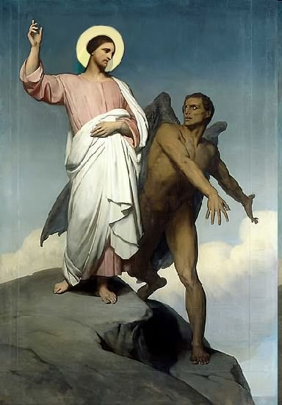

Slide 2
Topics to be studied
His existence
His origin
His fall
His personality
His names
His activities (Part 4)
His location – present and future
Our victory over him

Slide 4
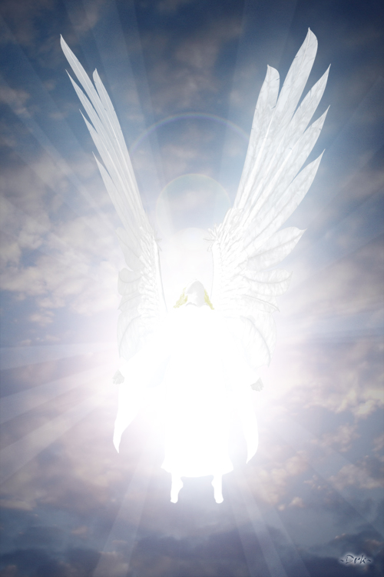
How does Satan imitate God?

Slide 5
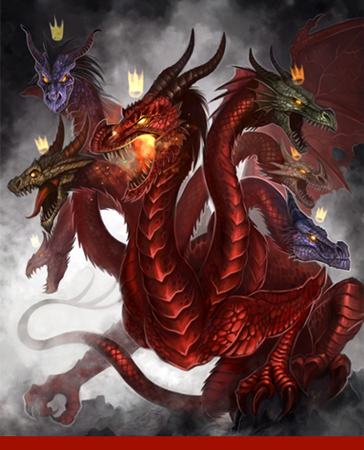
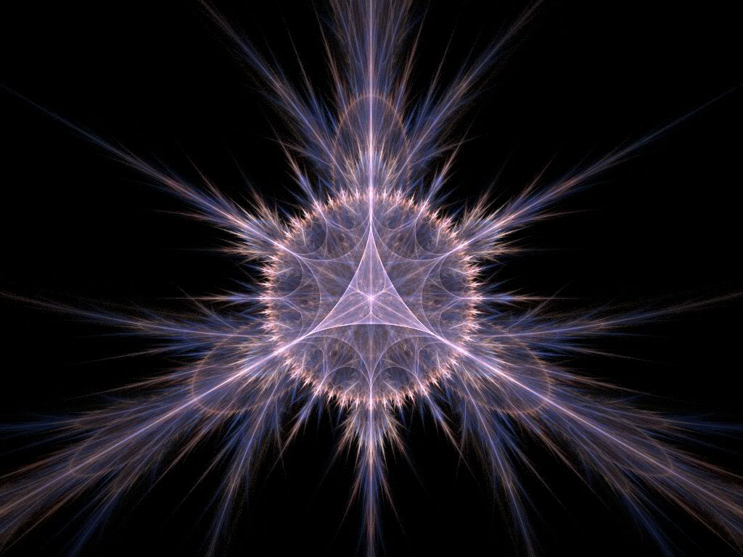
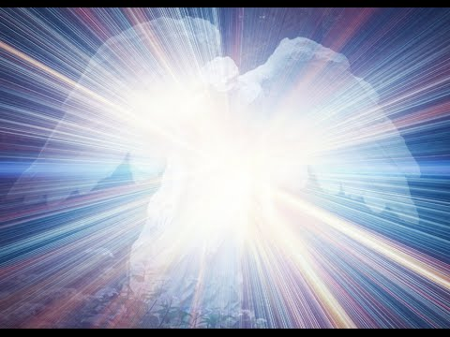
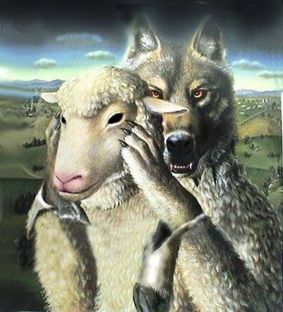
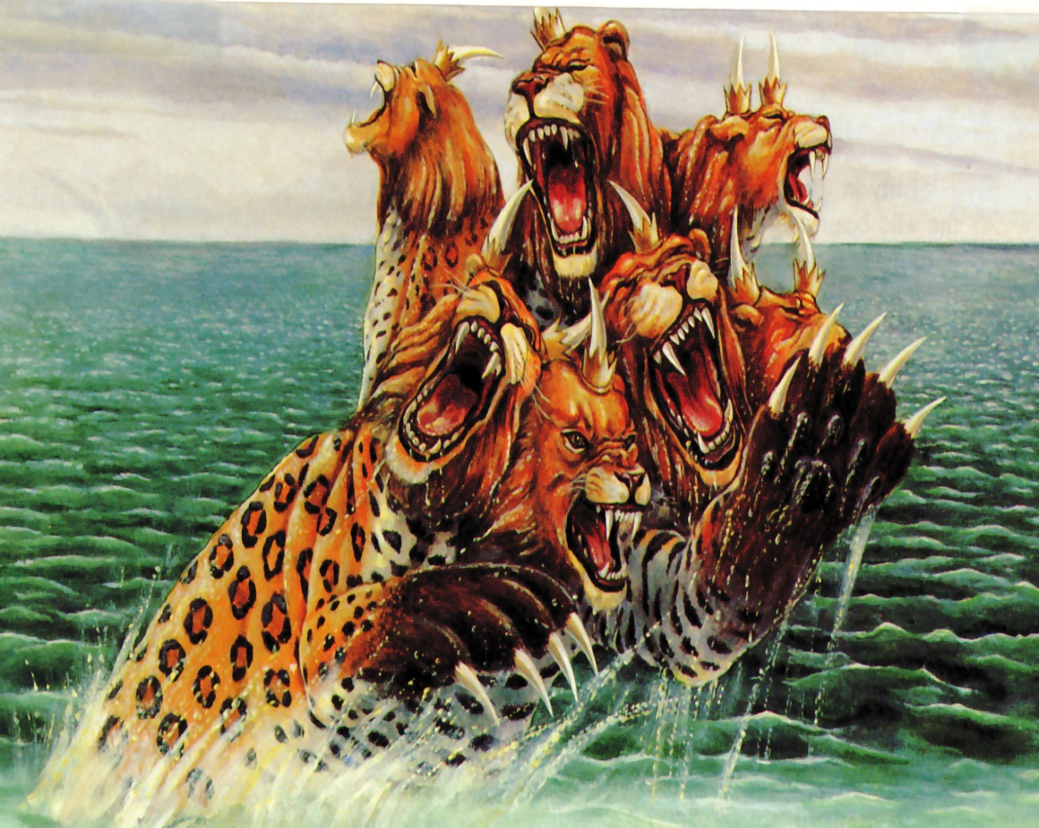
Satan has a false trinity

Slide 6
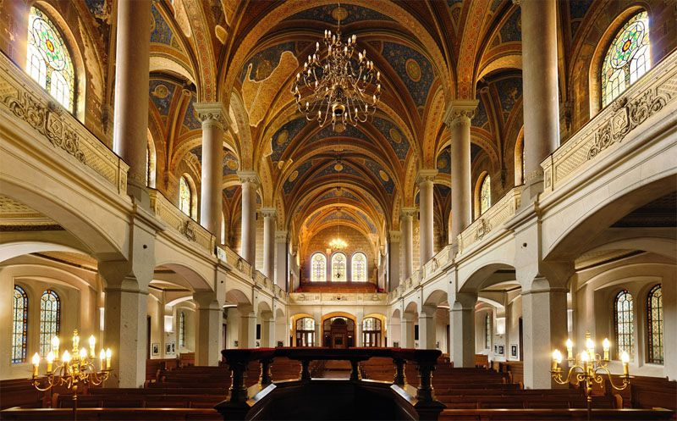
He has his synagogues

Slide 7
"I know thy works, and tribulation, and poverty, (but thou art rich) and I know the blasphemy of them which say they are Jews, and are not, but are the synagogue of Satan" (Rev. 2:9)
Synagogue (SIN-uh-gahg)
From a Greek root meaning "assembly." The most widely accepted term for a Jewish house of worship. The Jewish equivalent of a church, mosque or temple.

Slide 8
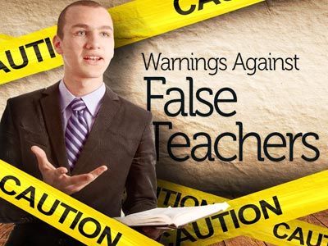
Satan has prophets and teachers

Slide 9
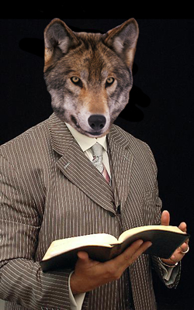
(2 Peter 2:1) “But there were false prophets also among the people, even as there shall be false teachers among you, who privily shall bring in damnable heresies, even denying the Lord that bought them, and bring upon themselves swift destruction.”

Slide 10
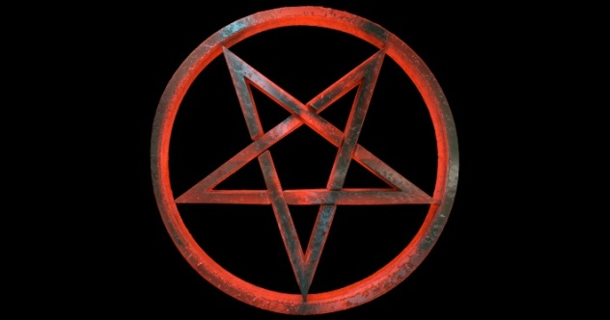
Satan has his doctrines

Slide 11
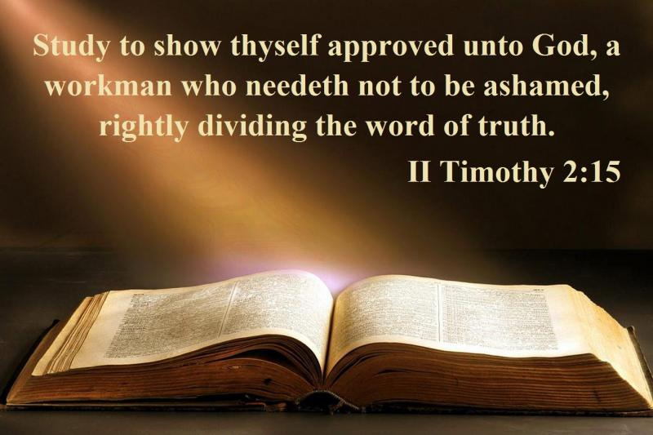
"Now the Spirit speaketh expressly, that in the latter times some shall depart from the faith, giving heed to seducing spirits, and doctrines of devils" (1 Tim. 4:1)
Satanic doctrine would be any teaching contrary to the Bible!

Slide 12
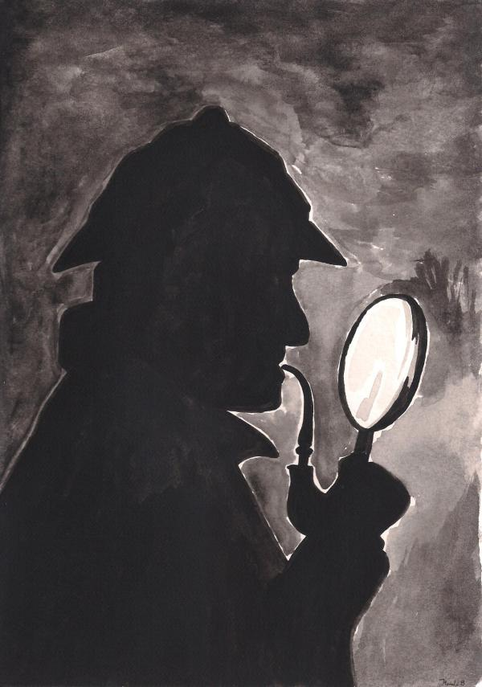
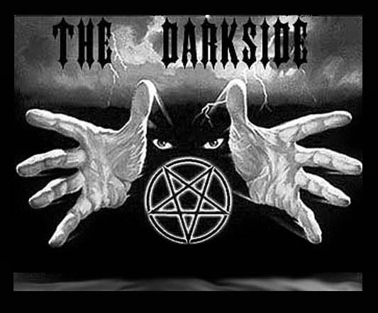
Satan has his mysteries
"For the mystery of iniquity doth already work: only he who now letteth will let, until he be taken out of the way“
(2 Thess. 2:7).

Slide 13
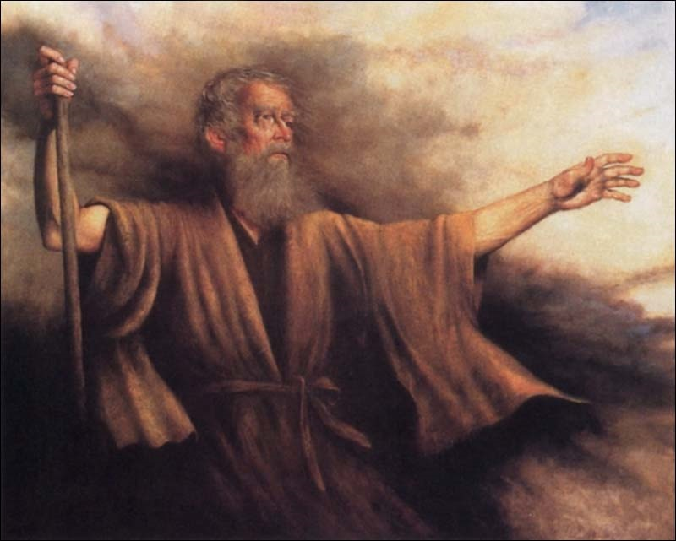
Biblical Warning Concerning Occult Involvement (Deuteronomy 18:9-13)
“When thou art come into the land which the LORD thy God giveth thee, thou shalt not learn to do after the abominations of those nations. There shall not be found among you any one that…For all that do these things are an abomination unto the LORD: and because of these abominations the LORD thy God doth drive them out from before thee. Thou shalt be perfect with the LORD thy God.”

Slide 14
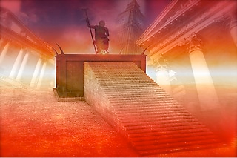
Satan has a throne

Slide 15
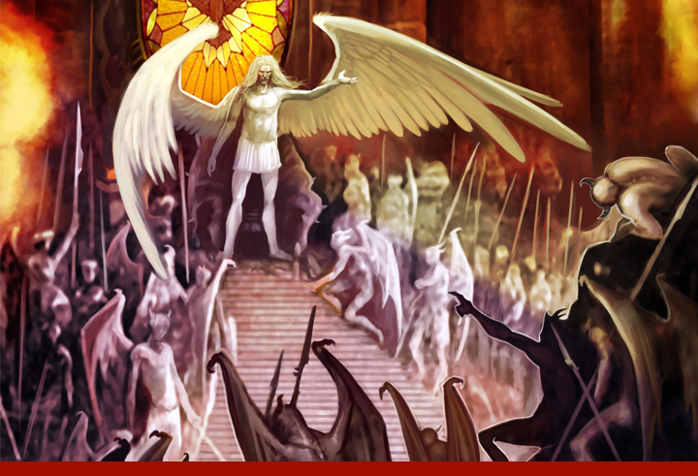
"I know thy works, and where thou dwellest, even where Satan’s seat is: and thou holdest fast my name, and hast not denied my faith, even in those days wherein Antipas was my faithful martyr, who was slain among you, where Satan dwelleth." (Rev. 2:13)

Slide 17
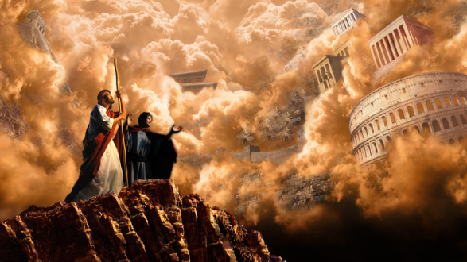
Satan has his kingdoms

Slide 18
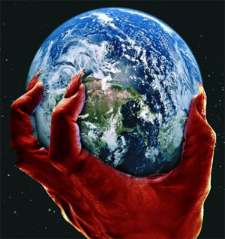
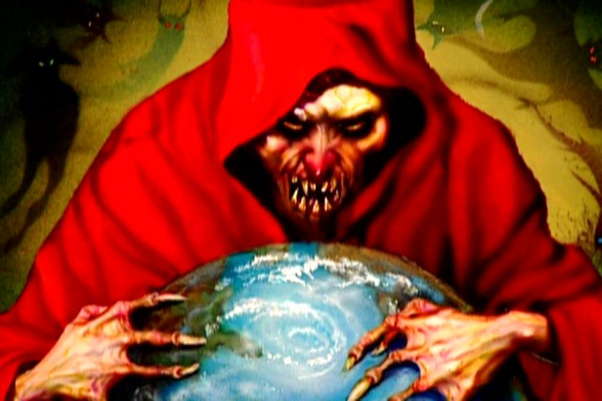
II Cor. 4:4 “In whom the god of this world hath blinded the minds of them which believe not, lest the light of the glorious gospel of Christ, who is the image of God, should shine unto them.”
Eph 2:2 “Wherein in time past ye walked according to the course of this world, according to the prince of the power of the air, the spirit that now worketh in the children of disobedience.”
John 14:30 “Hereafter I will not talk much with you: for the prince of this world cometh, and hath nothing in me.”

Slide 19
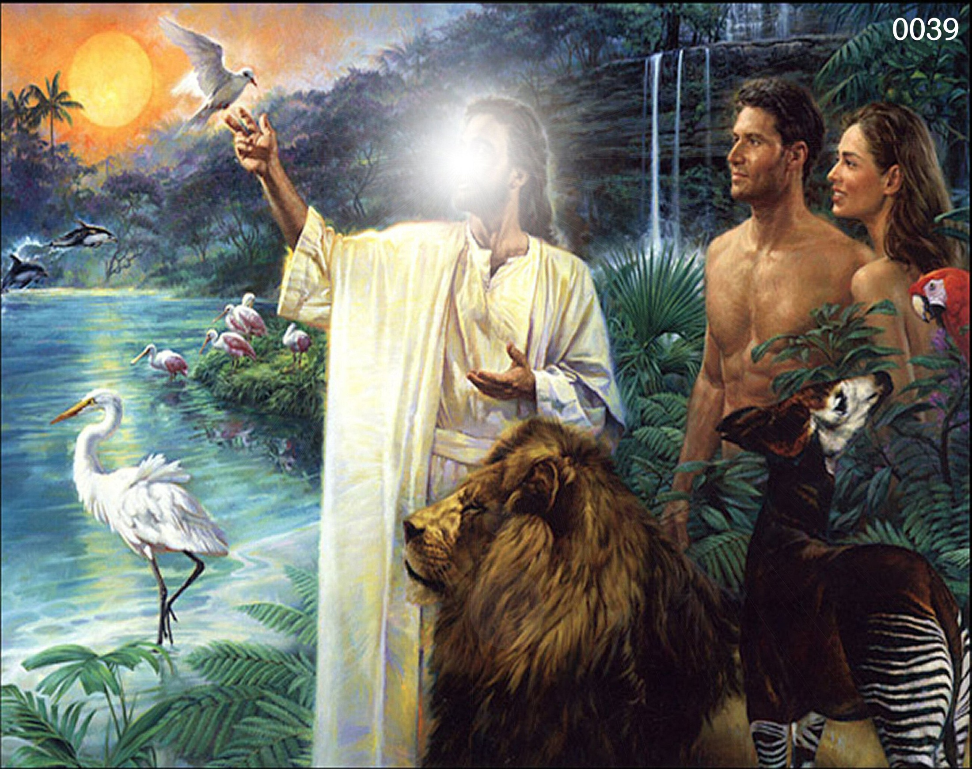
“And God blessed them, and God said unto them, Be fruitful, and multiply, and replenish the earth, and subdue it: and have dominion over the fish of the sea, and over the fowl of the air, and over every living thing that moveth upon the earth.” (Genesis 1:28)

Slide 20
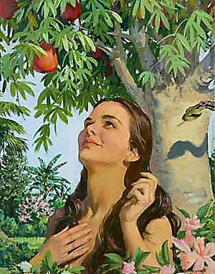
"Now the serpent was more subtile than any beast of the field which the Lord God had made. And he said unto the woman, Yea, hath God said, Ye shall not eat of every tree of the garden?" (Gen. 3:1)

Slide 21
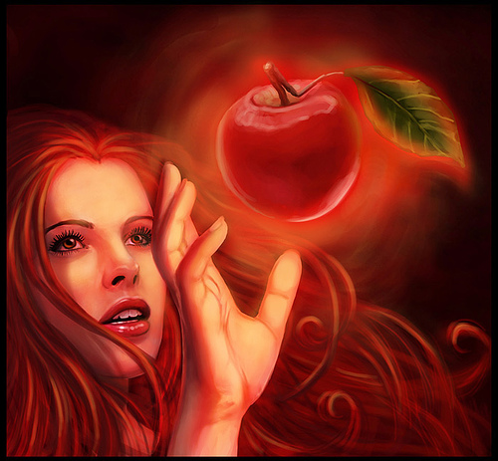
"And when the woman saw that the tree was good for food, and that it was pleasant to the eyes, and a tree to be desired to make one wise, she took of the fruit thereof and did eat…”

Slide 22
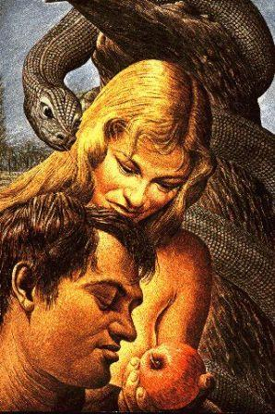
“…and gave also unto her husband with her; and he did eat."
(Gen. 3:6)

Slide 23
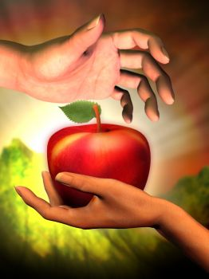
(I Tim. 2:14) “And Adam was not deceived, but the woman being deceived was in the transgression.”

Slide 24
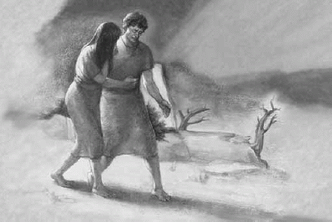
“The Consequences of the Fall”

Slide 25
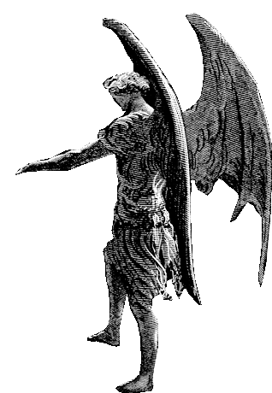
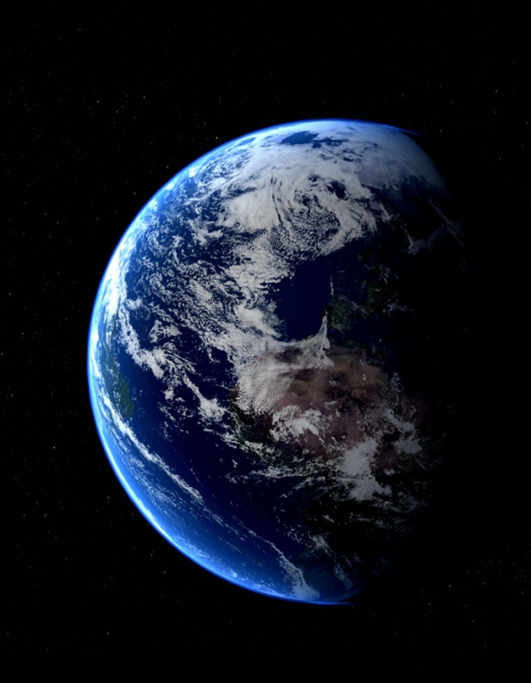

Slide 26
(Matthew 4:8-9)
“Again, the devil taketh him up into an exceeding high mountain, and sheweth him all the kingdoms of the world, and the glory of them; And saith unto him, All these things will I give thee, if thou wilt fall down and worship me.”

Slide 27
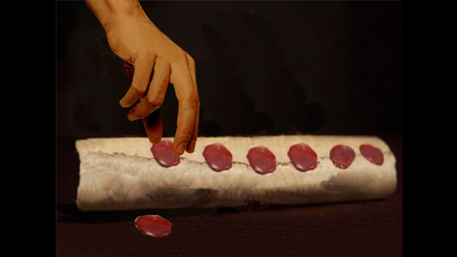
The Seven Sealed Book (Revelation 5:1-14)

Slide 28
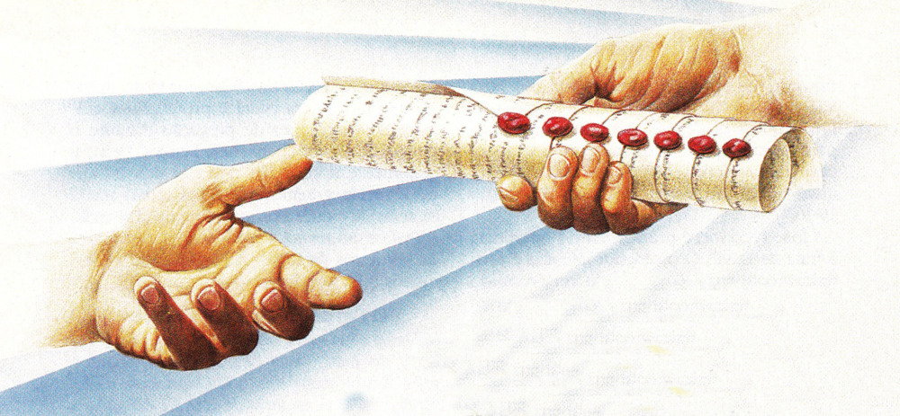
“And I saw in the right hand of him that sat on the throne a book written within and on the backside, sealed with seven seals.”

Slide 29
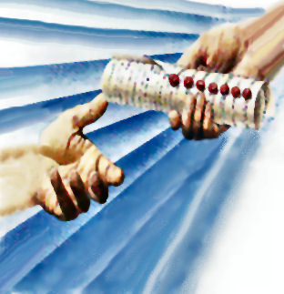
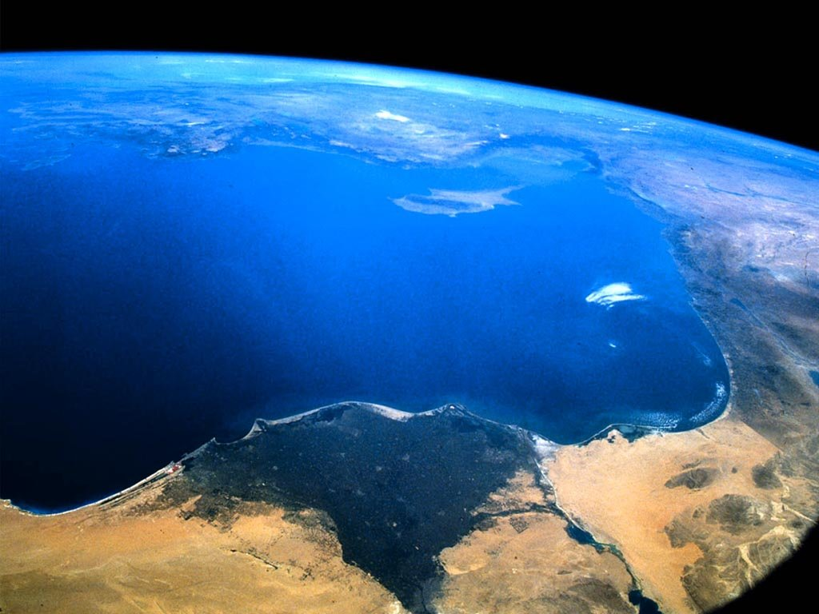
The seven sealed book is the title deed to the earth.
“The earth is the Lord’s, and the fullness thereof.” (Psalms 24:1)
“Thou hast created all things, and for thy pleasure they are and were created.”
(Revelation 4:11)

Slide 30
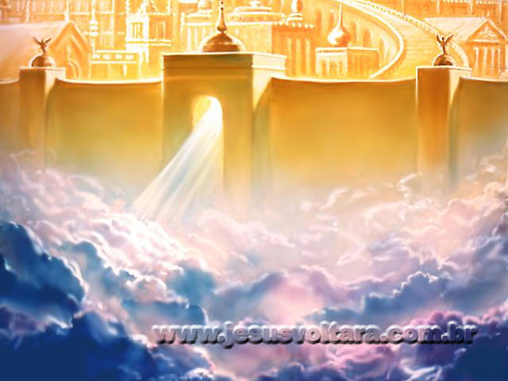
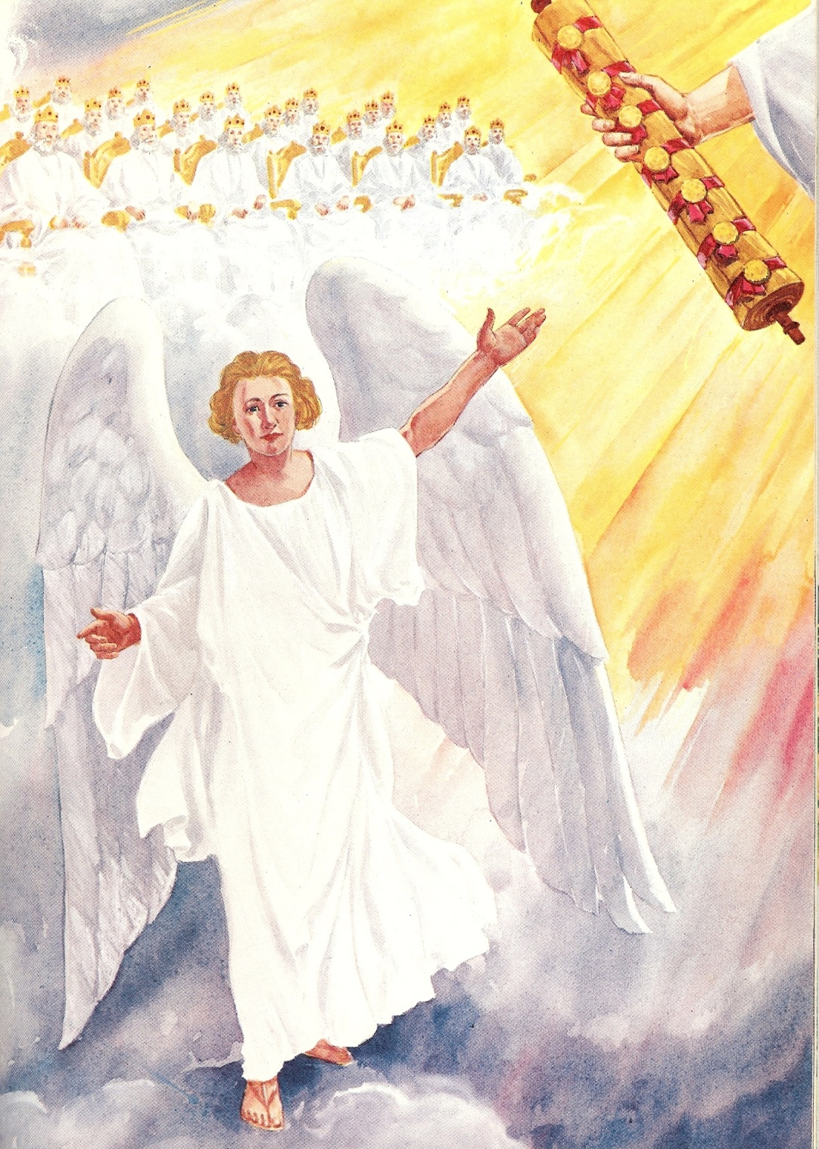
“And I saw a strong angel proclaiming with a loud voice, Who is worthy to open the book, and to loose the seals thereof?”

Slide 31
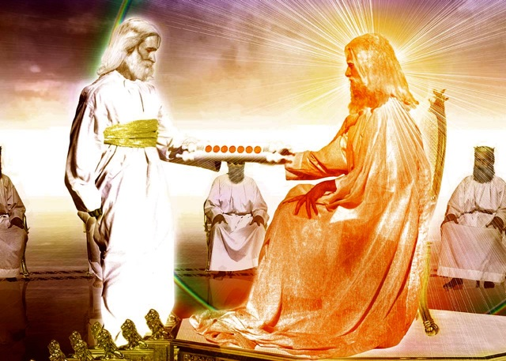
“And he came and took the book out of the right hand of Him that sat upon the throne…”

Slide 32
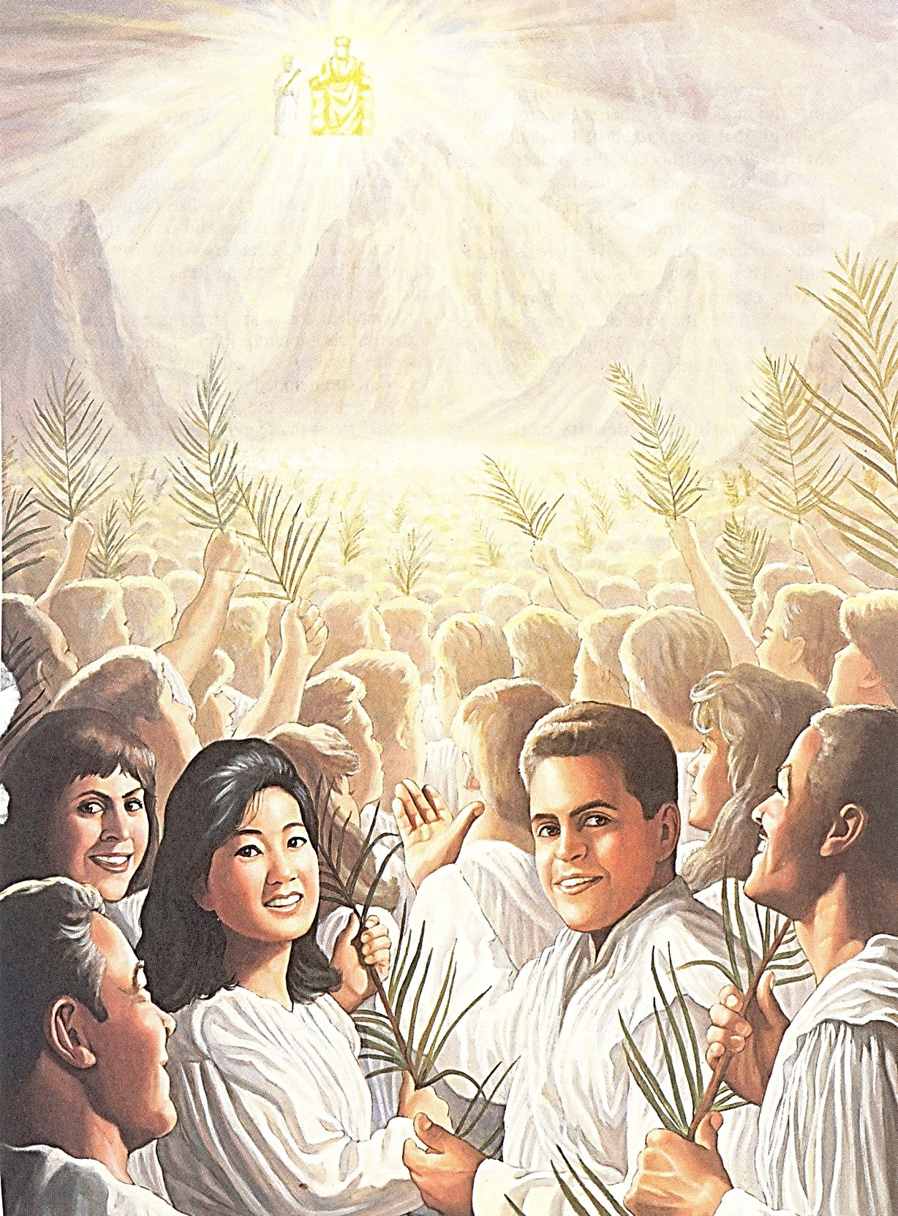
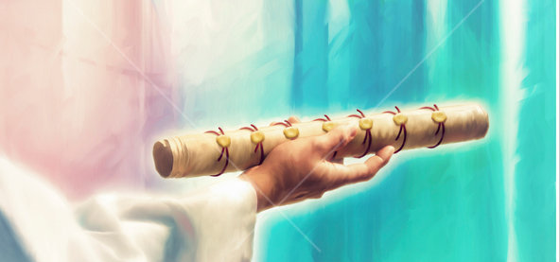
Heaven Erupts in Praise

Slide 33
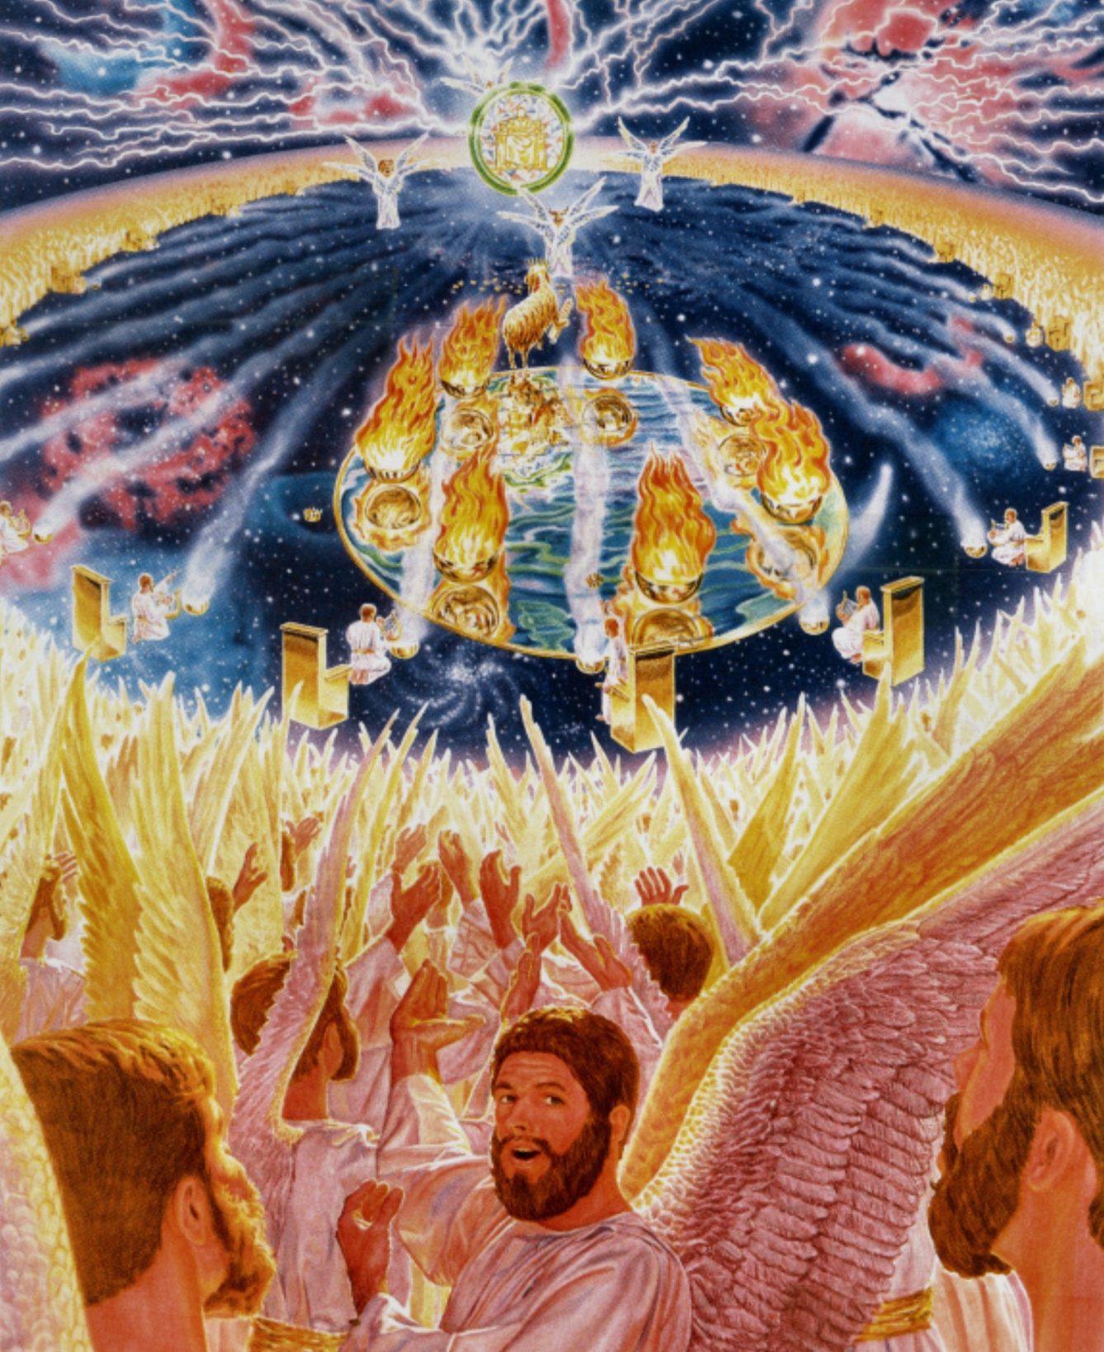
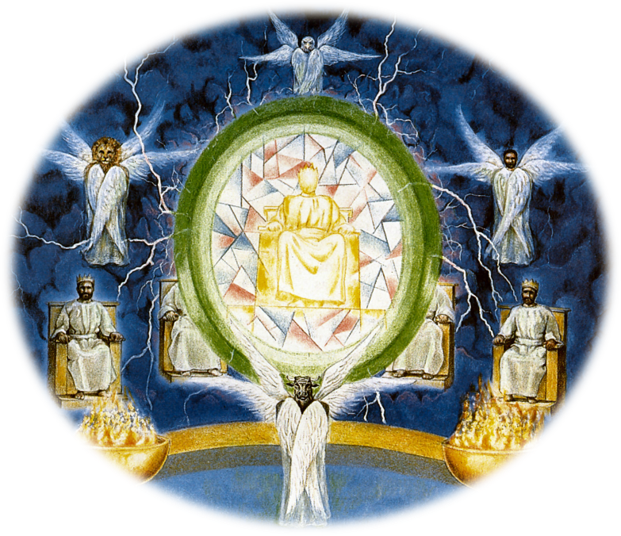
“Thou art worthy”

Slide 34
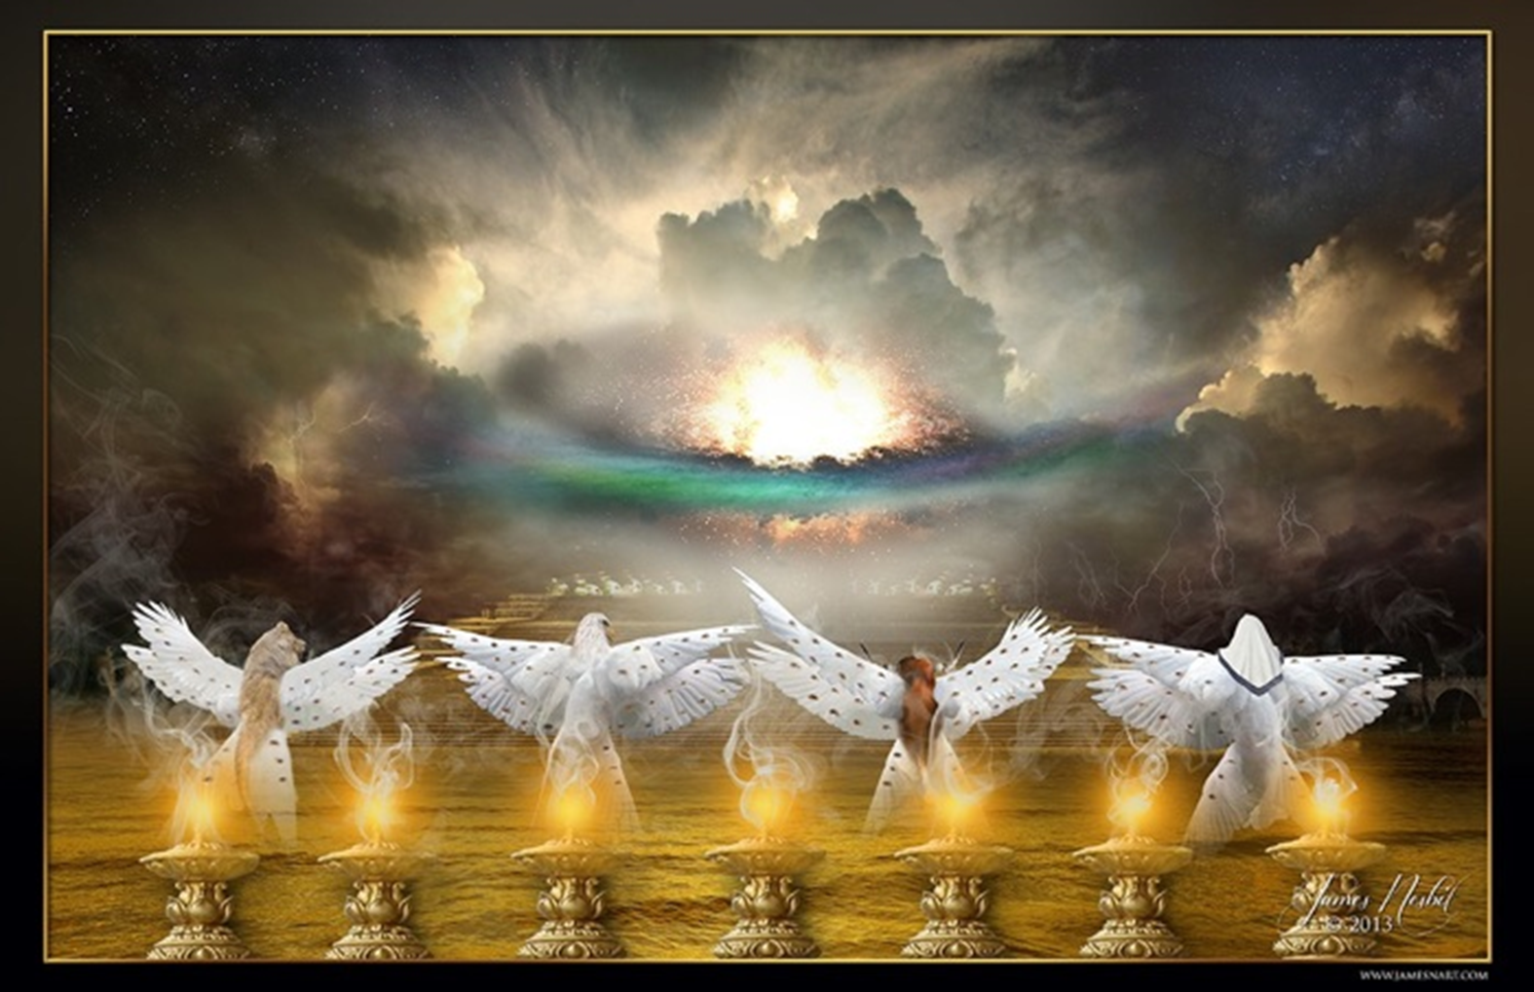
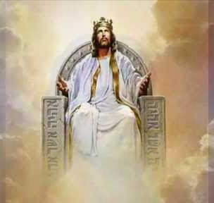
“The four beasts fell down before the Lamb.”

Slide 35
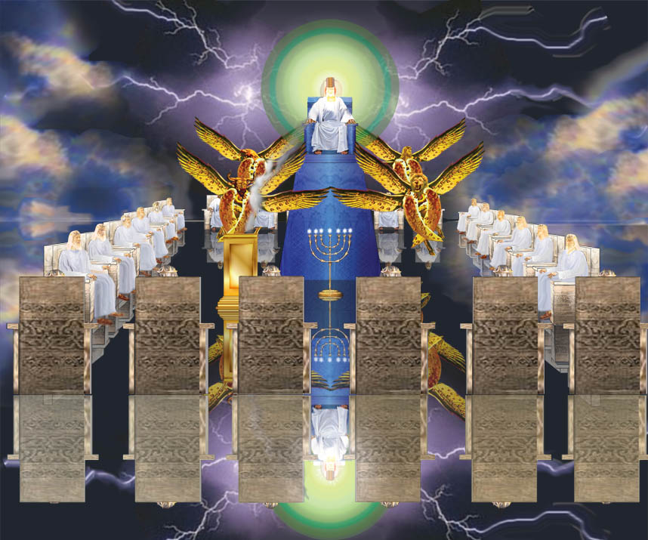
“And twenty elders fell down and worshipped him that liveth forever and ever.”

Slide 36
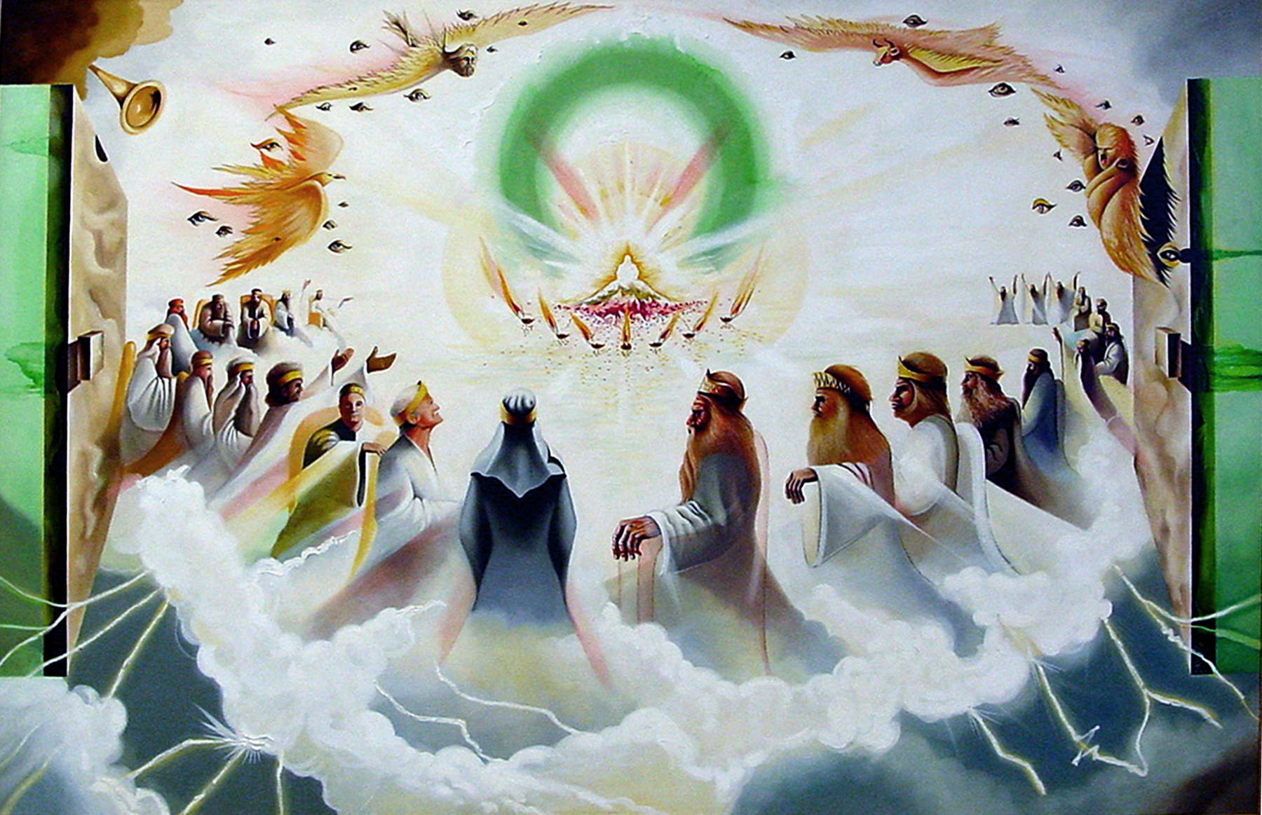
“And they sung a new song, saying, Thou are worthy to take the book, and to open the seals thereof: for thou wast slain, and hast redeemed us to God by thy blood…”

Slide 37
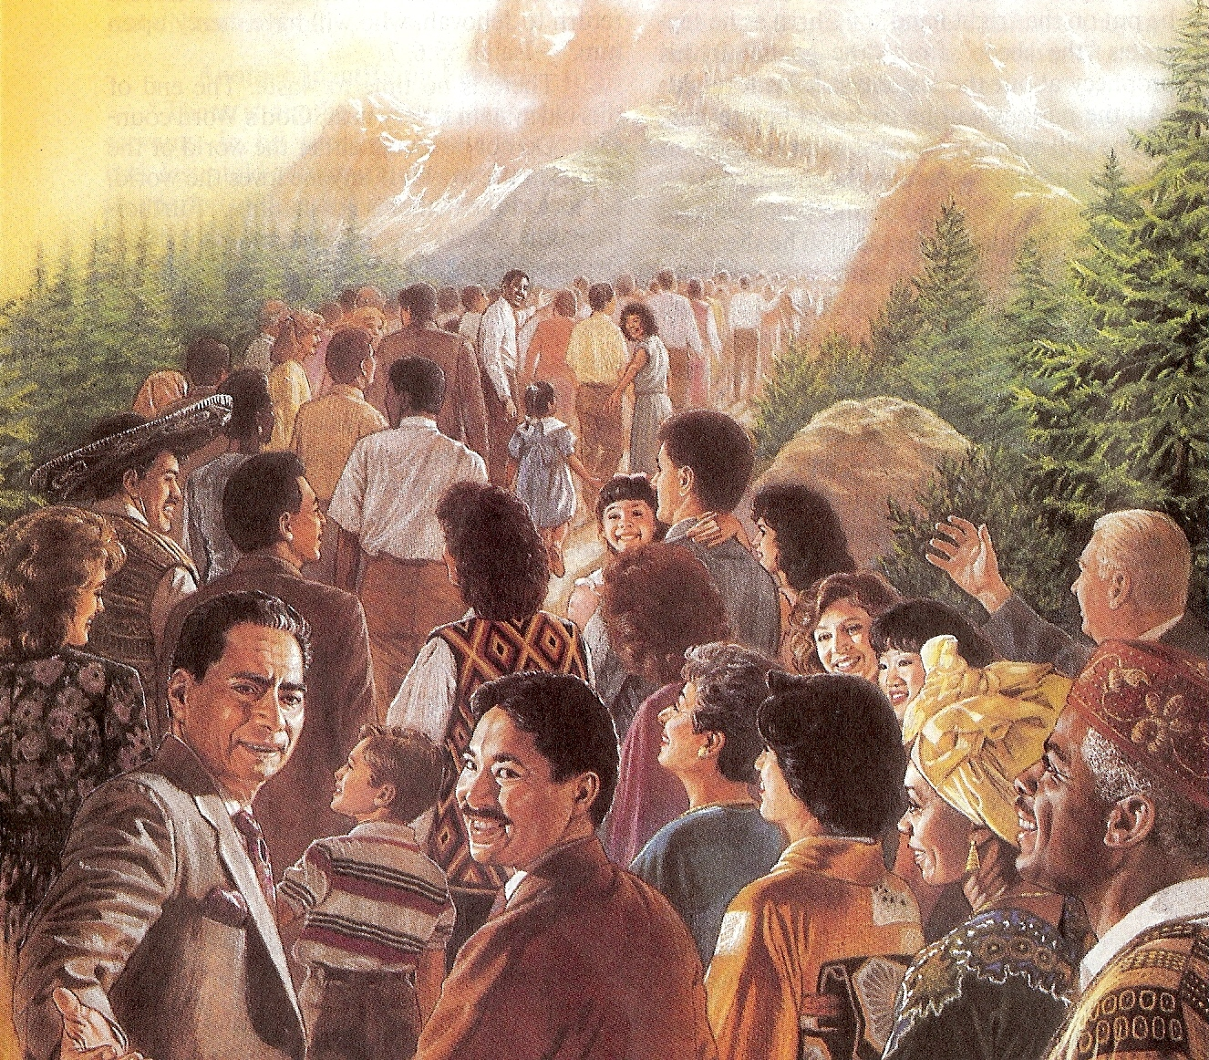
“Thou hast redeemed us to God…out of every kindred, tongue, people, and nation…”

Slide 38
“And I beheld, and I heard the voice of many angels round about the throne and the beasts and the elders: and the number of them was ten thousand times ten thousand, and thousands of thousands. Saying with a loud voice, Worthy is the Lamb that was slain to receive power, and riches, and wisdom, and strength, and honour, and glory, and blessing.”

Slide 39
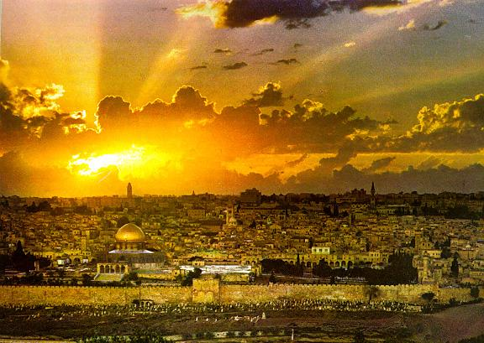
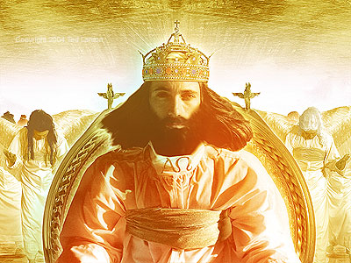
“The kingdoms of this world are become the kingdoms of our Lord, and of His Christ; and He shall reign for ever and ever.” (Revelation 11:5)

Slide 40
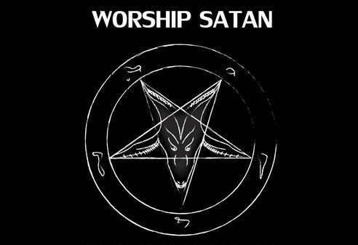
Satan desires Worship

Slide 41
“For thou hast said in thine heart…”
I will ascend into heaven - Obviously Satan had the third heaven in mind here, the very abode of God.
I will exalt my throne above the stars of God - A reference to angels. Satan desired the worship of angels.
I will sit also upon the mount of the congregation, in the sides of the north - Lucifer sought to enter God’s "executive office" somewhere in the north and sit on his throne.
I will ascend above the heights of the clouds - This may well refer to that special Shekinah glory of God.
I will be like the most High - He wanted to be like El-Elyon. This name literally means, "the strongest strong one."

Slide 42
“All these things will I give thee, if thou wilt fall down and worship me.”

Slide 43
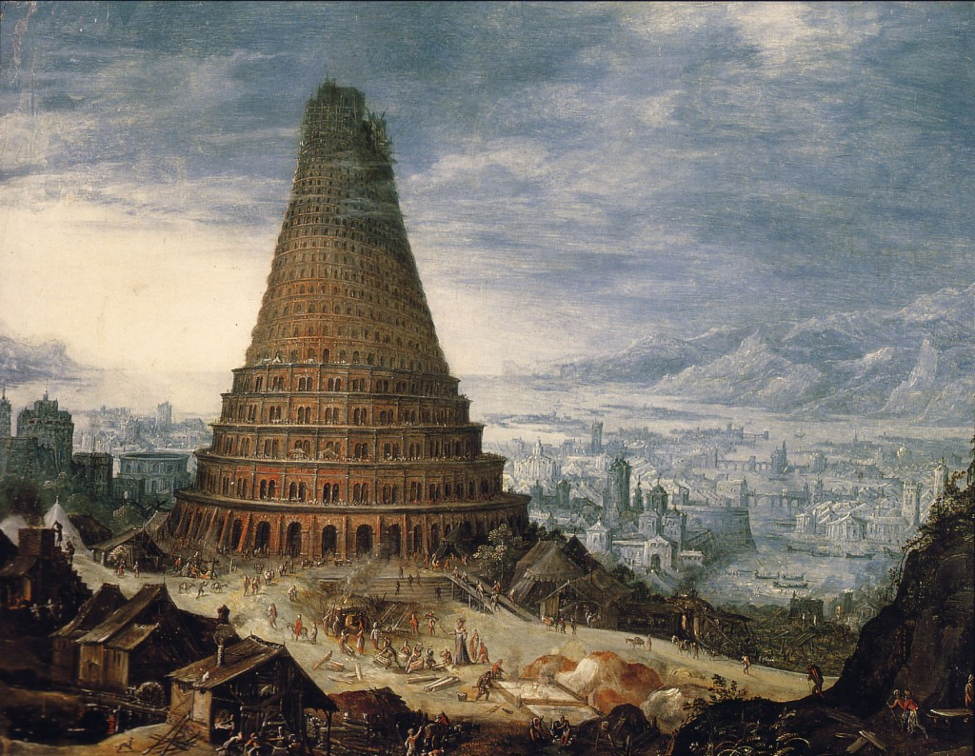
Who is behind all false religion?

Slide 44
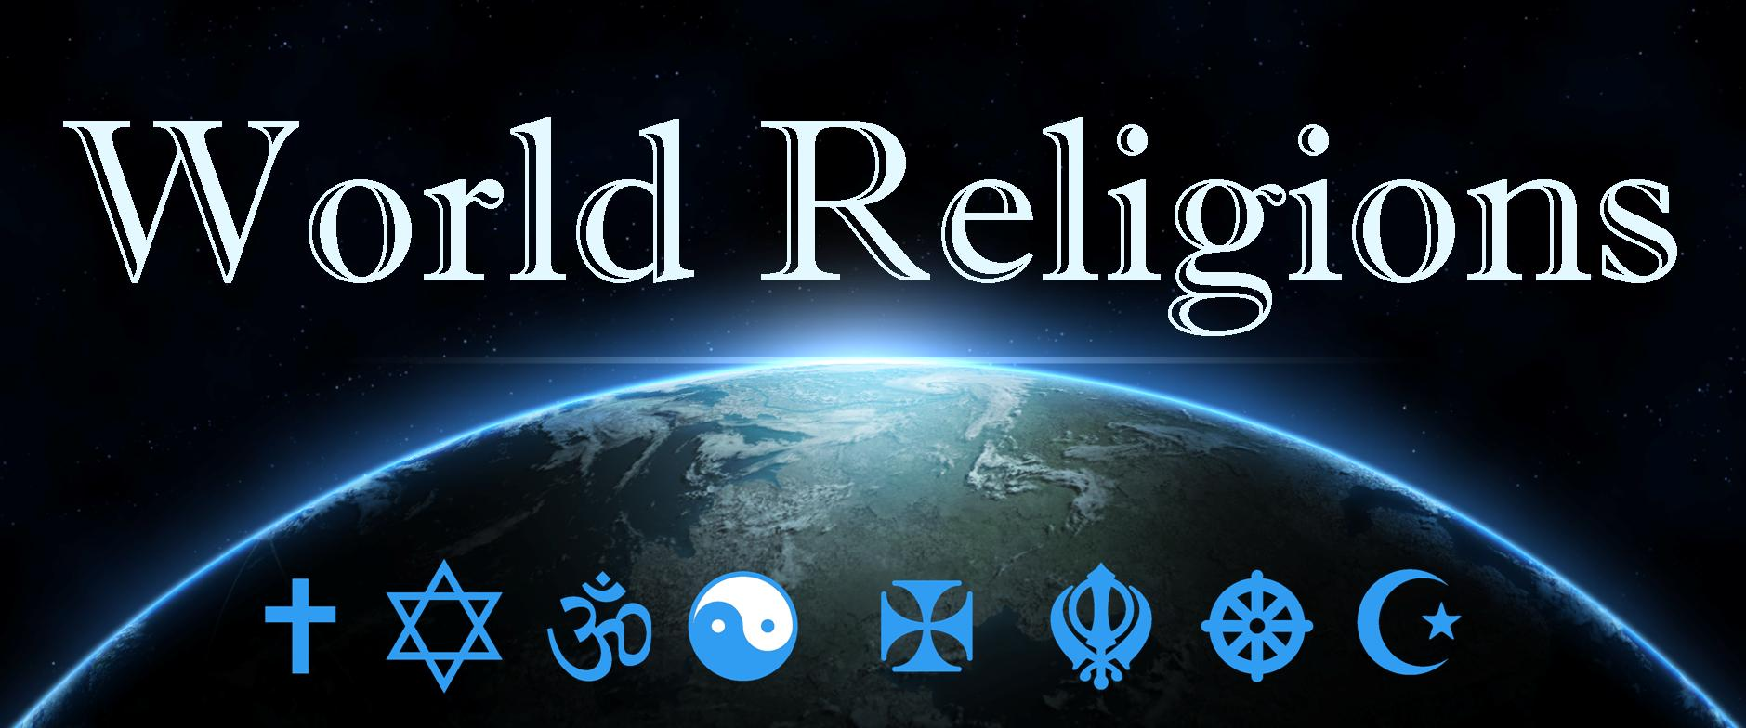
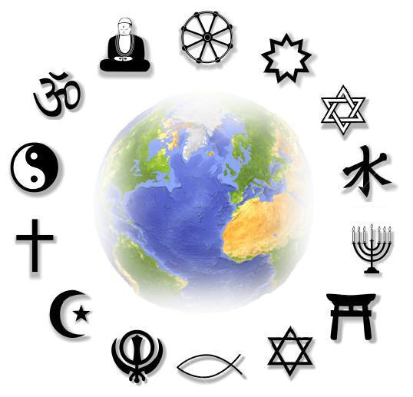
"I know thy works, and tribulation, and poverty, (but thou art rich) and I know the blasphemy of them which say they are Jews, and are not, but are the synagogue of Satan" (Rev. 2:9)

Slide 46
“But I say, that the things which the Gentiles sacrifice, they sacrifice to devils, and not to God: and I would not that ye should have fellowship with devils. Ye cannot drink the cup of the Lord, and the cup of devils: ye cannot be partakers of the Lord's table, and of the table of devils.” (1 Cor. 10:20-21)

Slide 52
Exd. 34:14 “For thou shalt worship no other god: for the LORD, whose name is Jealous, is a jealous God.”
John 4:23-24 “…true worshippers shall worship the Father in spirit and in truth: for the Father seeketh such to worship him. God is a Spirit: and they that worship him must worship him in spirit and in truth.”
Matt. 15:9 “But in vain they do worship me, teaching for doctrines the commandments of men.”
Psalm 96:9 “O worship the LORD in the beauty of holiness.”
1 Sam. 15:25 “Now therefore, I pray thee, pardon my sin, and turn again with me, that I may worship the LORD.”
Deut. 26:10 “And now, behold, I have brought the firstfruits of the land, which thou, O LORD, hast given me. And thou shalt set it before the LORD thy God, and worship before the LORD thy God.”
2 King 17:36 “Him shall ye fear, and him shall ye worship, and to him shall ye do sacrifice.”

Slide 53
Jer. 26:2 “Thus saith the LORD; Stand in the court of the LORD'S house, and come to worship in the LORD'S house.”
Phil. 3:3 “For we are the circumcision, which worship God in the spirit, and rejoice in Christ Jesus, and have no confidence in the flesh.”
Acts 17:23 “For as I passed by, and beheld your devotions, I found an altar with this inscription, TO THE UNKNOWN GOD. Whom therefore ye ignorantly worship, him declare I unto you.”

Slide 55
Preeminence = To be first in rank and influence.
To have first place.

Slide 56
(3 John 1:9-12)
“I wrote unto the church: but Diotrephes, who loveth to have the preeminence among them, receiveth us not. Wherefore, if I come, I will remember his deeds which he doeth, prating (to talk excessively) against us with malicious words: and not content therewith, neither doth he himself receive the brethren, and forbiddeth them that would, and casteth them out of the church. Beloved, follow not that which is evil, but that which is good. He that doeth good is of God: but he that doeth evil hath not seen God. Demetrius hath good report of all men, and of the truth itself: yea, and we also bear record; and ye know that our record is true.”

Slide 58
Satan has his worshipers

Slide 59
"And they worshipped the dragon which gave power unto the beast: and they worshipped the beast, saying, Who is like unto the beast? who is able to make war with him?" (Rev. 13:4)

Slide 60
“And the dragon gave him his power, and his seat, and great authority.”

Slide 61
“And I saw, and behold a white horse: and he that sat on him had a bow; and a crown was given unto him: and he went forth conquering; and to conquer.”
(Revelation 6:2)

Slide 62
“…and his deadly wound was healed: and all the world wondered after the beast…”
“…and his deadly wound was healed: and all the world wondered after the beast…”
“…and his deadly wound was healed: and all the world wondered after the beast…”

Slide 63
Abomination of desolation

Slide 65
“He (false prophet) deceiveth them that dwell on the earth by the means of those miracles which he had power to do…saying to them…that they should make an image to the beast, which had the wound by a sword, and did live.”

Slide 66
“And he (false prophet) had power to give life unto the image of the beast, that the image of the beast should both speak…” (Revelation 13:15)

Slide 69
“I saw the souls of those who had been beheaded because of their testimony of Jesus and because of the word of God, and those who had not worshiped the beast or his image, and had not received the mark on their forehead and on their hand.”

Slide 70
“Why Do Muslims Behead People?”

Slide 71
Quran -“When your Lord revealed to the angels: I am with you, therefore make firm those who believe. I will cast terror into the hearts of those who disbelieve. Therefore strike off their heads and strike off every fingertip of them.” “Therefore, when ye meet the Unbelievers , strike off their heads.” “Oh ye who believe! Murder those of the disbelievers and let them find harshness in you.”

Slide 72
“Fight them on until there is no more tumult and religion becomes that of Allah” "Fight those who do not believe in God and the last day... fight People of the Book, (Christian and Jews) who do not accept the religion of truth (Islam).”

Slide 74
“Fear none of those things which thou shalt suffer: behold, the devil shall cast some of you into prison, that ye may be tried; and ye shall have tribulation ten days…”

Slide 75
Satan has a false trinity
Satan has his synagogues
Satan has prophets and teachers
Satan has his doctrines
Satan has his mysteries
Satan has a throne
Satan has a kingdom
Satan desires worship
Satan has worshipers

