Slide 1
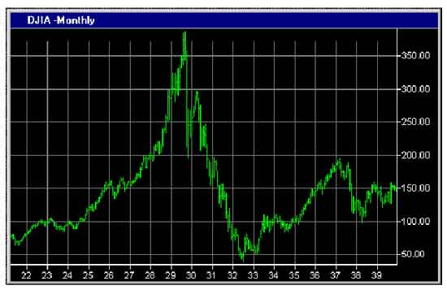
Financial Freedom
(Part 11)
What does it mean to be
financially free?
“And ye shall know the truth and the truth shall make you free.” (John 8:32)

Slide 2
Gambling Right or Wrong?

Slide 3
Proverbs 28:22 “He that hasteth to be rich hath an evil eye, and considereth not that poverty shall come upon him.”

Slide 4
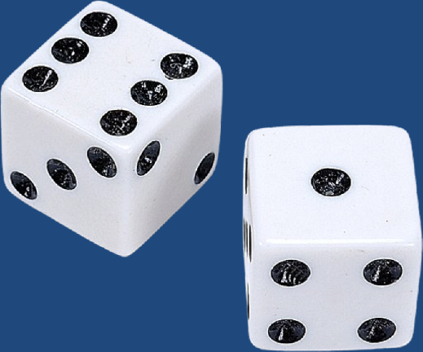
The Word Gambling Does Not Appear in the Word of God
There are however many principles contained in the Word of God that can be directly applied to gambling –
Hebrews 5:11-14
Gambling defined:
To play games of chance for money or other stakes.
To take a risk in order to gain something of value.
An act which depends upon chance or uncertain venture.

Slide 5
Deception of Gambling
Satan is the master of deception and temptation
“The Devil, which deceiveth the whole world…he deceiveth them that dwell on the earth…” (Revelation 12:9, 13:14)

Slide 6
Four Aspects of Deception Jesus – “Take heed that ye be not deceived.” (Luke 21:8)
We can deceive ourselves – I Corinthians 3:18
We can be deceived by others – Ephesians 5:6
We can be deceived by sin – Hebrews 3:13
We can be deceived by Satan – II Corinthians 11:3-15

Slide 7
Three Aspects of Temptation
We can be tempted by our own lust – James 1:12-16
Desire
Deception
Deliberation
Disobedience
Development
Destruction

Slide 8
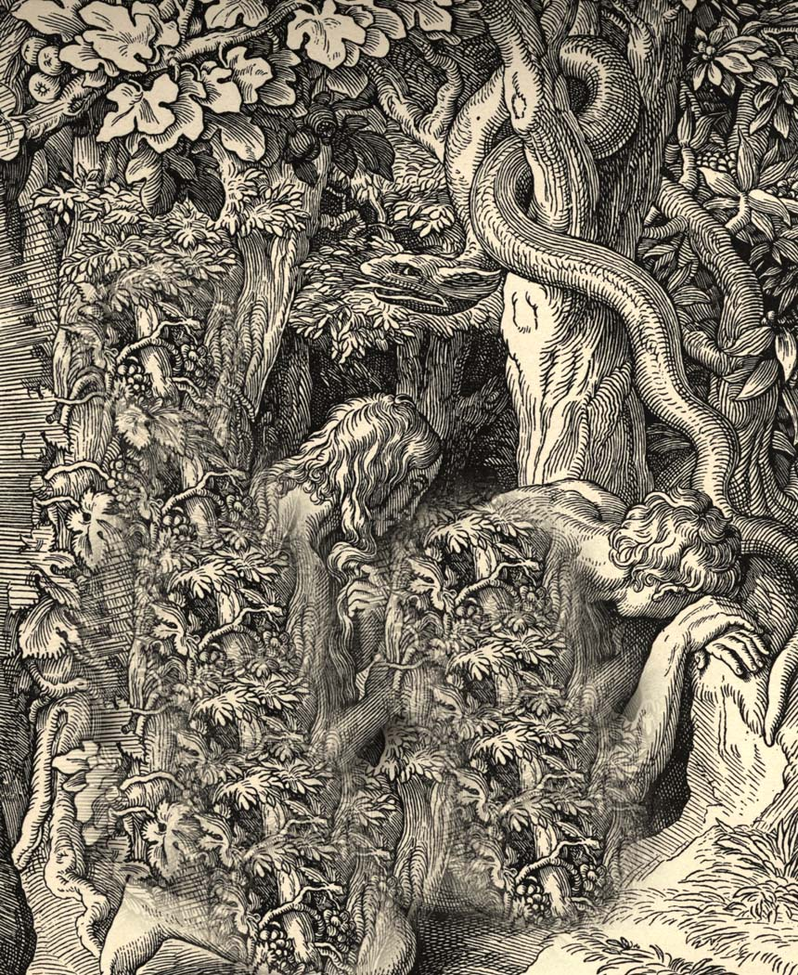
We can be tempted by others – Matthew 16:1
We can be tempted by Satan – Matthew 4:1-11

Slide 9
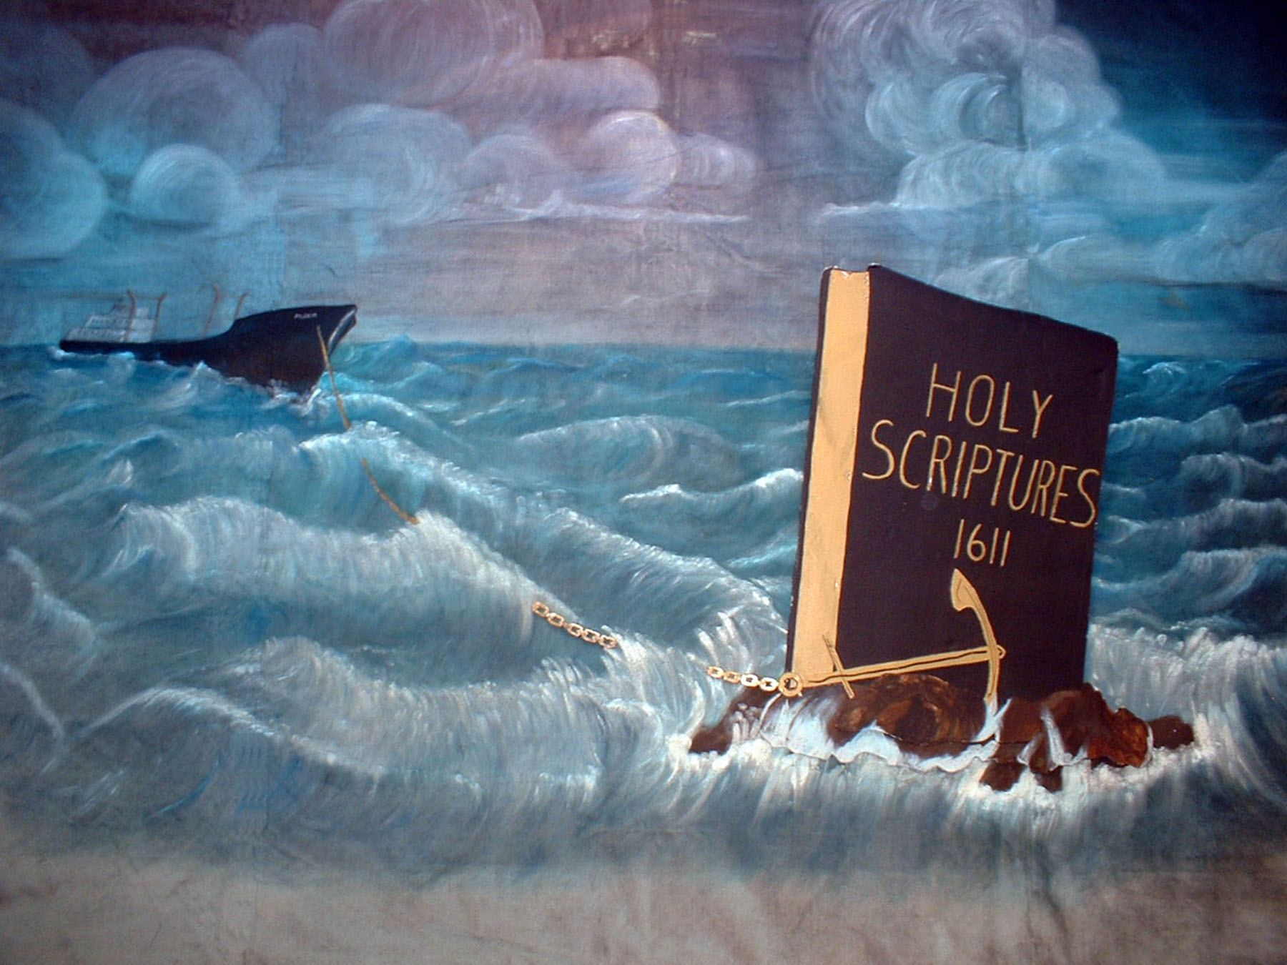
Rejecting Deception
The only way to reject deception is with the
“Truth of Scripture”

Slide 10
Resisting Temptation
Do not put yourself in the place of temptation – Mark 14:28
Pray for wisdom to discern temptation – Matthew 26:41
Flee temptation – I Corinthians 10:13-14
Never be prideful and think that you are above temptation – Proverbs 16:18
Ask God for grace to resist temptation – Hebrews 2:18, 4:15-16

Slide 11
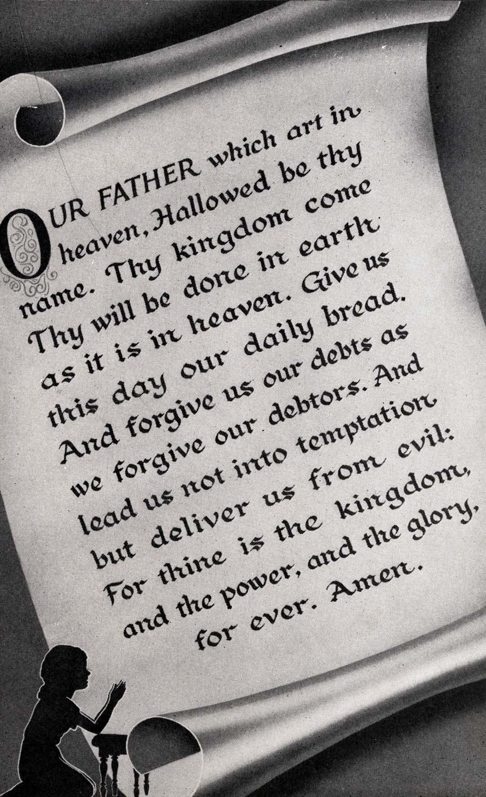
Endure temptation (do not give in) – James 1:12
Claim the promise of II Peter 2:9 –
“The Lord knoweth how to deliver the godly out of temptation.”

Slide 12
The Destruction of Gambling (Luke 12:15; I Timothy 6:9-10)
1964 – Six million compulsive gamblers
1993 – Thirty million compulsive gamblers
2007 – Forty two million compulsive gamblers

Slide 13
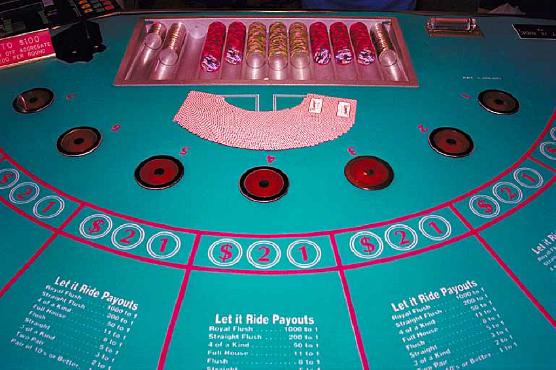
Odds Against the Gambler
Legalized gambling – 60% - 75%
Illegal gambling – Much higher
Establishment gambling – House wins 8 out of 10 times

Slide 14
Gambling attracts organized crime
Increase of drugs, drinking, break-up of the family, poverty, immorality, illegal gambling, corruption of public officials, etc.
Los Angeles Chief of Police – In analyzing the gambling situation in his city said:
“A society that bases its financial structure on the weaknesses of its people doesn’t deserve to survive.”

Slide 15
Massachusetts Crime Commission – Study on Gambling:
“In areas where gambling is illegal, wide open gambling operations are often in full swing because of the protection money paid to local public officials. Corruption is one of the largest industries in our nation. Such corruption in our nation amounts to the wholesale value of one-half the automobiles produced in our country in an ordinary year. Once a public official has accepted such bribes, he is no longer truly a public servant. He is a bought man who must now wink his eye at many vices including robbery, prostitution, and even murder because of his monetary relationship with the racketeers. This kind of individual makes

Slide 16
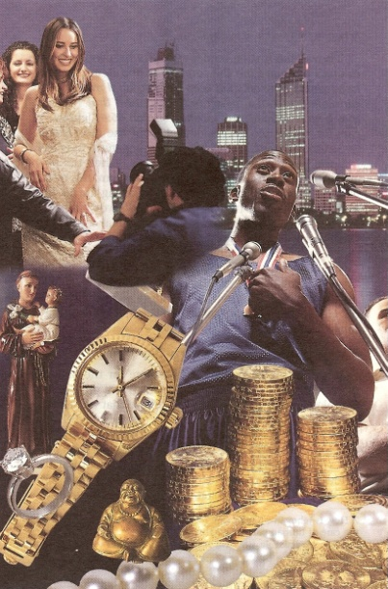
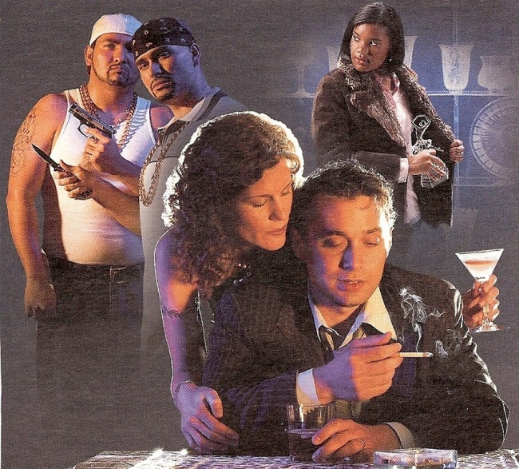
it exceedingly difficult for the majority of public officials who are honest and must contend with public loss of respect for the law because of the dishonesty of a few. The fact is that gambling destroys society. Gamblers do not say “Let’s stop here.” Greed is never satisfied. Unless the tide is turned against gambling, the corruption, racketeering, and immorality for which it is paying the bill will undermine the strength and vitality of our nation.”
(July 14, 1973)

Slide 17
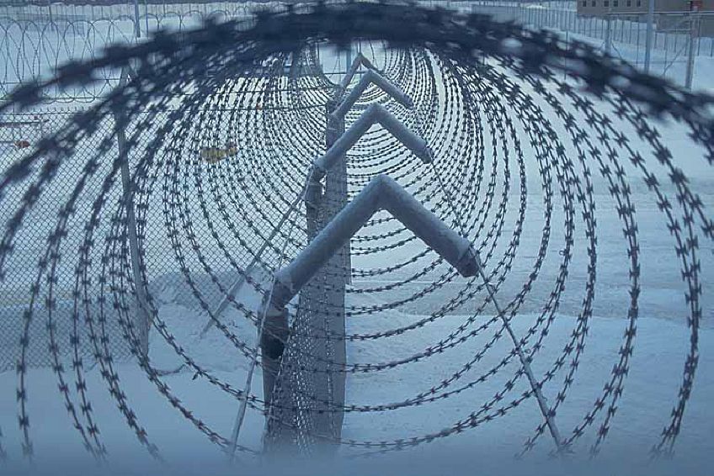
Every dollar raised from gambling sources means five dollars spent on “higher police cost, higher court cost and higher penitentiary cost.”

Slide 18
Gambling Defended
You can not point to a “proof text” to disprove gambling – “Thou shalt not gamble”
It’s just for fun –
It’s just a form of entertainment –
It’s part of human nature –
All of life is a risk –
Farmer
Builder
Stocks

Slide 19
It’s a good source for government revenue –
It’s a good source for charity money –
“It is more blessed to give than to receive…”

Slide 20
Gambling Disproved “Gambling Violates Biblical Principles”
Working for money – “If a man does not work, neither should he eat…”
Physical labor – Ephesians 4:28
Mental labor (wise investments) – Matthew 25:14-23
Spiritual labor – I Corinthians 9:6-14
Faithful hardworking steward – Luke 16:10-15
Serving God rather than money – Matthew 6: 24-34

Slide 21
Being content with what you have – Philippians 4:11-13
Warning against having temporal values – Luke 12:15
Set your affections on things above, not the things of this world – Colossians 3:1-4
Separation from the world – II Corinthians 6:14-7:1
Avoiding the appearance of evil – I Thessalonians 5:22
Following Christ’s example – I Peter 2:21
Do all things to the glory of God – I Corinthians 10:31

Slide 22
Do not be a stumbling block – Romans 14:13
Is it fitting conduct for a child of God – Ephesians 4:1
Is it considered a worldly activity – John 17:16
Would you like to be found doing it when the Lord returns – I John 2:28-3:4
Will it harm your Christian testimony – I Timothy 4:12
Will it put you in the place of temptation – I Corinthians 10:13
Is it potentially destructive – Ecclesiastes 4:8, 5:13-19

Slide 23
Could it turn your heart away from following the Lord – Proverbs 11:28, 22:11
Will it attract the wrong kind of friends – Proverbs 19:4
If riches increase, you will not be satisfied – Ecclesiastes 2:10-11, 5:10
Focus on giving and not getting – Luke 6:38
Lay up treasures in heaven – Matthew 6:19-21

Slide 24
Apply the threefold test of Scripture to Gambling “Proving what is acceptable unto the Lord”
Test it by the Word of God – II Timothy 2:15
Test it by its Fruit – Matthew 7:15-20
Test it by the Spirit – Romans 14:23

Slide 25
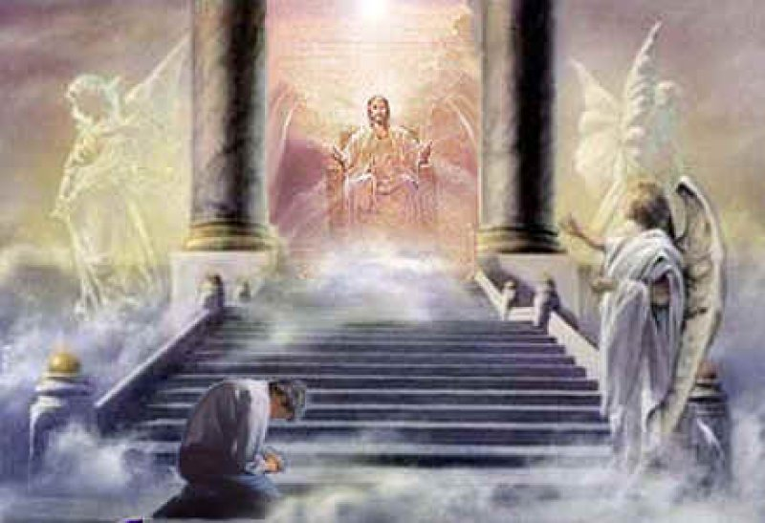
“For we must all appear before the judgment seat of Christ; that every one may receive the things done in his body, according to that he hath done, whether it be good or bad.”

