Slide 1
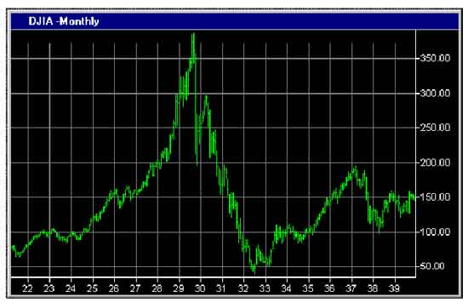
Financial Freedom
(Part 12)
What does it mean to be
financially free?
“And ye shall know the truth and the truth shall make you free.” (John 8:32)

Slide 2
Review:
Biblical principles of stewardship
What the Bible teaches about borrowing
The sting of interest
Establishing scriptural convictions
Developing a giving spirit
What it means to be financially free

Slide 3
Importance of living on a budget
Making a choice to serve God rather
than money or material possessions
Reasons for lack of funds
Establishing the tithe as a weekly
reminder that everything we have
belongs to God
Giving to meet the needs of others
Knowing who not to give money to
The Law of the Harvest

Slide 4
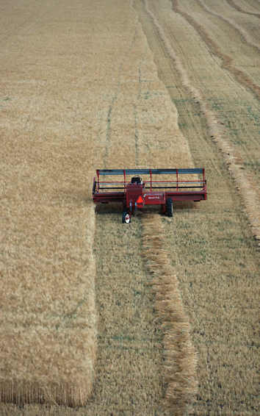
Galatians 6:7-9
We reap what we sow
We reap where we sow
We reap in proportion to what we sow
We reap in another season than which we sow

Slide 5
The Wisdom of Solomon Concerning Finances
“Violations of God’s Word result in financial
loss” (Proverbs)
Gambling – Right or Wrong? Proverbs 28:22 “He that hasteth to be rich hath an evil eye, and considereth not that poverty shall come upon him.”

Slide 6
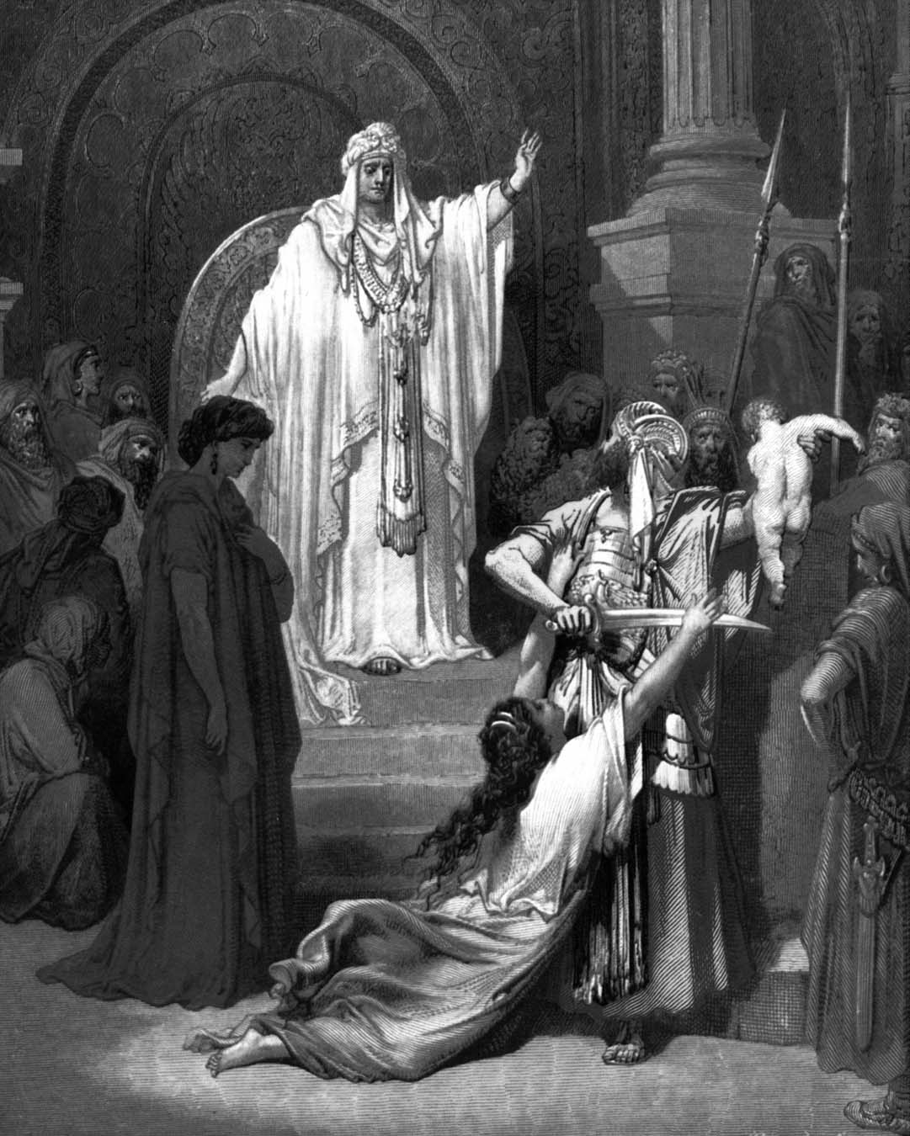
The Wisdom of Solomon Concerning Finances “More financial principles from Proverbs.”

Slide 7
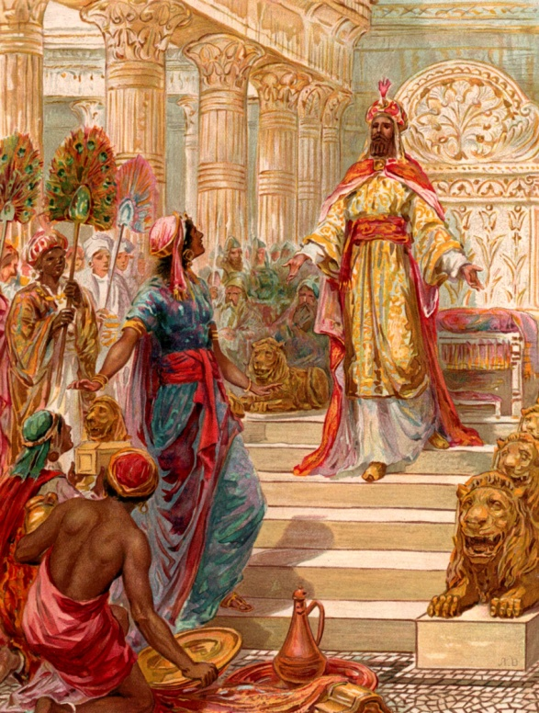
“Bow down thine ear, and hear the words of the wise, and apply thine heart unto my knowledge. For it is a pleasant thing if thou keep them within thee; That thy trust may be in the Lord.
I have made known to thee this day, even to thee. Have not I written to thee excellent things in counsels and knowledge, that I might make thee know the certainty of the words of truth, that thou mightest answer the words of truth to them that send thee.”

Slide 8
Material Possessions “Servant or Master” “No man can serve two masters…”
Recognize that all material blessings come from God – “The blessing of the Lord. It maketh rich, and He addeth no sorrow with it.” – 10:22

Slide 9
Obtain material possessions the right way
1) Through diligent and honest work –
“He becometh poor that dealeth with a slack (negligent) hand: but the hand of the diligent maketh rich.” – 10:4
“Wealth gotten by vanity (dishonesty) shall be diminished: but he that gathereth by labor shall increase.” – 13:11

Slide 11
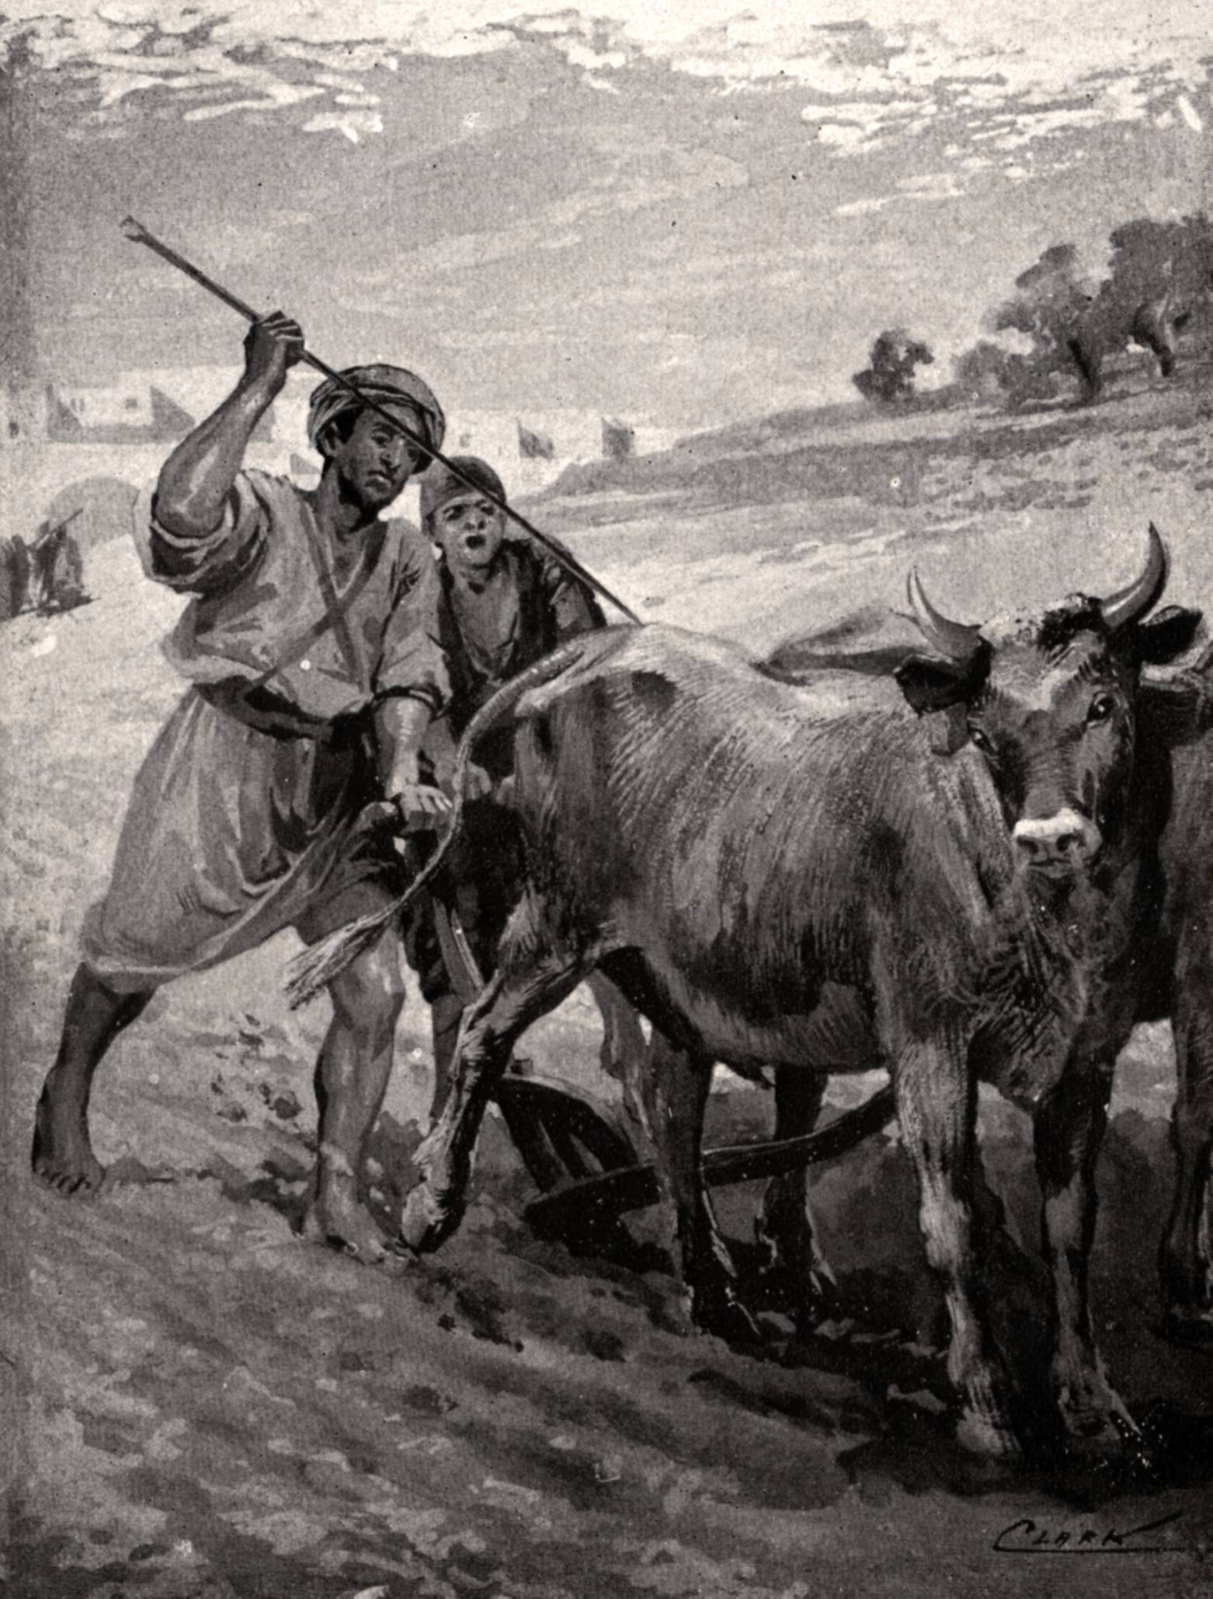
2) Through using the resources (gifts, abilities, possessions, finances) God has entrusted to you –
“Where no oxen are, the crib is clean: but much increase is by the strength of the ox.” – 14:4

Slide 12
The Virtuous Mother (Proverbs 31:10-31) “Develops the potential of her home”
“Every wise woman buildeth her house: but the foolish plucketh it down with her hands.” – 14:1

Slide 13
31:10 An excellent wife is hard to find. She cannot be bought with expensive jewels or fancy sports cars. Her inner beauty cannot be purchased-it is far greater than money can buy.
31:11 Her husband trusts her with all of his possessions. He is not concerned that she will drain the checkbook or run up the charge account for her own whims. Rather, she will help to save and economize in order to establish financial security.
31:12 She is a devoted helpmeet for his good, a “responder” to his love, one who lives for his fulfillment.

Slide 14
31:13 She decorates the home, keeps the house tidy, and even mops the floor with a song in her heart and praise on her lips.
31:14 She shops wisely at the local supermarket and fresh-vegetable stands for the best buys in food and provides well-balanced nutritious meals that are attractively served.
31:15 She rises early in the morning and serves a good breakfast to her husband and children before driving her children to school and starting her day’s schedule.

Slide 15
31:16 She holds home Tupperware parties. From the money she earns, she pays her children’s tuition for a Christian education.
31:17 She goes to the local health club and exercises her body to keep physically fit and strong.
31:18 She senses when her muscles are well toned, because she can keep up with the busy pace of her family well into the evening.
31:19 She picks up her needlepoint when she sits down, and keeps her hands busy.

Slide 16
31:20 She makes time to assist those who are needy, making soup and casseroles for the sick neighbors and arranging time for volunteer charity work for the poor.
31:21 She is a season ahead, planning what warm winter clothes will be needed for the family before the snow begins to fall.
31:22 She selects her own wardrobe carefully and is well groomed in modest apparel. She is not seen outside her home with curlers in her hair, nor does she dress to gain attention.

Slide 17
31:23 Her husband is a respected businessman among the leaders of the community.
31:24 She operates a ladies’ boutique from her home (some might term it a “garage sale”), selling some of the lovely articles she has created.
31:25 Charm and self-confidence are her characteristics, and she faces the future with joy and hope.
31:26 She speaks with wisdom from studying the Word of God, and her life is an example of kindness to others.
31:27 She manages her home with great care and does not sit around idly, watching TV or chatting with her friends on the telephone.

Slide 18
31:28 Her children love and respect her, and her husband sings her praises, saying:
31:29 “You, my darling, are the greatest woman God could have given me.”
31:30 A charming and beautiful woman can be deceiving, but a woman who reverences the Lord shall be praised.
31:31 Her children and her community, who know her well, will see all that she has done and will admire and praise her.

Slide 19
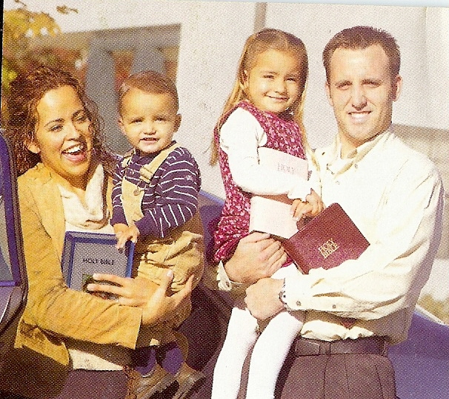
Godly Father “Assumes the headship of his home”

Slide 20
“The house of the wicked shall be overthrown: but the tabernacle of the upright shall flourish.” – 14:11
“In the house of the righteous is much treasure: but in the revenues of the wicked is trouble.” – 15:6
“The glory of children are their fathers.” – 17:6

Slide 21
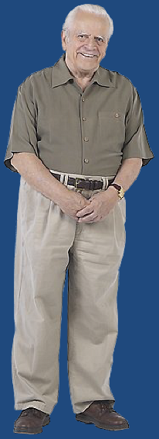
“The glory of young men is their strength: and the beauty of old men is the gray head…The hoary (gray) head is a crown of glory, if it be found in the way of righteousness.” – 20:29, 16:31

Slide 22
The Next Generation “My Son…” “One generation passeth away, and another generation cometh.” (Ecclesiastes 1:4)
Pass on your faith
Pass on your values
Pass on your work ethic
Pass on your standards
Pass on your convictions
Pass on your commitment
Pass on your wisdom
Pass on your love

Slide 23
3) Through wise and righteous endeavors –
“The crown of the wise is their riches: but the foolishness of fools is folly.” – 14:24
“I love those that love me; and those that seek me early shall find me. Riches and honor are with me; yea, durable riches and righteousness. My fruit is better than gold, yea, that fine gold; and my revenue than choice silver. I lead in the way of righteousness, in the midst of the paths of judgment. That I may cause those that love me to inherit substance (wealth); and I will fill their treasures.” – 8:17-21

Slide 24
“Through wisdom is a house builded; and by understanding it is established: And by knowledge shall the chambers be filled with all precious and pleasant riches.” – 24:3-4
“The upright shall have good things in possession.” – 28:10

Slide 25
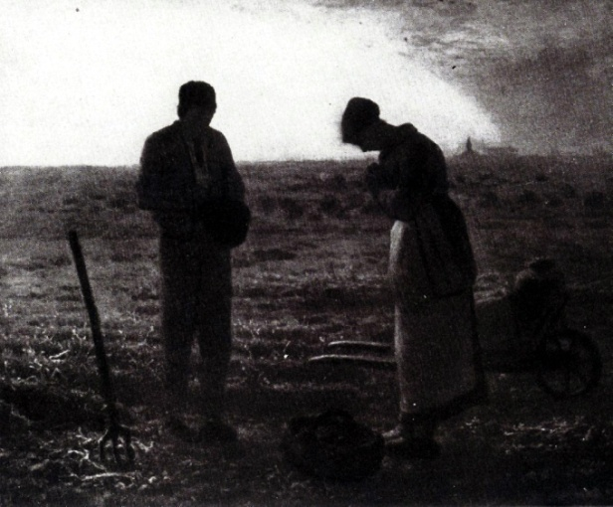
4) Through humble faith in God –
“By humility and the fear of the Lord are riches, and honor, and life.” – 22:4
“He that putteth his trust in the LORD shall be made fat.” - 28:25
“Whoso putteth his trust in the LORD shall be safe.” - 9:25
“He is a shield unto them that put their trust in him.” - 30:5

Slide 26
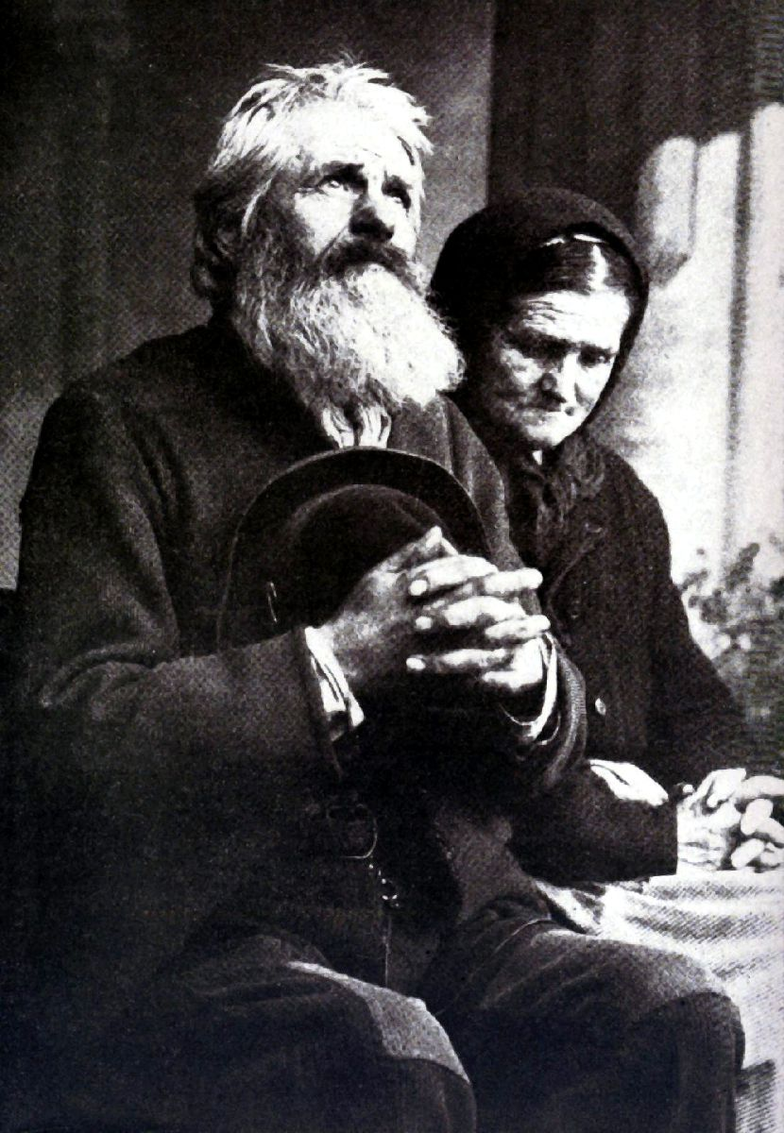
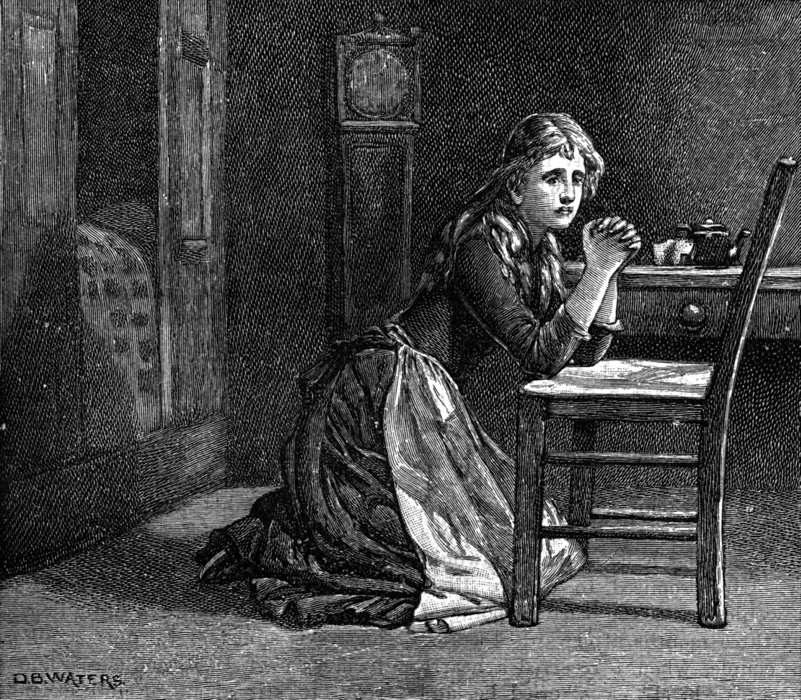
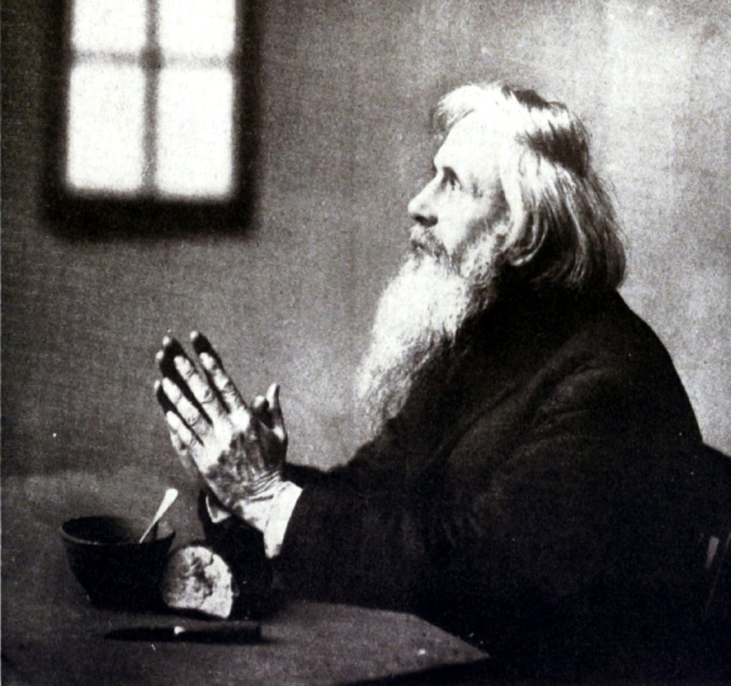
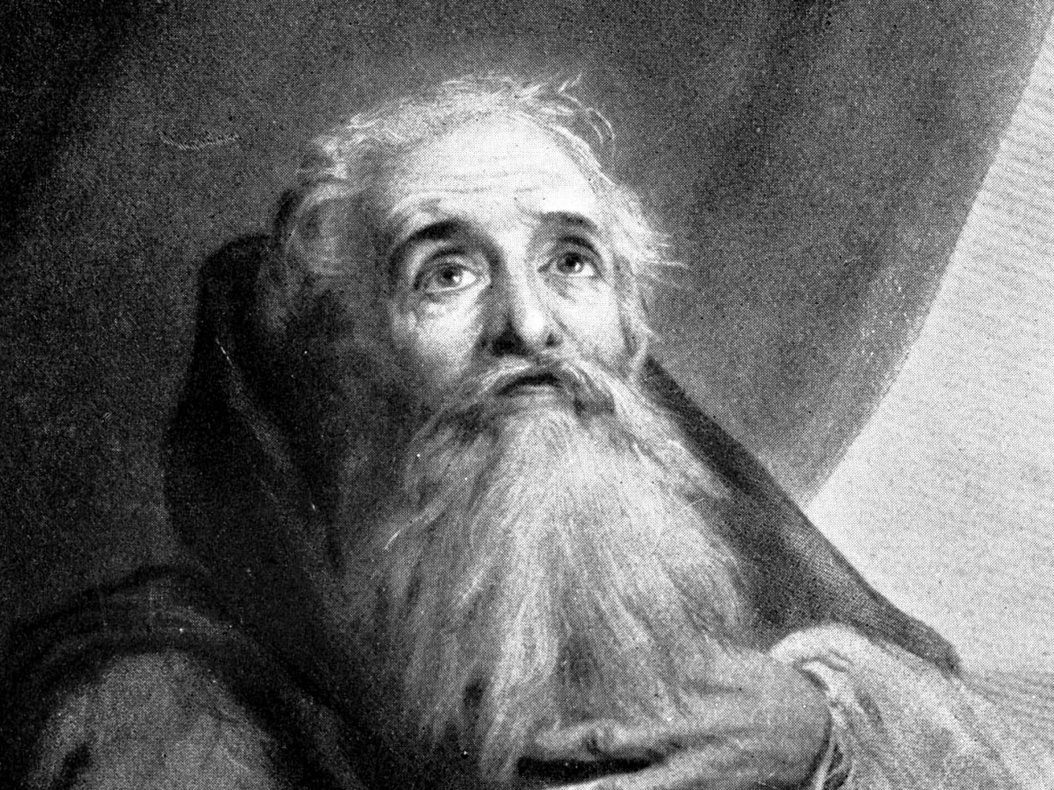
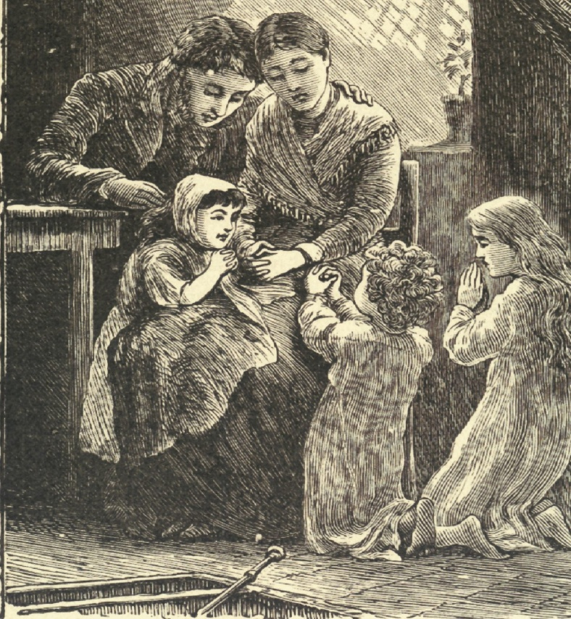
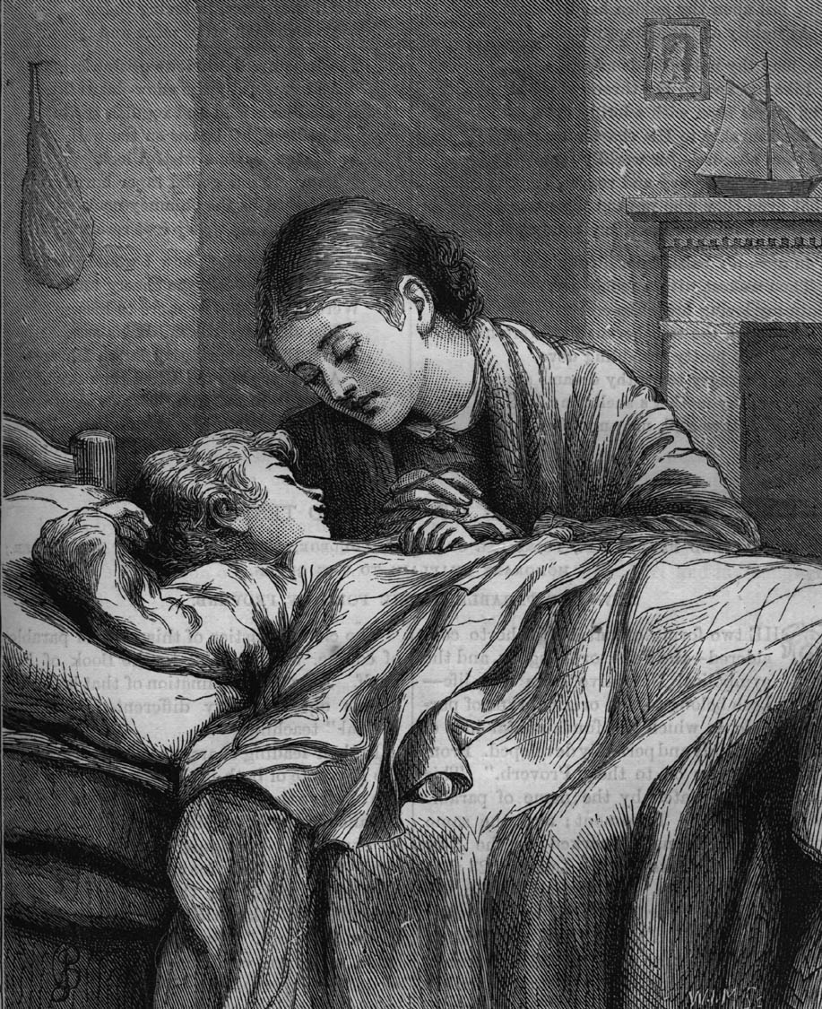
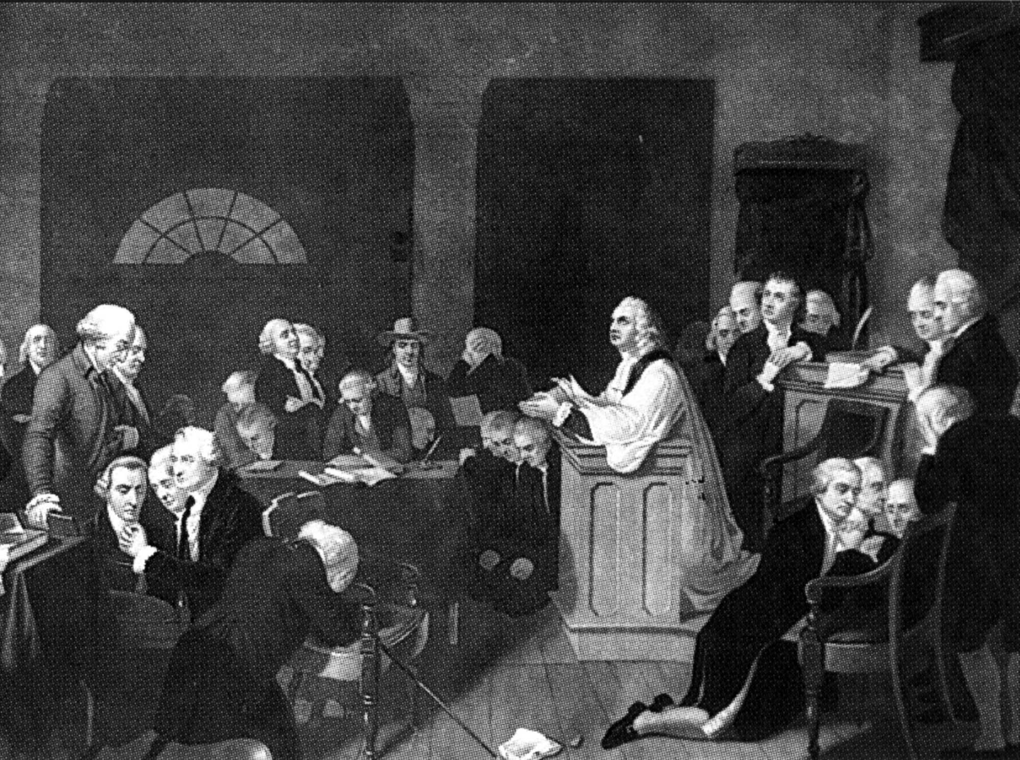
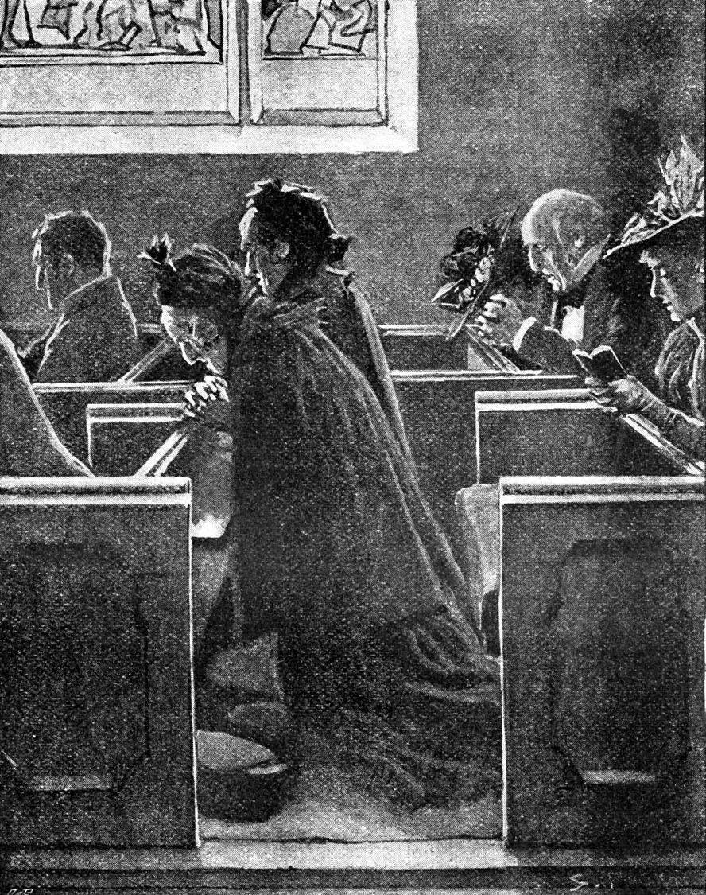

Slide 27
Review
Recognize that all material blessings come from God
Obtain material possessions the right way
1) Through diligent and honest work
2) Through using the resources that God has entrusted to you
3) Through wise and righteous endeavors
4) Through humble faith in God

Slide 28
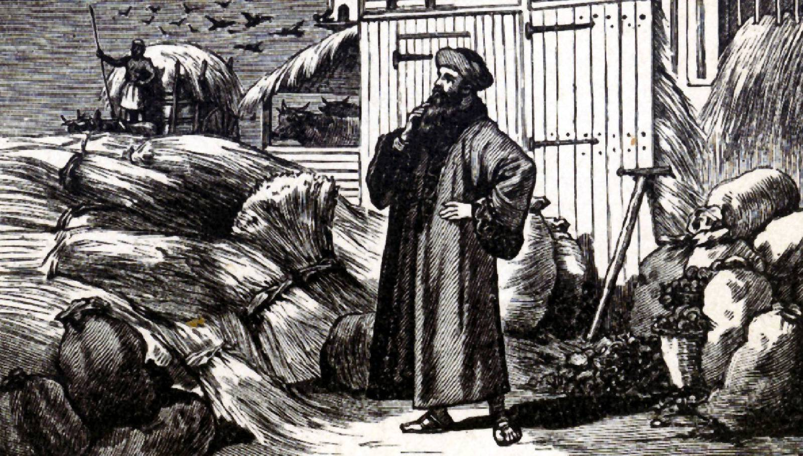
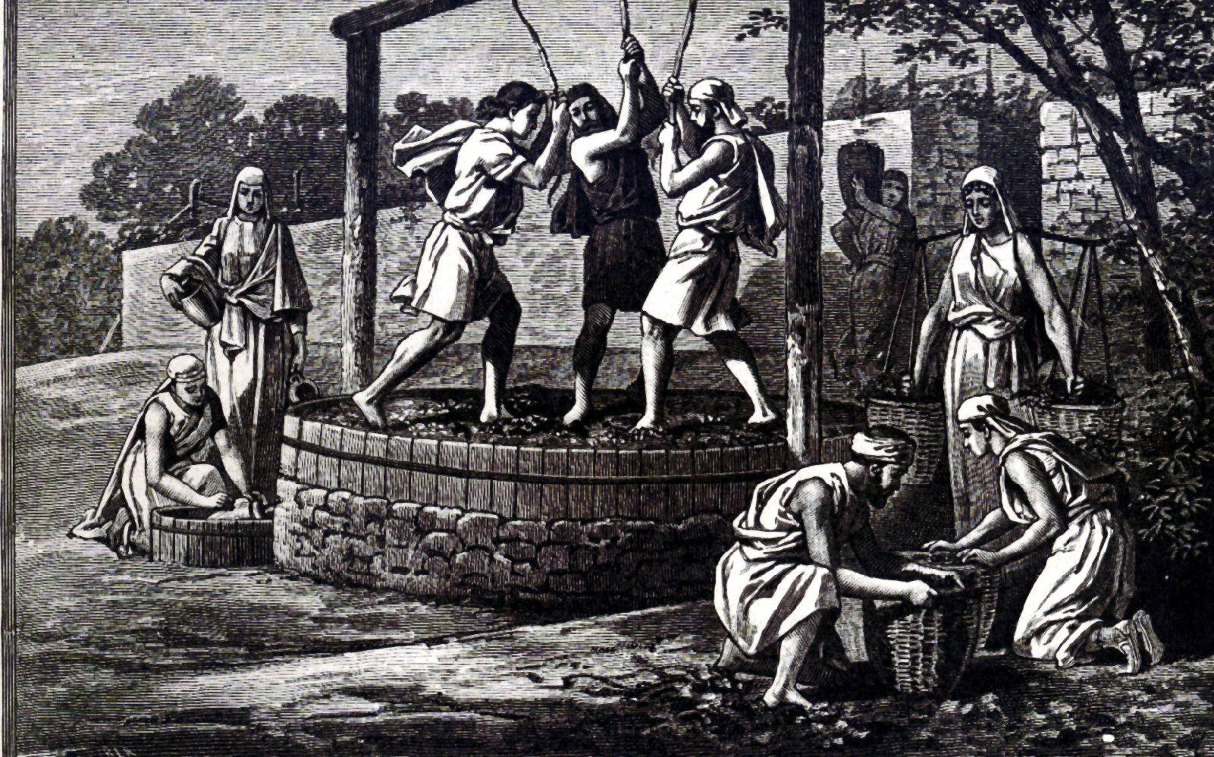
Honor God with your Possessions
Dedicate them to God by giving them to Him first – “Honor the Lord with thy substance (possessions) , and with the first fruits of all thine increase. So shall thy barns be filled with plenty, and thy presses shall burst out with new wine.” - 3:9-10

Slide 29
Give generously to those in need –
“There is that scattereth, and yet increaseth; and there is that withholdeth more than is meet, but it tendeth to poverty. The liberal soul shall be made fat; and he that watereth shall be watered also himself.” - 11:24-25
“He that hath pitty upon the poor lendeth to the Lord; and that which he hath given will he pay him again.” - 19:17

Slide 30
Take Good Care of your Possessions
Manage them diligently – 27:23-27
Conserve them wisely – “The slothful man roasteth not that which he took in hunting: but the substance of a diligent man is precious.” – 12:27
Preserve them for your children – “A good man leaveth an inheritance to his children’s children…House and riches are the inheritance of fathers: and a prudent wife is from the Lord.” – 13:22, 19:14

Slide 31
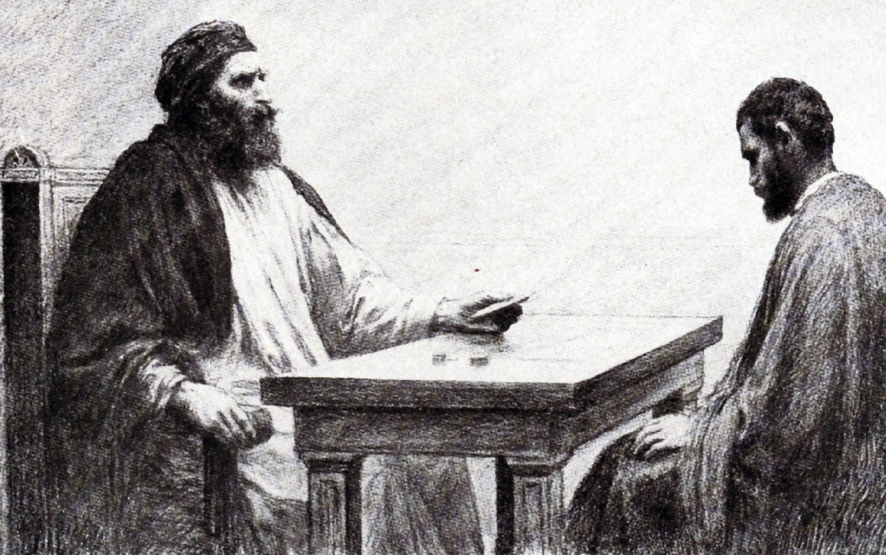
“Give an account of thy stewardship” (Luke 16:2)

