Slide 1
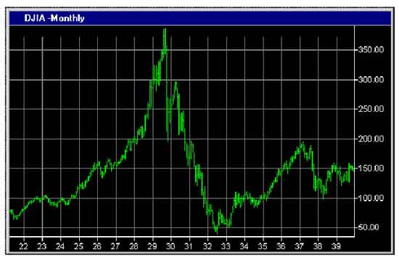
Financial Freedom
(Part 6)
What does it mean to be
financially free?
“And ye shall know the truth and the truth shall make you free.” (John 8:32)

Slide 2
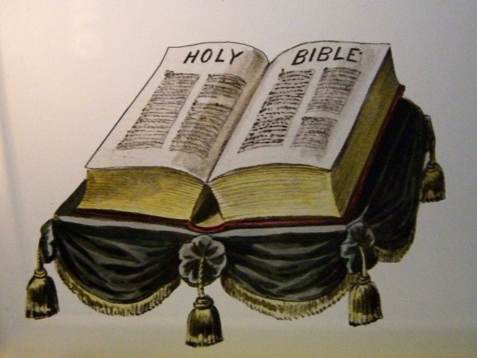
Review:
Biblical principles of Stewardship
What the Bible teaches about borrowing
The sting of interest
Establishing scriptural convictions
Developing a giving spirit
What it means to be financially free
The evidence of financial bondage
God’s purpose for money
Reasons for lack of funds
Loaning money/Co-signing
Bankruptcy
Identifying and rejecting false financial concepts
God’s way vs. Man’s way to financial success
Recognizing God’s financial reproofs
Importance of living on a budget

Slide 3
Personal Commitments
“I will purpose to work towards gaining and maintaining financial freedom according to Biblical principles.”
“I hereby acknowledge that any funds that I have or will receive are from God’s hand and must be earned and managed according to the principles of His Word.”
“I accept full responsibility for the financial problems and pressures that I am facing. I realize that many of these are God’s reproof for violating His financial principles. I will learn the reason for these reproofs and take the proper Scriptural steps to resolve them.”

Slide 4
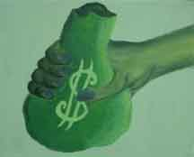
Financial Freedom “Making the Choice to Serve God Rather than Money”
Matthew 6:24
I Timothy 6:10

Slide 5
Personal Evaluation “But let a man examine himself…”
When you need an item, is is your first thought to buy it or to pray for it?
Would you consider a person successful if he were not wealthy?
Do you expect money to give peace of mind, security, influence, or happiness?
Do you find more excitement in getting money than in giving money?

Slide 6
Do you allow the cares of this world to choke out a daily time in God’s Word?
Have you ever compromised a Biblical conviction or standard in order not to lose a job or for financial gain?
In the past few years, have you ever sacrificed a relationship because of arguments over money?
Are you content with your present salary?
Are you content with the things you have?
Do you look forward to retirement more than the return of Christ?

Slide 7
Do you still carry bitterness towards some one who has caused you financial loss?
When you are with your friends, what do you talk about?
Do you talk more about financial matters than about spiritual matters?
Do you pray before every meal, even when non-Christians, business associates or clients are present?
Do you have convictions against selling such things as liquor, cigarettes, pornography etc?
Do you spend more time reading the business news than the Word of God?
Would you choose to work on the Lord’s Day rather than attend Church?

Slide 8
Are you more concerned about giving your children a financial heritage than a Godly heritage?
Would your family say that your job is more important to you than the Lord and your Church.
Do you have a secret desire to be rich?
Do you play the Lotto or engage in other forms of gambling?
Do you sacrificially give large sums of money to the Lord’s work?
Do you tend to limit your friendship to those who are popular, wealthy or influential?
Have you ever dedicated all of your money and possessions to God?

Slide 9
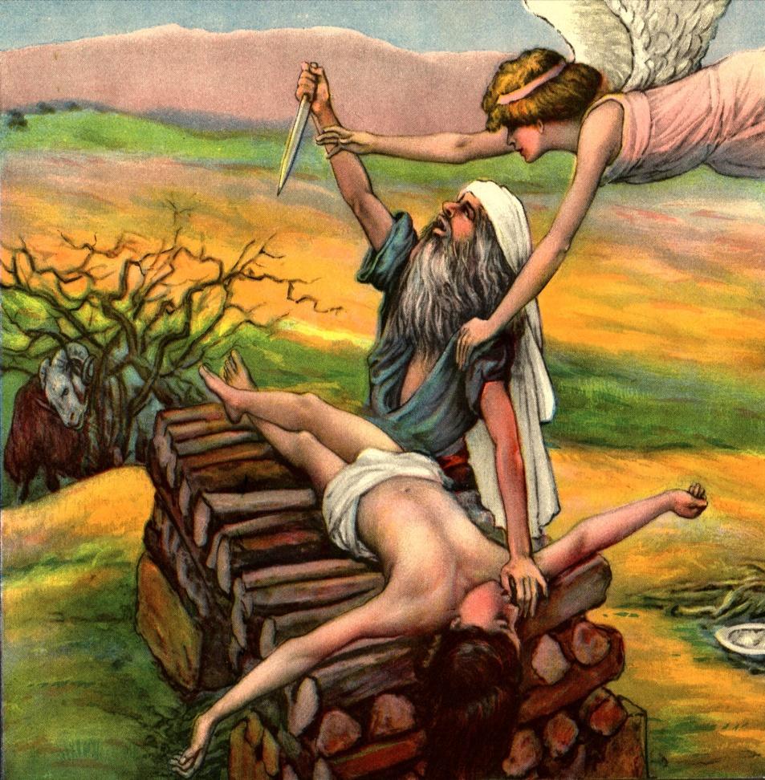
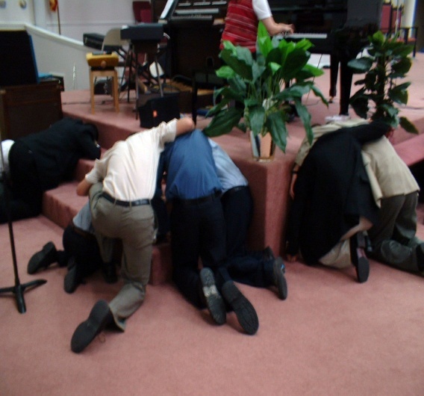
Money
Time
Friendships/Relationships
Possessions
Health
Reputation
Position
Influence
Control
Etc.

Slide 10
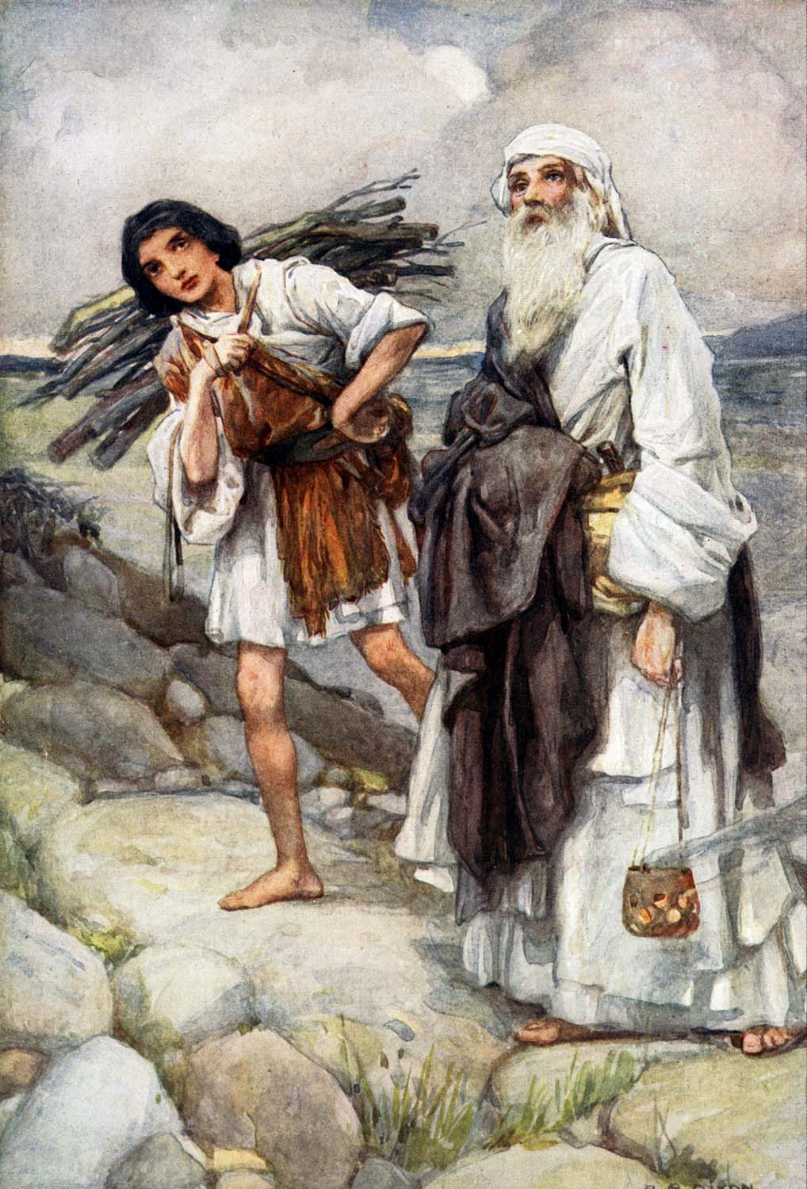
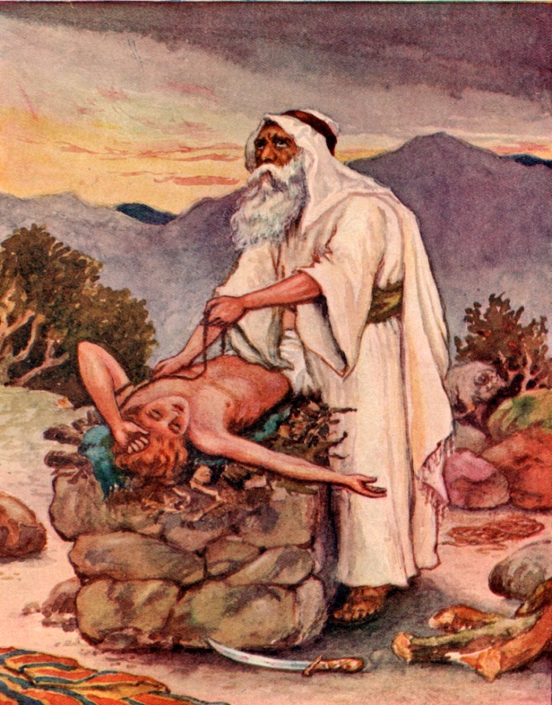
How to Serve God Rather Than Money
Name the things in your life that you love the most – “Take now thy son, thine only son Isaac, whom thou lovest…”

Slide 11
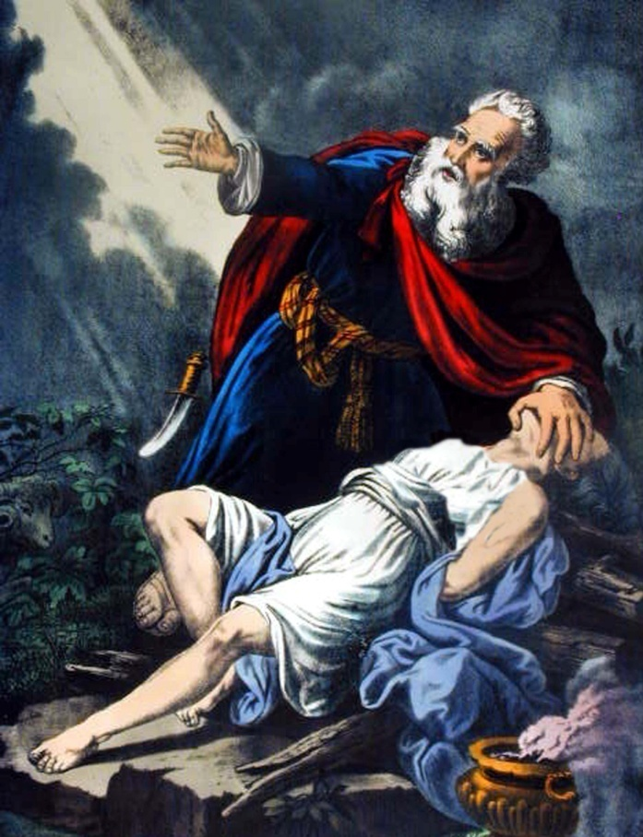
Start with the things you love the most –
Husband/Wife
Children
Parents
Sisters/Brothers
Home
Job
Freedom
Reputation
Influence
Friends/Boyfriend/Girlfriend
Possessions
Ability/Talents/Gifts

Slide 12
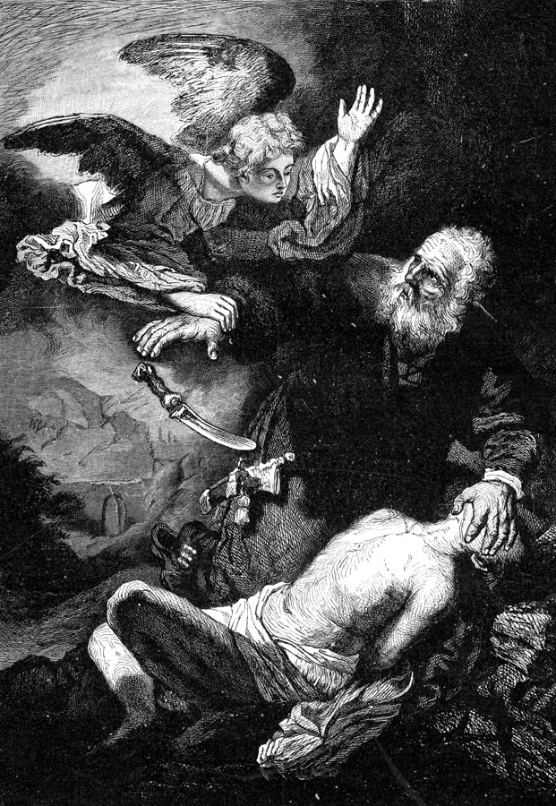
Appreciation
Acceptance
Forgiven
Privacy
Leisure
Success
Pleasure
Independence
Respect
Defend myself
Things
Good health
Money
Investments

Slide 13
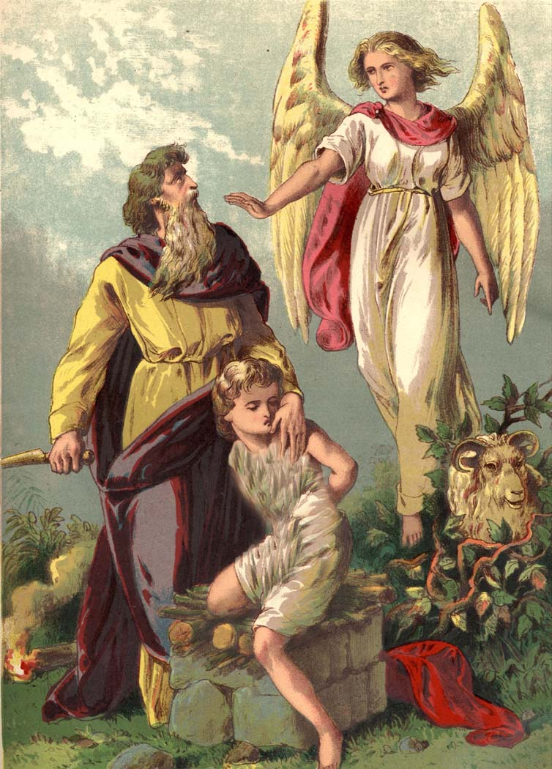
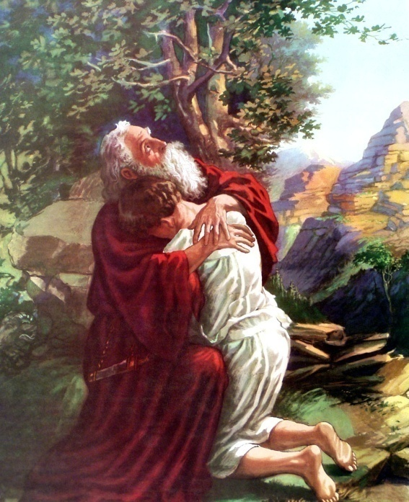
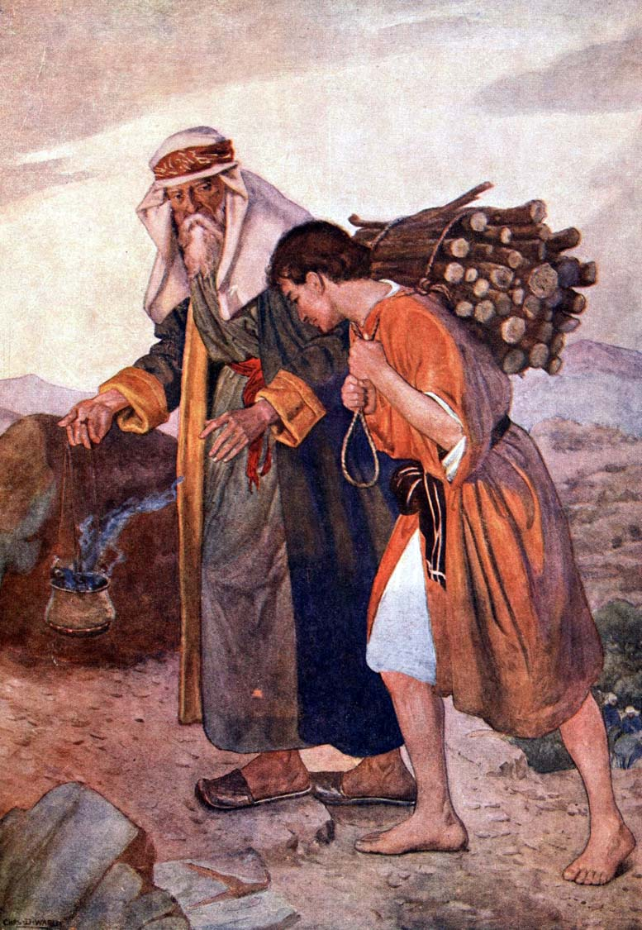
Present them completely to God by laying them on the altar – “Offer him there for a burnt-offering upon one of the mountains which I will tell thee of…”
Die to them in your emotions – “And Abraham stretched forth his hand, and took the knife to slay his son…”

Slide 14
Expect God to do wonderful things with the things that you give back to Him – “Because thou hast not withheld thy son…I will bless thee.”
“Now unto Him that is able to do exceeding abundantly above all that we could ask or think…”
Give God your marriage
Give God your family/children
Give God your home and possessions
Give God your friendships
Give God your talents and gifts
Give God your health
Give God your reputation
Give God your future

Slide 15
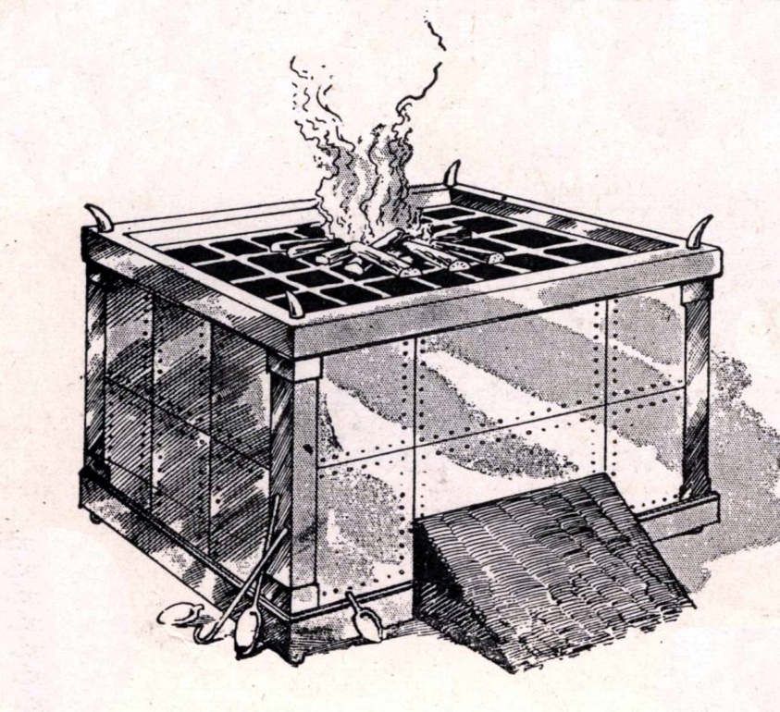
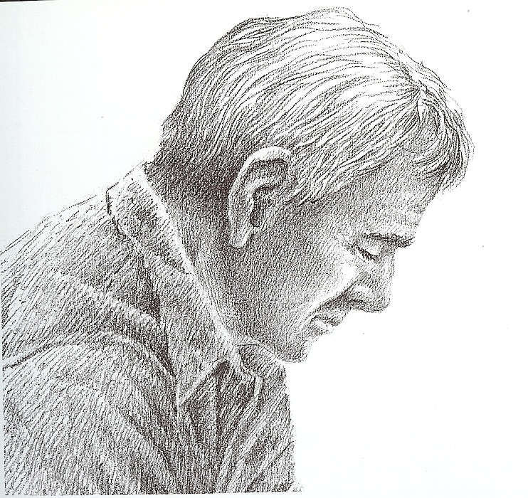
Picture Yourself Kneeling Before God’s Altar

Slide 16
Picture Yourself Laying Every Thing You Love on the Altar

Slide 17
What Does it Mean to Transfer Ownership to God?
Every decision as to how my money will be earned or used will be based on Scriptural principles.
I must view myself as a steward rather than an owner.
God has the right to use those funds as He sees fit.
I will give an account as to how I managed all the funds that God entrusted to me.

Slide 18
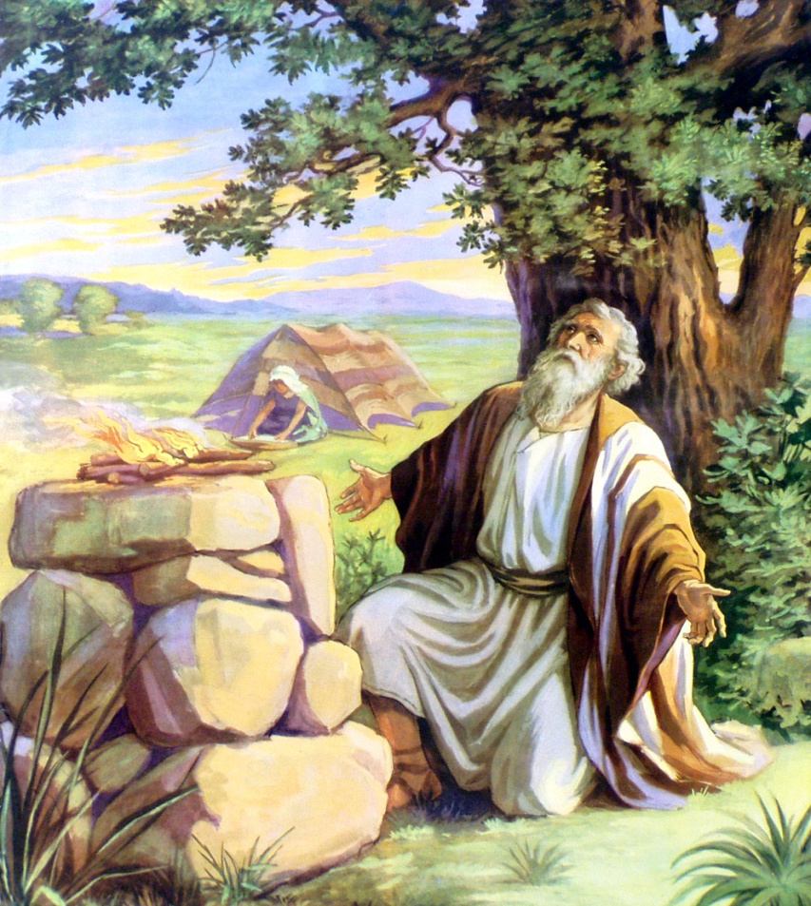
I will entrust to God even my most cherished possessions.
I will die to the emotional attachments that I have to my possessions.
I have purposed from this time on to serve God rather than money!

Slide 19
Make a Personal Commitment to Serve God Rather than Money
“I choose today to die to self. I now give the ownership and rights to all money, possessions, relationships, and time to God. I purpose that the principles of His Word will now be my final authority for earning and managing whatever God entrusts to me.”

