Slide 1
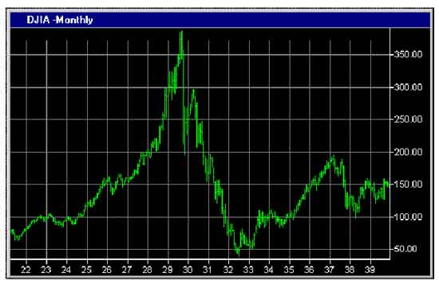
Financial Freedom
(Part 9)
What does it mean to be
financially free?
“And ye shall know the truth and the truth shall make you free.” (John 8:32)

Slide 2
Review:
Biblical principles of Stewardship
What the Bible teaches about borrowing
The sting of interest
Establishing scriptural convictions
Developing a giving spirit
What it means to be financially free

Slide 3
The evidence of financial bondage
God’s purpose for money
Reasons for lack of funds
Loaning money/Co-signing
Bankruptcy
Identifying and rejecting false financial
concepts
God’s way vs. Man’s way to financial
success
Recognizing God’s financial reproofs

Slide 4
Importance of living on a budget
Making a choice to serve God rather
than money or material possessions
Reasons for lack of funds
Establishing the tithe as a weekly
reminder that everything we have
belongs to God
Giving to meet the needs of others

Slide 5
“I will purpose to work towards gaining and maintaining financial freedom according to Biblical principles.”
“I hereby acknowledge that any funds that I have or will receive are from God’s hand and must be earned and managed according to the principles of His Word.”

Slide 6
“I accept full responsibility for the financial problems and pressures that I am facing. I realize that many of these are God’s reproof for violating His financial principles. I will learn the reason for these reproofs and take the proper Scriptural steps to resolve them.”
“From this point on I will purpose to faithfully pay my tithe to my local Church.”

Slide 7
“From this point on I will purpose in my heart to be open to the promptings of the Holy Spirit in the area of giving.”

Slide 8
Identifying People Who Should Not Receive Financial Assistance
People who are lazy – Proverbs 24:30-34
People who are irresponsible – Proverbs 9:6-9
People who reject wise counsel – Proverbs 1:30-33
People who refuse work – II Thessalonians 3:6-10
People who do not tithe – Malachi 3:8-11
People who are under God’s chastisement – Hebrews 12:6-11
Notes:
6-11

Slide 9
People who have a welfare mentality – Proverbs 30:15
People who have misused debt (credit card’s) - Deuteronomy 28:12
People who have mismanage their money – Matthew 25:26-28
People who refuse to live within their means –Deuteronomy 5:21
People who will not budget - Luke 14:28-30
People who do not exercise sales resistance – Matthew 6:19
People who are greedy – Hebrews 13:5

Slide 10
People who spend their money on alcohol, tobacco, drugs, computer games, DVD’s etc. – I Corinthians 6:12
People who are always letting others know about their needs – Matthew 7:7-11
People who are rebellious towards authority – Proverbs 17:11
People who have been dishonest – Ezekiel 22:13
People who refuse to repent at God’s reproofs – Proverbs 1:23-26

Slide 11
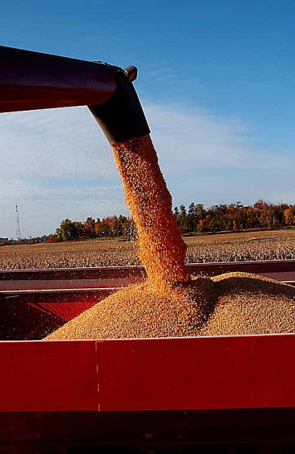
People who are immoral – Proverbs 2, 5-7
People who are wicked – Romans 1:20-32
People who have violated the “Law of the Harvest”

Slide 12
Understanding the Law of the Harvest and how it Relates to Finances

Slide 13
God has Established a Cause and Effect Sequence in His Creation
Moral decisions – Galatians 6:7-9
We reap what we sow
We reap where we sow
We reap in proportion to what we sow
We reap in another season than which we sow

Slide 14
The Giving of Money
“He which soweth sparingly shall reap also sparingly; and he which soweth bountifully shall reap also bountifully.” (II Corinthians 9:6)

Slide 15
Financial Cause and Effect Sequences
When some one is experiencing financial pressure or problems, it is important to consider the “Law of the Harvest.”
The “Sowing and Reaping” principle can be directly applied to financial matters.

Slide 16
It is important to ask the right Biblical questions in order to discover the reason behind the financial difficulties a person is experiencing.

Slide 17
Why?

Slide 18
Assets devoured – Malachi 3:10-11
Wealth in strangers houses – Proverbs 5:8-10
Deterioration – Proverbs 24:30-31
Loss of profits – Ephesians 6:2-3
Sorrows – I Timothy 6:10
Sudden poverty – Proverbs 1:10-19
Bondage – Proverbs 22:7
Business Losses – Proverbs 6:1-5
Miseries – James 5:1-4
Thefts – Matthew 6:19-20

Slide 19
God’s wrath – Proverbs 23:1-8, 17, 21-24
Begging for food – Proverbs 20:4, 13
Family trouble – Proverbs 15:27
No job – Proverbs 22:29
Poverty – Proverbs 22:4
Labor in vain – Ecclesiastes 5:4-6
Unanswered prayer – I Peter 3:7; Psalms 66:18
Public ridicule – Luke 14:28-29
No increase – Deuteronomy 15:5-11
Debt/Interest – I Timothy 6:6

Slide 20
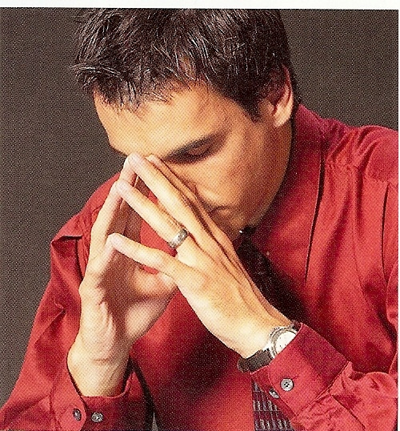

Slide 21
“I will prayerfully consider how the Law of the Harvest applies to my personal finances.”

